Slide 1
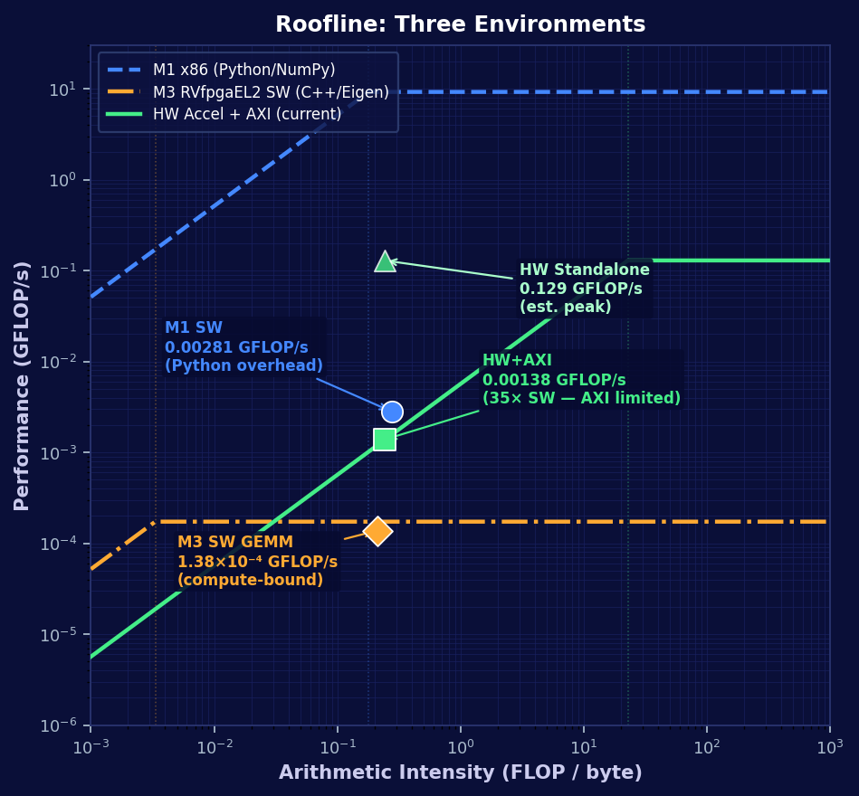
Kalman Filter Measurement Update Accelerator — AXI4-Lite RISC-V SoC
3×3 Systolic GEMM · Newton-Raphson Reciprocal · F64 IEEE-754 · Artix-7 100T | ECE 410/510 Spring 2026
M1
M2
M3
Post-M3
x86 Desktop (Python / NumPy)
RTL Core (Verilator Sim)
RVfpgaEL2 (SweRV EL2, AXI4-Lite)
Timing Closed (current)
i7-11800H @ 4.6 GHz · 51.2 GB/s DDR4 · F64
Q16.16 fixed-point compute core · PCIe TLP endpoint
F64 3×3 systolic GEMM + Newton-Raphson · C++/Eigen
NR datapath pipelined · WNS = +0.326 ns @ 100 MHz
81.7 µs/update · DOM: linalg.inv · Interface: PCIe Gen4
Sim PASS · Precision revised to F64 for M3
135/135 sim PASS · WNS = −50.4 ns (timing violation)
35× speedup over RVfpgaEL2 SW · target >200× (state retention)
① What are you doing?
Hardware-accelerate the Kalman Filter Measurement Update (Correct) phase on FPGA.
Predict: P⁻ₖ = APₖ₋₁Aᵀ + Q ← software (model flexibility)
Correct: K = P⁻Hᵀ(HP⁻Hᵀ+R)⁻¹ · x̂ₖ = x̂⁻+K(z−Hx̂⁻) · Pₖ=(I−KH)P⁻ ← hardware
② How have others implemented this?
Python: FilterPy / NumPy — pure software, no hardware acceleration.
C/C++: Eigen library or scalar loops — SW FP emulation on RISC-V (~75 cycles/FLOP @ 13 MHz, no HW FPU).
③ What's different here?
RTL core (SystemVerilog): 3×3 weight-stationary systolic GEMM array + Newton-Raphson scalar reciprocal FSM.
AXI4-Lite slave port — reusable on any RISC-V SoC interconnect; target: VeerWolf / SweRV EL2 (Nexys A7).
F64 IEEE-754 throughout — required for Newton-Raphson convergence and P-matrix numerical stability.
④ Accomplished so far
Timing closed at 100 MHz: WNS = +0.326 ns · 14,642 LUTs (23.1%) · 126 DSP48E1 (52.5%)
Co-simulation PASS: 135 / 135 elements verified ≤ 4 ULP across 15 Kalman iterations.
RVfpgaEL2 SW baseline: 1.38×10⁻⁴ GFLOP/s → HW+AXI realistic: 0.00138 GFLOP/s (35× speedup)
⑤ What's next?
SoC integration: attach accelerator to VeerWolfX AXI bus @ 0x80010000; write bare-metal C driver.
State retention: P/x internal feedback reduces 34 → 5 AXI transactions/update → projected >200× speedup.
Benchmark: measure GFLOP/s on hardware vs. SW baseline to declare success.
xc7a100tcsg324-1 · SweRV EL2 @ 13 MHz · VeerWolfX AXI · Nexys A7 FPGA · RVfpgaEL2 · F64 IEEE-754
Notes:
SPEAKER NOTES — 1-MINUTE SCRIPT
[0:00] This project hardware-accelerates the Kalman Filter Measurement Update step for RISC-V SoCs.
[0:07] The milestone strip traces the full journey. M1 profiled the Kalman filter on a desktop x86 machine in Python — 81.7 microseconds per update — and selected PCIe Gen4 as the target interface. M2 built an initial RTL core using Q16.16 fixed-point with a PCIe TLP endpoint, but precision analysis showed F64 was required. M3 pivoted the entire platform to RVfpgaEL2 — SweRV EL2 on Nexys A7 — switched to AXI4-Lite, rebuilt in F64 with a 3-by-3 systolic GEMM and Newton-Raphson unit, and passed co-simulation. But synthesis failed timing at minus 50 nanoseconds of slack.
[0:30] Post-M3, we pipelined the Newton-Raphson critical path and closed timing at positive 0.326 nanoseconds slack at 100 MHz.
[0:36] The roofline on the right shows all three environments. Blue dashed is the x86 desktop — actual Python performance sits far below the x86 roofline because interpreter overhead, not hardware, is the bottleneck. The amber dash-dot is the RVfpgaEL2 bare-metal baseline — the GEMM kernel is compute-bound and close to its ceiling, but that ceiling is only 1.73×10-to-the-minus-4 GFLOP/s because there is no hardware FPU. The green line is our accelerator on the AXI bus: the square shows the 35-times realistic speedup, AXI-limited; the triangle shows peak standalone potential.
[0:52] Next steps: SoC integration, a C driver, and a state-retention optimization that cuts AXI transactions from 34 down to 5, projecting over 200-times speedup over the RISC-V baseline.
[0:59] Questions?
── KEY NUMBERS ──
M1 SW (x86 Python): 0.00281 GFLOP/s (81.7 µs/update, i7-11800H, 51.2 GB/s DDR4)
M3 SW (RVfpgaEL2 GEMM): 1.38×10⁻⁴ GFLOP/s (1,667 µs/update, SweRV EL2 @ 13 MHz, no HW FPU)
HW standalone (est.): 0.129 GFLOP/s (100 MHz, ~51 compute cycles/update)
HW + AXI realistic: 0.00138 GFLOP/s (35× over M3 SW — AXI bottleneck @ 12.5 MHz, 48 µs)
HW + state retention: >0.00483 GFLOP/s (>200× over M3 SW — projected, 5 transactions)
M3 synthesis WNS: −50.419 ns (92 logic levels, NR combinational chain)
Post-M3 synthesis WNS: +0.326 ns @ 100 MHz (NR split to 2-stage pipeline, ~30 levels each)
Verification: 135/135 elements ≤ 4 ULP (15 iters × 9 x/P elements)
Resources: 14,642 LUTs (23.1%) · 126 DSP48E1 (52.5%) · 5,535 registers
AXI register map: CTRL@0x00 STAT@0x08 z@0x10 x_in@0x18–0x28 P_in@0x30–0x70 R@0xE8 x_out@0xA0–0xB0 P_out@0xB8–0xE0

