Slide 1
LiDAR Forecasting
46500 Probabilistic Methods in Wind Energy – Final Project
Prasanna Srinivasan, Joram de Vries

Slide 2
Outline
Scope and Goals
Understanding the Data
FFNN
Multi-Lagged Discrete Model
LSTM

Slide 3
Scope and Goals
Lidar data available from 2-beam and 4-beam lidars
Forecast structural loads using lidar data
Use a few modelling approaches and pick the best

Slide 4
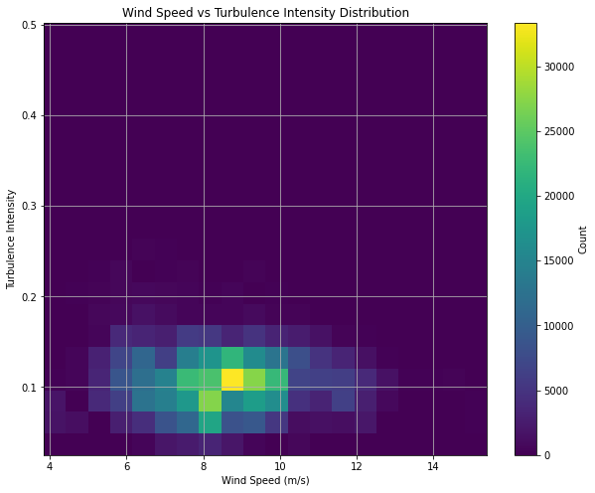
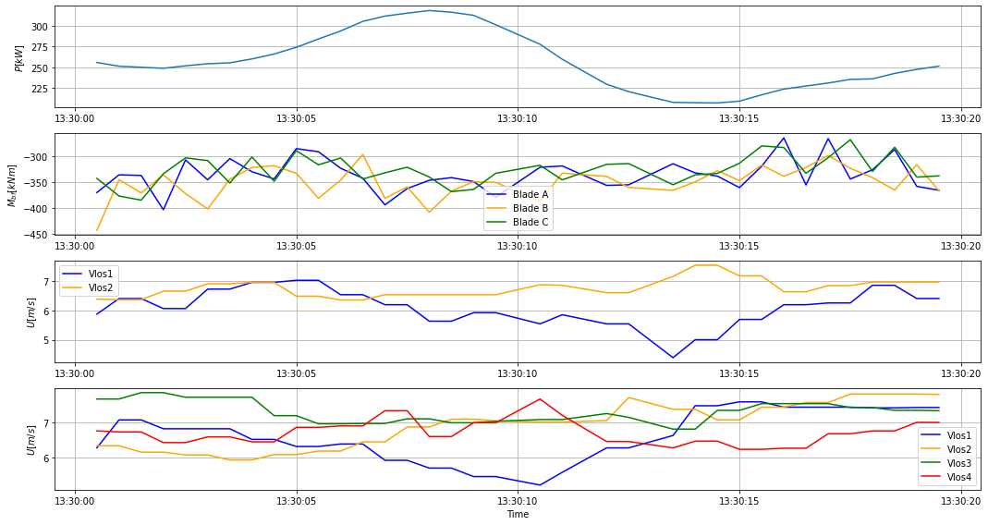
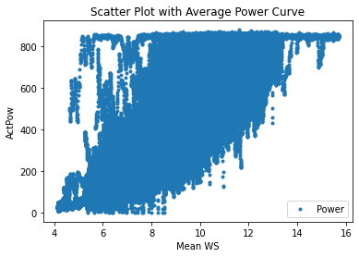
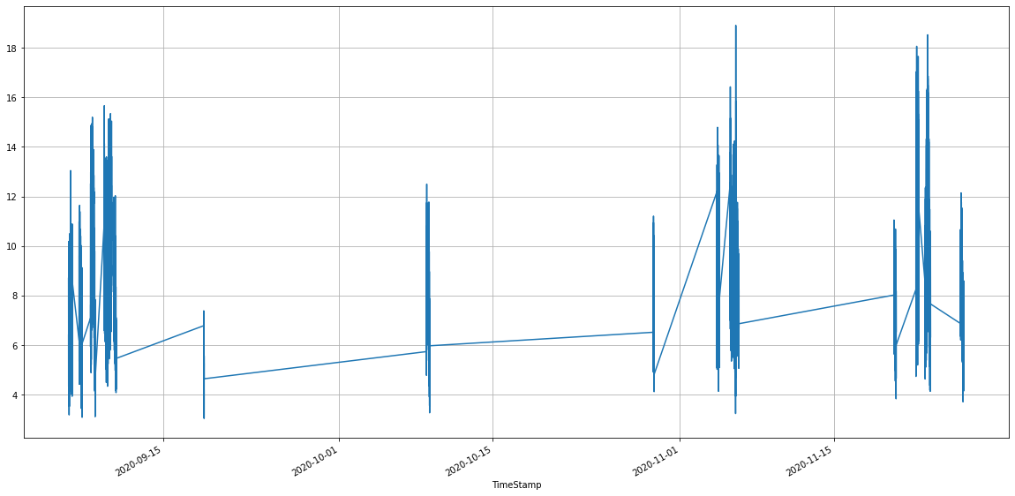
Understanding the data

Slide 5
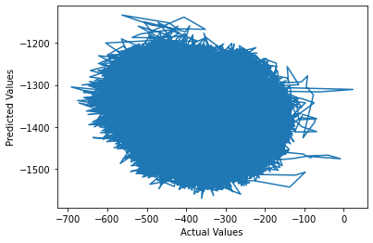
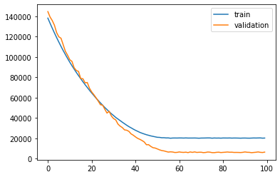
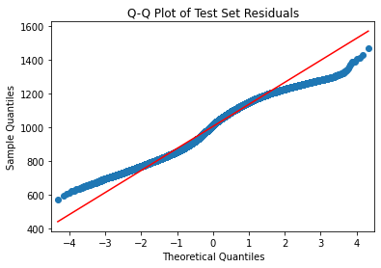
Feed Forward Neural Network

Slide 6
Multi-Lagged Discrete Model
Very similar to FFNN, using 3 layers
Using 5 timesteps of historical data plus current
Output predictions for 3 future timesteps plus current
82% of data points usable
Currently tanh actualisation because relu wasn’t working well, but tanh also not very successful
Similar offset issues to FFNN
Question from Lennard: Can we just use 1 future timestep for the output predictions?

Slide 7
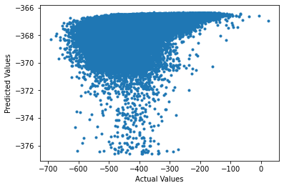
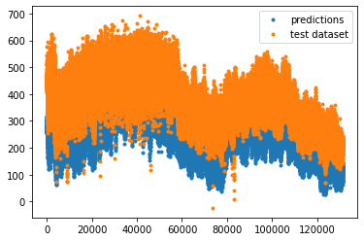
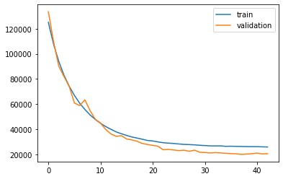
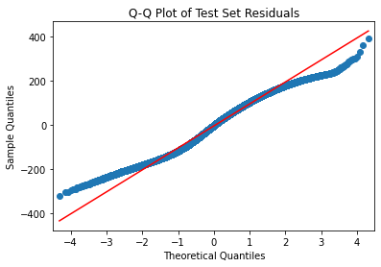
LSTM

Slide 8
Further Plans
RNN Model
Fix problems with Multi-lagged discrete model
Improve LSTM Model
GRU Model

