Slide 1
LiDAR Forecasting
46500 Probabilistic Methods in Wind Energy – Final Project
Prasanna Srinivasan, Joram de Vries

Slide 2
Outline
Scope and Goals
Understanding the Data
FFNN
Multi-Lagged Discrete Model
LSTM

Slide 3
Scope and Goals

Slide 4
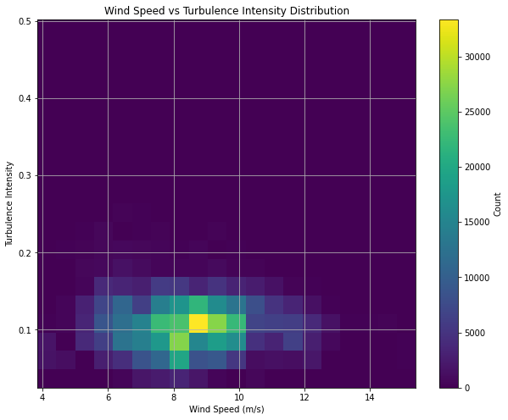
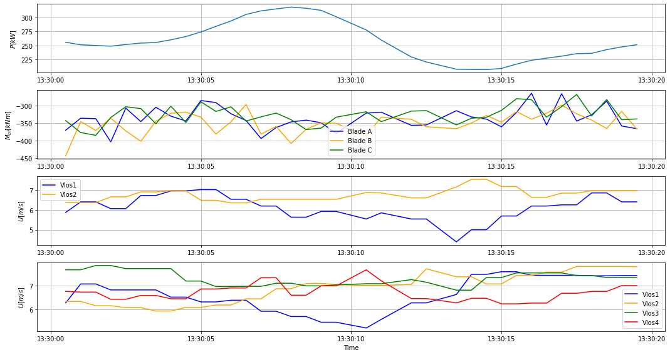
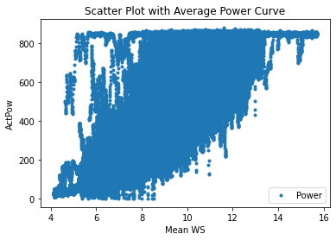
Understanding the data

Slide 5
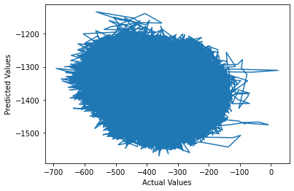
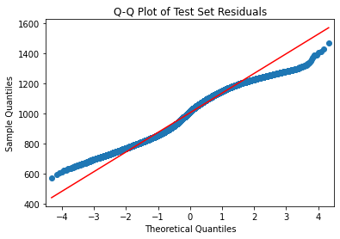
Feed Forward Neural Network

Slide 6
Multi-Lagged Discrete Model
Very similar to FFNN, using 3 layers
Using 5 timesteps of historical data plus current
Output predictions for 3 future timesteps plus current
82% of data points usable
Currently tanh actualisation because relu wasn’t working well, but tanh also not very successful
Similar offset issues to FFNN

Slide 7
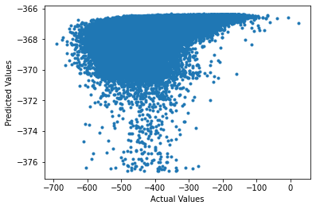
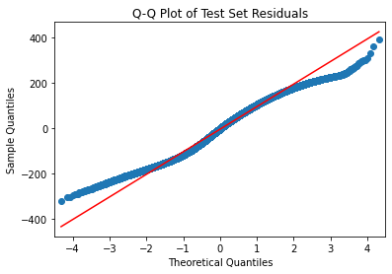
LSTM

