Slide 1
Loads and Power Forecasting using Nacelle-Based LiDAR
46500 Probabilistic Methods in Wind Energy – Final Project
Prasanna Srinivasan, Joram de Vries, Lennard Mascini

Slide 2
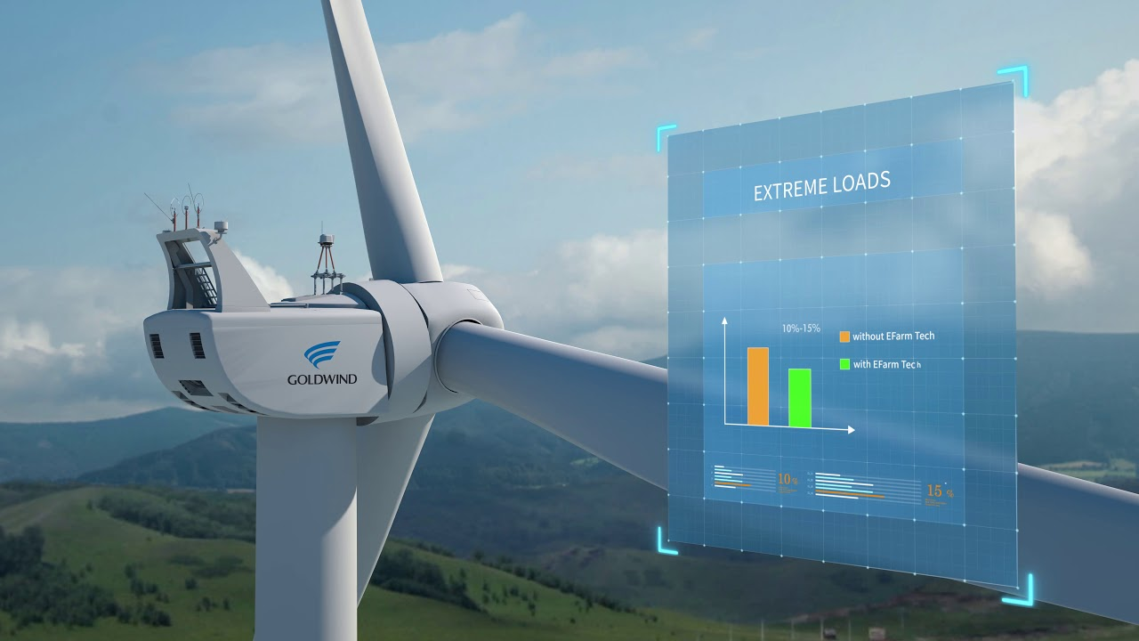
Outline
Scope and Goals
Understanding the Data
FFNN
Multi-Lagged Discrete Model
LSTM
Scope
Data
FFNN
MLDM
LSTM
Further Plans

Slide 3
Scope and Goals
Lidar data available from 2-beam and 4-beam lidars
Forecast structural loads using lidar data
Use a few modelling approaches and pick the best
Scope
Data
FFNN
MLDM
LSTM
Further Plans

Slide 4
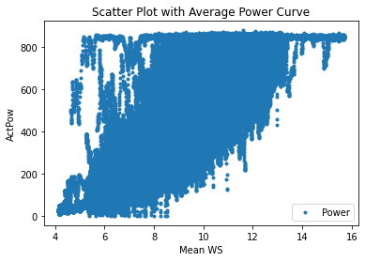
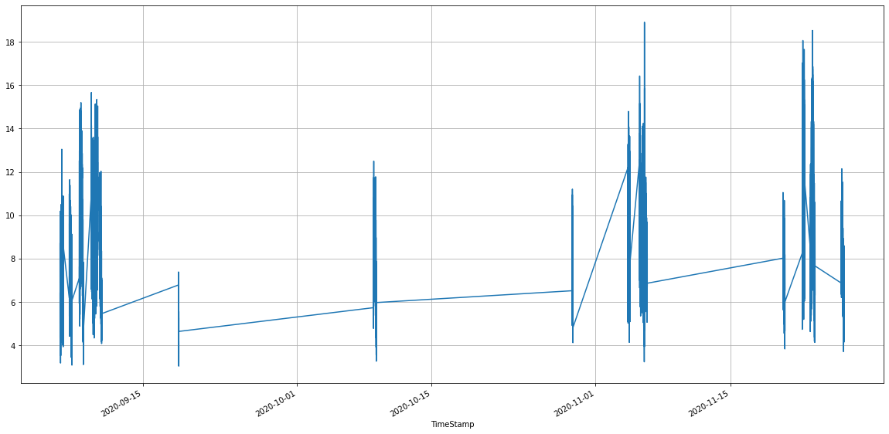
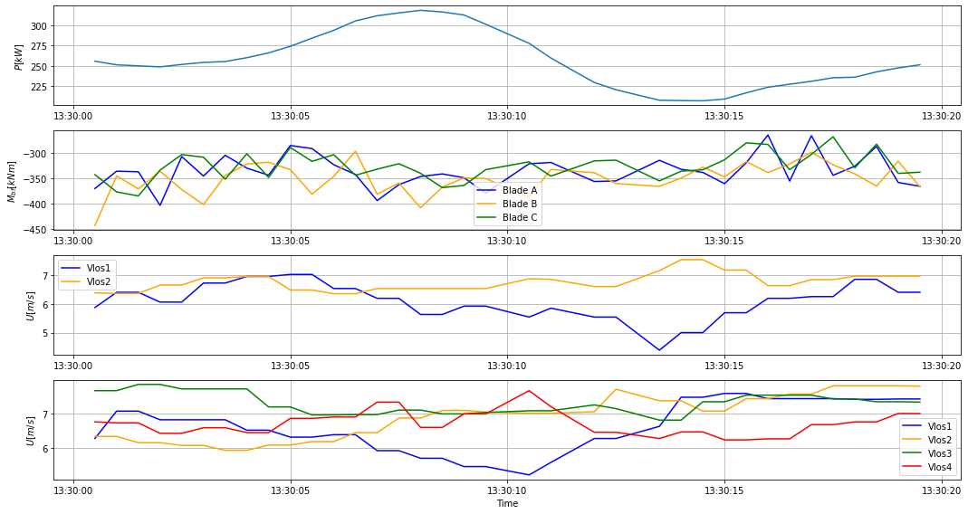
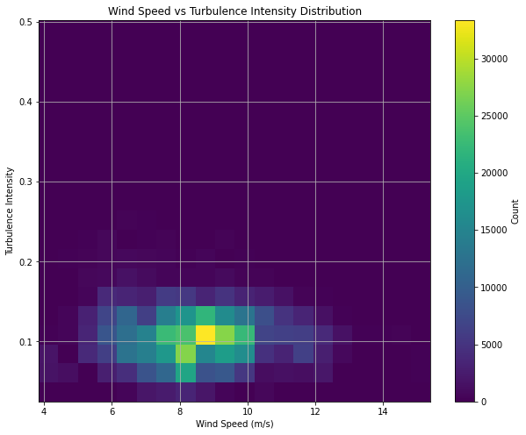
Understanding the data
Scope
Data
FFNN
MLDM
LSTM
Further Plans

Slide 5
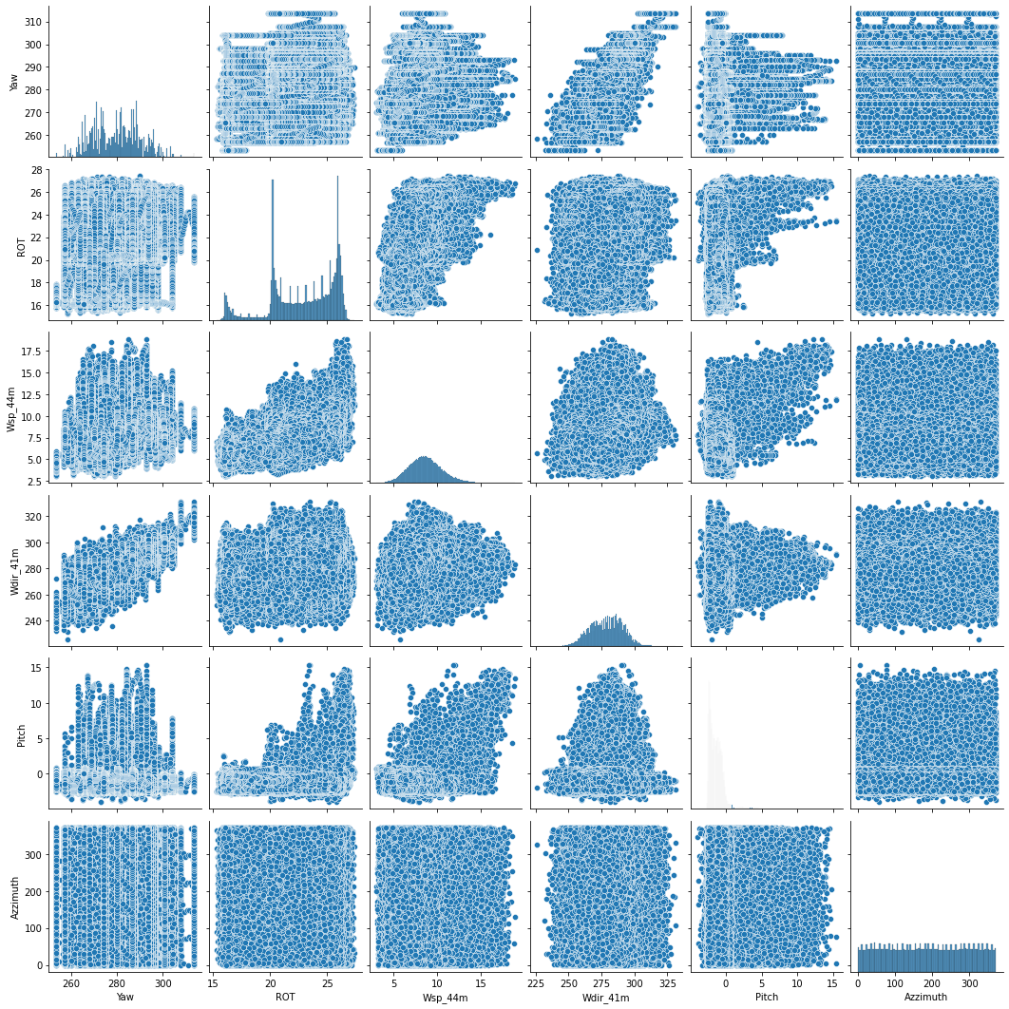
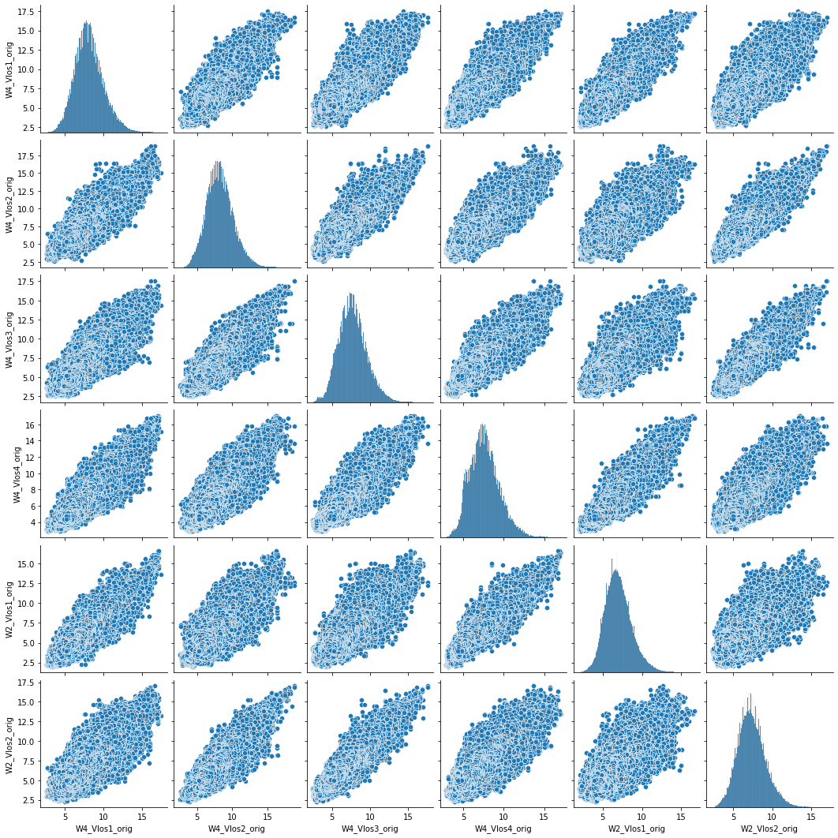
Understanding data correlation
Scope
Data
FFNN
MLDM
LSTM
Further Plans

Slide 6
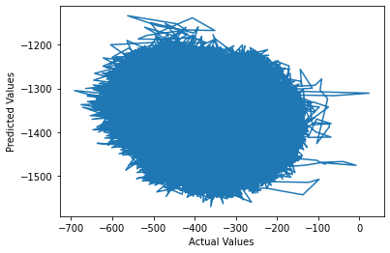
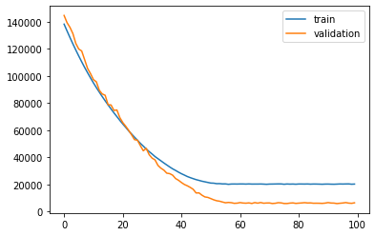
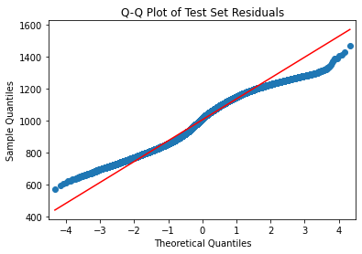
Feed Forward Neural Network
Scope
Data
FFNN
MLDM
LSTM
Further Plans

Slide 7
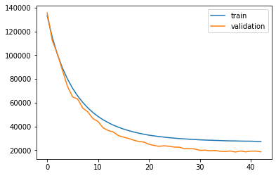
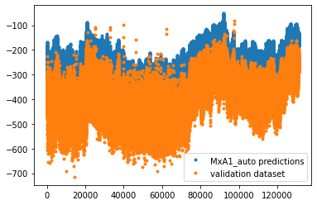
Multi-Lagged Discrete Model
Very similar to FFNN, using 3 layers
Using 5 timesteps of historical data plus current
Output predictions for 3 future timesteps plus current
82% of data points usable
Currently tanh actualisation because relu wasn’t working well
but tanh also not very successful
Similar offset issues to FFNN
Question from Lennard:
Can we just use 1 future timestep for the output predictions?
Scope
Data
FFNN
MLDM
LSTM
Further Plans

Slide 8
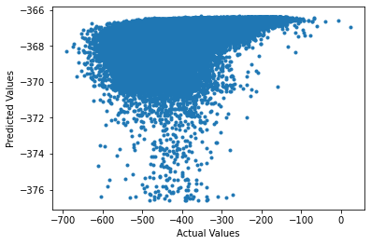
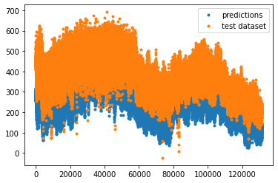
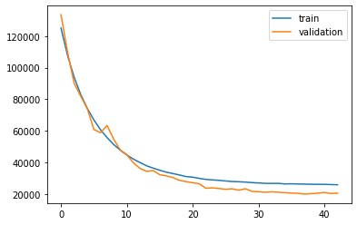
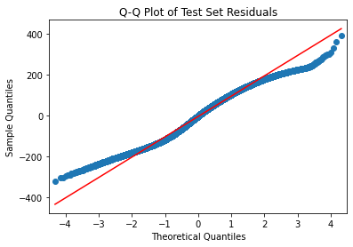
LSTM
Scope
Data
FFNN
MLDM
LSTM
Further Plans

Slide 9
Further Plans
RNN Model
Fix problems with Multi-lagged discrete model
Improve LSTM Model
GRU Model
Compare the 2 Beam LiDAR with 4 Beam LiDAR
Scope
Data
FFNN
MLDM
LSTM
Further Plans

