Slide 1
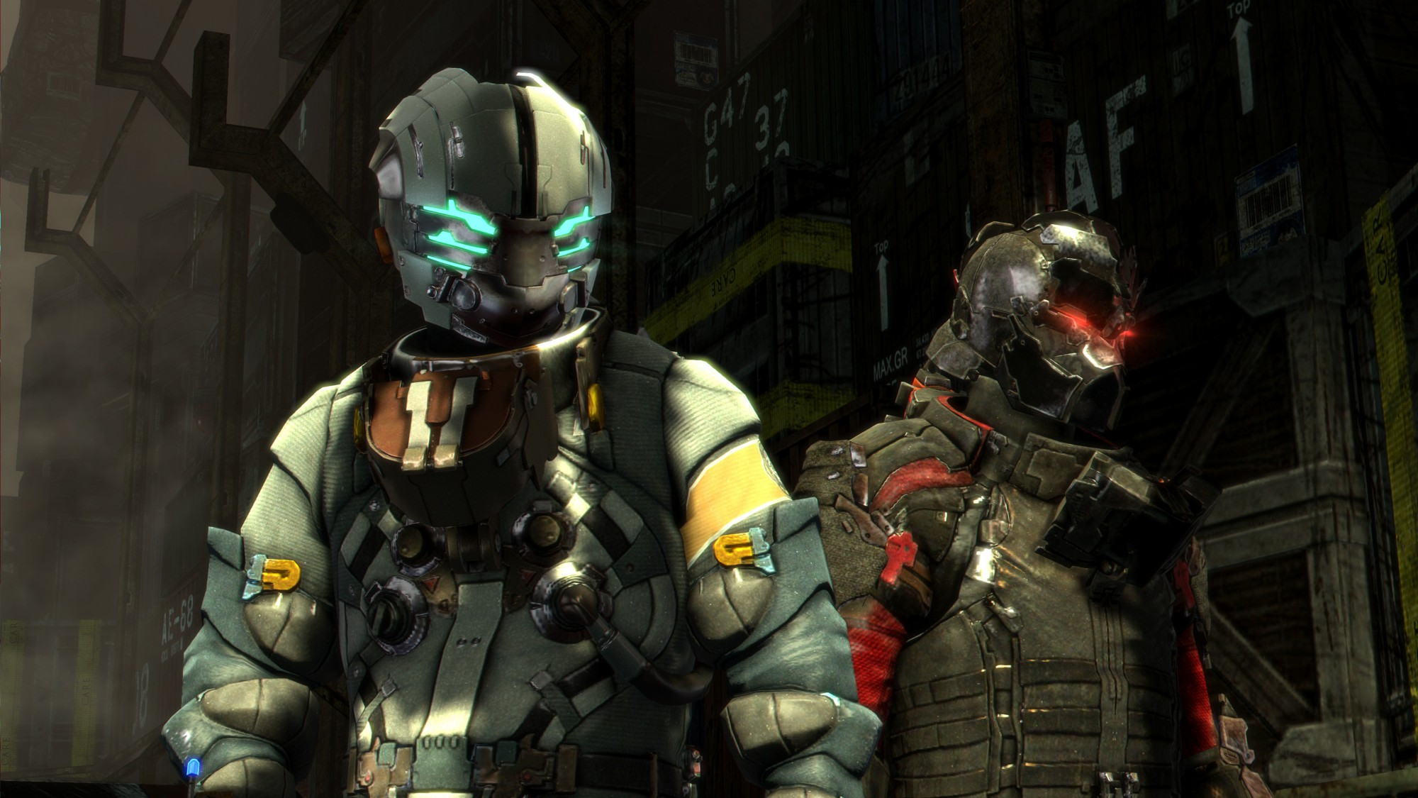
-PROJECT R-
----- Virtual Reality -----
Estima, Gabriel
Gamboa, Garnnett
Navalta, Joranne
Tagle, Raymond
Free PowerPoint Templates
Free PowerPoint Templates

Slide 2
Intro
Who would be our users?
Our users would be anyone who can perform simple kinetic movements. Our users would be especially the ones who loves playing games and any genre/category of games are included so, they can choose whatever game they want to play. Young and old, male and female are welcome to play the game they want in project R.
Free PowerPoint Templates
Free PowerPoint Templates

Slide 3
Limitation of our project:
The things we cannot provide to the users would be the feels of the weather present to what they are playing. For instance, the setting of what they are playing is raining or snowing we can not let them feel the cold and wet feels.
Proposal:
Project R would be a platform-like of games. To further explain it would be like the Playstore in reality you would be spawning in a place where you can see the icons of the games around you, you only need to choose whatever game you want and then it would transfer you immediately inside the game you have chosen. From there you can now start playing the game.
Free PowerPoint Templates
Free PowerPoint Templates

Slide 4



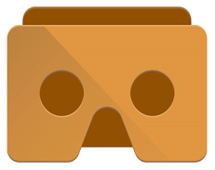
Usability Kit
OR
SketchApp
Adobe Photoshop
Google Cardboard
These tools were used to create images from scratch or to alter existing images
The Cardboard app lets you use any Works with Google Cardboard viewer with any Cardboard app, and includes a variety of immersive demos.
Free PowerPoint Templates
Free PowerPoint Templates

Slide 5
“
You have to learn the rules of the game. And then you have to play better than anyone else.
-- Einstein
Free PowerPoint Templates
Free PowerPoint Templates

Slide 6


Free PowerPoint Templates

