Slide 1
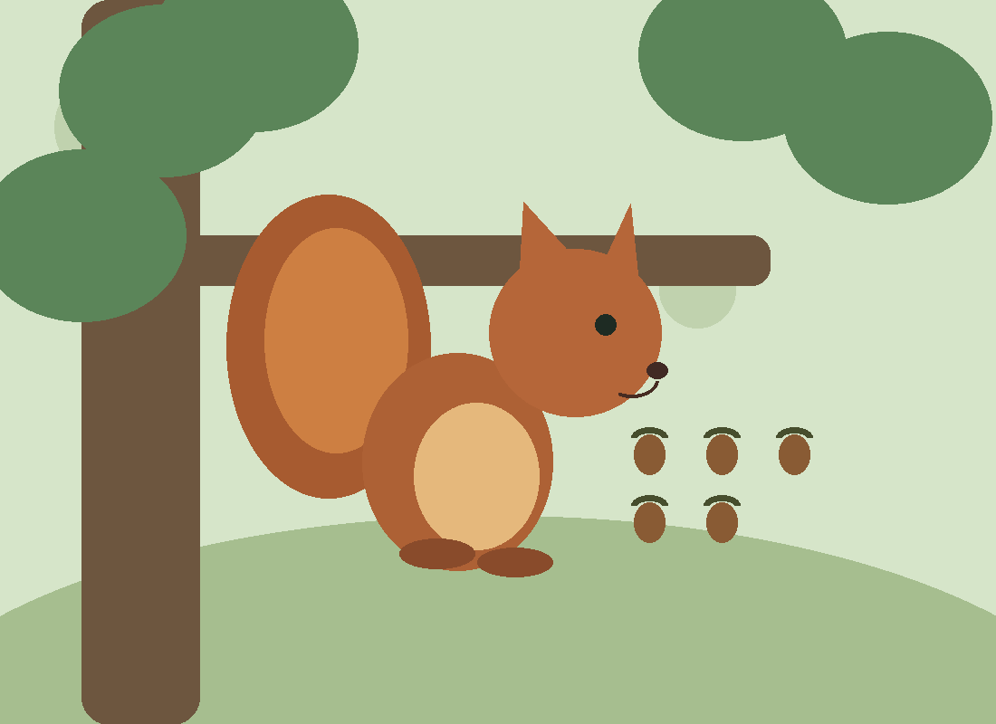
SQUIRRELS
An illustrated field guide to their history, biology, behavior, and ecological importance
A closer look at the animals all around us
01 / 15
Notes:
Open by asking the audience what they associate with squirrels. Explain that this talk covers more than backyard tree squirrels: it includes the whole squirrel family, its history, adaptations, and ecosystem roles.

Slide 2
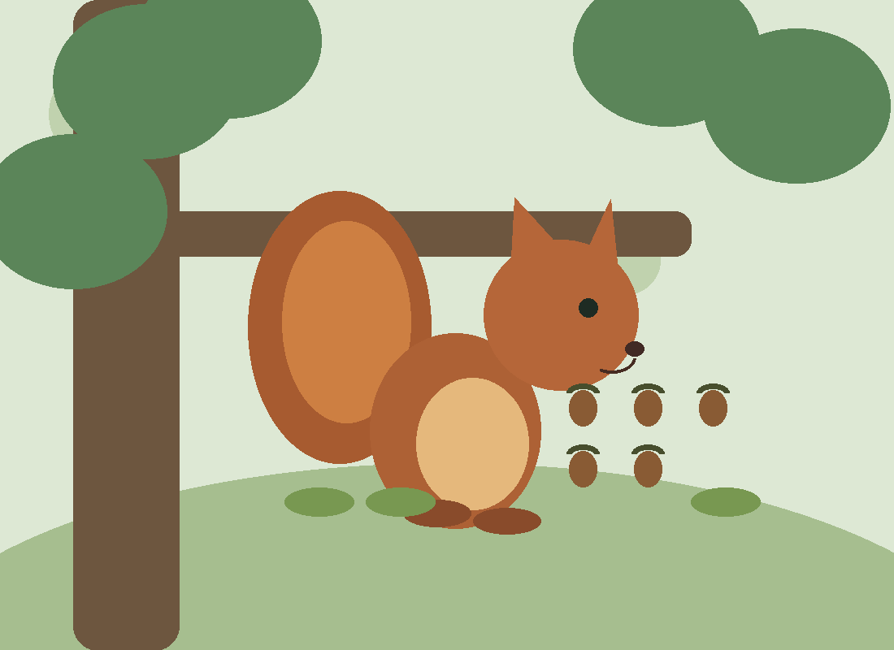
01 WHAT IS A SQUIRREL?
A surprisingly diverse family
• Squirrels are rodents in the family Sciuridae, which includes tree squirrels, ground squirrels, chipmunks, marmots, and flying squirrels.
• The family contains more than 280 living species, depending on the classification used.
• Like other rodents, squirrels have continuously growing incisors used for gnawing.
• They occur in forests, grasslands, mountains, deserts, and urban neighborhoods.
02 / 15
Notes:
Distinguish squirrels from other rodents: Sciuridae is one branch of Rodentia. Tree squirrels are only a subset. Explain that species totals vary as taxonomy is revised.

Slide 3
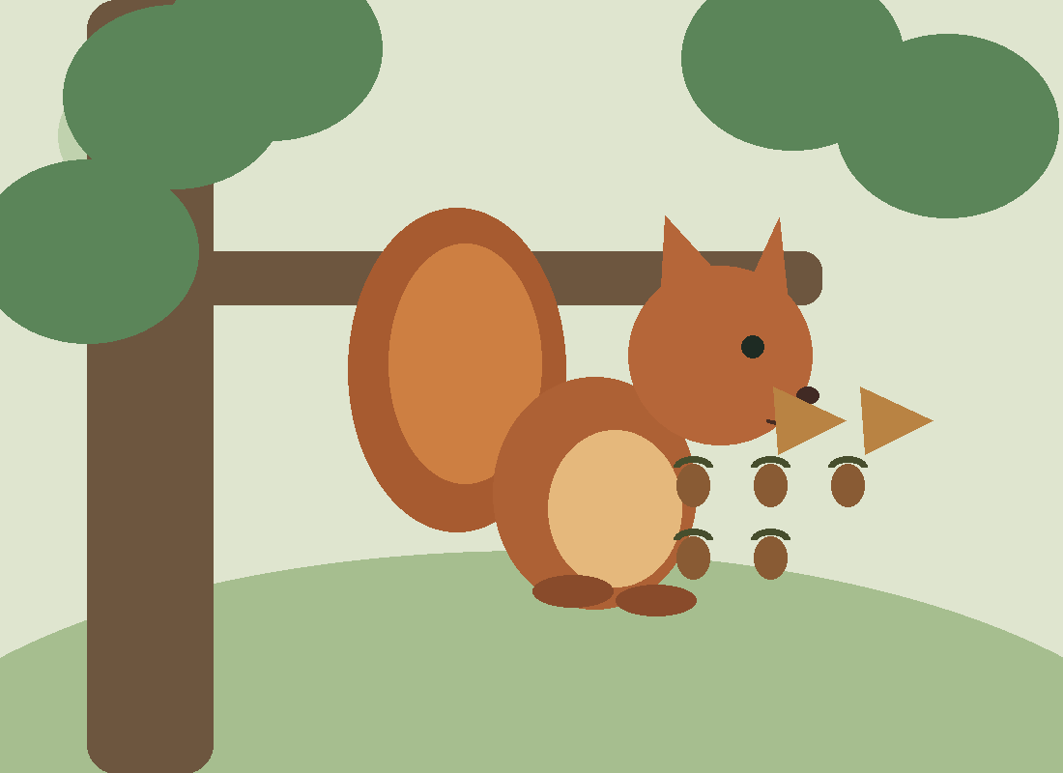
02 DEEP TIME
How squirrels evolved
• The squirrel fossil record extends back roughly 36 million years, to the late Eocene.
• Early squirrel relatives lived as mammals and habitats diversified through the Cenozoic era.
• Tree-dwelling, ground-dwelling, and gliding lifestyles evolved in different lineages.
• Continental change, climate, and vegetation helped shape where species live today.
03 / 15
Notes:
Explain that fossils give minimum ages, not necessarily the exact date the family originated. Mention that modern species are not unchanged ancient animals; they continue to evolve.

Slide 4
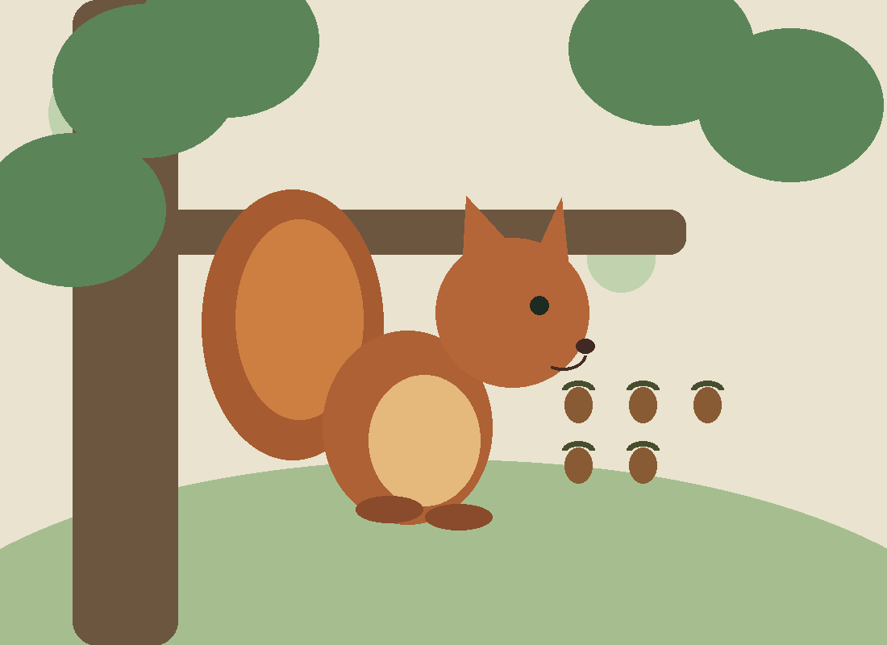
03 THE SQUIRREL FAMILY
Three familiar ways of life
• Tree squirrels: agile climbers, often active during daylight, with long tails and arboreal nests.
• Ground squirrels: many use burrows; some live in colonies and communicate with alarm calls.
• Flying squirrels: nocturnal gliders using a skin membrane called the patagium.
• Chipmunks and marmots show how different squirrel body sizes and habitats can be.
04 / 15
Notes:
Point out that flying squirrels glide rather than flap their wings. Many species fit broad groups imperfectly, and the categories are a teaching tool rather than a complete phylogeny.

Slide 5
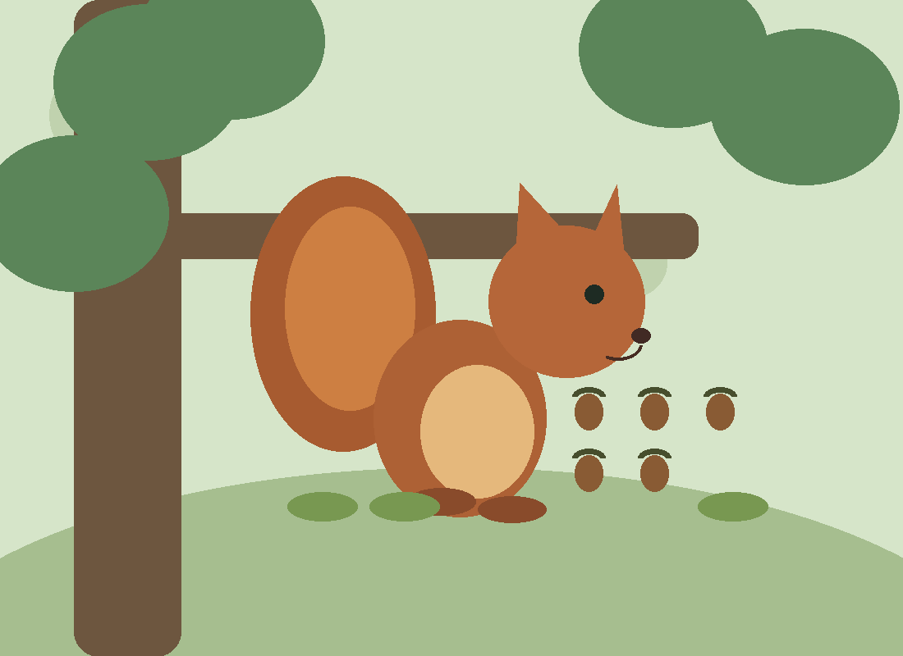
04 BUILT TO CLIMB
Anatomy and physical adaptations
• Sharp, curved claws grip bark; flexible ankles help some tree squirrels descend headfirst.
• Strong hind legs propel jumps between branches and across gaps.
• A long tail can help balance, steer, signal, and provide warmth.
• Large eyes, whiskers, and sensitive hearing help detect obstacles and threats.
05 / 15
Notes:
Describe a squirrel descending a trunk headfirst: hind feet can rotate to improve grip. Tail function varies by species and situation.

Slide 6
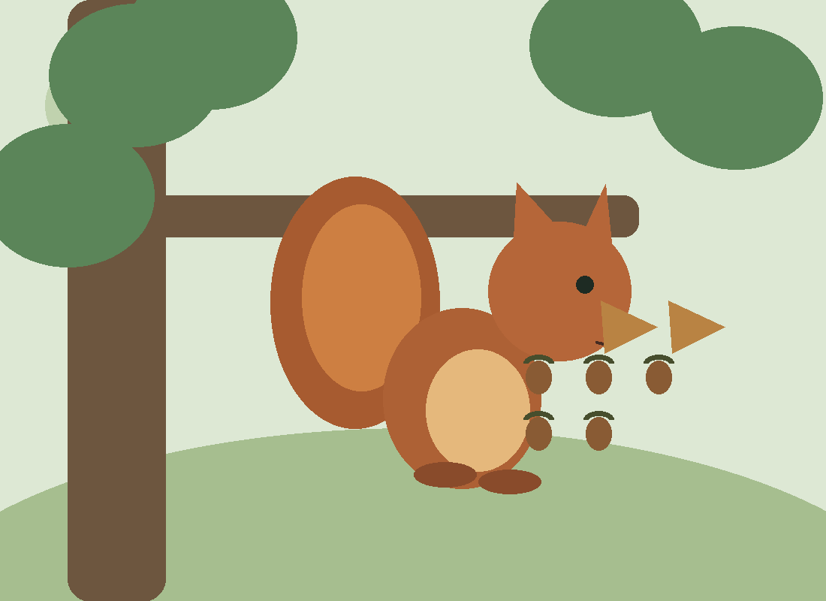
05 WHAT THEY EAT
More than just acorns
• Many species eat nuts, seeds, buds, fruits, flowers, and fungi.
• Some also eat insects, eggs, or other animal foods when available.
• Diet changes with season, geography, and the species of squirrel.
• Hard seeds and nuts reward strong incisors and skillful food handling.
06 / 15
Notes:
Avoid saying squirrels are strictly herbivores. Their diets are flexible, and local food supply shapes feeding behavior.

Slide 7

06 THE ART OF CACHING
Food storage and spatial memory
• Scatter-hoarding squirrels bury food in many separate locations rather than one large store.
• They use spatial cues and smell to locate caches; recovery is not perfect.
• Stored food helps buffer periods when fresh food is scarce.
• Unrecovered viable seeds may germinate, linking squirrel behavior to plant recruitment.
07 / 15
Notes:
Explain scatter-hoarding versus larder-hoarding. Some caches are stolen by other animals. Not every buried seed grows: conditions and seed viability matter.

Slide 8
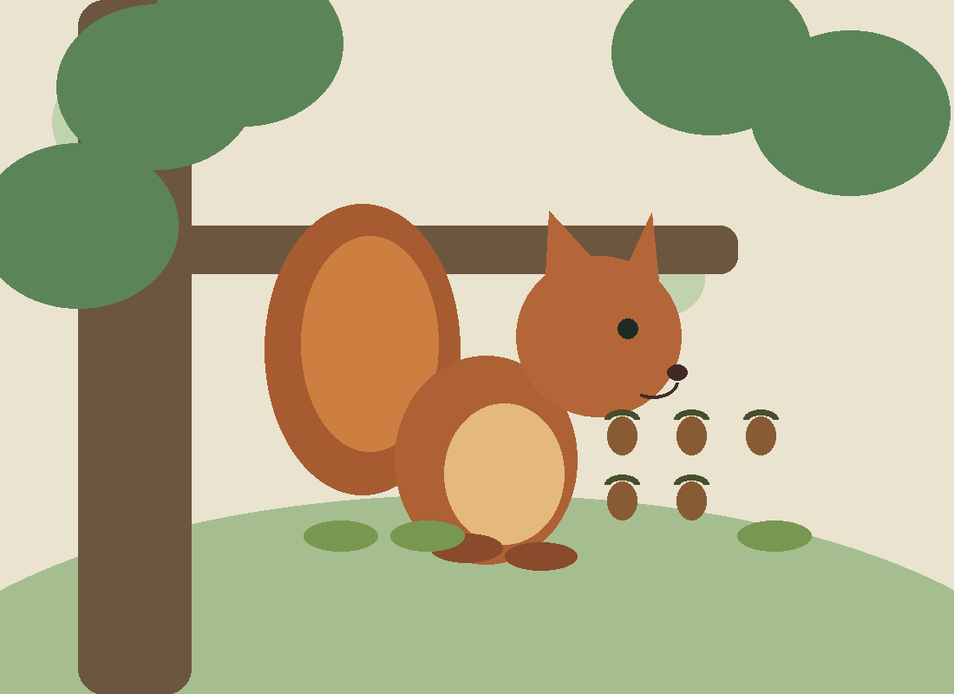
07 COMMUNICATION
Calls, tails, and social signals
• Alarm calls can signal nearby predators; different calls may reflect different threats.
• Tail flicking, posture, and chasing are important visual signals.
• Scent marking helps communicate in some species and contexts.
• Social systems vary widely: some are mostly solitary, while others form groups or colonies.
08 / 15
Notes:
Demonstrate a tail flick with your hand. Note that there is no single squirrel language shared across all species.

Slide 9
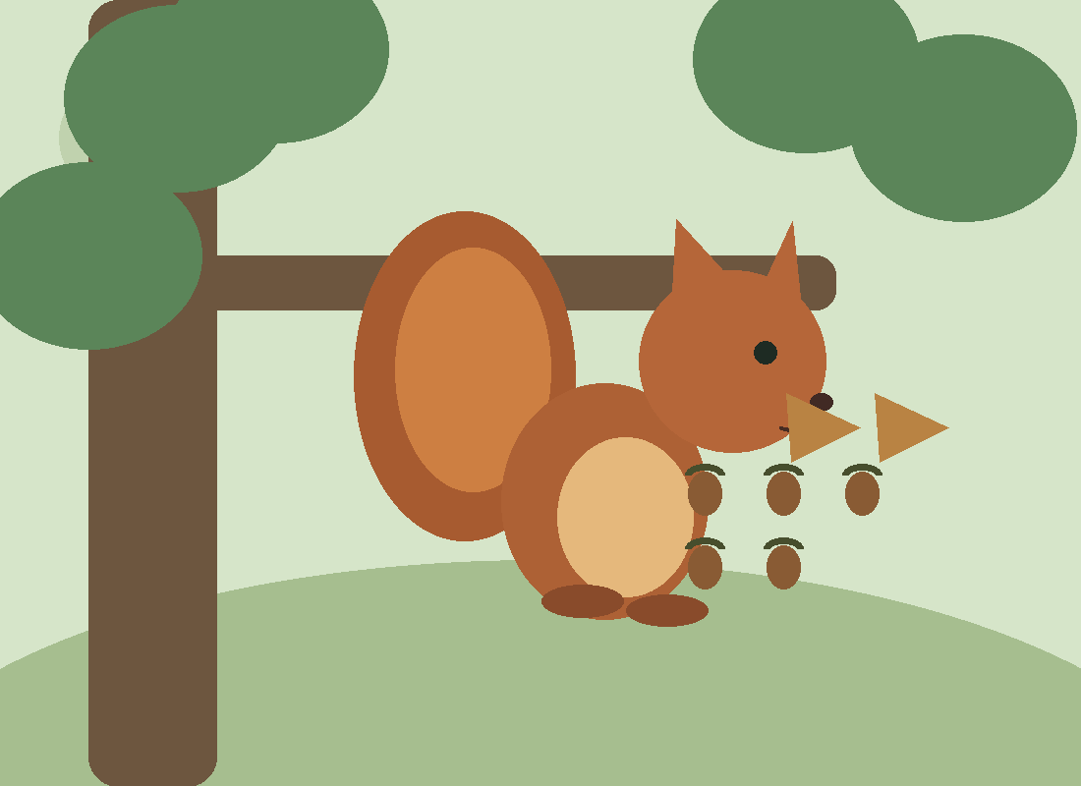
08 LIFE CYCLE
From newborn to independent
• Gestation and litter size vary by species, food availability, and climate.
• Tree squirrel young are born helpless and develop in protected nests called dreys or cavities.
• Parents—often mothers—provide milk and care until young are ready to forage.
• Juveniles learn to navigate, feed, avoid predators, and establish their own ranges.
09 / 15
Notes:
Emphasize species variation: do not give one gestation length for all squirrels. A drey is typically a nest of leaves and twigs high in a tree.

Slide 10
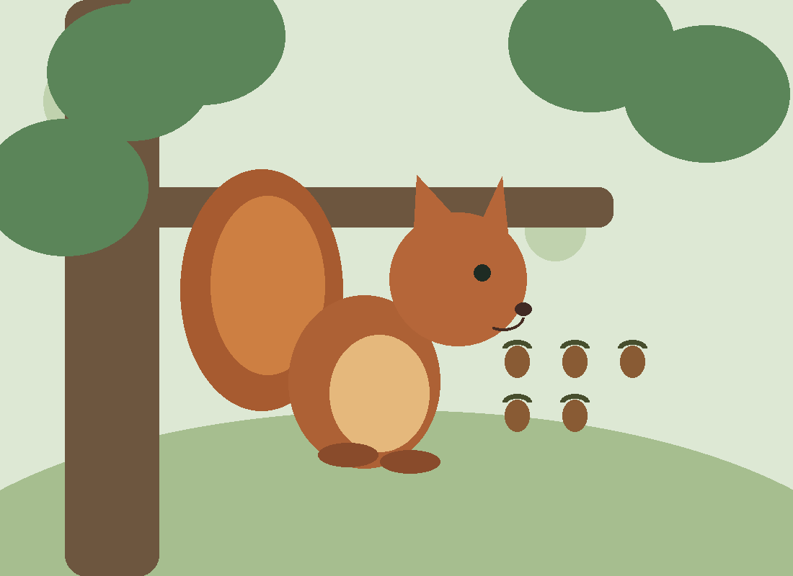
09 PREDATORS & SURVIVAL
Life is full of risks
• Hawks, owls, foxes, snakes, and domestic cats may prey on squirrels.
• Camouflage, rapid climbing, vigilance, and alarm calls reduce risk.
• Some ground squirrels retreat into burrows; flying squirrels often rely on nighttime activity.
• Survival also depends on food, disease, weather, and suitable nesting habitat.
10 / 15
Notes:
Predators vary by region and squirrel species. Explain that being common in cities does not make squirrels invulnerable.

Slide 11

10 FOREST ENGINEERS
Why squirrels matter to ecosystems
• Seed dispersal: caching can move nuts away from the parent tree.
• Food webs: squirrels are prey and also consumers of plants and fungi.
• Fungal relationships: some squirrels eat fungi and disperse spores.
• Their influence can be positive, negative, or neutral depending on the species and ecosystem.
11 / 15
Notes:
Use the phrase accidental gardeners carefully: many seeds are eaten, and some buried seeds never sprout. Ecological impacts depend on context.

Slide 12
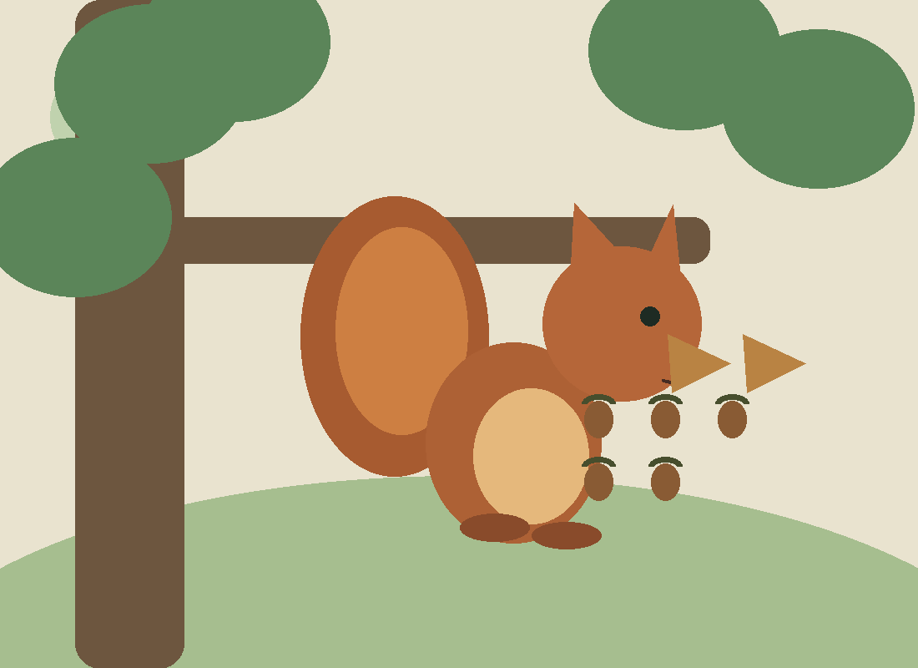
11 LIVING WITH HUMANS
Urban wildlife and conservation
• Parks, mature trees, and connected green spaces can support some squirrel species.
• Feeding wildlife can alter behavior, crowd animals, and create conflict.
• Roads, habitat fragmentation, invasive species, and disease can threaten populations.
• Conservation needs differ: abundant urban species and rare forest specialists face different challenges.
12 / 15
Notes:
Mention that some squirrels thrive around people while other squirrel species are threatened. Recommend watching wildlife at a distance and following local wildlife guidance.

Slide 13
12 FIVE SURPRISING FACTS
Small mammals, remarkable abilities
• Flying squirrels glide by stretching a patagium between limbs.
• Some ground squirrels hibernate; not all squirrels do.
• A squirrel’s incisors keep growing and are worn down by gnawing.
• Tree squirrels can descend headfirst using specialized ankle mobility.
• Some squirrel species have complex alarm calls and social relationships.
13 / 15
Notes:
Invite the audience to pick the most surprising fact. Clarify that hibernation and gliding are species-specific rather than universal squirrel traits.

Slide 14
THANK YOU
The next time you see a squirrel, notice the biology, history, and ecosystem story behind it.
Questions & discussion
14 / 15
Notes:
Summarize three key takeaways: squirrels are diverse, their behavior reflects specialized adaptations, and they influence ecosystems. Invite questions.

Slide 15
SOURCES & FURTHER READING
Suggested starting points
• Encyclopaedia Britannica — “Squirrel” and “Rodent” overviews.
• Animal Diversity Web (University of Michigan) — Sciuridae family accounts.
• Smithsonian National Museum of Natural History — mammal and fossil collections.
• IUCN Red List — species-specific conservation assessments.
• Thorington, Koprowski, Steele & Whatton (2012), Squirrels of the World.
15 / 15
Notes:
These are suggested reference starting points, not an assertion that every fact in the deck was checked against each source. For research or publication, verify specific claims against primary literature.

