Slide 1
OOP: Stratego
Jordan Dehmel, Nate Barnaik

Slide 2
Presentation Overview
Intro
What is Stratego?
Diagrams
4+1 Diagram / API docs
Development
Pieces / Board
Networking
GUI
Design Patterns Used
Testing
Use of design patterns / OOP

Slide 3
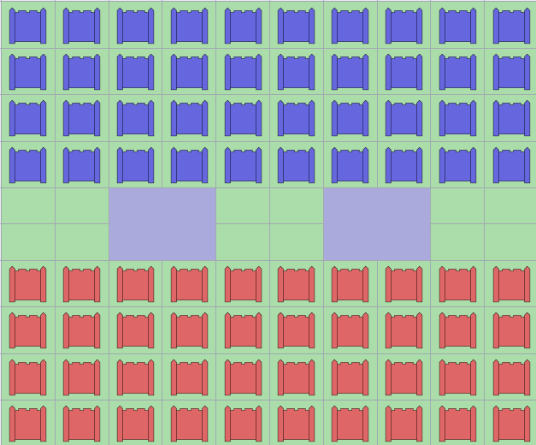
What is Stratego?
Classic board game
Each player has 40 pieces
1 Flag
Bombs
Troops
Special troop pieces
Move pieces in order to capture flag
10 by 10 board
Image via Wikipedia

Slide 4
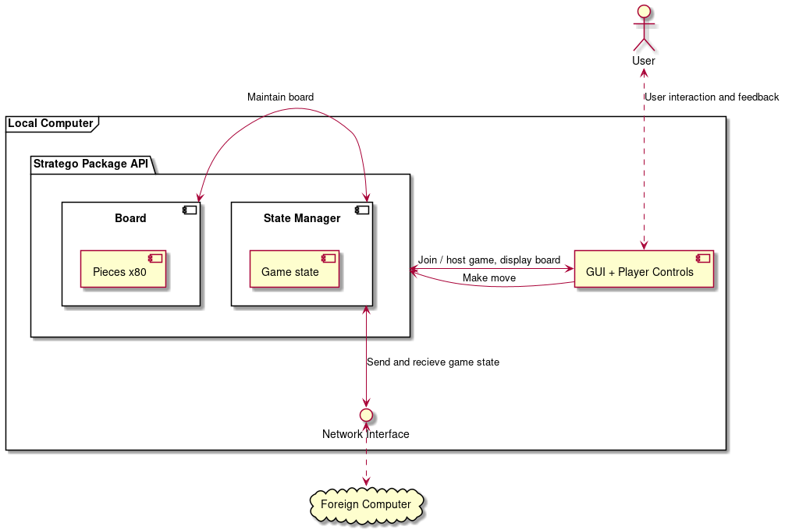
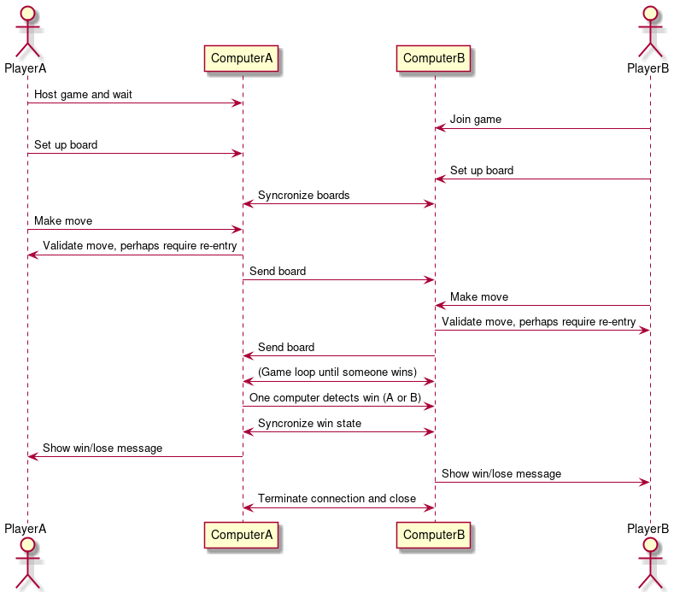
Development (right), Physical (left)

Slide 5
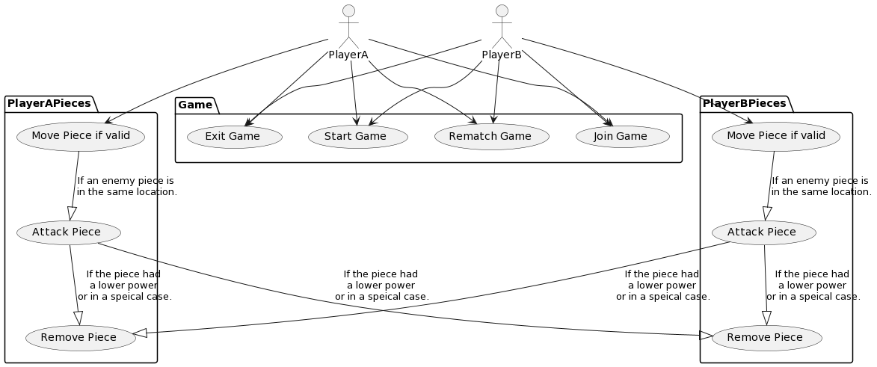
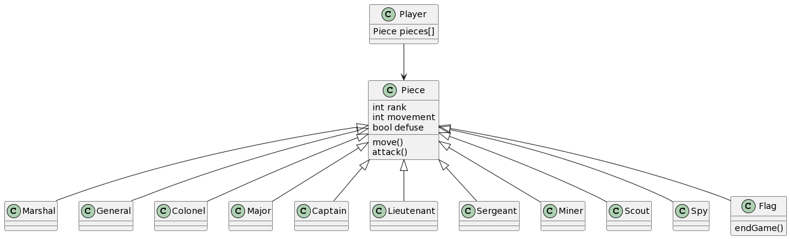
Logic (bottom)
Scenarios (top)

Slide 6
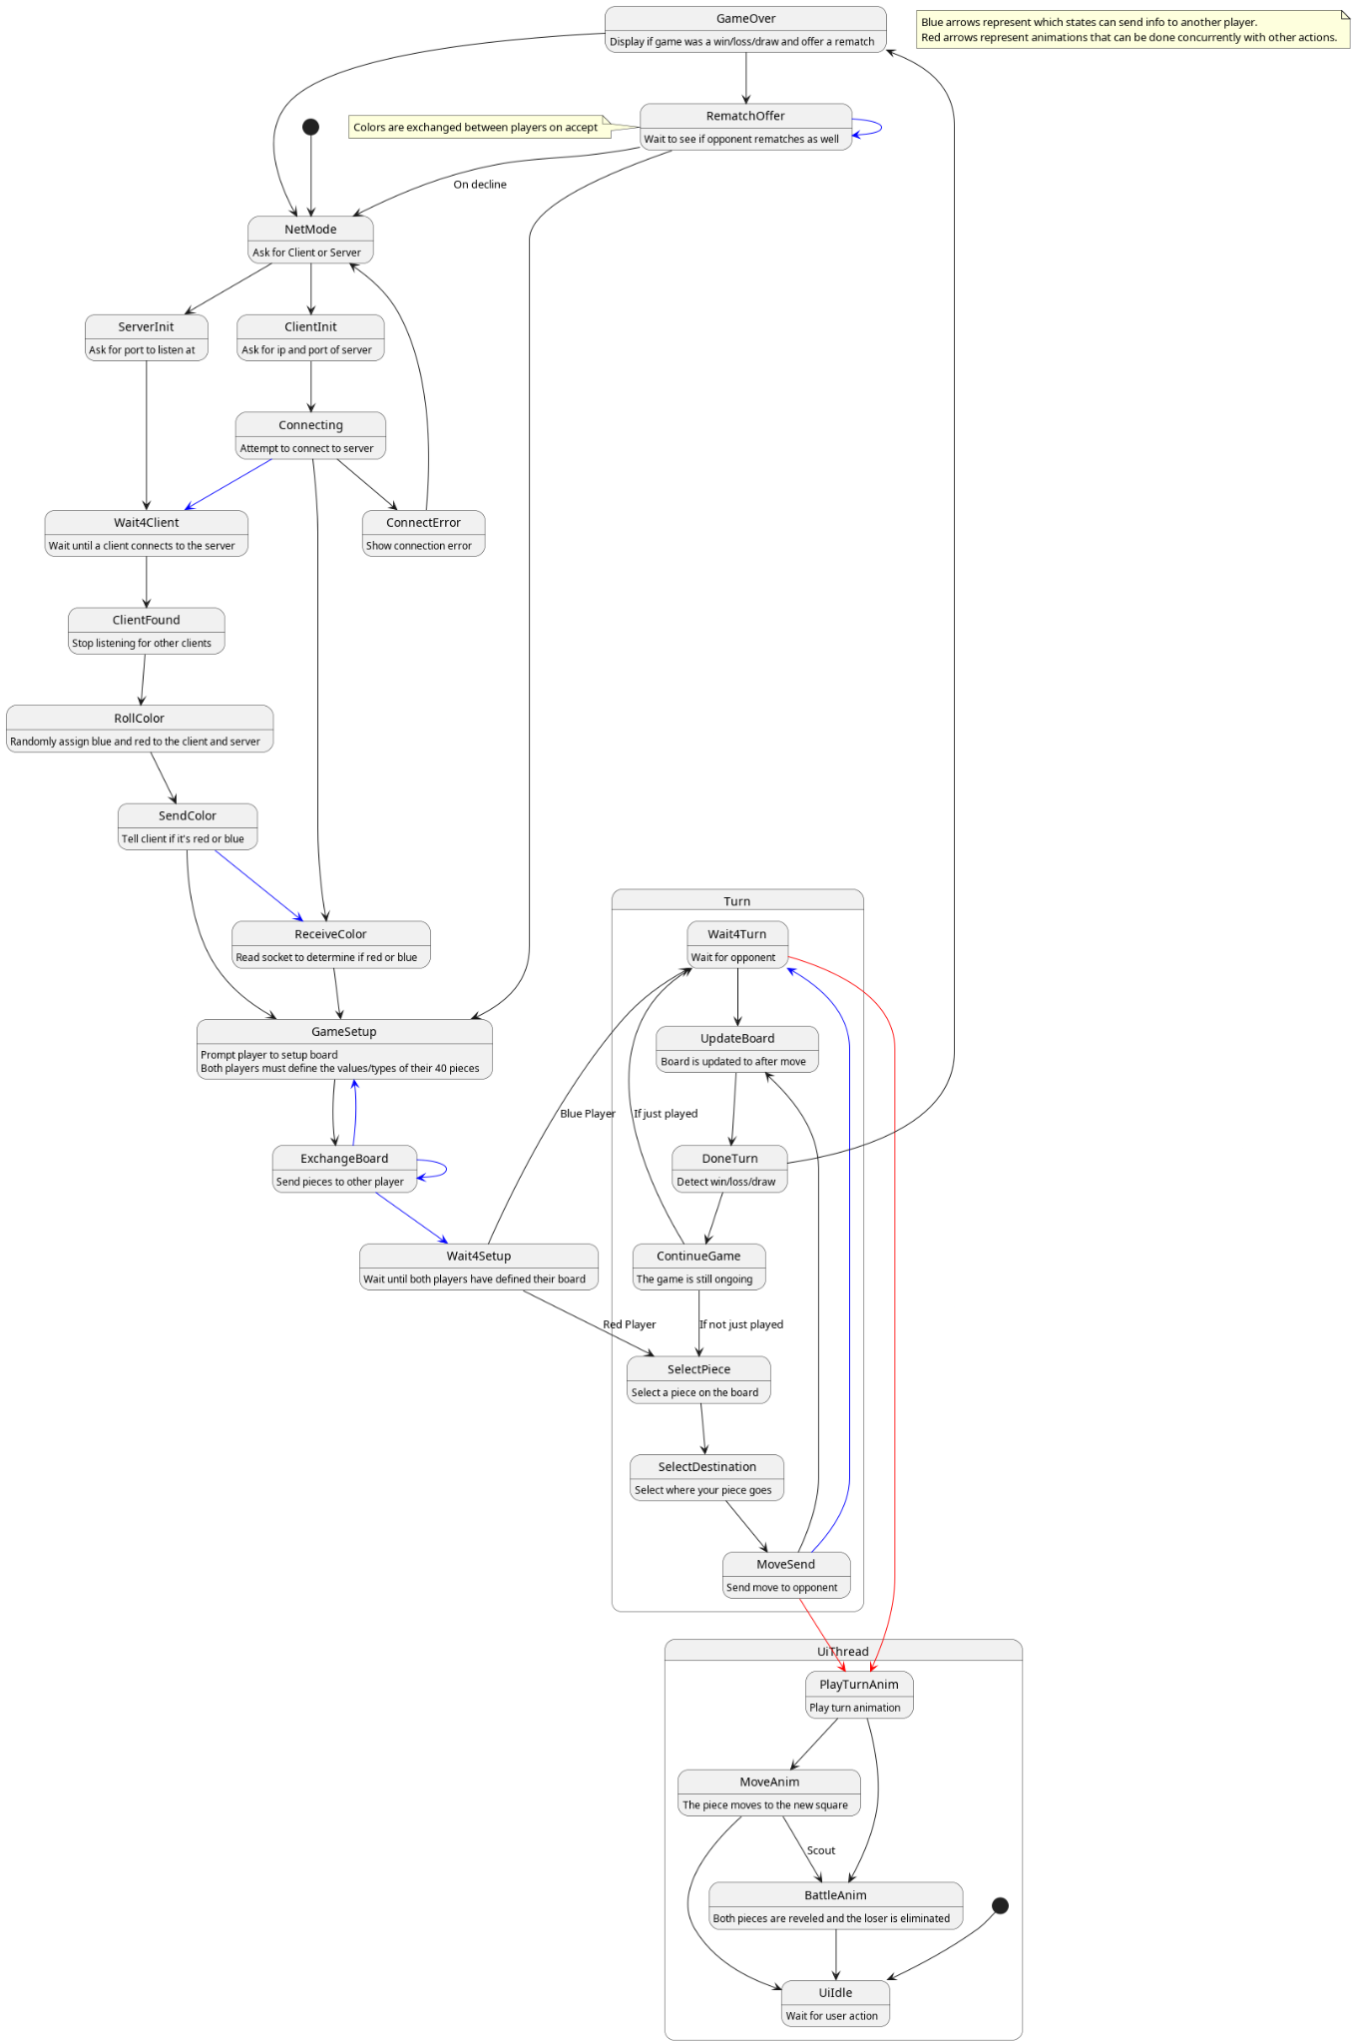
Process

Slide 7
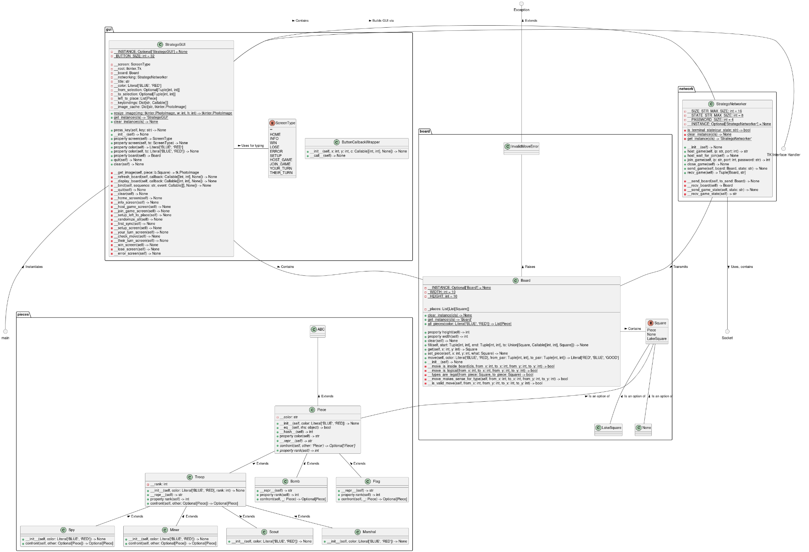
Inheritance and Class Relations
One “piece” abstract base class
Troops, bombs, flags, inherit from this
Special troops inherit from Troop class
Board
Aggregates pieces
Also aggregates lake square class
Networking
Handles network operations
GUI
Aggregates board, networking
Allows user input visually

Slide 8
Design Patterns Used
State machine
GUI (to move between game states)
Event-driven
Singleton
GUI
Board
Networker
Decorator
Type checking throughout
Class / static methods, unit testing, etc
Command
Used for board square callbacks
Keeps track of callback command, arguments to pass to it
Notes:
Jordan Starts here

Slide 9
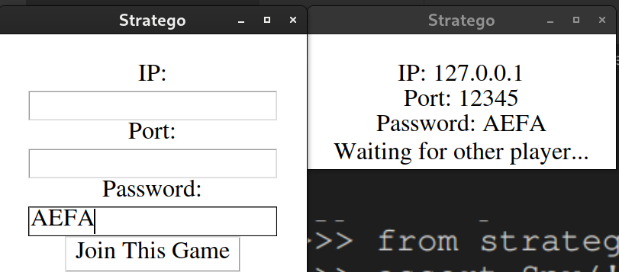
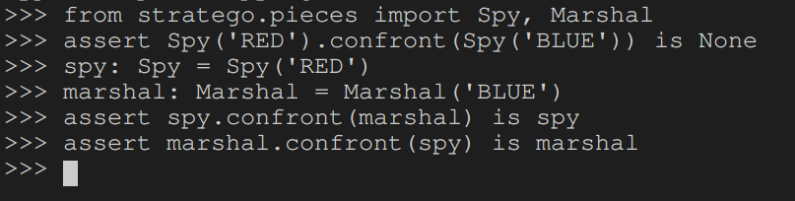
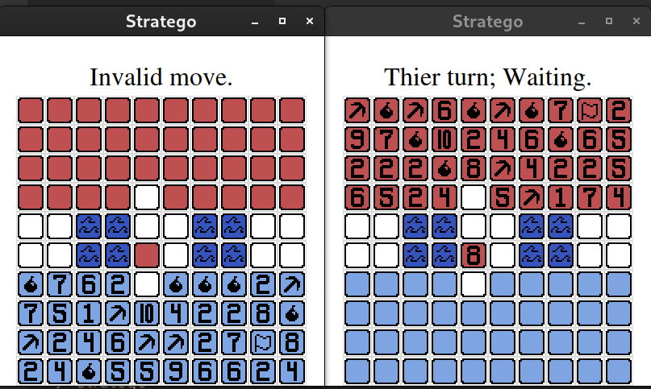
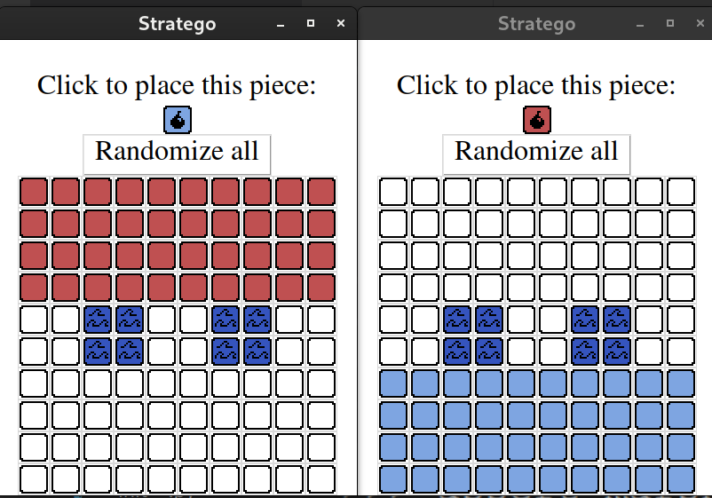
Manual Testing

Slide 10
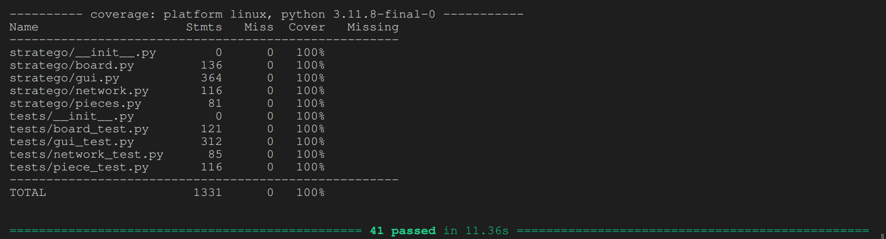
Automated Testing

Slide 11
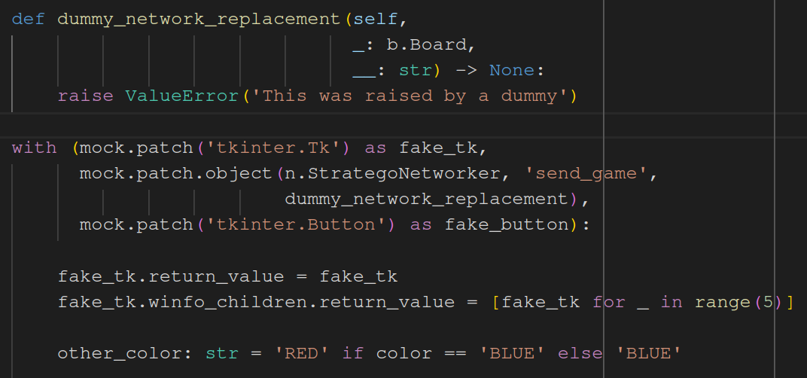
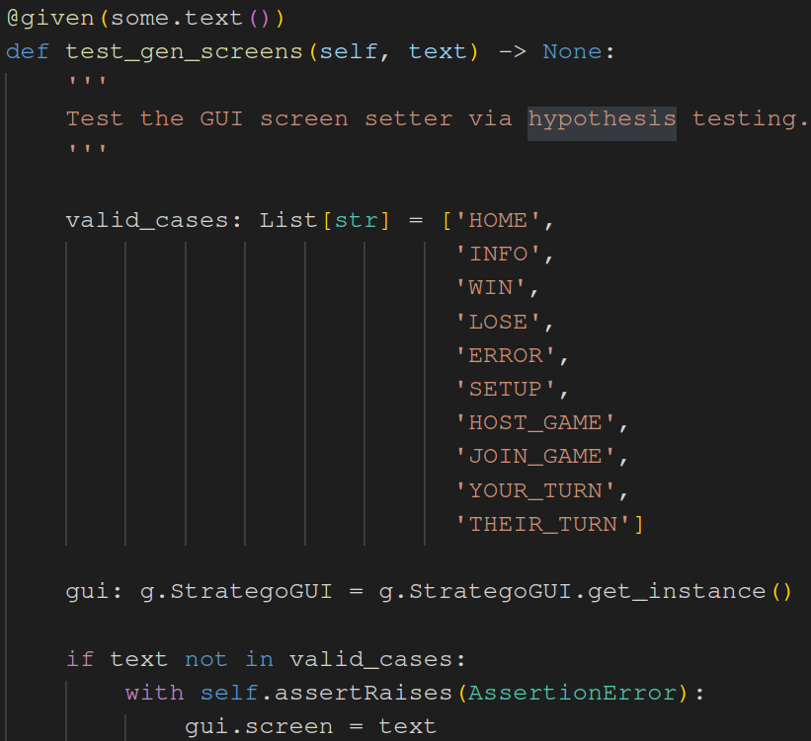
Use of Unit Testing Resources
Mocking / patching
Hypothesis testing

Slide 12
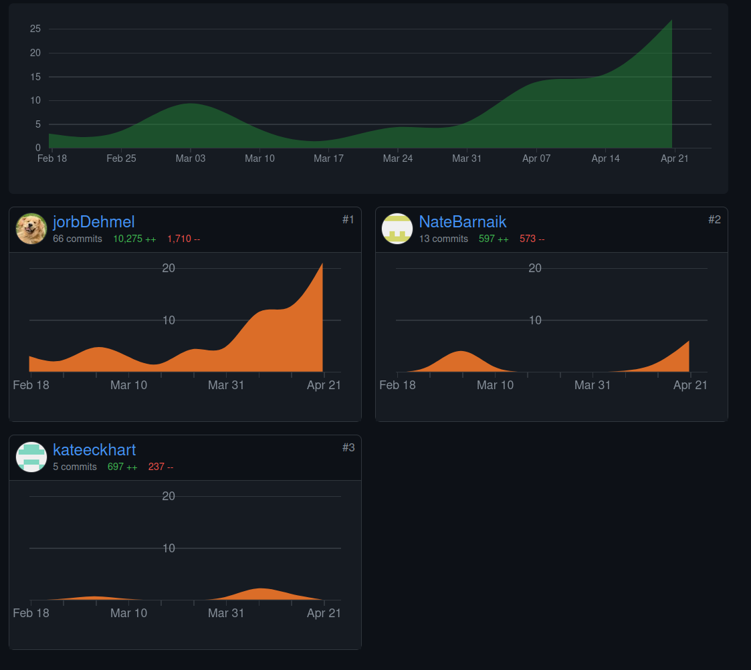
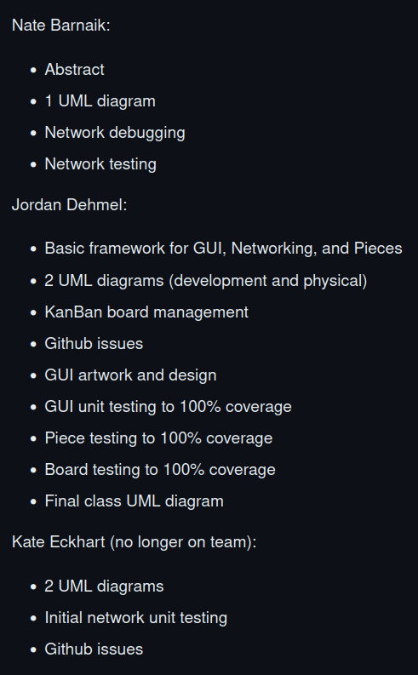
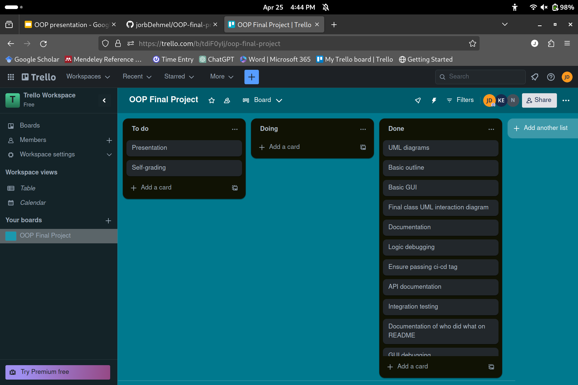
Member Contributions + KanBan

Slide 13
Demonstration

