Slide 1
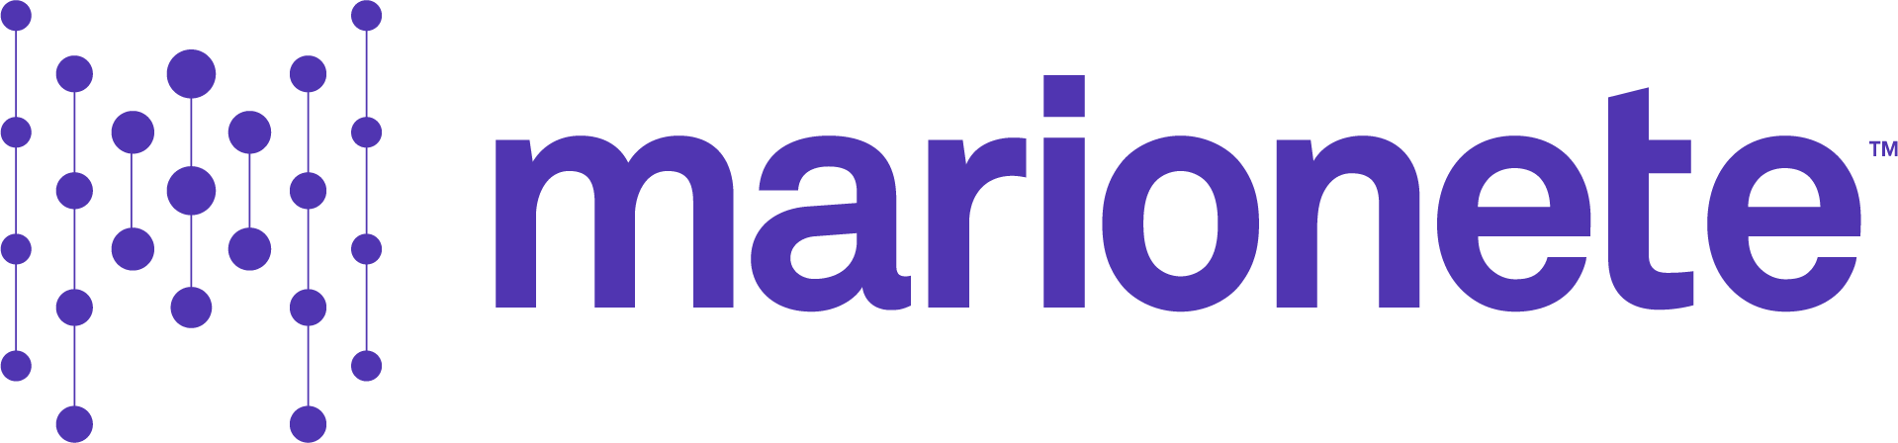

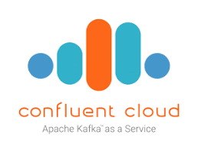





Data Intelligence Platform
Message Store
Data Intelligence Platform
Orchestration
Data Ingestion
ETL
Streaming analytics
Customer
Churn Prediction
1
SA
Legacy Databases
RAW
ODS
Facts
IBM DB2
Batch
Ingestion
BI & reporting
Customer
Segmentation
2
BI
Oracle DB
Data Warehouse
Data sharing & Marketplace
HR Analytics
Cloud Databases
CDC
Ingestion
Databricks SQL
DS
Azure SQL
3
Best-in-class DW performance
AI Applications
Streaming
Ingestion
AI Agent Systems
Operational
Dashboards
Enterprise Applications
AI
Workday
Prepare data
Build agents
Evaluate agents
Deploy agents
Apps
Risk Assessment
& Optimization
Oracle
NetSuite
ServiceNow
Govern agents
AP
Unified, Open and Scalable Lakehouse
Governance, Security, Observability, Interoperability, Sharing
Universal, Open Storage
Unity Catalog
Iceberg
© 2026 Marionete
14

