Slide 1
Image compression
DCT, DHT, JPEG2000

Slide 2
Introduction
Theory of DCT and DHT
Comparison of:
Mean Squared Error
Peak Signal to Noise Ratio
Computation Time

Slide 3

Discrete Cosine Transform (DCT)
Why DCT?
Orthogonal, real, separable
Fast algorithms exist
Availability of special purpose hardware

Slide 4

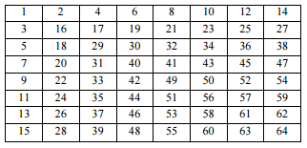
Discrete Hartley Transform (DHT)
Why DHT?
Memory requirement of DHT is about half of the DCT’s memory requirement
DHT can be computed via convolution
Forward and inverse transforms are the same with exception of a scale factor
Special scanning order
Scanning order is determined based on
quantization energy of the image.

Slide 5
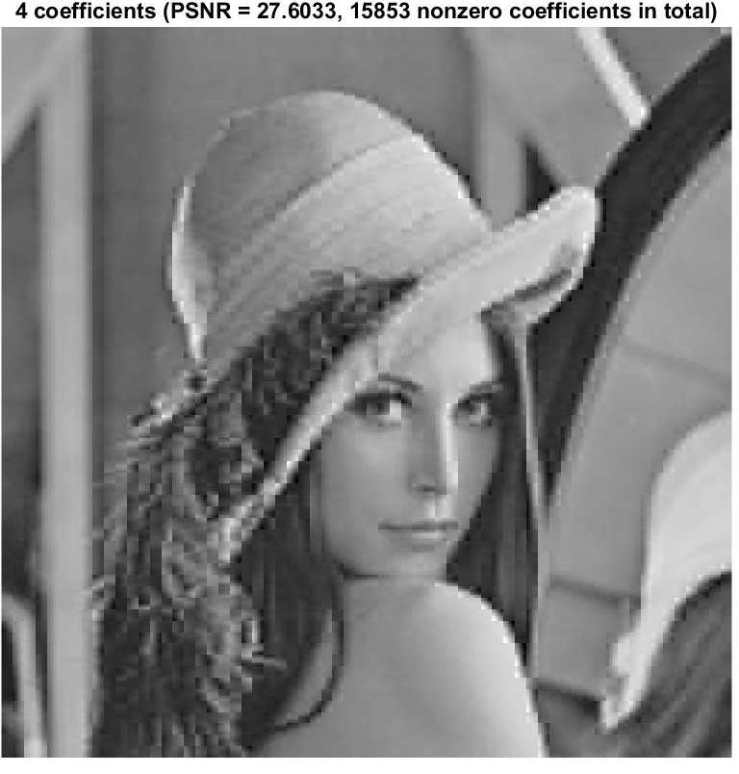

DCT VS. DHT – 4 Coefficients Kept
DCT
DHT

Slide 6

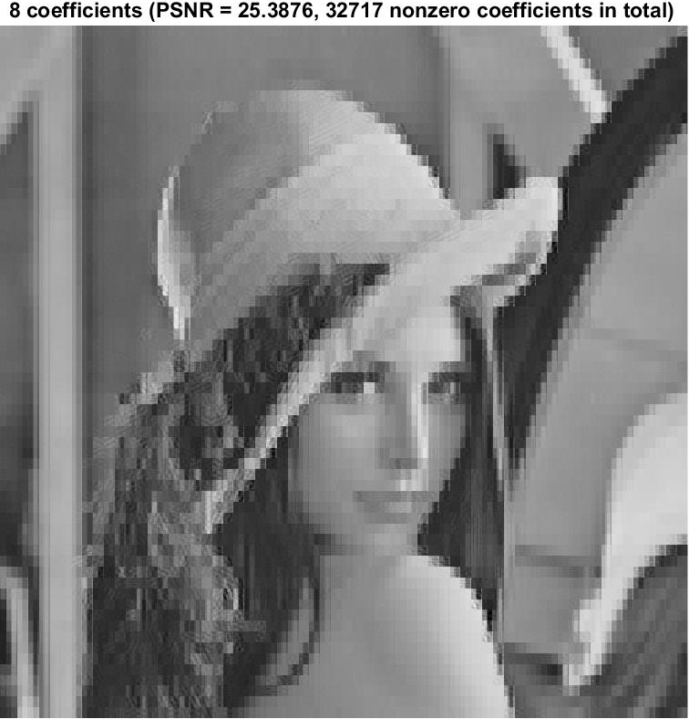
DCT VS. DHT – 8 Coefficients Kept
DCT
DHT

Slide 7


DCT VS. DHT – 16 Coefficients Kept
DCT
DHT

Slide 8


DCT VS. DHT – 32 Coefficients Kept
DCT
DHT

Slide 9
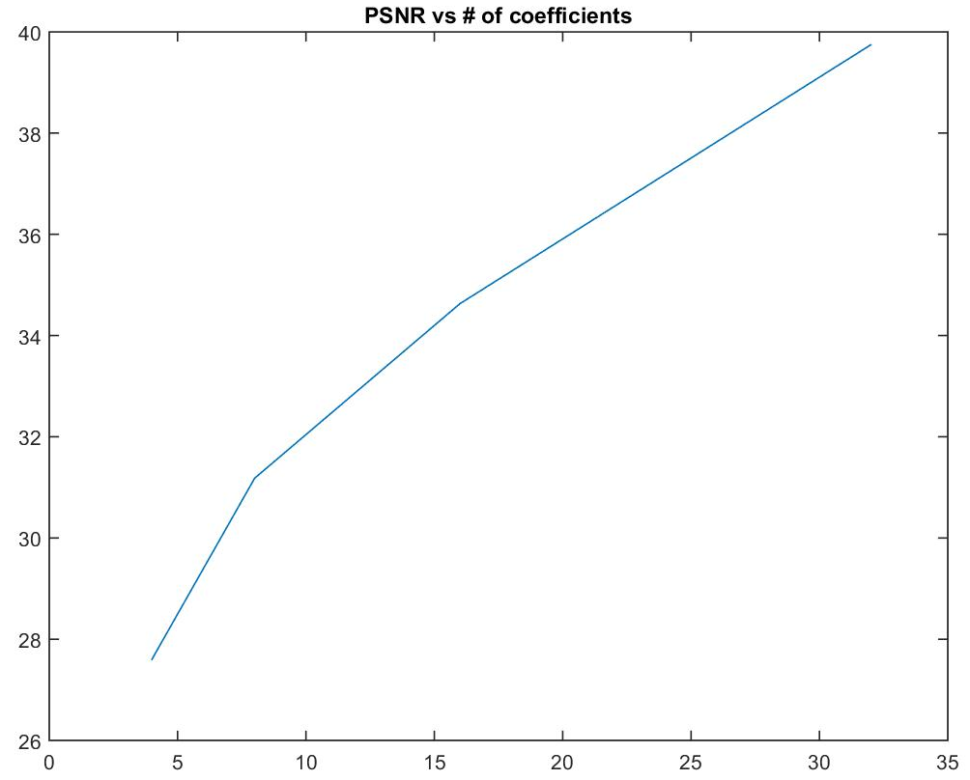
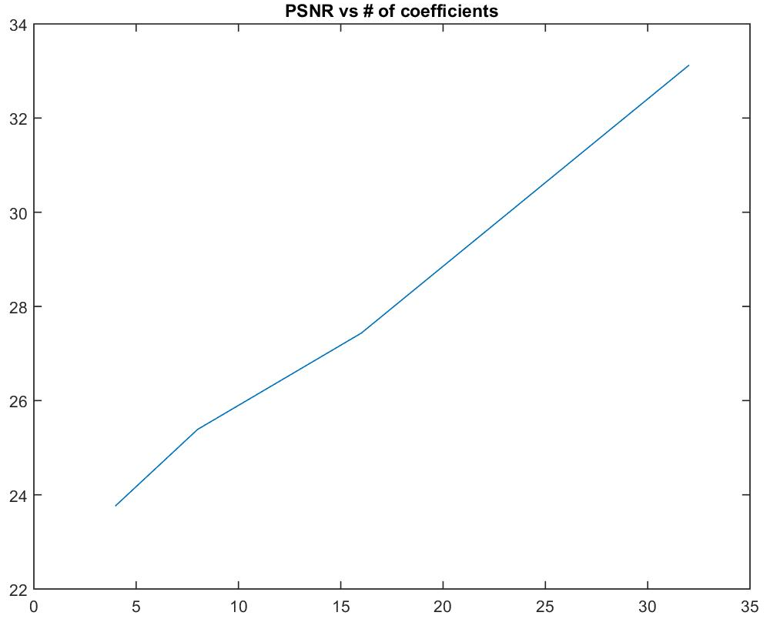
DCT VS. DHT – PSNR Comparison
DCT
DHT

Slide 10
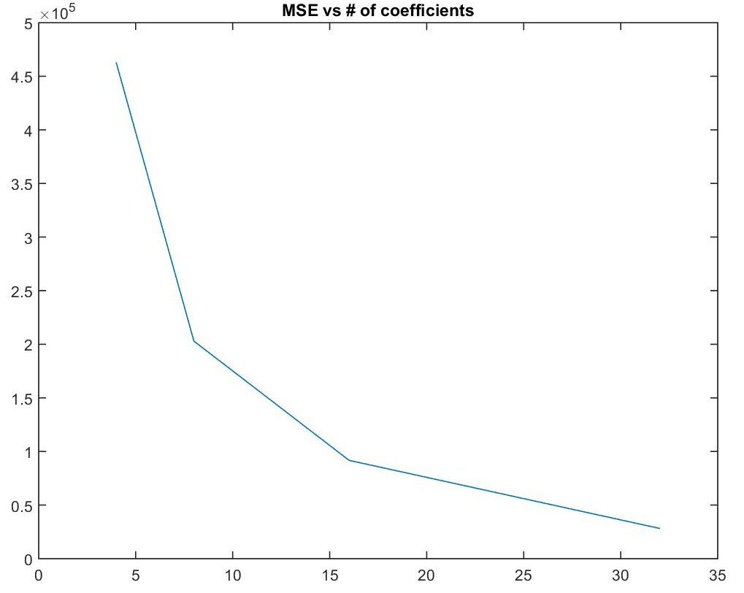
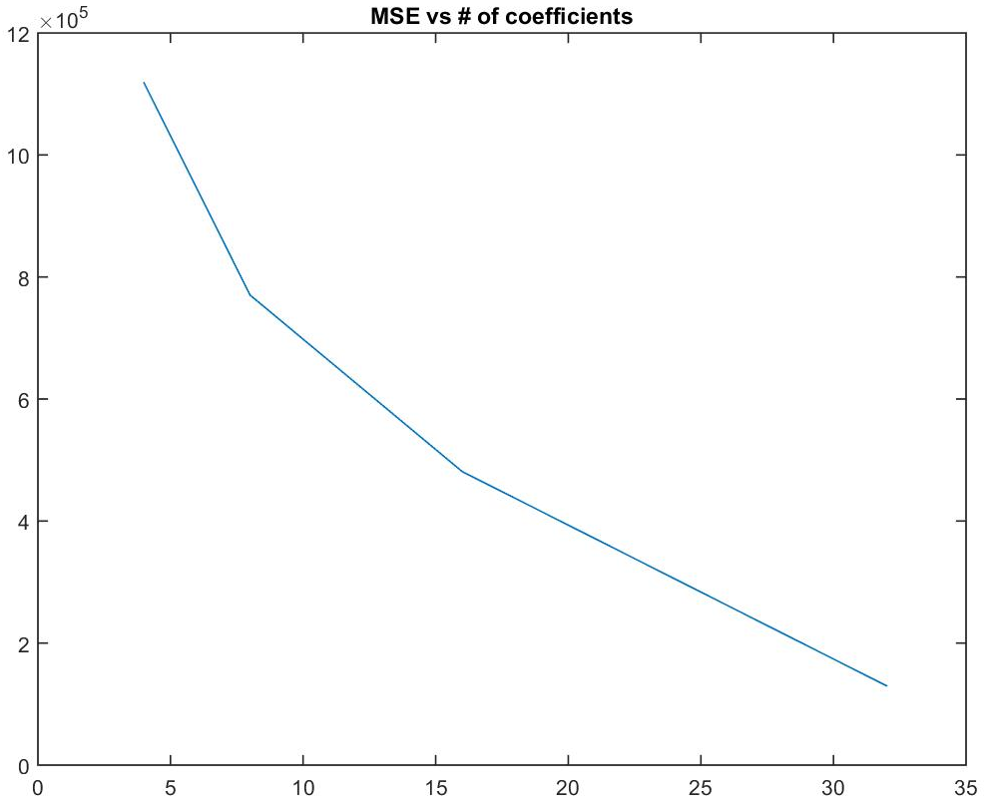
DCT VS. DHT – Mean Square Error
DCT
DHT

Slide 11
DCT VS. DHT – Conclusion
Peak Signal to Noise Ratio:
DHT resulted in a lower PSNR in every scenario
Mean Square Error:
DHT resulted in a higher MSE in every scenario
Computation time:
DCT – 1.349692 seconds
DHT – 1.386902 seconds

Slide 12
Jpeg 2000
Uses Wavelet transform
Coefficients are scalar quantized
Therefore, difficult to compare to with respect to number of coefficients kept in DCT and DHT.
Based on literature, results of JPEG 2000 are expected to be optimal.

Slide 13
References
JPEG Image Compression using DCT and DHT and Comparison of Both Techniques based on Mean Square Error and Peak Signal to Noise Ratio
Url:
http://citeseerx.ist.psu.edu/viewdoc/download?doi=10.1.1.402.3870&rep=rep1&type=pdf

