Slide 1

Sprint 1 Report
Jordan Nguyen-Vo Herbert
Yohann Sharma
Tirth Shah
Daniel Diyali
October 15th, 2026
Notes:
Background: F5F1E8
Text: 2C3E50

Slide 2

Project: ClubHub
University Club management system
  Web application for clubs, club registration, and events
      One place for students to find and join clubs, and for clubs to register and manage themselves

Slide 3
Software Architecture
PostgreSQL: Database
Entities and interactions with Spring
ThymeLeaf
Junit: Testing and Validation

Slide 4
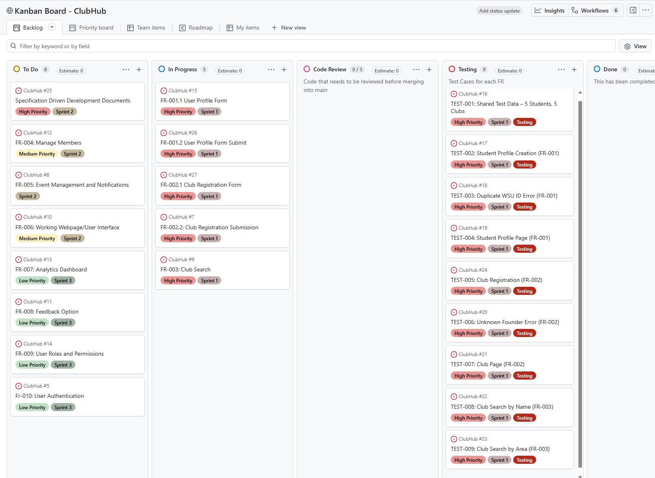
sprint backlog overview
ClubHub: Kanban Board

Slide 5
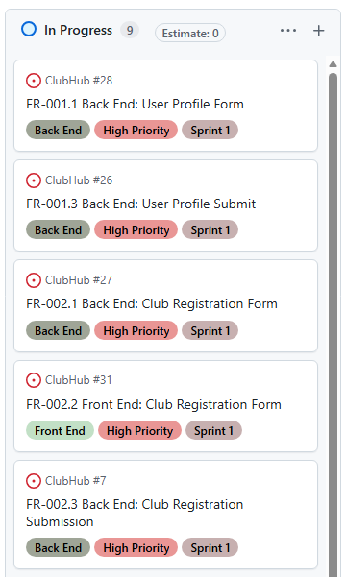
Changes to Kanban Board Structure
Improved visibility of project status and sprint progress.
  Previous requirement structure made progress difficult to track.
Front-end and back-end responsibilities are now clearly separated.
Development dependencies are easier to identify.
Front-end implementation can begin as soon as required APIs/services are available.
Back-end functionality can be tested independently before UI

Slide 6
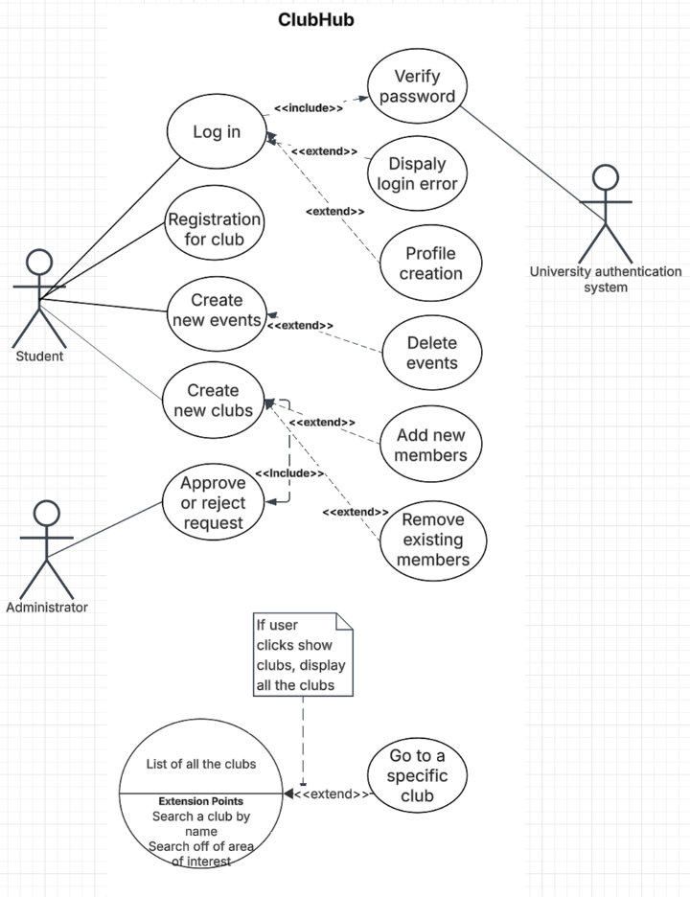
ClubHub Use Case Diagram
Student
  Log in
  Register
  Create event
  Create new clubs
Admin
  Approval

Slide 7
ClubHub Class Diagram
The classes are labeled according to the legend on the class diagram. Dashed border represents classes we have yet to code or implement. Blue represents entities (JPA); yellow represents enumeration classes; red/purple represents controllers and repositories; green represents forms or responses. Attributes and methods are listed with proper relationships.
Enum classes: need for setting values, they must be fixed and exact to prevent errors.
Controller classes: handles HTTP requests and manage flow of data between UI and database.
Entity classes: Stores information of basic classes.
Repository classes: to store and access data and rules from the database.
DTO classes: for forms and responses, so data can flow from the web page(s) to the backend.

Slide 8
ClubHub Collaboration Diagram for Student Profile Creation
← displayProfile()
POST studentForm ->
POST /studentFormSubmit() →
1: CreateProfile() →
ClubHubUI
1.1 : Get /StudentForm() →
:StudentController
← 2.1: DisplayForm()
Student
2: StudentForm()
save(student)
:StudentRepository
:Student
:StudentForm
: PostgreSQL
via Spring Data JPA

Slide 9
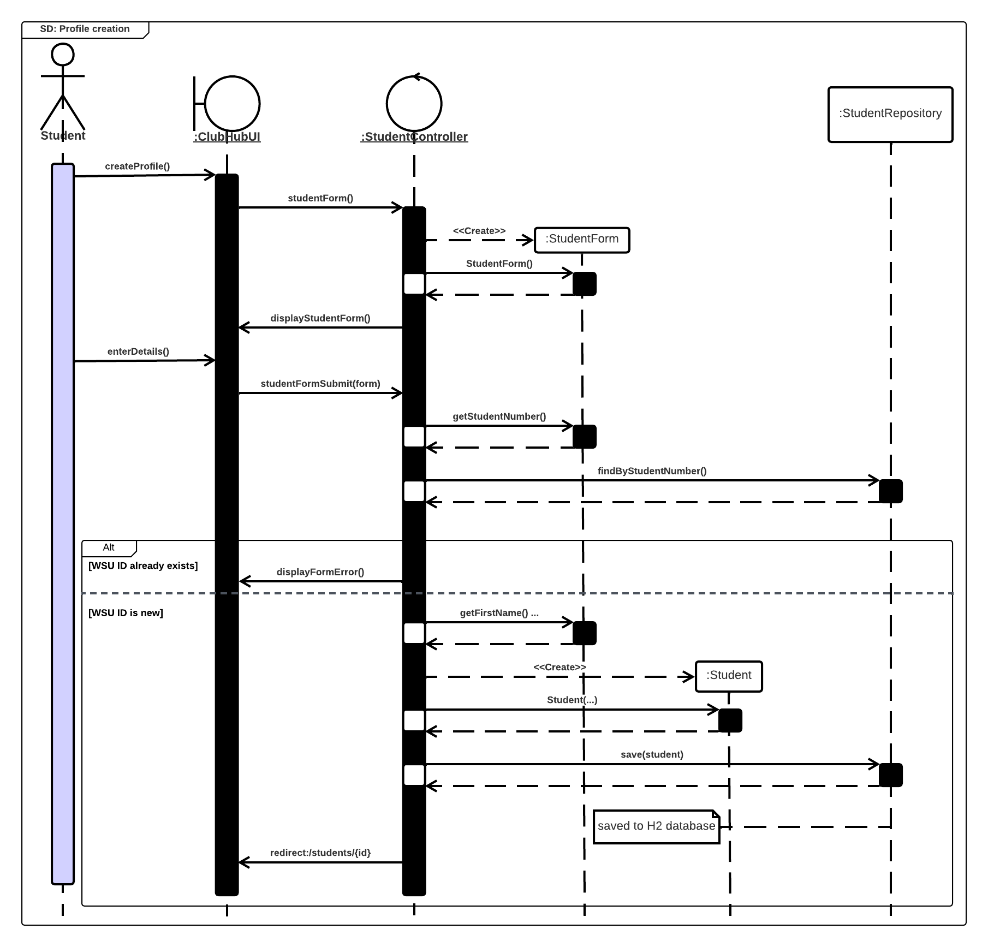
Sequence diagram: profile creation
MAIN SUCCESS PATH
01
Request the form
Student → ClubHubUI → StudentController
02
Submit details
The UI submits the completed StudentForm.
03
Check the WSU ID
StudentRepository looks up the submitted ID.
04
Create and save
A new Student is created and saved to H2.
05
Redirect
The student is sent to /students/{id}.
ALTERNATIVE: duplicate WSU ID → display form error

Slide 10
BackENd
Entity
Controller
Post/GET
Repository
Entity
  Java classes that become database tables (Student, Club, Member)
Controller
  Handles the entity associated requests
Post/Get
  The specific request from the browser
    GET: Loads a page
    POST: Form submission
Repository
  Interacts with the data base
    Retrieval/storage

Slide 11
Front ENd
Model
Template
HTML Page
Form/Link
Model:
  the controller puts data in the Model
Template:
  Thymeleaf fills the ${...} parts in the .html file
HTML Page
  The browser receives a finished page
Form / Link
  The user submits a form or clicks a link, which sends a new GET or POST back to the controller

Slide 12
Student profile Testing
5
0
3
TEST APPROACH
Test Runs
Failures
Issues closed
Spring Boot · MockMvc · StudentRepository
Shared sample data in SampleStudents.java
TEST-002
TEST-003
TEST-004
Profile creation
Duplicate WSU ID
Profile page
Five sample students are saved, redirected, and shown on their profile pages.
An error is shown, form values are preserved, and no second profile is created.
Details display without exposing passwords; missing profiles return 404.
EDGE CASES: Blank gender/pronouns · Blank major · WSU IDs with leading zeros · Hyphenated names

Slide 13
Club Testing
4 issues closed
For testing approach, I used SpringBoot, MockMvc, StudentRepository, ClubRepository, and files from controller and entities.
Club Registration
After adding all the club's details, it's ready for registration. It's registered if there's a valid student ID available.
Club Search by area
When searching for a club, select one area from the dropdown and if the club matches that area, the name will be displayed.
Club Search by name
When searching for a club, type its name. If it exists, the club's name comes up.
Club Page
After the registration, the club's page display's area of interest, status, description, and members.
Edge cases: if the student doesn't have a valid ID, then that student cannot register a club.

Slide 14
Features Implemented
FR-001: User Profile Management
  FR-001.1: Back End: User Profile Form
  FR-001.2: Front End: User Profile Page
  FR-001.3: Back End: User Profile Submission and Storage
  FR-001.4: Front End: User Profile Form & Submission
FR-002: Club Registration
  FR-002.1: Back End: Club Registration Form
  FR-002.2: Front End: Club Registration Form
  FR-002.3: Back End: Club Registration Submission
  FR-002.4: Front End: Club Registration Page
  FR-002.5 Front End: Club Registration Submission
FR-003: Club Search
  FR-003.1: Back End: Club Search Processing
  FR-003.2: Front End: Club Search Interface

Slide 15
FR-001.1: Back end: User Profile form
Functionality: User profile form successfully relays data from the front end to the back end.
User Stories: As a student, I need a form that can be filled out, so that I can submit a registration request, and have my ClubHub profile created.
Acceptance Criteria:
Feature: Back End: User Profile Form
Scenario: Successfully open the student profile form
Given that the student is logged in
And the student has entered valid information for their profile
When the student clicks "Create a student profile"
Then they are redirected to a form with fields that can filled out to then submit, and create their student profile.
Acceptance Criteria:
Feature: Back End: User Profile Form
Scenario: Unsuccessfully open the student profile form
Given that the student is not logged in
And the student has entered invalid information for their profile
When the student clicks "Create a student profile"
Then they are redirected page that states they have not created a student profile, and provides links to create a student profile and return to home.

Slide 16
FR-001.2: Front end: user profile page
Functionality: User profile page is accessible from the home page (index.html) and after student profile form has been filled out and submitted the user will get redirected to their user profile page. The user/student profile page lists their inputted information and provides a link back to the home page.
User Stories: As a student, I need a page that displays my user profile information, so that I can see my user profile information.
Acceptance Criteria:
Feature: User Profile Page (Front End)
Scenario: User successfully loads their student profile page, after submitting student profile form
Given that the student is logged in with valid credentials
And the student has filled out the student profile form
When the student submits the student profile form
Then they are redirected to their student profile page.
And the user is given a link back to the home page, on their profile page.
Acceptance Criteria:
Feature: User Profile Page (Front End)
Scenario: User unsuccessfully loads their student profile page
Given that the student is not logged in with valid credentials
And the student has not filled out the student profile form
When the student clicks my student profile
Then they are redirected to a page that states they have not created a user/student profile
And the user is given a link back to the home page and to the student profile form page.

Slide 17
FR-001.3: back end: User profile submission and storage
Functionality: After the user fills out the user profile form and submits it, the form and data will be stored.
User Stories: As a student, I need a form that can be filled out, so that I can submit the form and have my student profile created.
Acceptance Criteria:
Feature: User Profile Submission and Storage (Back End)
Scenario: Successfully create a profile
Given the student is logged in
And the student has entered valid information for their profile
When the student selects "Create Profile"
Then ClubHub creates the student's profile
And the student is redirected to a page displaying their profile information
Acceptance Criteria:
Feature: User Profile Submission and Storage (Back End)
Scenario: Create profile with a student ID that already has a profile
Given the student is logged in
And the student has entered a student ID that is already associated with an existing profile
When the student selects "Create Profile"
Then ClubHub does not create a new profile
And the student receives the message "A profile already exists for this student ID"
And the information entered remains displayed in the form

Slide 18
FR-001.4: front end: user profile form & submission
Functionality: Provide the user profile form that can be submitted.
User Stories: As a student, I need a form that can be filled out, so that I can submit the form and have my student profile created.
Acceptance Criteria:
Feature: User Profile Form & Submission (Front End)
Scenario: Successfully create a profile
Given the student is logged in
And the student has entered valid information for their profile
When the student selects "Create Profile"
Then ClubHub creates the student's profile
And the student is redirected to a page displaying their profile information
Acceptance Criteria:
Feature: User Profile Form & Submission (Front End)
Scenario: Create profile with a student ID that already has a profile
Given the student is logged in
And the student has entered a student ID that is already associated with an existing profile
When the student selects "Create Profile"
Then ClubHub does not create a new profile
And the student receives the message "A profile already exists for this student ID"
And the information entered remains displayed in the form

Slide 19
FR-002.1: Back end: club registration form
Functionality: Accept submission and store information for the club registration form.
User Stories: As a student who wants to start a new club, I need the backend to serve the club registration form with the data it needs, so that I can fill out a complete and accurate registration request.
Acceptance Criteria:
Feature: Serve club registration form
Scenario: Logged-in student opens the registration form
Given a student is logged in
When the student navigates to "/clubs/register"
Then the registration form is returned
And the category dropdown contains all categories stored in the database
And the founding officer fields are prefilled with the student's name and email
Acceptance Criteria:
Scenario: Unauthenticated user requests the form
Given a user is not logged in
When the user navigates to "/clubs/register"
Then the user is redirected to the login page

Slide 20
FR-002.2: Front end: club registration form
Functionality: Provide a responsive web page for the club registration form.
User Stories: As a student who wants to start a new club, I need a clear, easy-to-use club registration form, so that I can submit my club registration request without confusion or errors.
Acceptance Criteria:
Feature: Club registration form UI
Scenario: Form displays all fields
Given a logged-in student opens the club registration page
Then the form shows fields for club name, description, category, meeting info, faculty advisor, and contact email
And required fields are visibly marked
Scenario: Browser blocks incomplete submission
Given a student is filling out the registration form
When the student clicks Submit with the club name empty
Then the form is not submitted
And a message indicates the club name is required
Acceptance Criteria:
Scenario: Server errors are shown inline
Given a student submits a club name that already exists
When the page reloads with the server response
Then an error appears beneath the club name field
And all other entered values remain in the form
Scenario: Student cancels registration
Given a student is on the registration form
When the student clicks Cancel
Then the student is returned to the club list without saving anything

Slide 21
FR-002.3: back end: Club Registration Submission
Functionality: After the user submits the club registration form, the information shall be successfully stored.
User Stories: As a student who wants to start a new club, I need the backend to validate and store my club registration submission, so that my club registration request is saved and queued for admin approval.
Acceptance Criteria:
Scenario: Successful club registration
Given I am logged in with a valid student account
And I am on the club registration page
When I submit a registration form with a club name, description, and category
Then the registration is saved with a status of "Pending Approval"
And I am notified that an administrator will review my submission
Acceptance Criteria:
Scenario: Club registration request fails
Given I am logged in with a valid student account
And I am on the club registration page
When I submit my application
And the request fails before completion
Then no registration is created
And I am returned to the registration form

Slide 22
FR-002.3: back end: Club Registration Submission continued
Feature: Process club registration submission
Scenario: Valid submission is saved
Given a logged-in student
And no club named "Chess Club" exists
When the student submits a valid registration for "Chess Club"
Then a club record is saved with status "PENDING"
And the submission timestamp is recorded
And the student is linked as the founding officer
And the student is redirected to the submission confirmation page
Scenario: Missing required fields
Given a logged-in student
When the student submits a registration without a description
Then no club record is created
And the form is returned with an error for the description field
Acceptance Criteria:
Scenario: Duplicate club name
Given a club named "Chess Club" exists or is pending
When a student submits a registration named "chess club"
Then no club record is created
And the error "A club with this name already exists" is returned
Scenario: Invalid category
Given a logged-in student
When a submission includes a category not in the database
Then no club record is created
And an error indicates the category is invalid
Scenario: Unauthenticated submission
Given a user is not logged in
When a POST request is sent to "/clubs/register"
Then the request is rejected
And the user is redirected to the login page

Slide 23
FR-002.4: front end: Club page
Functionality: The front end will serve an html club page displaying club information.
User Stories: As a student, I need a page for each club showing its information, so that I can learn about the club and decide whether to join
Acceptance Criteria:
Feature: Club page
Scenario: Viewing an approved club
Given "Chess Club" has status "APPROVED"
When a student navigates to the Chess Club page
Then the page shows the club's name, description, category, meeting info, advisor, contact email, and officers
And a "Request to Join" button is shown
Scenario: Pending club hidden from other students
Given "Robotics Club" has status "PENDING"
When a student who did not submit it navigates to its page
Then a "Club not found" page is shown
Acceptance Criteria:
Scenario: Submitter can view their pending club
Given a student submitted "Robotics Club" and it is "PENDING"
When that student navigates to its page
Then the club details are shown with a "Pending Approval" banner
And the "Request to Join" button is not shown
Scenario: Nonexistent club
Given no club exists with id 9999
When a student navigates to "/clubs/9999"
Then a "Club not found" page is shown

Slide 24
FR-002.5: front end: Club registration submission
Functionality: The front end will serve an html club registration form that can be successfully submitted.
User Stories: As a student who submitted a club registration, I need confirmation of my submission and a way to check its status, so that I know my request went through and whether it was approved.
Acceptance Criteria:
Feature: Club registration submission UI
Scenario: Confirmation after submitting
Given a student successfully submits a registration for "Chess Club"
When the confirmation page loads
Then a success message says the request is awaiting admin approval
And a summary of the submitted details is shown
And a link to "My Club Requests" is shown
Scenario: Viewing request status
Given a student has submitted "Chess Club" and "Hiking Club"
When the student opens "My Club Requests"
Then both requests are listed with their status and submission date
Acceptance Criteria:
Scenario: Approved request links to club page
Given the student's "Chess Club" request has status "APPROVED"
When the student views "My Club Requests"
Then "Chess Club" shows status "Approved" with a link to its club page
Scenario: Rejected request shows reason
Given the student's "Hiking Club" request was rejected with the reason "Duplicate of Outdoors Club"
When the student views "My Club Requests"
Then "Hiking Club" shows status "Rejected" and the reason
Scenario: No requests yet
Given a student has never submitted a registration
When the student opens "My Club Requests"
Then a message says they have no club requests and links to the registration form

Slide 25
FR-003.1: Back end: club search
Functionality: The back end is able to search for clubs based on club name or area of interest.
User Stories: As a student, I need the backend to search clubs by name, category, and keywords, so that I can quickly find clubs that match my interests.
Acceptance Criteria:
Feature: Club search backend
Scenario: Search by keyword
Given approved clubs "Chess Club" and "Chess & Strategy Games" exist
When a search is performed with the keyword "chess"
Then both clubs are returned
Scenario: Keyword matches description
Given an approved club "Board Game Society" has "chess" in its description
When a search is performed with the keyword "chess"
Then "Board Game Society" is included in the results
Acceptance Criteria:
Scenario: Filter by category
Given approved clubs exist in the "Sports" and "Academic" categories
When a search is performed with category "Sports"
Then only clubs in the "Sports" category are returned
Scenario: Keyword and category combined
Given "Chess Club" is "Academic" and "Chess Boxing" is "Sports"
When a search is performed with keyword "chess" and category "Sports"
Then only "Chess Boxing" is returned
Scenario: Pending clubs excluded
Given "Robotics Club" has status "PENDING"
When a search is performed with keyword "robotics"
Then "Robotics Club" is not returned
Scenario: No parameters
When a search is performed with no keyword or category
Then all approved clubs are returned in alphabetical order

Slide 26
FR-003.2: front end: club search
Functionality: The front end is able to receive input values from the user to successfully search through the database and show clubs that match a club name or area of interest.
User Stories: As a student, I need a search bar and filters on the club search page, so that I can browse and find clubs easily.
Acceptance Criteria:
Feature: Club search UI
Scenario: Searching shows matching clubs
Given a student is on the club list page
When the student enters "chess" and clicks Search
Then matching clubs are displayed with name, category, and description snippet
And the search box still contains "chess"
Scenario: Filtering by category
Given a student is on the club list page
When the student selects "Sports" from the category dropdown and clicks Search
Then only Sports clubs are displayed
And "Sports" remains selected in the dropdown
Acceptance Criteria:
Scenario: No results
Given no clubs match the keyword "underwater basket weaving"
When the student searches for it
Then a "No clubs found" message is shown
And a "Clear filters" option is available
Scenario: Opening a club from results
Given search results are displayed
When the student clicks on "Chess Club"
Then the student is taken to the Chess Club page
Scenario: Paginated results
Given more than 20 clubs match a search
When the results load
Then the first 20 are shown with controls to view the next page

Slide 27
Responsible Use of ai
Sprint 1: Limited usage
    Team priority was to understand underlying architecture before transitioning to SDD
AI served in the capacity of a tutor
  Assisted with debugging and code correction
Repeated patterns seen in front end/backend interactions will be applied to future sprints
Meetings
  AI was used to generate meeting summaries, and then uploaded into MoM

Slide 28
Sprint review & retrospective
Change Development Approach
01
Clearly Defined Deadlines
02
Stronger Communication and Increased Availability
03
Pull Requests Before Merging Into Main
04
Breaking Down Functional Requirements
05

Slide 29
Change Development Approach
Issue
  Learning and implementation were occurring in parallel
    May not be best suited for the scope of this course
Moving Forward
  Specification Driven Development: Sprints 2 and 3
  Sprint 2: Beginning will focus on constitution and specification document development

Slide 30
Clearly Defined Deadlines
Issue
  Delay in feature development
    Academic obligations and external factors
Moving Forward
  Facilitate progress through structure
    Project manager will consistently follow up with developers

Slide 31
Pull Requests Before Merging Into Main
Issue
  Current architecture
    Downstream components rely on backend implementation
Moving Forward
  Pull requests will be made, and verified by project manager
  Improved Kanban board

Slide 32
Stronger Communication and Increased Availability
Issue
  Infrequent Meetings
    Made it hard to follow up with teammates, and testing was left until the end, when the number of features had become overwhelming
Moving Forward
  Regular Check-ins
    Meet more often so the project manager can check in regularly and testing happens alongside development.

Slide 33
Breaking Down Functional Requirements
Issue
  Functional requirements were high-level overviews
Moving Forward
  Each functional requirement will be reduced into backend and frontend components
    Improved Kanban board
      Facilitating better software engineering practices
    Clearer commination, particularly for developer responsible for testing and quality assurance

