Slide 1
AngularJS Zero’ish to Lessons Learned
Bryan Tharpe & Jordan Wester
Solution Architect(s), Slalom

Slide 2
AngularJS Basics
Bryan Tharpe
Solution Architect, Slalom

Slide 3
What is AngularJS?
MVC SPA Framework
Created in 2009
Declarative Markup
Promotes Testability
Notes:
Created by Misko Hevery and Adam Abrons in 2009 at BRAT Tech LLC
Later left and continued work at Google
Angular Directives allow you to have declarative markup
Produces much more readable HTML
Testability - Karama and Protractor –

Slide 4
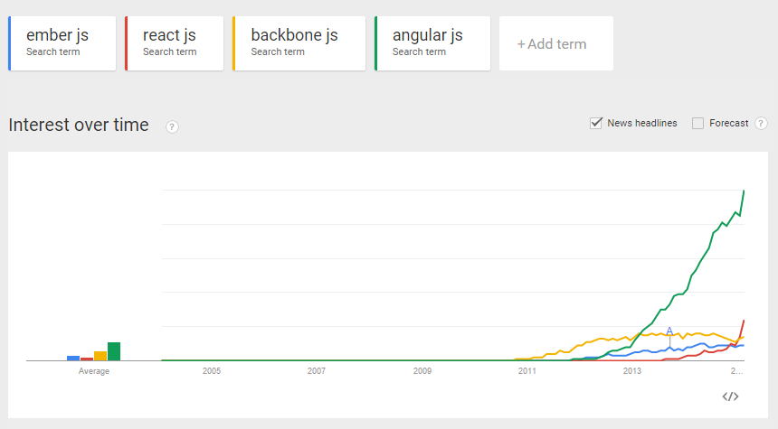
Why do we care?
Notes:
This graph says it all
Other frameworks may be starting to grow, angular far and away the most popular

Slide 5
Angular – Components

Slide 6
Modules
Basically everything ends up in a module
Modules are registered during runtime, order doesn’t matter
Uses Dependency Injection
angular.module(‘myApp’, [‘ngResource’, ‘ui.router’]);
angular.module(‘myApp’).otherAngularComponent(‘’…
Notes:
Way to componetize javascript
Modular javascript keeps the global scope clean
Add components onto modules a fluent syntax

Slide 7
ngRoute
Angular’s provided routing option
Was made more pluggable to allow replacement
Routes based on url paths, simple to implement
$routeProvider.
when('/importantRoute', {
templateUrl: 'importantRoute/importantRoute.html',
controller: 'ImportantRouteController'
}).
otherwise({
redirectTo: '/notFound'
});
Notes:
Only settable in config (like all providers are)
Huge Limitation: doesn’t allow for nested views

Slide 8
UI-Router
Community based improvement on the ngRoute option
Part of the Angular UI package
Configuration of paths based on states.
Nested Views
Link to other views using ui-sref directive
$stateProvider.state({
name: 'importantRoute',
url: 'importantRoute',
controller: 'ImportantRouteController',
templateUrl: 'importantRoute/importantRoute.html'
});
Notes:
Nesting views are configurable via a .Syntax, importantRoute.partOne

Slide 9
Controllers
Just like controllers in any other MVC framework
Interface between views and services
Connected to views through ng-controller or in your routeProvider
Expose data on the $scope object
Keep them skinny!
var myApp = angular.module('myApp',[]);
myApp.controller('GreetingController', ['$scope', function($scope) {
$scope.greeting = 'Hola!';
}]);
Notes:
Just like any other framework, the glue between your views and your models
Expose anything your view needs on the $scope object
No bloat, if its something that can be shared move to Service
Single view -> Single Controller
Prefer to connect controllers to views in the routeProvider, looks cleaner.
TODO: Best practice why not to do this
Limit what you put on $scope to help the angular digest cycle for dirty checks
$scope is inheritied, so what your debugging may have come from something higher up the chain than your controller

Slide 10
Views/Templates
Series of angular directives, filters, and form controls
Outside of directives, bound via {{ }} syntax
Model for the view comes from $scope
<h3> Make a word cloud! </h3> <div class="form-group"> <label>New Topic</label> <input type="text" class="form-control" ng-model="newTopic" /> </div> <button class="btn" ng-click="addTopic()">Add</button>
<span>{{newTopic}}</span>
Notes:
Ng-model directive – bind input field to a property on $scope
Ng-click directive – calls a function exposed on $scope
{{ }} binds directly to anything attached to $scope

Slide 11
Filters
Usable in views, controllers, and services
Format Text
Ex) toUpper, currency, etc
Filter Arrays
Ex) paging
Custom Filters
Ex) Whatever custom formatting/filtering need you may have
Chainable
<span ng-repeat="entry in ctrl.filteredArray | orderBy:’id’">
{{entry.name}}
</span>

Slide 12
Services and Factories
Should make any data calls in a factory or service
angular.module('wordCloudModule').service('wordCloudService', function(baseService) {
var topicResource = baseService.createResource('/topic');
var getTopics = function() {
return topicResource.query().$promise;
};
return {
getTopics: getTopics
};});
Notes:
Services are generally used via the new keyword
Factories come in instantiated and are shared

Slide 13
Directives
Augments/Replaces existing DOM elements
Lots of out of the box directives
Custom directives can be used to encapsulate custom DOM behavior
<my-dir></my-dir>
<span my-dir=“exp”></span>
Notes:
Directives are angulars way to extend the html spec, add attributes
Out of the box directives like model, click, controller, class, repeat, view, show, etc
If you need to access the dom via jquery or jqLite, this is where it goes
includes jqLite, if need all of jquery, will just run more bloated

Slide 14
“Lets look at 50 more slides before getting into some code!”
Nobody, Ever
Notes:
Demo will start with what we consider a barebones project for a production application.

Slide 15
Contact us
Bryan Tharpe
Solution Architect
Jordan Wester
Solution Architect
e bryant@slalom.com
e jordanw@slalom.com
c XXX-XXX-XXX
t XXX-XXX-XXX
f XXX-XXX-XXX
e xxxxxxxx@slalom.com
c XXX-XXX-XXX
t XXX-XXX-XXX
f XXX-XXX-XXX
e xxxxxxxx@slalom.com
c XXX-XXX-XXX
t XXX-XXX-XXX
f XXX-XXX-XXX
e xxxxxxxx@slalom.com
c XXX-XXX-XXX
t XXX-XXX-XXX
f XXX-XXX-XXX
e xxxxxxxx@slalom.com

