Slide 1
AngularJS
… a year later
Notes:
Topics are more gray/subjective
Feel free to ask questions along the way
If we start to run low on time, I may ask that we hold questions until after the presentation
Slides and demo code are available on GitHub

Slide 2
Application Stats
20,000+ users
25,000+ lines of code (HTML + JS)
~ 250 Angular files
7 modules
108 controllers
76 directives
38 services/factories
19 filters
Notes:
Set the stage for the other topics by putting the size of the project in perspective

Slide 3
Code Organization
Notes:
- The need for clear and consistent code organization becomes more important as the application grows
- Nobody cares where things live when you have a couple of dozen files

Slide 4
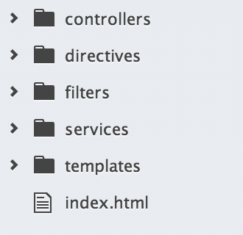
group by type
Notes:
Show an example of what grouping files by type looks like
Show how that breaks down as the number of files gets larger

Slide 5
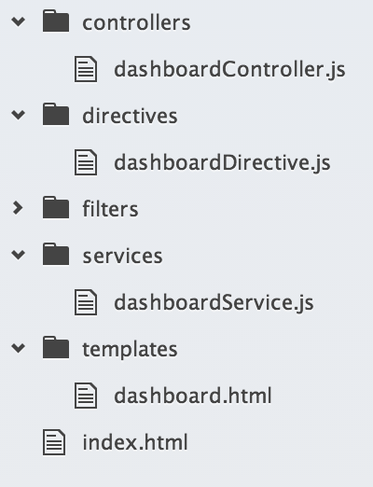
group by type
Notes:
Show an example of what grouping files by type looks like
Show how that breaks down as the number of files gets larger

Slide 6
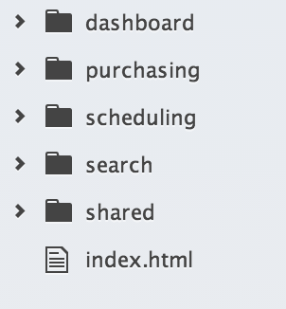
group by feature

Slide 7
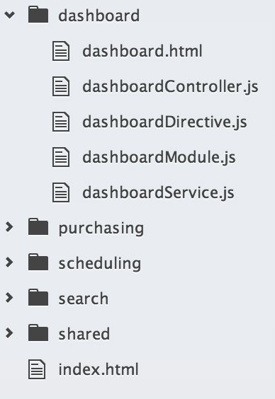
group by feature

Slide 8
Search Feature
Purchasing
Scheduling
Notes:
Features become blurred because data is relational
Features start to bring in parts of other features who’s data is related

Slide 9
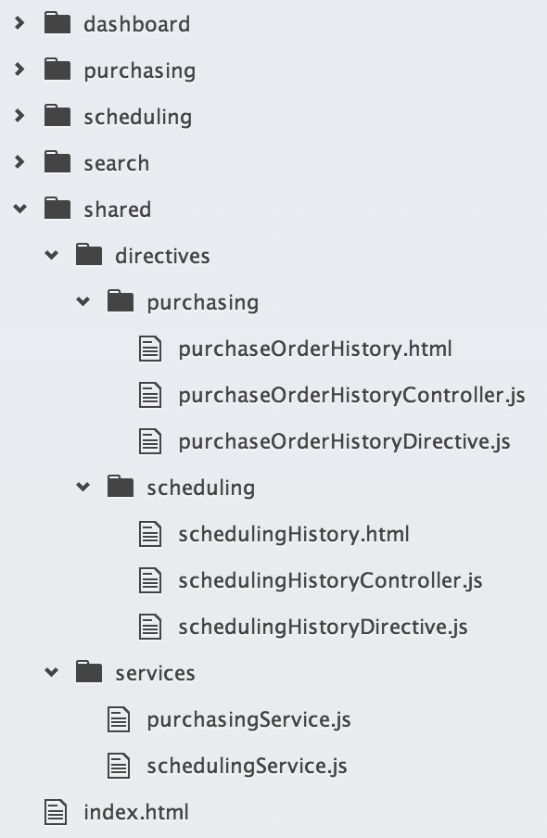
group by feature
Notes:
More and more files start to move to the shared folder as feature lines are blurred
Becomes more difficult to track down all files related to a particular feature

Slide 10
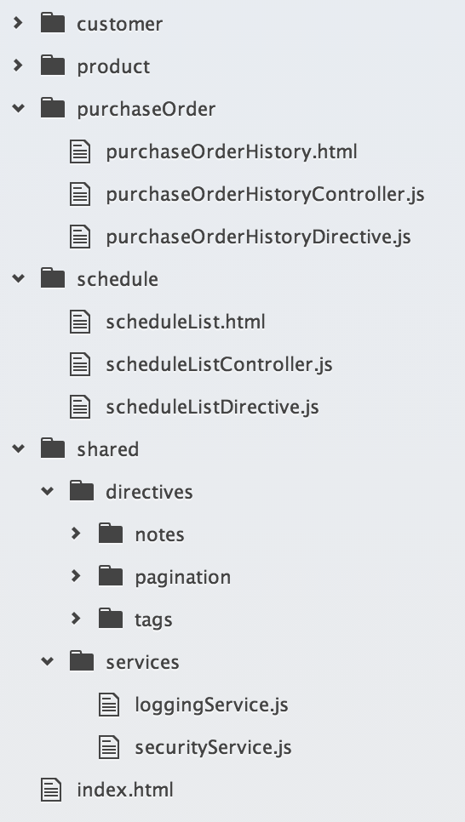
group by entity
Notes:
Keep everything related to an entity packaged together, regardless of whether it is used across multiple features
Shared folder holds functionality that is truly common and generic to the application
TODO: Put a module file in each of the folders

Slide 11
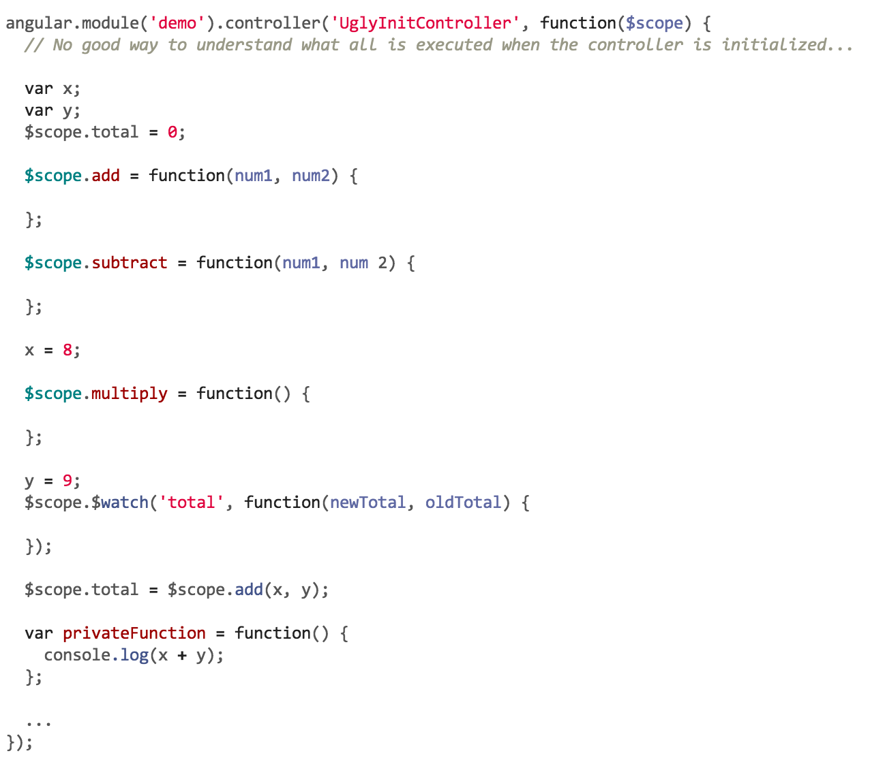
controller initialization

Slide 12
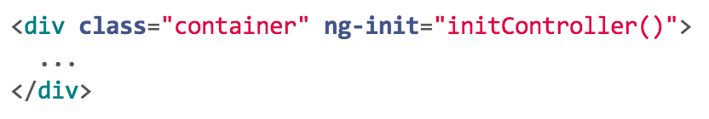
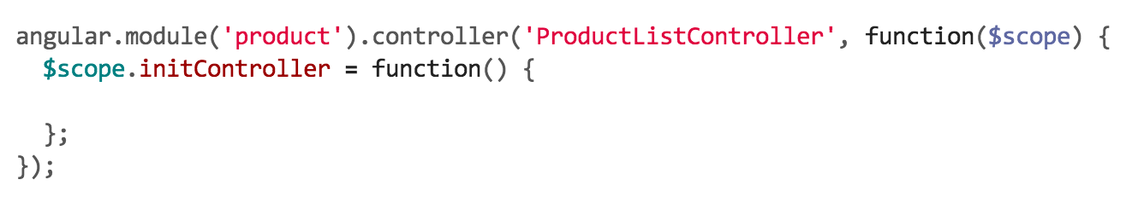
controller initialization

Slide 13
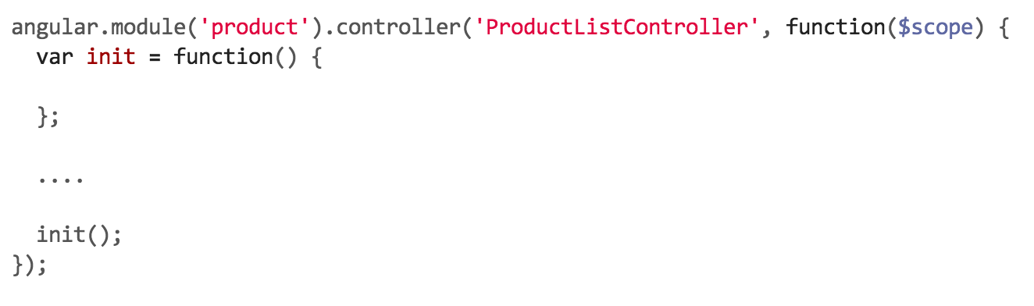
controller initialization

Slide 14
$watch vs. $on
Notes:
- Advantages and disadvantages of both

Slide 15
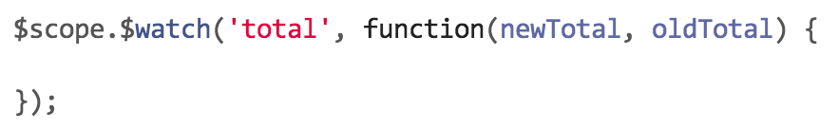
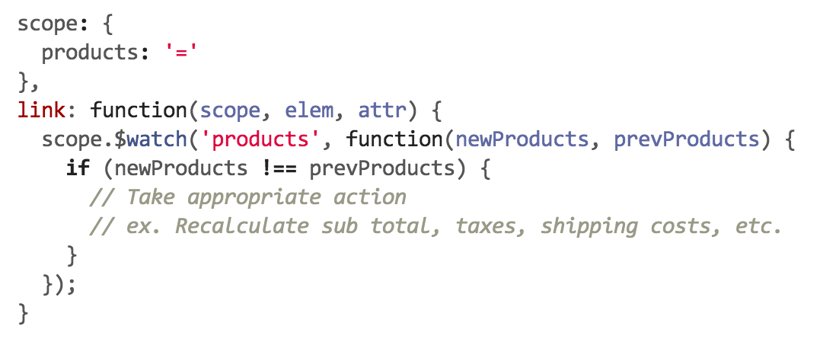
$watch
A way to listen for changes to an object in scope
Commonly used in the link function of a directive

Slide 16
Search
Filter
Detail
Filter
searchObject
Filter
searchObject: {
results: {
total: 254,
…
}
}
<< < 1 2 3 4 5 > >>
Notes:
Search page scenario
Shared search object that was passed to each directive and watched for changes
Became very coupled to one another
Directives started to rely on other directives to update data and for the searchObject to always be in a consistent format
ex. Was the search result count that pagination cared about called

Slide 17
events
More explicit
More control over when changes should be triggered
Listeners don’t need to have a reference to the $scope object
ex. $scope.$emit(eventName, data);
$rootScope
$scope
$scope
$scope
$scope
$scope
$rootScope
$scope
$scope
$scope
$scope
$scope
$rootScope
$scope
$scope
$scope
$scope
$scope
$emit
$broadcast
Notes:
More direct
More control over when actions happen
Listeners don’t need to have a reference to the scope object they are listening to
$scope.$emit: emits an event up the scope tree
$scope.$broadcast: broadcasts an event down the scope tree
$rootScope.$emit isolates events to the top level of the scope tree and gets rid of the question of what direction the event needs to be thrown

Slide 18
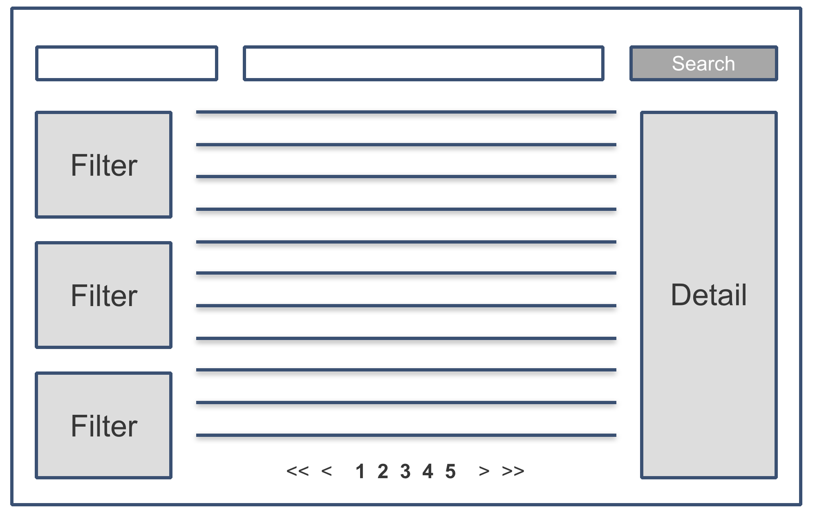
$rootScope
$scope
$scope
$scope
$scope
$scope
Notes:
$scope objects live at different levels of the scope tree
No way to know whether to do an $emit or a $broadcast from the controller’s scope if you want to communicate to the rest of the components on the page

Slide 19
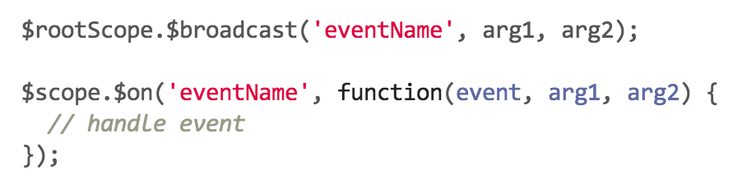
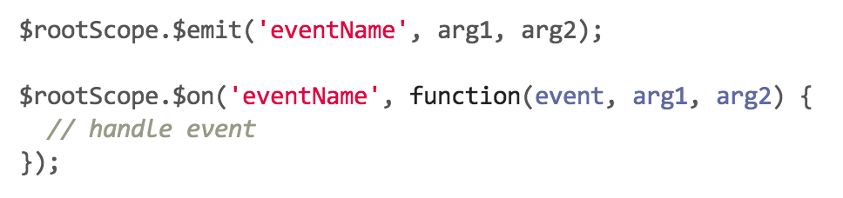
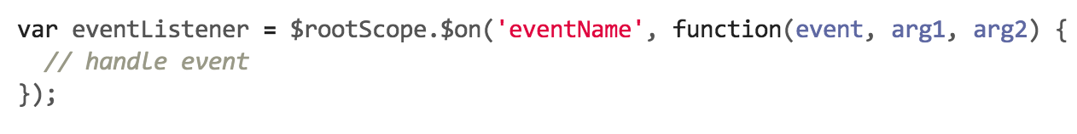
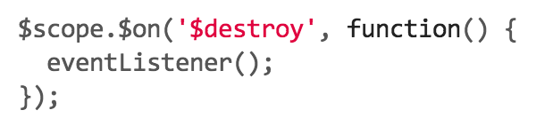
events
Notes:
2 options:
$broadcast events from $rootScope so all listeners are called
$emit an event from $rootScope to isolate the event to the top of the scope tree
If events are listened for on $rootScope, they must be cleaned up when the controller or directive is destroyed
Either way, encapsulate your strategy in a service

Slide 20
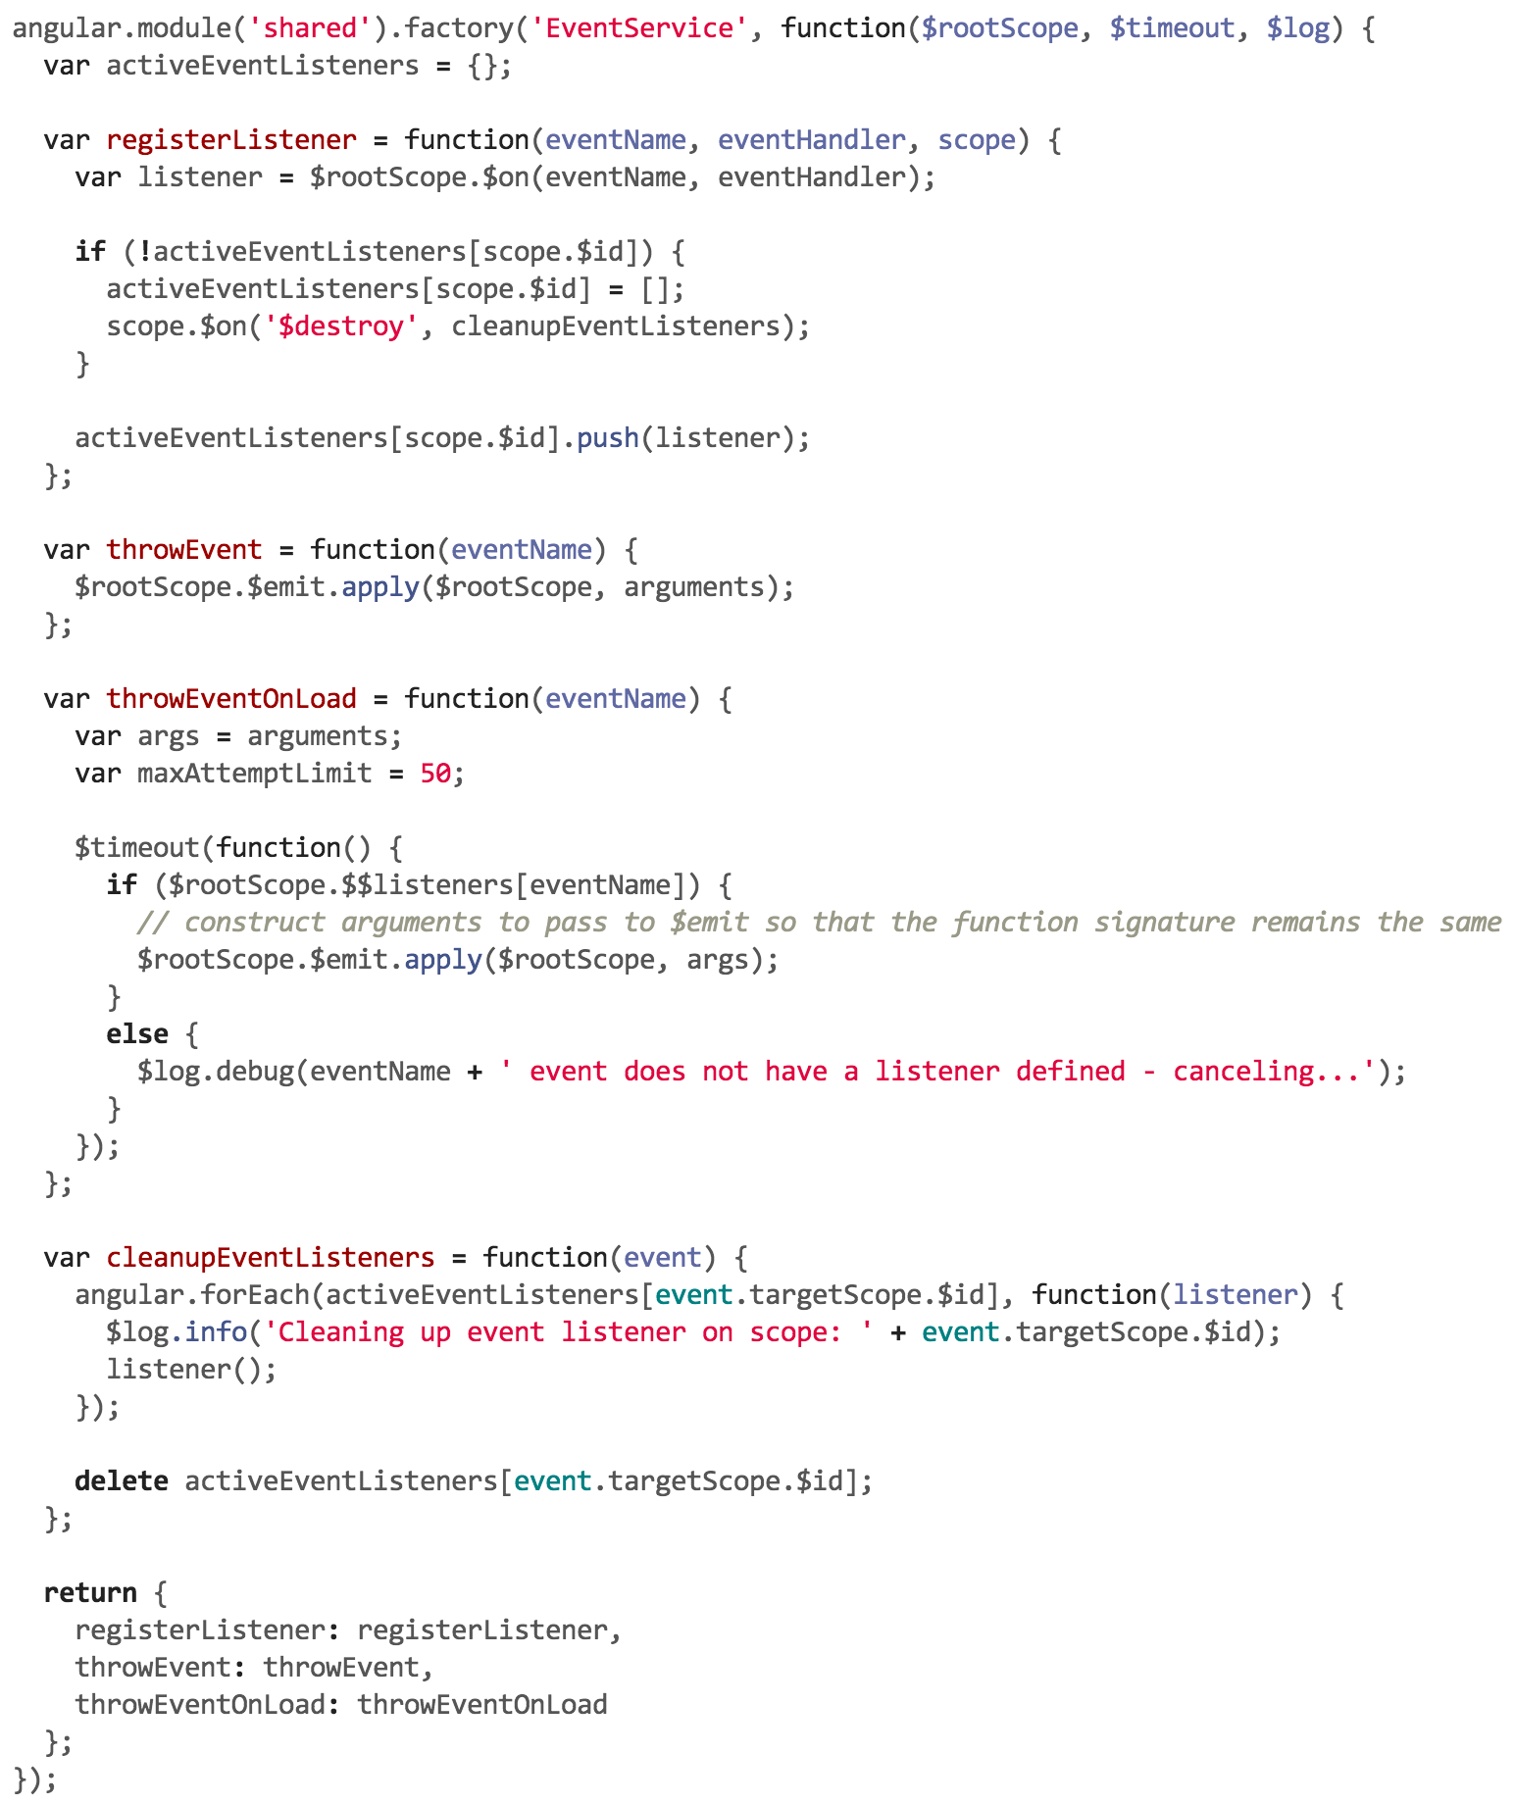
events
Notes:
- Switch over to show an eventService in Atom

Slide 21
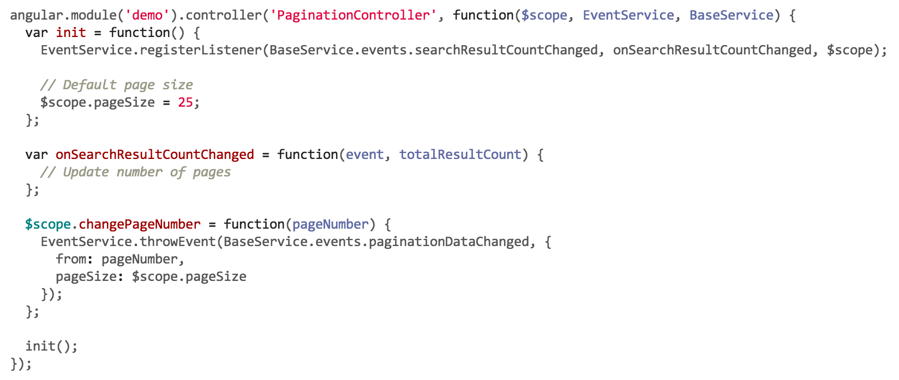
events
Notes:
Show an example of what a controller looks like after implementing the EventService

Slide 22
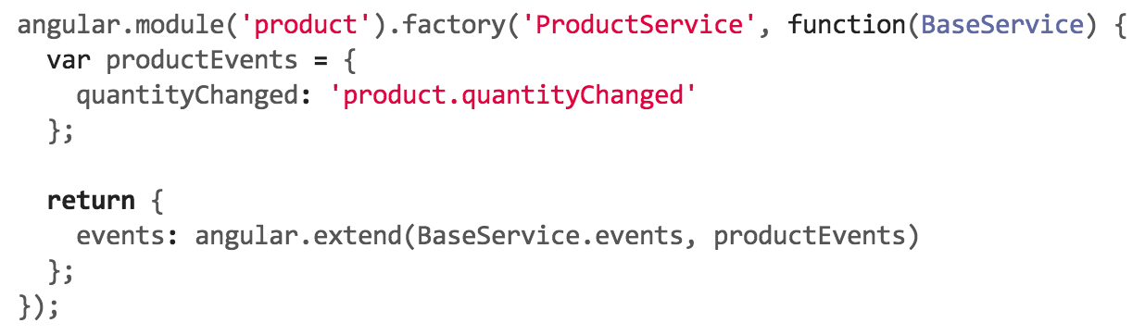
events
Notes:
Pushed all event names into services
All events related to a particular service were wrapped in an event object (dictionary)
All global events were created on the BaseService
ex. paginationDataChanged, searchResultCountChanged, userContextChanged, etc.
Each service extended the BaseService events and returned the merged object
Namespacing
serviceName + eventName

Slide 23
Search
Filter
Detail
EventService.throwEvent(
SearchService.events.searchResultCountChanged,
total
);
Filter
Filter
<< < 1 2 3 4 5 > >>
EventService.registerListener(
BaseService.events.searchResultCountChanged,
updatePagination
);
Notes:
Search page scenario
Shared search object that was passed to each directive and watched for changes
Became very coupled to one another
Directives started to rely on other directives to update data and for the searchObject to always be in a consistent format
ex. Was the search result count that pagination cared about called

Slide 24
Search
Filter
Detail
EventService.registerListener(
SearchService.events.paginationDataChanged,
updateSearchCriteria
);
Filter
Filter
<< < 1 2 3 4 5 > >>
EventService.throwEvent(
BaseService.events.paginationDataChanged,
paginationData
);
Notes:
Search page scenario
Shared search object that was passed to each directive and watched for changes
Became very coupled to one another
Directives started to rely on other directives to update data and for the searchObject to always be in a consistent format
ex. Was the search result count that pagination cared about called

Slide 25
Script Dependency Management

Slide 26
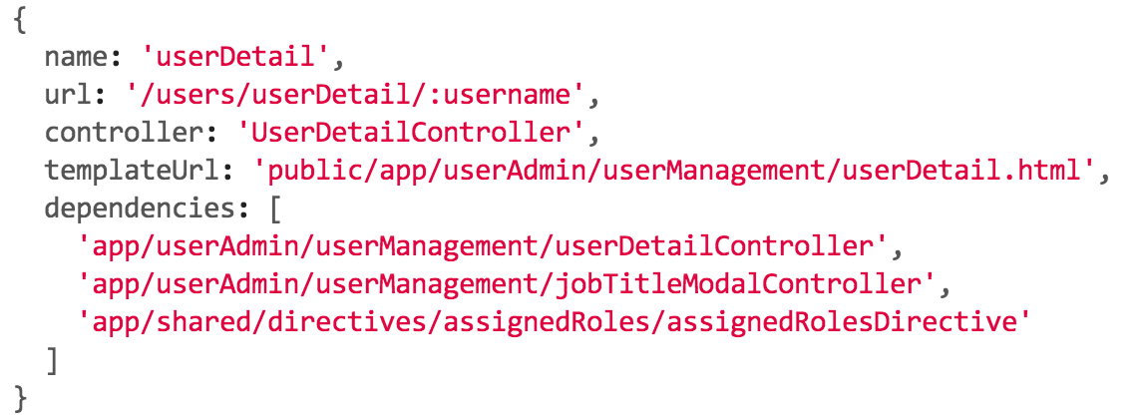
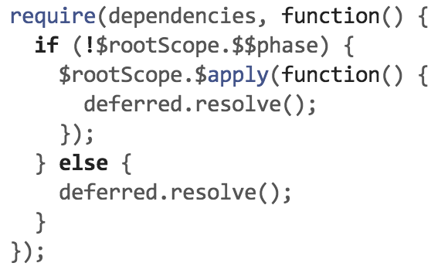
requireJS
Notes:
What is the difference between RequireJS dependencies and Angular dependencies
What does require do well
Very explicit
Efficient in what scripts/libraries are loaded
Groups scripts into modules and not in the global scope
But Angular already has the concept of modules so is it really needed?

Slide 27
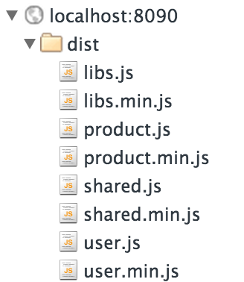
concat
Alternative approach to lazy loading with RequireJS, Browserify, etc.
Concatenate scripts and load everything when the application is bootstrapped
Use grunt or gulp
Better integration with CI
Concatenate libraries into a separate script
For app scripts, concat by module or into a single file
Sourcemaps can be generated if you want to have files split out for debugging
Notes:
Alternative approach to lazy loading by concatenating all scripts into 1 or multiple and listing them as static script references in you index.html
Can concat everything into 1 script or concat by module
Make sure you list the module file before the wildcard match of all the other files in the module
DEMO: Show gruntfile tasks used to concat, minify and generate sourcemaps
DEMO: Showing watch task keeping the concatenated/minified module scripts up to date while developing

Slide 28

Notes:
Walkthrough grunt tasks required for concat/minify
Show controller example of why ngAnnotate is needed before minification

Slide 29
AngularJS
current state

Slide 30
ES6
Next version of the ECMAScript standard
ES5 was released in 2009
Improvements:
Modules
Module Loaders
Classes
Promises
Many others (https://github.com/lukehoban/es6features)
Notes:
What is ES6?
Why does it effect Angular?
List key changes
Spec has already been finalized so no changes from that side
Future release cadence of ECMAScript will be every 18 months-ish

Slide 31
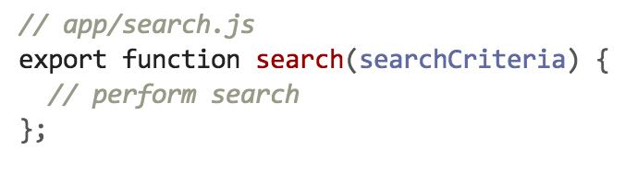
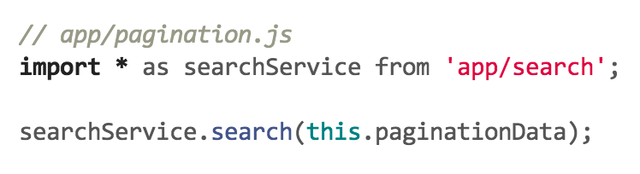
ES6 Modules
Replaces the need for other module loaders like RequireJS and CommonJS
Adds the ability to import and export all or partial implementations of a javascript file

Slide 32
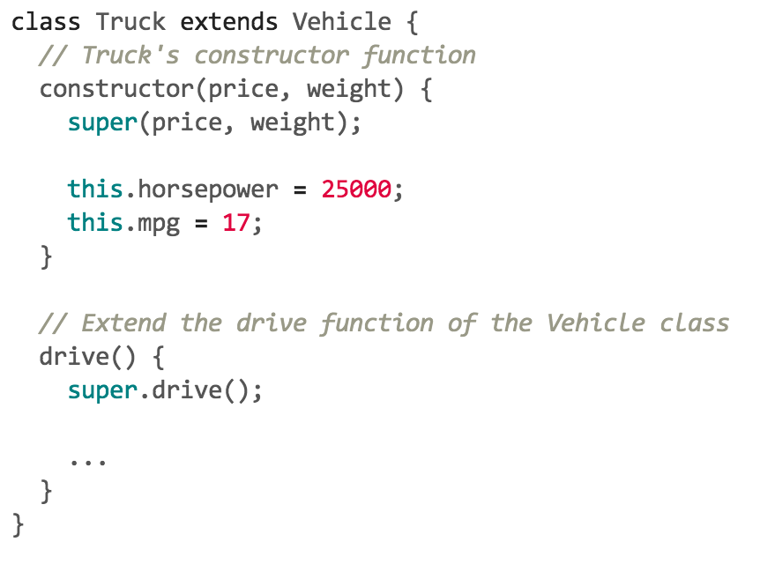
ES6 Classes
Notes:
Go over high level changes ES6 will bring
modules, classes, annotations
Which features are really relevant to Angular
What overlap does ES6 have w/ current versions of Angular

Slide 33
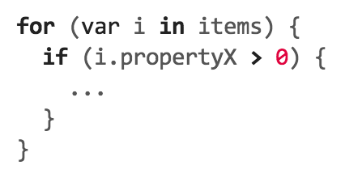
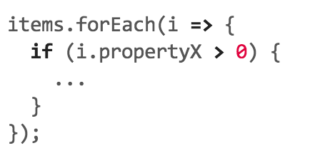
ES6 Arrow Syntax
Notes:
Go over high level changes ES6 will bring
modules, classes, annotations
Which features are really relevant to Angular
What overlap does ES6 have w/ current versions of Angular

Slide 34



Slide 35
Angular 2.0
Built from the ground up to adopt ES6 standards
Still a work in progress
“Things might/will change”
Alpha release available on GitHub (link below)
No official documentation available yet
Many topics are being discussed at ng-conf (going on right now)
Angular 2 on GitHub: https://github.com/angular/angular
Intro to Angular 2: https://www.youtube.com/watch?v=uD6Okha_Yj0&feature=youtu.be
ng-conf 2015 videos: TODO: put a link to the ng-conf 2015 videos
Notes:
Heavily tailored to changes coming w/ ES6
ex. Angular modules are no longer needed since ES6 has it’s own concept of modules
Overall, Angular wants to be built on top of web standards, not create their own set of standards
In my mind, they’re really two different frameworks
Angular 1 will still be supported for the foreseeable future

Slide 36
ES6 w/ Angular 1.x ??

Slide 37
ES6 w/ Angular 1.x
Yes ??
No current browsers support running ES6 today
Have to use Traceur, Babel or any other ES6 to ES5 transpilers
Each support a subset of the full ES6 spec
What are you looking to gain?
Is performance going to suffer in a production environment?
What amount of effort would it save us if we upgraded an app to Angular 2?
Using ES6 w/ Angular today: http://blog.thoughtram.io/angularjs/es6/2015/01/23/exploring-angular-1.3-using-es6.html
Preparing for Angular 2: https://www.airpair.com/angularjs/posts/preparing-for-the-future-of-angularjs
Future ready Angular 1.3 app: http://rangle.io/bloghow-to-embrace-angular-2-today-with-future-friendly-angular-1-3/
Notes:
Traceur, Babel… many other transpires
Possibly makes since if you’re wanting to do a gradual migration to Angular 2.0

Slide 38
Questions

Slide 39
https://github.com/jordan-wester/mvp-mix-2015

Slide 40
Contact Us
Bryan Tharpe
Solution Architect
Jordan Wester
Solution Architect
c XXX-XXX-XXX
t XXX-XXX-XXX
f XXX-XXX-XXX
bryant@slalom.com
c XXX-XXX-XXX
t XXX-XXX-XXX
f XXX-XXX-XXX
jordanw@slalom.com
c XXX-XXX-XXX
t XXX-XXX-XXX
f XXX-XXX-XXX
e xxxxxxxx@slalom.com

