Slide 1
Github:
jordan17101996github
A program used to repository, start a branch, write comments and open pull requests.

Slide 2
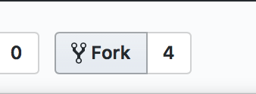
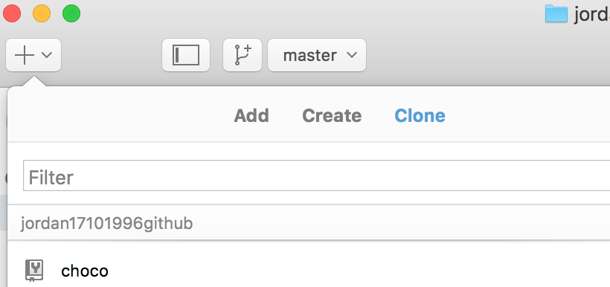
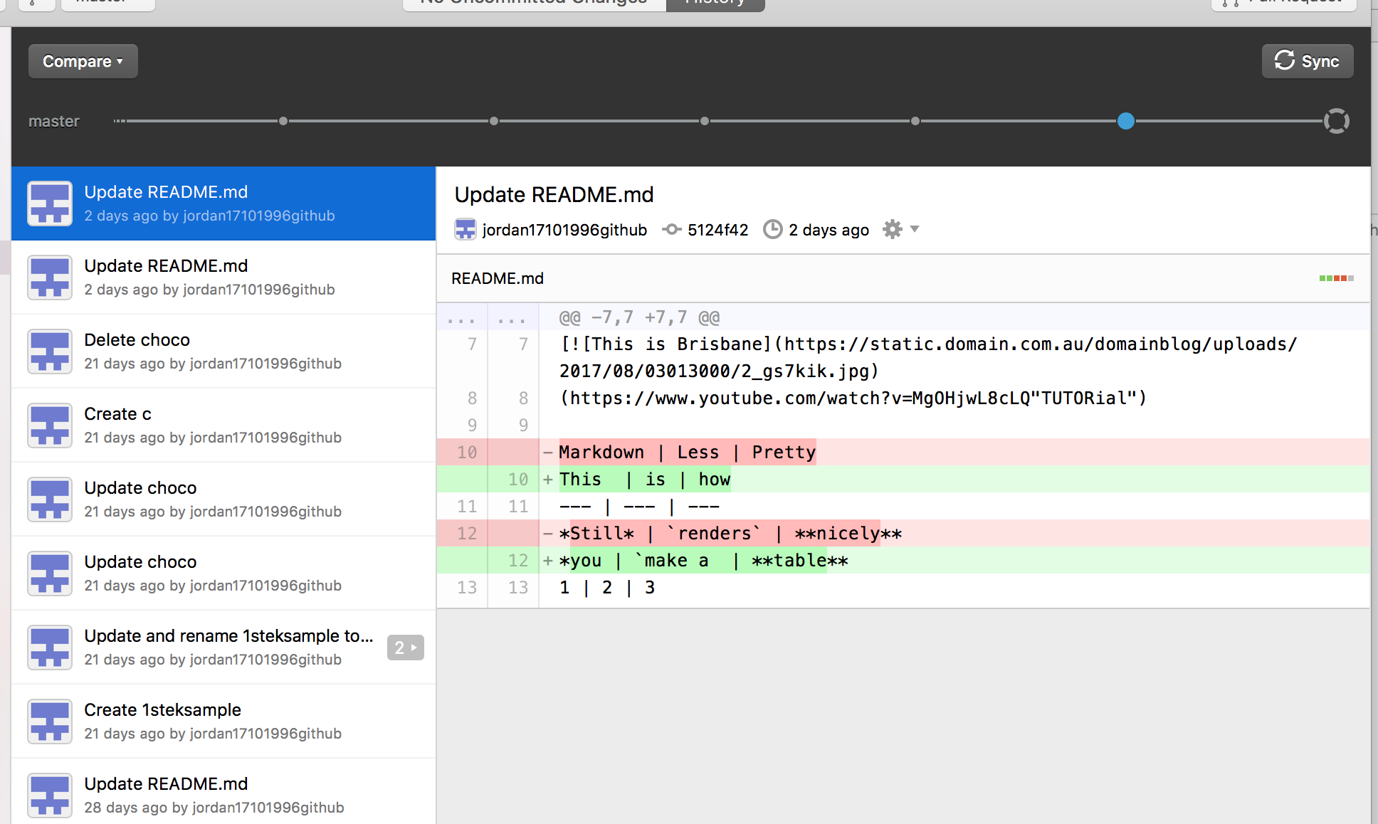
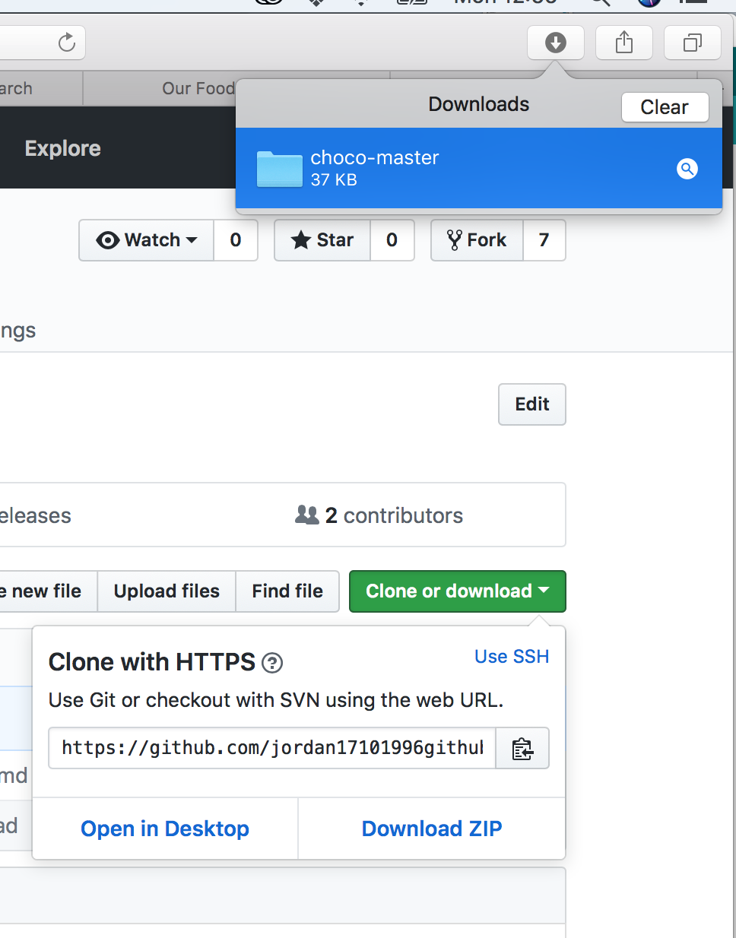
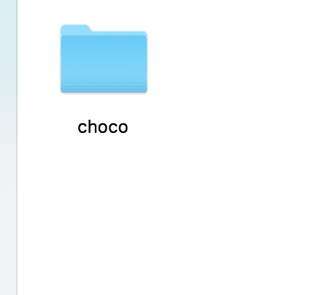
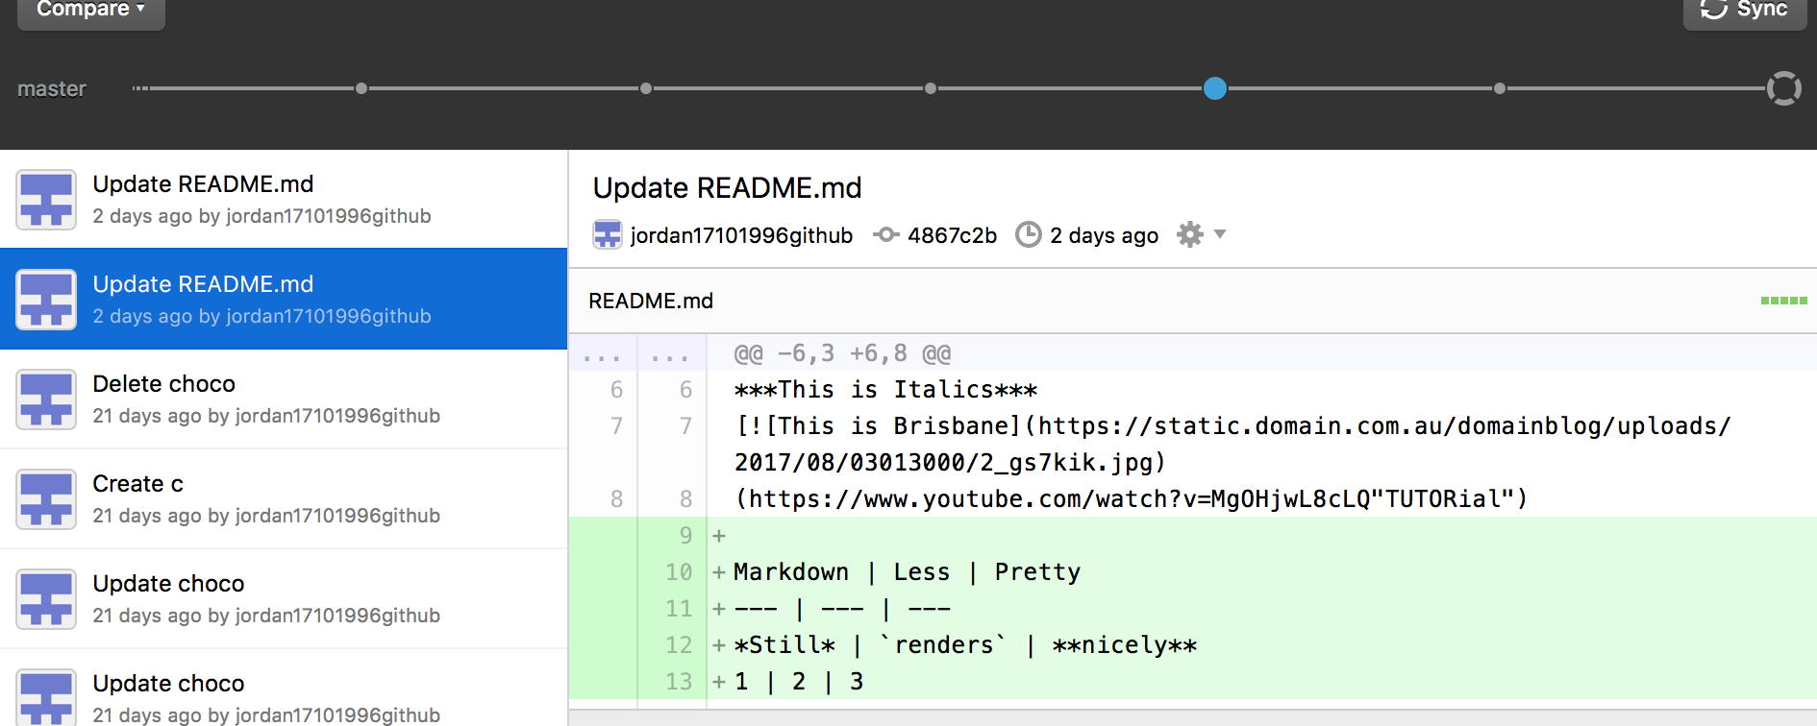
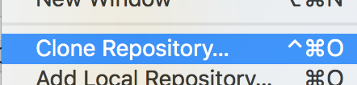
Fork & Clone
‘Clone’ and ‘Fork’ are similar functions; they both allow you to make a copy.
I use the ‘Fork’ to make a copy of other users repositories for edit.
I used the ‘Clone’ key to download a copy of one of the author’s repository.

Slide 3
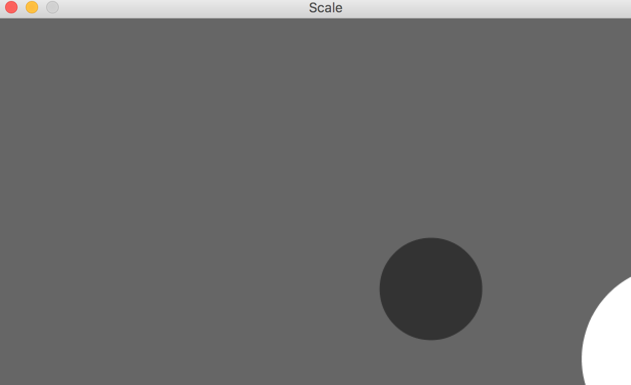
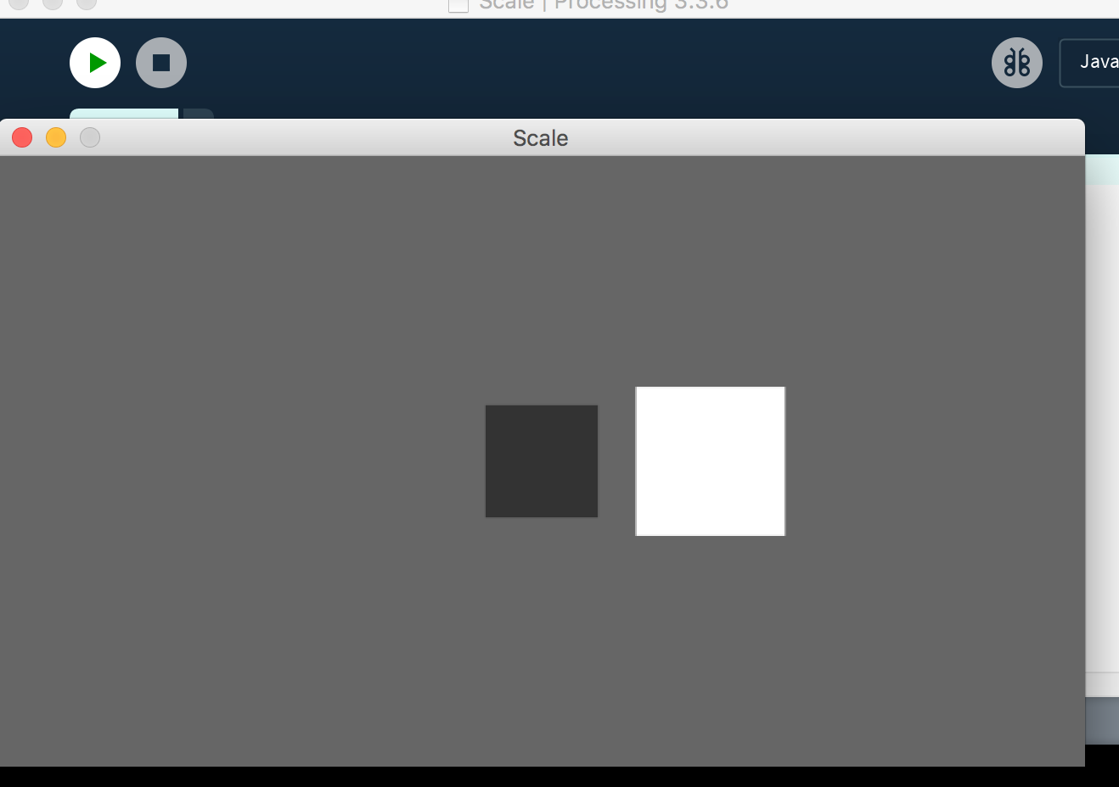
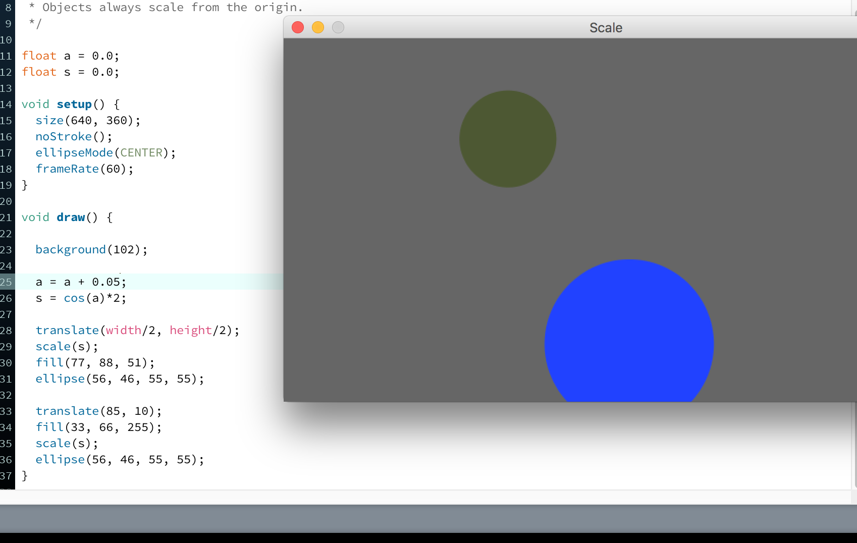
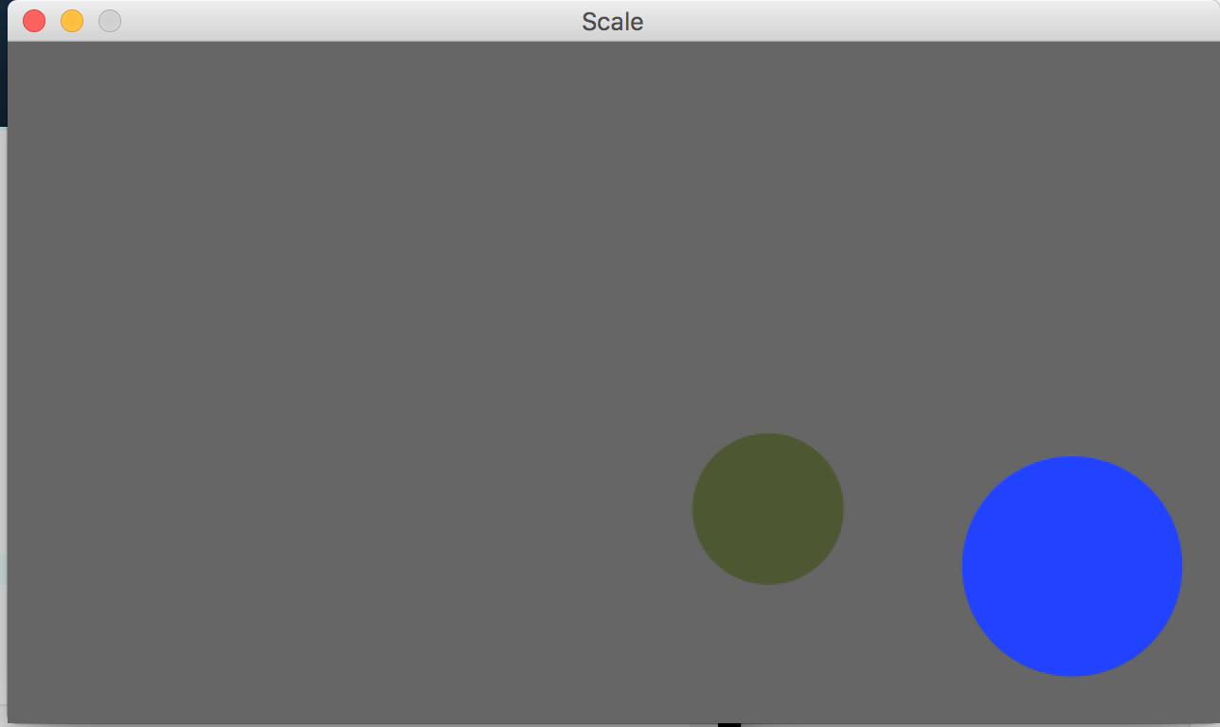
Alteration
To change square to circle, I change the rectMode to ellipseMode.

Slide 4
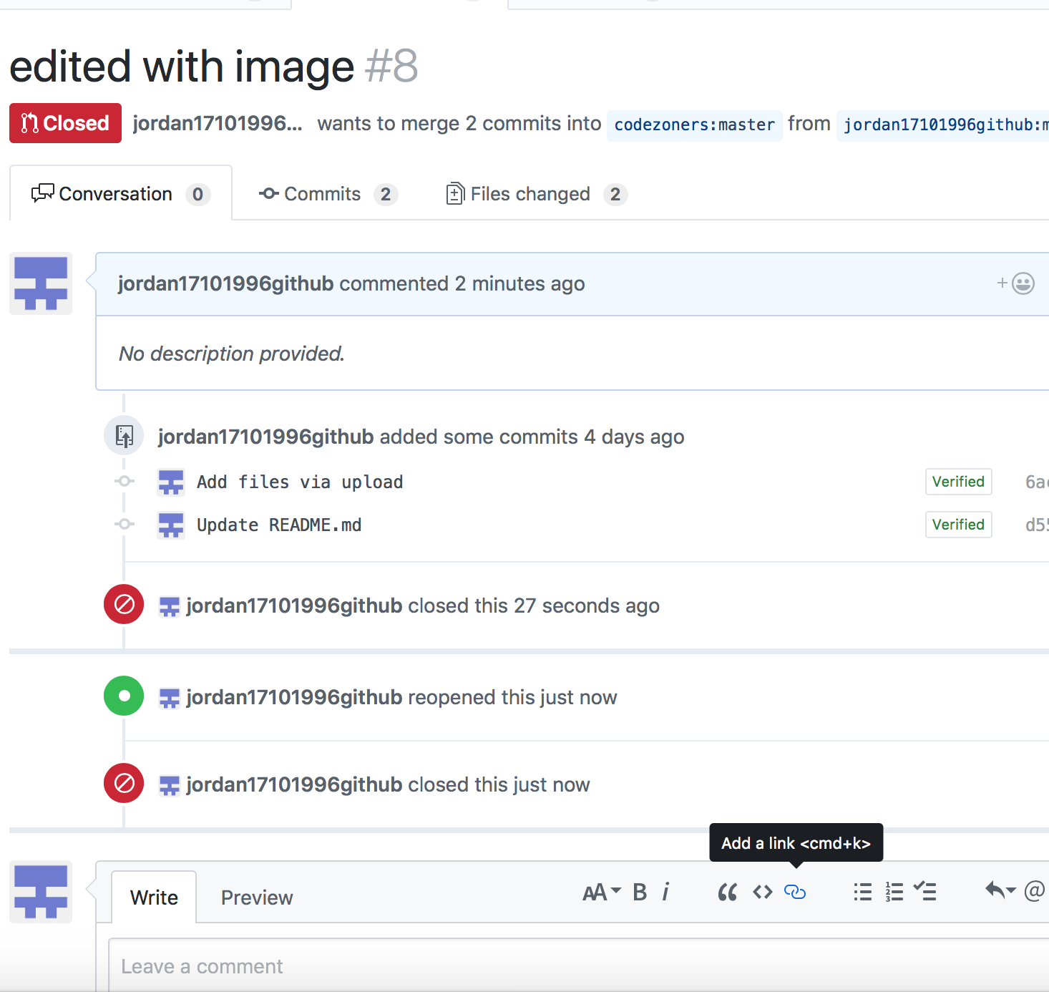
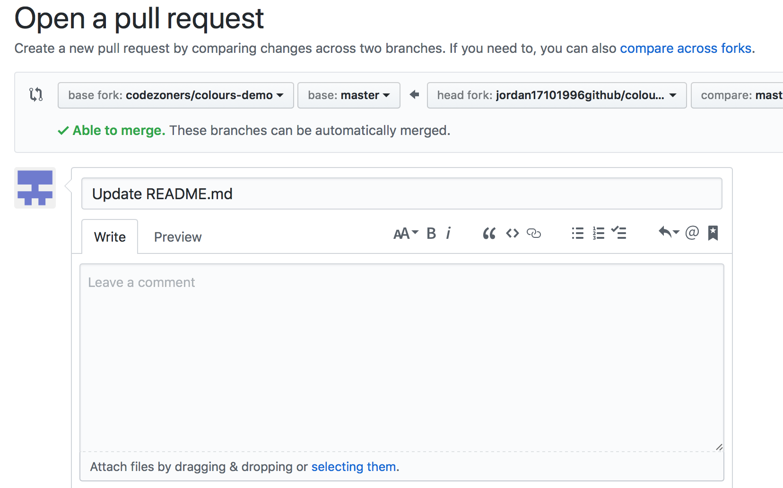
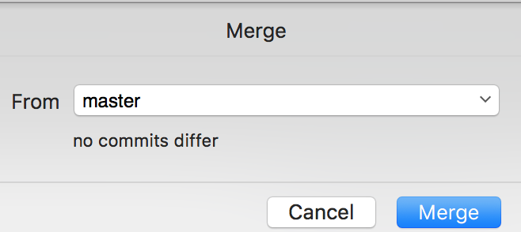
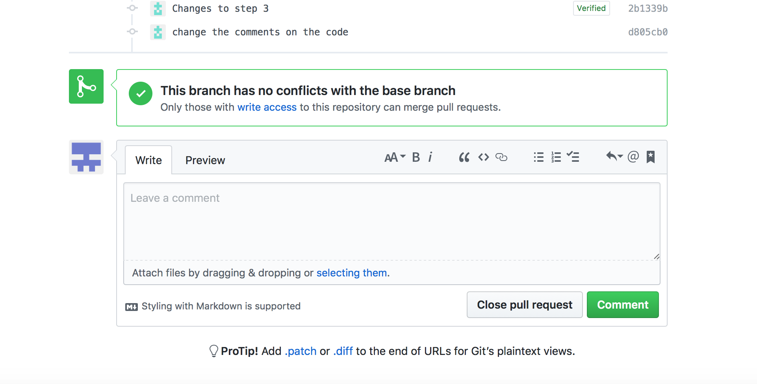
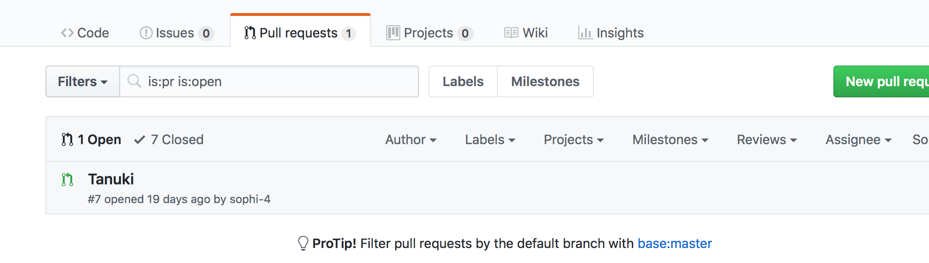
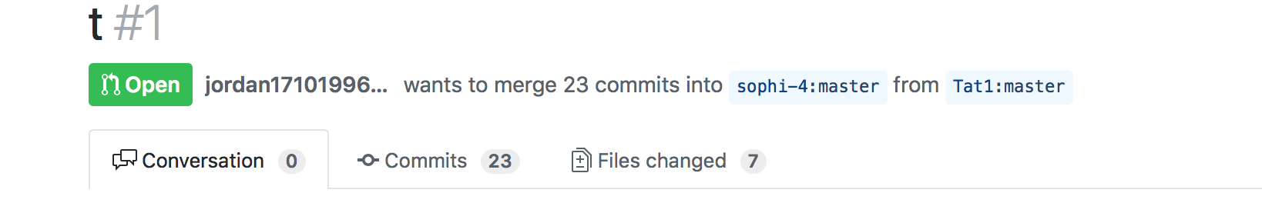
Pull Request
Pull request lets others view the change you’ve made. If you plan on merging the changes, the author has to confirm it that is if you open the pull request. Also, it can be done by click on ‘Merge’ from github.

Slide 5
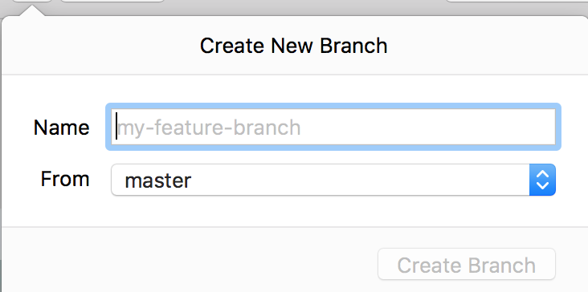
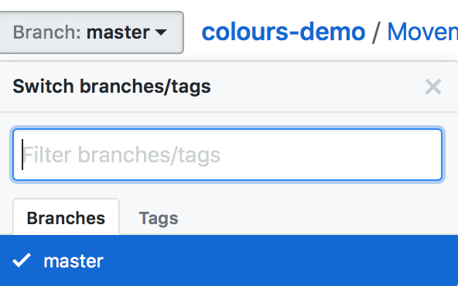
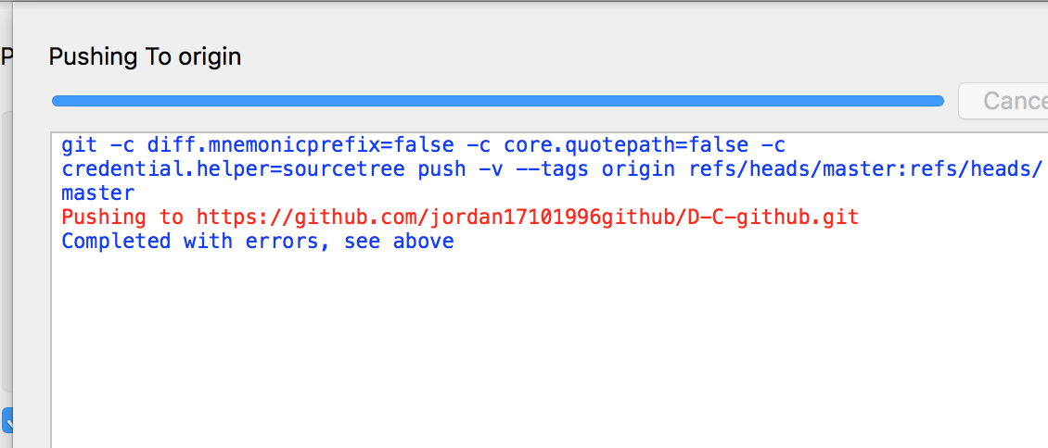
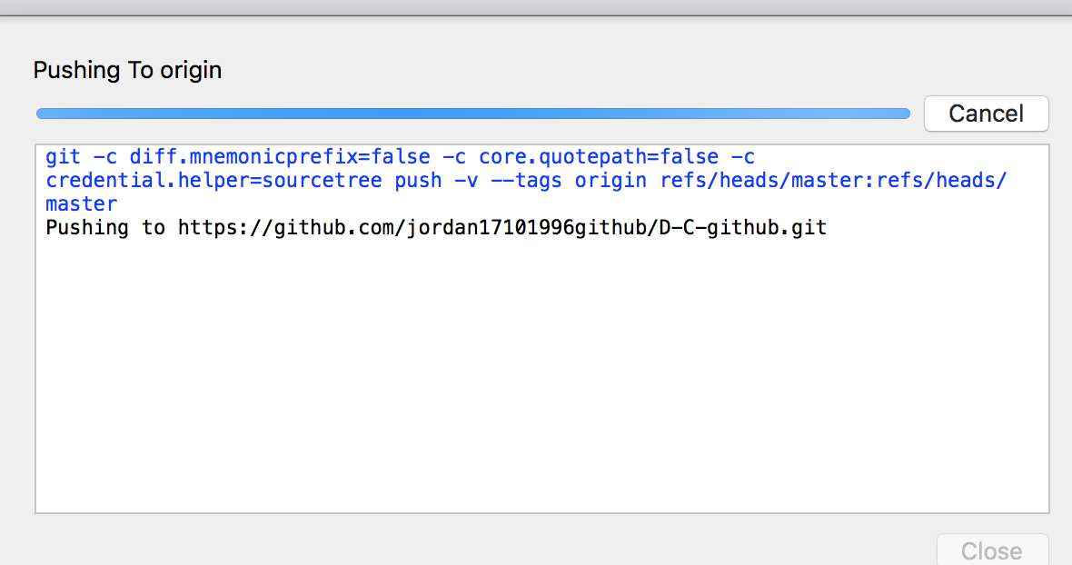
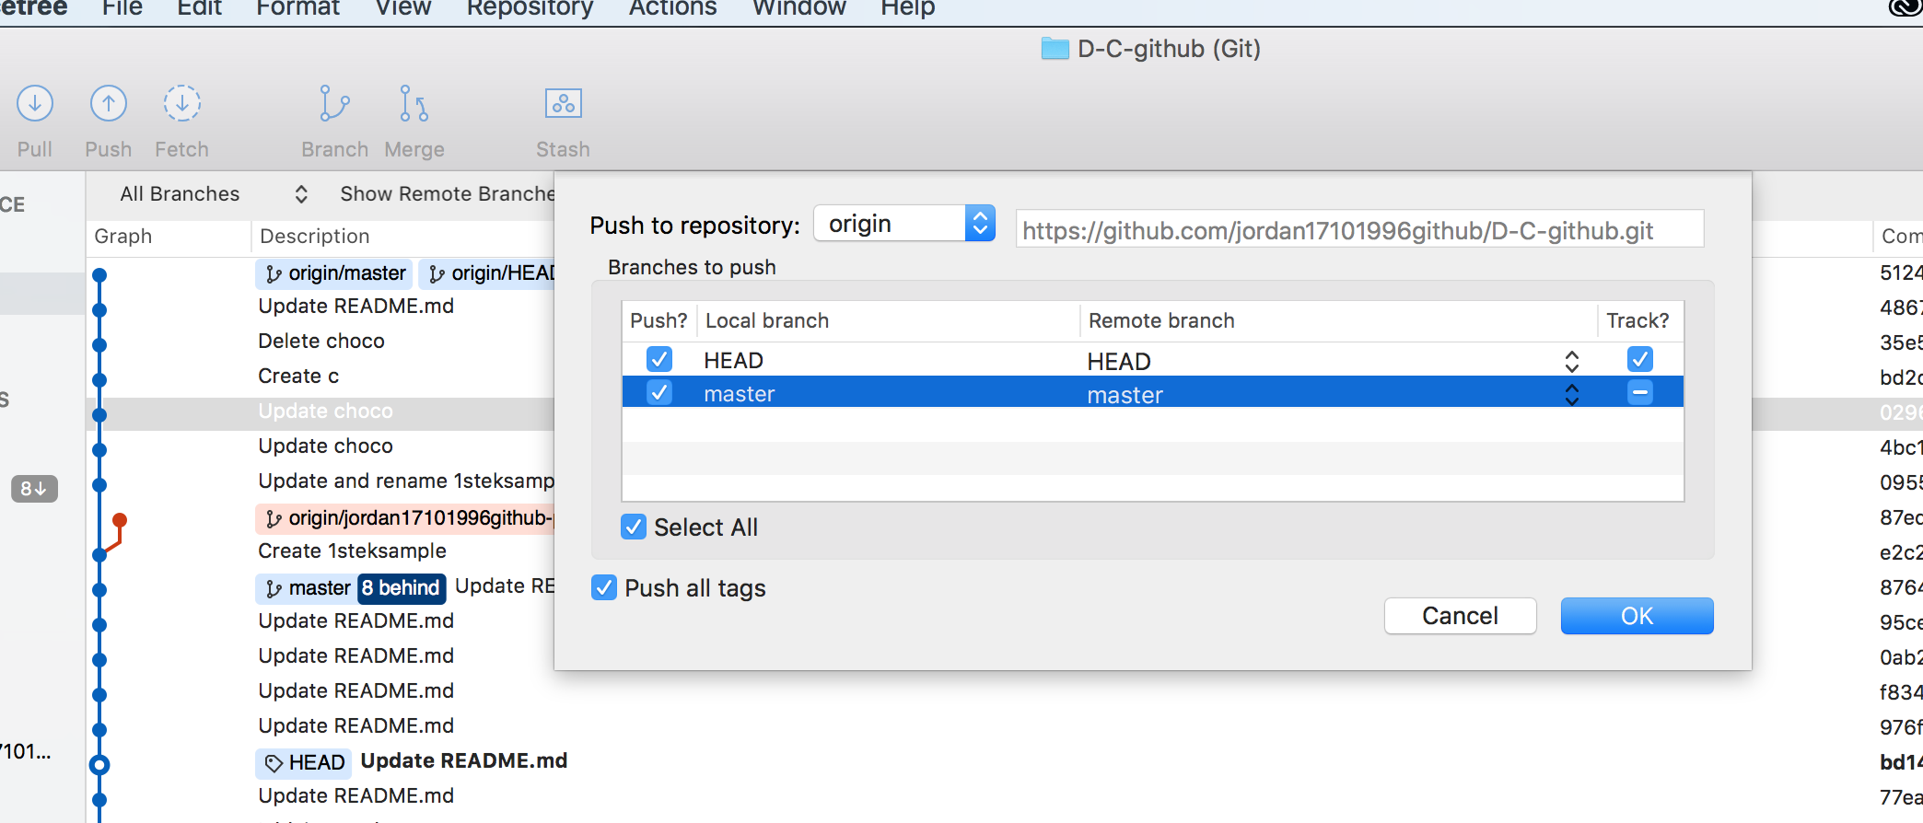
Branch & Pull
To change, rename or create new branches, you simply click on the name of it e.g. Master.
I used the ‘Push’ key from GitHub desktop, but I had to press cancel as it was taking a long time to process.

Slide 6
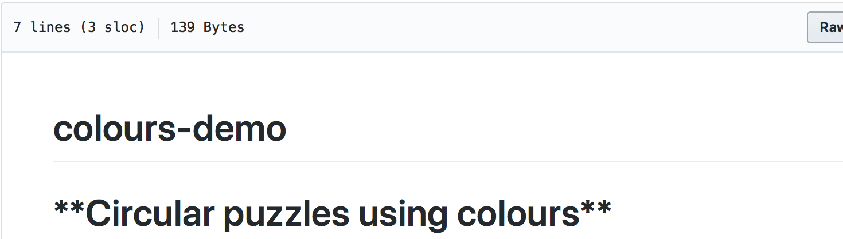
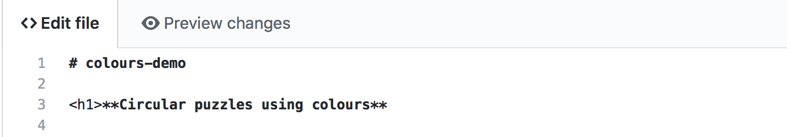
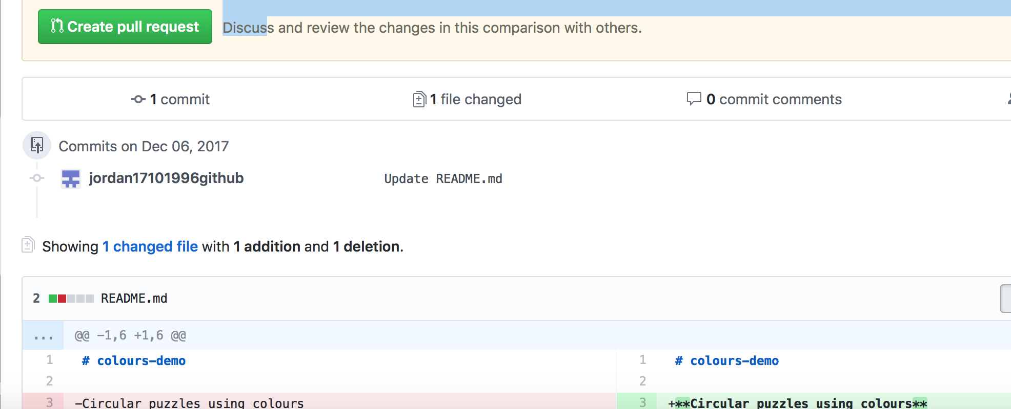
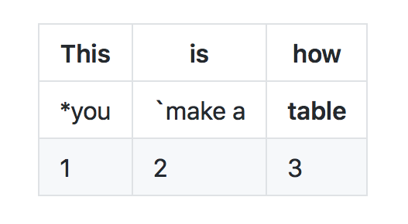
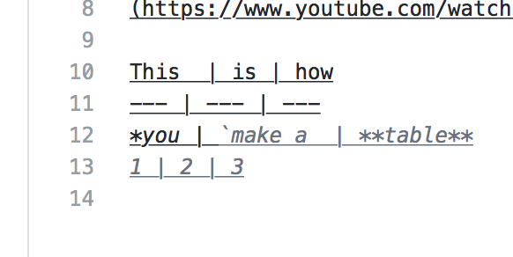
Text and tables
I changed the text from one of my classmates’ repos into <H1> which is the big font and <H6> is the miniature font. I experimented with font sizes.
I used the vertical stroke to create tables.

Slide 7
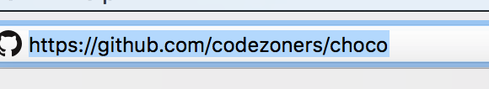
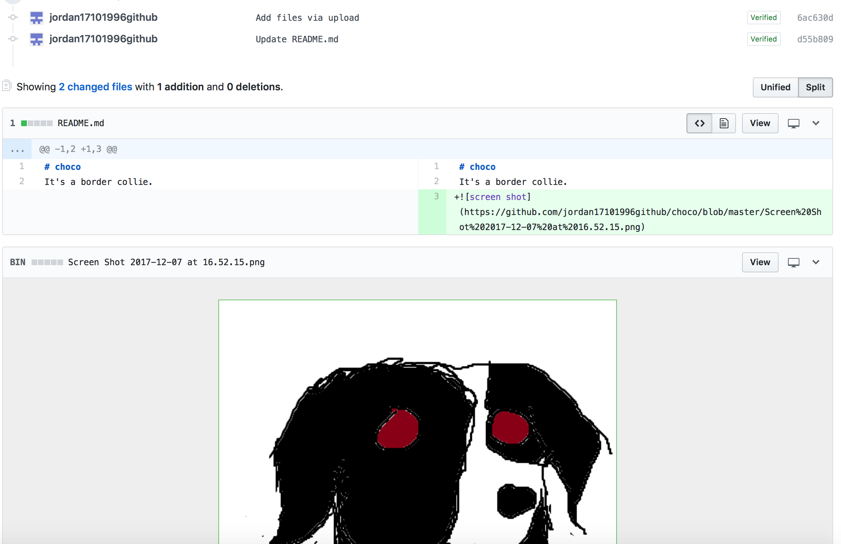
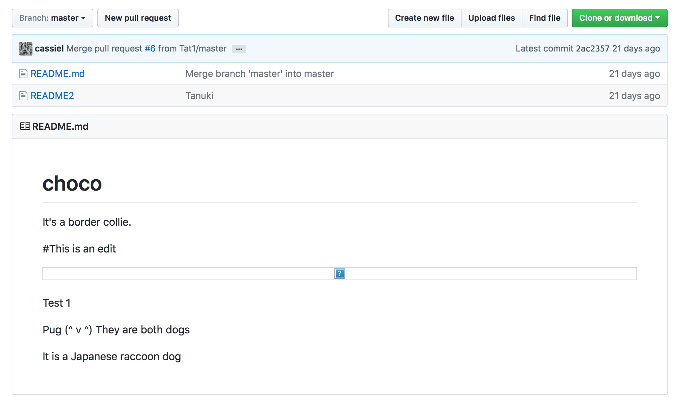
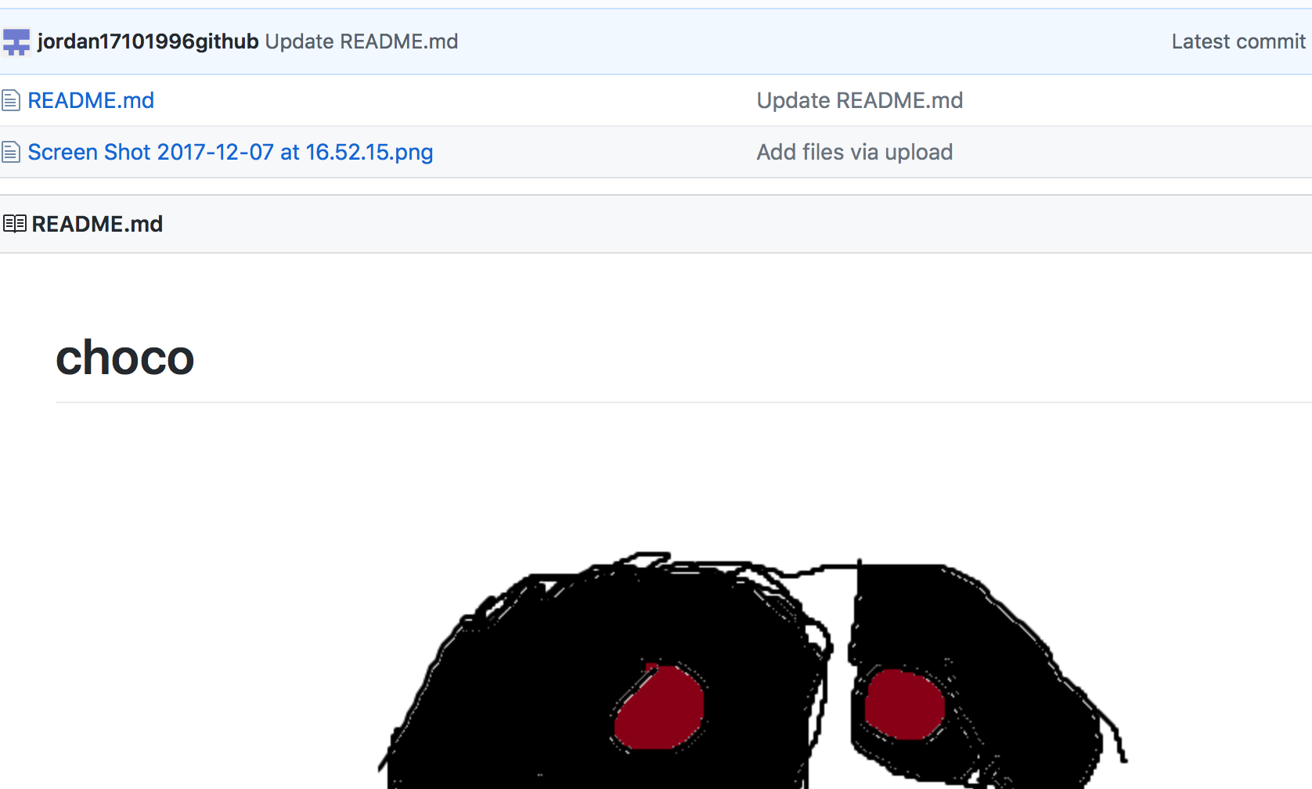
Fetching & Comparing
Fetching is when you retrieve new work made by other users. Fetching from a repository obtains all the new remote branches and tags without merging those changes into your own branches.
Unlike using the keys to make the dog symbol, I decided to add a vector image to show an example of the Border Collie’s appearance. I clicked on add files, then I copied the link and added brackets to make the image appear.
Git fetch

Slide 8
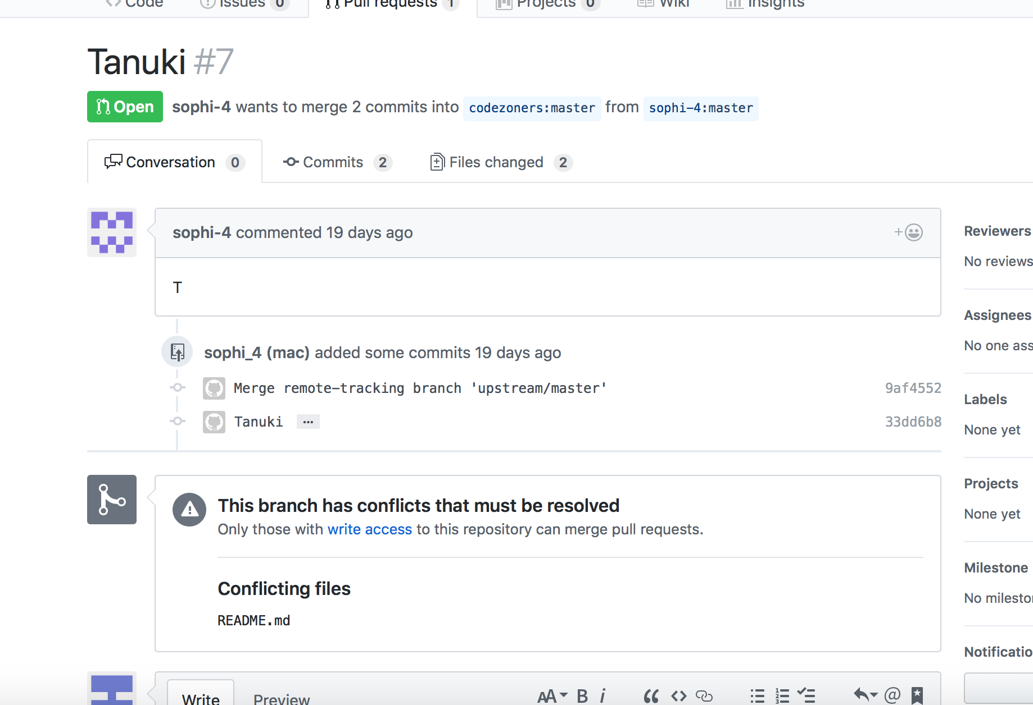
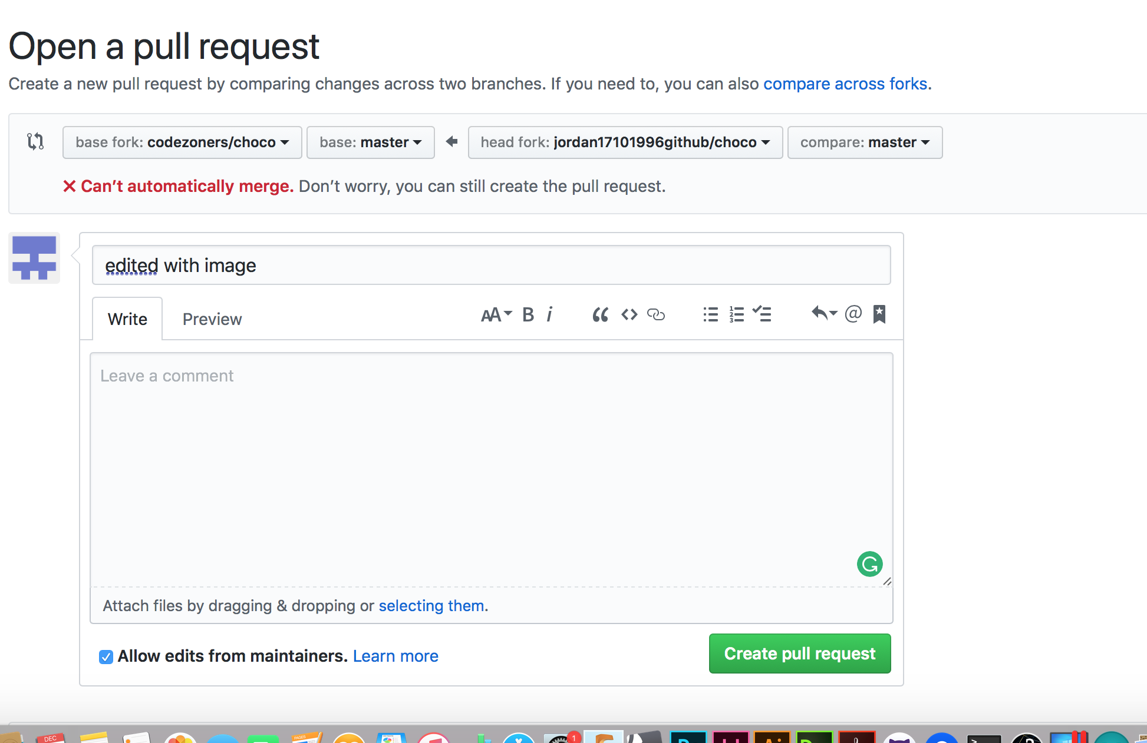
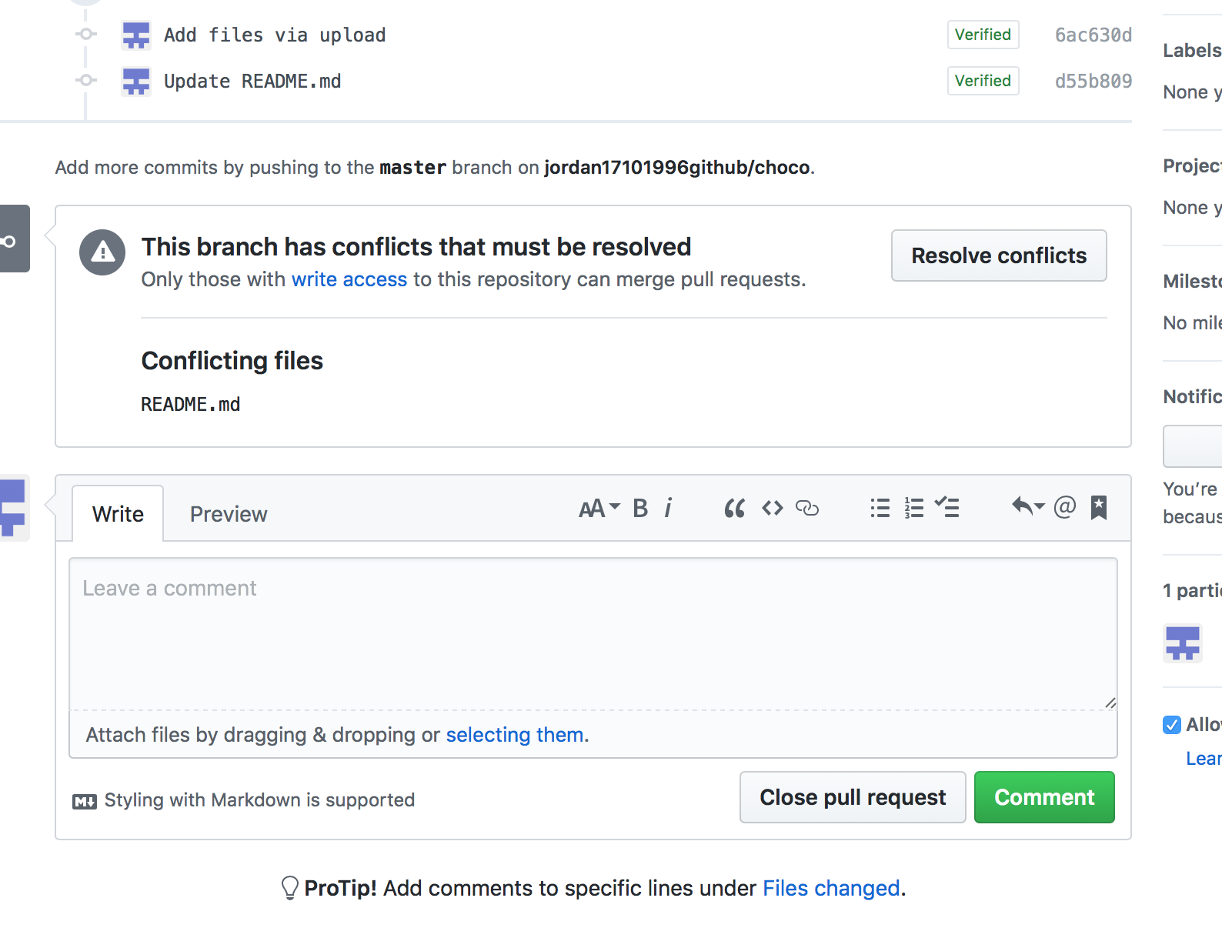
Merging
I attempted to merge the pull request, but another user merge the pull request to this repo. So, the only way to resolve this was that the author had to pick one the request.

Slide 9
Collaboration
We assisted each other with the properties of GitHub e.g. how to clone and fork each other’s repositories. It was useful for collaboration being in the same room.
We also used Slack to send our usernames for other users to view, clone, pull request and fork our repositories for enhancement and addition.
To distribute them to the original author, I use the pull request to let the original author view them. Also for merging, the author has to confirm them.

