Slide 1
Fair queueing and congestion control
Workshop on Congestion Control
Hamilton Institute, Sept 2005
Jim Roberts (France Telecom)
Joint work with Jordan Augé

Slide 2
Fairness and congestion control
fair sharing: an objective as old as congestion control
  cf. RFC 970, Nagle, 1985
  non-reliance on user cooperation
  painless introduction of new transport protocols
  implicit service differentiation
fair queueing is scalable and feasible
  accounting for the stochastics of traffic
  a small number of flows to be scheduled
  independent of link speed
performance evaluation of congestion control
  must account for realistic traffic mix
  impact of buffer size, TCP version, scheduling algorithm

Slide 3
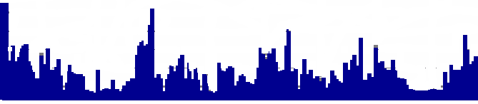
Flow level characterization of Internet traffic
traffic is composed of flows
  an instance of some application
  (same identifier, minimum packet spacing)
flows are "streaming" or "elastic"
  streaming SLS = "conserve the signal"
  elastic SLS = "transfer as fast as possible"
start
end
inter-packet < T
silence > T
streaming
elastic

Slide 4
Characteristics of flows
arrival process
  Poisson session arrivals: succession of flows and think times
size/duration
  heavy tailed, correlation
think times
start of
session
flow
arrivals
end of
session

Slide 5

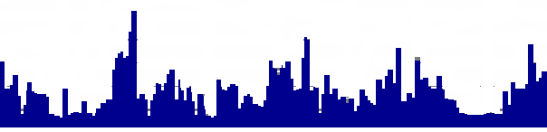
Characteristics of flows
arrival process
  Poisson session arrivals: succession of flows and think times
size/duration
  heavy tailed, correlation
flow peak rate
  streaming: rate ⇔ codec
  elastic: rate ⇔ exogenous limits (access link,...)
rate
rate
duration
duration

Slide 6
Three link operating regimes
"transparent"
"elastic"
"congested"
flows
overall
rate
negligible
loss and delay
excellent for elastic,
some streaming loss
low throughput,
significant loss
FIFO
sufficient
need
scheduling
need
overload control

Slide 7

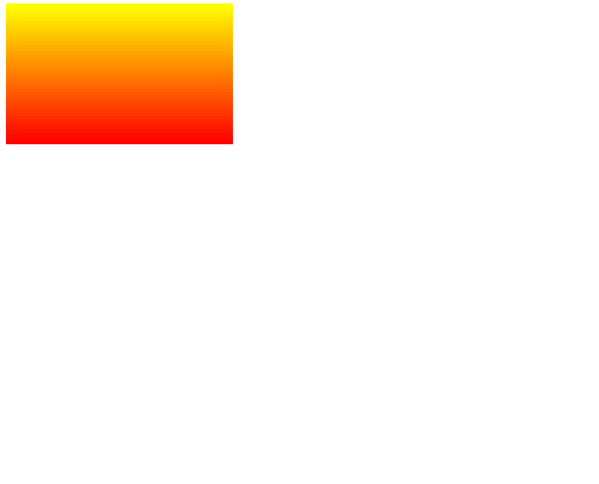
Performance of fair sharing without rate limit (ie, all flows bottlenecked)
a fluid simulation:
  Poisson flow arrivals
  no exogenous peak rate limit ⇒ flows are all bottlenecked
  load = 0.5 (arrival rate x size / capacity)
start
end
average
rate
incoming flows
high
link
rate
low
20 seconds

Slide 8
The process of flows in progress depends on link load
flows in progress
30
20
10
0
high
load 0.5
low

Slide 9

The process of flows in progress depends on link load
flows in progress
30
20
10
0
high
load 0.6
low

Slide 10

The process of flows in progress depends on link load
flows in progress
30
20
10
0
high
load 0.7
low

Slide 11

The process of flows in progress depends on link load
flows in progress
30
20
10
0
high
load 0.8
low

Slide 12

The process of flows in progress depends on link load
flows in progress
30
20
10
0
high
load 0.9
low

Slide 13
Insensitivity of processor sharing: a miracle of queuing theory !
link sharing ⇒ behaves like M/M/1
  assuming only Poisson session arrivals
if flows are bottlenecked, E [flows in progress] = ρ/(1−ρ)
  i.e., average ≤ 9 for ρ ≤ 0.9, but → ∞ as ρ → 1
but, in practice, ρ < 0.5 and E [flows in progress] = O(10⁴) !
20
E [flows in progress]
ρ/(1−ρ)
15
10
5
0
0
.2
.4
.6
.8
load, ρ

Slide 14

Trace data
an Abilene link (Indianapolis-Clevelend) – from NLANR
  OC 48, utilization 16 %
  flow rates ∈ (10 Kb/s, 10 Mb/s)
  ~7000 flows in progress at any time
>2.5 Mb/s
2.5 Gb/s
< 250 Kb/s
10 sec

Slide 15
Most flows are non-bottlenecked
each flow emits packets rarely
little queueing at low loads
  FIFO is adequate
  performance like a modulated M/G/1
at higher loads, a mix of bottlenecked and non-bottlenecked flows...
15 Mb/s
~1 ms
~7000 flows
2.5 Gb/s
~5 µs

Slide 16
Fair queueing is scalable and feasible
fair queueing deals only with flows having packets in queue
  <100 bottlenecked flows (at load < 90%)
  O(100) packets from non-bottlenecked flows (at load < 90%)
scalable since number does not increase with link rate
  depends just on bottlenecked/non-bottlenecked mix
feasible since max number is ~500 (at load < 90%)
  demonstration by trace simulations and analysis (Sigmetrics 2005)
can use any FQ algorithm
  DRR, Self-clocked FQ,...
  or even just RR ?

Slide 17
Typical flow mix
many non-bottlenecked flows (~10⁴)
  rate limited by access links, etc.
a small number of bottlenecked flows (0, 1, 2,...)
  Pr [ ≥ i flows] ~ ρ^{i} with ρ the relative load of bottlenecked flows
example
  50% background traffic
    ie, E[flow arrival rate] x E[flow size] / capacity = 0.5
  0, 1, 2 or 4 bottlenecked TCP flows
    eg, at overall load = 0.6, Pr [≥ 5 flows] ≈ 0.003

Slide 18
Simulation set up (ns2)
one 50 Mbps bottleneck
  RTT = 100ms
25 Mbps background traffic
  Poisson flows: 1 Mbps peak rate
  or Poisson packets (for simplicity)
1, 2 or 4 permanent high rate flows
  TCP Reno or HSTCP
buffer size
  20, 100 or 625 packets (625 = b/w x RTT)
scheduling
  FIFO, drop tail
  FQ, drop from front of longest queue

Slide 19
Results:
- 1 bottlenecked flow,
- Poisson flow background

Slide 20
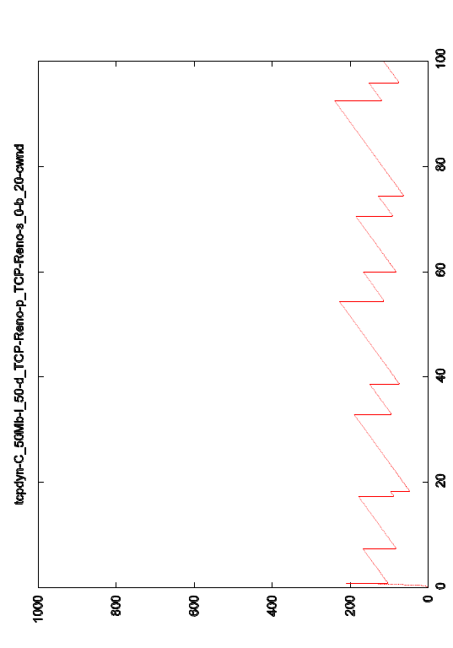
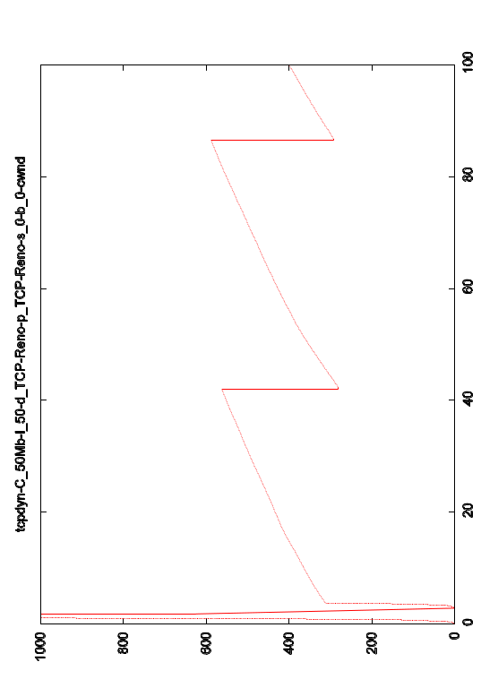
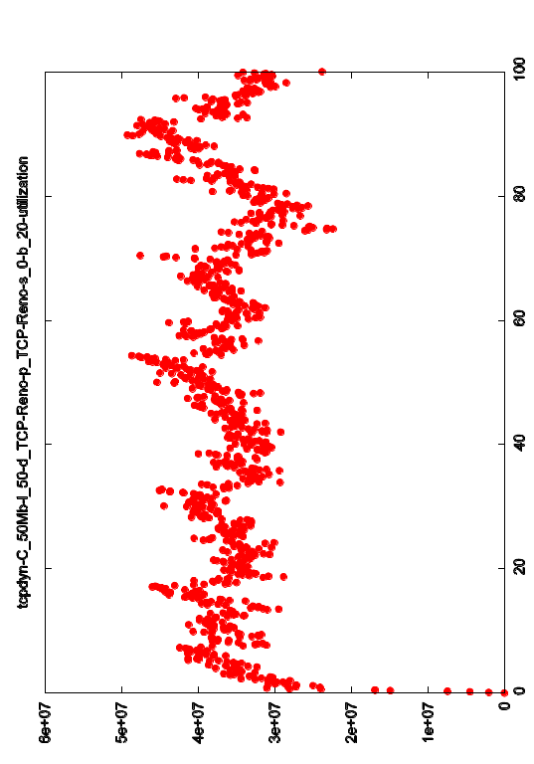
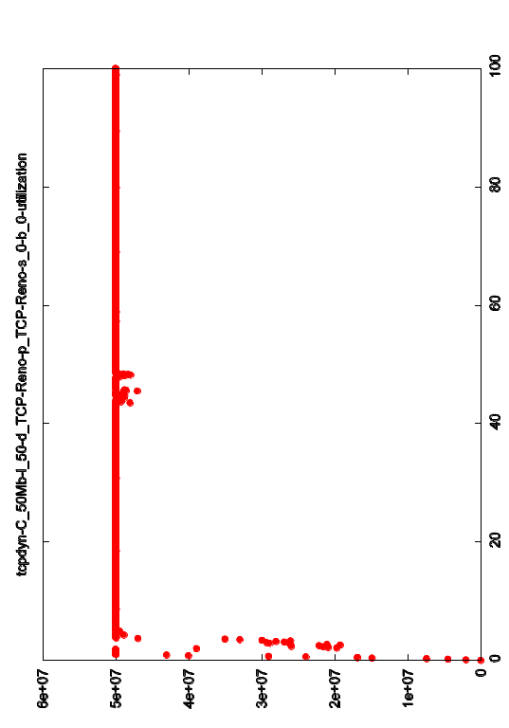
FIFO + Reno
20 packets
625 packets
1000
cwnd
(pkts)
0
1
utilization
0
100s
100s

Slide 21
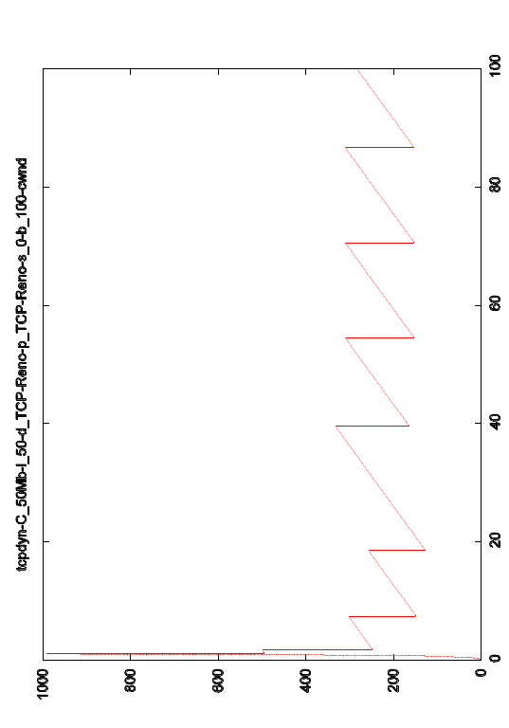
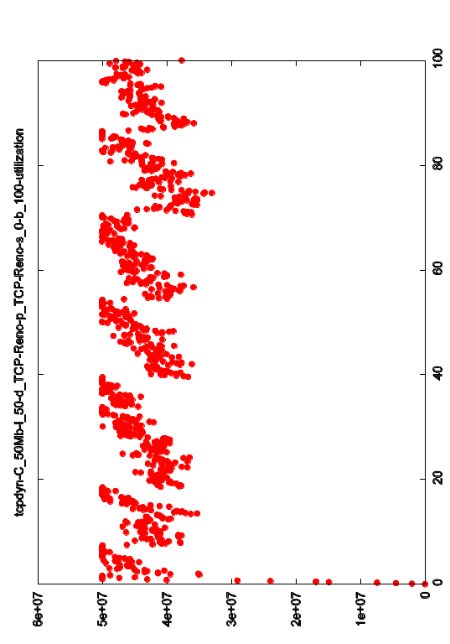
FIFO + Reno
20 packets
100 packets
1000
Severe throughput loss with small buffer:
- realizes only 40% of available capacity
cwnd
(pkts)
0
1
utilization
0
100s
100s

Slide 22
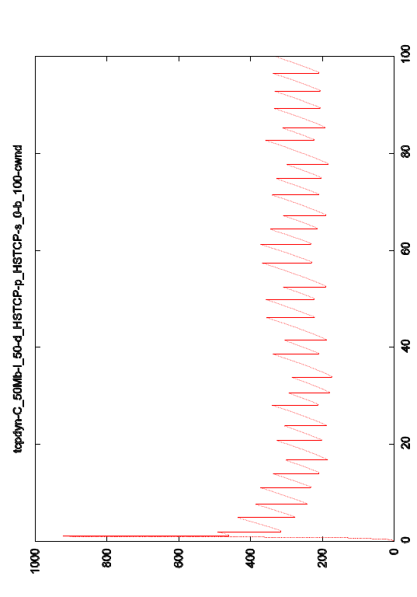
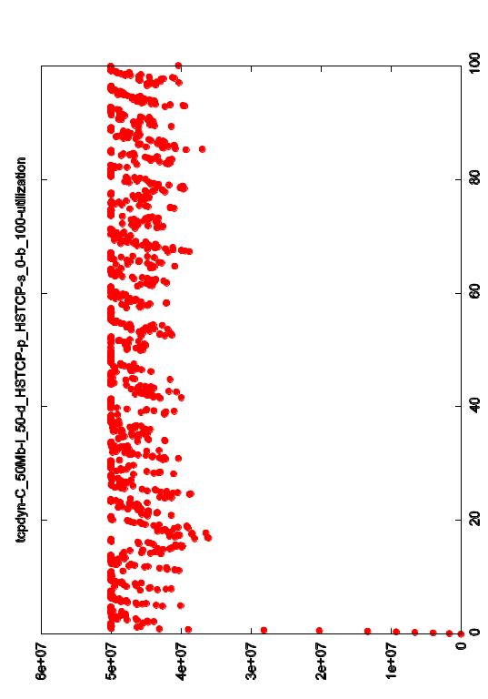
FIFO + 100 packet buffer
Reno
HSTCP
1000
HSTCP brings gain in utilization,
higher loss for background flows
cwnd
(pkts)
0
1
utilization
0
100s
100s

Slide 23
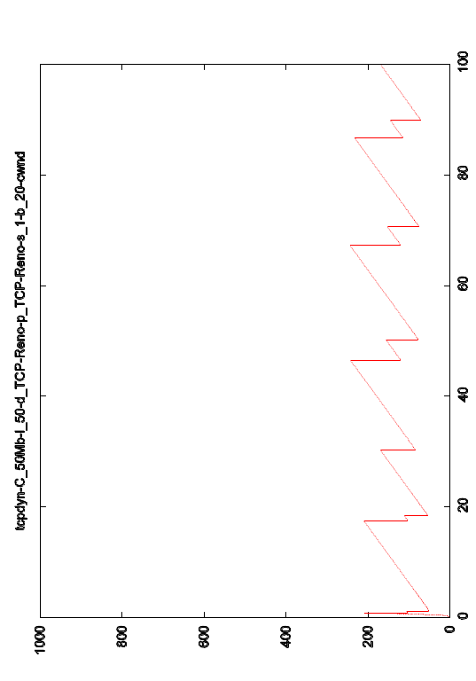
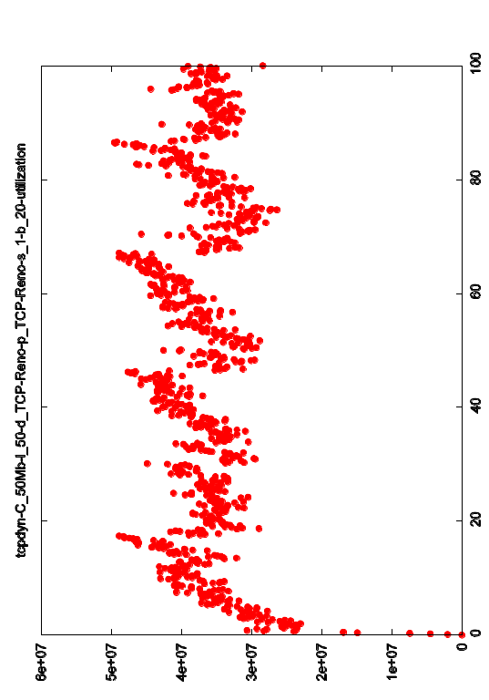
Reno + 20 packet buffer
FIFO
FQ
1000
FQ avoids background flow loss,
little impact on bottlenecked flow
cwnd
(pkts)
0
1
utilization
0
100s
100s

Slide 24
Results:
- 2 bottlenecked flows,
- Poisson packets background

Slide 25
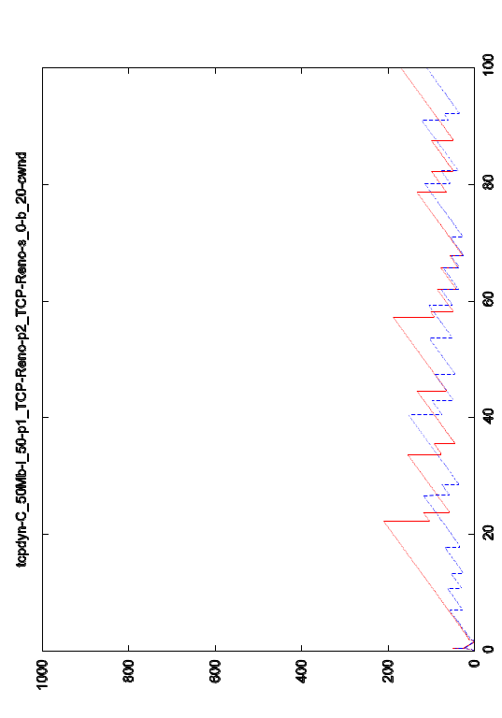
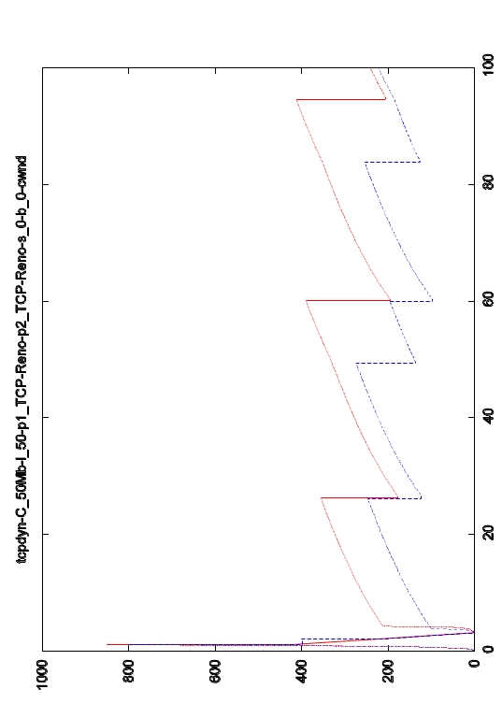
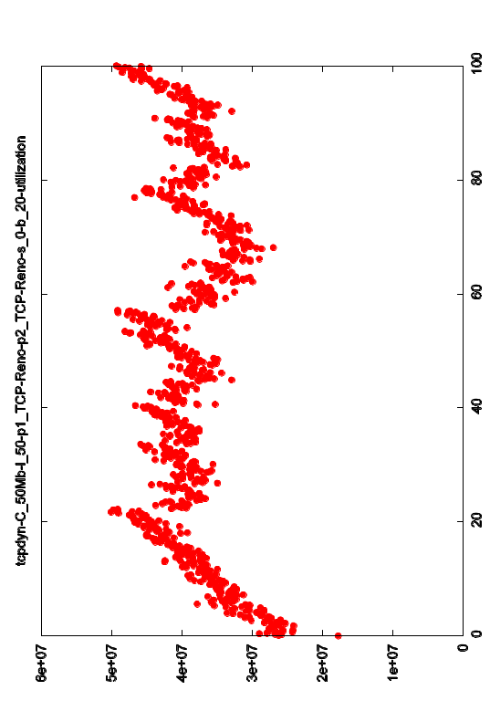
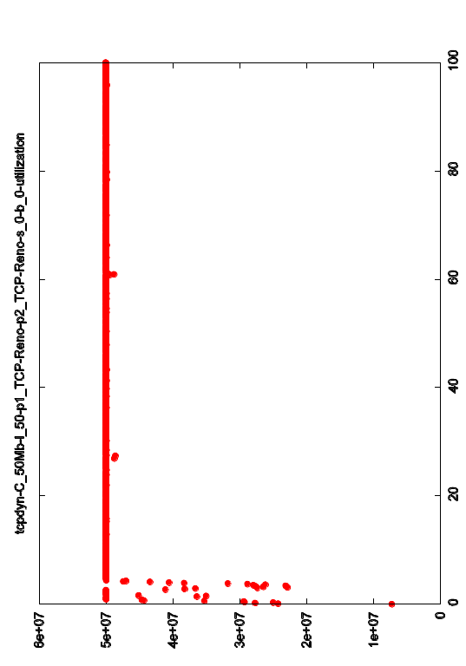
FIFO + Reno + Reno
20 packets
625 packets
1000
Approximate fairness with Reno
cwnd
(pkts)
0
1
utilization
0
100s
100s

Slide 26
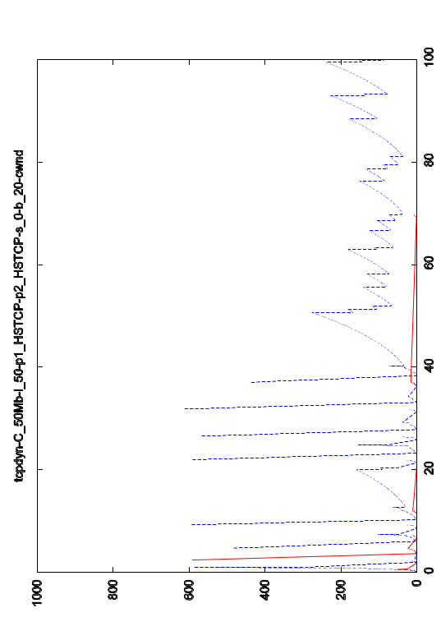
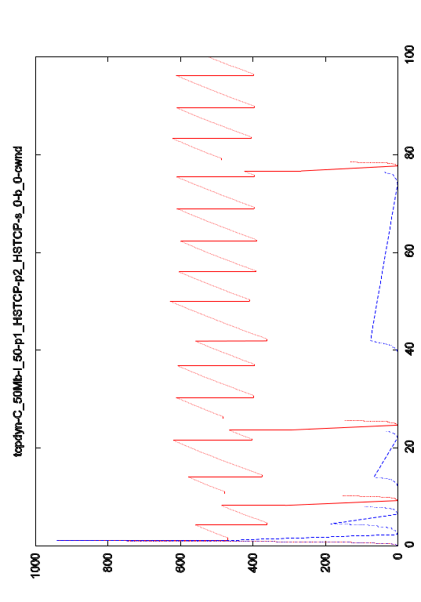
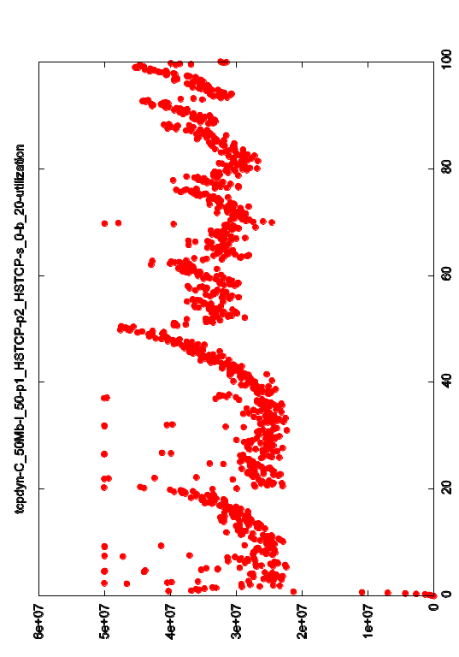
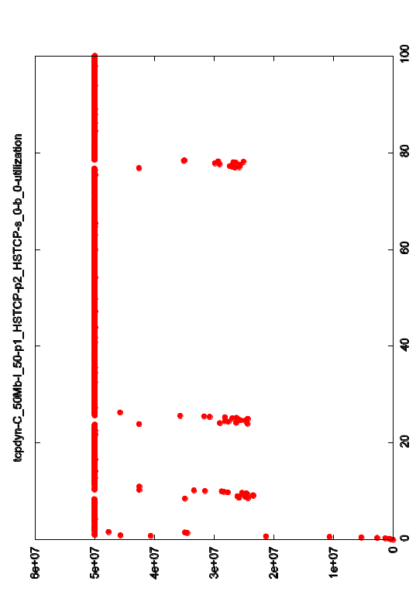
FIFO + HSTCP + HSTCP
20 packets
625 packets
1000
cwnd
(pkts)
0
1
utilization
0
100s
100s

Slide 27
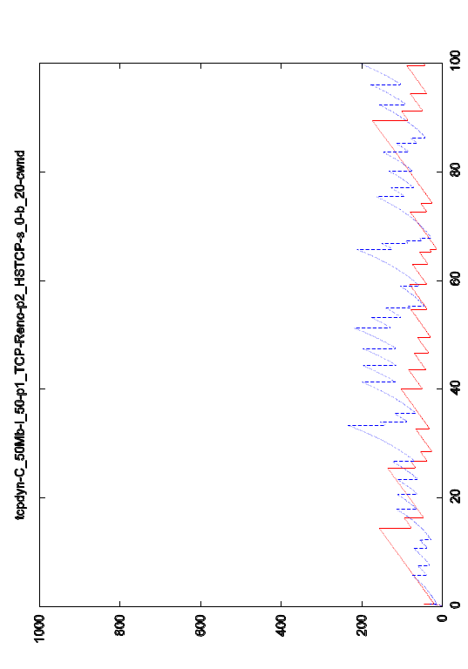
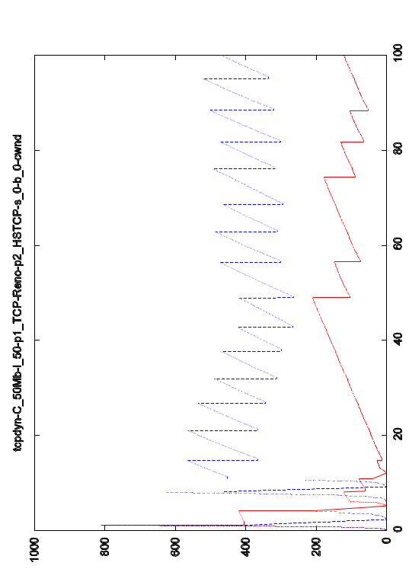
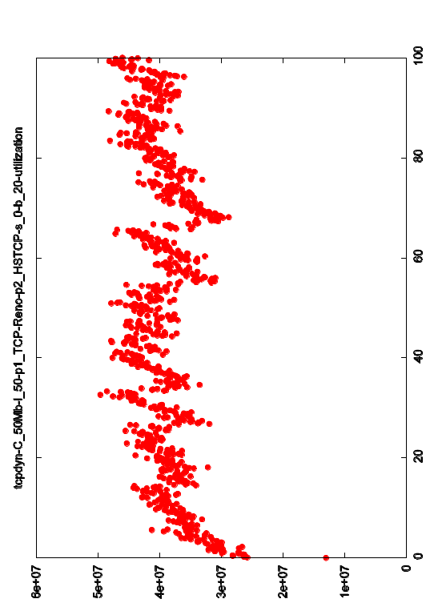
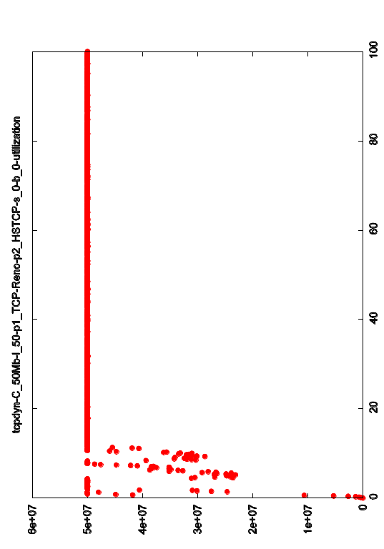
FIFO + HSTCP + Reno
20 packets
625 packets
1000
HSTCP is very unfair
cwnd
(pkts)
0
1
utilization
0
100s
100s

Slide 28
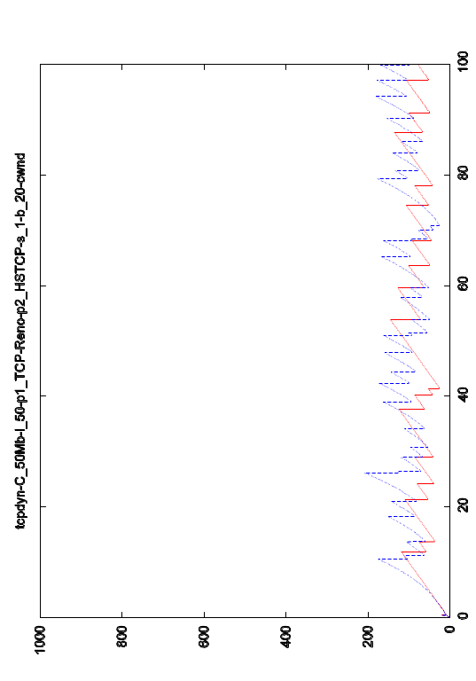
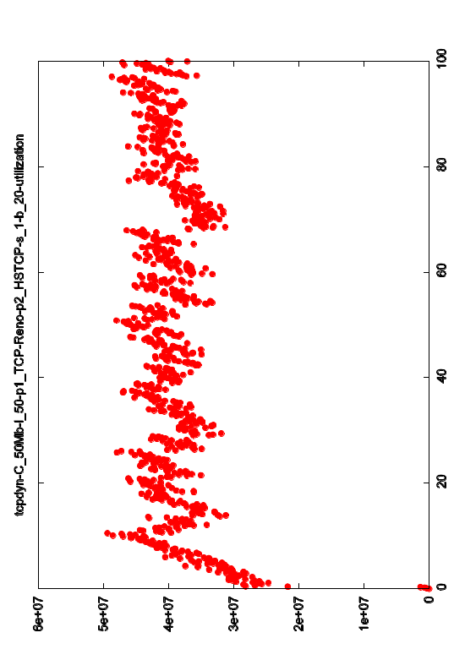
Reno + HSTCP + 20 packet buffer
FIFO
FQ
1000
cwnd
(pkts)
0
1
utilization
0
100s
100s

Slide 29
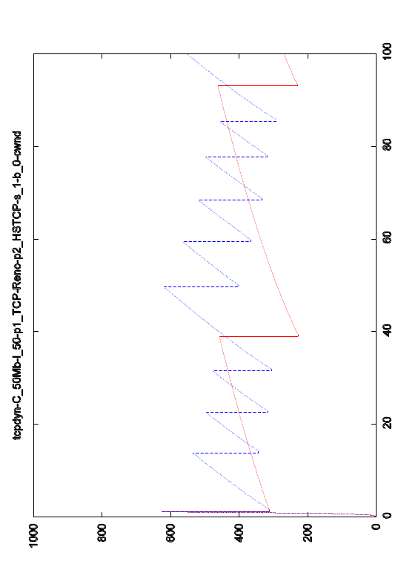
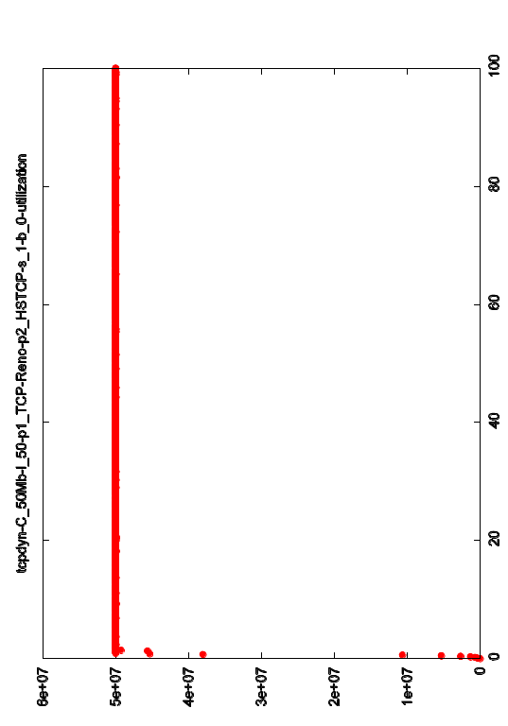
Reno + HSTCP + 625 packet buffer
FIFO
FQ
1000
Fair queueing is effective (though
HSTCP gains more throughput)
cwnd
(pkts)
0
1
utilization
0
100s
100s

Slide 30
Results:
- 4 bottlenecked flows,
- Poisson packet background

Slide 31
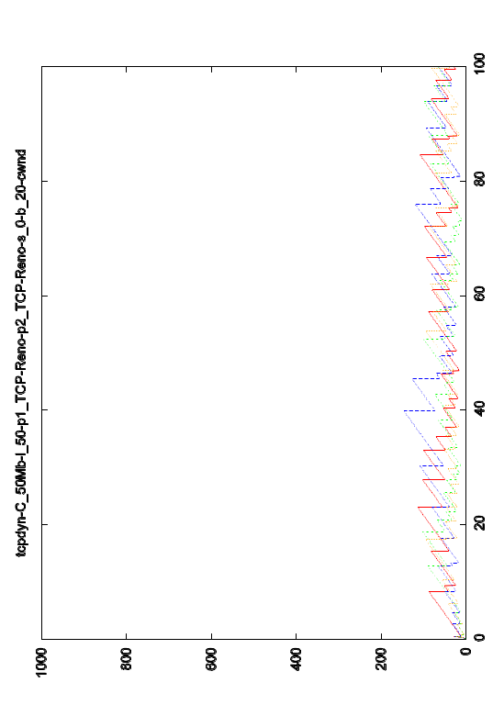
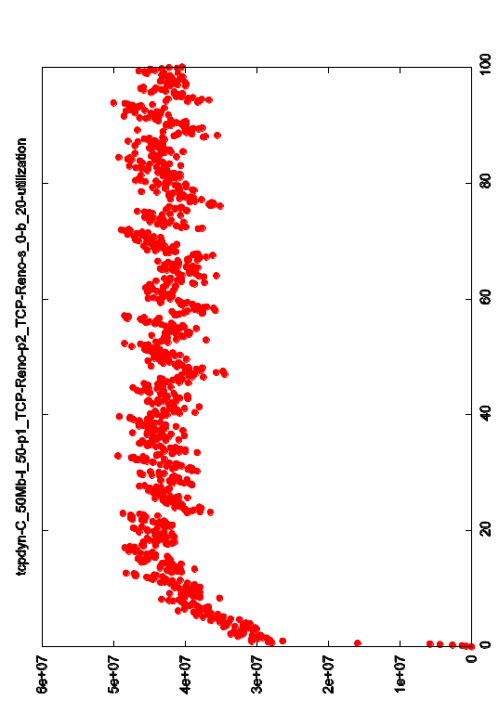
All Reno + 20 packet buffer
1 flow
4 flows
1000
Improved utilization with 4 bottlenecked flows,
approximate fairness
cwnd
(pkts)
0
1
utilization
0
100s
100s

Slide 32
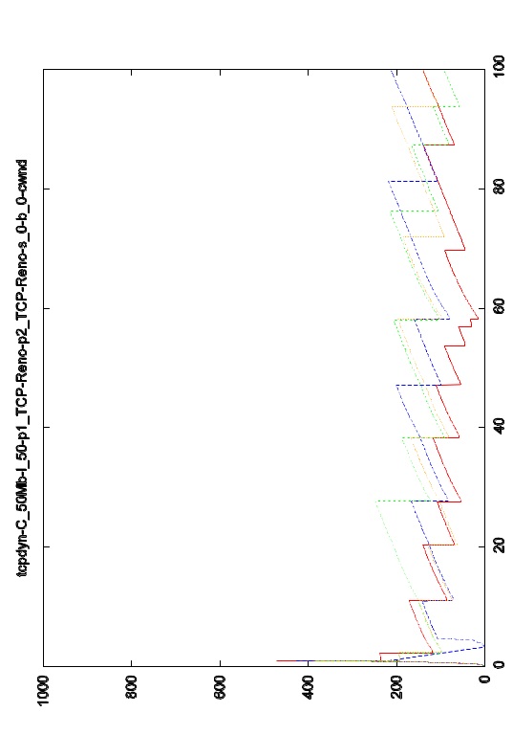
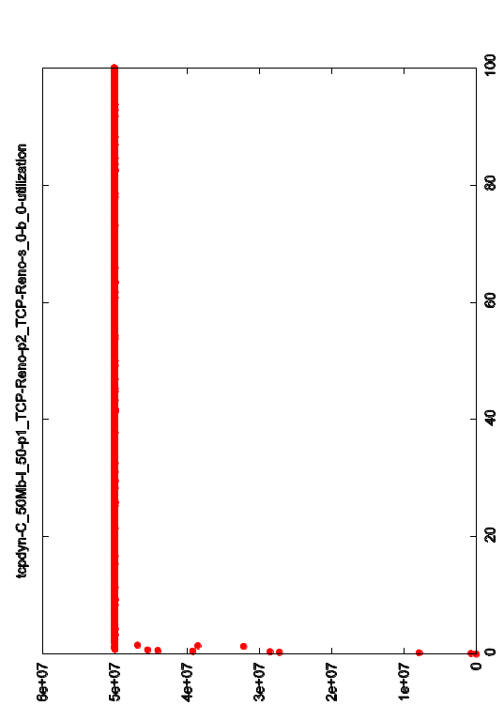
All Reno + 625 packet buffer
1 flow
4 flows
1000
Approximate fairness
cwnd
(pkts)
0
1
utilization
0
100s
100s

Slide 33
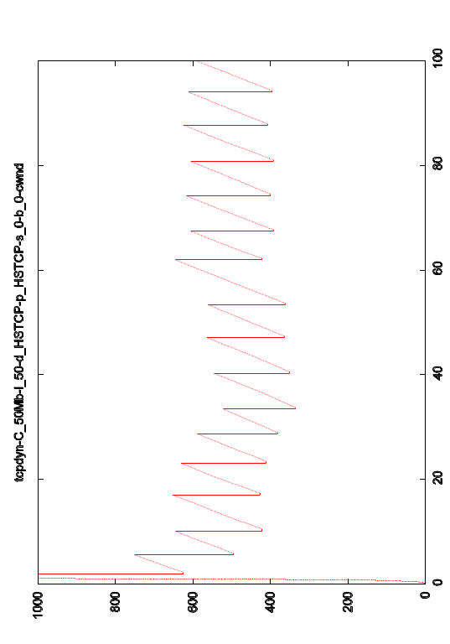
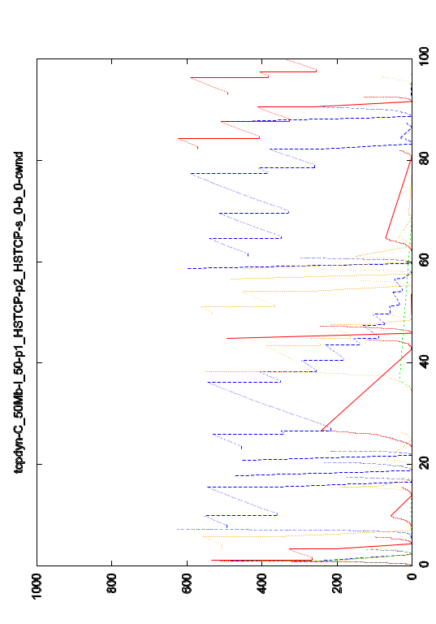
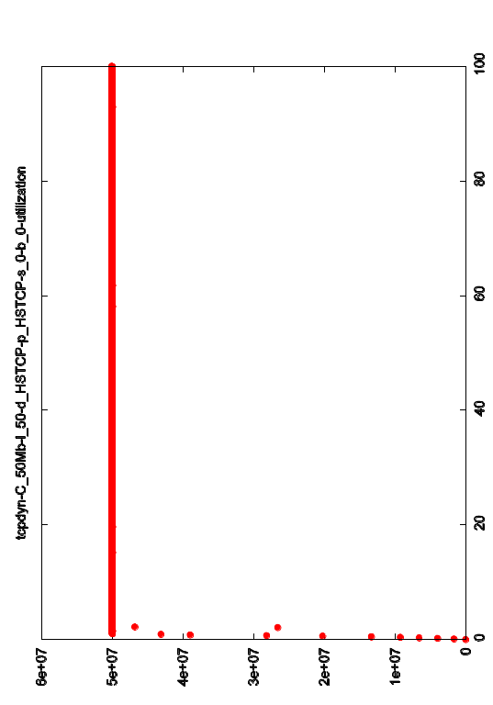
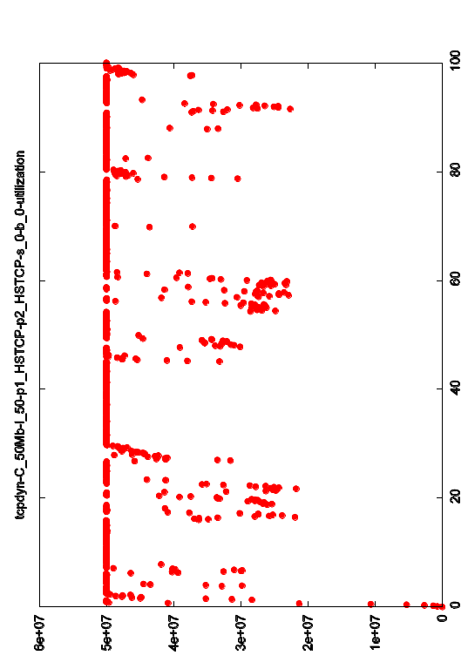
All HSTCP + 625 packet buffer
1 flow
4 flows
1000
Poor fairness, loss of throughput
cwnd
(pkts)
0
1
utilization
0
100s
100s

Slide 34
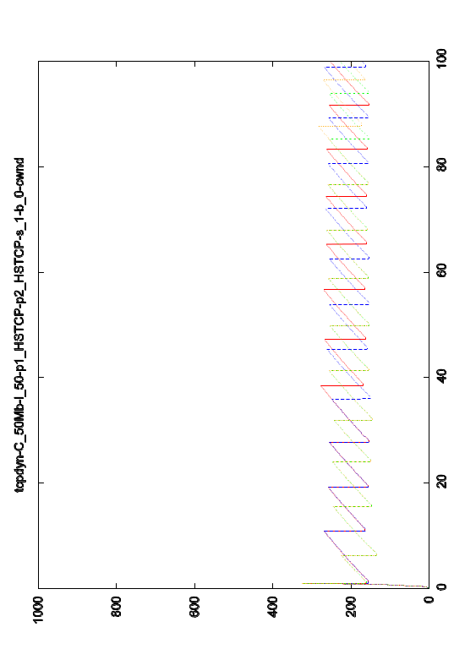
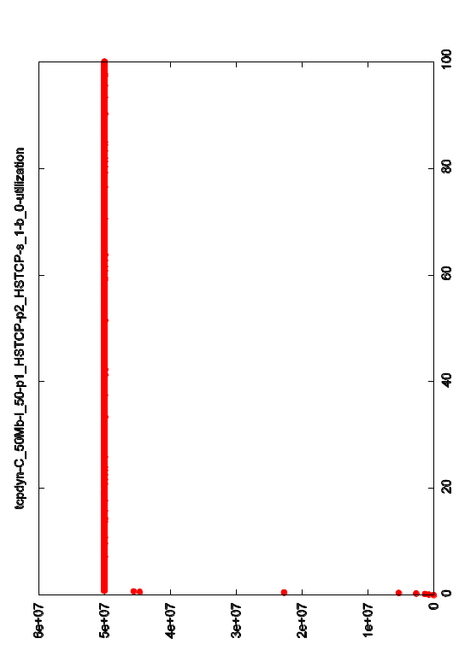
All HSTCP + 625 packet buffer
FIFO
FQ
1000
Fair queueing restores fairness,
preserves throughput
cwnd
(pkts)
0
1
utilization
0
100s
100s

Slide 35
Conclusions
there is a typical traffic mix
  small number of bottlenecked flows (0, 1, 2,...)
  large number of non-bottlenecked flows
fair queueing is feasible
  O(100) flows to schedule for any link rate
results for 1 bottlenecked flow + 50% background
  severe throughput loss for small buffer
  FQ avoids loss and delay for background packets
results for 2 or 4 bottlenecked flows + 50% background
  Reno approximately fair
  HSTCP very unfair, loss of utilization
  FQ ensures fairness for any transport protocol
alternative transport protocols ?

