Slide 1

Heart Disease Risk Factors in the US
Jordan Bennett

Slide 2
Data Sources
US Centers for Disease Control and Prevention (CDC) Interactive Atlas of Heart Disease and Stroke
https://nccd.cdc.gov/DHDSPAtlas/?state=County&tt=HI&classid=1&subid=1&hifilters=%5B%5B9,1%5D,%5B2,1%5D,%5B3,1%5D,%5B4,1%5D,%5B7,1%5D%5D&ol=%5B10,14%5D

Slide 3
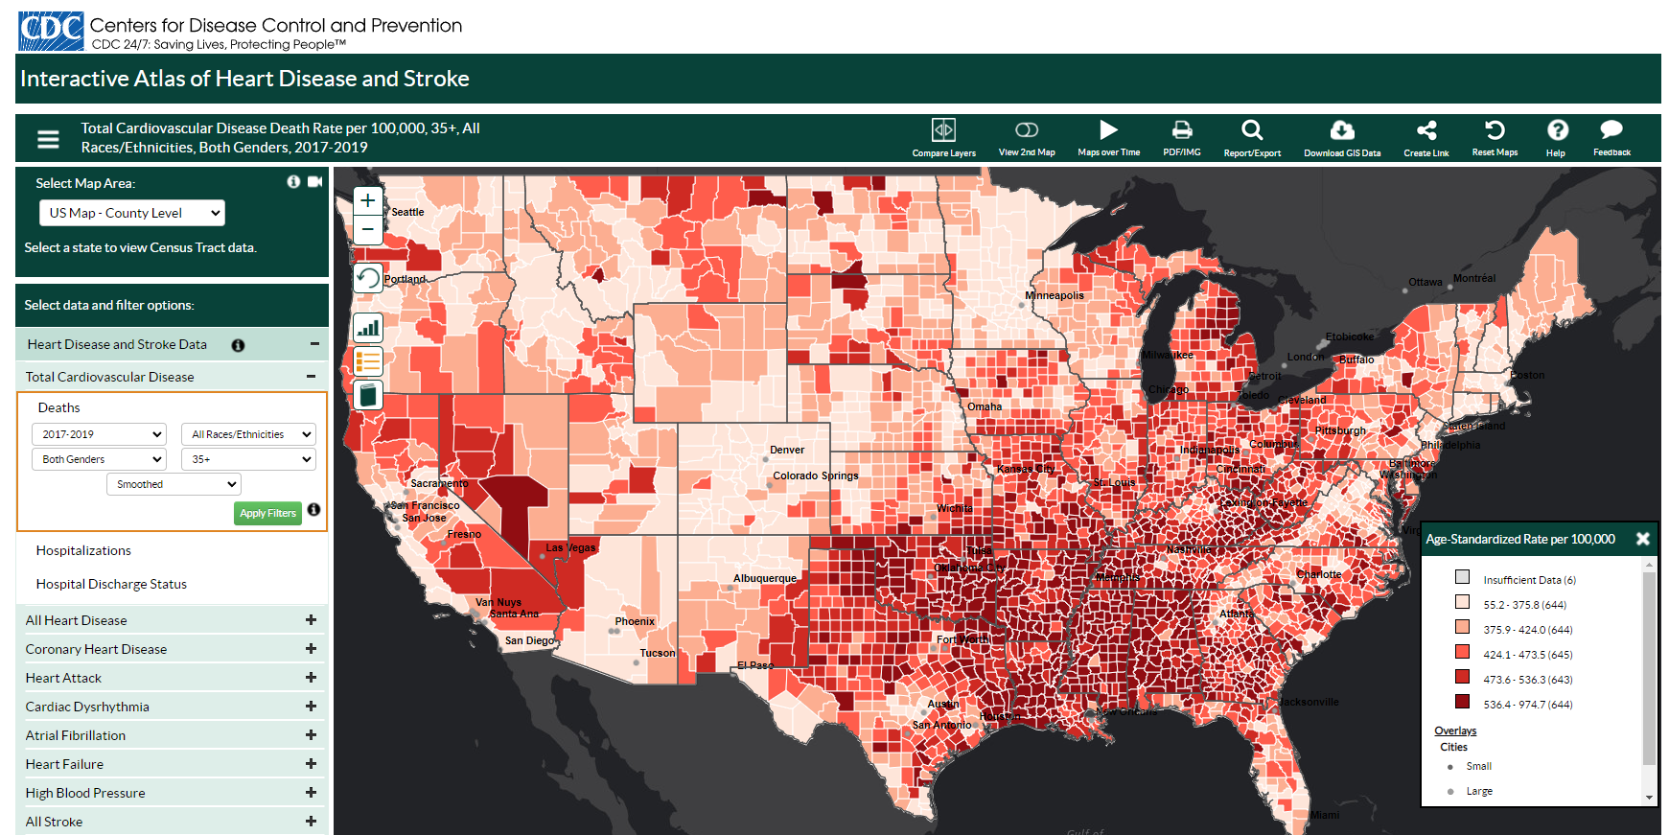
Data Sources

Slide 4
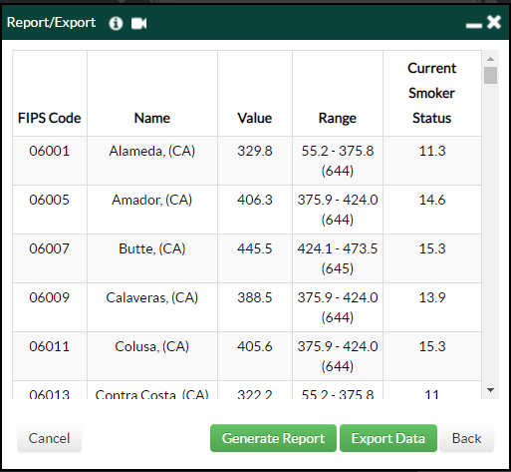
Data Sources

Slide 5
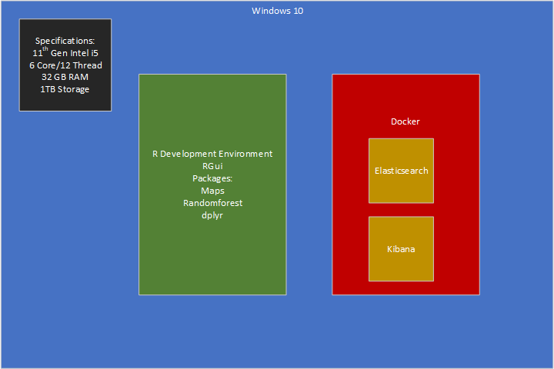
Computing Environment

Slide 6
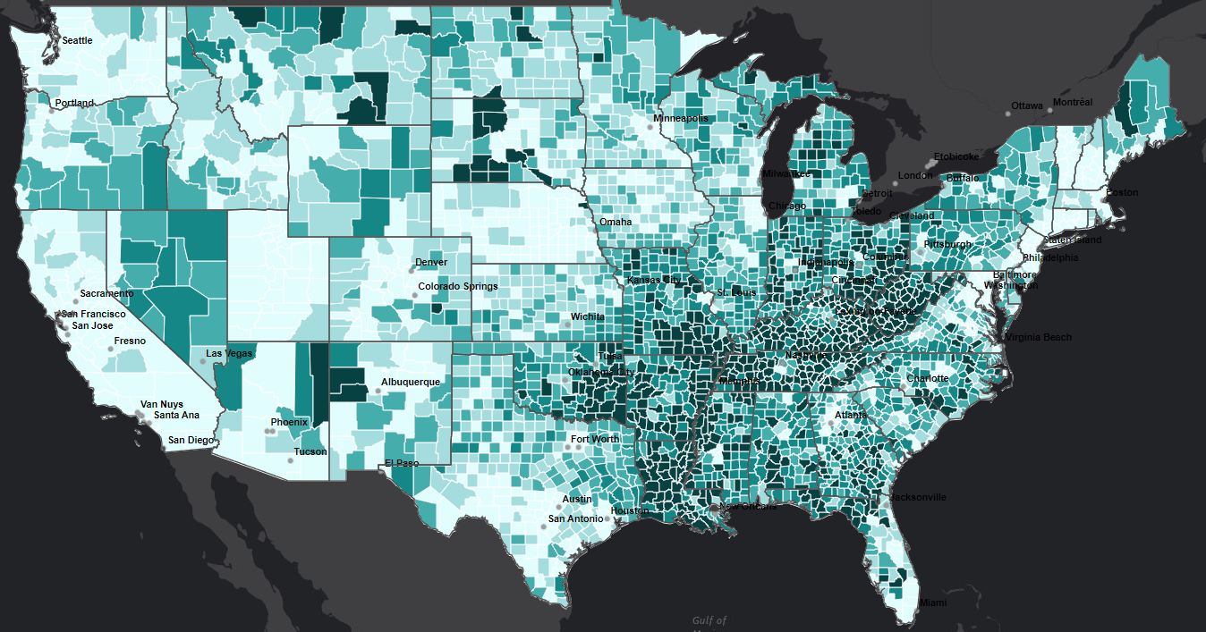
Data Exploration – Smoking Rates

Slide 7
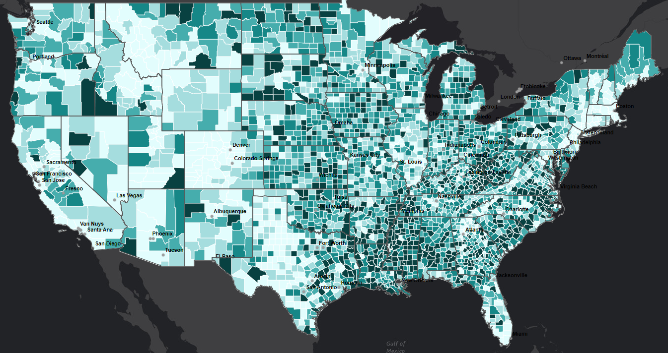
Data Exploration – Obesity Percentage

Slide 8
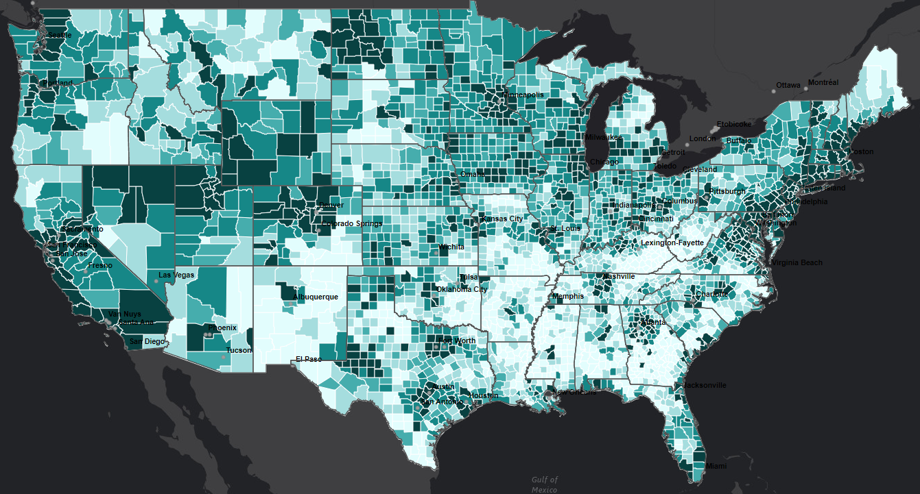
Data Exploration – Median Income

Slide 9
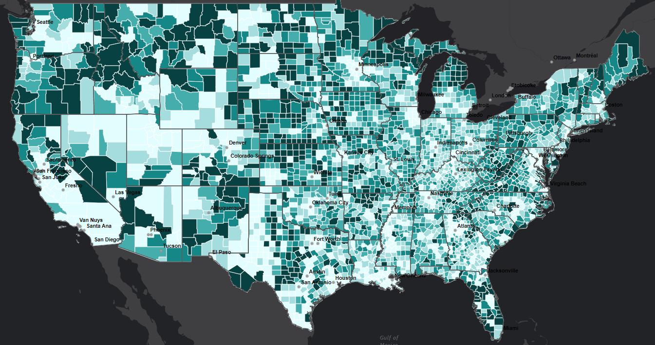
Data Exploration – Over 65

Slide 10
Data Exploration – Over 65

Slide 11
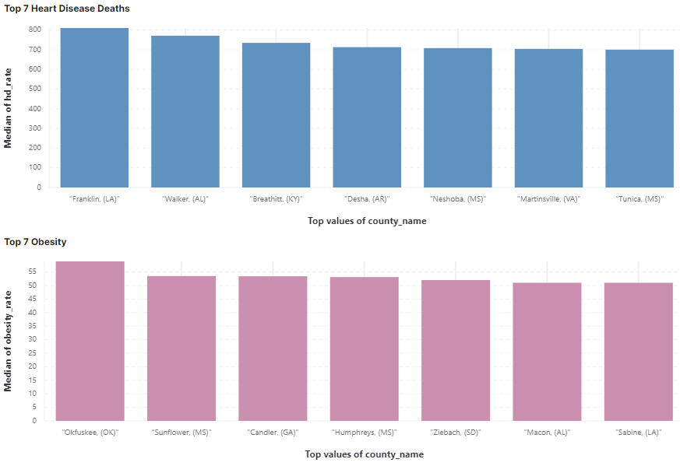
Data Exploration
Top Obesity

Slide 12
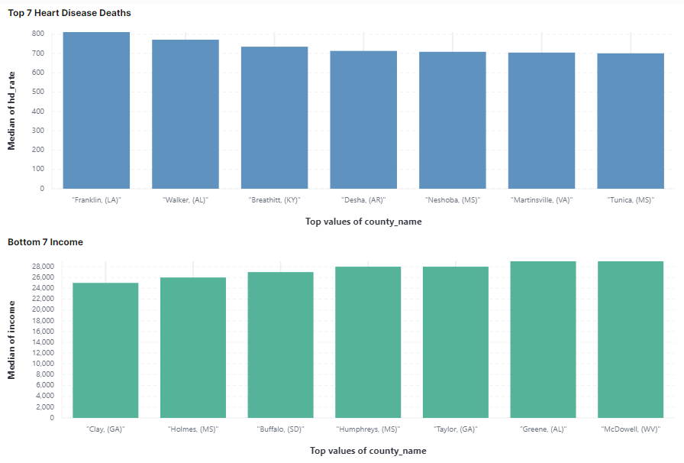
Data Exploration
Bottom Income

Slide 13
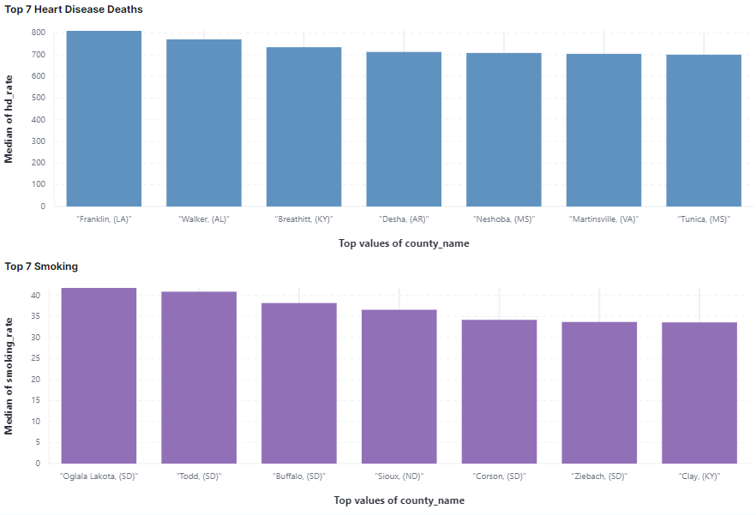
Data Exploration
Top Smokers

Slide 14
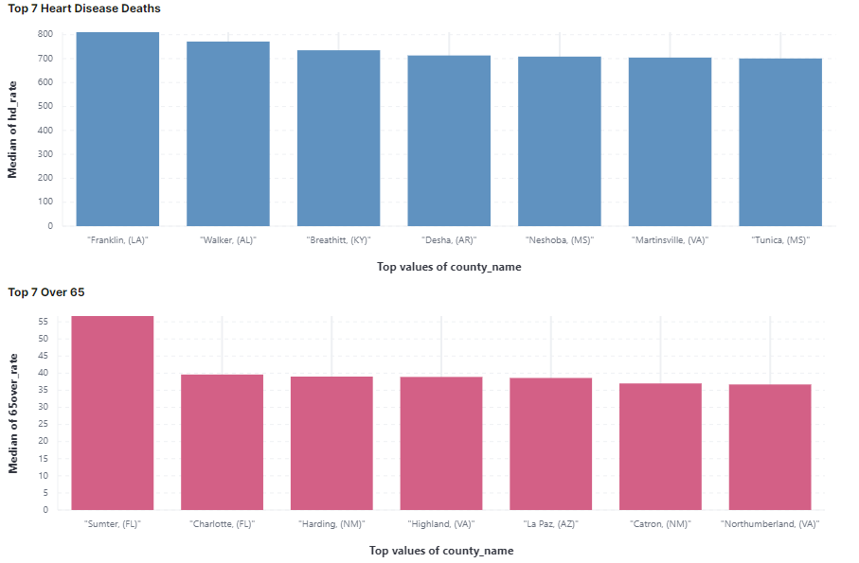
Data Exploration
Top Over 65

Slide 15
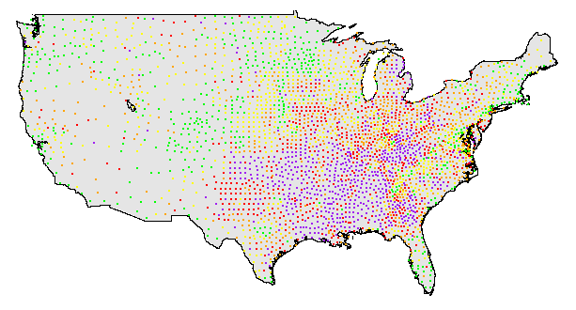
Mapping the Data

Slide 16

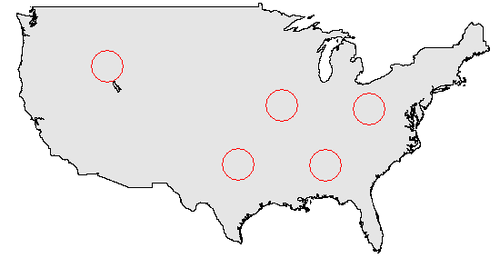
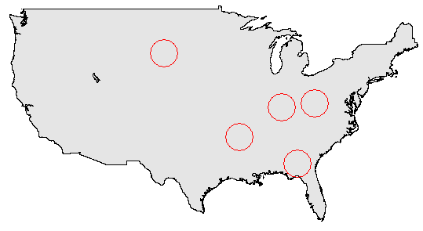
K-means Clustering
Heart Disease Deaths
High Smoking Rates

Slide 17
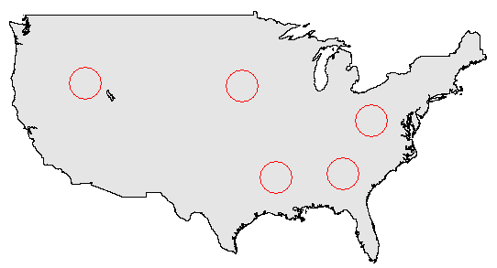
K-means Clustering
Heart Disease Deaths
High Obesity Rates

Slide 18
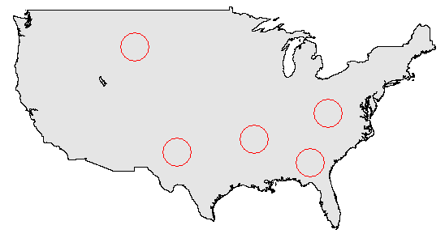
K-means Clustering
Heart Disease Deaths
Low Income Rates

Slide 19
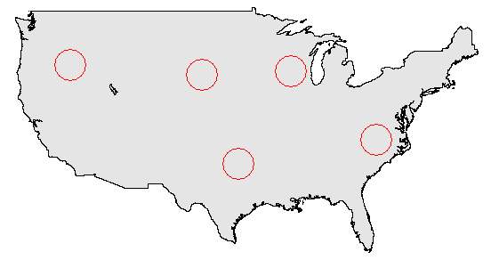
K-means Clustering
Heart Disease Deaths
High Over-65 Rates

Slide 20

Random Forrest Classifier

Slide 21
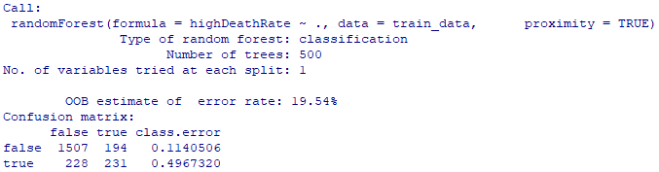
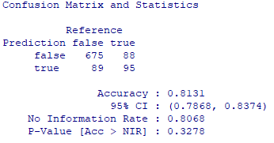
Classification – Smoking
Training Data
Test Data

Slide 22
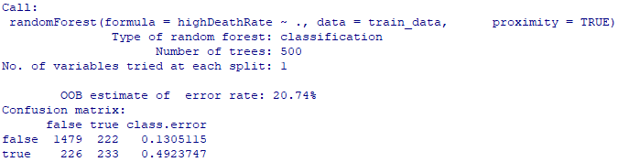
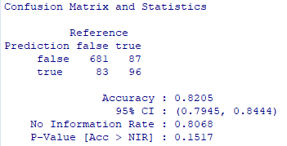
Classification – Income
Training Data
Test Data

Slide 23
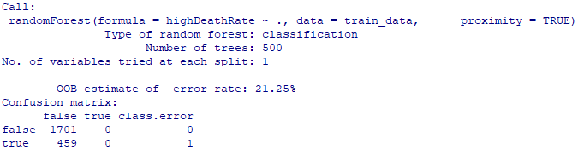
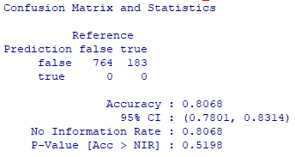
Classification – Age
Training Data
Test Data

Slide 24
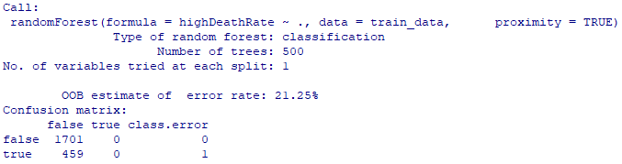
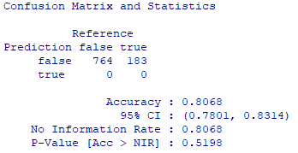
Classification – Obesity
Training Data
Test Data

Slide 25


Classification – Income + Smoking
Training Data
Test Data

Slide 26
Thoughts for Improvement
More time
Large dataset
Many risk factors
A lot of health and environmental factors left to investigate

