Slide 1

SAS Workbench
A SAS and Python Perspective
Jordan Bakerman – Data Scientist

Slide 2


What is SAS Workbench?
Centralized Coding Application
Light Weight and On-Demand
Web based development environment for SAS, Python, and R practitioners.
IDE agnostic. Choose between VSCode, Jupyter Notebook, etc.
Spin-up and Spin-down CPU/GPU compute resources as needed.
Cloud agnostic. AWS, Azure, GCP, etc.
Start coding in the cloud faster!

Slide 3



SAS Workbench Features
Independent
or Symbiotic
Secure and
IT Friendly
Optimal Cloud
Performance
Workbench can be a stand-alone application.
Manage, govern, and deploy Workbench models with SAS Viya 4.
Deploy Astores, DATA Step code, or pickle files.
Data resides within cloud subscription and firewall.
Access engines available.
Reduces administrative burden for hybrid teams.
Users download OS packages from IT managed list.
High performance analytics optimized for cloud parallelization.
Workbench APIs allow OS users to leverage SAS algorithms and speed.

Slide 4


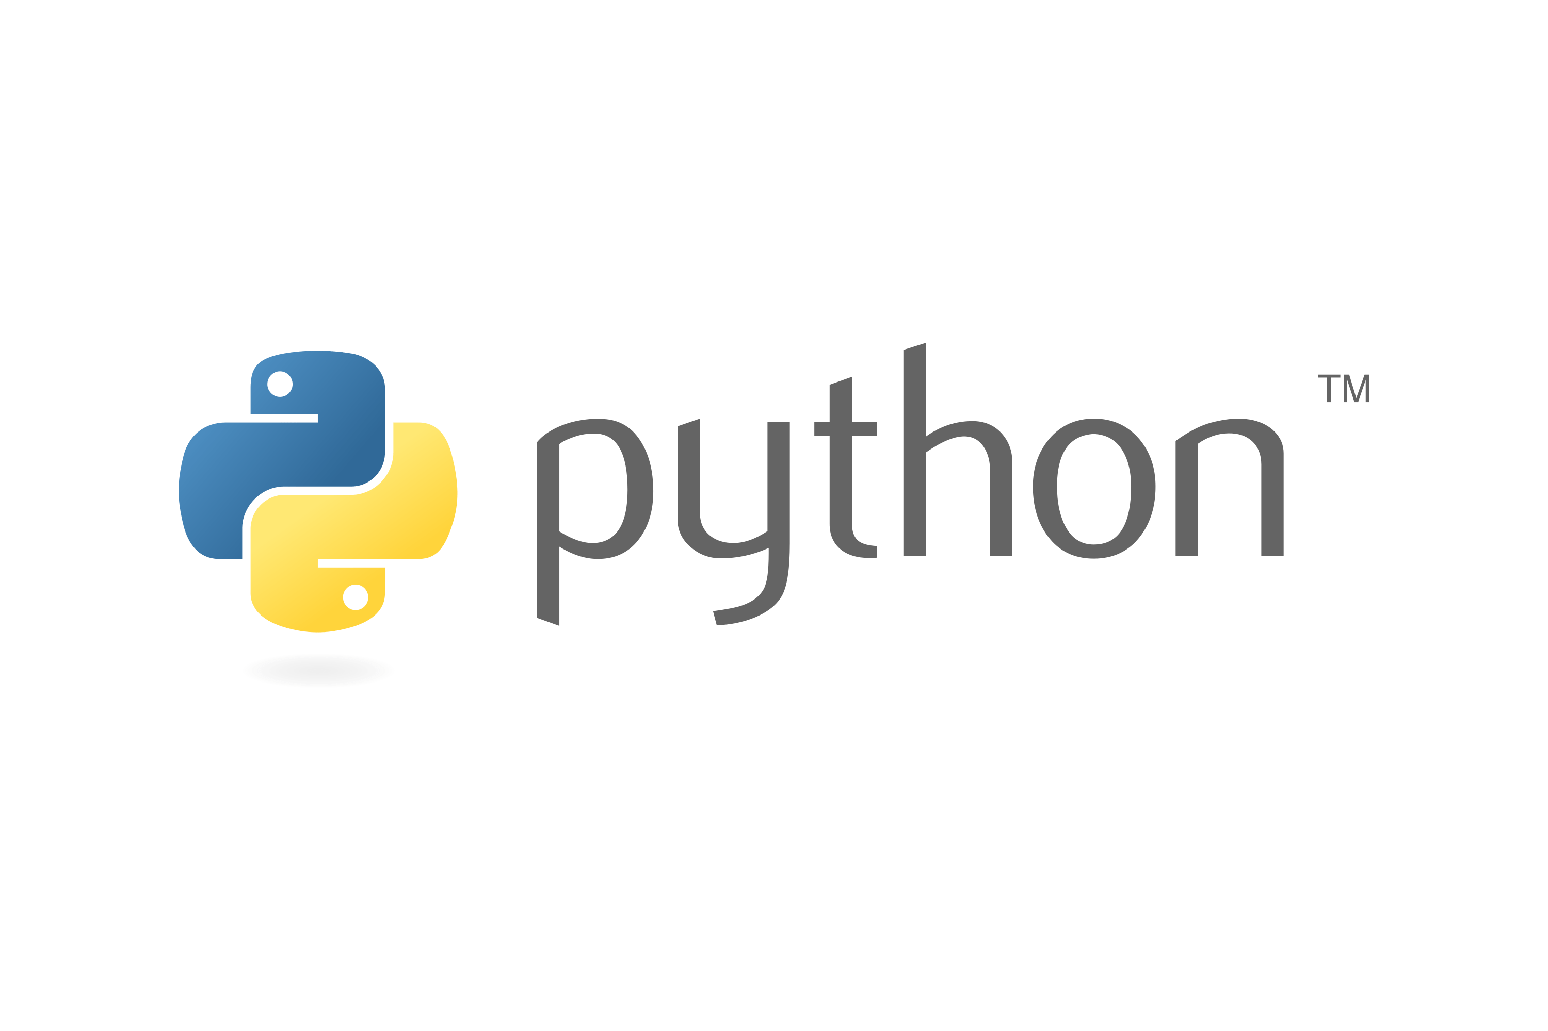
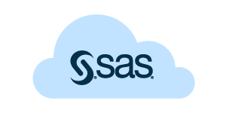

Workbench Inheritance from SAS Viya
Language and IDE Agnostic
Multithreaded Algorithms
High performance parallel processing algorithms.
SAS open-source packages wrap up SAS algorithms have a look and feel of OS syntax.

Slide 5
SAS Workbench Improvements
SAS Viya
SAS Workbench
Engines
Compute
CAS
Single Unified Engine
SAS 9 code runs on Compute and SAS Viya code runs on CAS
Both SAS 9 and SAS Viya code runs on a single unified engine.
SAS Code
API Code
The SWAT package is meant to have a look and feel of open-source code.
The sasviya.ml package code is meant to appear identical to scikit-learn code.

Slide 6
SAS Code on Workbench
Workbench enables SAS coders to leverage SAS 9 procedures and the next generation of SAS Viya procedures on a single application and engine.
head
MCMC
VARREDUCE
GRADBOOST
LOGISTIC
FREQ
REGISTERMODEL
TREESPLIT
TTEST
ARIMA
TABULARGAN
WB

Slide 7
Scikit-Learn VS Workbench
Scikit-Learn
Workbench
from sklearn.linear_model import LogisticRegression
mymod = LogisticRegression(
fit_intercept = True,
max_iter = None
tol = .0001
)
mymod.fit(x_trian, y_train)
from sasviya.ml.linear_model import LogisticRegression
mymod = LogisticRegression(
fit_intercept = True,
max_iter = None,
tol = .0001
)
mymod.fit(x_trian, y_train)
OS
WB

Slide 8



Model Governance
The SASCTL package enables users to move deployment artifacts to SAS Model Manager for deployment and model governance. Deployment artifacts include metadata, score code, and model comparison statistics.
Workbench
OS APIs
Pure OS
SAS Pickle
Submit Astore files or DATA Step score code to SAS Model Manager
Submit Python pickle files and R RDA files to SAS Model Manager
Convert a SAS model built with SAS to a pickle file

Slide 9
SAS Workbench
This demonstration illustrates how to leverage SAS Viya cloud algorithms from the Python API in SAS Workbench.

