Slide 1
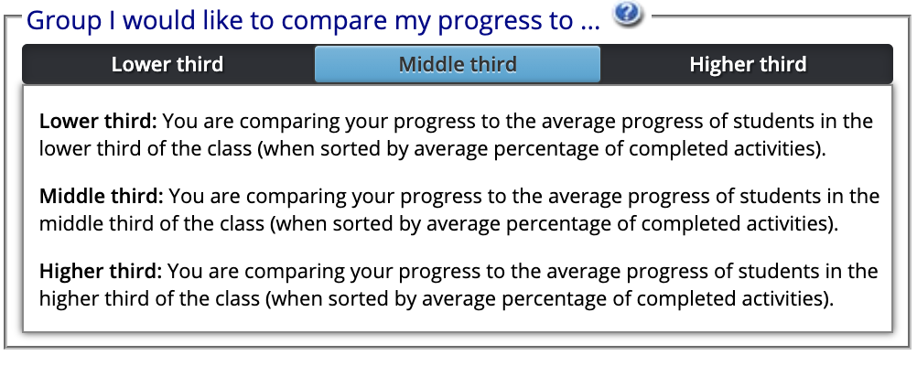
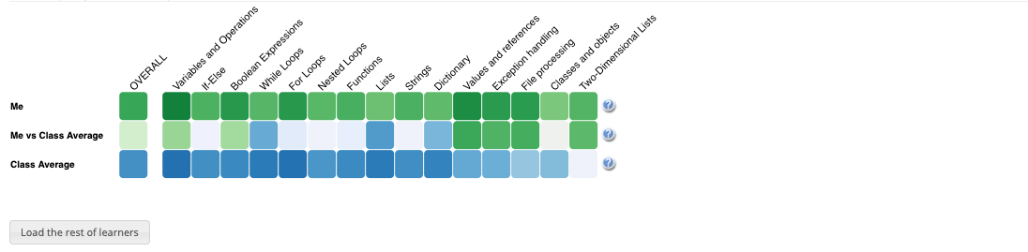
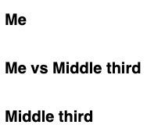

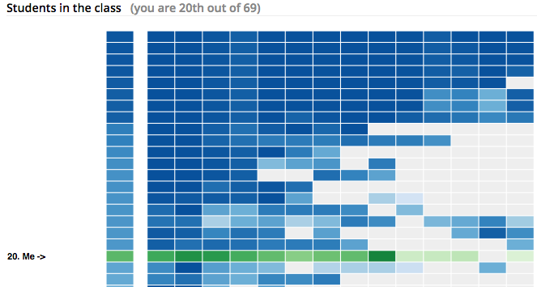

When you click on Lower third, Middle third or Higher third, the progress visualization below will be automatically updated to reflect the average progress of the students in that selected group. Students are divided into three equal groups based on their rank
If you want to compare your progress with lower/middle/higher third group of the students in the class, you need to click “Lower third”/ “Middle third” / “Higher Progress”. The system will remember your choice next time you accessed it.
Progress Visualization
First row (Me) shows your progress (Darker green means more progress on that topic)
Second row(Me vs group) compares your progress with the average progress of the students in selected group (Darker green means you have more progress than the group; darker blue means they have more progress than you; grey means equal progress.
Third row (Group) shows the average progress of students in the selected group (Darker blue means more progress on that topic)
Click the button above to load the list of other students (anonymized) and shows in which position you are in terms of progress

Slide 2
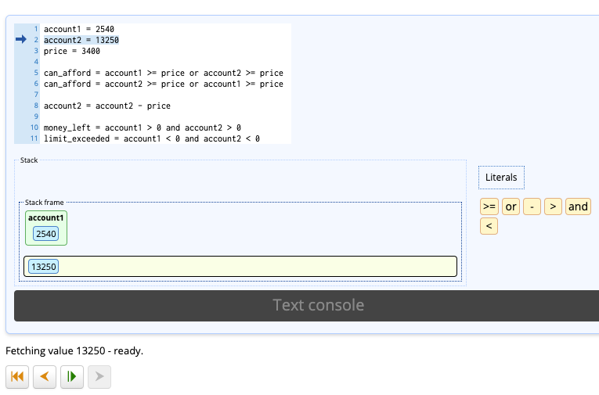
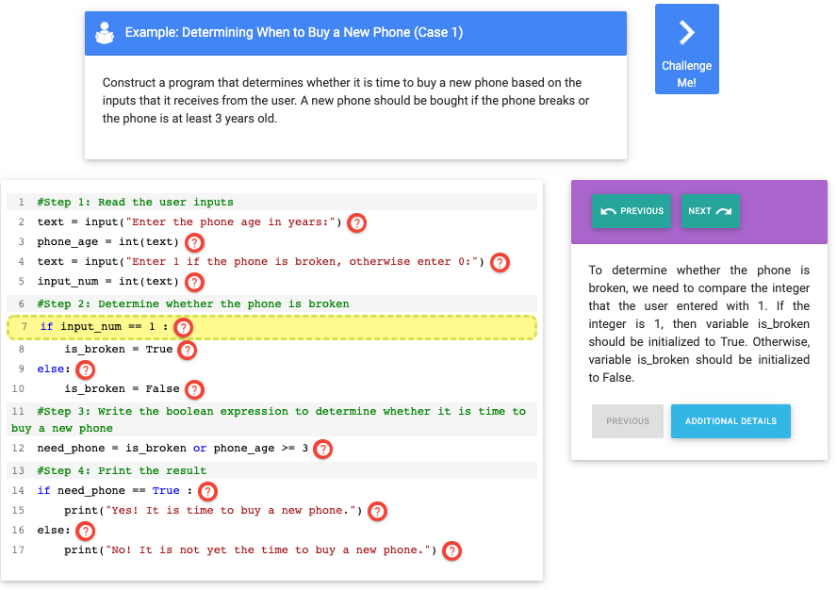
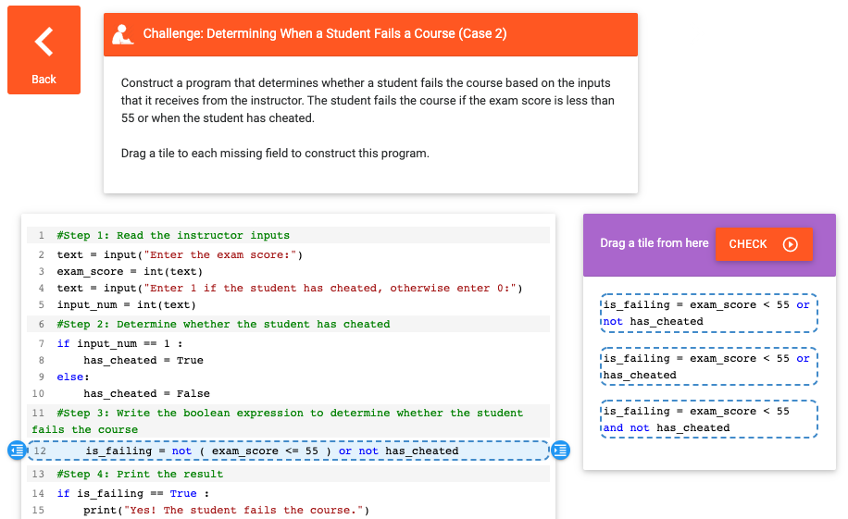
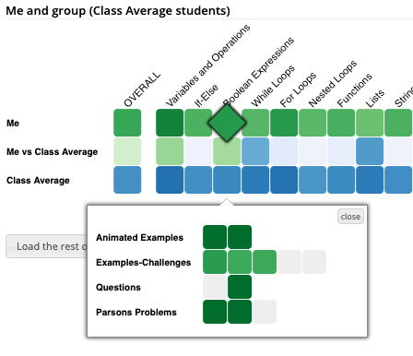
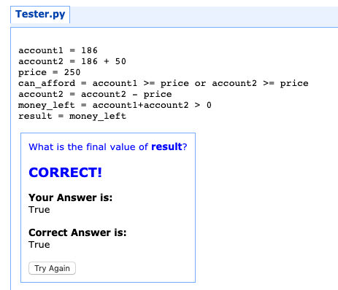
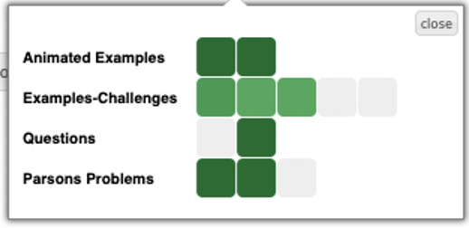
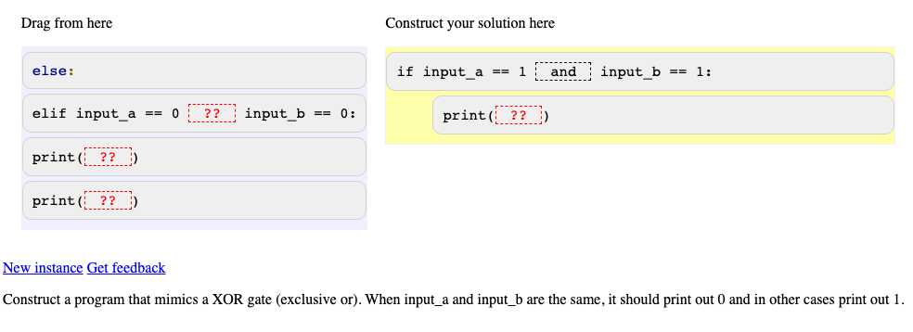

How to Increase your Progress?
To have more greener cells on Me row, you need to interact with the learning activities inside each topic.
Click on a topic cell as shown below and access the contents. Viewing animation steps, clicking on example lines or solving challenges, questions and parsons problems to increase your progress.
Animated Examples
Play animation steps to how the program executed
Examples-Challenges
Check how a program is constructed line by line in examples and challenge yourself with challenges and complete the missing lines.
Tracing Problems
Predict the output of the program. It is either the console output or the value of result variable.
Parsons Problem
Reorder the program lines to solve the given task at the bottom of the screen. Pay attention to indentation.

