Slide 1
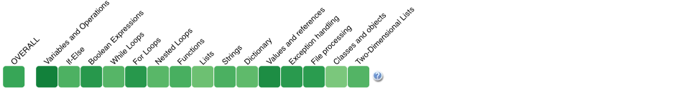

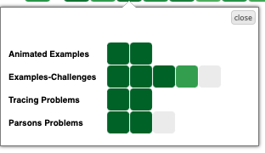
Progress Visualization
Me row shows your progress (Darker green means more progress on that topic)
How to Increase your Progress?
To have more greener cells on Me row, you need to interact with the learning activities inside each topic.
Click on a topic cell as shown below and access the contents. Viewing animation steps, clicking on example lines or solving challenges, questions and parsons problems to increase your progress.
(Check next page)

Slide 2
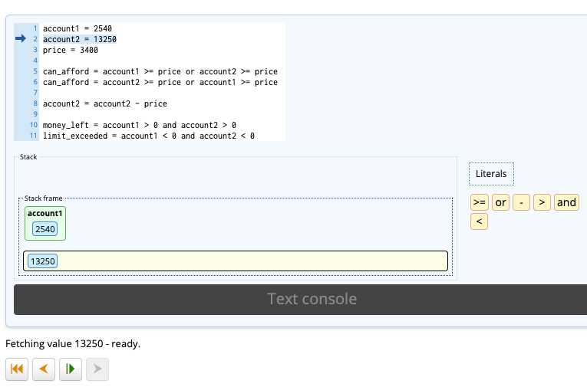
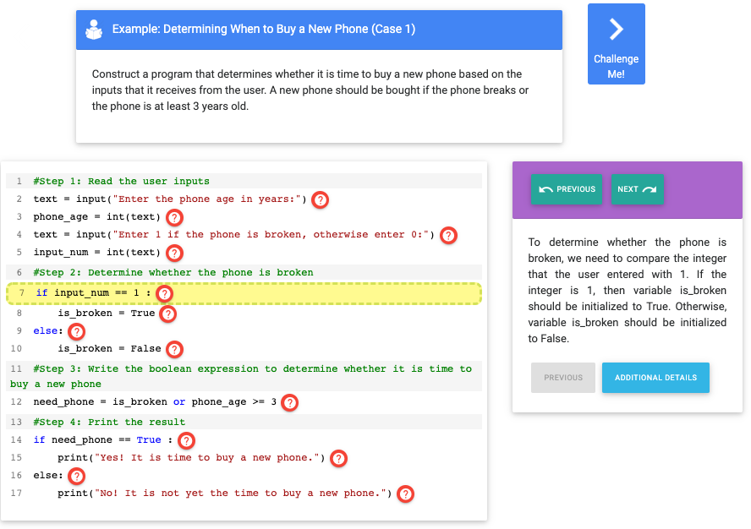
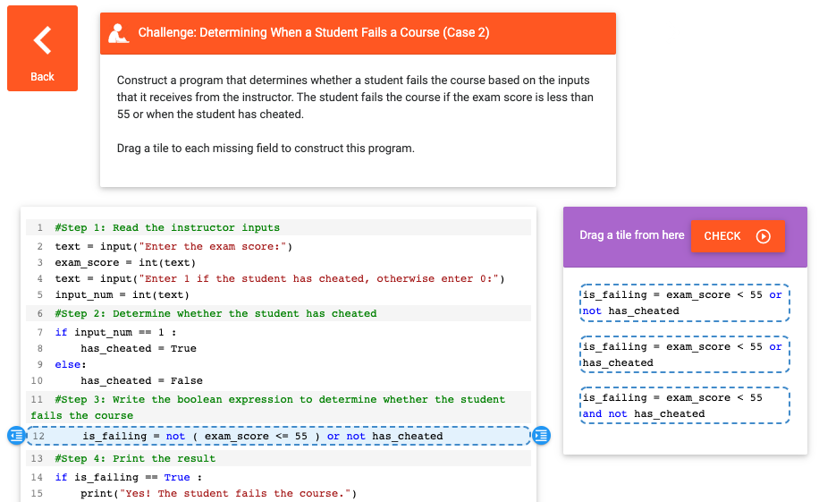
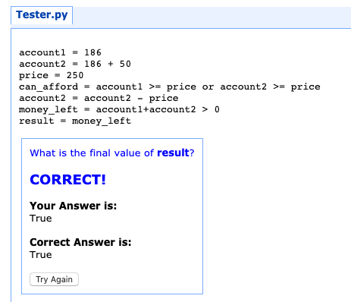
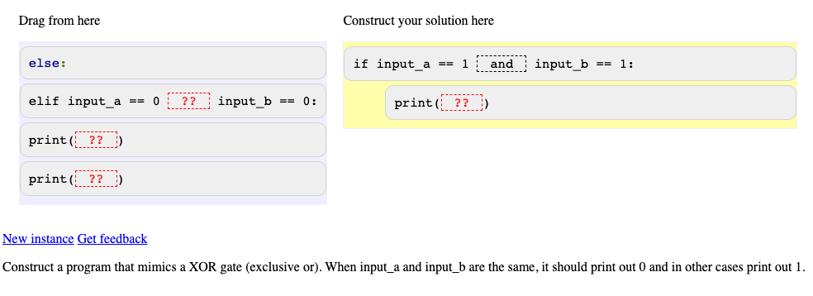
Examples-Challenges
Check how a program is constructed line by line in examples and challenge yourself with challenges and complete the missing lines.
Animated Examples
Play animation steps to how the program executed
Tracing Problems
Predict the output of the program. It is either the console output or the value of result variable.
Parsons Problem
Reorder the program lines to solve the given task at the bottom of the screen. Pay attention to indentation.

