Slide 1
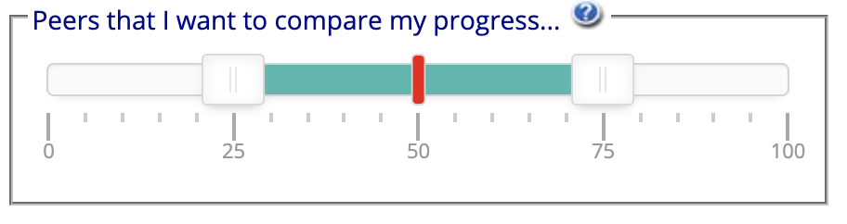
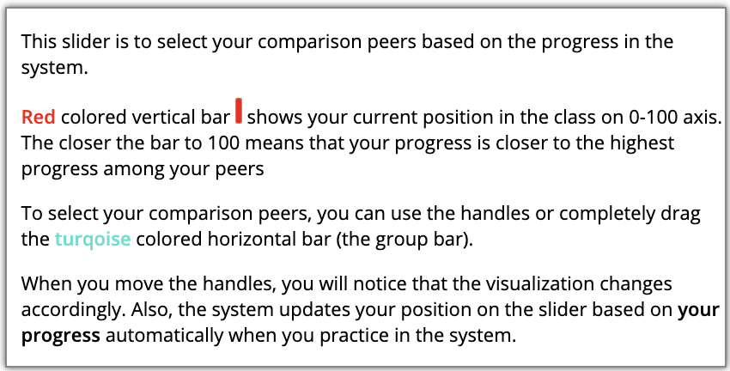
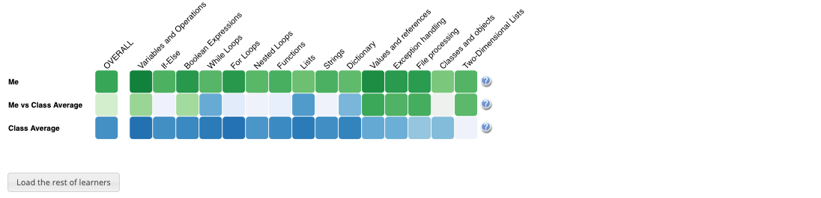
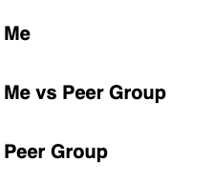


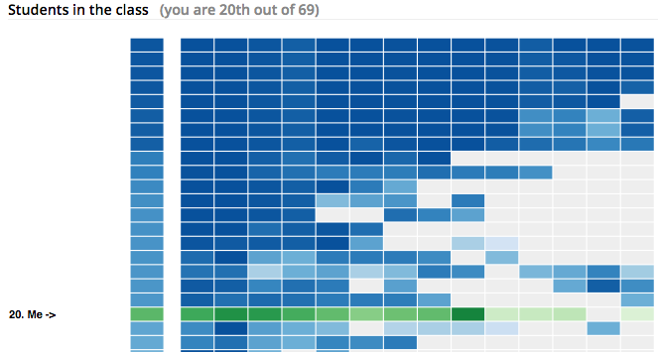

Based on your and your peers’ progress in the system, the system will update your position in the slider automatically. Also, the average progress of the Peer group will be reflected as shown below based on your comparison peers.
Progress Visualization
First row (Me) shows your progress (Darker green means more progress on that topic)
Second row(Me vs group) compares your progress with the average progress of the selected peers (Darker green means you have more progress than the Dynamic group; darker blue means they have more progress than you; grey means equal progress.
Third row (Group) shows the average progress of the selected peers (Darker blue means more progress on that topic)
Click the button above to load the list of other students (anonymized) and shows in which position you are in terms of progress

Slide 2
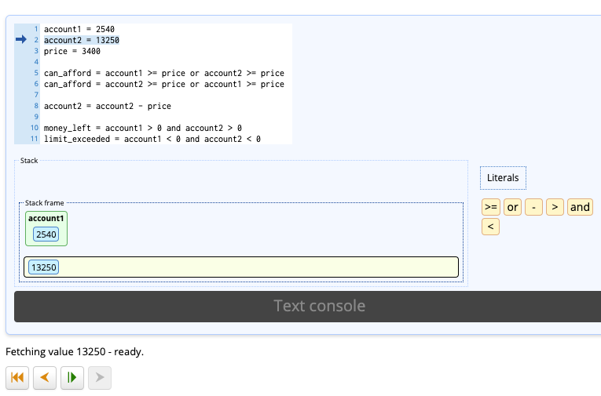
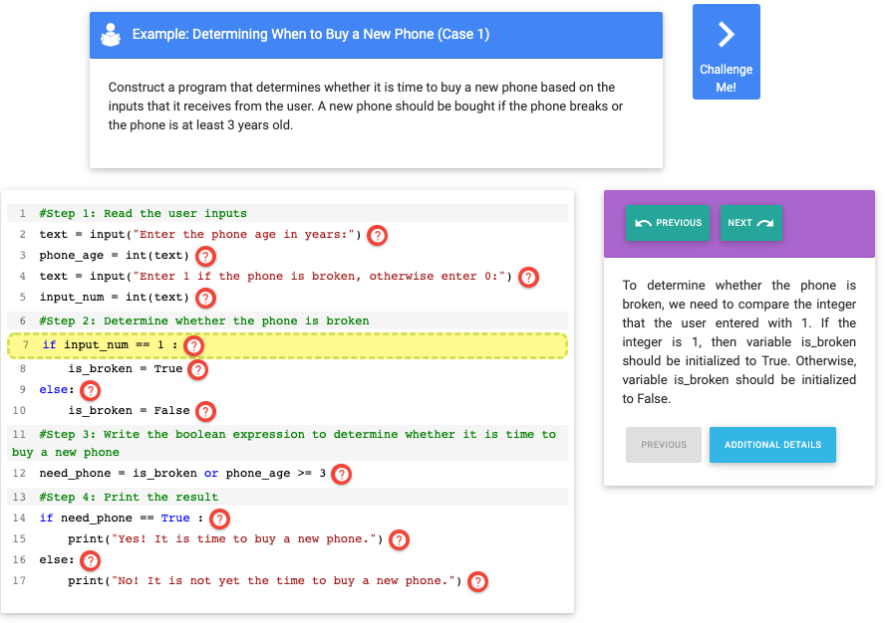
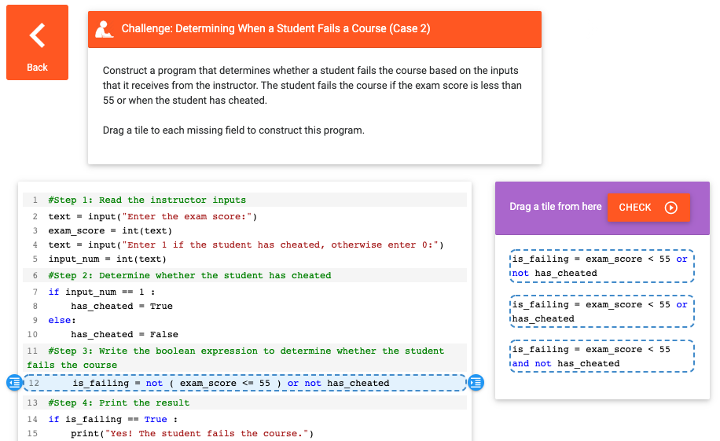
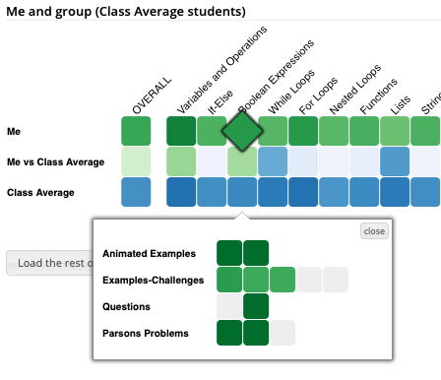
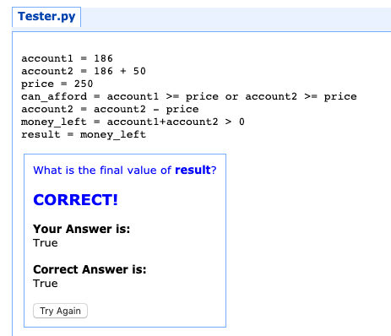
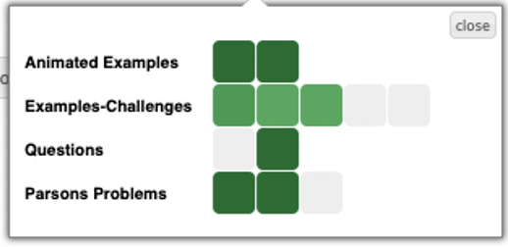
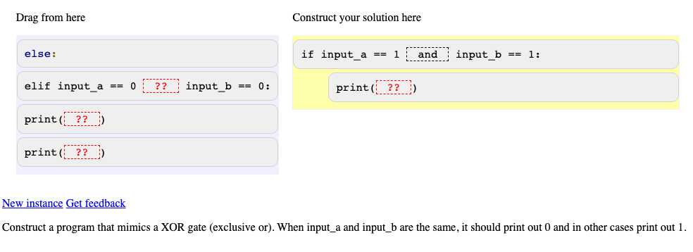

How to Increase your Progress?
To have more greener cells on Me row, you need to interact with the learning activities inside each topic.
Click on a topic cell as shown below and access the contents. Viewing animation steps, clicking on example lines or solving challenges, questions and Parsons problems to increase your progress.
Animated Examples
Play animation steps to how the program executed
Examples-Challenges
Check how a program is constructed line by line in examples and challenge yourself with challenges and complete the missing lines.
Tracing Problems
Predict the output of the program. It is either the console output or the value of result variable.
Parsons Problem
Reorder the program lines to solve the given task at the bottom of the screen. Pay attention to indentation.

