Slide 1
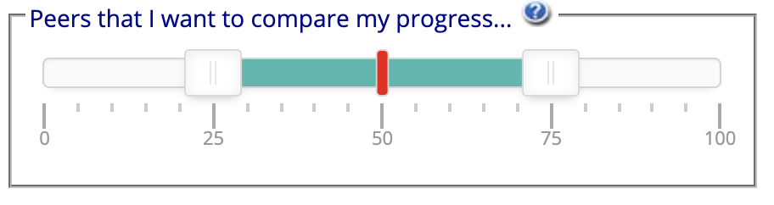
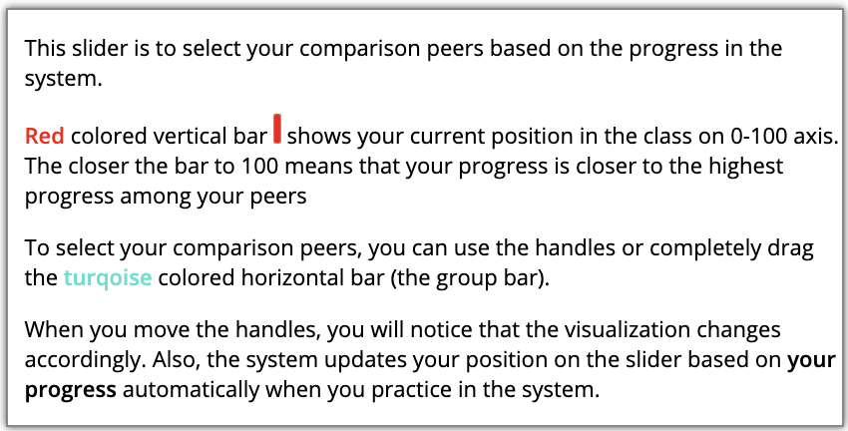
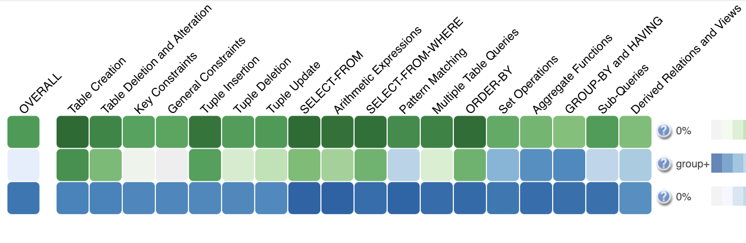
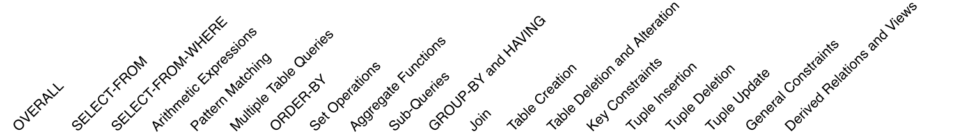
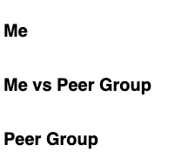


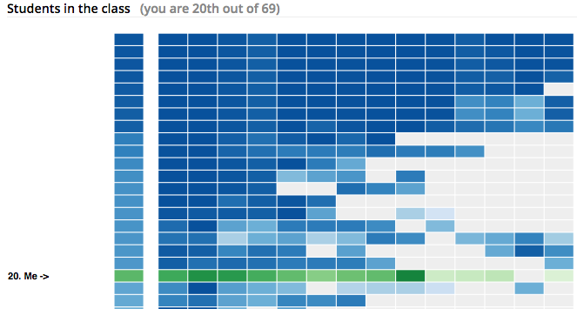
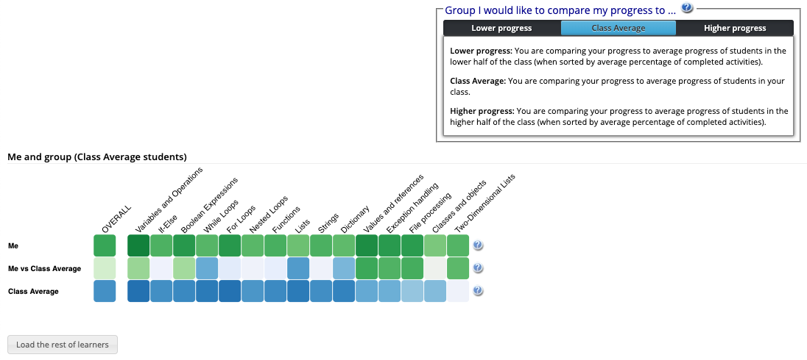

Based on your and your peers’ progress in the system, the system will update your position in the slider automatically. Also, the average progress of the Peer group will be reflected as shown below based on your comparison peers.
Progress Visualization
First row (Me) shows your progress (Darker green means more progress on that topic)
Second row(Me vs group) compares your progress with the average progress of the selected peers (Darker green means you have more progress than the Dynamic group; darker blue means they have more progress than you; grey means equal progress.
Third row (Group) shows the average progress of the selected peers (Darker blue means more progress on that topic)
Click the button above to load the list of other students (anonymized) and shows in which position you are in terms of progress

Slide 2
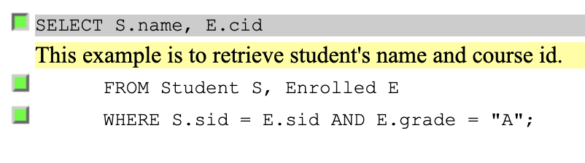
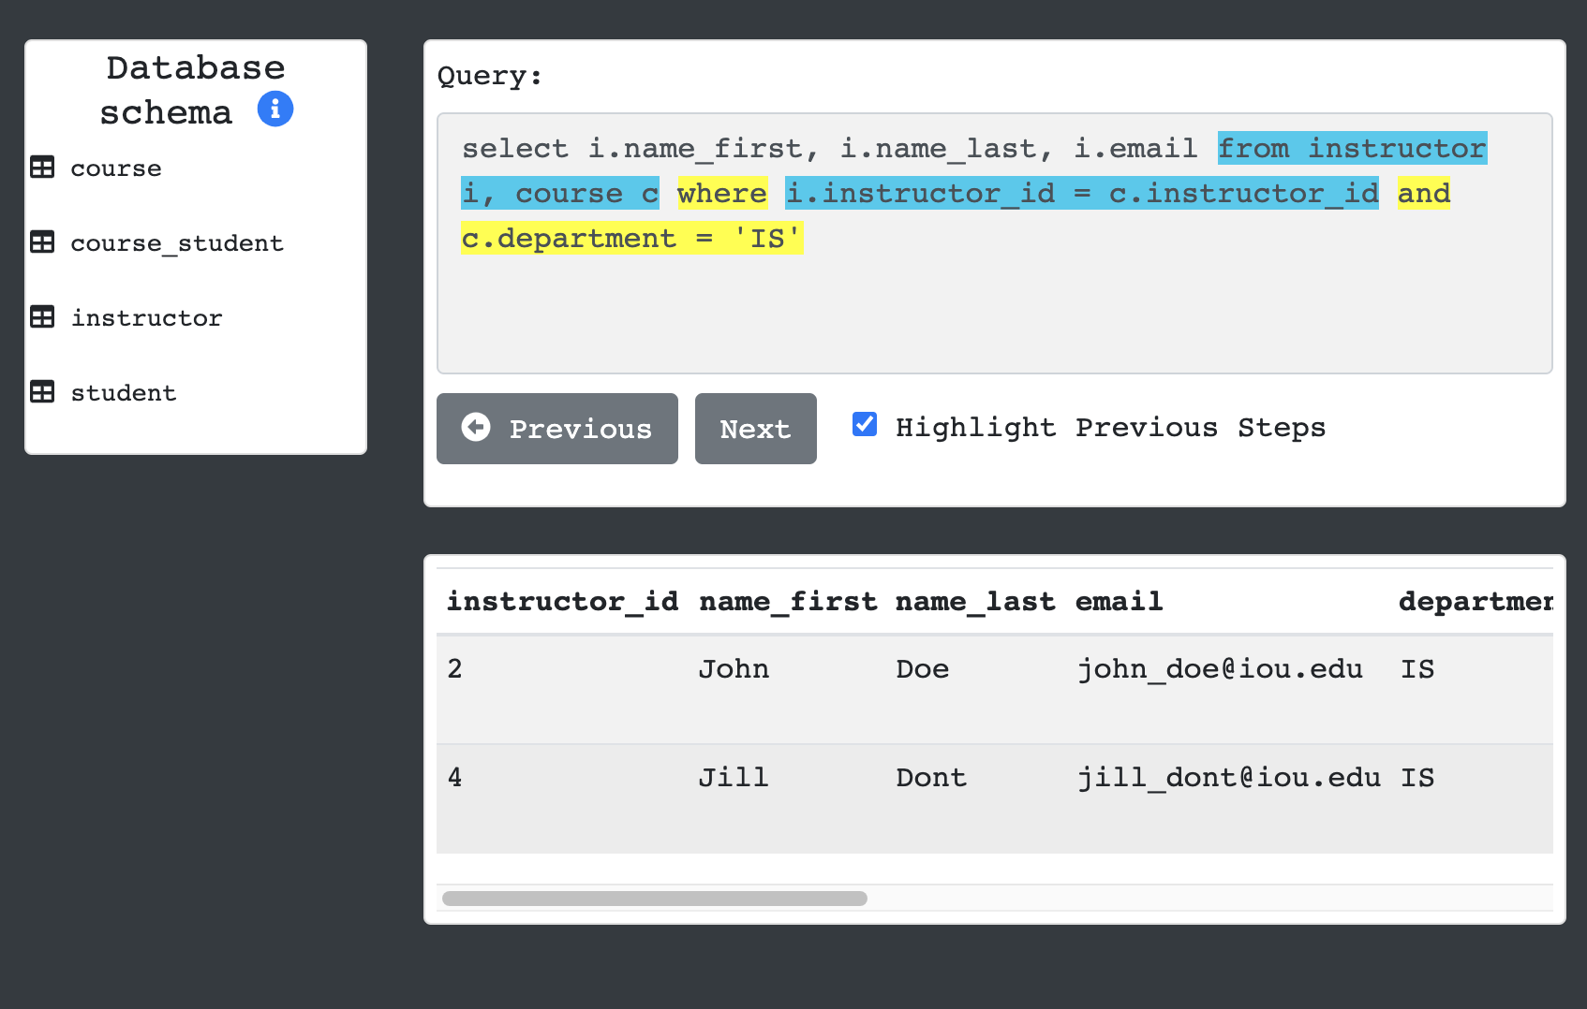
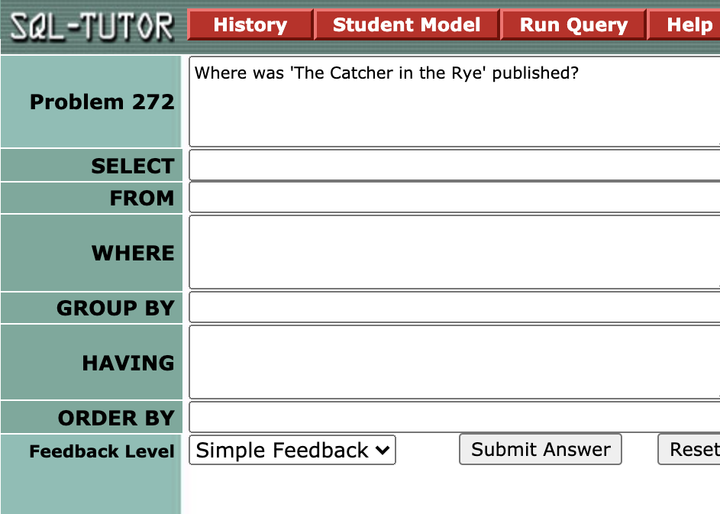
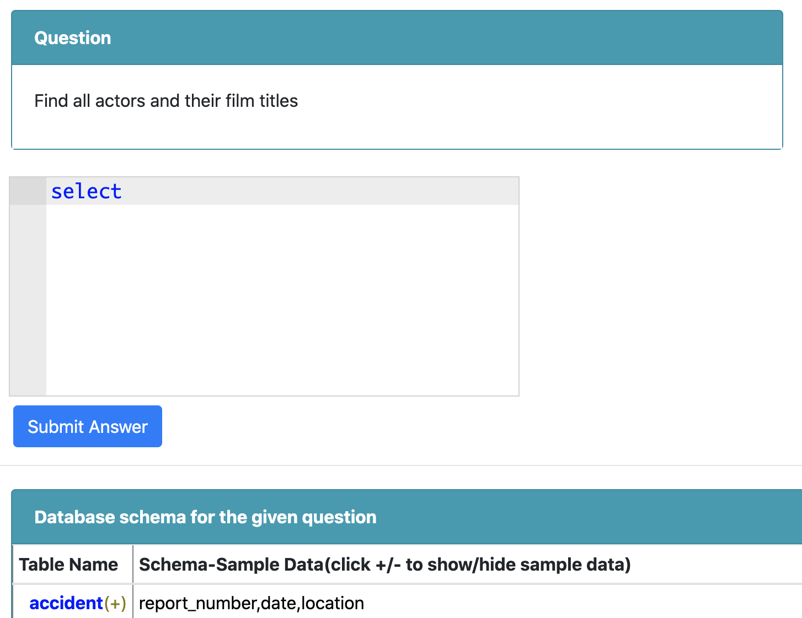
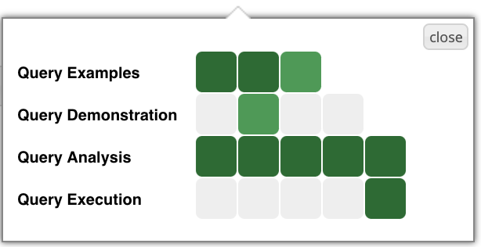
How to Increase your Progress?
To have more greener cells on Me row, you need to interact with the learning activities inside each topic.
Click on a topic cell as shown below and access the contents. Viewing query example lines, viewing query demonstrations, or solving problems will increase increase your progress (darker green colors)
Query Examples
View line by line annotations of SQL statements
Query Demonstration
Check how an SQL statement is being executed. You can view intermediate results tables by clicking to Next, Previous buttons. You can also view which parts of the statement is being executed.
Query Analysis
You can write SQL statements to solve a given problem statement.
Query Execution
Similar to Query Analysis content, here you can solve more problems by writing SQL statements more freely.

