Slide 1
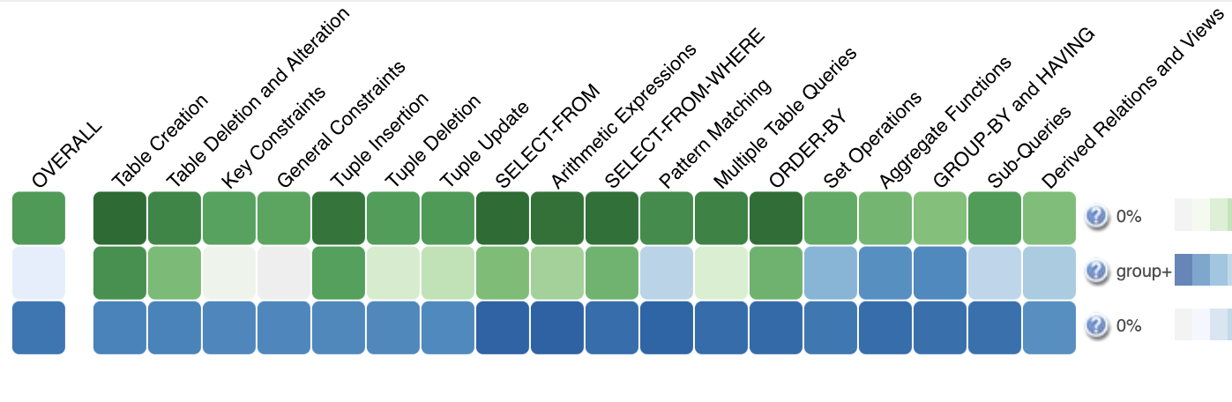
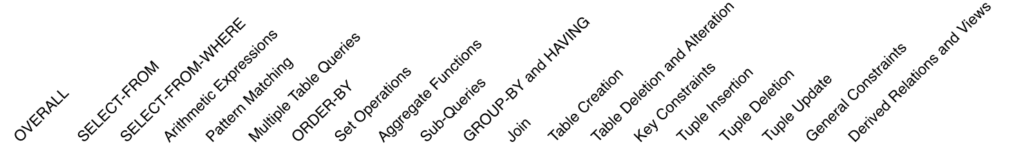
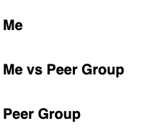


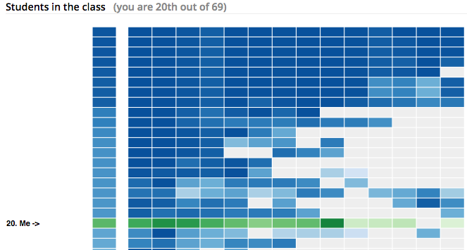

The system lets you practice with multiple learning content and track your progress in the system.
The system also has features to compare your in-system progress with your peers in the class.
Progress Visualization
First row (Me) shows your progress (Darker green means more progress on that topic)
Second row(Me vs group) compares your progress with the average progress of the selected peers (Darker green means you have more progress than the Dynamic group; darker blue means they have more progress than you; grey means equal progress.
Third row (Group) shows the average progress of the selected peers (Darker blue means more progress on that topic)
Click the button above to load your peers and see your current ranking among them based on your progress in the system.

Slide 2
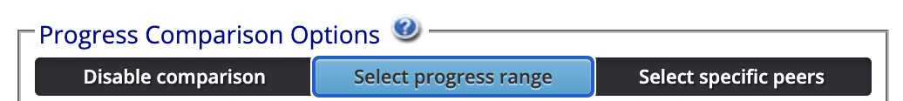
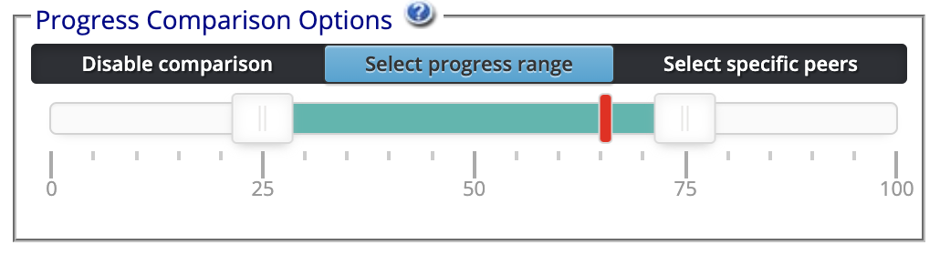
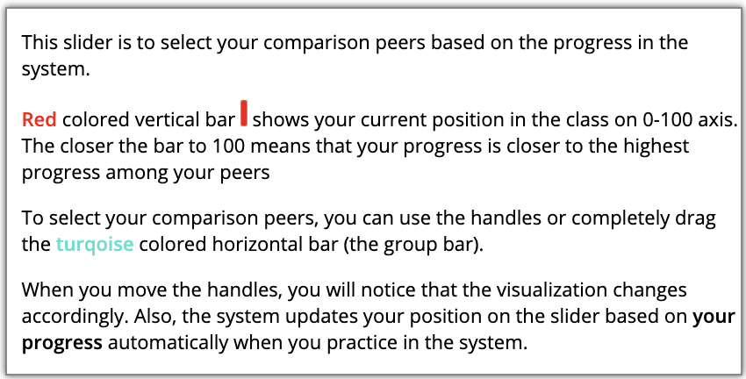
There are 3 progress comparison options
By clicking on ‘Disable comparison’ option you can disable all progress comparison features. You only see ‘Me’ row in the Grid view (‘Me vs Peer Group’ and ‘Peer Group’ rows will be hidden)
You can select your peers based on a specific progress range. (See below for details)
You can select your peers by their full names. (See next slide for details)
Based on your and your peers’ progress in the system, the system will update your position in the slider automatically. Also, the average progress of the Peer group will be reflected as shown below based on your comparison peers.

Slide 3
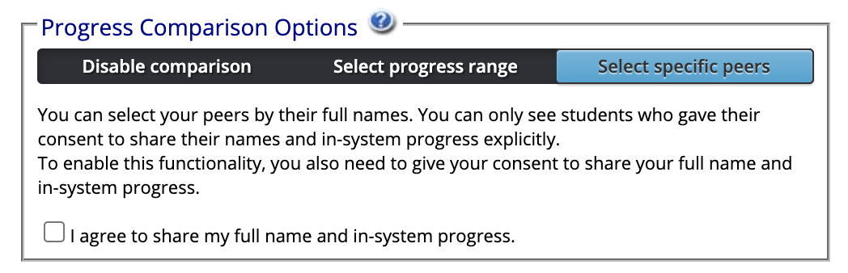
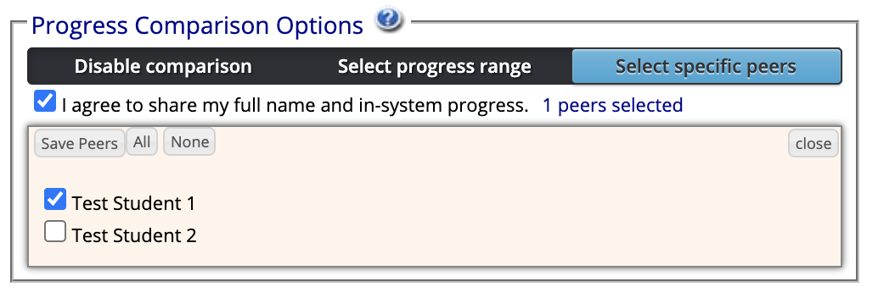
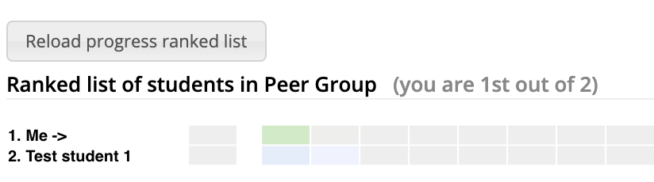
To select specific peers, first you need to provide your consent to share your full name and progress with others.
After providing your consent, you will see other students who provided their consent. You can select your specific peers among these students. When you click ‘Save Peers’, the visualizations will be updated and will reflect your current selection of peers.
With this option, you can see the progress ranking with your peers’ full names.

Slide 4
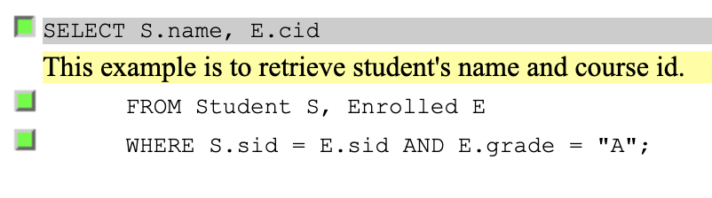
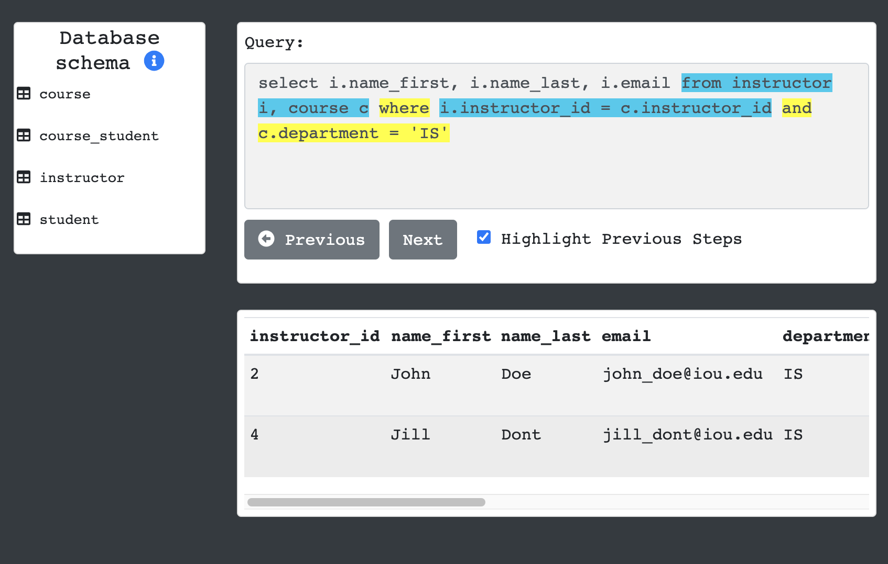
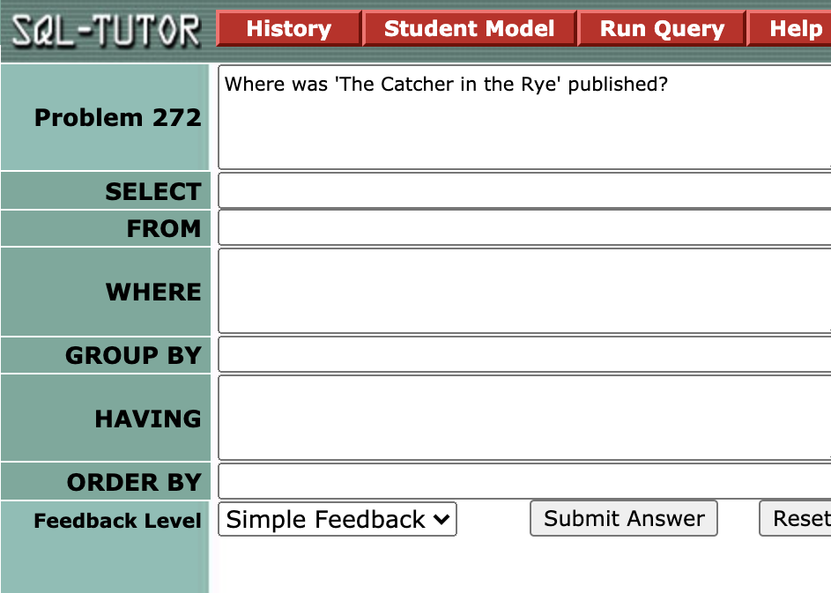
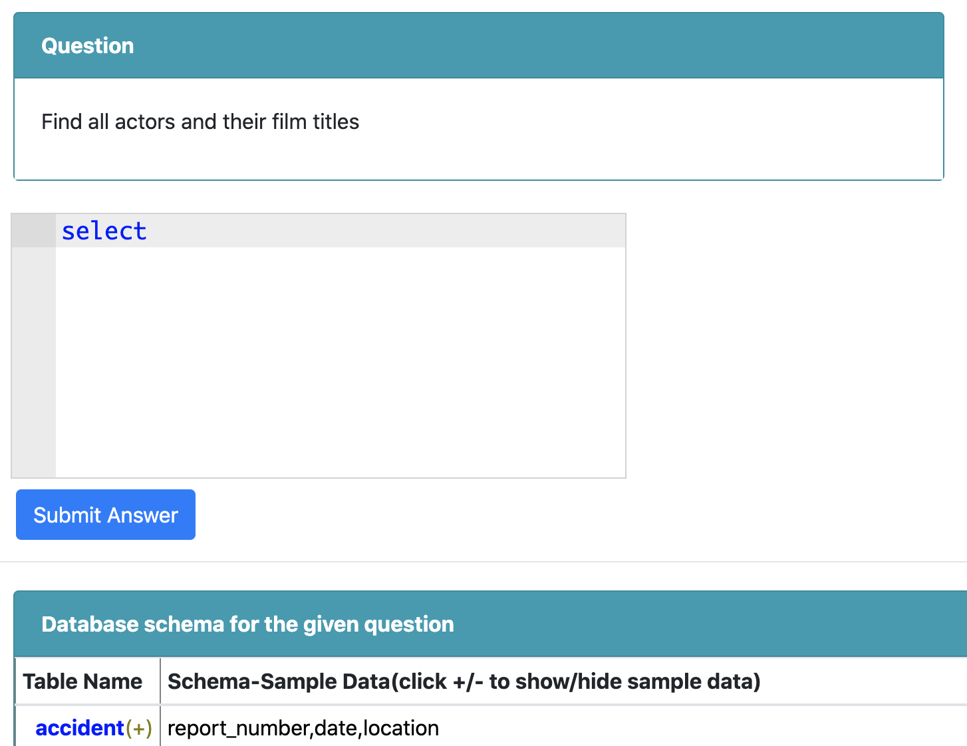
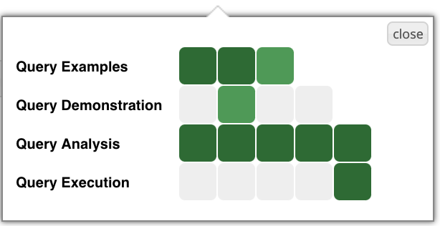
How to Increase your Progress?
To have more greener cells on Me row, you need to interact with the learning activities inside each topic.
Click on a topic cell as shown below and access the contents. Viewing query example lines, viewing query demonstrations, or solving problems will increase increase your progress (darker green colors)
Query Examples
View line by line annotations of SQL statements
Query Demonstration
Check how an SQL statement is being executed. You can view intermediate results tables by clicking to Next, Previous buttons. You can also view which parts of the statement is being executed.
Query Analysis
You can write SQL statements to solve a given problem statement.
Query Execution
Similar to Query Analysis content, here you can solve more problems by writing SQL statements more freely.

