Slide 1

Logic Apps Enterprise Integration
Notes:
This deck is a template for What The Hack lectures.
It is recommended that Coaches deliver mini-lectures ahead of each Challenge that set context for the challenge and introduce & explain any key technologies.
At a minimum, it is handy to have a slide with the key goals of each challenge to display on the screen when running the hack in-person.

Slide 2

Logic Apps Enterprise Integration
Welcome & Intros
<Coach Name>
<Coach Name>
<Coach Title>
<Coach Title>
<Coach Name>
<Coach Name>
<Coach Title>
<Coach Title>
Notes:
Coaches/Presenters for THIS hack/lecture event should be listed on this slide.
Original contributors to the hack content & these slides include:
Please list original contributors to this hack here in the speaker notes and give them credit when delivering this content.
<Original Author 1>
<Original Author 2>
…
<Original Author N>

Slide 3



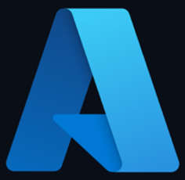




Azure Integration Services
Microservice and API orchestration with Logic Apps
Serverless compute execution with Functions
Create, access control, usage analysis, and management of APIs thanks to API Management
Extract, Load, Transform data with Data Factory
Enterprise messaging with Service Bus
Event Grid for raising and delivering events

Slide 4
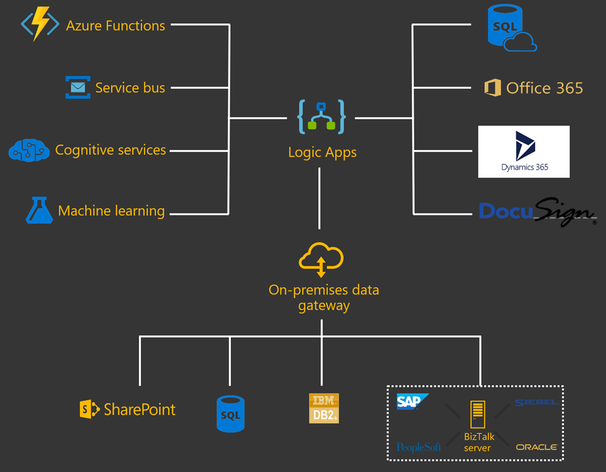
Logic Apps
Serverless engine to build automated workflows to integrate apps and data between cloud services and on-premises systems

Slide 5
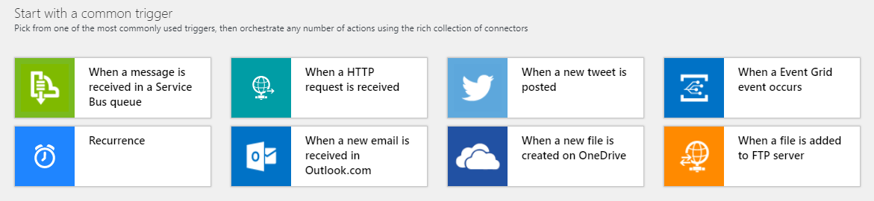
Built in triggers

Slide 6
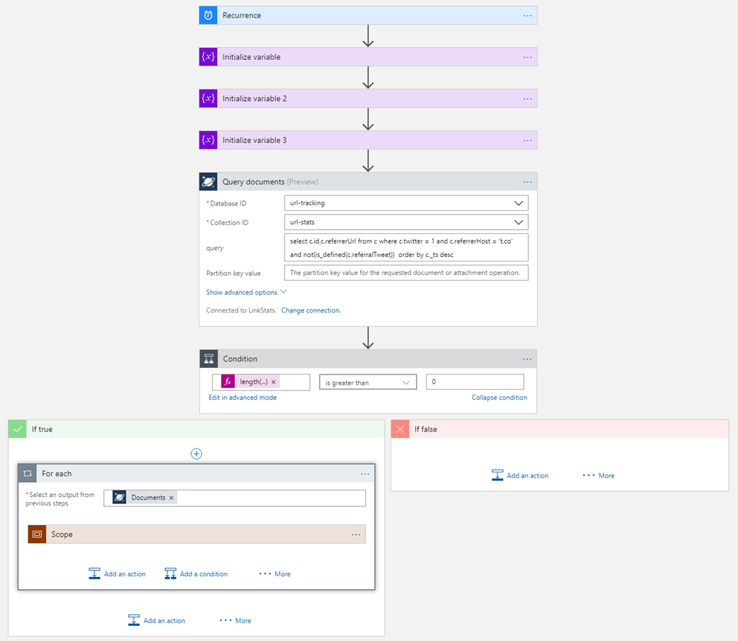
Logic Apps
Graphical "low-code" workflow designer

Slide 7











Easy Hybrid Integration
On-premises Data Gateway
Azure API
Management
Azure Service Bus
On-premises data gateway for rich data and application integration
Azure API Management for SOAP and backend APIs
Service Bus for cross platform support
Logic Apps
Logic Apps
Logic Apps
GatewayCloud Service
APIM
Azure Service Bus relay
Virtual network or public
Topics
Queues
Gateway
Data Sources
LOB
Systems
SOAP web services
Backend
APIs
API-based

Slide 8
Demo

Slide 9

Challenge Zero Get your machines ready & deploy to Azure!
Install the Azure CLI
Install Bicep
Install Visual Studio Code
Install Logic Apps Standard extension
Install Azure Developer CLI
Install Azure Functions Core Tools
Install .NET 6
Notes:
Modify this slide and add the pre-reqs specific to your hack here.
Each challenge slide should list the key goals for the challenge.

Slide 10

Challenge 1 Process JSON input data & write to Storage
Notes:
For each “mini-lecture”, have a topic title and/or sub-topic title.
Each mini-lecture should be no longer than 5-10 minutes in length.
Only deliver one lecture ahead of each challenge.
Do not attempt to present all of the lectures before students start hacking.

Slide 11
Challenge 2 Write to SQL
Notes:
For each “mini-lecture”, have a topic title and/or sub-topic title.
Each mini-lecture should be no longer than 5-10 minutes in length.
Only deliver one lecture ahead of each challenge.
Do not attempt to present all of the lectures before students start hacking.

Slide 12
Challenge 3 Modularize & integrate with Service Bus
Notes:
For each “mini-lecture”, have a topic title and/or sub-topic title.
Each mini-lecture should be no longer than 5-10 minutes in length.
Only deliver one lecture ahead of each challenge.
Do not attempt to present all of the lectures before students start hacking.

Slide 13
Challenge 4 Monitor end-to-end workflow
Notes:
For each “mini-lecture”, have a topic title and/or sub-topic title.
Each mini-lecture should be no longer than 5-10 minutes in length.
Only deliver one lecture ahead of each challenge.
Do not attempt to present all of the lectures before students start hacking.

Slide 14
Challenge 5 Validation & custom response
Notes:
For each “mini-lecture”, have a topic title and/or sub-topic title.
Each mini-lecture should be no longer than 5-10 minutes in length.
Only deliver one lecture ahead of each challenge.
Do not attempt to present all of the lectures before students start hacking.

Slide 15
Challenge 6 Parameterize with app settings
Notes:
For each “mini-lecture”, have a topic title and/or sub-topic title.
Each mini-lecture should be no longer than 5-10 minutes in length.
Only deliver one lecture ahead of each challenge.
Do not attempt to present all of the lectures before students start hacking.

Slide 16
Challenge 7 Authenticate with AzureAD when calling custom API
Notes:
For each “mini-lecture”, have a topic title and/or sub-topic title.
Each mini-lecture should be no longer than 5-10 minutes in length.
Only deliver one lecture ahead of each challenge.
Do not attempt to present all of the lectures before students start hacking.

Slide 17
Challenge 8 Visual Studio Code authoring
Notes:
For each “mini-lecture”, have a topic title and/or sub-topic title.
Each mini-lecture should be no longer than 5-10 minutes in length.
Only deliver one lecture ahead of each challenge.
Do not attempt to present all of the lectures before students start hacking.

Slide 18

Thank You for Attending! https://aka.ms/wth
Notes:
Thank students for attending and share the link to the What The Hack website with them.

