Slide 1
Creating compliant SPARK presentations
As a content creator for SPARK, you have an important role to play in ensuring our content is compliant. Now, more than ever, Microsoft is committed to being accessible, sensitive and respectful to persons around the globe, and ensuring we properly attribute any third-party resources.
As you create your presentations, videos and training assets, please use the following checklist to ensure your content is compliant in the three areas: Accessibility, Global Readiness, and CELA: licensing and privacy.
Accessibility Help Microsoft fulfill our commitment to create products, services, tools, and content to be used by people of all abilities. | Run Office Check Accessibility tool. Correct any flagged issues including: Missing alternate text (alt-text) for all images Reading order not logical Use of color exclusively to communicate or contrast not great enough Font too small Add closed-captions to all video and audio files.
Global Readiness Minimize risk for Microsoft by ensuring products, services, and communications respect and comply with global and local legal and cultural expectations for geography, culture, and language. | Run PoliCheck on all PPT and videos. Address all Sev. 1 and Sev. 2 issues flagged. Fix confirmed Sev 1 issues. Review images for geopolitical risk. Secure images for geography, maps and flags from Global Readiness. Confirm country names.
CELA: licensing and privacy Avoid potential risk exposure by ensuring references to personal and third-party (non-Microsoft) products are approved, licensed, and used correctly. | Ensure any 3rd party IP or content has required permissions. Obtain required permissions to use person’s name, image, etc. Remove all hidden data and personal information from documents. Only use approved fictitious names. Curate all Microsoft logos from Brand Central.

Slide 2
Presenting to support compliance
As a Microsoft presenter, how you deliver your content makes a huge difference in being compliant across our 3 areas: Accessibility, Global Readiness and CELA: licensing and privacy.
As you practice and deliver your presentations, please review the following checklist to help your delivery be more compliant and accessible for your audience.
Accessibility Help Microsoft fulfill our commitment to create products, services, tools, and content to be used by people of all abilities. | Present as if people cannot see your slides. Close your eyes and listen to help you determine what is needed. When demoing, describe what you are doing. Avoid the word “click”. Use “select” instead. Turn on the “real-time captioning” function in PowerPoint. Practice using PowerPoint’s Presentation Coach to get suggestions.
Global Readiness Minimize risk for Microsoft by ensuring products, services, and communications respect and comply with global and local legal and cultural expectations for geography, culture, and language. | Be respectful of all cultures and religions. Profanity is not allowed. Avoid slang and idioms.
CELA: licensing and privacy Avoid potential risk exposure by ensuring references to personal and third-party (non-Microsoft) products are approved, licensed, and used correctly. | Do not use people’s names with out permission. Do not wear non-Microsoft logos (including clothing brands & sports teams).
To learn more about improving the accessibility of your presentations? Please visit aka.ms/PowerPointAccessibilityWebinar.

Slide 3
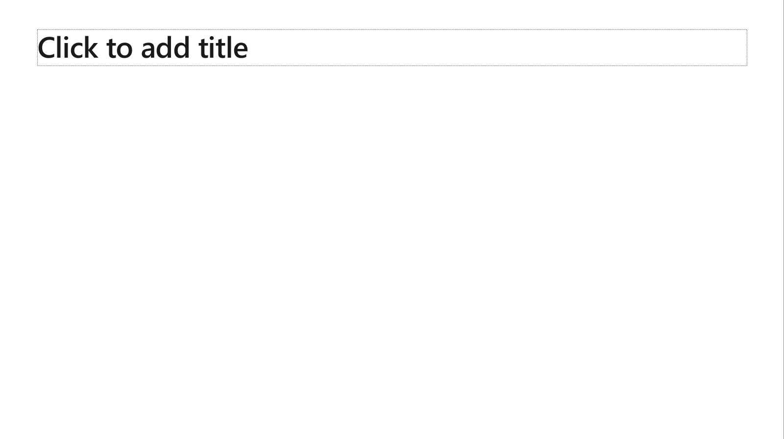
Ensure slide content is accessible
Take the following steps to create accessible content that everyone can consume effectively.
Contrast
Use high contrast colors for maximum readability
The recommended contrast ratio is at least 4.5:1
Shape and color
Use different shapes with a legend to indicate statuses to accommodate for color blindness
Example:
Alt text
Alt text helps people with screen readers understand the content of slides
You should create alternative text for shapes, pictures, charts, tables, SmartArt graphics, or other objects
Here’s how:
Right click on item
Select Edit Alt Text
Enter a Description
If an object is meant to add visual styling and doesn’t contain meaning (e.g. stylistic borders), do not add alt text and instead check Mark as decorative
Slide layouts
Using a built-in slide layout that matches your content ensures a hierarchical reading order of text blocks
Example:
If a new slide will have a title, rather than starting with a blank layout and adding a text block for the title, choose one of the built-in layouts with a title placeholder
Reading order
Screen readers describe content on the screen in the order it was created
To ensure your content is read back in the order you prefer, arrange your objects in the Selection Pane appropriately. Objects on the bottom of the selection pane are read first
Here’s how:
Click the Home tab
In the Drawing group, select the Arrange drop-down menu
Click Selection Pane…
Text
Text
Text
Subject 1
Subject 2
Subject 3
Color Contrast Analyzer
Download this tool to determine the legibility of text and the contrast of visual elements
Download
C1
C2
C3
Additional tips
Be sure to run the Accessibility Checker! Go to File click the Check for Issues drop down menu click Check Accessibility
Videos need to be accessible: If your presentation includes a video, ensure it is captioned and audio described (if appropriate)
Visit the Office Accessibility Center to learn more about accessibility in PowerPoint

Slide 4
Brand and accent colors accessibility
Type and background combinations must meet a minimum 4.5:1 contrast ratio to help ensure people of all abilities can access and understand our communications.
Pick colors carefully and avoid relying on color alone to convey information. Always provide text or other graphical cues to guide customers to our message.
Examples demonstrate correct color use for on-screen applications.
Get the Color Contrast Analyzer
Get more information on accessibility
Get the Microsoft color guidelines PDF
Dark Orange
Rich Black
R255 G147 B73 Hex #FF9349
Dark Yellow
Rich Black
R254 G240 B0 Hex #FEF000
Dark Green
Rich Black
R155 G240 B11 Hex #9BF00B
Dark Teal
Rich Black
R48 G229 B208 Hex #30E5D0
Dark Blue
Rich Black
R80 G230 B255 Hex #50E6FF
Dark Purple
Rich Black
R213 G157 B255 Hex #D59DFF
White
Rich Black
R216 G59 B1
Hex #D83B01
Rich Black
R255 G185 B0
Hex #FFB900
White
R16 G124 B16
Hex #107C10
White
Rich Black
R0 G133 B117
Hex #008575
White
Rich Black
R0 G120 B212
Hex #0078D4
White
Rich Black
R134 G97 B197
Hex #8661C5
Light Orange
White
R107 G41 B41 Hex #6B2929
Light Yellow
White
R106 G75 B22 Hex #6A4B16
Light Green White
R5 G75 B22 Hex #054B16
Light Teal
White
R39 G75 B71 Hex #274B47
Light Blue
White
R36 G58 B94 Hex #243A5E
Light Purple
White
R59 G46 B88 Hex #3B2E58
White
R255 G255 B255
Hex #FFFFFF
Orange
Dark Orange
Dark Yellow
Green
Dark Green
Teal
Dark Teal
Blue
Dark Blue
Purple
Dark Purple
Rich Black
R0 G0 B0
Hex #000000
White
Light Orange
Orange
White
Light Yellow
Yellow
White
Light Green
White
Light Teal
Teal
White
Light Blue
Blue
White
Light Purple
Purple
Extra Light Gray
R242 G242 B242
Hex #F2F2F2
Light Gray
R230 G230 B230
Hex #E6E6E6
Gray
R210 G210 B210
Hex #D2D2D2
Mid Gray
R115 G115 B115
Hex #737373
Dark Gray
R80 G80 B80
Hex #505050
Extra Dark Gray
R47 G47 B47
Hex #2F2F2F

Slide 5
Containers Everywhere in Azure!
Jordan Bean and Matt Ruma

Slide 6

Recording Session is in Progress
If you prefer us not to include you in the recording, please drop off now.

Slide 7
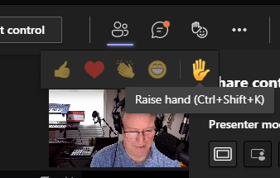

Questions during the session
Ctrl+Shift+K is a quick way to raise or lower your hand
In a regular teams meeting, please use the “Raise Your Hand” feature if you want to ask a question versus posting it in the chat window

Slide 8
Microsoft Confidential

Slide 9


Welcome to
Microsoft SPARK FY22H2!
For the field, by the field
Microsoft SPARK is a virtual learning conference open to all Microsoft internal employees, with a target audience of field individual contributors in Services, Sales and Support. Join us for your choice of 700+ peer led learning sessions across 7 solution areas and 66+ tracks – There is truly something for everyone!
This is an opportunity to exercise a growth mindset, learn with your peers, build connections across time zones, and hear new perspectives and solutions. Content will include delivery management, technical sessions (100-400+ level), diversity and inclusion topics, engineering releases, industry specific sessions, VIP speakers and much more.
For more information on additional sessions, content recordings, and slide decks, visit http://aka.ms/MicrosoftSPARK

Slide 10
Session learning objective
At the end of this session, you should be better able to…
[Learning Objective 1]
This slide is required. Do NOT delete.
Please expand notes window at bottom of slide and read. Then Delete this text box.
Notes:
This slide is required. Do NOT delete. This should the first slide in your presentation after your session opening.
This slide should be part of your session opening and introduce what the learner will be better able to do as a result of attending this session.
You should have no more than 3 learning objectives for your session. Best practice: 1 Learning objective for 60 minute session. Aim for depth vs. breadth.
Good learning objectives should be learner centric, start with a verb (e.g., articulate, demonstrate, deliver, architect, troubleshoot, design) and be S.M.A.R.T (specific, measurable, achievable, realistic, time-bound). The learning objective should define a desired learner behavior (NOT what you are going to present).
The learning objectives on this slide should match those defined and published for your session on the SPARK session submission form.

Slide 11
Text layout (without bullet points)
Main topic: Segoe UI, size 28pt
Segoe UI, size 20pt for second level
Segoe UI, size 16pt for third level

Slide 12
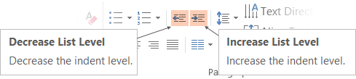
Adjusting list levels
Main topic: Segoe UI, size 28pt
Segoe UI, size 20pt for second level
Segoe UI, size 16pt for third level
Use the “Decrease List Level” and “Increase List Level” tools on the Home menu to change text levels.
Try this:
Place your cursor in the line of text that says “Segoe UI, size 20pt for second level”
Next click the Home tab, and then on the “Decrease List level” tool. Notice how the line moves up one level.
Now try placing your cursor in one of the top “Main topic…” line of text. Click the “Increase List Level” tool and see how the text is pushed in one level.
Use these 2 tools to adjust your text levels as you work

Slide 13
Example with longer headline text wrapping to a second line
When the headline text is 2 lines, move this text block down to align to the lower blue guide
If you don’t see guidelines, click on the View menu, and then check the box in front of “Guides”
Use a “soft return” Shift + Enter to wrap text without adding extra line spacing

Slide 14
Bullet points layout with subtitle Set the subtitle to 20pt in the same text block, with character spacing Normal
Move the text block down vertically to align to lower guide
If you don’t see guidelines, click on the View menu, and then check the box in front of “Guides”
Hyperlink style: www.microsoft.com

Slide 15
Title square photo layout
Smaller text

Slide 16
Square photo layout

Slide 17
Section title

Slide 18
Section title

Slide 19
Section title

Slide 20
Section title

Slide 21
Demo
Speaker name

Slide 22
Thank you to the SPARK team
This event could not happen without the army of volunteers who have dedicated their time over the months leading up to this week. The SPARK program would like to thank the following individuals for their support:
Core Team
Liz Tesch
Communications
Nicholas Orlando
Mark Grimes
Nick Fadziewicz
VIP Speaker Series
Ann Johnson
Operations
Aaron Gutierrez
Scott Kissel
Eunice Chinchilla
Steve Taylor
Misba Saleem
David Roman
Craig Riter
Srinivas Varukala
Fernanda Seika
Tools
•Brian Culver
•Craig Riter
•Arun Kumar
•Brandon India
•Chet Crosby
•Doug McInnis
•Emmanuel Nkanu
•Felicia Ju
•Jowoy Holmon
•Martin Estrada
•Md Ullah
•Mehak Vij
•Michelle Chuang
•Mike Swantek
•Mohammed Quadri
•Nate Chen
•Nicholas Orlando
•Nick Fadziewicz
•Raj Bhat
•Raji Subramanian
•Sam Shah
•Srinivas Varukala
•Sufyaan Kalota
•Suresh Swaminathan
•Tony Feissle
•Zenia Saqib
Liz Tesch
Alex Weinert
Uli Homann
Jason Zander
Panel session -Rob Lefferts, Nichola DiCola, Sue Bohn, Michael Wallent, Sarah Mocke
Track Owners
Speakers
Attendees
Almost 40 Track Owners managing over 400 sessions
More than 800 Speakers
Tens of thousands of Attendees, just like you!

Slide 23
Conference Feedback
Please take an opportunity to complete our survey
Helps get feedback on how to make the Event even better
Provide support for Microsoft SPARK so we can continue providing these types of events
Gives insights into the Microsoft SPARK stakeholders like the Product Group, Customer Experience teams, and others

Slide 24
Thank You

