Slide 1



GitHub Copilot for Data Professionals
A supply-chain data workflow: from raw signals to trusted decisions
Jordan Bean
Principal Cloud & AI Apps Solution Engineer
Notes:
Open by setting context: this deck follows one end-to-end data workflow and shows exactly where Copilot helps without replacing domain accountability.

Slide 2
Why Copilot for data teams
Repeated code work
Context switching
Quality pressure
Copilot fit
Schema checks, joins, validation rules, Spark transforms, SQL variants, and notebook cleanup consume significant engineering time.
Data engineers move between Python, PySpark, SQL, and platform-specific patterns in the same feature or incident.
Faster iteration is valuable only when tests, data contracts, and governance checks remain intact.
Draft faster, refine with constraints, and validate with guardrails.
Copilot is most useful for accelerating the middle of data work: drafting, explaining, and refactoring code. Data professionals still own data meaning, reliability, and production readiness.
Notes:
Use this as a framing slide: Copilot supports velocity and consistency, not judgment replacement.

Slide 3
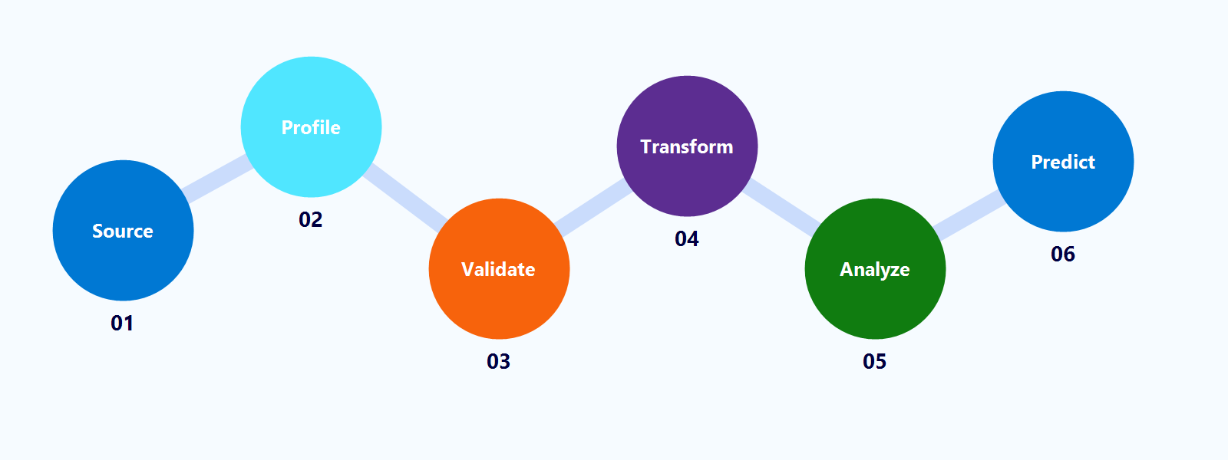
One supply-chain workflow for this demo
Step 1
Generate supply-chain source data
examples/python/00_generate_sample_data.py
Step 2
Profile orders, shipments, and inventory
examples/python/01_ingest_profile.py
Step 3
Create quality checks and quarantine paths
examples/python/02_data_quality_checks.py
Step 4
Transform supplier and inventory signals in Fabric
examples/python/03_fabric_spark_transform.py
Step 5
Analyze late shipments and stockout risk in SQL
examples/sql/04_fabric_sql_analytics.sql
Step 6
Predict late-delivery risk
examples/python/05_feature_engineering_ml.py
Notes:
Tell the audience the rest of the deck follows this exact script order so they can replay it after the session.

Slide 4
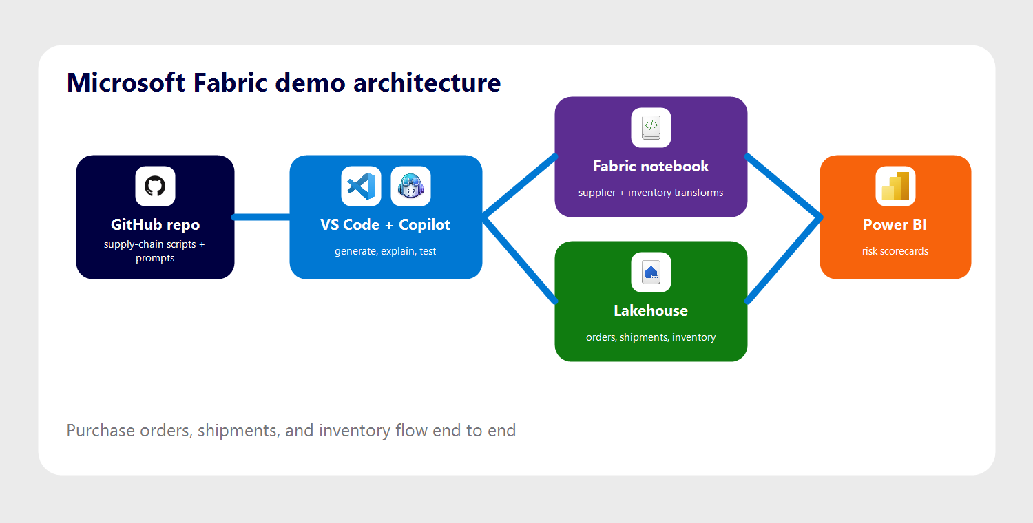
Demo environment: GitHub + Copilot + Microsoft Fabric
One connected workflow: purchase orders + shipments + inventory -> trusted tables -> risk analytics -> prediction.
Notes:
Do not over-rotate on architecture detail. Anchor to the coding surfaces the audience uses every day.

Slide 5
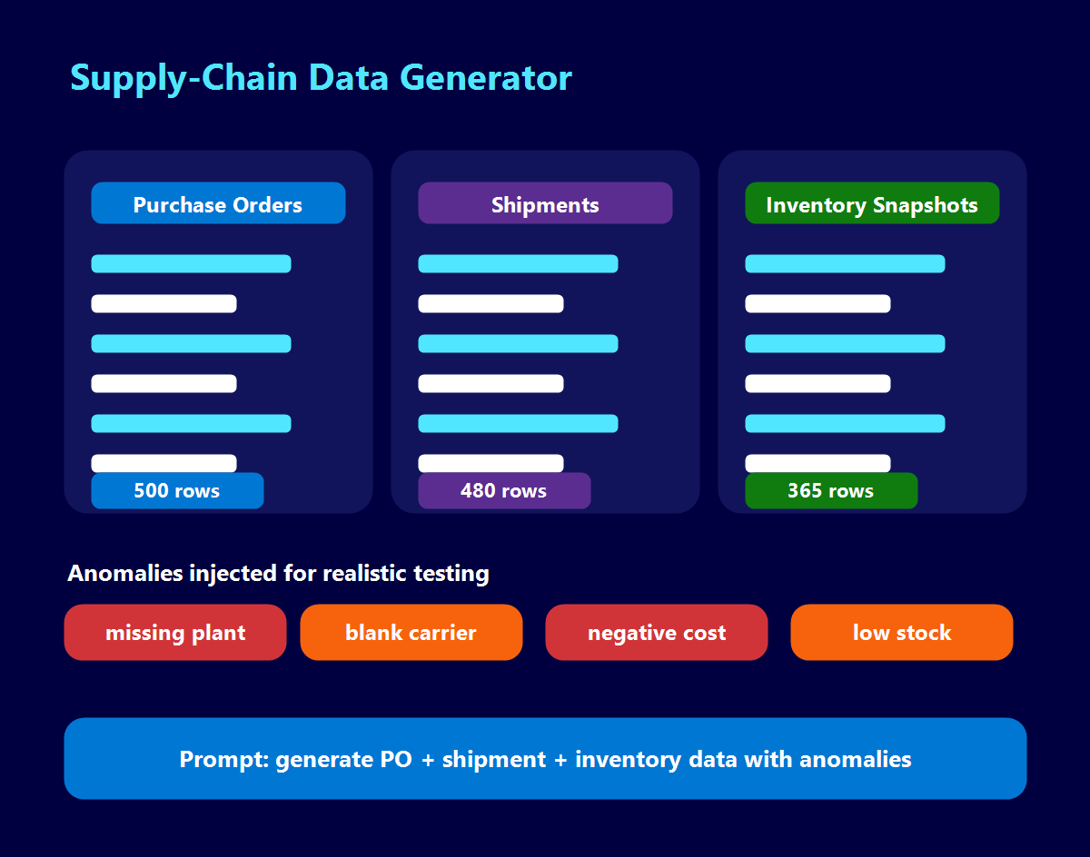
Step 1. Generate supply-chain data quickly
Data task
Create realistic purchase orders, shipments, and inventory snapshots with normal behavior plus controlled anomalies.
How Copilot helps
Draft generator code, then add edge cases such as missing plants, blank carriers, negative costs, and low inventory.
Value to the team
Teams start faster with representative operational data and spend less time hand-crafting fixtures.
Live example: purchase orders + shipments + inventory
Outcome: faster scenario setup and better supply-chain test coverage.
Notes:
Start practical: synthetic data and edge cases are immediate wins for data engineering teams.

Slide 6
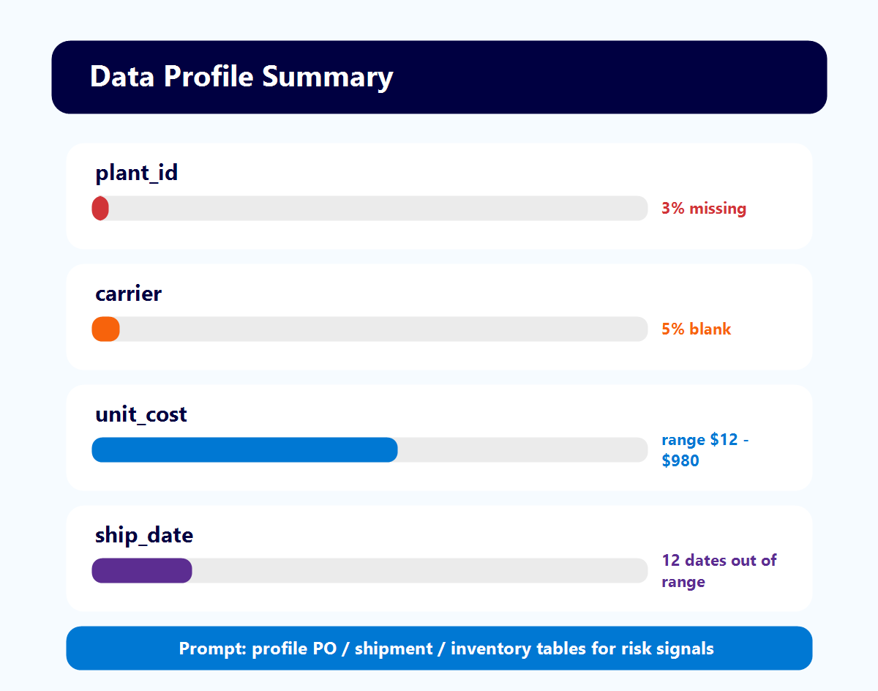
Step 2. Profile operational data and surface risks
Data task
Understand order, shipment, and inventory quality before building downstream transformations.
How Copilot helps
Generate reusable profiling helpers for missing plants, blank carriers, value ranges, and sample records.
Value to the team
Ad-hoc exploration becomes a repeatable profiling step for every supply-chain dataset.
Live example: automated profile summary for operational tables
Outcome: quicker issue discovery before pipeline logic is written.
Notes:
Highlight that interpretation plus code generation is more valuable than generation alone.

Slide 7
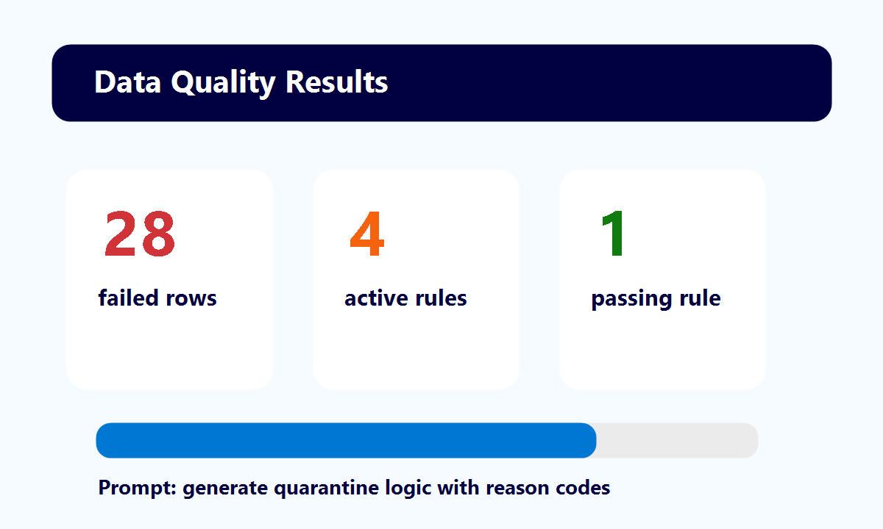
Step 3. Operationalize data quality checks
Data task
Enforce data contracts so bad operational records do not silently flow into analytics and models.
How Copilot helps
Draft validation rules for required fields, positive quantities, plausible dates, and non-negative costs.
Value to the team
Higher reliability with less manual coding effort for recurring quality controls.
Live example: PO, shipment, and inventory quarantine checks
Outcome: better trust in supplier scorecards and inventory risk views.
Notes:
This is the reliability bridge between exploratory notebooks and production pipelines.

Slide 8
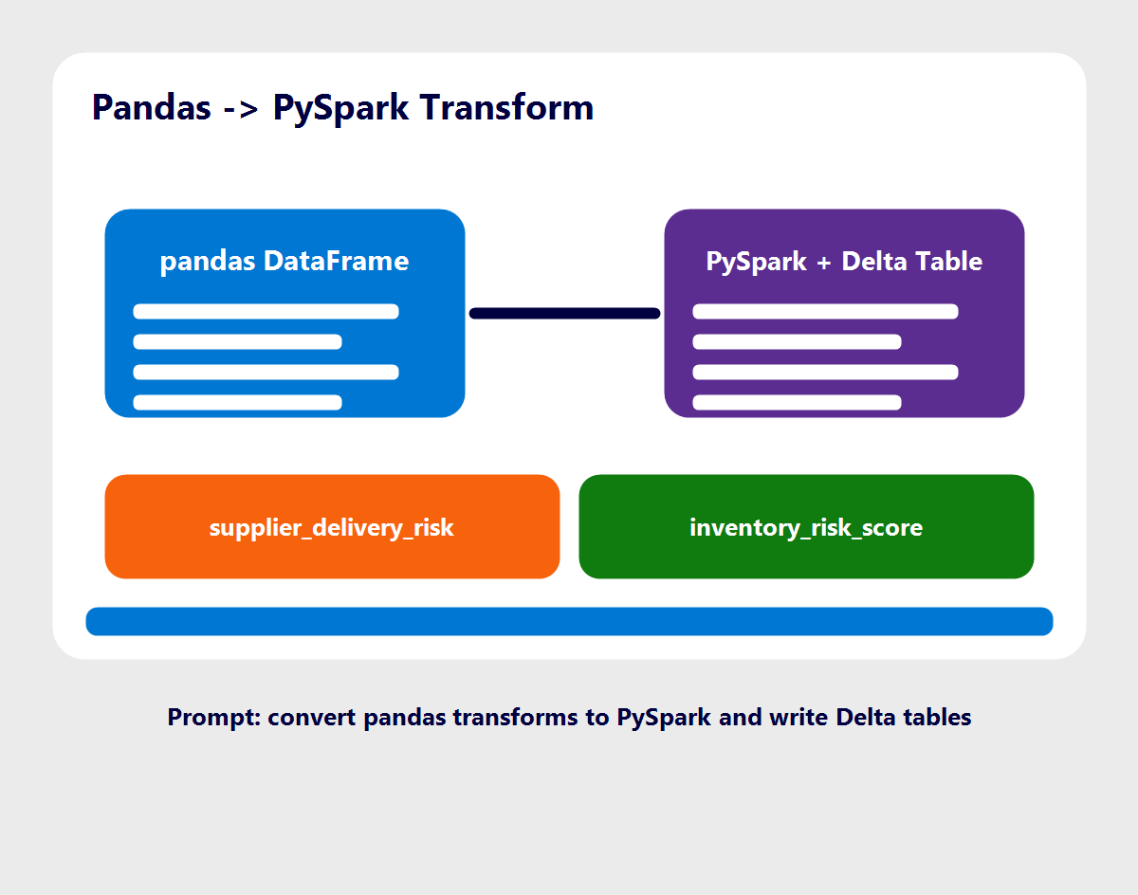
Step 4. Transform supplier and inventory signals
Data task
Move from local dataframe logic to scalable Fabric lakehouse transformations for supplier and stockout risk.
How Copilot helps
Translate pandas scorecards into PySpark and propose Delta table write patterns for reuse.
Value to the team
Faster path from prototype to production-ready processing in Microsoft Fabric.
Live example: supplier delivery + inventory risk transformations
Outcome: reduced rework when scaling local logic.
Notes:
Make the local-to-platform transition explicit, since this is where teams lose time.

Slide 9
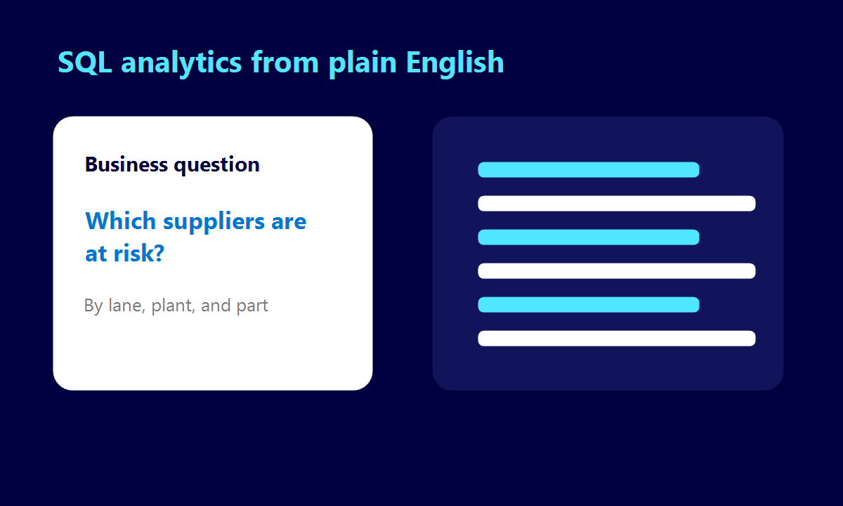
Step 5. Analyze supply-chain risk in SQL
Data task
Turn operational questions into explainable SQL analysis on lakehouse tables.
How Copilot helps
Draft the SQL, then explain assumptions in joins, filters, and window logic.
Value to the team
Analysts identify risky suppliers, lanes, and parts faster while keeping logic transparent.
Live example: late-delivery and stockout risk analysis
Outcome: quicker insight generation with clearer SQL intent.
Notes:
This keeps the story relevant for SQL-heavy teams.

Slide 10
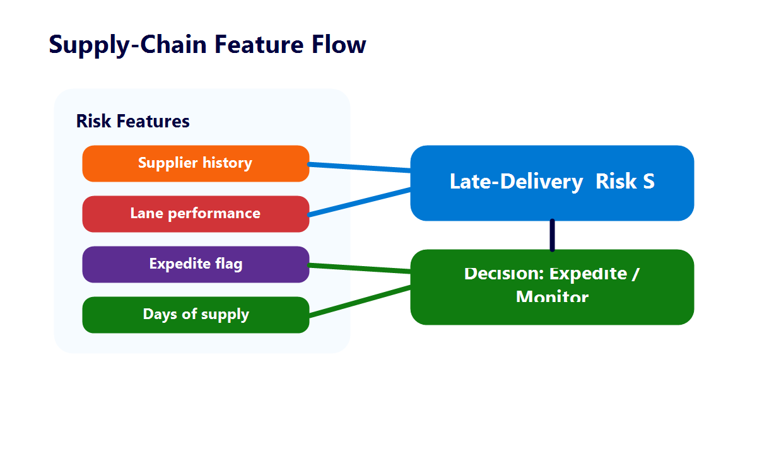
Step 6. Predict late-shipment risk
Data task
Create supply-chain risk features and evaluate a baseline model from orders, shipments, and inventory.
How Copilot helps
Suggest additional features, check leakage risk, and explain likely drivers in plain language.
Value to the team
Data scientists iterate on experiments faster and communicate model behavior more clearly.
Live example: late-shipment feature set and classification baseline
Outcome: shorter experiment cycles and better stakeholder understanding.
Notes:
Close the workflow loop by showing decision-support outputs, not only code snippets.

Slide 11
Prompt framework that works for data teams
1. Context
Dataset shape, schema, platform (Fabric), and business goal.
2. Task
What to produce: code, SQL, tests, explanation, or refactor.
3. Constraints
Performance limits, naming standards, privacy requirements, and accepted libraries.
4. Verification
Ask Copilot to add tests, edge cases, assumptions, and failure handling.
Notes:
Give the audience a reusable prompting recipe they can apply the same day.

Slide 12
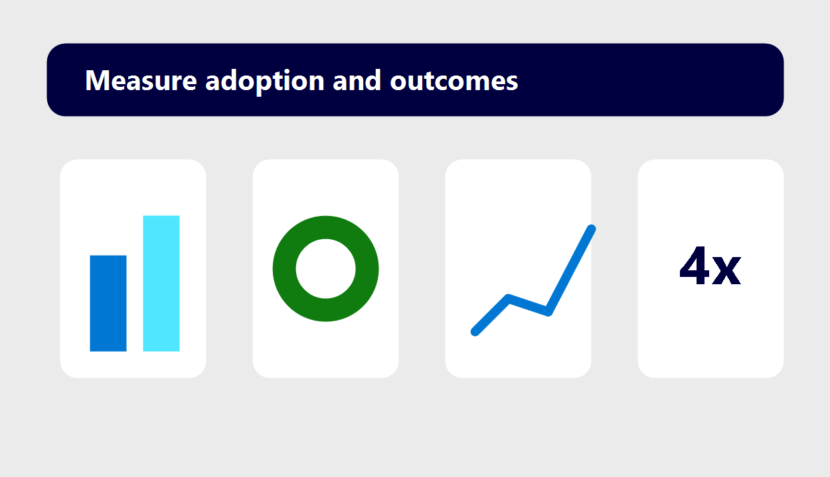
How to measure value
Speed
Time to first working draft for notebook, transform, or SQL query.
Quality
Defect escape rate, test coverage on generated helpers, and review findings.
Reuse
Adoption of shared prompt templates and common utility modules.
Business impact
Faster cycle time from data ingestion to trusted analytics decisions.
Notes:
Pair Copilot usage metrics with delivery metrics to tell a complete impact story.

Slide 13
Questions

