Slide 1


Post-Funding Preparation: A Business Approach to Program Sustainability
Demetria M. McNeal, PhD, MBA, CPLP
Sustainability Strategies Workshop | April 5, 2018

Slide 2
Why are we here?

Slide 3
To adjust our thinking…
toward the business of healthcare
programs and interventions

Slide 4
The Business Model is the foundation of your sustainability plan…

Slide 5
Notes:
how a company creates, delivers, and captures value or how a company makes money!

Slide 6
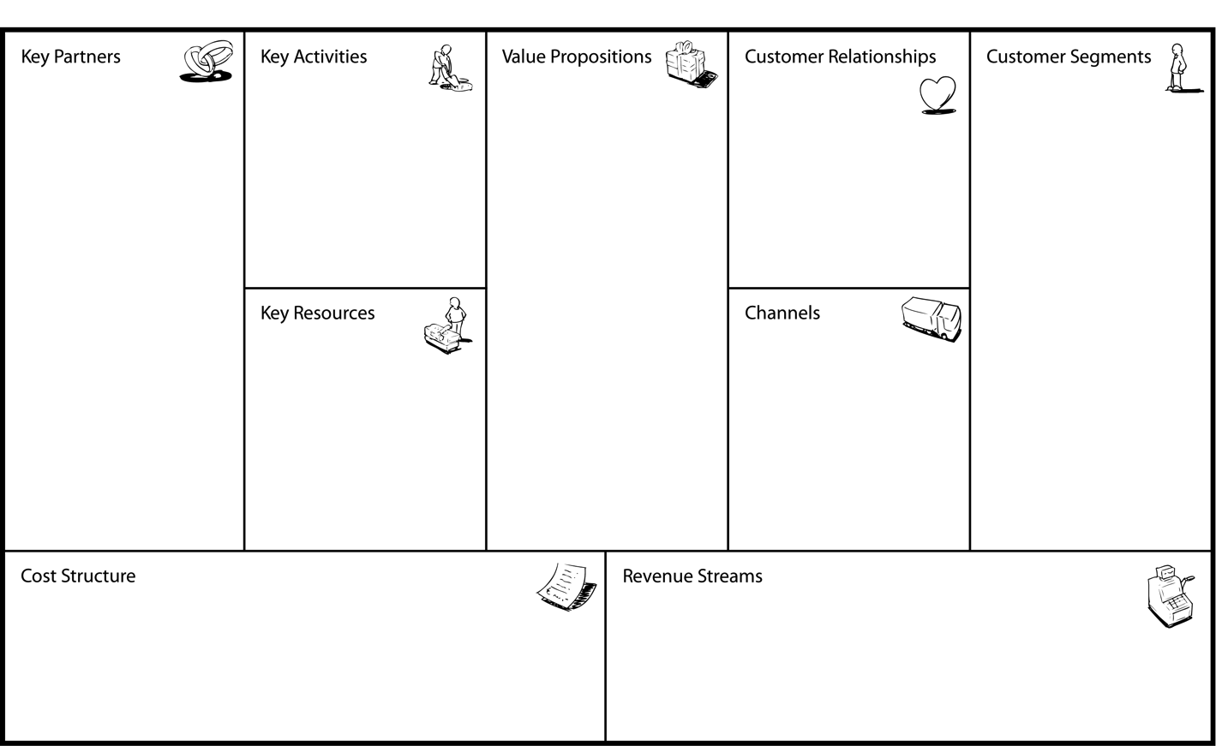
Customer Segments
Who are your most important customers?
What are their archetypes?
What job do they want you to get done for them?

Slide 7
Value Propositions
What customer problems are you helping to solve ?
What customer needs are you satisfying?
Notes:
describes the benefits your customers derive from your products or services.

Slide 8
Channels
Through which channels (sales, distribution, support) do your customers want to be reached?

Slide 9
Customer Relationships
How will you get, keep, and grow customers?

Slide 10
Revenue Streams
How will you make money?
What is revenue model?
What are pricing tactics?

Slide 11
Key Partners
Who are your Key Partners?
Who are your key suppliers?
What are you getting from them…and giving to them?

Slide 12
Key Activities
What Key Activities do you require?
Manufacturing?
Software development?
Personal concierge service? Etc.

Slide 13
Key Resources
What Key Resources do you require?
Financial? Physical? Intellectual property? Human resources?

Slide 14
Cost Structure
What are most important costs inherent in your business model?
What is mix of fixed and variable costs?

Slide 15
The Business Model Canvas Measures Value to the Business (or your organization).

Slide 16
…but for this workshop, we will focus on the customer and the value proposition

Slide 17
What is a Customer?
A person or organization that (potentially) buys and/or uses goods or services from another.

Slide 18
The definition of “customer” is often quite complex…

Slide 19
Who is the “customer”
for a health intervention?

Slide 20
The person receiving the intervention?

Slide 21
The person delivering the intervention?

Slide 22
What about regulators, reimbursement, and/or payers of the intervention?

Slide 23
Most of you have complex customer and stakeholder ecosystems.

Slide 24
What is a Customer Segment?
A group of people that shares a reason to purchase and/or utilize your product or service.

Slide 25
Customer Segments
Who are your most important customers?
What are their archetypes?
What job do they want you to get done for them?
What Value For Whom?

Slide 26
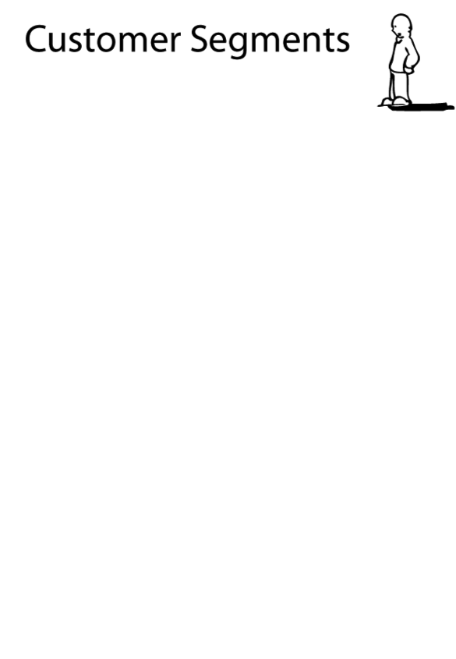
Example of a Customer Segment
Prescribing
physicians at….
Private practice
Clinics
Hospitals

Slide 27
Different Customer Segments often have…
Different Circumstances!
(Problems & Needs)

Slide 28
Inextricably Linked!
One cannot exist without the other

Slide 29
Value Propositions
What customer problems are you helping to solve ?
What customer needs are you satisfying?
What Value For Whom?
Notes:
describe the benefits your customers derive from your products or services.

Slide 30
Value Proposition Defined
It is a clear statement that explains how your product-service solves customers' problems or improves their situation (relevancy) and delivers specific benefits (quantified value).

Slide 31
What the Value Proposition Is…
It succinctly tells the ideal customer why they should buy from you and not from the competition (unique differentiation).

Slide 32
Value Proposition are the Components of the Business Hypothesis: Who, What, Why
For TARGET CUSTOMERS that NEED/DO ___________________
MY PRODUCT-SERVICE provides __________________________
That ENABLES them to do ___________________________________
BETTER than _____________________________________________
Providing the BENEFIT of ____________________________________

Slide 33
Value Proposition Components Defined
A
For TARGET CUSTOMERS that NEED/DO __________________
My PRODUCT-SERVICE provides __________________________
That ENABLES them to ____________________________________
BETTER than ____________________________________________
Providing the BENEFIT of ____________________________________
B
C
D
Customers. Who makes the “purchase” decision?
A
Jobs to be done. My product-service provides X to help my customer do Y.
B
Competitive alternative (X is better than Z)
C
Benefits SELL the technology, service, program, intervention
D
Notes:
Customer are PEOPLE (not buildings)

Slide 34
An Example Value Proposition for a Health Intervention
“To large employers, my smoking cessation program increases quit rate success by XX% more than alternative program A thereby reducing your healthcare costs and employee absenteeism rates [because it is evidence based].”

Slide 35
Group Exercise
In small groups (2-3 persons) identify and discuss the value proposition and customer segment(s) for your health intervention.

Slide 36
Program Sustainability Requires Capacity
Sustainability capacity is the ability to maintain programming and its benefits over time.
Schell, SF, Luke, DA, Schooley, MW, Elliott, MB, Herbers, SH, Mueller, NB, and Bunger, AC. (2013). Public health program capacity for sustainability: A new framework. Implementation Science, 8(15).
Notes:
To improve capacity for sustainability, we encourage strengthening the structures and processes that exist within your program to ensure you can strategically leverage resources to weather the changes and challenges that come your way.

Slide 37
Sustainability Factors That Impact a Program
Environmental support
Funding stability
Partnerships
Organizational capacity
Program evaluation
Program adaptation
Communication (dissemination)
Strategic planning
Notes:
Environmental support - Having a supportive internal/external climate for your program
Funding stability Establishing a consistent financial base for your program
Partnerships - Cultivating connections between your program and its stakeholders
Program eval - Assessing your program to inform planning and document results
Strategic communication with stakeholders and the public about your program
Strategic planning - Using processes that guide your program‘s directions, goals, and strategies

Slide 38
…but for this workshop, we will
focus on organizational capacity and program adaption

Slide 39
Organizational Capacity
Having the internal support and resources needed to effectively manage your program.

Slide 40
Program Adaptation
Taking actions that adapt your program to ensure its ongoing effectiveness.

Slide 41
Group Exercise
In small groups (2-3 persons) identify organizational capacity and program adaptation(s) necessary for program sustainability.
Notes:
Think about what is current org. capacity and what is needed capacity
How do you need to adapt the program?

Slide 42
Summary of Learnings
Align program/intervention model to the value of (all) customers.
Identify sustainability capacity.
Iterate and/or pivot program/intervention.

Slide 43
Thank you! Demetria M. McNeal demetria.mcneal@ucdenver.edu 303-724-8458 (office) 520-250-5606 (cell)

