Slide 1
Sustainability through Collaboration and Community Leadership
Erin Mooney,
Executive Director
Cultivando
April 5, 2018

Slide 2
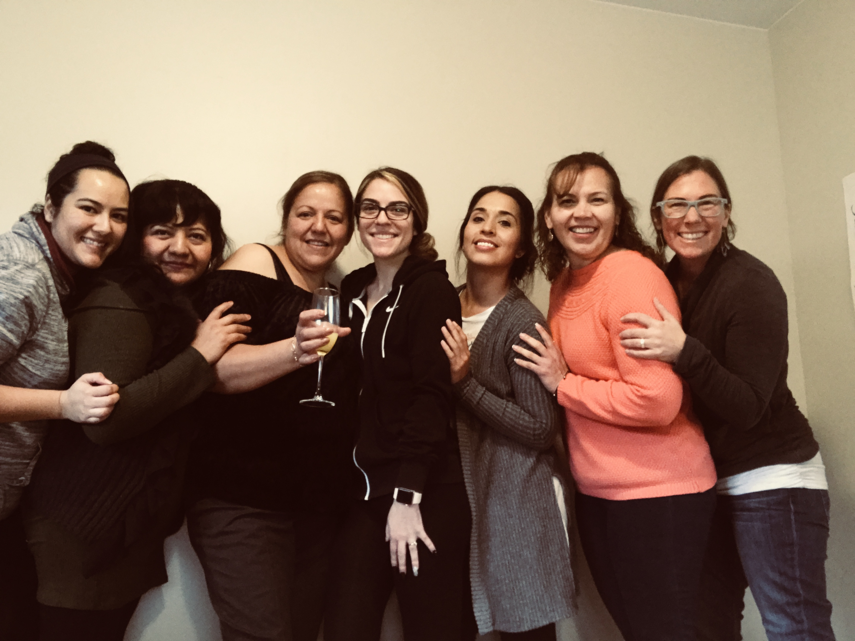
About Cultivando
Nonprofit in Adams County that trains and supports Spanish-speaking community members around leadership and systems change, working in the Promotora Model.
At the same time, we work with local organizations and agencies around equity, inclusion, and authentic community engagement.
Then we connect community members with partners for kind and collaborative project and policy/advocacy opportunities.
Early childhood, HEAL, food systems, racism and equity, housing emotional health, and other community-identified issues.

Slide 3
Cultivando’s Coalition work
Lead: LiveWell Commerce City and LiveWell South Adams County
Lead: Adams County Food Access Collaborative (coalition of food pantries and other partners interested in issues of food insecurity)
Lead: Community Coalition of FFN (Informal Childcare) Providers and community Promotoras
Participants: Many different coalitions and collaborations

Slide 4
Learning objectives
1) Discuss and evaluate collaborative strategies that could support sustainability (shared positions, local/government/contract funding, partner orgs)
2) Consider ways to embed work/leadership/expertise within impacted community for sustainability (and improved outcomes).

Slide 5
Collaborative strategies that support sustainability
Opportunities to share responsibility for work carrying forward
Can another org take on pieces?
Are there opportunities for collaborative grants or contracts?
Are community members and impacted community passionate about the project/service?
Can champions advocate to partners? Have they been?
Is this an opportunity to take inventory and evolve the project? Use data/eval to push forward or to rework strategies and reevaluate program/project
Setting aside ego and organizational interest to focus on community needs
If there isn’t momentum from impacted community, this can be a learning opportunity
Examples of success:
Cultivando’s relationship with the City of Commerce City, sustained funding for HEAL coalition in the City budget
Successes from your sustainability plans?

Slide 6
Community leadership and ownership
Nothing About Us Without Us
Projects and policies are generally most effective and successful when impacted community is deeply involved and ideally lead the work
Equity strategies embedded in community tend to build power and momentum over time
If a coalition invests in community leadership and community power, partners and funders tend to notice
Where has the funding been spent? Investments in community leadership and expertise stay in community and can grow.
Charity model vs Systems Model
Examples?

Slide 7
Deepening community relationships
Be able to willing to talk about root causes like poverty, racism, lack of meaningful access to needed resources for impacted communities.
Hire talented, trusted, and connected community members– value lived experience as expertise and move impacted community into paid leadership positions
Listen with humility to recommendations, concerns, needs, and expertise from community, be ready and willing to make project and org changes
Consider the culture of the coalition– food, language, facilitation style, power dynamics
Reduce barriers to participation: childcare, food, compensations, but most important is authentic listening and sharing (or giving up) power and decision making
Strive for orgs and coalitions to reflect community served
Be hyper aware of budget and how it relates to equity

Slide 8
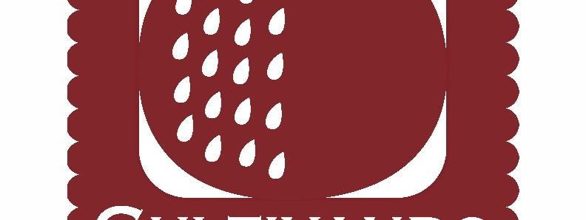
Thank you!
Question s? Follow up?
erin@cultivando.org

