Slide 1
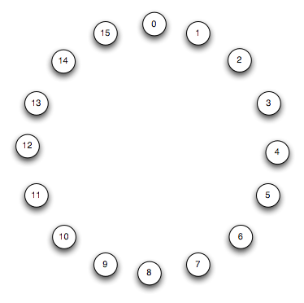
An Example DHT: Chord
Assume n = 2^{m} nodes for a moment
A “complete” Chord ring

Slide 2
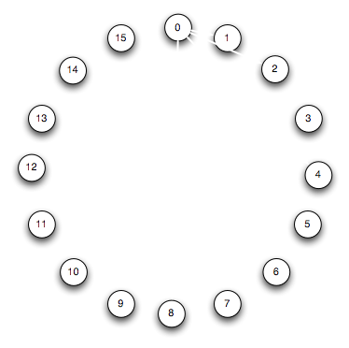
An Example DHT: Chord

Slide 3
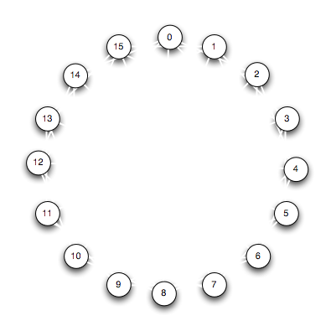
An Example DHT: Chord

Slide 4
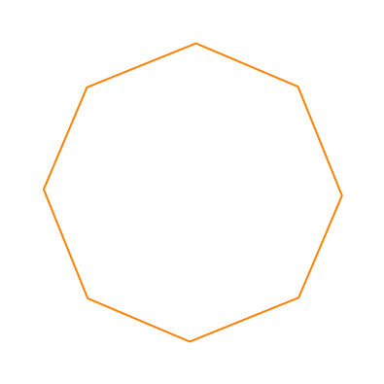
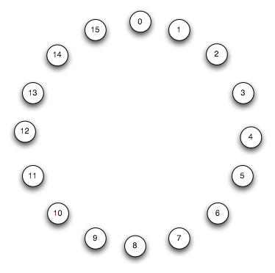
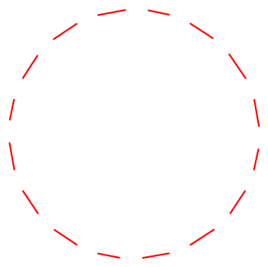
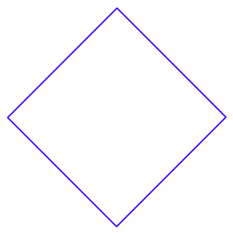
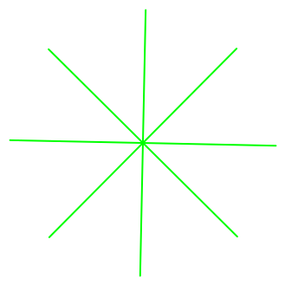
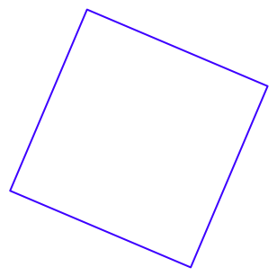
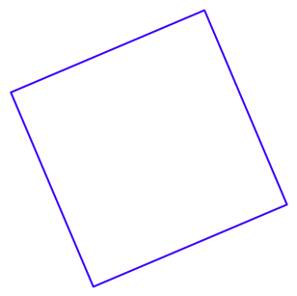
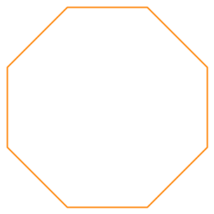
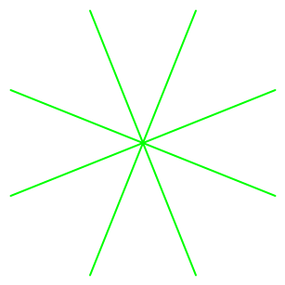

An Example DHT: Chord
Overlayed 2^{k}-Gons

Slide 5
Routing in Chord
At most one of each Gon
E.g. 1-to-0

Slide 6
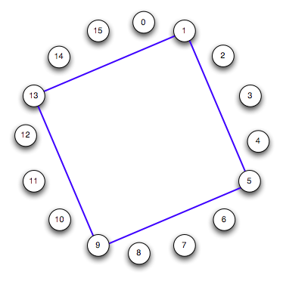

Routing in Chord
At most one of each Gon
E.g. 1-to-0

Slide 7
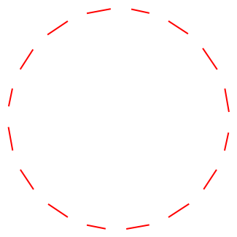

Routing in Chord
At most one of each Gon
E.g. 1-to-0

Slide 8

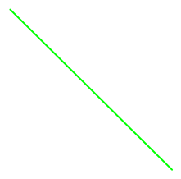
Routing in Chord
At most one of each Gon
E.g. 1-to-0

Slide 9

Routing in Chord
At most one of each Gon
E.g. 1-to-0

Slide 10
Routing in Chord
At most one of each Gon
E.g. 1-to-0
What happened?
We constructed the binary number 15!
Routing from x to y is like computing y - x mod n by summing powers of 2
2
4
8
1
Diameter: log n (1 hop per gon type) Degree: log n (one outlink per gon type)

Slide 11
What is happening here? Algebra!
Underlying group-theoretic structure
Recall a group is a set S and an operator • such that:
S is closed under •
Associativity: (AB)C = A(BC)
There is an identity element I ∈ S s.t. IX = XI = X for all X∈S
There is an inverse X⁻¹∈S for each element X∈S s.t. XX⁻¹ ⁼ X⁻¹X = I
The generators of a group
Elements {g₁, …, g_{n}} s.t. application of the operator on the generators produces all the members of the group.
Canonical example: (Z_{n}, +)
Identity is 0
A set of generators: {1}
A different set of generators: {2, 3}

Slide 12
Cayley Graphs
The Cayley Graph (S, E) of a group:
Vertices corresponding to the underlying set S
Edges corresponding to the actions of the generators
(Complete) Chord is a Cayley graph for (Z_{n},+)
S = Z mod n (n = 2^{k}).
Generators {1, 2, 4, …, 2^{k-1}}
That’s what the gons are all about!
Fact: Most (complete) DHTs are Cayley graphs
And they didn’t even know it!
Follows from parallel InterConnect Networks (ICNs)
Shown to be group-theoretic [Akers/Krishnamurthy ‘89]
Note: the ones that aren’t Cayley Graphs are coset graphs, a related group-theoretic structure

Slide 13
So…?
Two questions:
How did this happen?
Why should you care?

Slide 14
How Hairy met Cayley
What do you want in a structured network?
Uniformity of routing logic
Efficiency/load-balance of routing and maintenance
Generality at different scales
Theorem: All Cayley graphs are vertex symmetric.
I.e. isomorphic under swaps of nodes
So routing from y to x looks just like routing from (y-x) to 0
The routing code at each node is the same! Simple software.
Moreover, under a random workload the routing responsibilities (congestion) at each node are the same!
Cayley graphs tend to have good degree/diameter tradeoffs
Efficient routing with few neighbors to maintain
Many Cayley graphs are hierarchical
Made of smaller Cayley graphs connected by a new generator
E.g. a Chord graph on 2^{m+1} nodes looks like 2 interleaved (half-notch rotated) Chord graphs of 2^{m} nodes with half-notch edges
Again, code is nice and simple

Slide 15
Upshot
Good DHT topologies will be Cayley/Coset graphs
A replay of ICN Design
But DHTs can use funky “wiring” that was infeasible in ICNs
All the group-theoretic analysis becomes suggestive
Clean math describing the topology helps crisply analyze efficiency
E.g. degree/diameter tradeoffs
E.g. shapes of distribution/aggregation trees
Really no excuse to be “sloppy”

Slide 16
Consider Aggregation in Chord
Everybody sends their message to node 0
Assume greedy jumps (increasing Gon-order)
Intercept messages and aggregate along the way

Slide 17
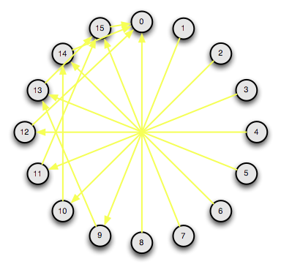
Consider Aggregation in Chord
Everybody sends their message to node 0
Assume greedy jumps (increasing Gon-order)
Intercept messages and aggregate along the way

Slide 18
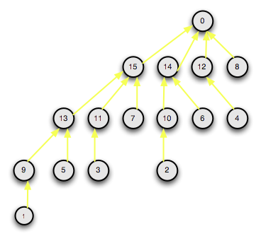
Consider Aggregation in Chord
Everybody sends their message to node 0
Assume greedy jumps (increasing Gon-order)
Intercept messages and aggregate along the way
Binomial Tree!!

Slide 19
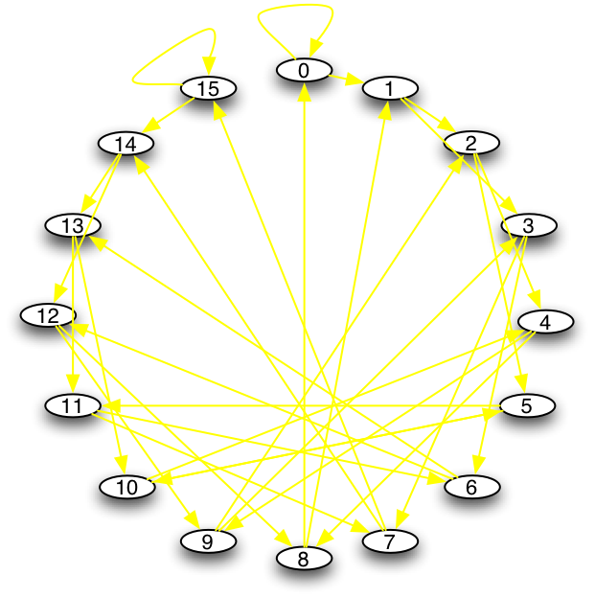
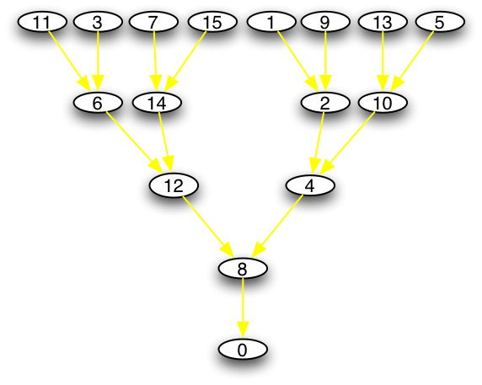
Aggregation in Koorde
Recall the DeBruijn graph:
Each node x points to 2x mod n and (2x + 1) mod n
(But note: not node-symmetric)

Slide 20
An Example DHT: Chord
Assume n = 2^{m} nodes for a moment
A “complete” Chord ring

Slide 21
An Example DHT: Chord

Slide 22
An Example DHT: Chord

Slide 23
An Example DHT: Chord
Overlayed 2^{k}-Gons

Slide 24
An Example DHT: Chord
Overlayed 2^{k}-Gons

Slide 25
An Example DHT: Chord
Overlayed 2^{k}-Gons

Slide 26
An Example DHT: Chord
Overlayed 2^{k}-Gons

Slide 27
An Example DHT: Chord
Overlayed 2^{k}-Gons

Slide 28
An Example DHT: Chord
Overlayed 2^{k}-Gons

Slide 29
An Example DHT: Chord
Overlayed 2^{k}-Gons

Slide 30
An Example DHT: Chord
Overlayed 2^{k}-Gons

Slide 31
An Example DHT: Chord
Overlayed 2^{k}-Gons

Slide 32
Routing in Chord
At most one of each Gon
E.g. 1-to-0

Slide 33
Routing in Chord
At most one of each Gon
E.g. 1-to-0

Slide 34
Routing in Chord
At most one of each Gon
E.g. 1-to-0

Slide 35
Routing in Chord
At most one of each Gon
E.g. 1-to-0

Slide 36
Routing in Chord
At most one of each Gon
E.g. 1-to-0

Slide 37
Routing in Chord
At most one of each Gon
E.g. 1-to-0

Slide 38
Routing in Chord
At most one of each Gon
E.g. 1-to-0

Slide 39
Routing in Chord
At most one of each Gon
E.g. 1-to-0

Slide 40
Routing in Chord
At most one of each Gon
E.g. 1-to-0

Slide 41
Routing in Chord
At most one of each Gon
E.g. 1-to-0
What happened?
We constructed the binary number 15!
Routing from x to y is like computing y - x mod n by summing powers of 2

Slide 42
Routing in Chord
At most one of each Gon
E.g. 1-to-0
What happened?
We constructed the binary number 15!
Routing from x to y is like computing y - x mod n by summing powers of 2
4

Slide 43
Routing in Chord
At most one of each Gon
E.g. 1-to-0
What happened?
We constructed the binary number 15!
Routing from x to y is like computing y - x mod n by summing powers of 2
4
1

Slide 44
Routing in Chord
At most one of each Gon
E.g. 1-to-0
What happened?
We constructed the binary number 15!
Routing from x to y is like computing y - x mod n by summing powers of 2
4
8
1

Slide 45
Routing in Chord
At most one of each Gon
E.g. 1-to-0
What happened?
We constructed the binary number 15!
Routing from x to y is like computing y - x mod n by summing powers of 2
2
4
8
1

Slide 46
Routing in Chord
At most one of each Gon
E.g. 1-to-0
What happened?
We constructed the binary number 15!
Routing from x to y is like computing y - x mod n by summing powers of 2
2
4
8
1
Diameter: log n (1 hop per gon type) Degree: log n (one outlink per gon type)

Slide 47
What is happening here? Algebra!

Slide 48
What is happening here? Algebra!
Underlying group-theoretic structure
Recall a group is a set S and an operator • such that:
S is closed under •
Associativity: (AB)C = A(BC)
There is an identity element I ∈ S s.t. IX = XI = X for all X∈S
There is an inverse X⁻¹∈S for each element X∈S s.t. XX⁻¹ ⁼ X⁻¹X = I
The generators of a group
Elements {g₁, …, g_{n}} s.t. application of the operator on the generators produces all the members of the group.
Canonical example: (Z_{n}, +)
Identity is 0
A set of generators: {1}
A different set of generators: {2, 3}

Slide 49
Cayley Graphs
The Cayley Graph (S, E) of a group:
Vertices corresponding to the underlying set S
Edges corresponding to the actions of the generators
(Complete) Chord is a Cayley graph for (Z_{n},+)
S = Z mod n (n = 2^{k}).
Generators {1, 2, 4, …, 2^{k-1}}
That’s what the gons are all about!
Fact: Most (complete) DHTs are Cayley graphs
And they didn’t even know it!
Follows from parallel InterConnect Networks (ICNs)
Shown to be group-theoretic [Akers/Krishnamurthy ‘89]

Slide 50
Cayley Graphs
The Cayley Graph (S, E) of a group:
Vertices corresponding to the underlying set S
Edges corresponding to the actions of the generators
(Complete) Chord is a Cayley graph for (Z_{n},+)
S = Z mod n (n = 2^{k}).
Generators {1, 2, 4, …, 2^{k-1}}
That’s what the gons are all about!
Fact: Most (complete) DHTs are Cayley graphs
And they didn’t even know it!
Follows from parallel InterConnect Networks (ICNs)
Shown to be group-theoretic [Akers/Krishnamurthy ‘89]
Note: the ones that aren’t Cayley Graphs are coset graphs, a related group-theoretic structure

Slide 51
So…?
Two questions:
How did this happen?
Why should you care?

Slide 52
How Hairy met Cayley

Slide 53
How Hairy met Cayley
What do you want in a structured network?
Uniformity of routing logic
Efficiency/load-balance of routing and maintenance
Generality at different scales
Theorem: All Cayley graphs are vertex symmetric.
I.e. isomorphic under swaps of nodes
So routing from y to x looks just like routing from (y-x) to 0
The routing code at each node is the same! Simple software.
Moreover, under a random workload the routing responsibilities (congestion) at each node are the same!
Cayley graphs tend to have good degree/diameter tradeoffs
Efficient routing with few neighbors to maintain
Many Cayley graphs are hierarchical
Made of smaller Cayley graphs connected by a new generator
E.g. a Chord graph on 2^{m+1} nodes looks like 2 interleaved (half-notch rotated) Chord graphs of 2^{m} nodes with half-notch edges
Again, code is nice and simple

Slide 54
How Hairy met Cayley
What do you want in a structured network?
Uniformity of routing logic
Efficiency/load-balance of routing and maintenance
Generality at different scales
Theorem: All Cayley graphs are vertex symmetric.
I.e. isomorphic under swaps of nodes
So routing from y to x looks just like routing from (y-x) to 0
The routing code at each node is the same! Simple software.
Moreover, under a random workload the routing responsibilities (congestion) at each node are the same!
Cayley graphs tend to have good degree/diameter tradeoffs
Efficient routing with few neighbors to maintain
Many Cayley graphs are hierarchical
Made of smaller Cayley graphs connected by a new generator
E.g. a Chord graph on 2^{m+1} nodes looks like 2 interleaved (half-notch rotated) Chord graphs of 2^{m} nodes with half-notch edges
Again, code is nice and simple

Slide 55
Upshot
Good DHT topologies will be Cayley/Coset graphs
A replay of ICN Design
But DHTs can use funky “wiring” that was infeasible in ICNs
All the group-theoretic analysis becomes suggestive
Clean math describing the topology helps crisply analyze efficiency
E.g. degree/diameter tradeoffs
E.g. shapes of distribution/aggregation trees
Really no excuse to be “sloppy”

Slide 56
Consider Aggregation in Chord
Everybody sends their message to node 0
Assume greedy jumps (increasing Gon-order)
Intercept messages and aggregate along the way

Slide 57
Consider Aggregation in Chord
Everybody sends their message to node 0
Assume greedy jumps (increasing Gon-order)
Intercept messages and aggregate along the way

Slide 58
Consider Aggregation in Chord
Everybody sends their message to node 0
Assume greedy jumps (increasing Gon-order)
Intercept messages and aggregate along the way

Slide 59
Consider Aggregation in Chord
Everybody sends their message to node 0
Assume greedy jumps (increasing Gon-order)
Intercept messages and aggregate along the way
Binomial Tree!!

Slide 60
Aggregation in Koorde
Recall the DeBruijn graph:
Each node x points to 2x mod n and (2x + 1) mod n

Slide 61
Aggregation in Koorde
Recall the DeBruijn graph:
Each node x points to 2x mod n and (2x + 1) mod n
(But note: not node-symmetric)

