Slide 1

Group 40 – Study Material Sharing Platform

Slide 2
Logical Data Model
Entity Relationship diagram

Slide 3
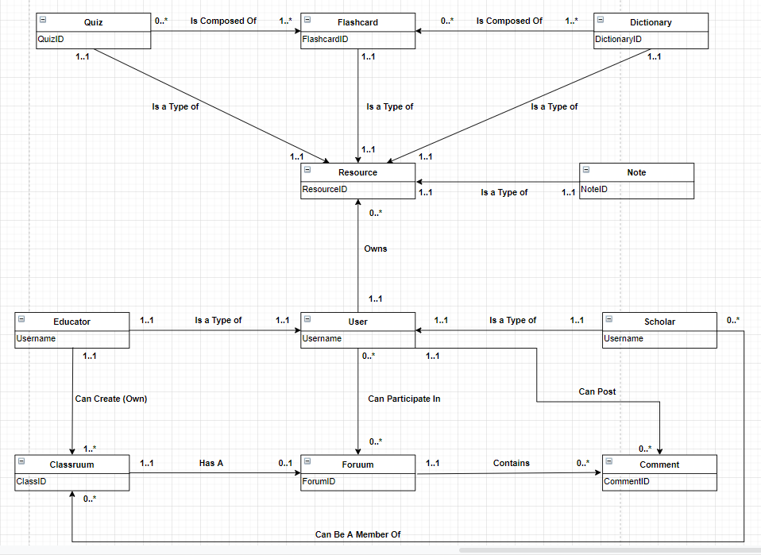
Our main aim is to allow users to create a variety of resources to aid with any type of individual learning
All users can create and manage these learning resources, with simple sharing capabilities being available to all users
Similar applications like Anki and Evernote only offer a very small number of resources, in comparison to our app

Slide 4
Resources

Slide 5
Users

Slide 6
Data Dictionary
Entity constraints

Slide 7
Entity Name | Description | Aliases | Occurrence
Quiz | A sorted collection of flashcards which can be from different sets of Dictionaries | Test | Zero or more Quizzes are composed by one or more Flashcards. Each Quiz is a type of resource
Flashcard | A resource containing two sides of text |  | Each Flashcard is a type of Resource
Dictionary | A collection of flashcards related to a topic | Deck | One or more Dictionaries is composed by zero or more Flashcards. Each Dictionary is a type of Resource
Resource | Some form of learning material | Item | A Resource can be owned by one and only one user
Note | A resource containing one side of text, which can be formatted according to the user |  | Each Note is a type of Resource
User | Someone that has access to the system | Account | One user can own multiple Resources. Zero or more Users can participate in Foruums
Scholar | General user who does not have class creating privileges | Student | Each and every Scholar is a type of User
Educator | User with the ability to create and manage classes | Teacher | Each and every Educator is a type of User. One Educator can own one or multiple Classruums
Classruum | A group that allows Educators to share resources with Scholars | Class | One or multiple Classruums can be owned by one Educator
Foruum | A public domain conversation hub which can be directly related to a specific Classruum | Forum | A single Forum can or cannot be directly related to a specific Classruum
Comment | An interaction posted by the User on a specific Foruum | Interaction | Zero or more Comments are contained in a particular Forum
System composed by a total of 11 entities
Two “main” entities: Resource and User
Other entities inherit properties from them

Slide 8
Entity | Multiplicity | Relationship | Multiplicity | Entity
Quiz Quiz | 0..* 1..1 | IsComposedOf IsaTypeOf | 1..* 1..1 | Flashcard Resource
Flashcard | 1..1 | IsaTypeOf | 1..1 | Resource
Dictionary Dictionary | 1..* 1..1 | IsComposedOf IsaTypeOf | 0..* 1..1 | Flashcard Resource
Resource | None | None | None | None
Note | 1..1 | IsaTypeOf | 1..1 | Resource
User User User | 1..1 0..* 1..1 | Owns CanParticipateIn CanPost | 0..* 0..* 0..* | Resource Foruum Comment
Scholar Scholar | 1..1 0..* | IsaTypeOf CanBeAMemberOf | 1..1 0..* | User Classruum
Educator Educator | 1..1 1..1 | IsaTypeOf CanCreate | 1..1 1..* | User Classruum
Classruum | 1..1 | HasA | 0..1 | Foruum
Foruum | 1..1 | Contains | 0..* | Comment
Comment | None | None | None | None
Sub-entities have 1..1 relationship IsaTypeOf with super-entity
Linking entities (e.g. between User and Foruum) are not represented

Slide 9
Entity | Attributes | Description | Data type and Length | Nulls
Quiz | ResourceID QuizName QuizTopic | Uniquely identifies the quiz Name of the Quiz Topic of the Quiz | 6 variable characters 30 variable characters 30 variable characters | No No Yes
Flashcard | ResourceID DictionaryID QuizID FrontContent BackContent | Uniquely identifies the flashcard Identifies Deck containing flashcard Identifies containing Quiz Content (text, etc) on the front of the card Content (text, etc) on the front of the card | 6 variable character 6 variable characters 6 variable charcaters 255 variable characters 255 variable characters | No Yes Yes No No
Dictionary | ResourceID DictionaryName | Uniquely identifies Dictionary Name of the Dictionary | 6 variable characters 30 variable characters | No No
Resource | ResourceID UserID Resource_Type ResourceName Privacy | Uniquely identifies Resource Identifies user owning Resource The type of Resource it is The name of the Resource The access level of the resource for non owners(public, private, shared) | 6 variable characters 6 variable charaters 10 Variable characters 30 Variable characters 7 Variable characters | No No No No no
Note | ResourceID NoteTitle NoteContent | Uniquely identifies Note Title of the Note Content (text, etc) of the note | 6 variable characters 30 variable characters 255 variable characters | No No No
User | Time_Created Username Email Hashed_Password Account_Type ClassID | The time the account was created Username of User Email of User Password for the User account Identifies the type of account (educator or scholar) Identifies which class the user is a member of | TimeStamp 30 variable characters 50 variable characters 127 variable characters 8 Variable characters 5 variable characters | No No No No No Yes
Every entity uniquely identified by numeric ID
Content length for flashcards and notes limited to 255 characters

Slide 10
Entity | Attributes | Description | Key | Nulls
Quiz | ResourceID QuizName QuizTopic | Uniquely identifies a quiz Name of the Quiz Topic of the Quiz | Primary key | No No Yes
Flashcard | ResourceID DictionaryID QuizID FrontContent BackContent | Uniquely identifies flashcard Uniquely identifies containing Deck Uniquely identifies containing Quiz Content (text, etc) on the front of the card Content (text, etc) on the front of the card | Primary key | No No No No No
Dictionary | ResourceID DictionaryName | Uniquely identifies Dictionary Name of the Dictionary | Primary key | No No No
Resource | ResourceID UserID Resource_Type Privacy | Uniquely identifies Resource Identifies user owning Resource The type of resource it is (quiz, note etc.) The access level of the resource (public, private or shared) | Primary key | No No No No
Note | ResourceID NoteTitle NoteContent | Uniquely identifies Note Title of the Note Content (text, etc) of the note | Primary key | No No No No
User | Username Email Password ClassID Time_created | Uniquely identifies User Email of User Hashed Password for the User account The class the user belongs to The time the user account was made | Primary key Alternate key | No No No Yes No
Attribute email of entity User can be used to alternatively identify single user
Some null attributes present (e.g. QuizTopic, ClassID in Foruum,etc)

Slide 11
Table Design
Logical / Physical

Slide 12
Logical And Physical Table Designs
User(Account_Type, Email, Username, Hashed_Password, ClassID, Created) Primary Key Username Foreign Key ClassID references Classruum(ClassID) Alternate Key Email | Foruum(ForumID, Creator, Forum_Title, Closed, Created) Primary Key ForumID Foreign Key Creator references User(Username)
Resources(Resource_type, Resource_ID, Creator, Privacy) Primary Key ResourceCode Foreign Key Creator references User(Username) | Comment(CommentID, ForumID, Creator, Comment_Content, Created) Primary Key CommentID Foreign Key ForumID references Foruum(ForumID) Foreign Key Creator references User(Username)
Classruum(ClassID, EducatorID, Class_Name) Primary Key ClassID Foreign Key EducatorID references User(Username) | Notes(ResourceID, NoteTitle, NoteContent) Primary Key ResourceID Foreign Key ResourceID references Resource(ResourceID)
FlashCard(ResourceID, FrontContent, BackContent, QuizID, DictionaryID) Primary Key ResourceID Foreign Key ResourceID references Resource(ResourceID) Foreign Key QuizID references Quiz(ResourceID) Foreign Key DictionaryID references Dictionary(ResourceID) | Quiz(ResourceID, QuizName, QuizTopic) Primary Key ResourceID Foreign Key ResourceID references Resource(ResourceID)
Dictionary(ResourceID, DictionaryName) Primary Key ResourceID Foreign Key ResourceID references Resource(ResourceID)
This is the logical table design for our underlying database.
Each table describes an entity that contains information that is necessary for maintaining relations withing the DB.

Slide 13
User Table
Physical Design
Domain Account_Type Variable length string maximum length 8 Domain Email_Adress Variable length character string maximum length 5 Domain Username Variable length character string maximum length 30 Domain Password Variable length character string maximum length 50 Domain Clasruum Variable length character string maximum length 5 Time_Created TIMESTAMP
Logical Design
User(Account_Type, Email, Username, Hashed_Password, ClassID, Created) Primary Key Username Foreign Key ClassID references Classruum(ClassID) Alternate Key Email
User( Account_Type Account_Type NOT NULL Email Email_Address NOT NULL Username Username NOT NULL Hashed_Password Password NOT NULL ClassID Classruum NULL Created Time_Created NOT NULL Primary Key Username Alternate Key Email Foreign Key ClassID references Class(ClassID)
This is the main table of the user where the majority of their personal information will be held and data that identifies what class they’re part of.

Slide 14
Resource Table
This is the resource table of the user, where the majority of a resource’s information will be held. It is the parent/superclass of all other resource types.
Privacy has a variable length of 7 due to it being either private, public or shared.
Logical Design
Resources(Resource_type, Resource_ID, Creator, Privacy) Primary Key ResourceID Foreign Key Creator references User(Username)
Resources( Type Resource_Type NOT NULL ID Resource_ID NOT NULL Name Resource_Name NOT NULL Creator Owner NOT NULL Privacy Privacy NOT NULL Primary Key ID Foreign Key Creator references User(Username)
Physical Design
Domain Resource_Type Variable length string maximum length 10 Domain Resource_ID Variable length character string maximum length 6 Domain Resource_Name Variable length character string maximum length 30 Domain Owner Variable length character string maximum length 30 Domain Privacy Variable length character string max size 7

Slide 15
Classruum Table
Logical Design
Physical Design
Classruum(ClassID, EducatorID, Class_Name) Primary Key ClassID Foreign Key EducatorID references User(Username)
Domain ClassID Variable length string maximum length 6 Domain ClassName Variable length character string maximum length 25 Domain Owner Variable length character string maximum length 8
Classruum( ClassID ClassID NOT NULL Class_Name Name NOT NULL EducatorID Owner NOT NULL Primary Key ClassID Foreign Key EducatorID references User(Username)
This is the table for Classruum. It contains basic information about the Class such as the owner and its name.
The ClassName has a maximum length of 25, e.g. “COMP201 – 2019/2020”.

Slide 16
Comment Table
Logical Design
Physical Design
Comment(CommentID, ForumID, Creator, Comment_Content, Created) Primary Key CommentID Foreign Key ForumID references Foruum(ForumID) Foreign Key Creator references User(Username)
Domain CommentID Integer Domain ForumID Integer Domain Comment_Content Variable length character string maximum length 300 Domain Owner Variable length character string maximum length 30 Domain Time_Created TimeStamp
Comment( | CommentID CommentID NOT NULL
 | ForumID ForumID NOT NULL
 | Content Comment_Content NOT NULL
 | Creator Owner NOT NULL
 | Created Time_Created NOT NULL
 | Primary Key CommentID
 | Foreign Key Creator references User(Username)
 | Foreign Key ForumID references Forum(ForumID)
This is the table for a comment - a text item that can be left on a foruum. Despite being similar to a resource in the way it acts it is not so it contains all the necessary information for it to exist without a parent child relationship with resource.

Slide 17
Flashcard Table
Logical Design
Physical Design
Flashcard(ResourceID, FrontContent, BackContent, QuizID, DictionaryID) Primary Key ResourceID Foreign Key ResourceID references Resource(ResourceID) Foreign Key QuizID references Quiz(ResourceID) Foreign Key DictionaryID references Dictionary(ResourceID)
Domain ResourceID variable length character string maximum length 6 Domain FrontContent variable length character string maximum length 255 Domain BackContent variable length character string maximum length 255 Domain QuizID variable length character string maximum length 5 Domain DictionaryID variable length character string maximum length 5
Flashcard(ResourceID ResourceID NOT NULL FrontContent FrontContent NOT NULL BackContent BackContent NOT NULL QuizID QuizID NULL DictionaryID DictionaryID NULL ) Primary Key ResourceID Foreign Key ResourceID references Resource(ResourceID) Foreign Key QuizID references Quiz(ResourceID) Foreign Key DictionaryID references Dictionary(ResourceID)
This is the Flashcard Table. It’s a type of resource that is a child of the resource table. It contains the necessary information to create a flashcard and to link it with a quiz or dictionary.

Slide 18
Notes Table
Logical Design
Physical Design
Notes(ResourceID, NoteTitle, NoteContent) Primary Key ResourceID Foreign Key ResourceID references Resource(ResourceID)
Domain ResourceID variable length character string maximum length 6 Domain FrontContent variable length character string maximum length 255 Domain NoteTitle variable length character string maximum length 30
Notes(ResourceID ResourceID NOT NULL NoteContent NoteContent NOT NULL NoteTitle NoteTitle NOT NULL ) Primary Key ResourceID Foreign Key ResourceID references Resource(ResourceID)
This is the Notes Table. It’s a type of resource that is a child of the resource table. It contains the necessary information to create a note.

Slide 19
Foruum Table
Physical Design
Logical Design
Domain ForumID Integer Domain Forum_Title Variable length character string maximum length 25 Domain Closed Binary Domain Owner Variable length character string maximum length 30 Domain Time_Created TimeStamp
Foruum(ForumID, Creator, Forum_Title, Closed, Created) Primary Key ForumID Foreign Key Creator references User(Username)
Forum(ForumID ForumID NOT NULL Closed Closed NOT NULL Creator Owner NOT NULL Created Time_Created NOT NULL Forum_Title Forum_Title NOT NULL Primary Key ForumID Foreign Key Creator references User(Username)
This is the Foruum Table. A place for users to ask questions and discuss topics. It contains the necessary information to create a forum that contains comments.

Slide 20
Quiz Table
Physical Design
Logical Design
Domain ResourceID Variable length character string maximum length 6 Domain QuizName Variable length character string maximum length 25 Domain QuizTopic Variable length character string maximum length 25
Quiz(ResourceID, QuizName, QuizTopic) Primary Key ResourceID Foreign Key ResourceID references Resource(ResourceID)
Quiz(ResourceID ResourceID NOT NULL Name QuizName NOT NULL Topic QuizTopic NOT NULL ) Primary Key ResourceID Foreign Key ResourceID references Resource(ResourceID)
This is the Quiz Table. It’s a type of resource that is a child of the resource table. It contains the necessary information to create a flashcard and to link it with a quiz or dictionary.

Slide 21
Dictionary Table
Logical Design
Physical Design
Dictionary(ResourceID, DictionaryName) Primary Key ResourceID Foreign Key ResourceID references Resource(ResourceID)
Domain ResourceID Variable length character string maximum length 6 Domain Name Variable length character string maximum length 25
Dictionary(ResourceID ResourceID NOT NULL Name DictionaryName NOT NULL ) Primary Key ResourceID Foreign Key ResourceID references Resource(ResourceID)
This is the Dictionary Table. It’s a type of resource that is a child of the resource table. It contains the necessary information to create a flashcard and to link it with a quiz or dictionary.

Slide 22
Transaction Table
Interactions between entities

Slide 23
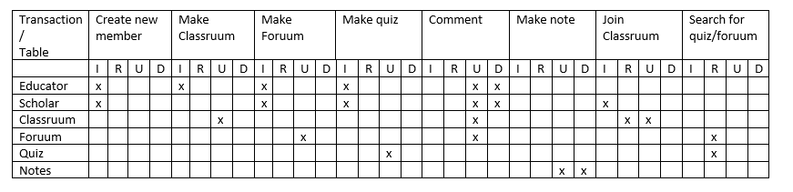
Each header in this column represents an action which can take place, where a transaction will need to be made within a table.
Each header in this row represents the table in use for each transaction.

Slide 24
The columns IRUD stand for :
Input
Read
Update
Delete
The crosses represent when this action is required for a transaction.

Slide 25
For example, to make a classruum, you need an input from an Educator. Only then (within the educator table) will it show that they own a classruum.
The columns IRUD stand for :
Input
Read
Update
Delete
This Updates Classruums as there is now a new classruum.
The crosses represent when this action is used.

Slide 26
The transaction table can be used to see how all of the tables are used. For example you can see how many actions can be performed by Educators/ Scholars. It can also predict how often each database will be used, which will help us to test the program in the future.

Slide 27
Example of a Scholar creating an account and finding foruum of the classroom setup by their teacher
From this transaction table you can see that most Users when using the program normally (e.g. creating member, searching, joining a class, making a comment) will have some form of interaction with most of the tables.

Slide 28
Interface Design
Entity Relationship diagram

Slide 29
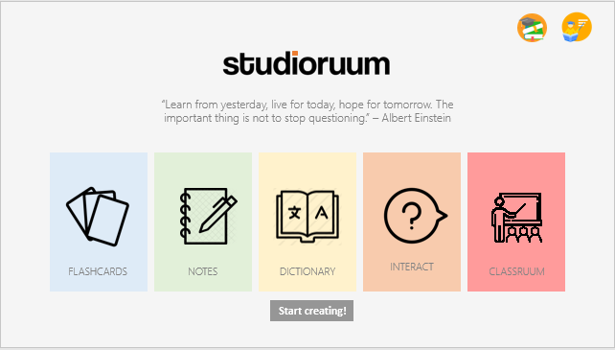
Introduction
In the initial design for our interface, we had to consider the form and functionality of our program.
We have chosen to implement a more professional approach (whilst maintaining our accessibility) compared to the likes of competitor applications (for example Quizlet).
This is denoted through our simplistic and minimalistic colour pallet (pastel) and ease of access. We ensured to fulfil the objectives specified in the requirements whilst maintaining the theme and visual representation of our product.

Slide 30
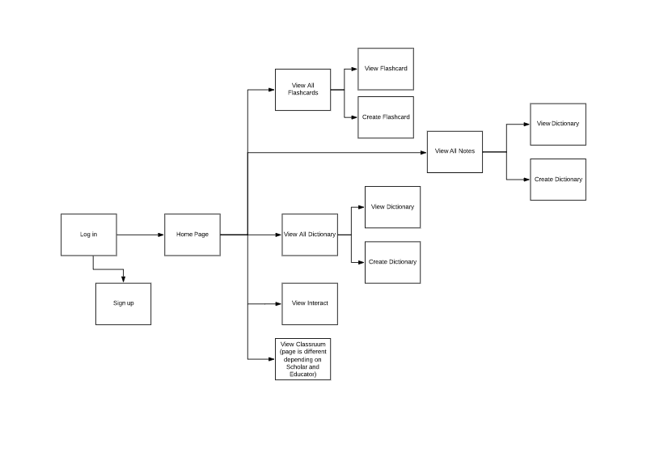
Navigation

Slide 31
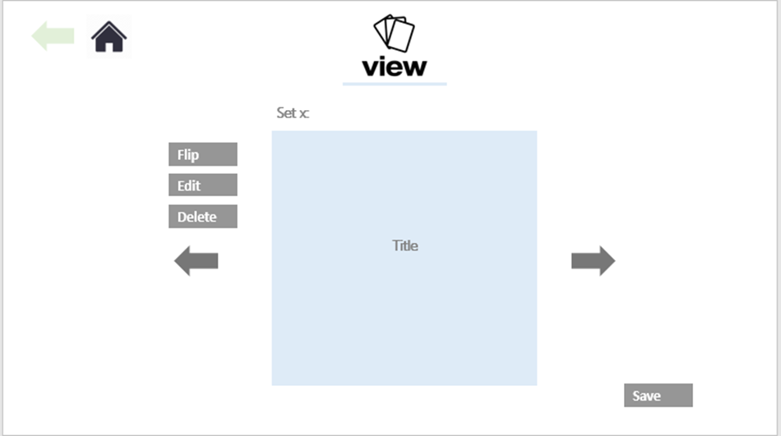
Navigation
We have tried to make navigation as simple and intuitive as possible.
This diagram allowed us to plan the structure of the program. It was our first step in the interface as we needed to know how the program would flow, and what screens were essential.
The diagram can be navigated in reverse using the “back” button. In every screen there will be button at the stop that allows the user to go back if they make mistakes, or just want to view a previous screen.
And a home button that takes you to the “home screen”. This is the screen where they can choose a section of the program, and essentially, their path down the diagram.

Slide 32
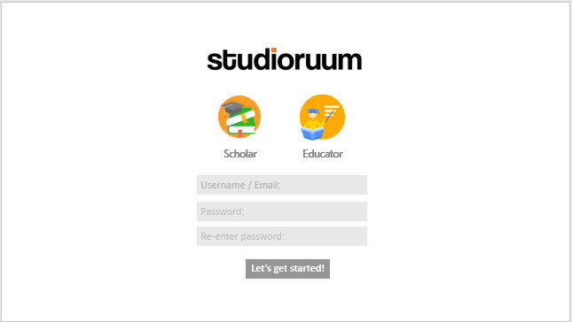
Iconography and Theme
We would need to ensure the icons and pictures used in the final version are copyright free and free to use.
This might not be the same iconography we plan to use in the final version, but, it gives us an outline of how the buttons looked on screen and plan how our final version will look.

Slide 33
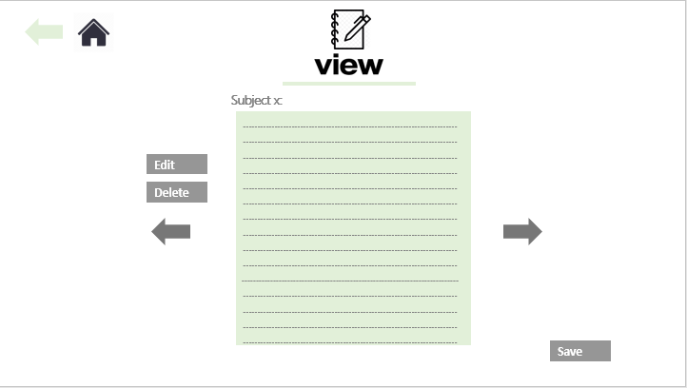
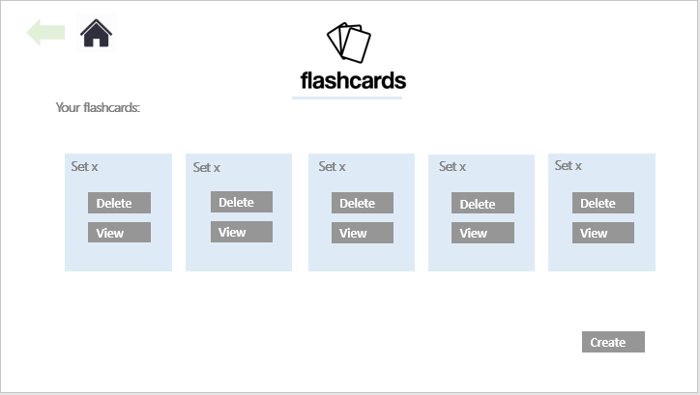
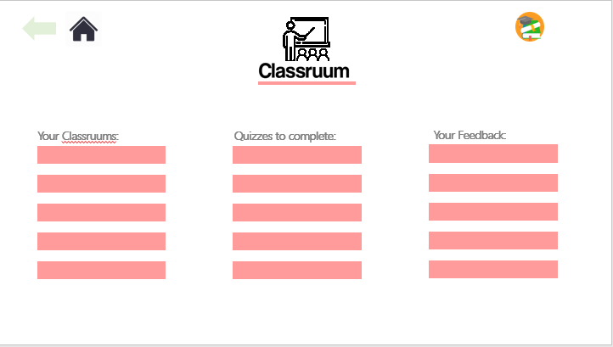
Screens
We chose to design our interface by producing mock screens; basically depicting how we would like it to turn out. We expect the design to differ from our plan, but the majority will be designed within that framework.

Slide 34

Loading Screen
This is the loading screen of our application, we can’t show it on the screenshot but we plan to have the letters animate “studioruum” appear on the screen as if they were being typed out.
From the beginning of the interface design we wanted to adapt a minimalistic approach and try to make our application look as professional as possible, while still keeping in the theme of a learning resource.

Slide 35
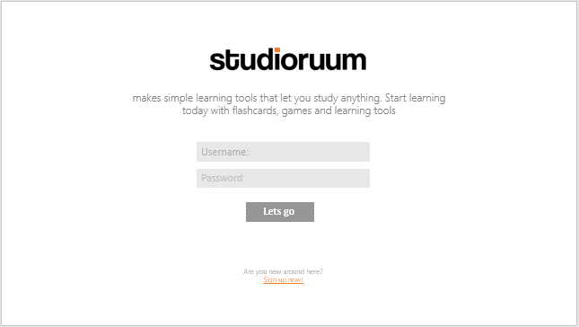
Welcome Screen
Here are our login and sign up pages. On the sign up page the user can choose whether they are a Scholar or an Educator by clicking on the relevant icon

Slide 36
Home Page
This is the main page of our application, this is the page that both the scholars and educators navigate from. We have tried to keep to the professional look but also tried to add some colour to keep the user’s attention onto our program.

Slide 37
Flashcard Related Pages
This is the “home” page for the flashcards.
This screen appears when the user clicks on the flashcard button from the Home screen.
It is from this page that the user can access all their flashcard needs, for example, view/delete existing flashcards or create new ones.
We have used the colour from
the button on the home page as the prominent colour in the flashcard related screens and this is something we kept consistent with throughout.

Slide 38
Flashcard Related Pages
This is the page that appears when the user clicks “View” on the Flashcard home page.
We allow the user to edit/delete any flashcard in the set and also navigate through all flashcards which are part of the set.
When the user clicks save they are then transitioned back to the Flashcard homepage.

Slide 39
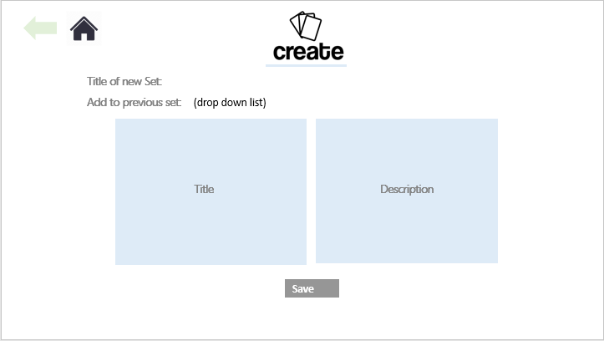
Flashcard Related Pages
This is the page that appears when the user clicks “Create” on the Flashcard home page.
This page allows the user to create a new set for these flashcards to belong to or if these flashcards belong to a set that has already been created we give that option as well.
Again once the user clicks “Save” they are taken back to the Flashcard Home page.

Slide 40
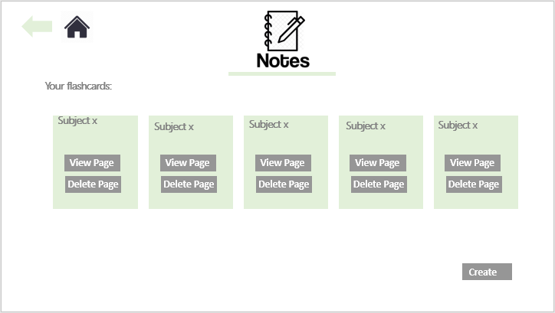
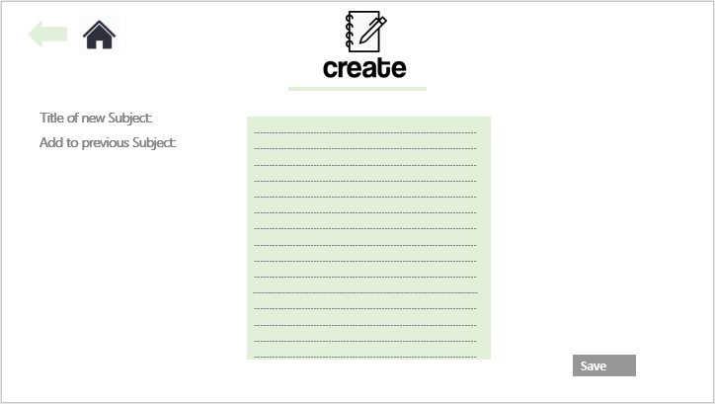
Notes Related Pages
Above are all of the pages that are connected with “Notes” (the button from the home page). They all serve exactly the same functionality as the Flashcard related pages except the colour scheme has been changed and these notes are saved as a lined page instead of a small lined flashcard.

Slide 41
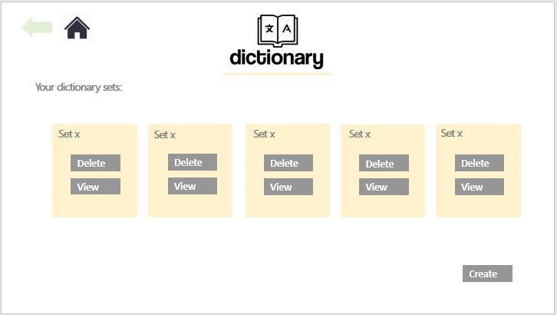
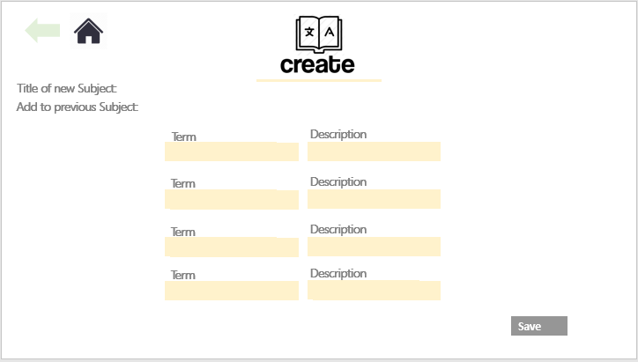
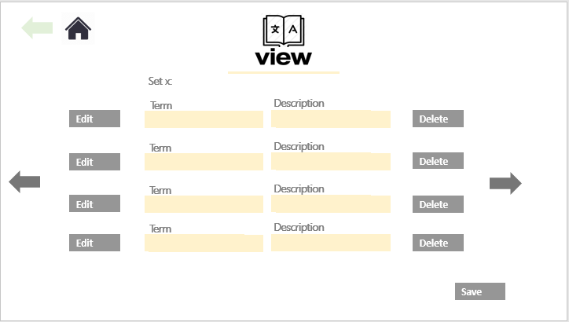
Dictionary Related Pages
Above are all of the pages that are connected with “Dictionary” (the button from the home page). They all serve exactly the same functionality as the Flashcard and Notes related pages except the colour scheme has been changed and the dictionary is laid out as a one line term followed by a one line definition.

Slide 42
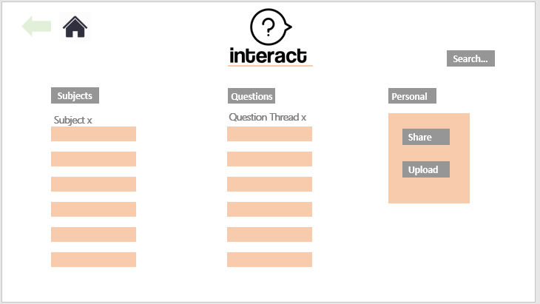
Interact Screen
This is our “Interact” page, which acts very similar to a typical Forum page except with a few additional features.
We have allowed every user of our application to upload resources onto the Interact section in the hopes that it aids another user.
There is also a search bar within this page so the user can get quick access to the resources they require.
We have 2 columns, one for subjects and one for questions. The Subject column contains the most popular searched subjects e.g. “Biology”, “Maths”. The Question column will contain the most FAQ.

Slide 43
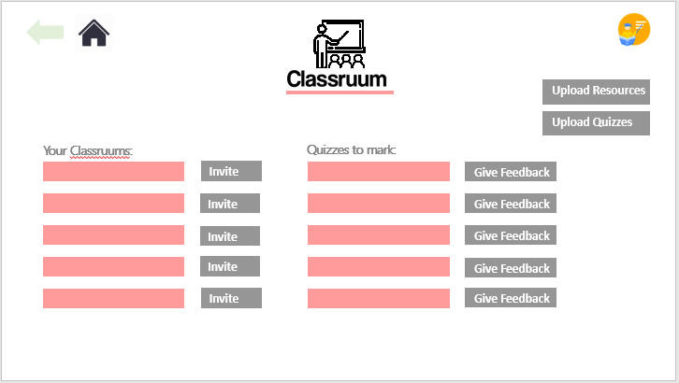
Classruum Screens
These are all of the pages related to the Classruum button on the home page. Depending on which type of user that the user chose in the signing up step decides which Classruum page they see.
The top page (on the right) is what the Scholar sees, this contains the Classruums they are apart of, the quizzes they need to complete and any feedback they have received from previous quizzes.
The bottom page (on the right) is what the Educator sees. The main difference between the two is that an Educator can create their own Classruums and scholars to them. It is also the Educators responsibility to upload resources and feedback to their Classruums.

Slide 44
Design Interface
If you have any enquiries about the design of the interface, please feel free to ask now!

Slide 45
Planning
How are we doing this

Slide 46
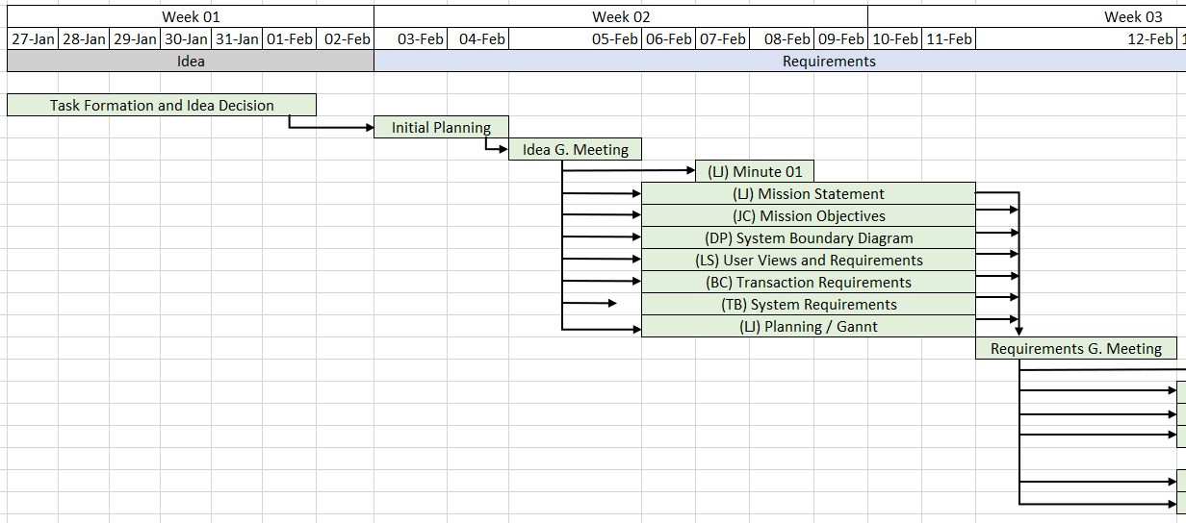
Gannt Chart (Pt. 1)

Slide 47
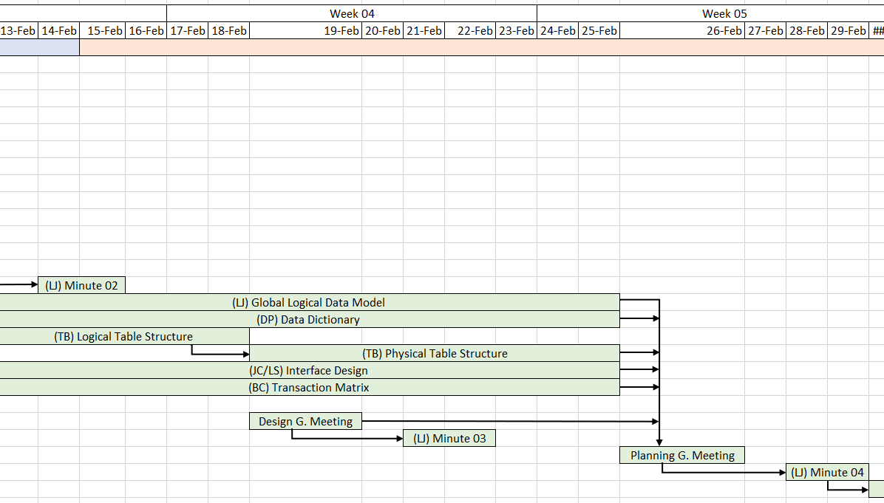
Gannt Chart (Pt. 2)

Slide 48
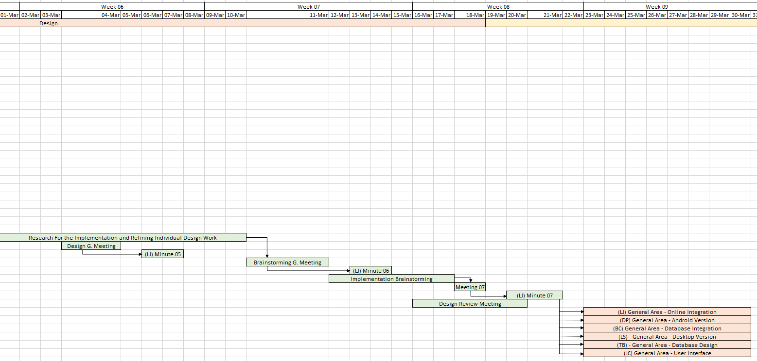
Gannt Chart (Pt. 3)

Slide 49
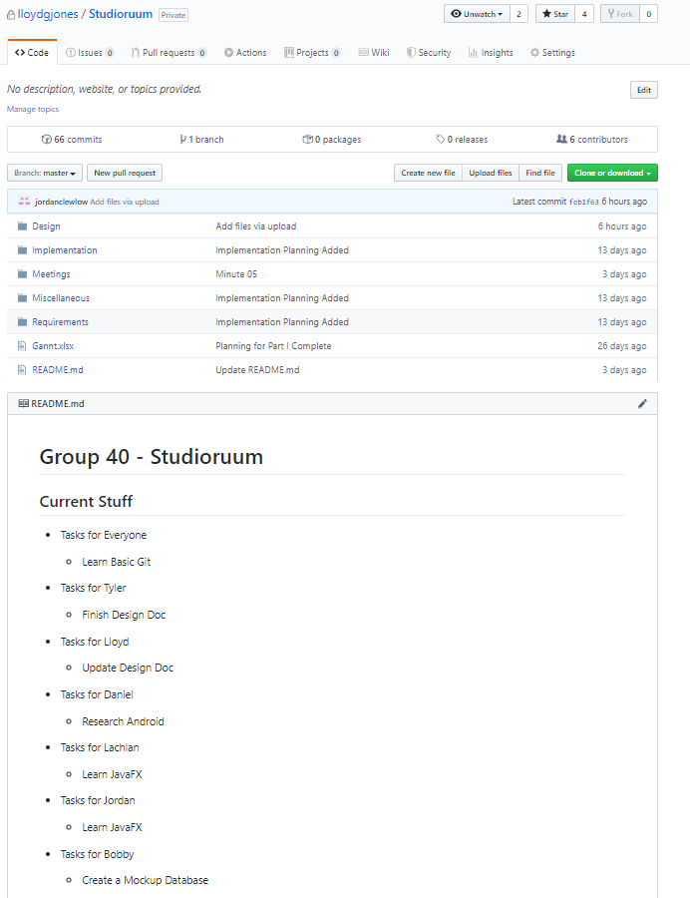
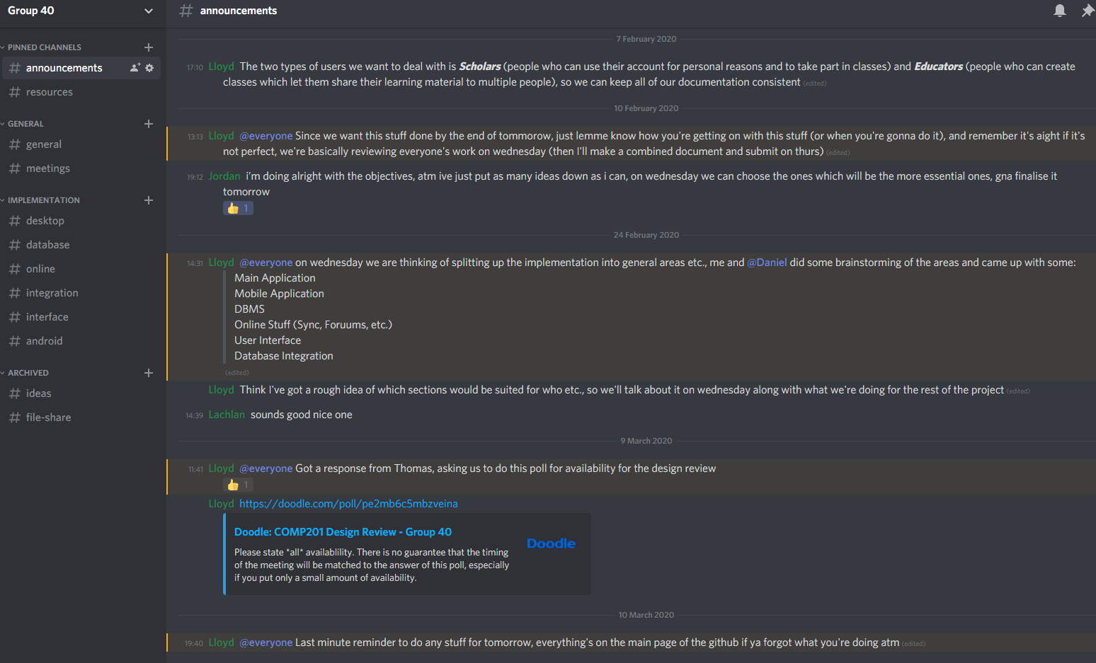
Other Tools

Slide 50
Questions
We’re done so feel free to ask them

