Slide 1
Digital Aristotle
Tom Curtin
Sam Gervais

Slide 2

Problem Definition
Math is complex
Students > Teachers
Websites are free for students
Pace of taught material
Notes:
Math is a complex subject in which many students struggle understanding
There are not enough teachers to be able to give students individual attention
The Digital Aristotle would be a free method of individualized tutoring as opposed to the expensive cost of human tutoring
Subject material taught in a classroom is either taught too fast or too slow for students

Slide 3

Importance
Opportunity for success
More Technological competition
Notes:
A greater sense of education creates more opportunity for success for students in the working world
A greater influx of educated people creates a boosted economy and more technological competition

Slide 4
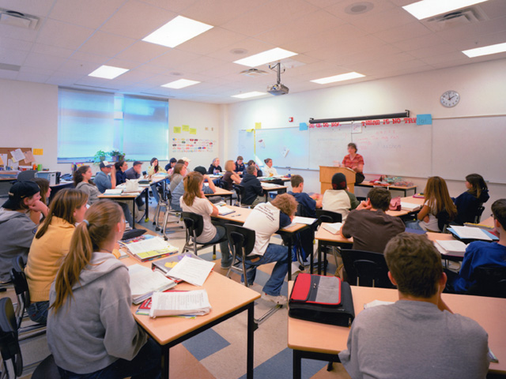
Digital Aristotle for Us
The only method is of the traditional classroom
Not a lot of individual attention
Notes:
Math, especially algebra and geometry, are difficult fields to comprehend when the only method of teaching used is the traditional classroom method.
The traditional teaching method does not give students individualization required to fully understand these fields.

Slide 5
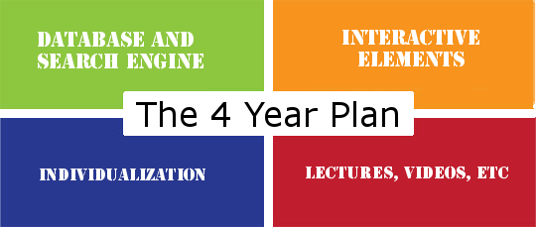
The Four Year Plan
Notes:
First Year:
Create search engine capable of looking though knowledge database with a plethora of information
Second Year:
Add Interactive elements such as tests, homework, and practice problems
Third Year:
Add individualization through test, homework, practice, etc.
Fourth Year:
Create a way for students to receive lectures

Slide 6

Methods: The User
Webpage
- Search Bar

Slide 7

Methods: The Server
Tornado web framework
- Asynchronous
Client to server
Customizable

Slide 8
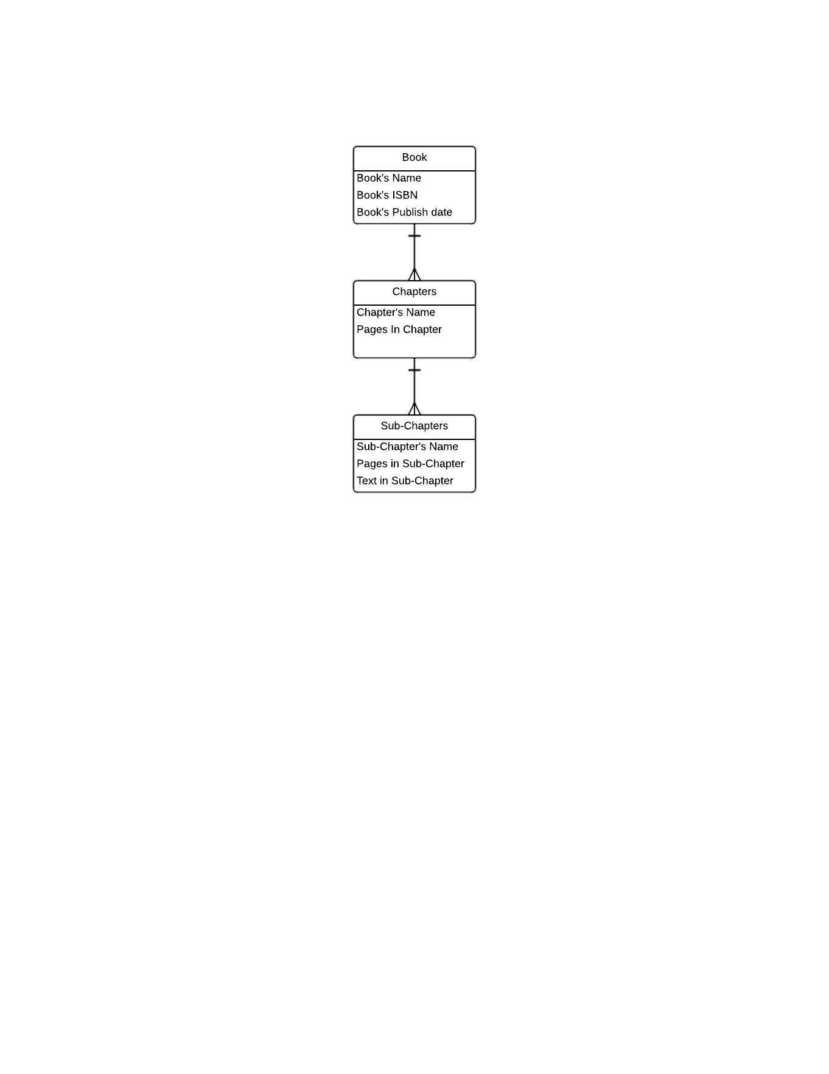
Methods: The database
Search through PDF
- Font
- Book → Chapter → Subchapter

Slide 9
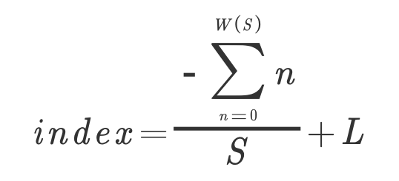
Methods: Locating
Fuzzy Search
- Levenshtein Distance
Index
- Insert, delete, substitute
Memoize

Slide 10
Results
Far from completion
First Year of four years finished

