Slide 1
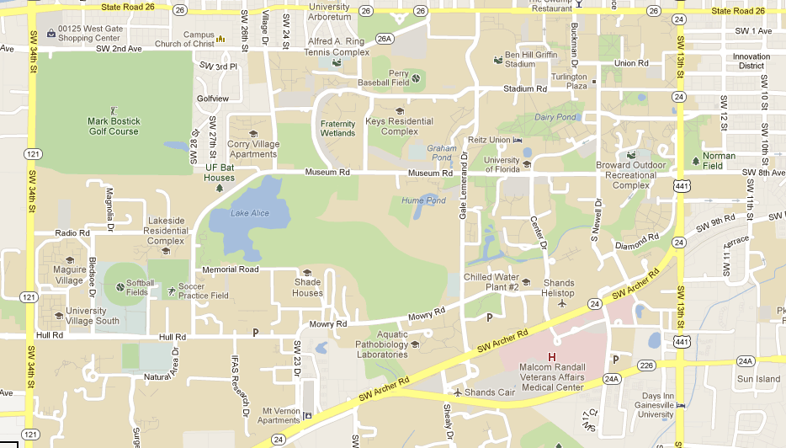
MapFlix
-FIND FILMS BY LOCATION-
Project by Jordan Fine
Problem: Finding foreign films on Netflix doesn’t provide the user to browse movies by location deeper than dominant countries (such as France, Brazil, Germany,etc). Users who frequently watch foreign films, noted that finding films by location is one of the top things they use to find a film. With my interface, I was addressing the issue for users to find movies based off any location and give the user more control.

Slide 2
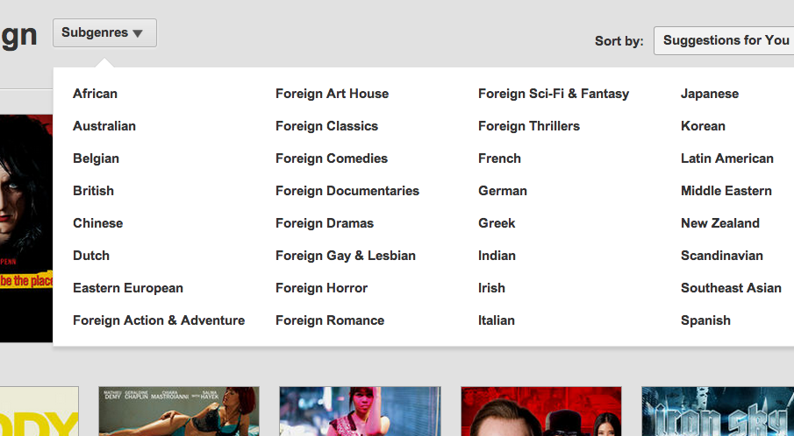
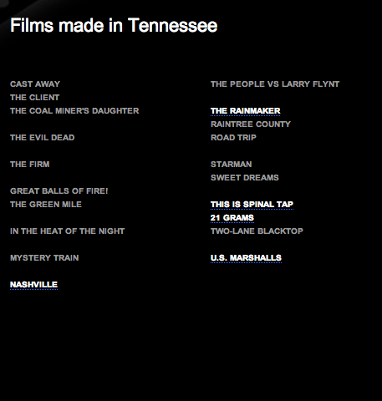
Current Interface
Netflix – Foreign Films Section
Movie-Locations.com

Slide 3
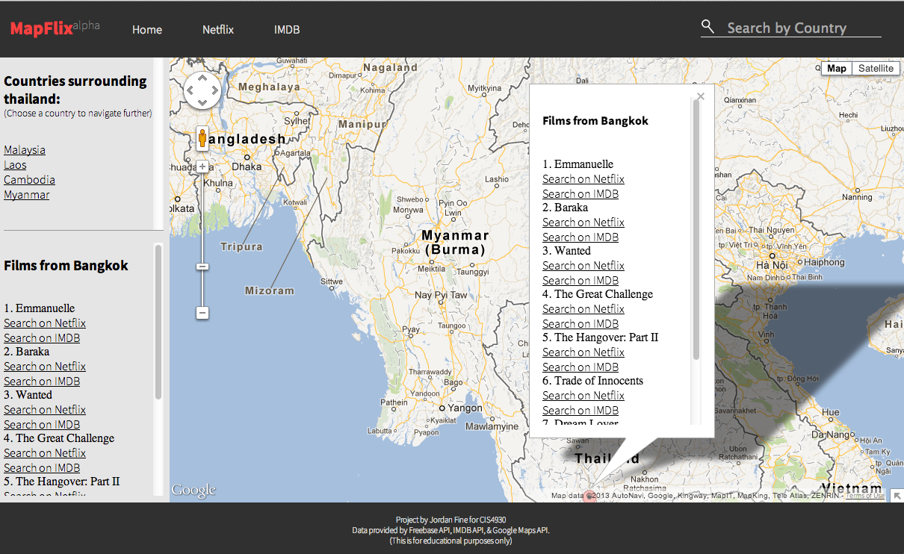
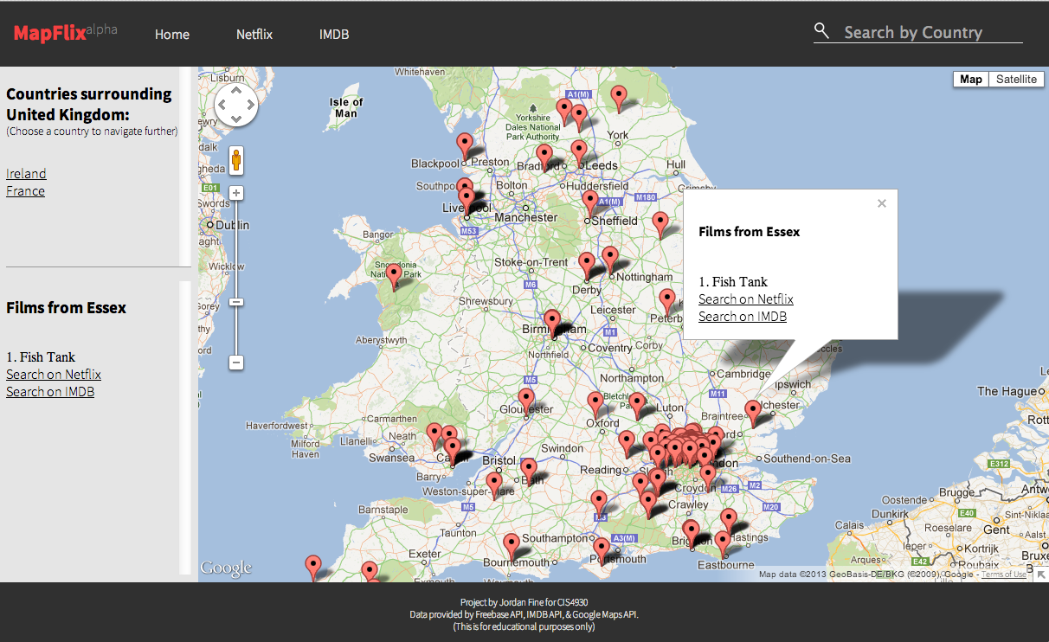
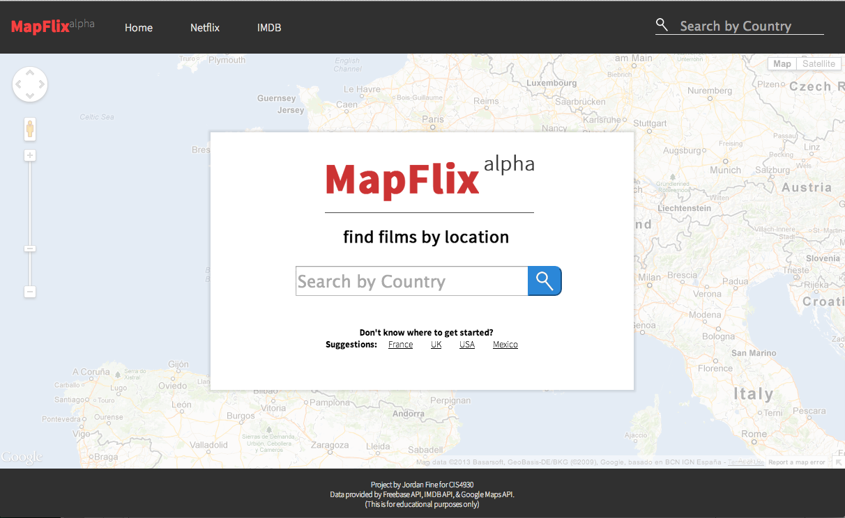
MapFlix

Slide 4
User Study Conditions
Hypotheses:
  Primary: Participants will strongly agree that Mapflix provides a satisfying browsing experience over the Netflix browsing experience.
  Secondary: Participants will be satisfied with the quality of content found on Mapflix, over the content found via Netflix’s Browsing Method.
8 participants used Netflix
8 participants used Mapflix
Total: 16 Participants
Each group took a pre-study and post-study survey.

Slide 5
Results & Analysis
Satisfaction: Ease of Use, Repeated Use, Aesthetics, and Lack of Confusion
  Variance & Std.Deviation: VERY LOW
  T-Value : 0.25 (VERY LOW)
  Reject Hypothesis, Accept NULL Hypothesis
  Subcategory Aesthetics received a T-Value of 2.86. Participants favored MapFlix’s Aesthetics, but overall satisfaction was too close to accept hypothesis
Content:
  Variance & Std.Deviation: VERY LOW
  T-Value: 0.43 (VERY LOW)
  Reject Hypothesis, Accept NULL Hypothesis

Slide 6
Conclusion
From Pre-Study Survey: Importance of Control
  Moderately Important to Very Important
    3.77 on 4 point scale
  Users want the most control when browsing data
Ideas presented in this project could be researched further to a larger population.
Users of Netflix are at a moderate level of satisfaction. This gives room for Designers and Developers to try new UX designs and concepts, but also must be cautious on every UX decision made, potential of losing users.
Users find geographic visualization an added benefit, but still favor searching methods present in Netflix.

