Slide 1
Object-Oriented Design & Patterns Cay S. Horstmann
Chapter 2 Object-Oriented Design Process

Slide 2
Chapter Topics
From Problem to Code
The Object and Class Concepts
Identifying Classes
Identifying Responsibilities
Relationships Between Classes
Use Cases
CRC Cards
UML Class Diagrams
Sequence Diagrams
State Diagrams
Using javadoc for Design Documentation
Case Study: A Voice Mail System

Slide 3
From Problem to Code
Three Phases:
Analysis
Design
Implementation
Case Study: Voice Mail System

Slide 4
Analysis Phase
Functional Specification
Completely defines tasks to be solved
Free from internal contradictions
Readable both by domain experts and software developers
Reviewable by diverse interested parties
Testable against reality

Slide 5
Design Phase
Goals
Identify classes
Identify behavior of classes
Identify relationships among classes
Artifacts
Textual description of classes and key methods
Diagrams of class relationships
Diagrams of important usage scenarios
State diagrams for objects with rich state

Slide 6
Implementation Phase
Implement and test classes
Combine classes into program
Avoid "big bang" integration
Prototypes can be very useful

Slide 7
Object and Class Concepts
Object: Three characteristic concepts
State
Behavior
Identity
Class: Collection of similar objects

Slide 8
Identifying Classes
Problem Description: A voice mail system
A person dials an extension number and, provided the other party does not pick up the telephone, leaves a message.
The other party can later retrieve the messages, keep them, or delete them.
Real systems have a number of fancy features:
Message forwarding
Distribution lists can be defined, retained, and edited.
Authorized persons can send broadcast messages to all users.
We will consider the core operations.

Slide 9
Identifying Classes
Rule of thumb: Look for nouns in problem description
Mailbox
Message
User
Passcode
Extension
Menu
Focus on concepts, not implementation
MessageQueue stores messages
Don't worry yet how the queue is implemented

Slide 10
Categories of Classes
Tangible Things
Agents
Events and Transactions
Users and Roles
Systems
System interfaces and devices
Foundational Classes

Slide 11
Identifying Responsibilities
Rule of thumb: Look for verbs in problem description
Behavior of MessageQueue:
Add message to tail
Remove message from head
Test whether queue is empty
OO Principle: Every operation is the responsibility of a single class
Example: Add message to mailbox
Who is responsible: Message or Mailbox?

Slide 12
Class Relationships
Dependency ("uses")
Aggregation ("has")
Inheritance ("is")

Slide 13
Dependency Relationship
C depends on D: Method of C manipulates objects of D
Example: Mailbox depends on Message
If C doesn't use D, then C can be developed without knowing about D

Slide 14
Coupling
Minimize dependency: reduce coupling
A class should only have a few dependencies
Permits development of classes in parallel
Example: Replace
void print() // prints to System.out
with
String getText() // can print anywhere
Different parts of the program can use the string differently
Removes dependence on System, PrintStream

Slide 15
Aggregation
Object of a class contains objects of another class
Example: MessageQueue aggregates Messages
Example: Mailbox aggregates MessageQueue
Implemented through instance fields

Slide 16
Multiplicities
1 : 1 or 1 : 0...1 relationship:
public class Mailbox
{
. . .
private Greeting myGreeting;
}
1 : n relationship:
public class MessageQueue
{
. . .
private ArrayList<Message> elements;
}

Slide 17
Inheritance
More general class = superclass
More specialized class = subclass
Subclass supports all method interfaces of superclass (but implementations may differ)
Subclass may have added methods, added state
Subclass inherits from superclass
Example: ForwardedMessage inherits from Message
Example: Greeting does not inherit from Message (Can't store greetings in mailbox)

Slide 18
Use Cases
Analysis technique
Each use case focuses on a specific scenario
Use case = sequence of actions
Action = interaction between actor and computer system
Each action yields a result
Each result has a value to one of the actors
Use variations for exceptional situations

Slide 19
Sample Use Case
Leave a Message:
Caller dials main number of voice mail system
System speaks prompt:
Enter mailbox number followed by #
User types extension number
System speaks:
You have reached mailbox xxxx. Please leave a message
now
Caller speaks message
Caller hangs up
System places message in mailbox

Slide 20
Sample Use Case -- Variations
Variation #1
1.1. In step 3, user enters invalid extension number
1.2. Voice mail system speaks
You have typed an invalid mailbox number.
1.3. Continue with step 2.
Variation #2
2.1. After step 4, caller hangs up instead of speaking message
2.3. Voice mail system discards empty message

Slide 21
CRC Cards
CRC = Classes, Responsibilities, Collaborators
Developed by Beck and Cunningham
Use an index card for each class
Class name on top of card
Responsibilities on left
Collaborators on right

Slide 22
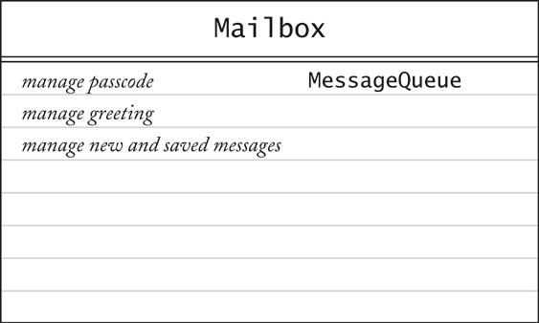
CRC Cards
Responsibilities should be high level
1 - 3 responsibilities per card
Collaborators are for the class, not for each responsibility

Slide 23
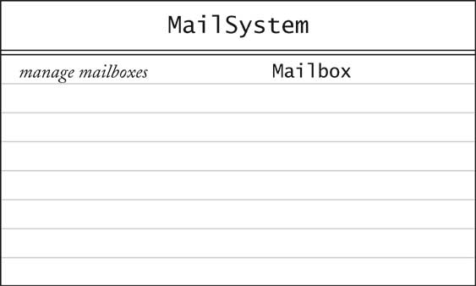
Walkthroughs
Use case: "Leave a message“
Caller connects to voice mail system
Caller dials extension number
"Someone" must locate mailbox
Neither Mailbox nor Message can do this
New class: MailSystem
Responsibility: manage mailboxes

Slide 24
UML Diagrams
UML = Unified Modeling Language
Unifies notations developed by the "3 Amigos" Booch, Rumbaugh, Jacobson
Many diagram types
We'll use three types:
Class Diagrams
Sequence Diagrams
State Diagrams

Slide 25
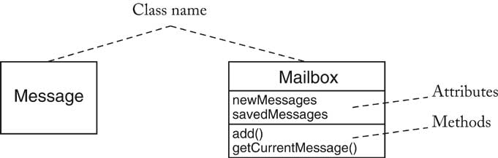
Class Diagrams
Rectangle with class name
Optional compartments
Attributes
Methods
Include only key attributes and methods

Slide 26
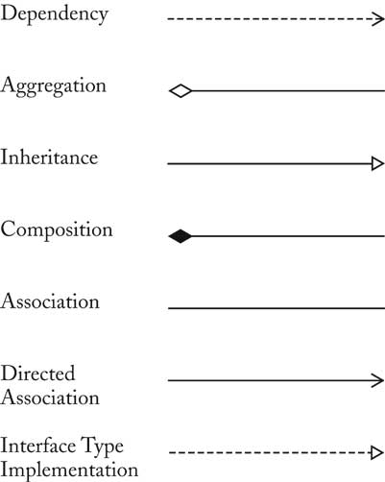
Class Relationships:

Slide 27
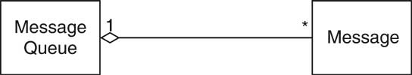
Multiplicities
any number (0 or more): *
one or more: 1..*
zero or one: 0..1
exactly one: 1

Slide 28
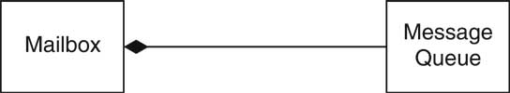
Composition
Special form of aggregation
Contained objects don't exist outside container
Example: message queues permanently contained in mail box

Slide 29
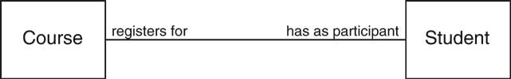
Association
Some designers don't like aggregation
More general association relationship
Association can have roles

Slide 30
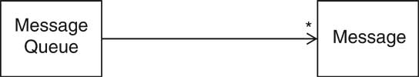
Association
Some associations are bidirectional
Can navigate from either class to the other
Example: Course has set of students, student has set of courses
Some associations are directed
Navigation is unidirectional
Example: Message doesn't know about message queue containing it

Slide 31
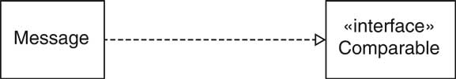
Interface Types
Interface type describes a set of methods
No implementation, no state
Class implements interface if it implements its methods
In UML, use stereotype «interface»

Slide 32
Tips
Use UML to inform, not to impress
Don't draw a single monster diagram
Each diagram must have a specific purpose
Omit inessential details

Slide 33
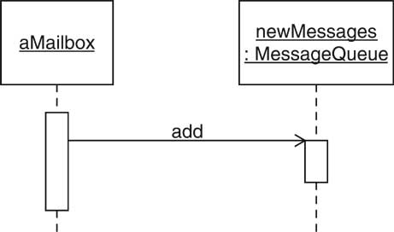
Sequence Diagrams
Each diagram shows dynamics of scenario
Object diagram: class name underlined

Slide 34
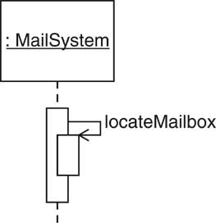
Self call

Slide 35
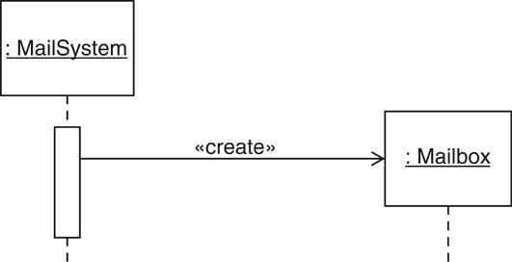
Object Construction

Slide 36
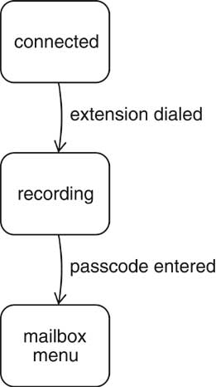
State Diagram
Use for classes whose objects have interesting states

Slide 37
Design Documentation
Recommendation: Use Javadoc comments
Leave methods blank
/**
Adds a message to the end of the new messages.
@param aMessage a message
*/
public void addMessage(Message aMessage)
{
}
Don't compile file, just run Javadoc
Makes a good starting point for code later

Slide 38
Case Study: Voice Mail System
Use text for voice, phone keys, hangup
1 2 ... 0 # on a single line means key
H on a single line means "hang up"
All other inputs mean voice
In GUI program, will use buttons for keys (see ch. 4)

Slide 39
Use Case: Reach an Extension
User dials main number of system
System speaks prompt:
Enter mailbox number followed by #
User types extension number
System speaks:
You have reached mailbox xxxx. Please leave a message
now

Slide 40
Use Case: Leave a Message
Caller carries out Reach an Extension
Caller speaks message
Caller hangs up
System places message in mailbox

Slide 41
Use Case: Log in
Mailbox owner carries out Reach an Extension
Mailbox owner types password and #
(Default password = mailbox number. To change, see Change the Passcode)
System plays mailbox menu:
Enter 1 to retrieve your messages.
Enter 2 to change your passcode.
Enter 3 to change your greeting.

Slide 42
Use Case: Retrieve Messages
Mailbox owner carries out Log in
Mailbox owner selects "retrieve messages" menu option
System plays message menu:
Press 1 to listen to the current message
Press 2 to delete the current message
Press 3 to save the current message
Press 4 to return to the mailbox menu
Mailbox owner selects "listen to current message"
System plays current new message, or, if no more new messages, current old message.
Note: Message is played, not removed from queue
System plays message menu
User selects "delete current message". Message is removed.
Continue with step 3.

Slide 43
Use Case: Retrieve Messages
Variation #1
1.1. Start at Step 6
1.2. User selects "save current message".
Message is removed from new queue and appended to old queue
1.3. Continue with step 3.

Slide 44
Use Case: Change the Greeting
Mailbox owner carries out Log in
Mailbox owner selects "change greeting" menu option
Mailbox owner speaks new greeting
Mailbox owner presses #
System sets new greeting

Slide 45
Use Case: Change the Greeting
Variation #1: Hang up before confirmation
1.1. Start at step 3.
1.2. Mailbox owner hangs up.
1.3. System keeps old greeting.

Slide 46
Use Case: Change the Passcode
Mailbox owner carries out Log in
Mailbox owner selects "change passcode" menu option
Mailbox owner dials new passcode
Mailbox owner presses #
System sets new passcode

Slide 47
Use Case: Change the Passcode
Variation #1: Hang up before confirmation
1.1. Start at step 3.
1.2. Mailbox owner hangs up.
1.3. System keeps old passcode.

Slide 48
CRC Cards for Voice Mail System
Some obvious classes:
Mailbox
Message
MailSystem

Slide 49
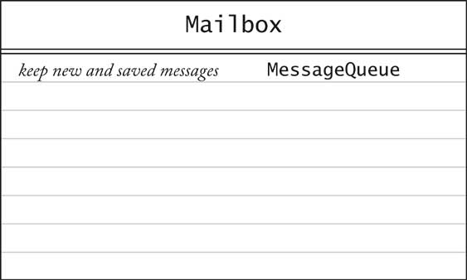
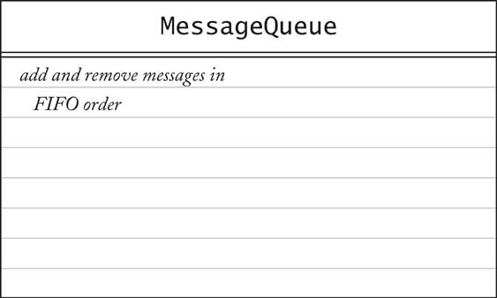

Slide 50
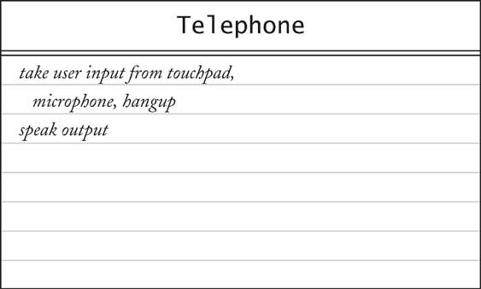
Telephone
Who interacts with user?
Telephone takes button presses, voice input
Telephone speaks output to user

Slide 51
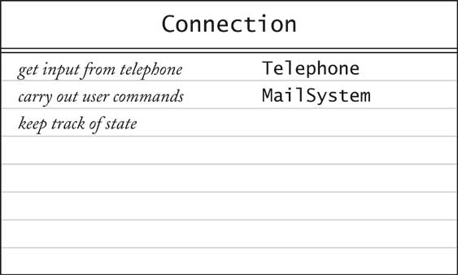
Connection
With whom does Telephone communicate
With MailSystem?
What if there are multiple telephones?
Each connection can be in different state (dialing, recording, retrieving messages,...)
Should mail system keep track of all connection states?
Better to give this responsibility to a new class

Slide 52
Analyze Use Case: Leave a message
User dials extension. Telephone sends number to Connection
(Add collaborator Telephone to Connection)
Connection asks MailSystem to find matching Mailbox
Connection asks Mailbox for greeting
(Add responsibility "manage greeting" to Mailbox,
add collaborator Mailbox to Connection)
Connection asks Telephone to play greeting
User speaks message. Telephone asks Connection to record it.
(Add responsibility "record voice input" to Connection)
User hangs up. Telephone notifies Connection.
Connection constructs Message
(Add card for Message class,
add collaborator Message to Connection)
Connection adds Message to Mailbox

Slide 53
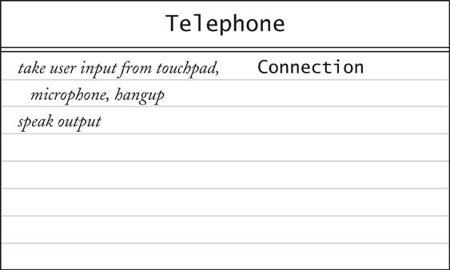
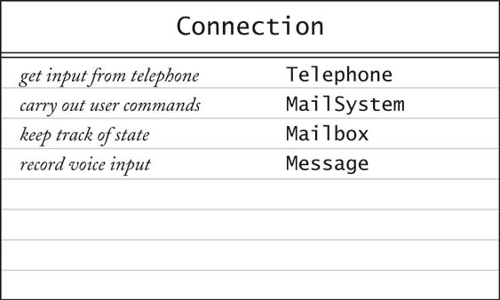
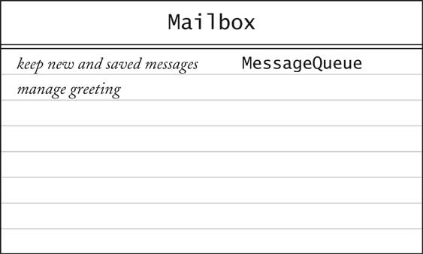
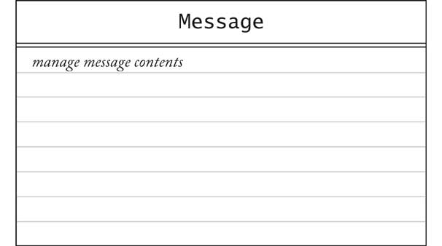
Result of Use Case Analysis

Slide 54
Analyse Use Case: Retrieve messages
User types in passcode. Telephone notifies Connection
Connection asks Mailbox to check passcode.
(Add responsibility "manage passcode" to Mailbox)
Connection sets current mailbox and asks Telephone to speak menu
User selects "retrieve messages". Telephone passes key to Connection
Connection asks Telephone to speak menu
User selects "listen to current message". Telephone passes key to Connection
Connection gets first message from current mailbox.
(Add "retrieve messages" to responsibility of Mailbox).
Connection asks Telephone to speak message
Connection asks Telephone to speak menu
User selects "save current message". Telephone passes key to Connection
Connection tells Mailbox to save message
(Modify responsibility of Mailbox to "retrieve,save,delete messages")
Connection asks Telephone to speak menu

Slide 55
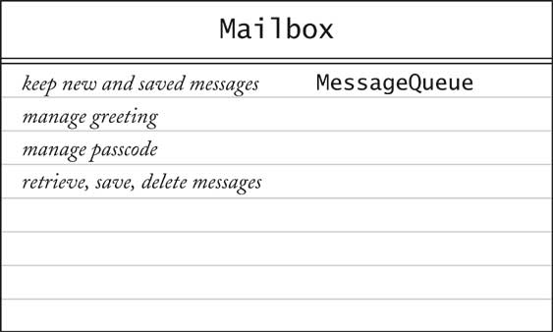
Result of Use Case Analysis

Slide 56
CRC Summary
One card per class
Responsibilities at high level
Use scenario walkthroughs to fill in cards
Usually, the first design isn't perfect.
(You just saw the author's third design of the mail system)

Slide 57
UML Class Diagram for Mail System
CRC collaborators yield dependencies
Mailbox depends on MessageQueue
Message doesn't depend on Mailbox
Connection depends on Telephone, MailSystem, Message, Mailbox
Telephone depends on Connection

Slide 58
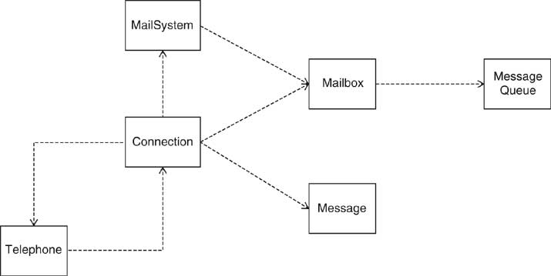
Dependency Relationships

Slide 59
Aggregation Relationships
A mail system has mailboxes
A mailbox has two message queues
A message queue has some number of messages
A connection has a current mailbox.
A connection has references to a mailsystem and a telephone

Slide 60
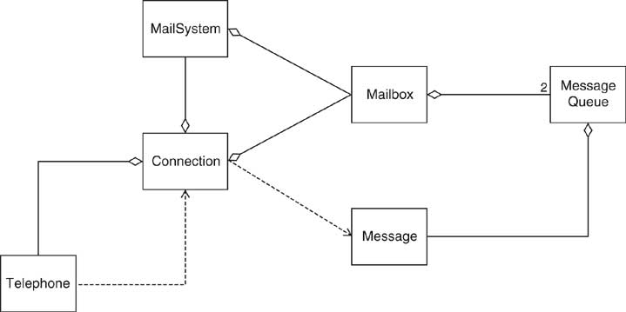
UML Class Diagram for Voice Mail System

Slide 61
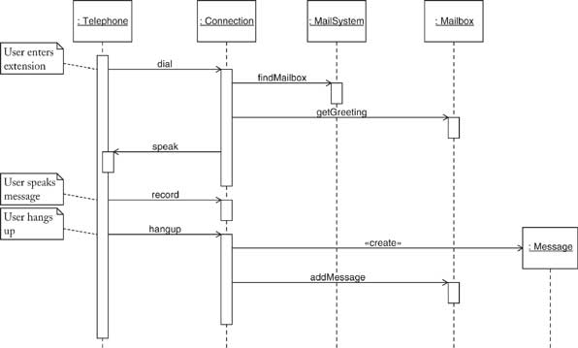
Sequence Diagram for Use Case: Leave a message

Slide 62
Interpreting a Sequence Diagram
Each key press results in separate call to dial, but only one is shown
Connection wants to get greeting to play
Each mailbox knows its greeting
Connection must find mailbox object:
Call findMailbox on MailSystem object
Parameters are not displayed (e.g. mailbox number)
Return values are not displayed (e.g. found mailbox)
Note that connection holds on to that mailbox over multiple calls

Slide 63
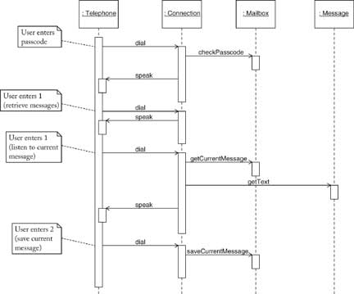
Sequence Diagram for Use Case: Retrieve messages

Slide 64
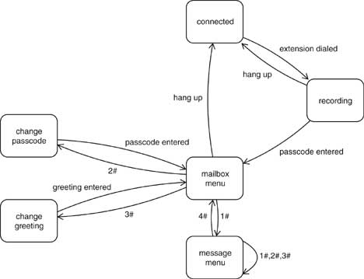
Connection State Diagram

Slide 65
01: /** //Message Class
02: A message left by the caller.
03: */
04: public class Message
05: {
06: /**
07: Construct a Message object.
08: @param messageText the message text
09: */
10: public Message(String messageText)
11: { 12: text = messageText;
12: }
13:
14: /**
15: Get the message text.
16: @return message text
17: */
18: public String getText()
19: { 21: return text;
20: }
21:
22: private String text;
23: }

Slide 66
01: import java.util.ArrayList; //MessageQueue Class
02:
03: /**
04: A first-in, first-out collection of messages. This
05: implementation is not very efficient. We will consider
06: a more efficient implementation in chapter 3.
07: */
08: public class MessageQueue
09: {
10: /**
11: Constructs an empty message queue.
12: */
13: public MessageQueue()
14: { queue = new ArrayList<Message>();
15: }
16: /**
17: Remove message at head.
18: @return message that has been removed from the queue
19: */
20: public Message remove()
21: { return queue.remove(0);
22: }

Slide 67
23: /** //MessageQueue Class
24: Append message at tail.
25: @param newMessage the message to be appended
26: */
27: public void add(Message newMessage)
28: { queue.add(newMessage);
29: }
30:
31: /**
32: Get the total number of messages in the queue.
33: @return the total number of messages in the queue
34: */
35: public int size()
36: { return queue.size();
37: }
38: /**
39: Get message at head.
40: @return message that is at the head of the queue, or null
41: if the queue is empty
42: */
43: public Message peek()
44: { if (queue.size() == 0) return null;
45: else return queue.get(0);
46: }
47: private ArrayList<Message> queue;
48: }

Slide 68
001: /** //Mailbox Class
002: A mailbox contains messages that can be listed, kept or discarded.
003: */
004: public class Mailbox
005: {
006: /**
007: Creates Mailbox object.
008: @param aPasscode passcode number
009: @param aGreeting greeting string
010: */
011: public Mailbox(String aPasscode, String aGreeting)
012: {
013: passcode = aPasscode;
014: greeting = aGreeting;
015: newMessages = new MessageQueue();
016: keptMessages = new MessageQueue();
017: }
018:
019: /**
020: Check if the passcode is correct.
021: @param aPasscode a passcode to check
022: @return true if the supplied passcode matches the mailbox passcode
023: */
024: public boolean checkPasscode(String aPasscode)
025: {
026: return aPasscode.equals(passcode);
027: }

Slide 69
029: /** //Mailbox Class
030: Add a message to the mailbox.
031: @param aMessage the message to be added
032: */
033: public void addMessage(Message aMessage)
034: {
035: newMessages.add(aMessage);
036: }
037:
038: /**
039: Get the current message.
040: @return the current message
041: */
042: public Message getCurrentMessage()
043: {
044: if (newMessages.size() > 0)
045: return newMessages.peek();
046: else if (keptMessages.size() > 0)
047: return keptMessages.peek();
048: else
049: return null;
050: }
051:

Slide 70
052: /** //Mailbox Class
053: Remove the current message from the mailbox.
054: @return the message that has just been removed
055: */
056: public Message removeCurrentMessage()
057: { if (newMessages.size() > 0)
059: return newMessages.remove();
060: else if (keptMessages.size() > 0)
061: return keptMessages.remove();
062: else
063: return null;
064: }
066: /**
067: Save the current message
068: */
069: public void saveCurrentMessage()
070: { Message m = removeCurrentMessage();
072: if (m != null)
073: keptMessages.add(m);
074: }

Slide 71
076: /** //Mailbox Class
077: Change mailbox's greeting.
078: @param newGreeting the new greeting string
079: */
080: public void setGreeting(String newGreeting)
081: { greeting = newGreeting;
083: }
085: /**
086: Change mailbox's passcode.
087: @param newPasscode the new passcode
088: */
089: public void setPasscode(String newPasscode)
090: { passcode = newPasscode;
092: }
094: /**
095: Get the mailbox's greeting.
096: @return the greeting
097: */
098: public String getGreeting()
099: { return greeting;
101: }
102:
103: private MessageQueue newMessages;
104: private MessageQueue keptMessages;
105: private String greeting;
106: private String passcode;
107: }

Slide 72
001: /** //Connection Class
002: Connects a phone to the mail system. The purpose of this
003: class is to keep track of the state of a connection, since
004: the phone itself is just a source of individual key presses.
005: */
006: public class Connection
007: {
008: /**
009: Construct a Connection object.
010: @param s a MailSystem object
011: @param p a Telephone object
012: */
013: public Connection(MailSystem s, Telephone p)
014: {
015: system = s;
016: phone = p;
017: resetConnection();
018: }
019:

Slide 73
020: /** //Connection Class
021: Respond to the user's pressing a key on the phone touchpad
022: @param key the phone key pressed by the user
023: */
024: public void dial(String key)
025: { if (state == CONNECTED)
027: connect(key);
028: else if (state == RECORDING)
029: login(key);
030: else if (state == CHANGE_PASSCODE)
031: changePasscode(key);
032: else if (state == CHANGE_GREETING)
033: changeGreeting(key);
034: else if (state == MAILBOX_MENU)
035: mailboxMenu(key);
036: else if (state == MESSAGE_MENU)
037: messageMenu(key);
038: }
040: /**
041: Record voice.
042: @param voice voice spoken by the user
043: */
044: public void record(String voice)
045: { if (state == RECORDING || state == CHANGE_GREETING)
047: currentRecording += voice;
048: }

Slide 74
050: /** //Connection Class
051: The user hangs up the phone.
052: */
053: public void hangup()
054: {
055: if (state == RECORDING)
056: currentMailbox.addMessage(new Message(currentRecording));
057: resetConnection();
058: }
059:
060: /**
061: Reset the connection to the initial state and prompt
062: for mailbox number
063: */
064: private void resetConnection()
065: {
066: currentRecording = "";
067: accumulatedKeys = "";
068: state = CONNECTED;
069: phone.speak(INITIAL_PROMPT);
070: }
071:

Slide 75
072: /** //Connection Class
073: Try to connect the user with the specified mailbox.
074: @param key the phone key pressed by the user
075: */
076: private void connect(String key)
077: {
078: if (key.equals("#"))
079: {
080: currentMailbox = system.findMailbox(accumulatedKeys);
081: if (currentMailbox != null)
082: {
083: state = RECORDING;
084: phone.speak(currentMailbox.getGreeting());
085: }
086: else
087: phone.speak("Incorrect mailbox number. Try again!");
088: accumulatedKeys = "";
089: }
090: else
091: accumulatedKeys += key;
092: }
093:

Slide 76
094: /** //Connection Class
095: Try to log in the user.
096: @param key the phone key pressed by the user
097: */
098: private void login(String key)
099: {
100: if (key.equals("#"))
101: {
102: if (currentMailbox.checkPasscode(accumulatedKeys))
103: {
104: state = MAILBOX_MENU;
105: phone.speak(MAILBOX_MENU_TEXT);
106: }
107: else
108: phone.speak("Incorrect passcode. Try again!");
109: accumulatedKeys = "";
110: }
111: else
112: accumulatedKeys += key;
113: }
114:

Slide 77
115: /** //Connection Class
116: Change passcode.
117: @param key the phone key pressed by the user
118: */
119: private void changePasscode(String key)
120: { if (key.equals("#"))
122: { currentMailbox.setPasscode(accumulatedKeys);
124: state = MAILBOX_MENU;
125: phone.speak(MAILBOX_MENU_TEXT);
126: accumulatedKeys = "";
127: }
128: else
129: accumulatedKeys += key;
130: }
132: /**
133: Change greeting.
134: @param key the phone key pressed by the user
135: */
136: private void changeGreeting(String key)
137: { if (key.equals("#"))
139: { currentMailbox.setGreeting(currentRecording);
141: currentRecording = "";
142: state = MAILBOX_MENU;
143: phone.speak(MAILBOX_MENU_TEXT);
144: }
145: }

Slide 78
147: /** //Connection Class
148: Respond to the user's selection from mailbox menu.
149: @param key the phone key pressed by the user
150: */
151: private void mailboxMenu(String key)
152: {
153: if (key.equals("1"))
154: {
155: state = MESSAGE_MENU;
156: phone.speak(MESSAGE_MENU_TEXT);
157: }
158: else if (key.equals("2"))
159: {
160: state = CHANGE_PASSCODE;
161: phone.speak("Enter new passcode followed by the # key");
162: }
163: else if (key.equals("3"))
164: {
165: state = CHANGE_GREETING;
166: phone.speak("Record your greeting, then press the # key");
167: }
168: }
169:

Slide 79
170: /** //Connection Class
171: Respond to the user's selection from message menu.
172: @param key the phone key pressed by the user
173: */
174: private void messageMenu(String key)
175: { if (key.equals("1"))
177: { String output = "";
179: Message m = currentMailbox.getCurrentMessage();
180: if (m == null) output += "No messages." + "\n";
181: else output += m.getText() + "\n";
182: output += MESSAGE_MENU_TEXT;
183: phone.speak(output);
184: }
185: else if (key.equals("2"))
186: { currentMailbox.saveCurrentMessage();
188: phone.speak(MESSAGE_MENU_TEXT);
189: }
190: else if (key.equals("3"))
191: { currentMailbox.removeCurrentMessage();
193: phone.speak(MESSAGE_MENU_TEXT);
194: }
195: else if (key.equals("4"))
196: { state = MAILBOX_MENU;
198: phone.speak(MAILBOX_MENU_TEXT);
199: }
200: }

Slide 80
202: private MailSystem system; //Connection Class
203: private Mailbox currentMailbox;
204: private String currentRecording;
205: private String accumulatedKeys;
206: private Telephone phone;
207: private int state;
208:
209: private static final int DISCONNECTED = 0;
210: private static final int CONNECTED = 1;
211: private static final int RECORDING = 2;
212: private static final int MAILBOX_MENU = 3;
213: private static final int MESSAGE_MENU = 4;
214: private static final int CHANGE_PASSCODE = 5;
215: private static final int CHANGE_GREETING = 6;
216:
217: private static final String INITIAL_PROMPT =
218: "Enter mailbox number followed by #";
219: private static final String MAILBOX_MENU_TEXT =
220: "Enter 1 to listen to your messages\n"
221: + "Enter 2 to change your passcode\n"
222: + "Enter 3 to change your greeting";
223: private static final String MESSAGE_MENU_TEXT =
224: "Enter 1 to listen to the current message\n"
225: + "Enter 2 to save the current message\n"
226: + "Enter 3 to delete the current message\n"
227: + "Enter 4 to return to the main menu";
228: }

Slide 81
01: import java.util.ArrayList; //MailSystem Class
02:
03: /**
04: A system of voice mail boxes.
05: */
06: public class MailSystem
07: {
08: /**
09: Constructs a mail system with a given number of mailboxes
10: @param mailboxCount the number of mailboxes
11: */
12: public MailSystem(int mailboxCount)
13: {
14: mailboxes = new ArrayList<Mailbox>();
15:
16: // Initialize mail boxes.
17:
18: for (int i = 0; i < mailboxCount; i++)
19: {
20: String passcode = "" + (i + 1);
21: String greeting = "You have reached mailbox " + (i + 1)
22: + ". \nPlease leave a message now.";
23: mailboxes.add(new Mailbox(passcode, greeting));
24: }
25: }

Slide 82
27: /** //MailSystem Class
28: Locate a mailbox.
29: @param ext the extension number
30: @return the mailbox or null if not found
31: */
32: public Mailbox findMailbox(String ext)
33: {
34: int i = Integer.parseInt(ext);
35: if (1 <= i && i <= mailboxes.size())
36: return mailboxes.get(i - 1);
37: else return null;
38: }
39:
40: private ArrayList<Mailbox> mailboxes;
41: }

Slide 83
01: import java.util.Scanner; //Telephone Class
02:
03: /**
04: A telephone that takes simulated keystrokes and voice input
05: from the user and simulates spoken text.
06: */
07: public class Telephone
08: {
09: /**
10: Construct phone object.
11: @param aScanner that reads text from a character-input stream
12: */
13: public Telephone(Scanner aScanner)
14: { scanner = aScanner;
16: }
17:
18: /**
19: Speak a message to System.out.
20: @param output the text that will be "spoken"
21: */
22: public void speak(String output)
23: { System.out.println(output);
25: }

Slide 84
27: /** //Telephone Class
28: Loops reading user input and passes the input to the
29: Connection object's methods dial, record or hangup.
30: @param c the connection that connects this phone to the
31: voice mail system
32: */
33: public void run(Connection c)
34: { boolean more = true;
36: while (more)
37: { String input = scanner.nextLine();
39: if (input == null) return;
40: if (input.equalsIgnoreCase("H"))
41: c.hangup();
42: else if (input.equalsIgnoreCase("Q"))
43: more = false;
44: else if (input.length() == 1 && "1234567890#".indexOf(input) >= 0)
46: c.dial(input);
47: else
48: c.record(input);
49: }
50: }
52: private Scanner scanner;
53: }

Slide 85
01: import java.util.Scanner; //MailSystemTester Class
02:
03: /**
04: This program tests the mail system. A single phone
05: communicates with the program through System.in/System.out.
06: */
07: public class MailSystemTester
08: {
09: public static void main(String[] args)
10: {
11: MailSystem system = new MailSystem(MAILBOX_COUNT);
12: Scanner console = new Scanner(System.in);
13: Telephone p = new Telephone(console);
14: Connection c = new Connection(system, p);
15: p.run(c);
16: }
17:
18: private static final int MAILBOX_COUNT = 20;
19: }

Slide 86
End

