Slide 1



Rockbuster Stealth
Analysis by Jordan henghold

Slide 2

Introduction
Rockbuster Stealth LLC is a company which has previously rented movies out from storefronts across the globe.
Rockbuster’s management crew now plans to transition from storefronts to utilizing an online platform to rent out movies, so that the company can continue to thrive in a streaming-dominated industry.
Project Goals:
- The Company 2020 Launch strategy is to be implemented by the business intelligence initiative to launch the new online strategy.
- Streaming pros like Amazon Prime and Netflix must be competitively considered to complete data-driven results in this project, while ensuring sustainable strategies and decisions validated by data.

Slide 3
Overview
599 Customers
109 Countries
600 Cities
6 Languages (English is most frequent)
1,000 Films in Database
16,044 Total Rentals
Total Payments: 14,596 Total Revenue: $61,312.04

Slide 4
Rental Duration Averages and Rates
 | Minimum | Maximum | Average | Count
Rental Duration | 3 | 7 | 4.99 | 1,000
Rental Rate | 0.99 | 4.99 | 2.98 | 1,000
Length | 46 | 185 | 115.27 | 1,000
Replacement Cost | 9.99 | 29.99 | 19.98 | 1,000

Slide 5
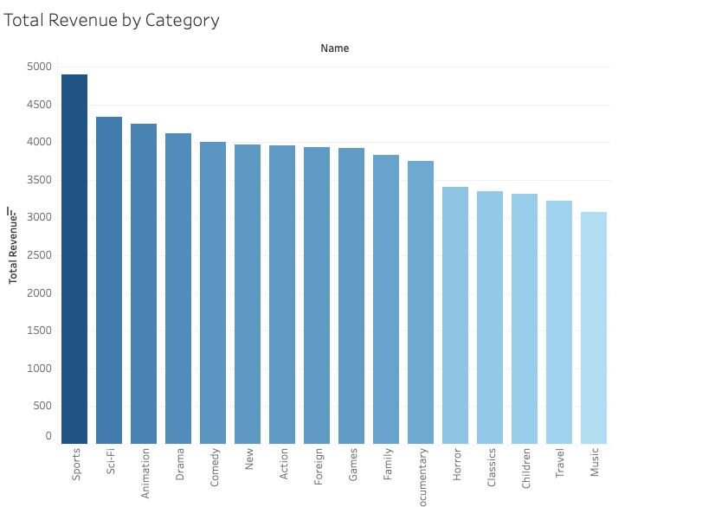
Movie Categories by Popularity & Contribution to percentage of Revenue
Data Interpretation:
Greatest Revenue- Sport ($4,892 in Revenue), 8% Rev.
Least Revenue- Music, Travel, Children, Classics, Horror (under $3,401 each in Rev.), 27% Rev.
Remaining Categoric Revenue- Sci-Fi, Animation, Drama, Comedy, New, Action, Foreign, Games, Family, and Documentary ($4,336-$3,750 range in Rev.), 65% Rev.
Link to Graph:
https://public.tableau.com/app/profile/jordan.henghold/viz/RockbusterRevenuebyCategory/TotalRevenuebyCategory?publish=yes

Slide 6
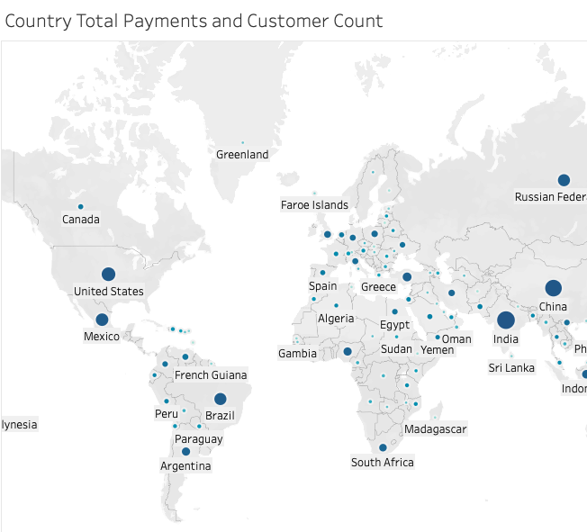
Total Payments and Customer Count by Country
599 Customers across 109 Countries
Link to Tableau Map:
https://public.tableau.com/app/profile/jordan.henghold/viz/RockbusterMap_16938586828500/CountryPaymentsCustomerCount?publish=yes

Slide 7
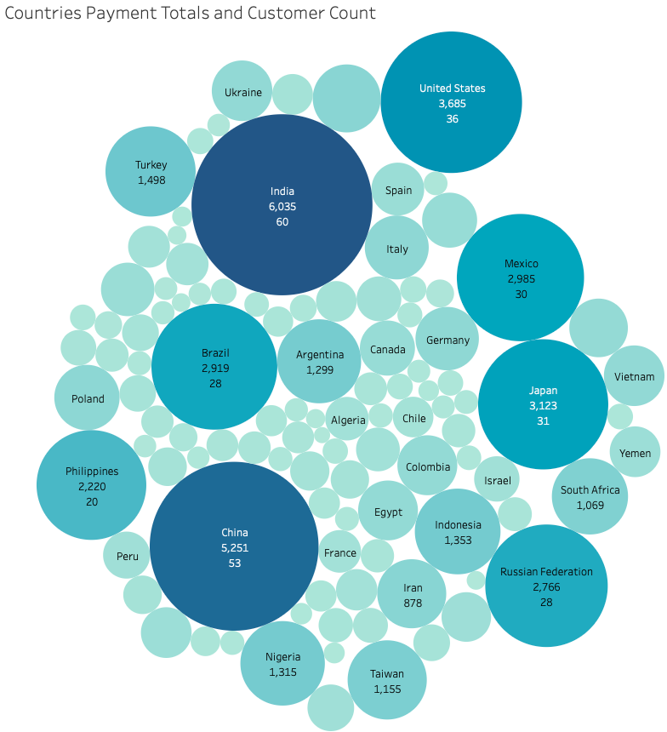
Top 10 Countries BY Revenue & Customer Count
India, 60 customers, 10% of Revenue
China, 53 customers, 8% of Revenue
USA, 36 customers, 6% of Revenue
Japan, 31 customers, 5% of Revenue
Mexico, 30 customers, 5% of Revenue
Brazil, 28 customers, 4% of Revenue
Russia, 28 customers, 4% of Revenue
Philippines, 20 customers, 3% of Revenue
Turkey, 15 customers, 2% of Revenue
Indonesia, 14 customers, 2% of Revenue
Link to Tableau Bubble Chart:
https://public.tableau.com/app/profile/jordan.henghold/viz/RockbusterBubbleChart/Sheet1?publish=yes

Slide 8
Top Customers
Top 5: Global
Customer_ID | First_Name | Last_Name | Country | City | Total_Amount_Paid
148 | Eleanor | Hunt | Runion | Saint-Denis | $211.55
526 | Karl | Seal | United States | Cape Coral | $208.58
178 | Marion | Snyder | Brazil | Santa Barbara | $194.61
137 | Rhonda | Kennedy | Netherlands | Apeldoorn | $191.62
144 | Clara | Shaw | Belarus | Molodetno | $189.60
Top 5: Top 10 Cities
Customer_ID | First_Name | Last_Name | Country | City | Total_Amount_Paid
225 | Arlene | Harvey | India | Ambattur | $111.76
424 | Kyle | Spurlock | China | Shanwei | $109.71
240 | Marlene | Welch | Japan | Iwaki | $106.77
486 | Glen | Talbert | Mexico | Acua | $100.77
537 | Clinton | Buford | United States | Aurora | $98.76

Slide 9
Conclusive Recommendations
The highest grossing countries (China and India) are bringing in revenues exceeding $5,200 per country—representing 18% of total revenue.
There are customers in the database presenting immense loyalty– creating a loyalty program would be a useful incentive to offer boosting revenue while collecting client feedback.
Genres which remain most popular (Sport, Sci-Fi, Animation, etc.) should be massively provided with a diverse selection of options so that revenue remains consistent.
Expand the customer base even further by looking to countries which Rockbuster has not yet branched into—for untapped market potential (i.e. countries in Europe, Africa, America, etc.).
Promotional campaigns should be incited into our top countries to solidify the continued revenue in our strongest geographic regions (India, China, US, Japan, Mexico, etc.).
Focus less money into the least popular genres during the initial launch (Music, Travel, Children, etc.).

Slide 10
Thank you!
For comments, questions and concerns:
jordanhenghold@gmail.com
*If Tableau links provide any trouble, right-click the link, go to hyperlink and then Open! ☺

