Slide 1
Cluster IOT: Unit testing
Week 7
Adrian Gould
Murray Hay
Sander Huijsen
ICT40120 Certificate IV in Programming

Slide 2
In this session, you will learn about unit testing
Background about unit testing
Short video about unit testing in Python
Socratica: https://www.youtube.com/watch?v=1Lfv5tUGsn8
Components of the Python unittest framework
Exercise:
Write your first unit test
Wrap up
Session duration: about 40 minutes

Slide 3
What is unit testing?
It’s in the name… It tests units of code
For example: a single function
In an OO context, those units are usually classes
Preferably, unit testing is part of an automated process
Sometimes integrated into CI/CD workflow:
Commit a change ⇒ run tests ⇒ accept (or decline) change
Notes:
CI/CD ⇒ Continuous Integration / Continuous Deployment

Slide 4
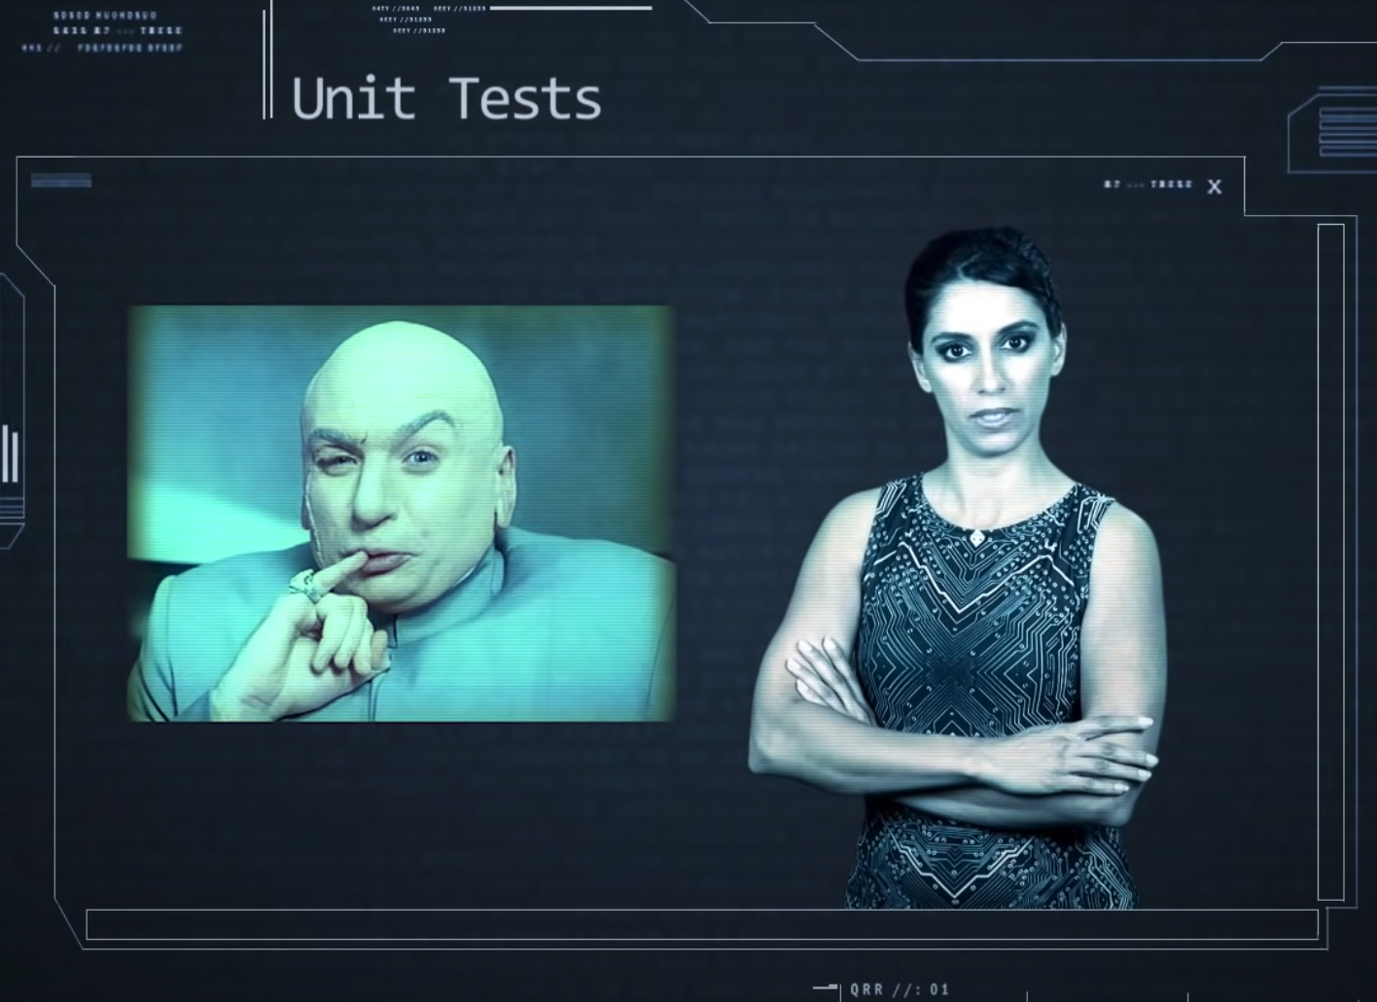
Video: Socratica on Python unit testing
Link: https://www.youtube.com/watch?v=1Lfv5tUGsn8
Notes:
https://www.youtube.com/watch?v=1Lfv5tUGsn8

Slide 5
Python unit testing
Python provides the unittest framework
Inspired by JUnit
Concepts used in unit testing:
Test fixture
Test case
Test suite
Test runner

Slide 6
Test fixture
This pertains to the preparation need to run (a) test(s)
Cleanup too
For example:
Creating temporary or proxy database
Creating or setting up directories
Starting a server process

Slide 7
Test case
This is the individual unit of testing
Test cases are derived from the base class TestCase
It checks for a specific response to a stimulus (input)
Based on “assertions” (statements that should be True)

Slide 8
Test suite
This is a collection of test cases or test suites
Use this to group tests that belong together

Slide 9
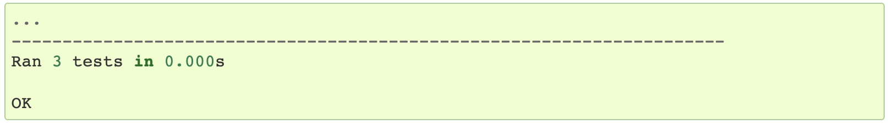
Test runner
Runs the tests and conveys the results (pass/fail) to the user
Example output of a successful run:

Slide 10
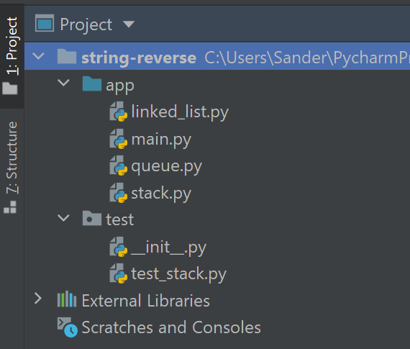
Project structure
The project has a separate
app directory
test directory
The test directory is a “package”
hence the __init__.py (which can be empty)
without it, no tests will be found!
Notes:
This is just an example of how you can set up your project. For very simple project, like the one in Exercise 1, you don't need to do this. Just put the unit tests in the same folder as the source code.

Slide 11
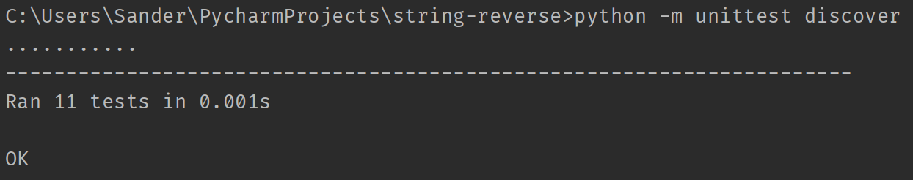
Running unit tests
This will automatically discover unit tests
If the terminal in PyCharm doesn’t work, use a regular terminal

Slide 12
Structure of unit tests
Example: test_stack.py
import unittest
from app.stack import Stack # The object we’re testing
class TestStack(unittest.TestCase):
def setUp(self):
# Prepare the test fixture:
# create a stack to be used by each test
# that has a depth of 3 objects.
self.stack = Stack(max_size=3)
Notes:
The method setUp is called before each and every test in the class.
That way, each test can run from a pre-defined state, in this case using an empty stack with a capacity of three elements.
It also prevents code duplication, as you don’t have to instantiate a Stack object for each test.

Slide 13
Structure of unit tests
A single test in the test class:
class TestStack(unittest.TestCase):
# continued…
def test_is_empty_is_true_for_empty_stack(self):
self.assertTrue(self.stack.is_empty())
Notes:
This assert method tests that the return value from the method is_empty() is indeed True for an empty Stack. If the methods returns False, an exception is raised, and the test fails.
If you’re expecting a False result, you can also use the self.assertFalse() method of the test class.

Slide 14
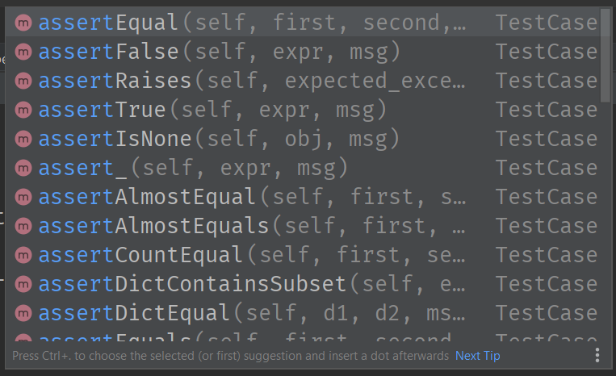
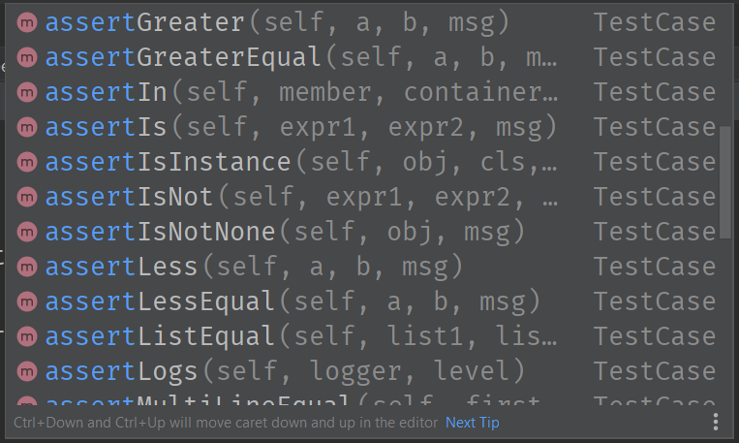
Assertions
There are numerous assertions available

Slide 15
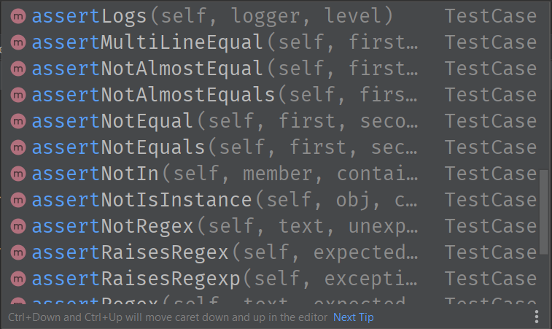
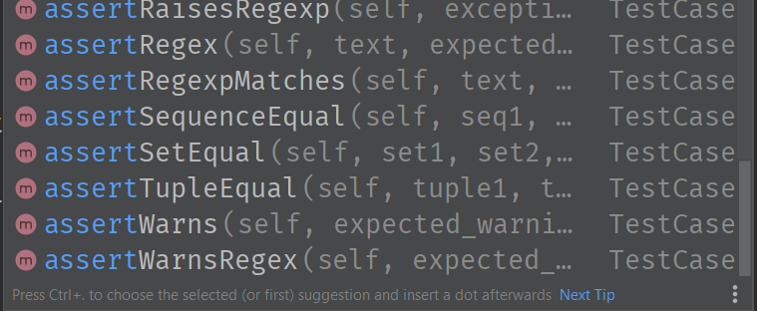
Assertions
There are numerous assertions available

Slide 16
Common assertions
We’ve seen assertTrue (assertFalse tests opposite)
self.assertEquals(a, b) compares two values a and b
If a != b, an exception is raised, and the test fails.
A third parameter can be used as a “message” field, which will be shown if the test fails.

Slide 17
Common assertions
If you want to test whether an exception is raised:
def test_exception_is_raised(self):
# You can tell which exception is expected
with self.assertRaises(IndexError):
self.stack.push(3)
Please note that the Socratica video shows another method of checking for exceptions.
Notes:
This technique uses a context manager (the “with” statement).

Slide 18
Exercise 1 – In class
Write a function that calculates the sum of two numbers
Call it add or add2, not sum (that is a built-in function)
Include a docstring!
Write the unit tests that check:
that correct values are calculated for integer, floating point, and complex numbers (e.g., 2 - 1j is complex)
that a TypeError is raised if any of the arguments is not a valid type
Question:
do you need to test for a ValueError like in the Socratica video?

Slide 19
Exercise 2 - SOCA
Download the file string_num_value.zip from Blackboard
Unpack it somewhere and load it as a project in your IDE
Probably PyCharm
Run the unit tests from within the IDE
Can you make any of the tests fail?
Can you implement the missing functionality and the test that goes with it?
Notes:
SOCA = Structured Out of Class Activities

