Slide 1


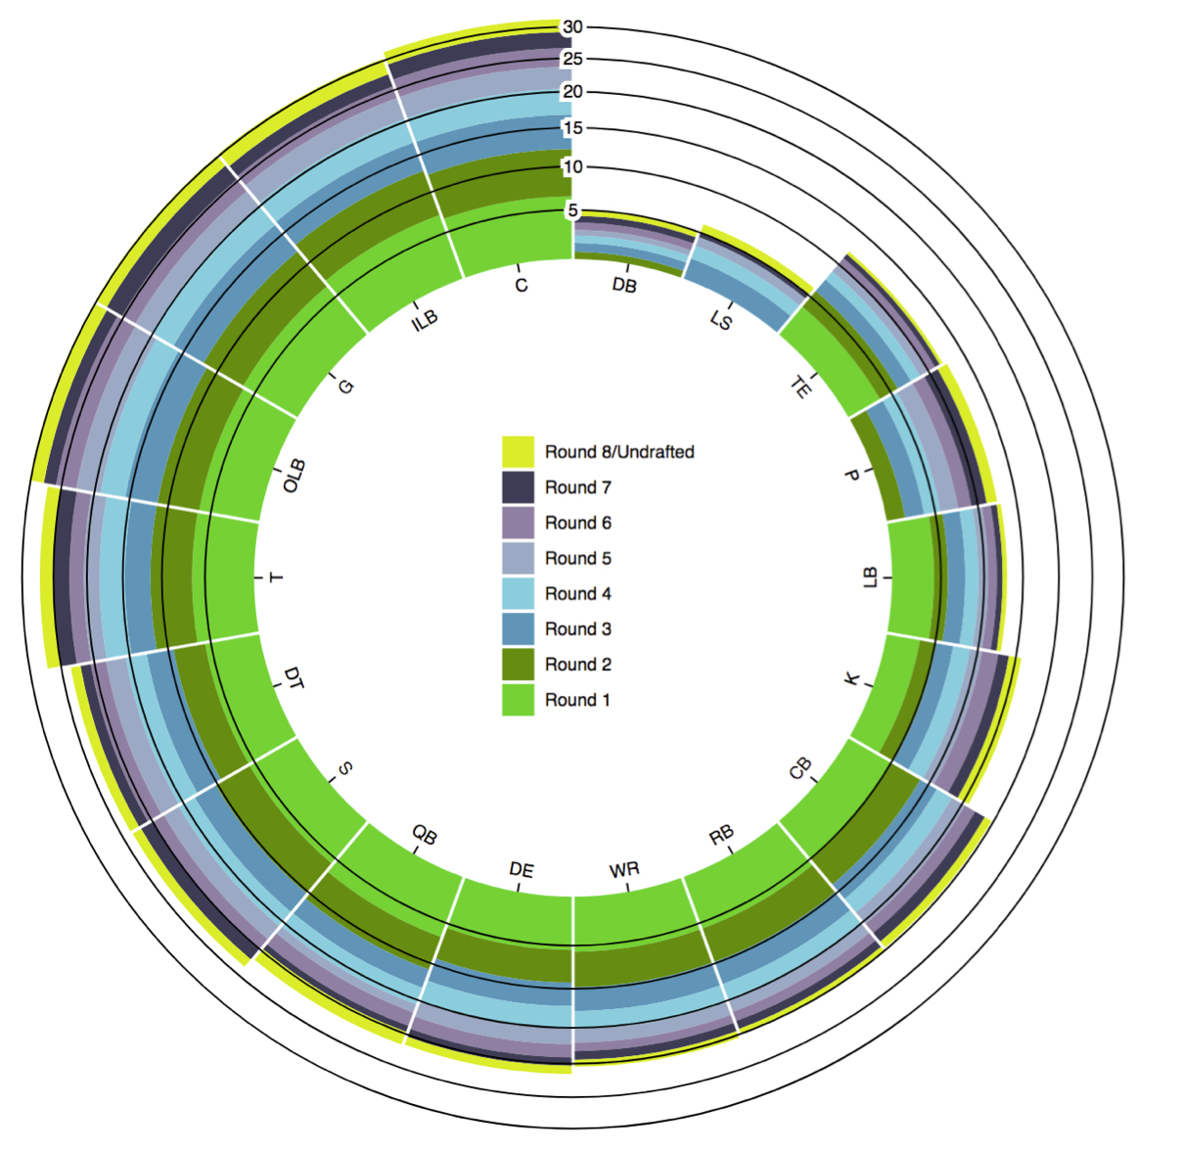
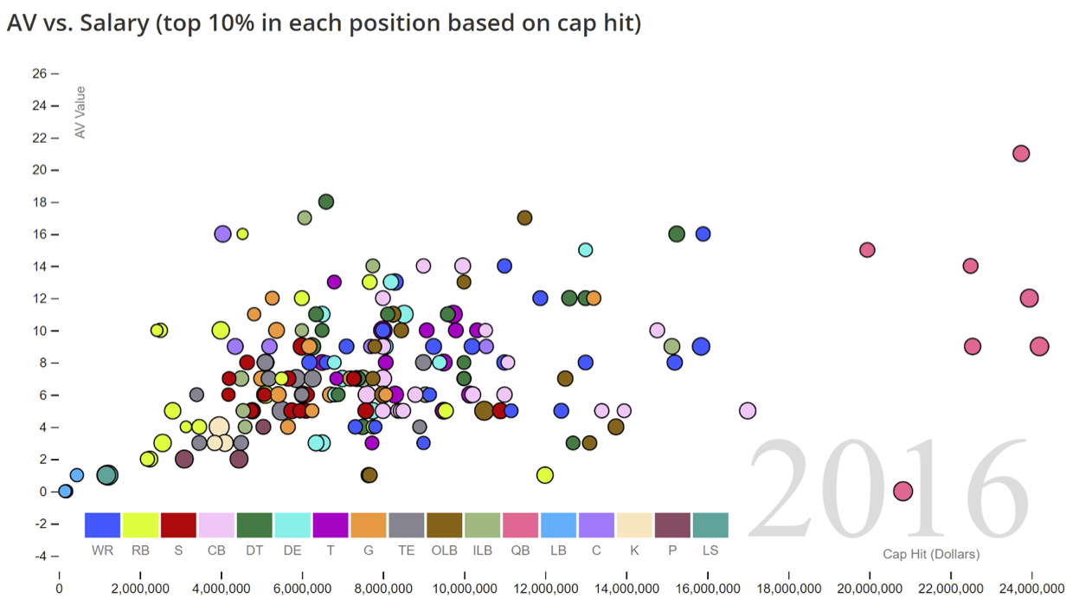
Analysis of NFL Player Valuation
CSCI 1951A
Isaiah Bryant, Edan Eingal, Kevin Li, Steven Liao
OVERVIEW
SALARY ANALYSIS
DRAFT ANALYSIS
TEAM COMPOSITION
DATA

