Slide 1

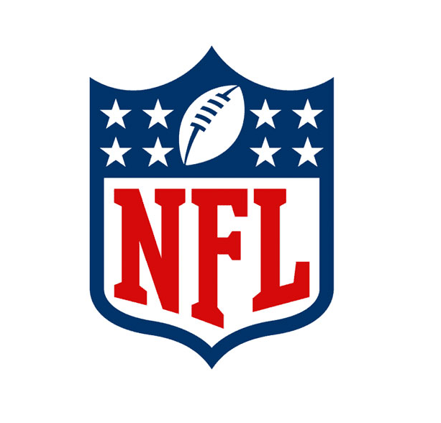
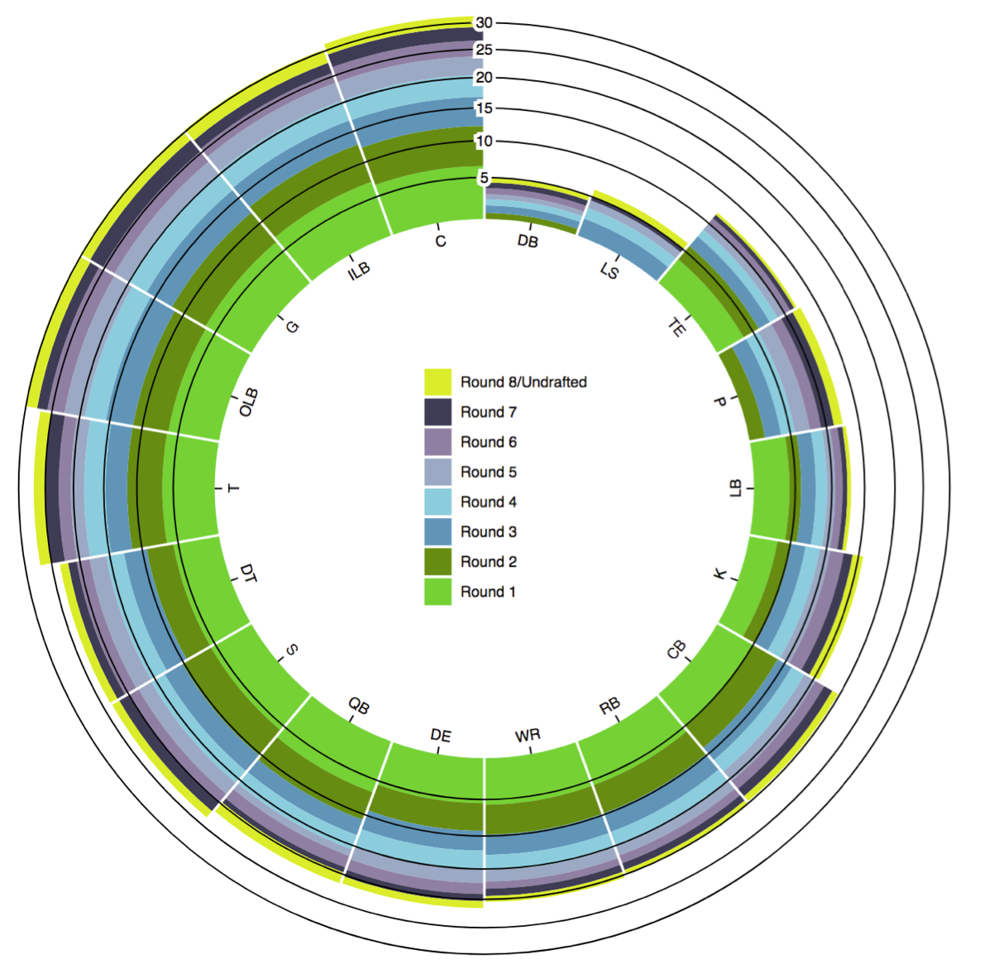
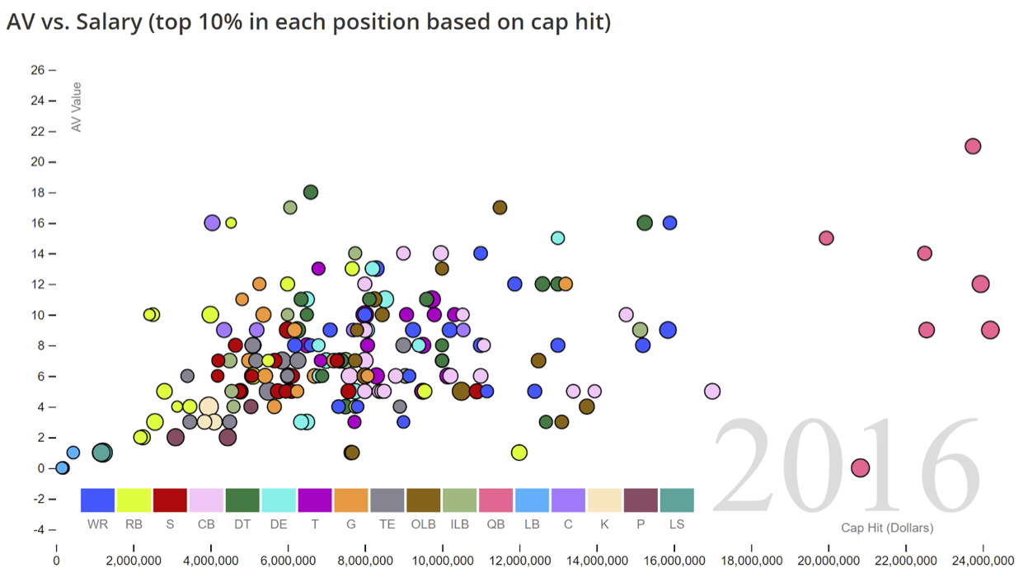
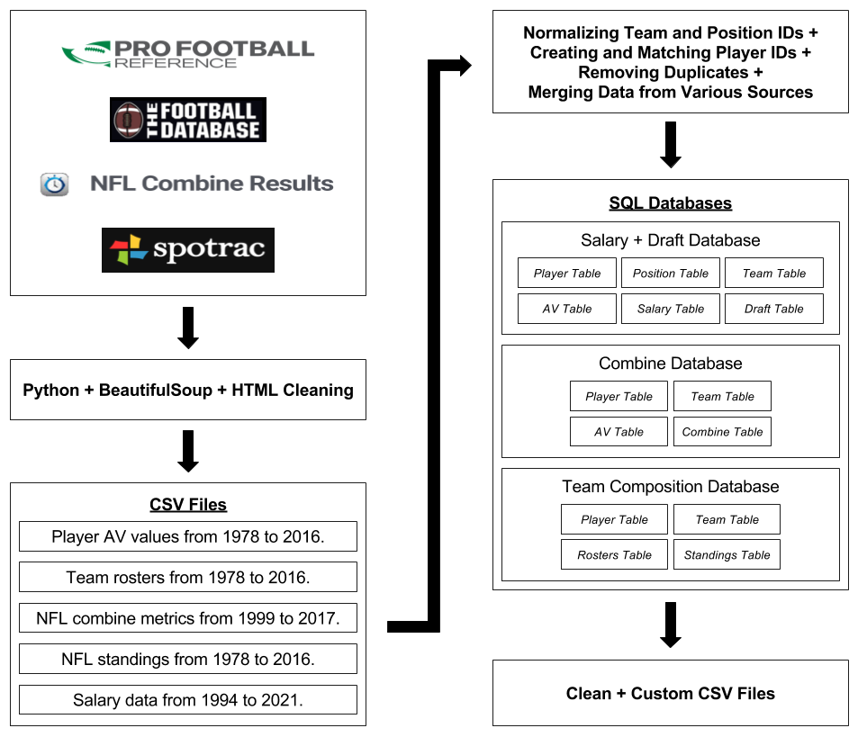
Analysis of NFL Player Valuation
CSCI 1951A
Isaiah Bryant, Edan Eingal, Kevin Li, Steven Liao
OVERVIEW
CHALLENGES
DRAFT ANALYSIS
TEAM COMPOSITION
Our analysis of the draft dates from 1980, and groups all players in a given position and drafted in the same round together (with the exception of Round 8 and undrafted players). The results show clearly:
A decreasing total average AV value as the draft rounds increase
A higher contribution to AV from certain positions such as quarterbacks (QB)
A relatively steady average AV value for kickers (K) indicating that teams may wish to draft these positions in later rounds.
SALARY ANALYSIS
DATA COLLECTION
COMBINE NEAREST NEIGHBORS
We performed a k nearest neighbors algorithm using the combine and AV data that we collected in order to determine the projected seasonal AV of all players selected in the first round of the 2017 NFL draft. We based this analysis purely on combine metrics, choosing to ignore other measurables such as college statistics, personality, and injury history that NFL teams often utilize to evaluate draft prospects. The results below were obtained using a k value of 3 and by limiting comparisoxn to neighbors with the same position.
- We collected AV data from 1978 to 2016 from Pro Football Reference, roster data from 1978 to 2016 from Pro Football Reference and The Football Database, combine data from 1999 to 2017 from Pro Football Reference and NFL Combine Results, standings data from 1978 to 2016 from Pro Football Reference, and salary data from 1994 to 2021 from Spotrac.
his data using Python’s BeautifulSoup package.
- We stored this data in CSV files.
- We cleaned the data in the CSV files and merged similar data.
- We loaded the cleaned data into SQL databases. We decided that it would be best to store data used in separate parts of our project in different databases.
- We created custom-made CSV files with cleaned data using SQL queries.

