Slide 1
DAEMONARCHY 1.5.X
Daemonarchy
The Omarchy desktop, running on FreeBSD, installed the way the Omarchy ISO installs it on Arch.
Edition for 1.5.1. Describes the published 1.5.0 release (2026-11-04) as documented in the repository; 1.5.1 items are plans, not shipped.
Notes:
Open with the one-sentence definition. The name is a homage: Omarchy's -archy, ruled by the BSD daemon. Say up front that this deck describes what the repository documents for 1.5.0 and what 1.5.1 plans, and marks both honestly.

Slide 2
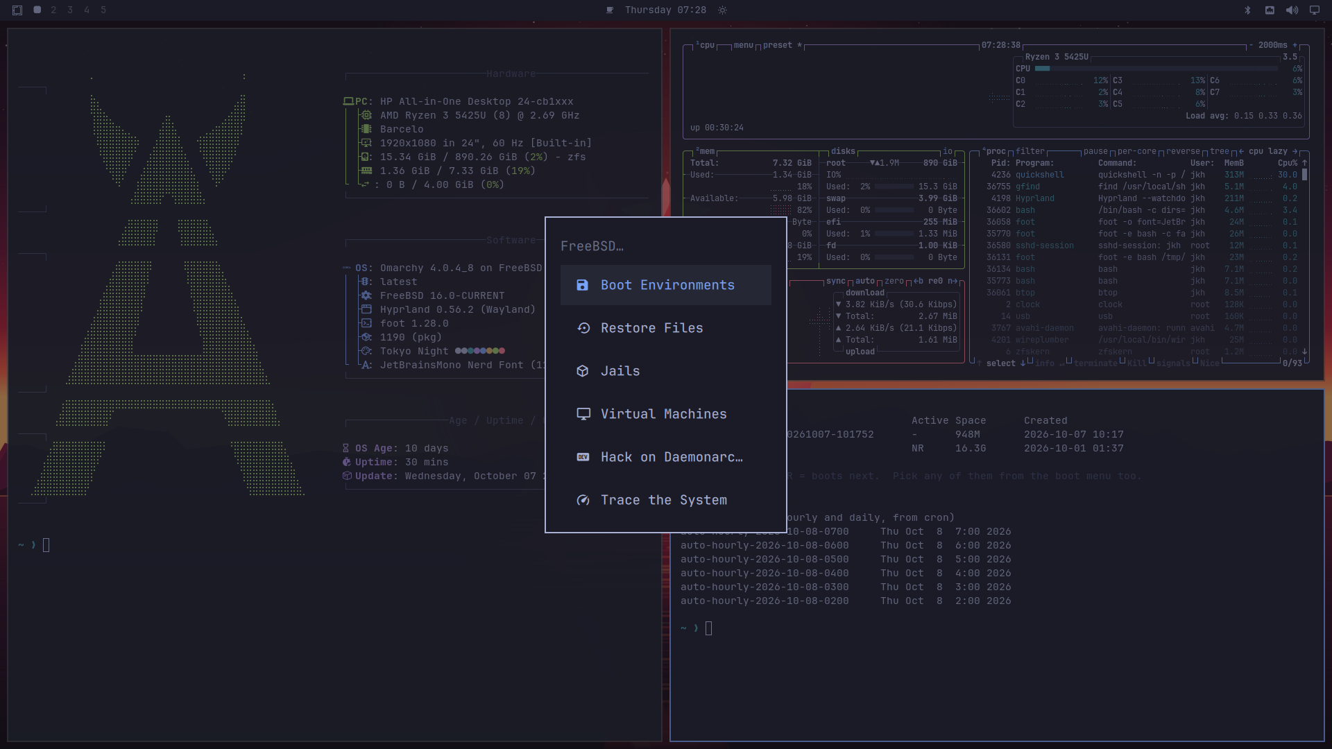
WHAT IT IS
An opinionated desktop on an operating system you can inspect
Omarchy's Hyprland desktop, ported to FreeBSD. The Omarchy software comes unchanged apart from FreeBSD compatibility, from the x11-wm/omarchy port.
A bootable installer image with the same welcome, keyboard, account, hostname and timezone questions as the Omarchy ISO.
FreeBSD 16.0-CURRENT underneath, from a snapshot; each image is tied to the snapshot it was built from.
Independent. Not affiliated with or endorsed by Omarchy, the FreeBSD Project or the FreeBSD Foundation.
The Daemonarchy desktop with the System > FreeBSD menu open (docs/images/desktop.png).
Daemonarchy | users | 1.5.1
Source: README.md (intro, Names and marks)
2
Notes:
The screenshot shows fastfetch, btop, boot environments and home snapshots with the System > FreeBSD menu open.

Slide 3
WHY IT EXISTS
Two projects joined, neither claimed
Daemonarchy is a union of two projects and says so wherever the system describes itself (About reads "Omarchy <version> on FreeBSD <release>").
From Omarchy
From FreeBSD
Added by Daemonarchy
A keyboard-driven Hyprland desktop with one set of opinions.
The installer's look and its setup form, sourced from Omarchy's own files so the questions and validation are identical.
Its panels: network, Wi-Fi, Bluetooth, sound.
ZFS with boot environments instead of Snapper snapshots.
Jails, bhyve virtual machines and DTrace.
Its own network, Wi-Fi (wpa_supplicant) and Bluetooth stacks, and the Ports/pkg package collection.
An installer onto a whole disk, a selected GPT partition or free space.
A signed package feed for what pkg.FreeBSD.org does not publish.
Original artwork, login theme and the System > FreeBSD menu.
Daemonarchy | users | 1.5.1
Source: README.md (What FreeBSD adds, The installer, Names and marks)
3

Slide 4
SAME
What stays the same as FreeBSD
It is FreeBSD, not a reimplementation: your FreeBSD knowledge and tools still apply.
The base system
The tools
The hardware layer
FreeBSD 16.0-CURRENT, OSVERSION 1600029 in 1.5.0.
Base, kernel and 32-bit libraries come from a FreeBSD snapshot's base.txz, kernel.txz and lib32.txz.
Built from the owned daemonarchy-src fork, which tracks upstream and sends useful fixes back.
pkg and the official FreeBSD package collection: compatible packages come from pkg.FreeBSD.org.
ZFS, boot environments, jails, bhyve and DTrace.
Optional shallow /usr/src and /usr/ports Git checkouts, pinned to the release.
FreeBSD's drivers and Wi-Fi stack, with DRM and firmware kernel modules built for the snapshot kernel.
Bluetooth keyboards and mice through FreeBSD's own stack.
Linux programs only through FreeBSD's Linuxulator, and only once an exact version is qualified.
Daemonarchy | users | 1.5.1
Source: README.md (What the image contains, Source); docs/freebsd-application-policy.md
4

Slide 5
DIFFERENT
What is different from stock FreeBSD
Area
Stock FreeBSD
Daemonarchy
Out of the box
A base system you build a desktop on
A finished Omarchy Hyprland desktop with SDDM, menus, theme and artwork
Installer
bsdinstall
Omarchy-style questions, a network step (packages download at install) and a disk step with optional encryption
Packages
pkg.FreeBSD.org
Also a signed Daemonarchy feed, published as GitHub release assets, with the Omarchy ports and snapshot-built GPU and Wi-Fi modules
Base and kernel source
Upstream FreeBSD
An owned fork, daemonarchy-src, pinned by full commit per release
Releases
FreeBSD's schedule
Its own semantic version; each image tied to one CURRENT snapshot
Upgrades
FreeBSD's own tools
pkg upgrade updates applications; base and kernel still arrive by a new image (network upgrade is planned for 1.5.1)
Daemonarchy | users | 1.5.1
Source: README.md; HACKING.md (the upgrade model today); docs/roadmap/release-1.5.1.md
5

Slide 6
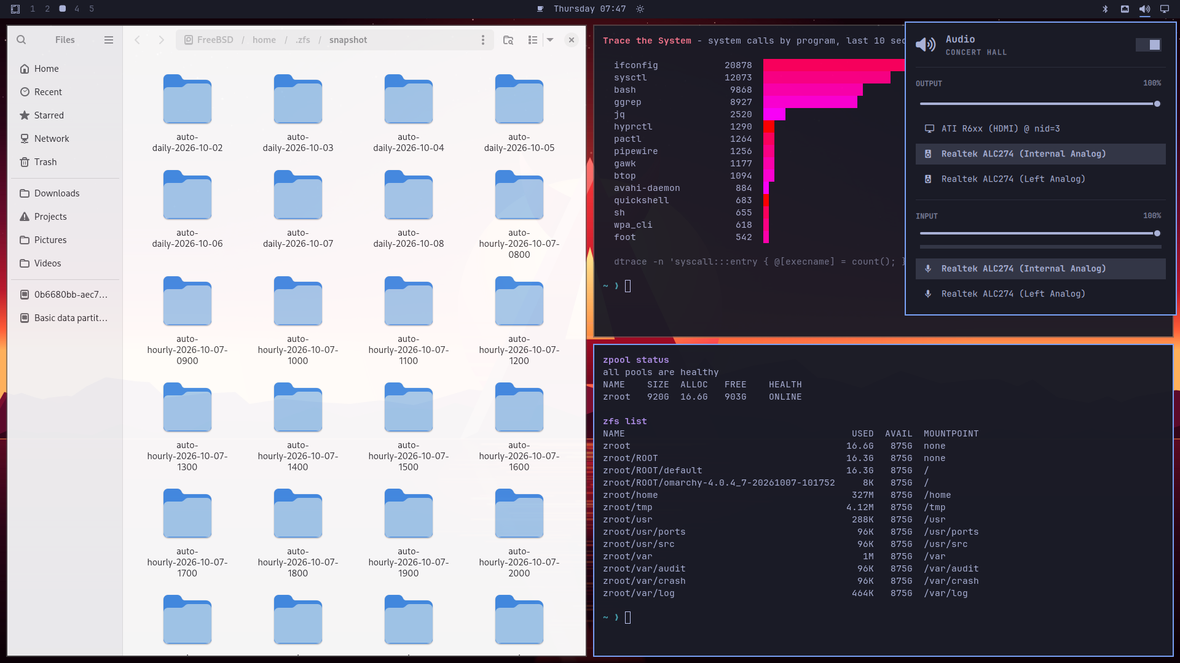
WHAT YOU GET
FreeBSD's strengths, one menu away
Boot environments. Every Omarchy update first saves a bootable copy of the whole system; roll back from the menu or the boot loader.
Restore files. Hourly and daily ZFS snapshots of home directories, kept for a day and a week.
Jails and virtual machines. FreeBSD containers, and bhyve for Linux, Windows or the BSDs.
Trace the system with live DTrace views.
Hack on Daemonarchy from the same menu: fetch the sources and run the desktop from your own checkout.
Home snapshots in Files, a live DTrace view, the ZFS pool and the sound panel (docs/images/freebsd.png).
Daemonarchy | users | 1.5.1
Source: README.md (What FreeBSD adds)
6

Slide 7
WHAT SHIPPED
New in 1.5.0, with the evidence stated
The release was re-scoped on 2026-11-03 to work that has evidence.
Windows programs and Steam (amd64)
Graphical package manager
Faster login on one machine
Apps menu entries that set up Wine, Wine Mono and DXVK on first launch.
VERIFIED On a build VM the real first run created the prefix, ran Valve's installer, and Steam updated itself (headless).
NOT VERIFIED A Windows game or Steam window on real hardware.
daemonarchy-pkg: a GTK 4 window over the installer's planner, with a plan before every change.
LIMIT Packaged, but no real-desktop evidence yet; OctoPkg stays the fallback.
Aquamarine probes connectors only on hotplug.
VERIFIED MSI Raider 18 HX: login to the shell 2.95 s to 1.32 s warm, from the first version of the patch.
NOT VERIFIED Hotplug, resume, lid and VT switch.
Daemonarchy | users | 1.5.1
Source: docs/release-1.5.0.md (What changes)
7

Slide 8
INSTALLING
How it installs
A USB stick, a network connection, and answers to the familiar questions.
Download
Write a stick
Boot
Answer
Install
The .iso.xz and its .sha256 from the GitHub release
xz -dc image.iso.xz | dd of=/dev/<usb> bs=1M
Secure Boot off, or enroll the project certificate
Welcome, keyboard, account, hostname, timezone, network, disk
ZFS layout, base system, then pkg installs the desktop
Whole-disk mode erases the disk; partition mode replaces only the partition you select. The installer needs a network: packages download during the install.
Unattended installs read answers from a CIDATA drive. A console rescue menu and approved remote debugging help when something goes wrong.
Daemonarchy | users | 1.5.1
Source: README.md (Download, The installer, Unattended installs); docs/getting-started.md; docs/rescue-console.md
8

Slide 9
HONEST NUMBERS
Install weight: a measured, uncomfortable comparison
Measured at 1.4.0 and recorded in the repository; not re-measured for 1.5.0.
Installed size (GiB)
Archive download (GiB)
Install fetch vs install (s, live8 run)
16.8 GiB
5.55 GiB
2565 s
7.9 GiB
2.7 GiB
141 s
Omarchy v4.0.6
Daemonarchy 1.4.0
Omarchy v4.0.6
Daemonarchy 1.4.0
Fetching packages
Installing them
About 1,189 packages against about 918. Omarchy's ISO carries its whole mirror (6.19 GB); ours is a 1.59 GB .iso.xz and the rest comes over the network. Omarchy's "about ten minutes" is its documented figure, not reproduced here.
Candidates to trim (about 5.3 GiB installed) are listed but not yet removed; 1.4.1 added a parallel package fetch.
Daemonarchy | users | 1.5.1
Source: docs/install-weight-vs-omarchy.md; docs/release-1.4.1.md
9
Notes:
These are the 2026-10-30 investigation figures for the 1.4.0 line. Say plainly that delivery, not package count, is the main gap, and that nothing here claims 1.5.0 is faster.

Slide 10
EVIDENCE
What is verified, and what is not
Published does not mean physically qualified. The release notes keep the two apart.
Evidence in hand
Not verified
Signed Daemonarchy package feeds, with the public key installed as daemonarchy.pub.
amd64 image (BIOS or UEFI) and its signed Secure Boot bundle published with checksums.
aarch64 image installs and boots under QEMU with an e1000e NIC (919 archives, about 20 minutes).
Windows programs first run on a build VM, headless.
Physical runs of the final amd64 image on the MSI Raider 18 HX and the MacBookPro16,1 were not made before publication.
No Windows game or Steam window on real hardware.
Wi-Fi and Hyprland on any particular machine: no guarantee.
Image-based upgrade and rollback; the exact-image network matrix.
Daemonarchy | users | 1.5.1
Source: docs/release-1.5.0.md (What is not done, Hardware status and limits)
10

Slide 11
STATUS
Architectures and hardware, plainly
Target
Status
What the repository says
amd64 (BIOS or UEFI)
Published
The primary image. Hardware results are per machine and per build; read the hardware quirks before choosing.
aarch64 (UEFI)
Community validation
Installs and boots in QEMU; a VirtIO GPU path reaches the SDDM greeter and session in software. Known issue: with QEMU's default virtio-net card the install stalls during package fetch, so use an e1000e card. The fix, daemonarchy-src PR #59, is merged and ships in 1.5.1.
NVIDIA RTX Spark laptop
Deferred
The first physical arm64 target: tested, not yet working. The kernel stops starting CPUs; support is deferred and no physical-desktop evidence is claimed.
Apple silicon laptops
Not a target
They cannot be install targets; Macs appear only as QEMU hosts.
Daemonarchy | users | 1.5.1
Source: docs/release-1.5.0.md; docs/aarch64.md; docs/application-note-rtx-spark.md
11

Slide 12

COMMUNITY VALIDATION
aarch64 today: it boots in QEMU
What was seen: an installed disk reaching the SDDM greeter and the Omarchy session in software, in QEMU with a VirtIO GPU.
What was not: hardware 3D, a physical GPU, sound, Wi-Fi, upgrade, or the live desktop on real hardware.
Help wanted: if you have arm64 hardware, try it and report the machine, the image SHA-256 and the result. Success reports help as much as failures.
The SDDM greeter in a QEMU guest, software rendering (docs/images/aarch64-qemu-sddm-greeter.png). Not physical hardware.
Daemonarchy | users | 1.5.1
Source: docs/aarch64.md (Status in 1.5.0)
12

Slide 13
KEEPING IT CURRENT, SAFELY
Trust and updates
Signed by design
What pkg upgrade does
What it does not do
Packages from the Daemonarchy feed are signed; the installer adds its public key.
amd64 Secure Boot: a signed boot bundle and a published certificate.
In 1.5.0 no signing key was on a build machine; each release is signed in one planned session.
Updates applications from the signed feeds, with no new ISO.
The desktop's Update saves a boot environment first (per the README; implemented in omarchy-freebsd).
It does not upgrade the base, kernel, loader or trust anchors. No base or kernel feed is published yet.
Moving to a release that changes the snapshot or kernel still needs the new ISO.
Daemonarchy | users | 1.5.1
Source: HACKING.md (the upgrade model today); docs/release-1.5.0.md (Upgrading); docs/mastering-1.5.0.md
13

Slide 14
NEXT
What 1.5.1 plans
Plans, not claims: each item needs retained evidence before it counts as done.
Fix and upgrade
Fork and build
Still open
PLANNED The aarch64 virtio-net receive stall fix (daemonarchy-src PR #59) ships.
PLANNED Network upgrade of base, kernel, modules and boot files with boot-environment rollback (NETUP-001), trust rotation (NETUP-002) and upgrade QA (NETUP-003).
PLANNED A fork guide and one configuration for publishing your own installer and feeds (FORK-001).
PLANNED Faster native builds through Literate AI (BUILD-001 and related). No speed-up is claimed today.
LIMIT RTX Spark laptop support, T2 Touch ID and complete GUI package manager evidence remain open.
Daemonarchy | users | 1.5.1
Source: docs/roadmap/release-1.5.1.md; docs/release-1.5.0.md
14

Slide 15
GET STARTED
Try it, report it, help
Daemonarchy is open source under the licenses listed in the repository.
Download the latest release from github.com/jordanhubbard/daemonarchy and read its release notes and hardware limits first.
Follow docs/getting-started.md: write the stick, install, and your first hour on the desktop.
Report results with the machine, the image SHA-256 and what you ran. Open an issue on the repository.
Hack on it with the engineering deck and HACKING.md: the repository maps its five repositories, the build loop and the release gates.
Remember the limits: Wi-Fi and Hyprland are not guaranteed on any particular machine.
Daemonarchy | users | 1.5.1
Source: README.md; docs/getting-started.md; docs/aarch64.md (Reporting)
15

