Slide 1


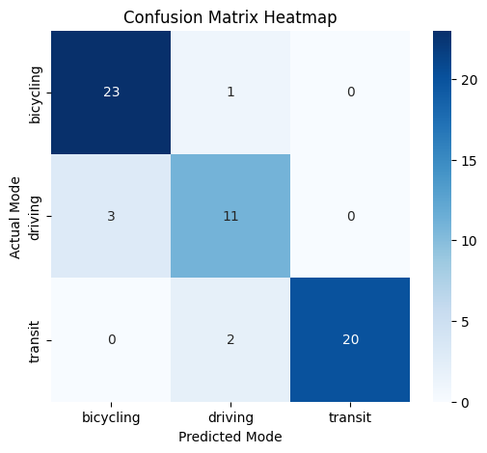
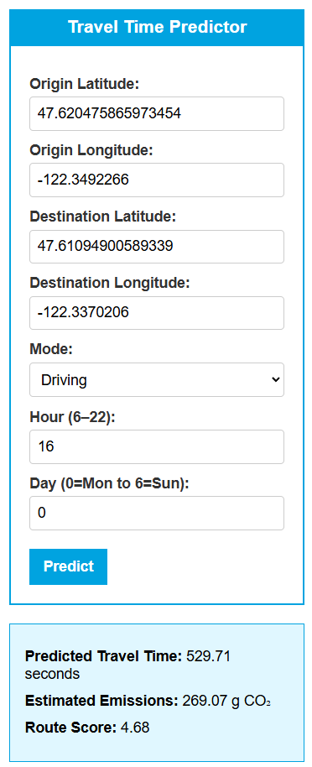
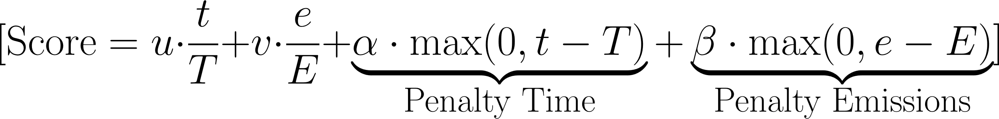
Multi-Modal Route Optimization with Hybrid Travel
Jordan Clifford, Dr. Grzegorz Chmaj
School of Computing and Artificial Intelligence at Arizona State University,
Smart Cities at University of Nevada, Las Vegas
Abstract
Data
This project explores an intelligent, data-driven approach to optimizing urban travel using multi-modal transportation options such as driving, public transit, bicycling, and walking. Leveraging real-world route data from Seattle and incorporating travel time, distance, and estimated carbon emission.
Results
]
Trained regression model with features of time , distance, and mode to predict travel duration
Designed a scoring formula that balances travel time and emissions to rank route options
Implemented q learning but results were skewed heavily even with penalty adjustments, indictating a better reward tuning
Objective
Create Machine Learning models trained on travel data of the routes of notable Seattle Locations to predict behavior across different modes (driving, transit, bicycling, and walking).
At any given route, optimize the route choice between two different locations based on the travel time and emissions created, with the use of a scoring formula to showcase this.
With a lower score being the best option
Conclusion
Methodology
𝑡: Actual travel time (in seconds)
𝑇: Maximum acceptable travel time (threshold)
𝑒: Actual emissions (grams of CO₂)
𝐸: Maximum acceptable emissions (threshold)
𝑢: Weight for normalized travel time
𝑣: Weight for normalized emissions

