Slide 1


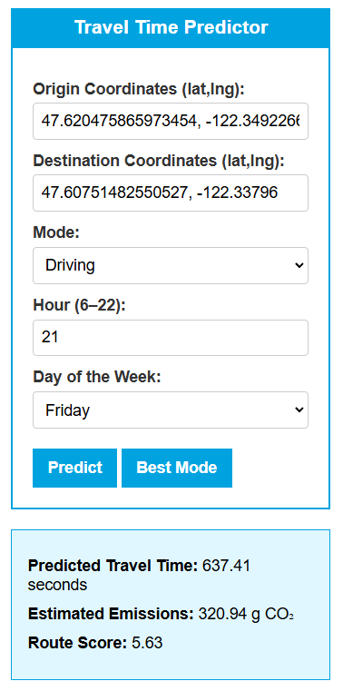
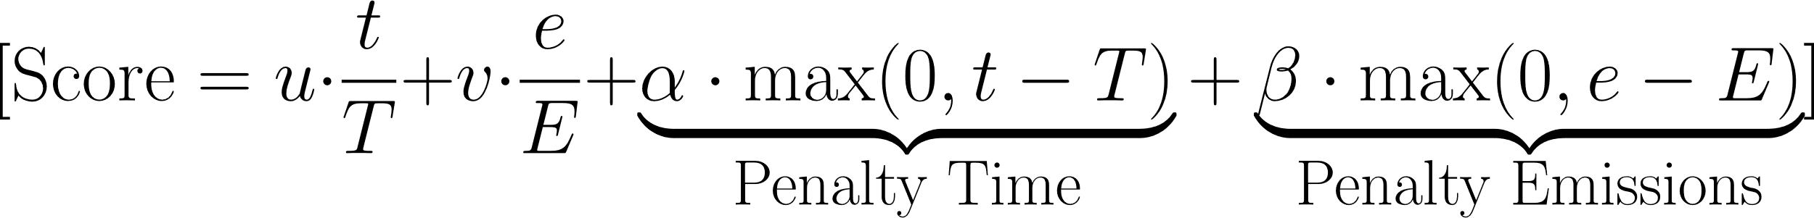
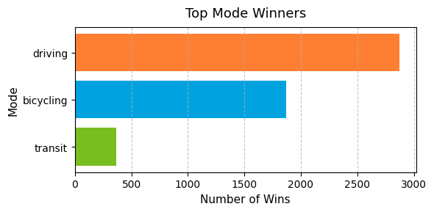
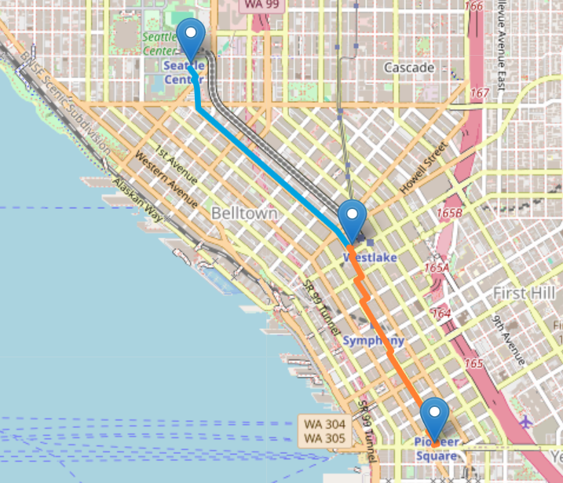
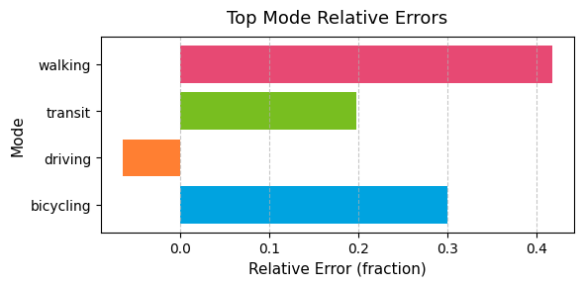

Optimizing Hybrid Travel Using Multi-Modal Routing
Jordan Clifford, Dr. Grzegorz Chmaj
School of Computing and Artificial Intelligence at Arizona State University,
Smart Cities at University of Nevada, Las Vegas
Abstract
Implementation
Results
This project presents a data-driven approach to optimizing urban travel through multiple transportation modes of driving, transit, bicycling, and walking. Using real-world data from the dense city of Seattle, the model incorporates travel time, distance, and estimated carbon emissions to recommend an efficient and sustainable travel choice [4].
Data Collection : Collected over Seattle-based travel routes across multiple modes, simulated from a whole week of travel from 6 am to 10 pm, collected with Google Maps API [4].
Feature Extraction : Parsed data to extract key variables: travel time, distances, transport mode, estimated emissions.
Model Training : Trained regression (Random Forest) and reinforcement (Q-learning) model to predict travel duration and mode recommendation based on extracted features [2][3].
Prediction : Applied model to new routes to estimate travel time across modes.
Score Computation : Designed scoring function to balance predicted time and emissions, selecting the lowest scored route.
The regression model demonstrated strong performance on the test set, with low error rates through transit and driving. Bicycling showed a more moderate error rate with walking showing a relatively higher one; this is due to both modes not having any variance across different times/days.
Q-learning was attempted at the beginning, yet highly mode-biased results caused a shift towards the scoring formula approach with more of an ability to tune route recommendations [2].
From the route scoring formula, driving was considered the top mode through most scenarios, as bicycling was a strong alternative with no emissions raised with decent travel times. Transit was less optimal due to emissions and higher travel times than bicycling in the dense routes collected. With walking rarely being recommended due to higher predicted durations.
Objective
Train machine learning models using real-world data from Seattle Routes.
Predict behavior across modes: driving, transit, bicycling, walking.
Optimize travel decisions by combining travel time and emissions via a scoring formula [1][2].
Formula
𝑡 : Actual travel time (in seconds) 𝑇 : Maximum acceptable travel time (threshold) 𝑒 : Actual emissions (grams of CO₂) 𝐸 : Maximum acceptable emissions (threshold) 𝑢, 𝑣 : Weights for time and emissions α, β: Penalties for exceeding thresholds.
Data
To evaluate the regression model’s generalizability, a dataset of 52 multimodal travel routes was split into 42 training samples and 10 testing samples.
User Interface of Regression Model
References
Conclusion
[1] Bengio, Y., Lodi, A., & Prouvost, A. (2020). Machine Learning for Combinatorial Optimization: A Methodological Tour d’Horizon. European Journal of Operational Research.
[2] Zhu, H., & Ziliaskopoulos, A. (2023). Multimodal Transportation Routing Optimization Based on Multi-Objective Q-Learning Under Time Uncertainty. Complex & Intelligent Systems, Springer Nature.
[3] Feng, Z., et al. (2022). Route Optimization via Environment-Aware Deep Network and Reinforcement Learning. ACM Transactions on Intelligent Systems and Technology.
[4] Google Developers. (2024). Distance Matrix API | Google Maps Platform. https://developers.google.com/maps/documentation/distance-matrix
As the regression model with the scoring formula shown how driving was the most optimal by the system, bicycling was a great low-emission alternative. This shows how the integration of machine learning can offer a strong foundation for routing systems to come. Future steps can scale this project towards improving walking accuracy, having more complex variables like weather, and expanding the routing system towards different cities.
Routing
Mode Winners Across Training Set
Acknowledgements
Dr. Brendan Morris
Dr. Grzegorz Chmaj
NSF #2349616
Visualization of Multi-Modal Routing Between Three Points of Interest
Error Rate Through Testing Set

