Slide 1
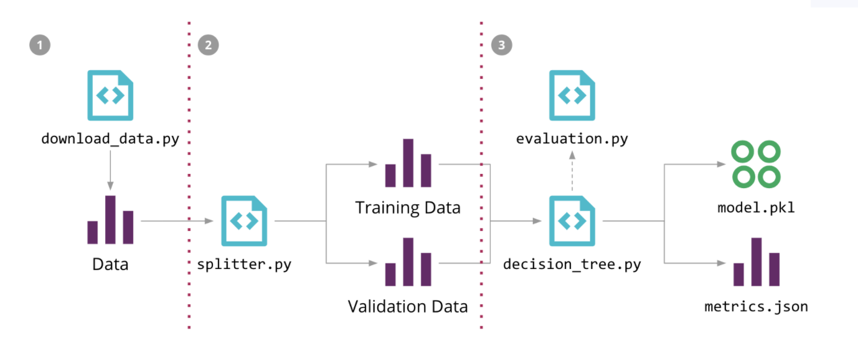

Slide 2
< />
API pull
GloVe model
< />
CART classifier
raw data
data preprocessing
< />
tokenization
vectorized data

Slide 3
GloVe model
< />
API pull
CART classifier
< />
< />
raw data
data preprocessing
tokenization
vectorized data

