Slide 1
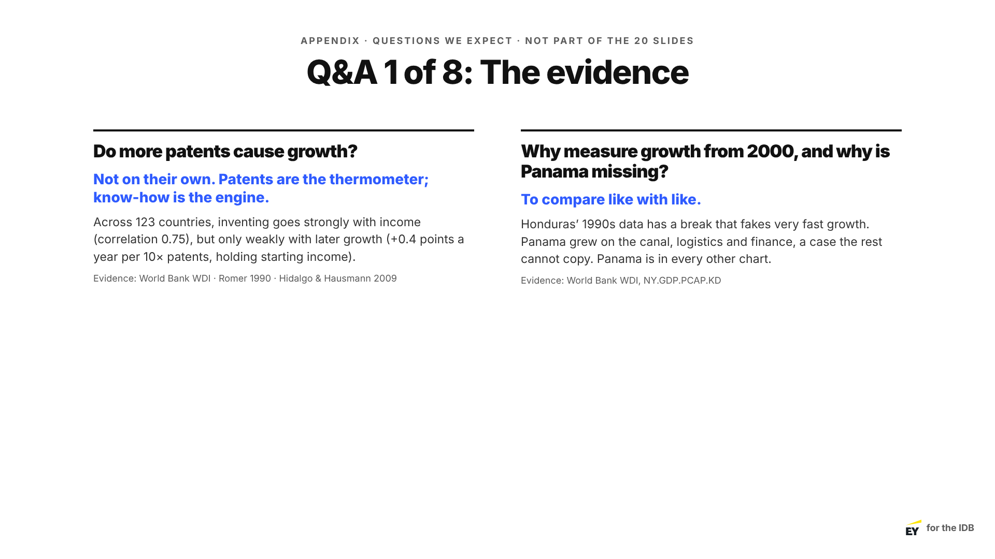
Notes:
Appendix
Appendix: use only in Q&A. Repeat the question, give the short answer, then the reason. Hand back to Speaker 5.

Slide 2
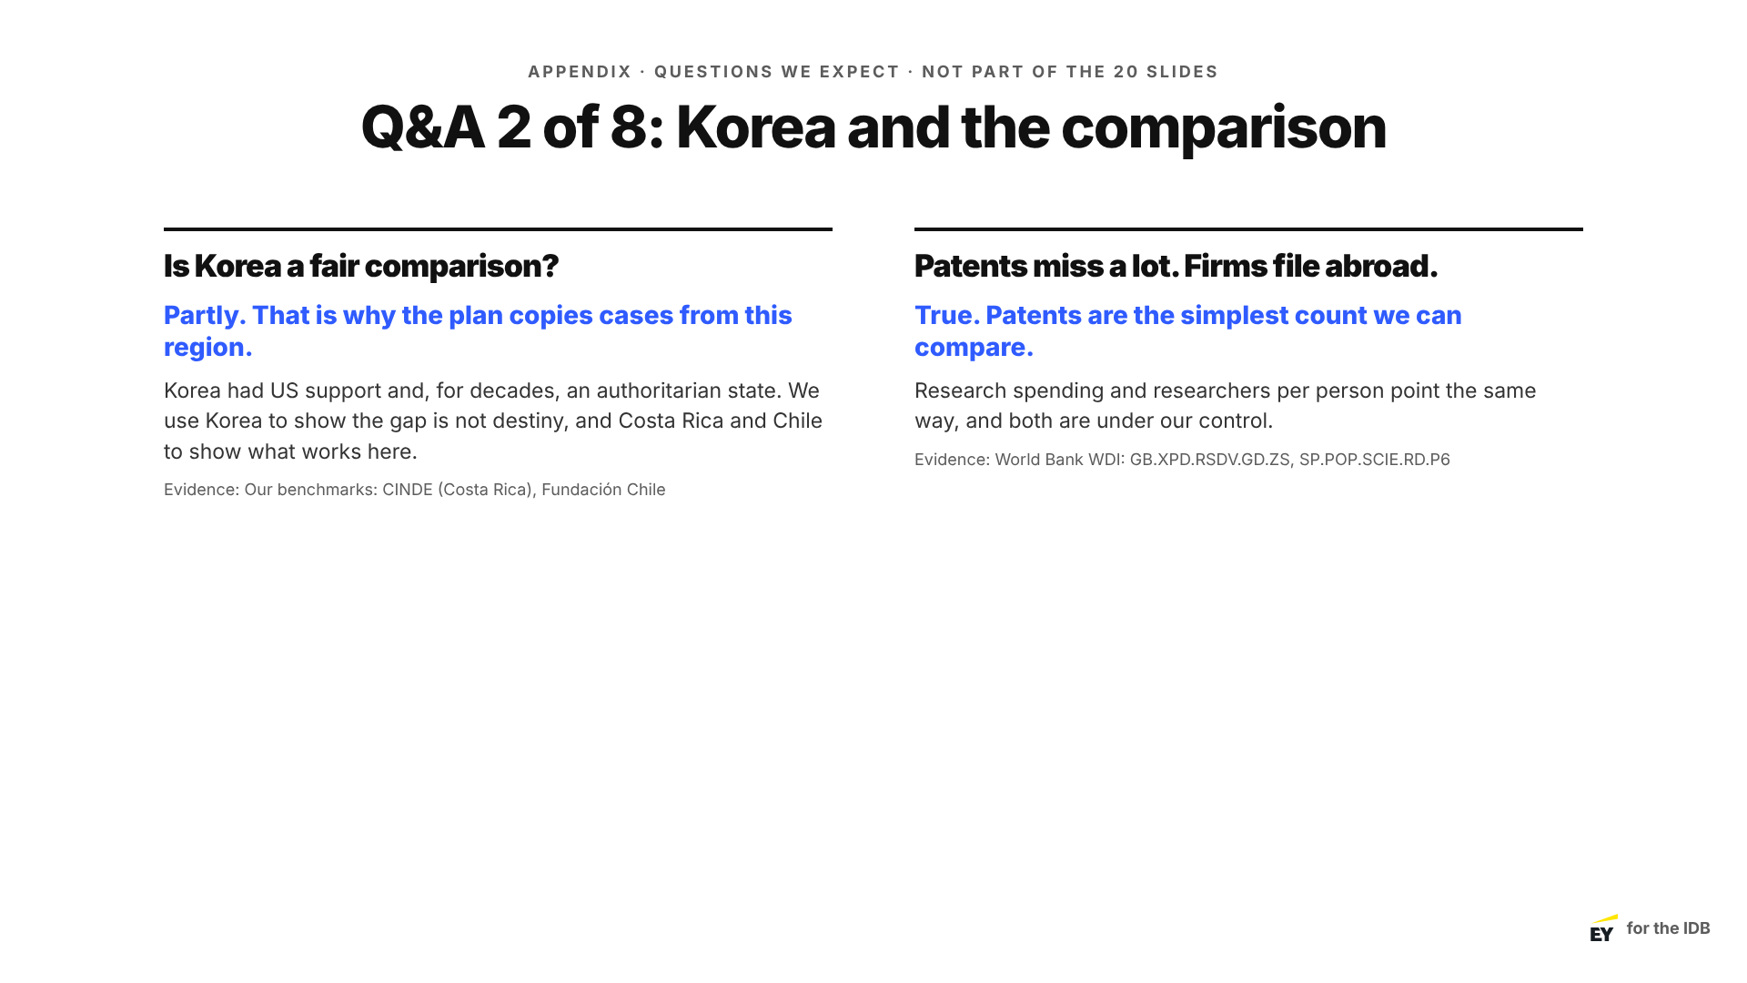
Notes:
Appendix
Appendix: use only in Q&A. Repeat the question, give the short answer, then the reason. Hand back to Speaker 5.

Slide 3
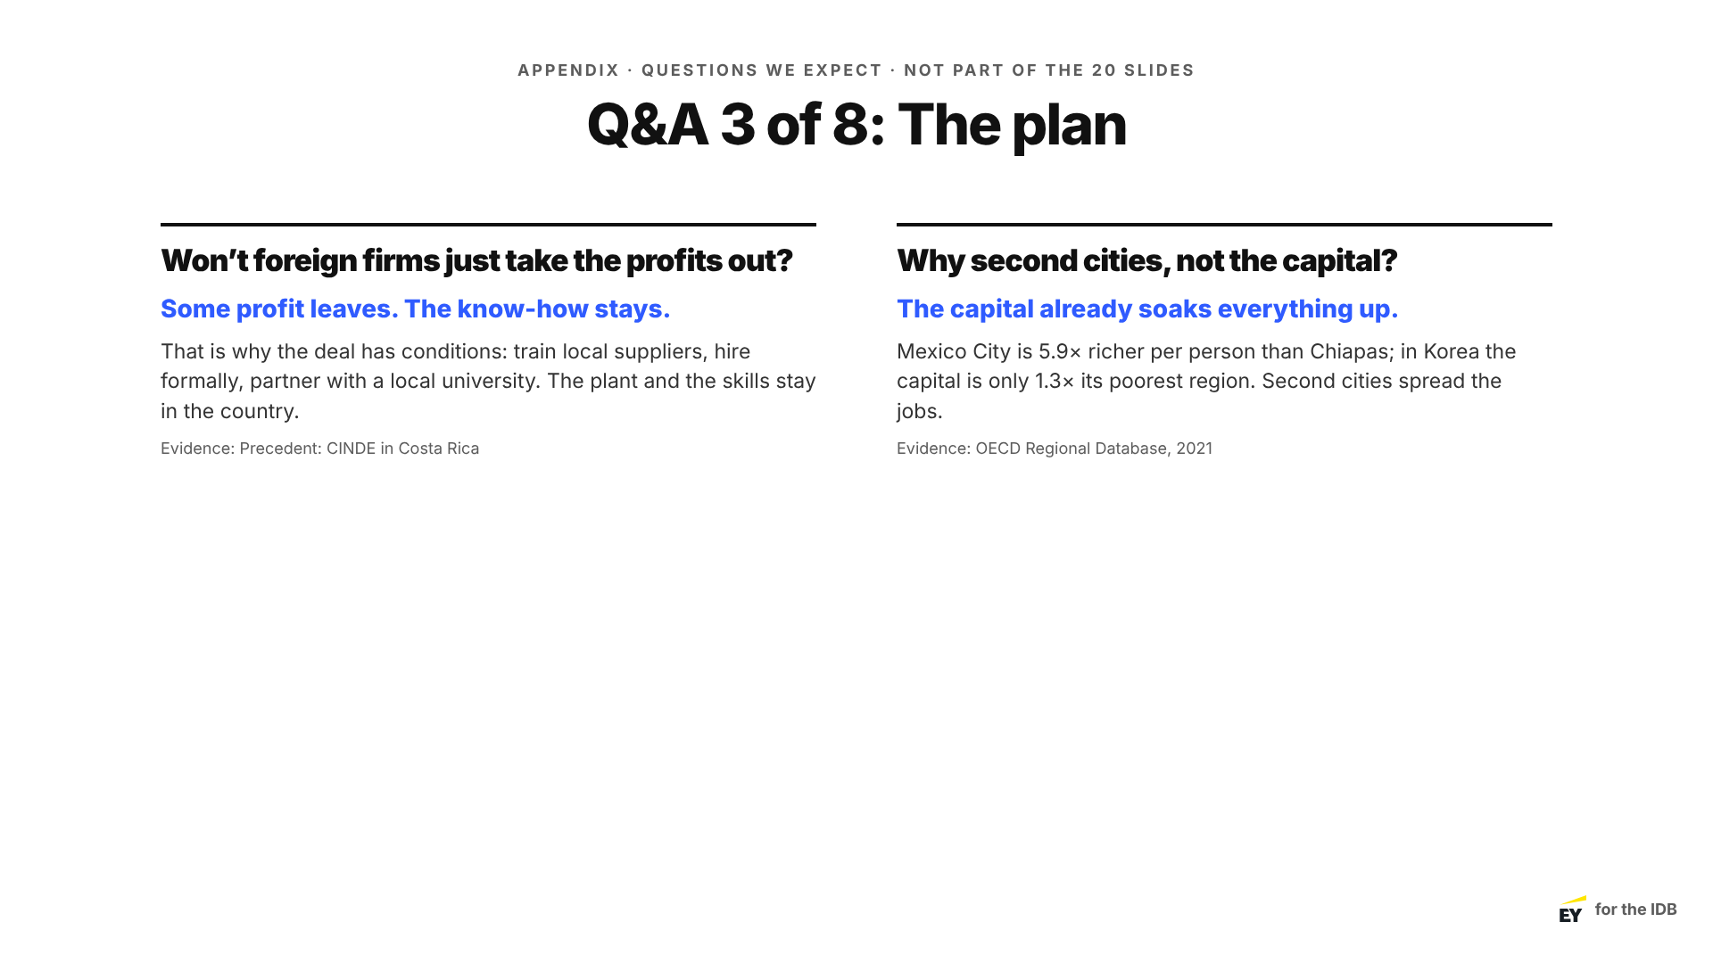
Notes:
Appendix
Appendix: use only in Q&A. Repeat the question, give the short answer, then the reason. Hand back to Speaker 5.

Slide 4
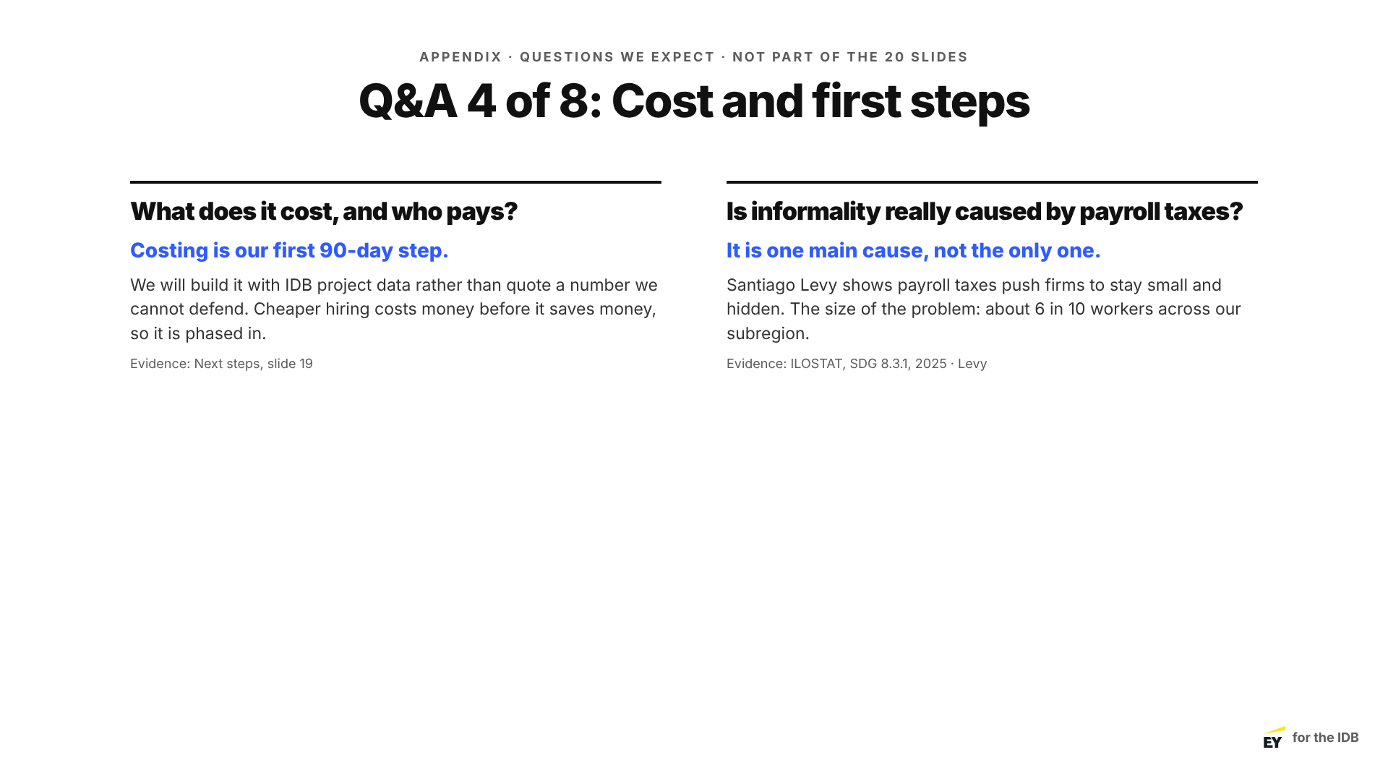
Notes:
Appendix
Appendix: use only in Q&A. Repeat the question, give the short answer, then the reason. Hand back to Speaker 5.

Slide 5
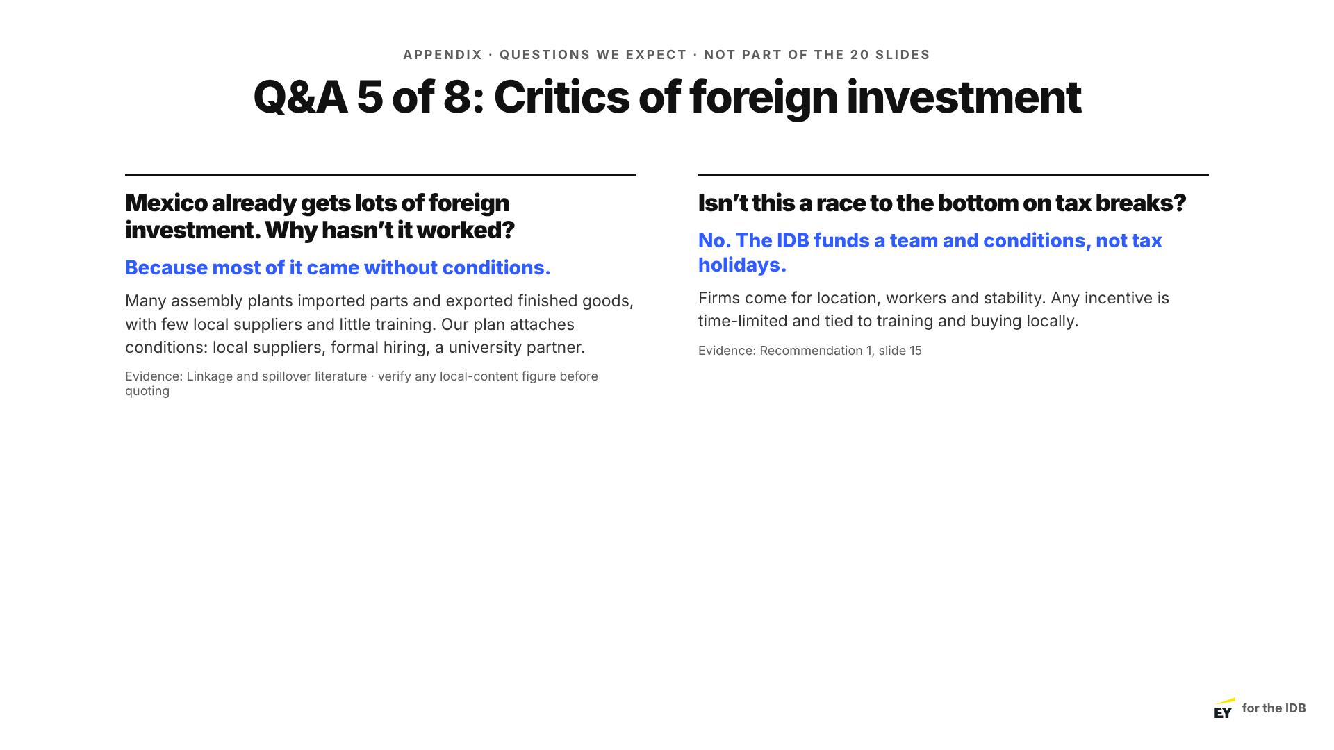
Notes:
Appendix
Appendix: use only in Q&A. Repeat the question, give the short answer, then the reason. Hand back to Speaker 5.

Slide 6
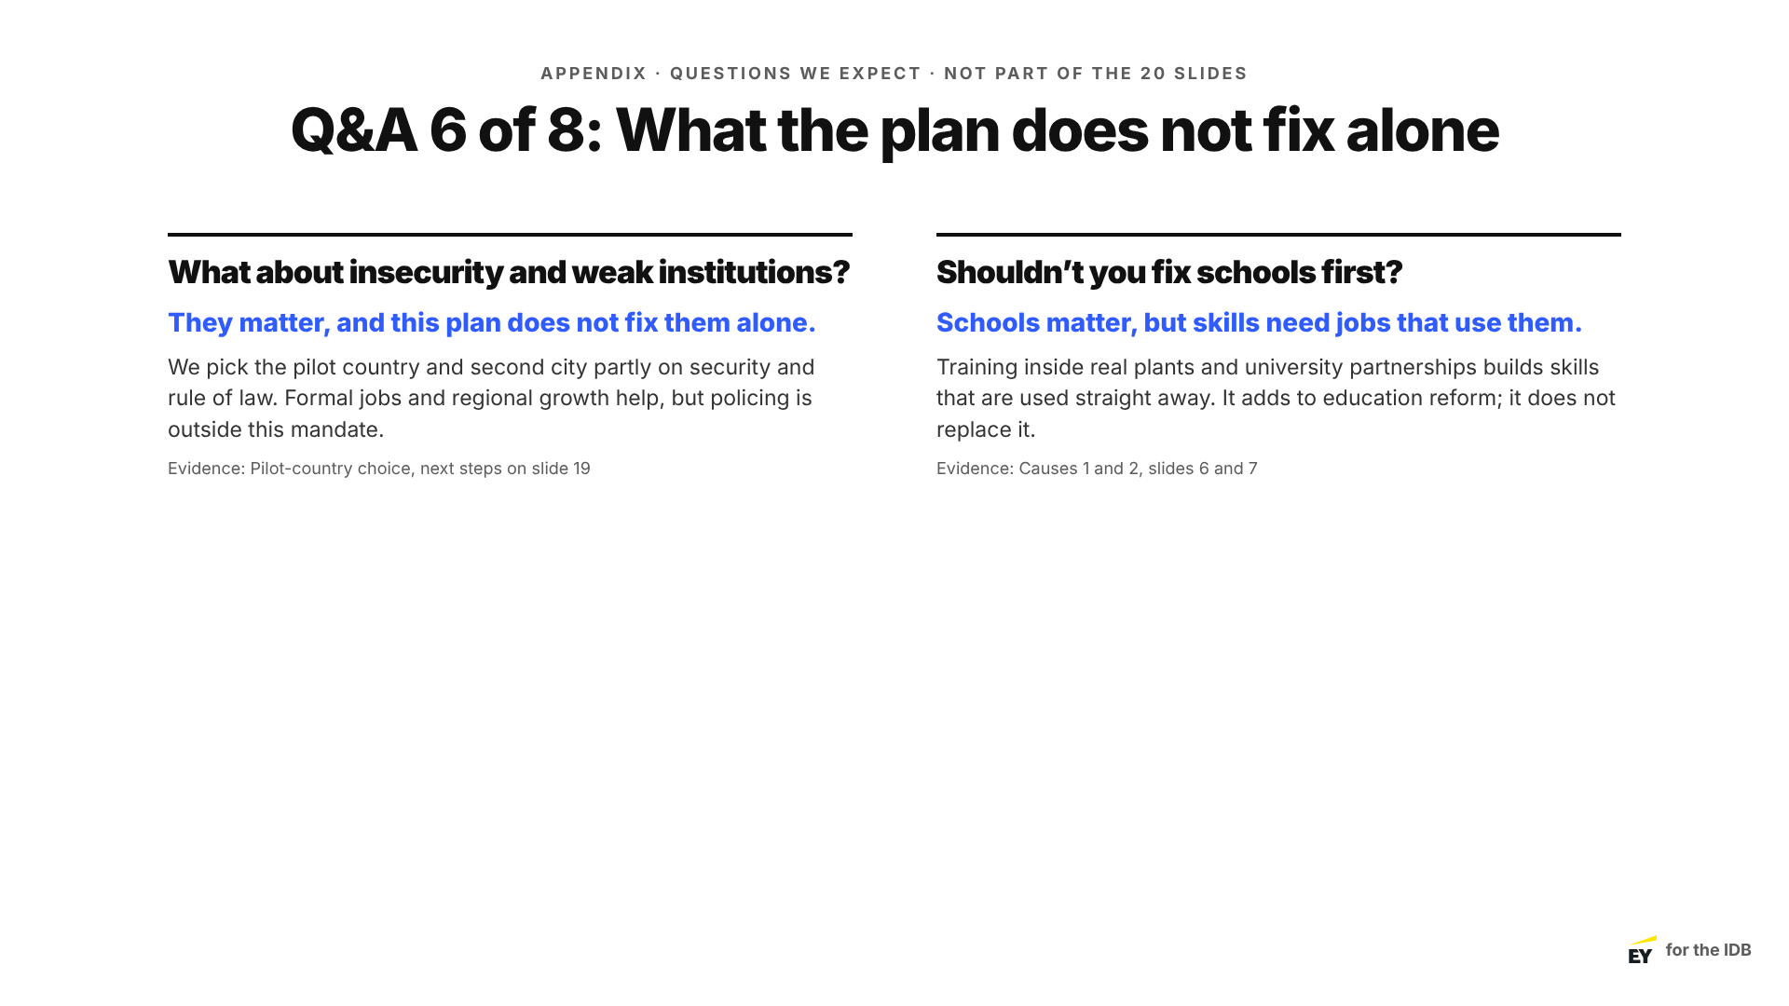
Notes:
Appendix
Appendix: use only in Q&A. Repeat the question, give the short answer, then the reason. Hand back to Speaker 5.

Slide 7
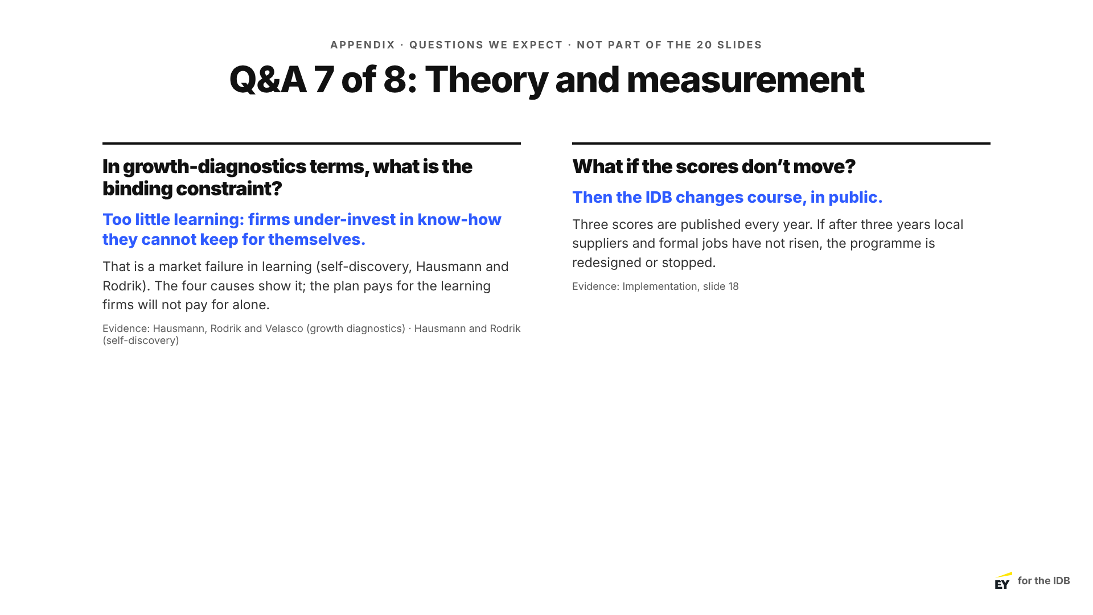
Notes:
Appendix
Appendix: use only in Q&A. Repeat the question, give the short answer, then the reason. Hand back to Speaker 5.

Slide 8

Notes:
Appendix
Appendix: use only in Q&A. Repeat the question, give the short answer, then the reason. Hand back to Speaker 5.

