Slide 1
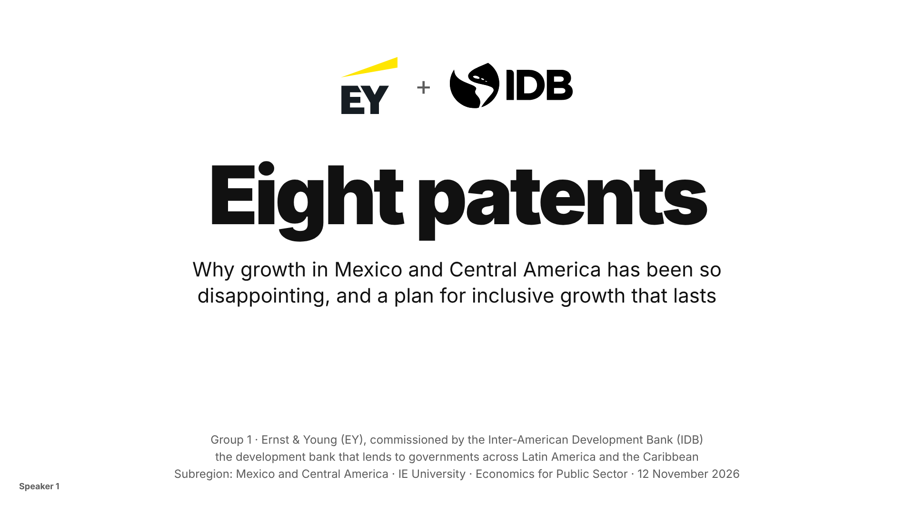
Notes:
Speaker 1
Speaker 1 · about 30 seconds. Open with the hook, out loud, before any introduction: "Last year, a whole country filed eight patents." Then click.

Slide 2
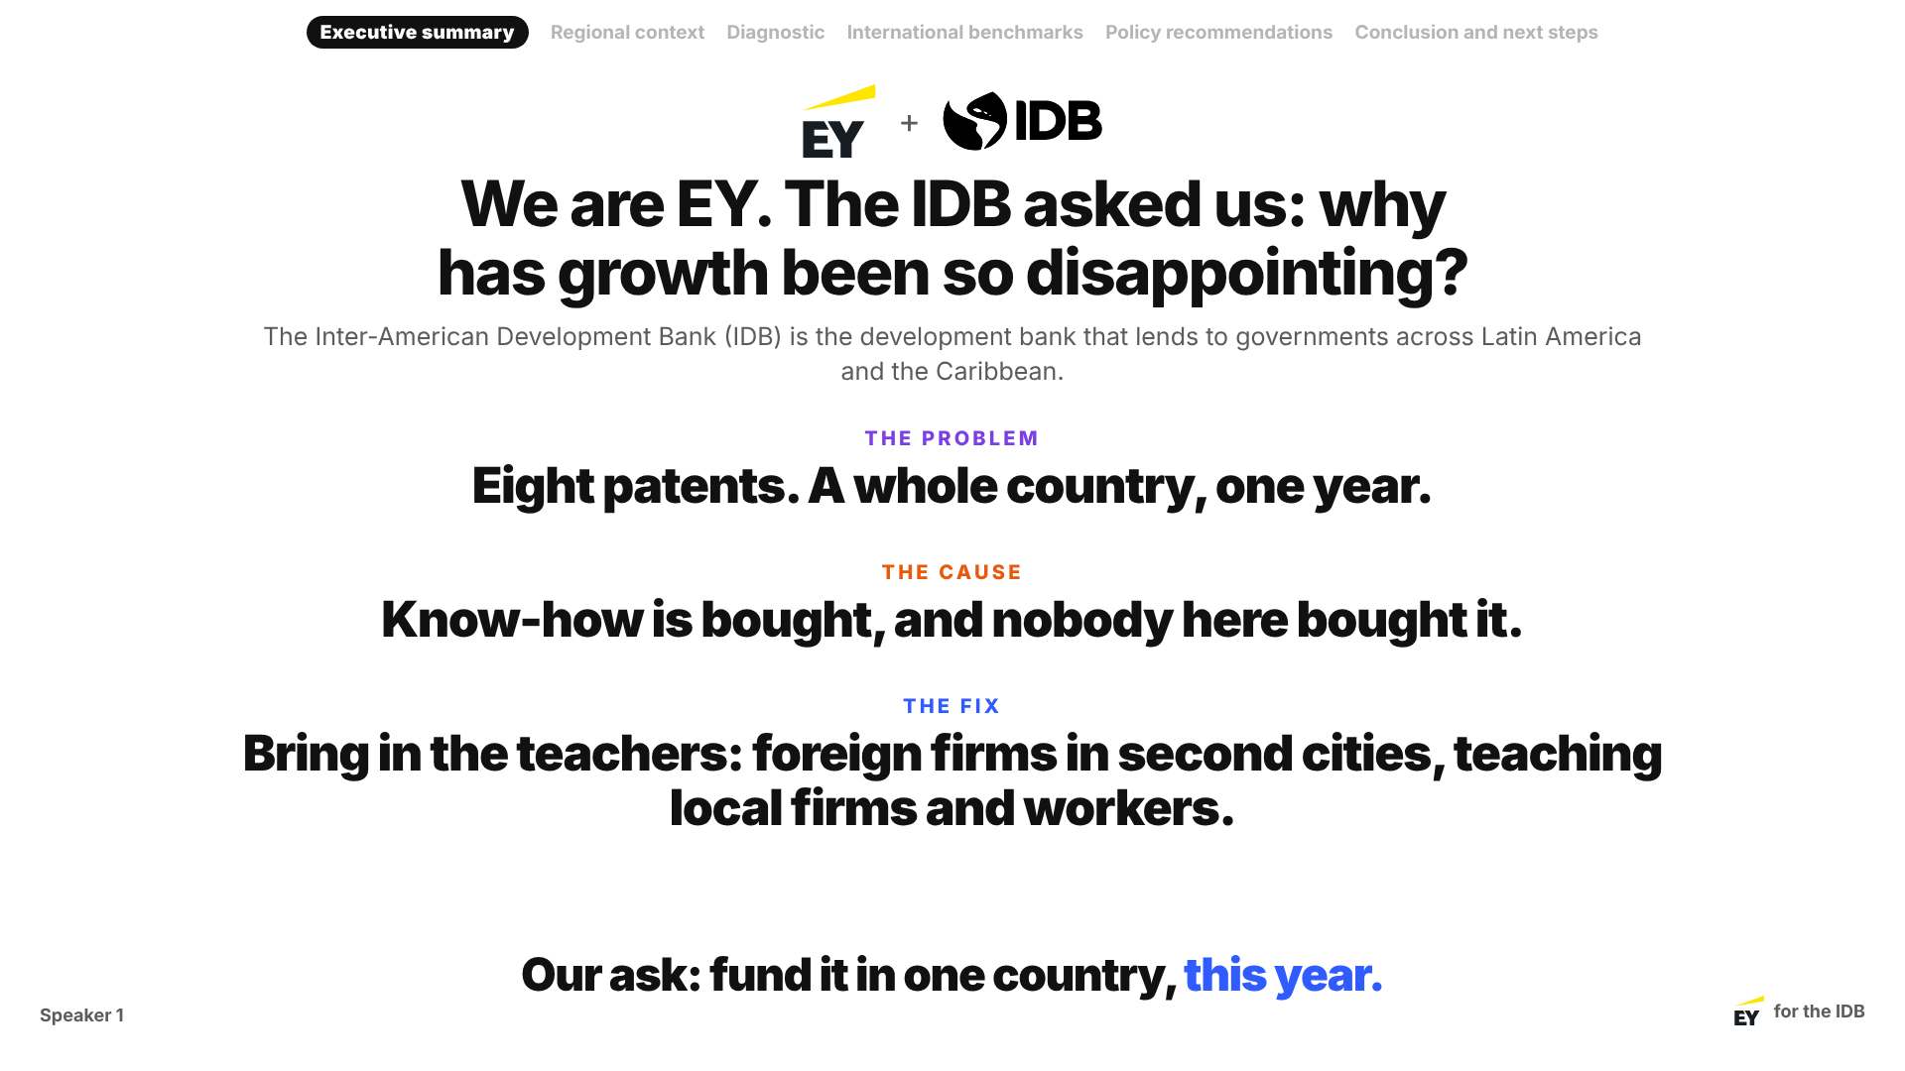
Notes:
Speaker 1
Speaker 1 · Executive summary · about 1 minute 30.
"We are Group 1 from Ernst & Young. We were commissioned by the Inter-American Development Bank, the IDB, the development bank that lends to governments across Latin America and the Caribbean. The IDB asked us one question: why has growth in Mexico and Central America been so disappointing?" (Full names once; "EY" and "the IDB" after this.)
Three clicks: the problem is on screen. Click: the cause. Click: the fix. Click: the ask.
"The problem: eight patents, a whole country, one year. The cause: know-how is bought, and nobody here bought it. (Message #1) The fix: bring in the teachers, foreign firms in second cities, teaching local firms and workers. Our ask: fund it in one country, this year."

Slide 3
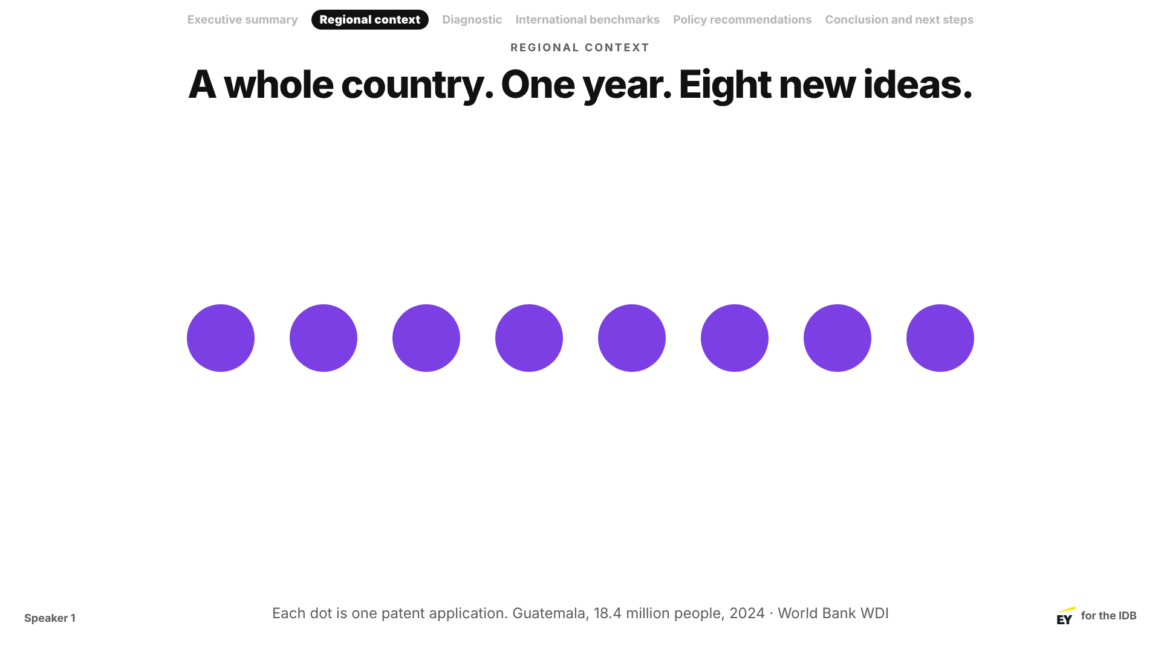
Notes:
Speaker 1
Speaker 1 · Regional context · about 45 seconds. Wait for all eight dots.
"Last year, the whole of Guatemala filed eight patents. Eight. For 18 million people." A patent is a new invention someone registers: the simplest count of new ideas a country produces.

Slide 4
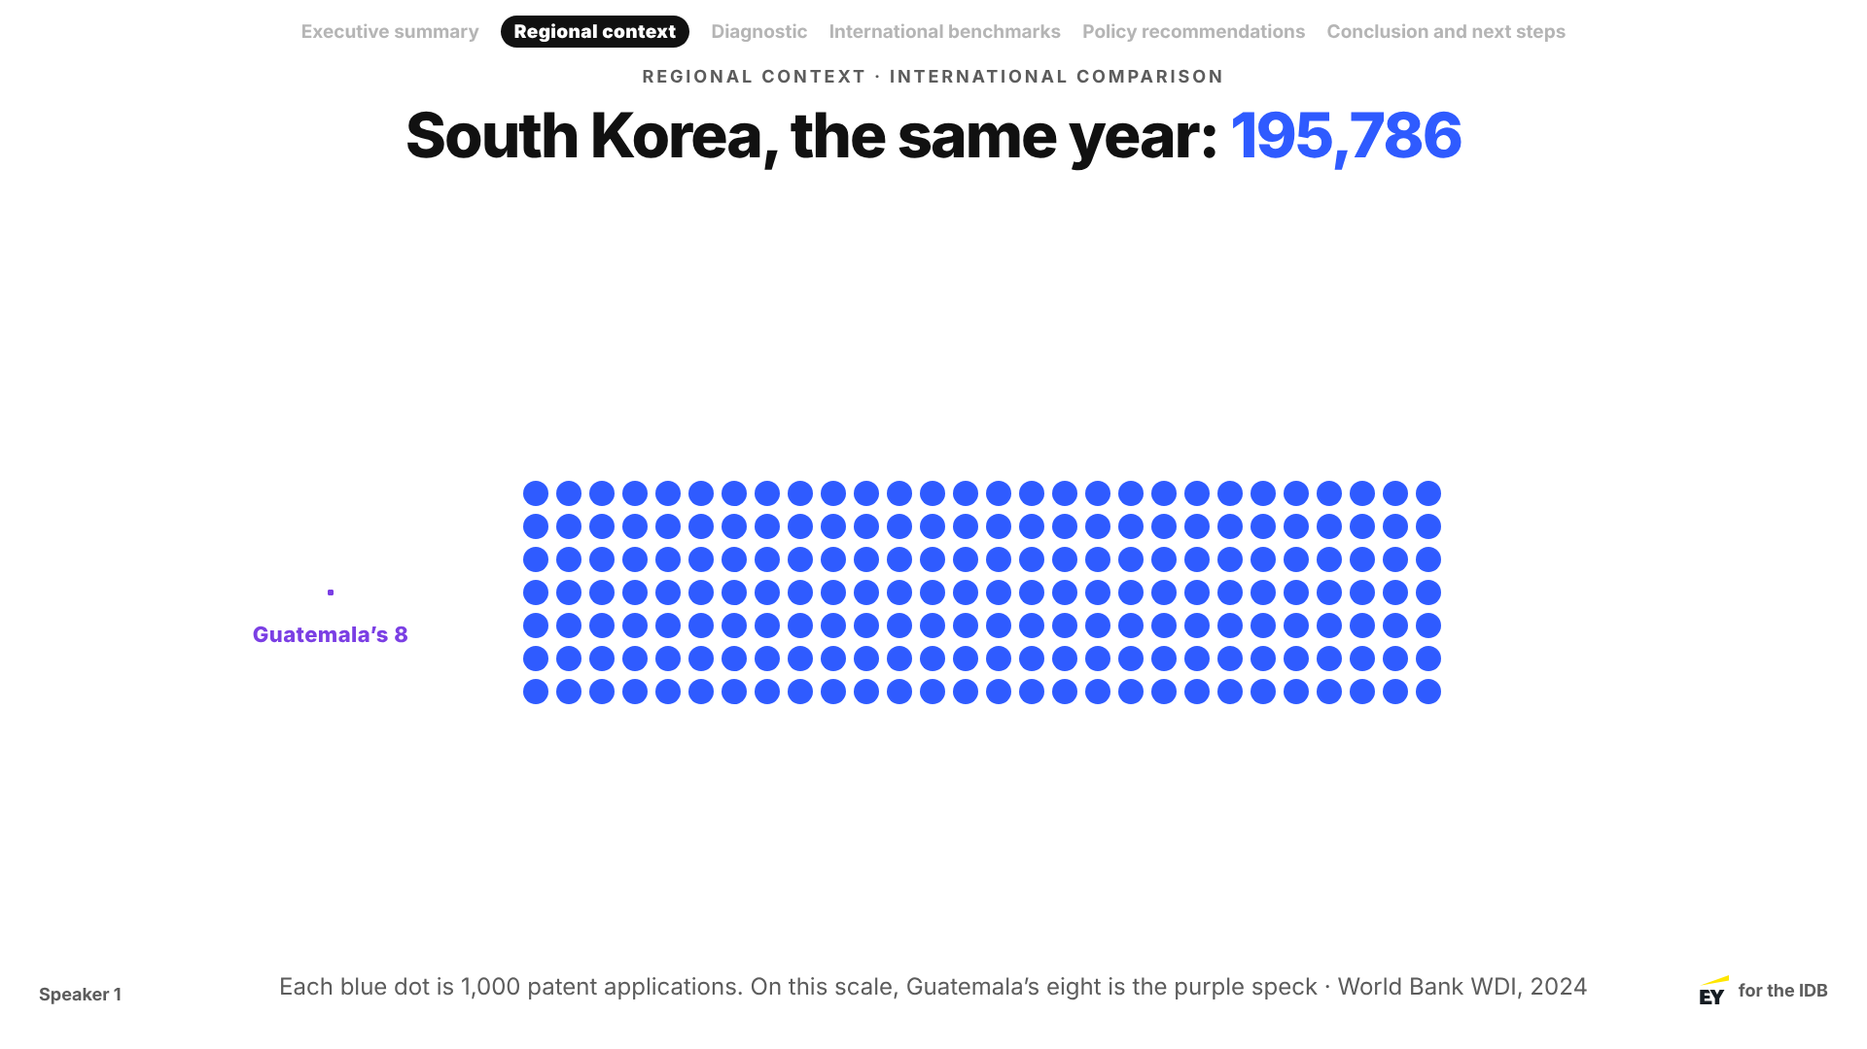
Notes:
Speaker 1
Speaker 1 · about 30 seconds. The eight dots shrink into a speck as Korea's fill the slide.
"The same year, South Korea filed 195,786." Pause. "And Korea has fewer people than Mexico."

Slide 5
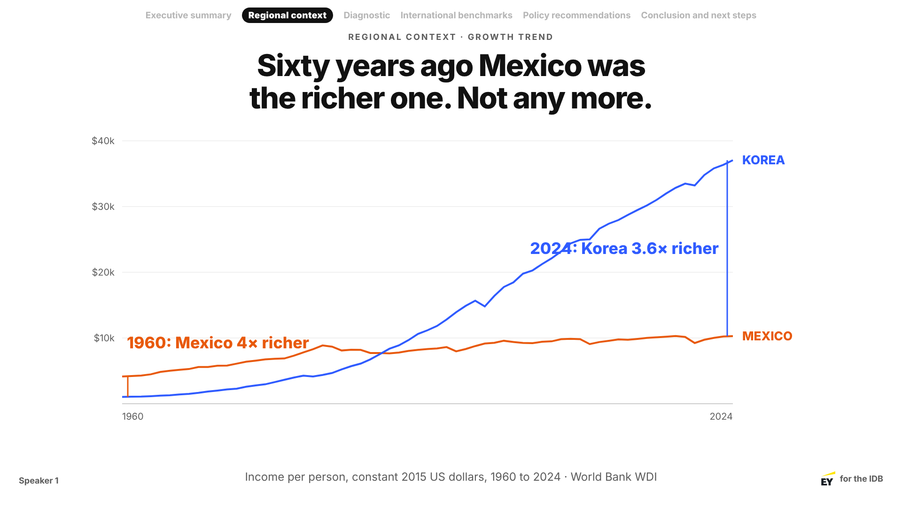
Notes:
Speaker 1
Speaker 1 · about 45 seconds.
"This is what disappointing growth looks like. In 1960 Mexico was four times richer than Korea. Around 1988 they swapped. Today Korea is 3.6 times richer."
Hand-off: "So why? [Speaker 2] has the diagnosis."

Slide 6
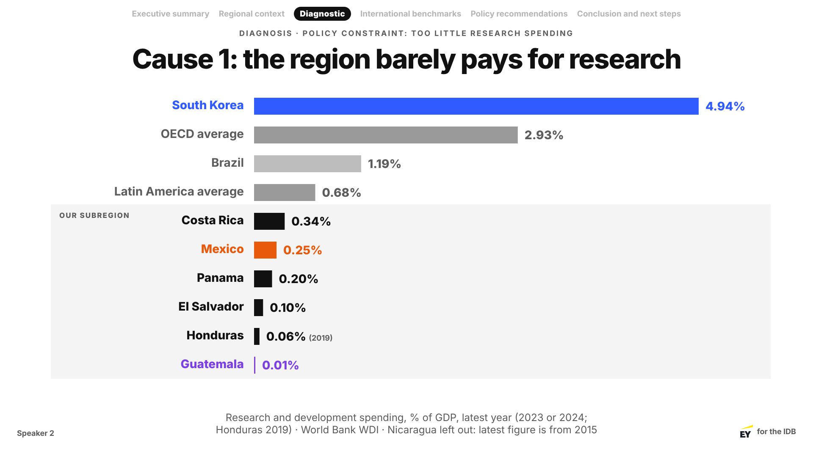
Notes:
Speaker 2
Speaker 2 · Diagnostic · about 45 seconds.
"Four causes. First: the region barely pays for research. Korea spends almost 5% of its economy on research every year; the OECD average is about 3%; Latin America, under 0.7%. And our subregion is at the bottom of Latin America: Mexico 0.25%, Guatemala almost zero. That is a policy choice, written into a budget."

Slide 7
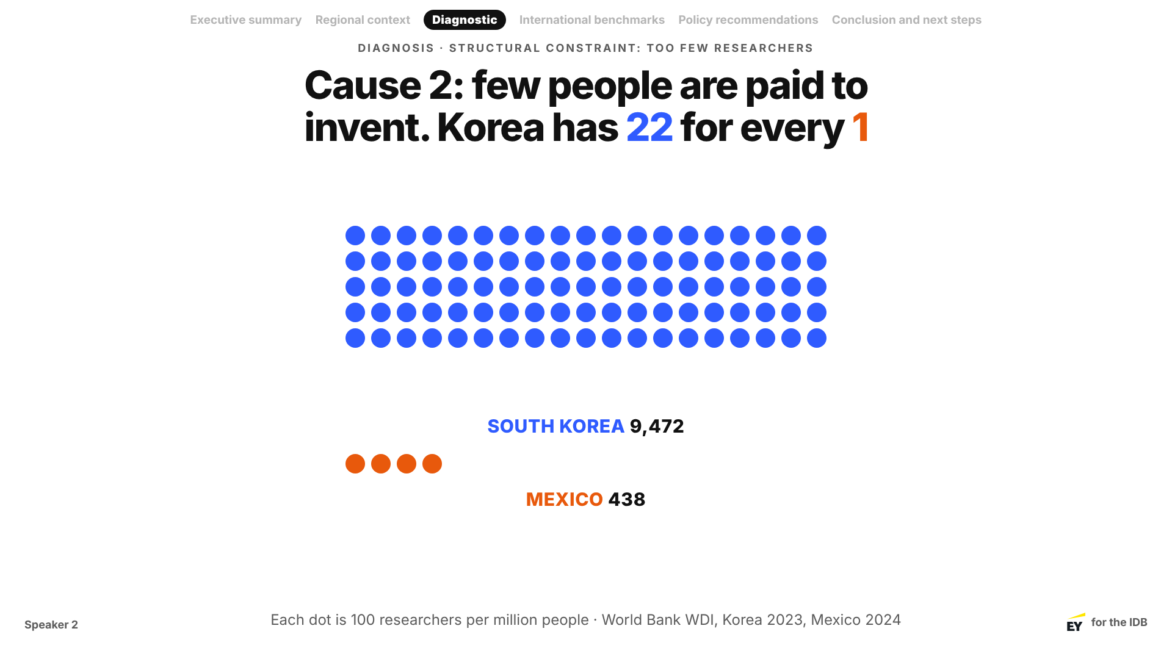
Notes:
Speaker 2
Speaker 2 · about 45 seconds.
"Second: few people are paid to invent. For every researcher in Mexico, Korea has about 22." If time: "Guatemala has about 26 researchers in the whole country."

Slide 8
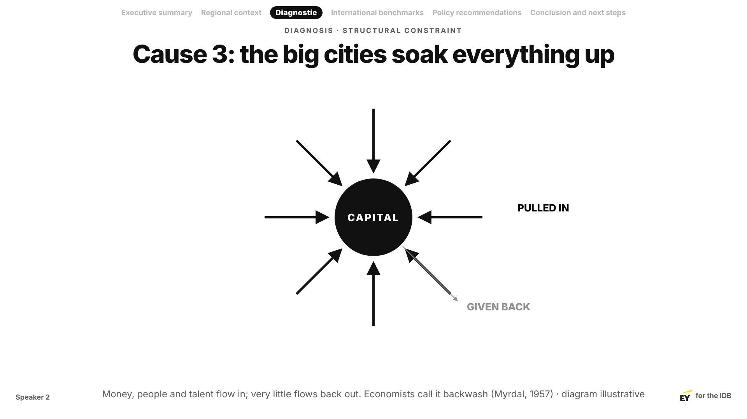
Notes:
Speaker 2
Speaker 2 · about 1 minute.
"Third: the capital cities pull in the money, the people and the talent, and send very little back. Myrdal called it backwash. Everyone else calls it leaving."

Slide 9
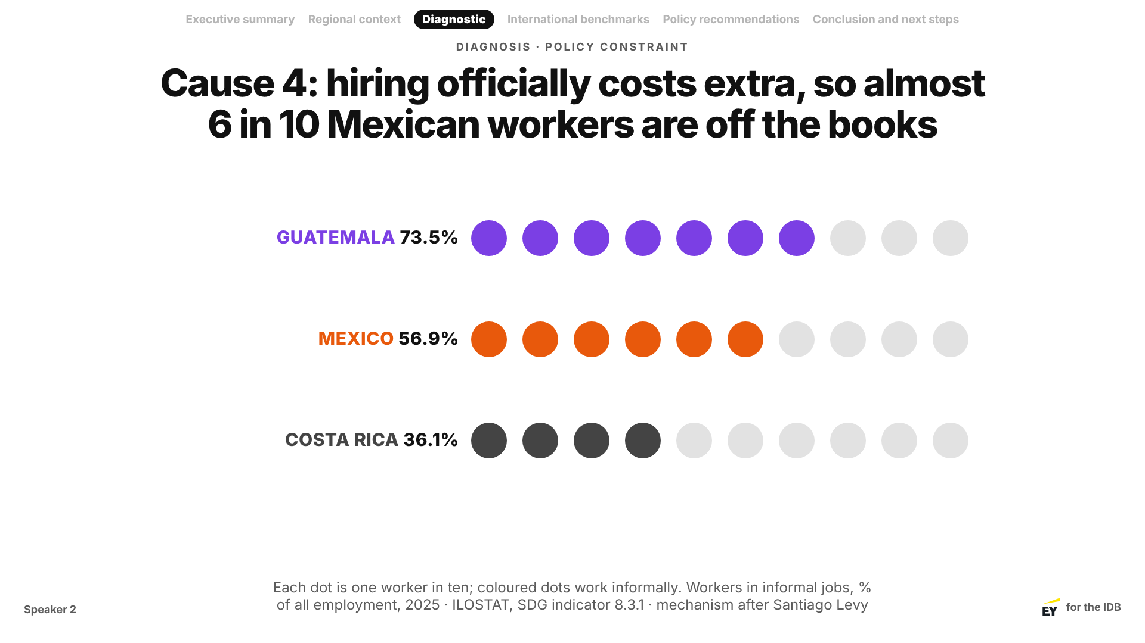
Notes:
Speaker 2
Speaker 2 · about 1 minute.
"Fourth: hiring someone officially costs extra, because payroll taxes pay for health and pensions. So firms stay small and off the books. In Guatemala 7 in 10 workers are informal; in Mexico almost 6 in 10; in Costa Rica about 4 in 10." (ILOSTAT, 2025; Santiago Levy's argument.)

Slide 10
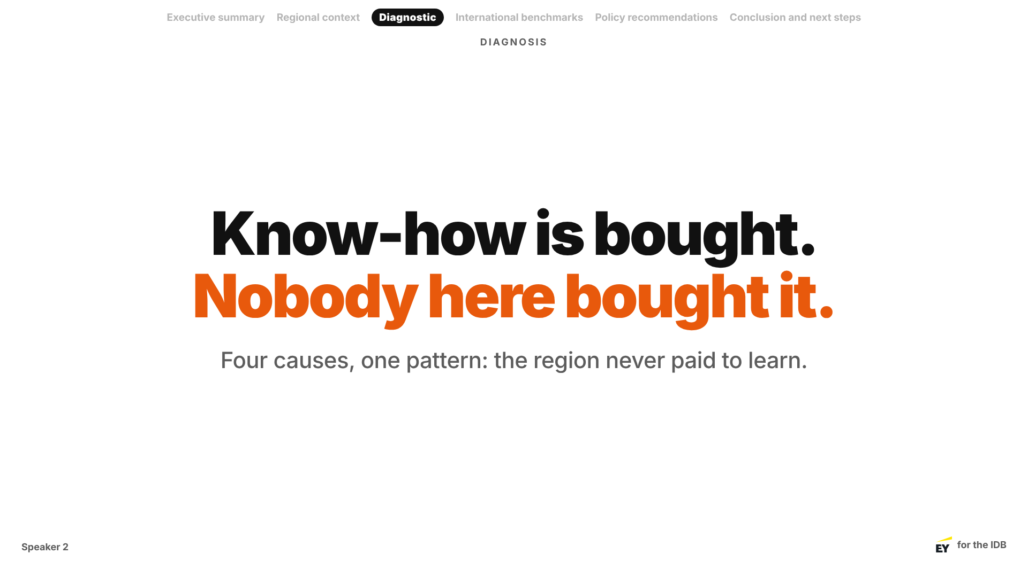
Notes:
Speaker 2
Speaker 2 · the climax · about 45 seconds. Slow down.
"Four causes, one pattern. Know-how is bought, and nobody here bought it." (Message #2)
Hand-off: "Is this destiny? No. [Speaker 3] shows who has done it."

Slide 11
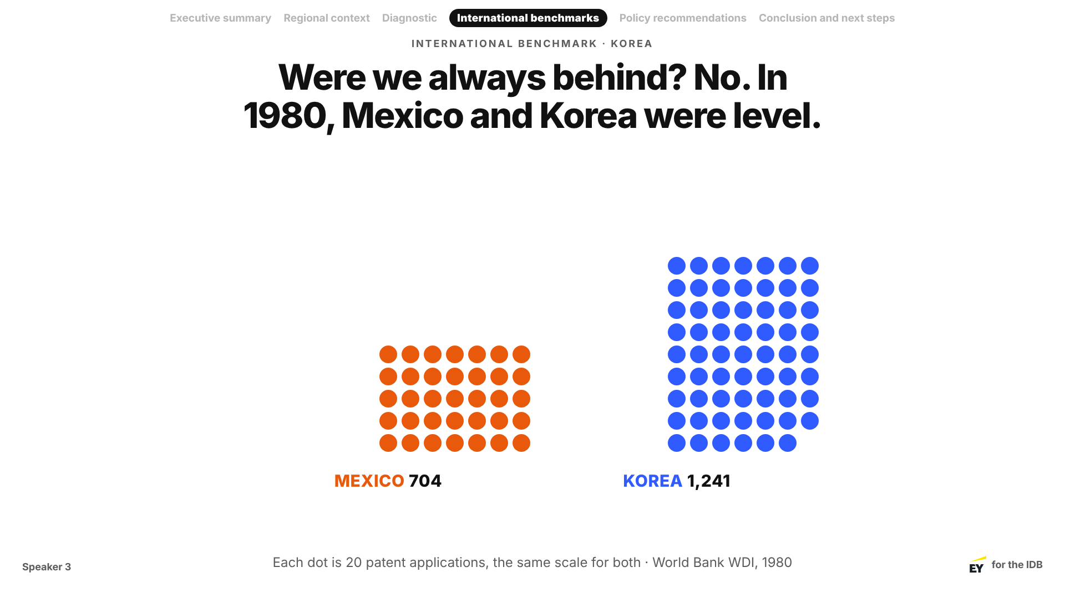
Notes:
Speaker 3
Speaker 3 · International benchmarks · about 45 seconds.
"Were we always behind? No. In 1980 Mexico filed 704 patents and Korea 1,241. Two kids, same classroom, similar grades."

Slide 12
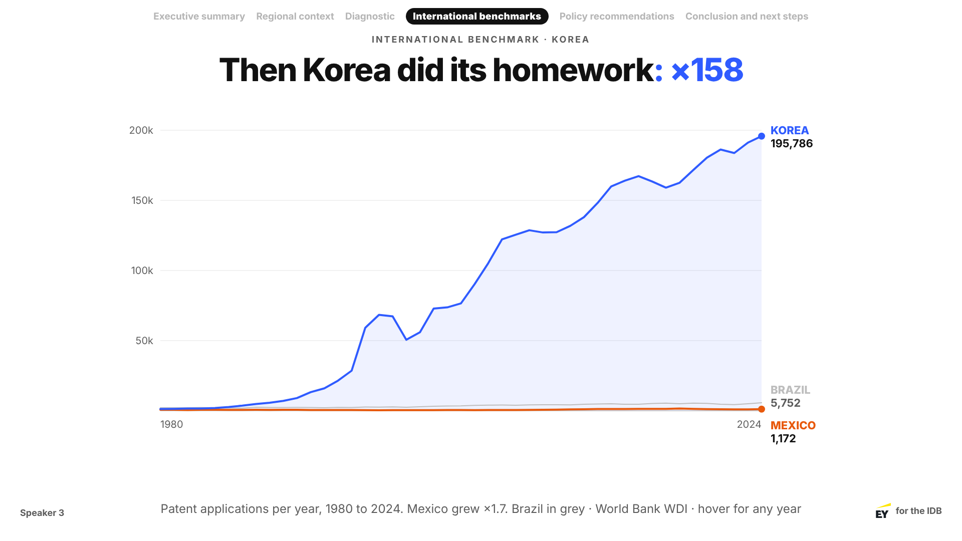
Notes:
Speaker 3
Speaker 3 · about 1 minute 15. Two clicks on this slide.
Click 1: the chart draws 1980 to 1985, zoomed in. "Here they are in the early 1980s. Level."
Click 2: it pulls back to 2024. Let it move, then: "Then Korea did its homework. Its patents grew 158 times. Mexico's, 1.7 times."

Slide 13
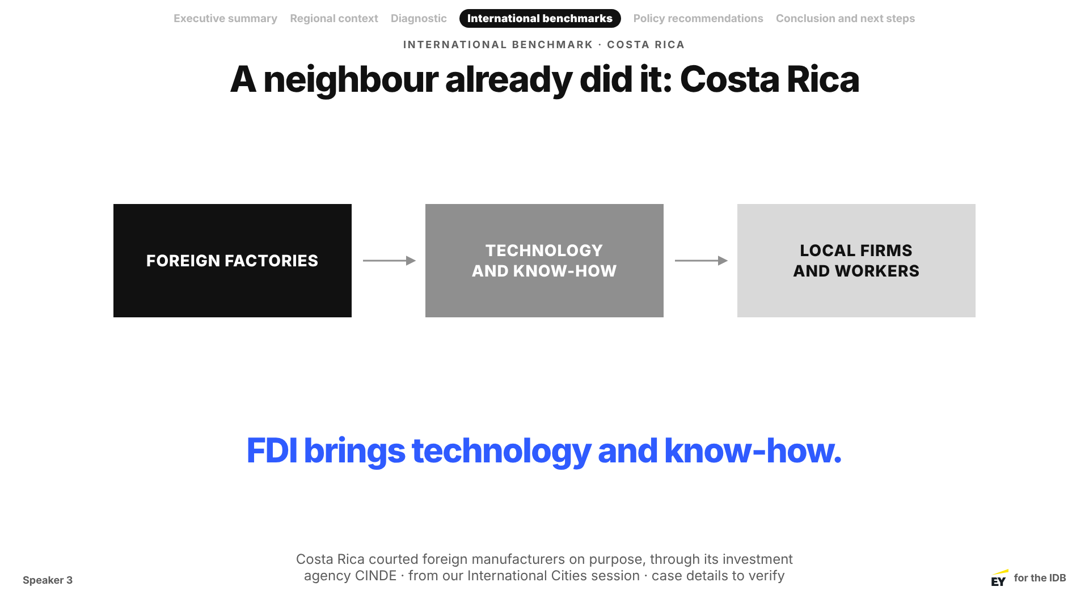
Notes:
Speaker 3
Speaker 3 · about 1 minute.
"And it has been done next door. Costa Rica went after foreign factories on purpose, through its agency CINDE. FDI brings technology and know-how, and local firms and workers learn from it." (Message #3: know-how can be bought.) ⚠ Check the CINDE details.
Hand-off: "So what should the IDB do? [Speaker 4]."

Slide 14
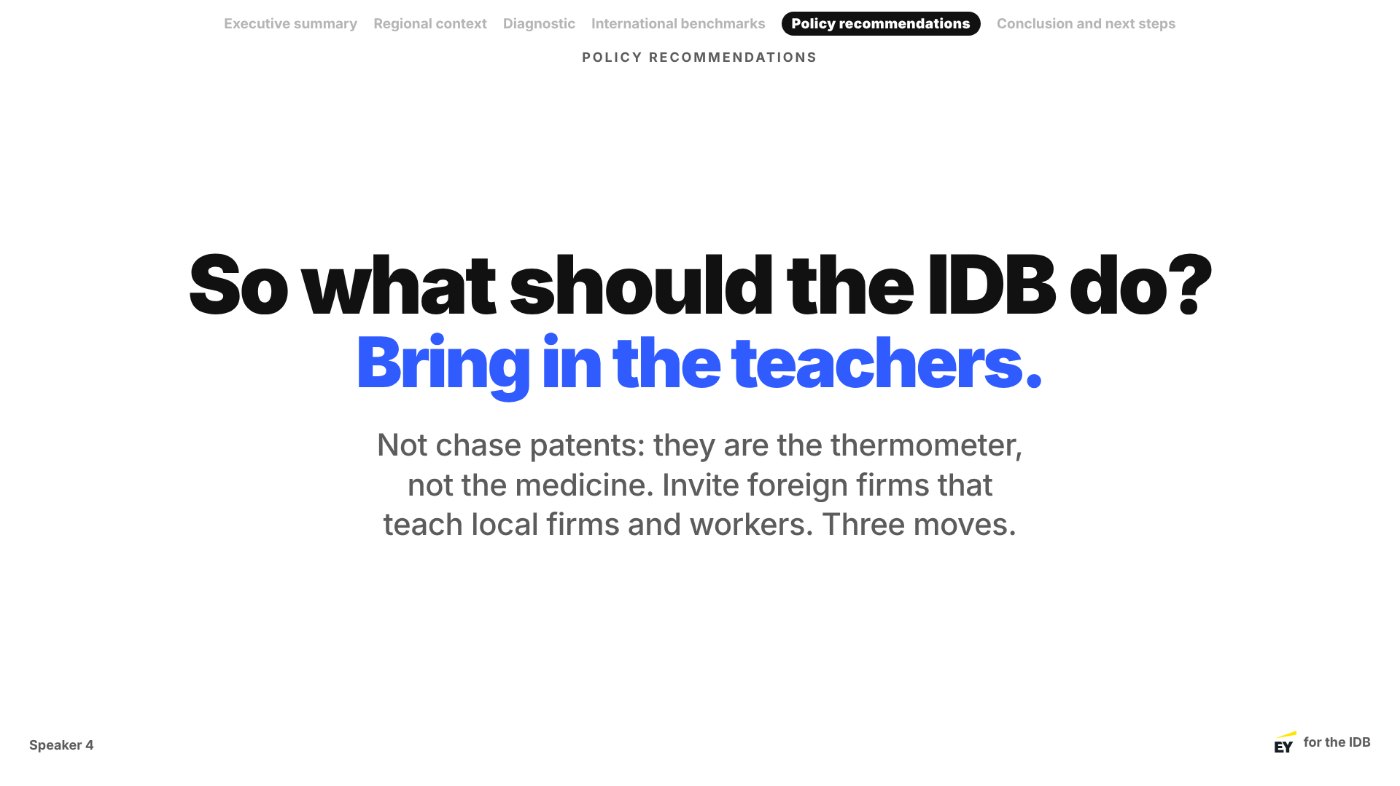
Notes:
Speaker 4
Speaker 4 · Policy recommendations · about 45 seconds.
"So what should the IDB do? Not chase patents. Patents are the thermometer, not the medicine. The medicine is know-how, and the fastest way to get it is to bring in the teachers: foreign firms that set up here and teach local firms and workers. Three moves, one for each cause."

Slide 15
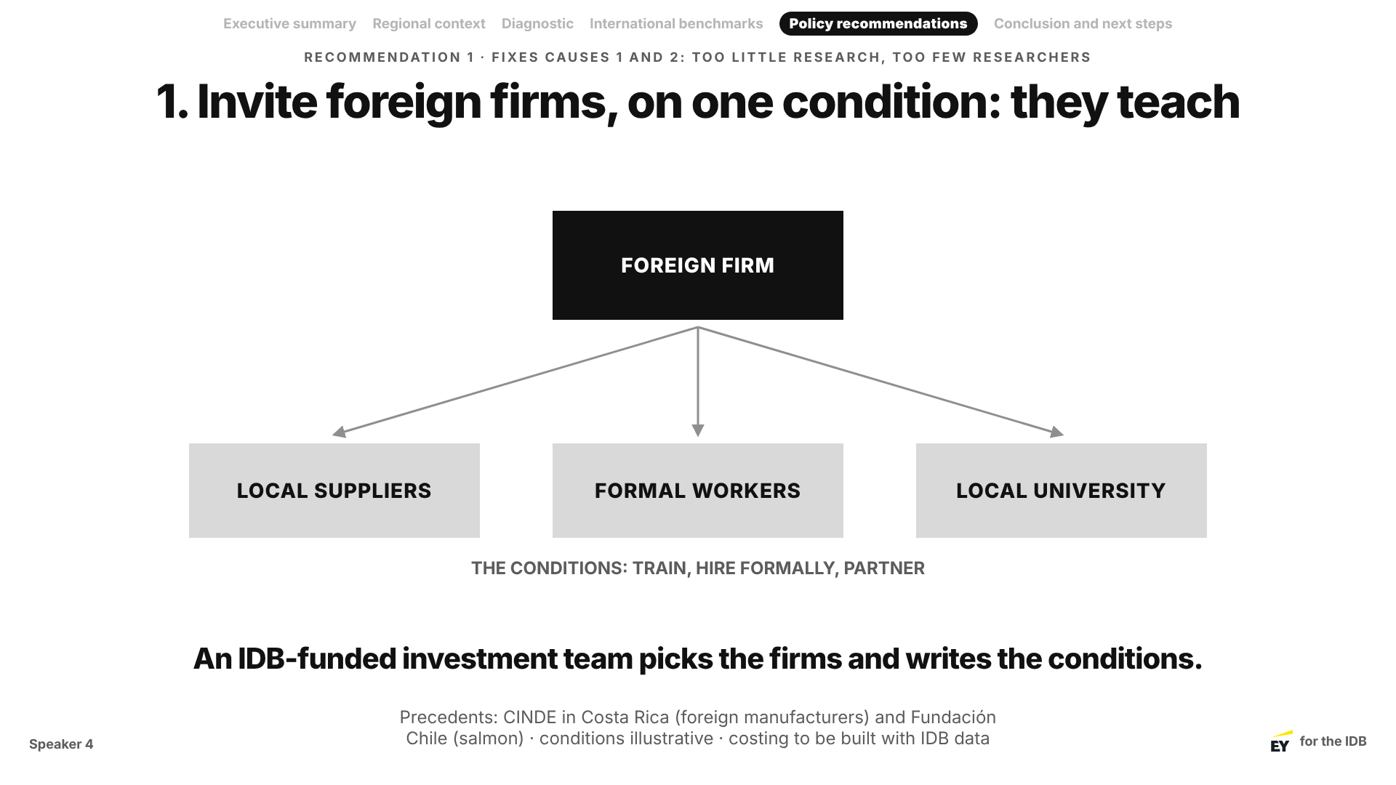
Notes:
Speaker 4
Speaker 4 · about 1 minute 15. Fixes causes 1 and 2.
"One: invite foreign firms, on one condition: they teach. They train local suppliers, hire formally, and partner with a local university. An IDB-funded investment team picks the firms and writes the conditions. Costa Rica did this with CINDE; Chile did something similar for salmon." Why now: factories leaving China are choosing new homes.

Slide 16
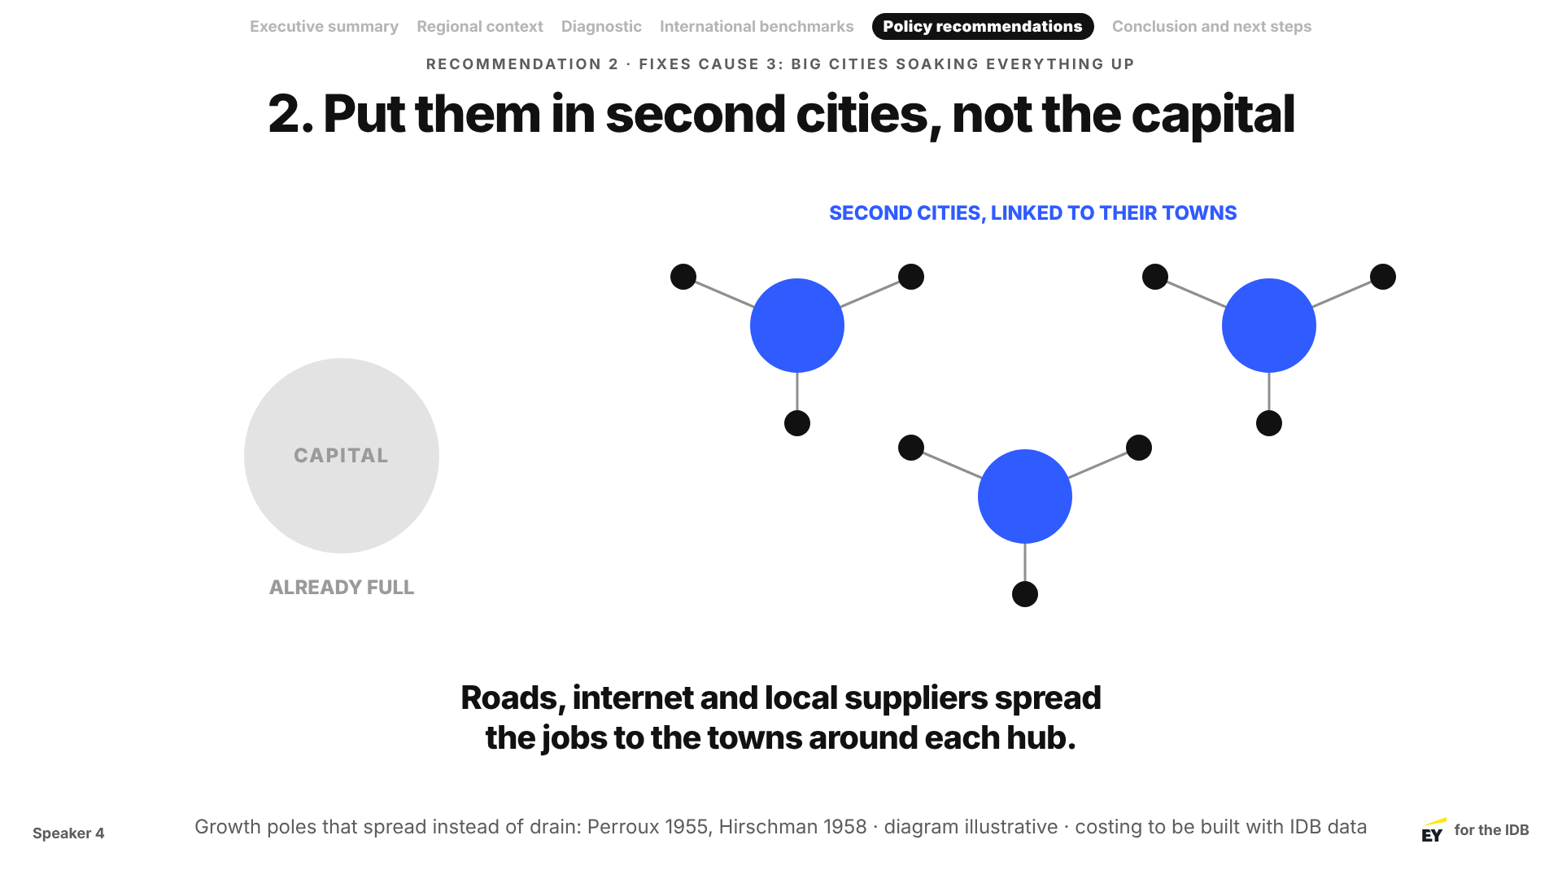
Notes:
Speaker 4
Speaker 4 · about 1 minute. Fixes cause 3.
"Two: put them in second cities, not the capital. The capital is already full. Second cities linked to their towns spread the jobs instead of draining them." Example cities to name if asked: [group to choose, e.g. Querétaro or Mérida in Mexico].

Slide 17
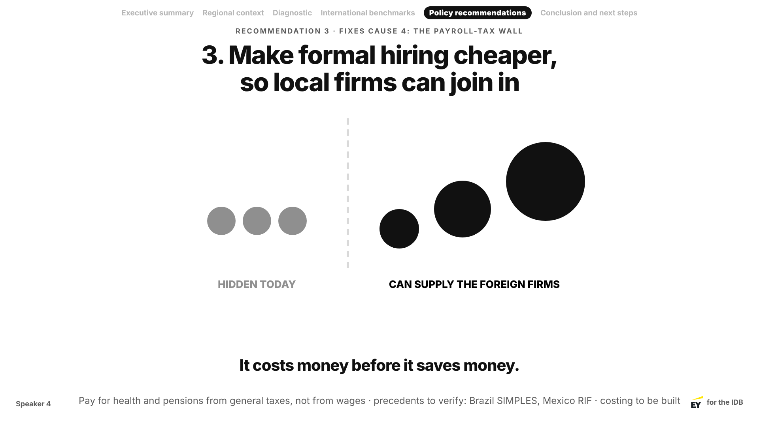
Notes:
Speaker 4
Speaker 4 · about 1 minute. Fixes cause 4.
"Three: make formal hiring cheaper. Pay for health and pensions from general taxes, not wages. Then local firms can come onto the books and become suppliers to the foreign firms." Say the cost first: "It costs money before it saves money."
Hand-off: "[Speaker 5] on how we roll it out."

Slide 18
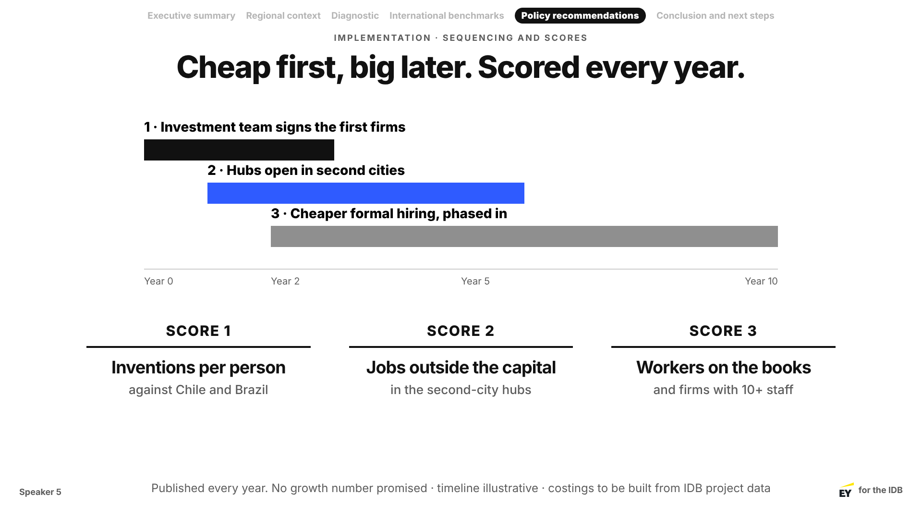
Notes:
Speaker 5
Speaker 5 · about 1 minute 15.
"Governments last four years; these programmes don't. So the cheapest, fastest step goes first, and each step has to earn the next. Every year we publish three scores. We are not promising a growth number." If asked: inclusive, because it reaches towns and informal workers; sustainable, because know-how lasts.

Slide 19
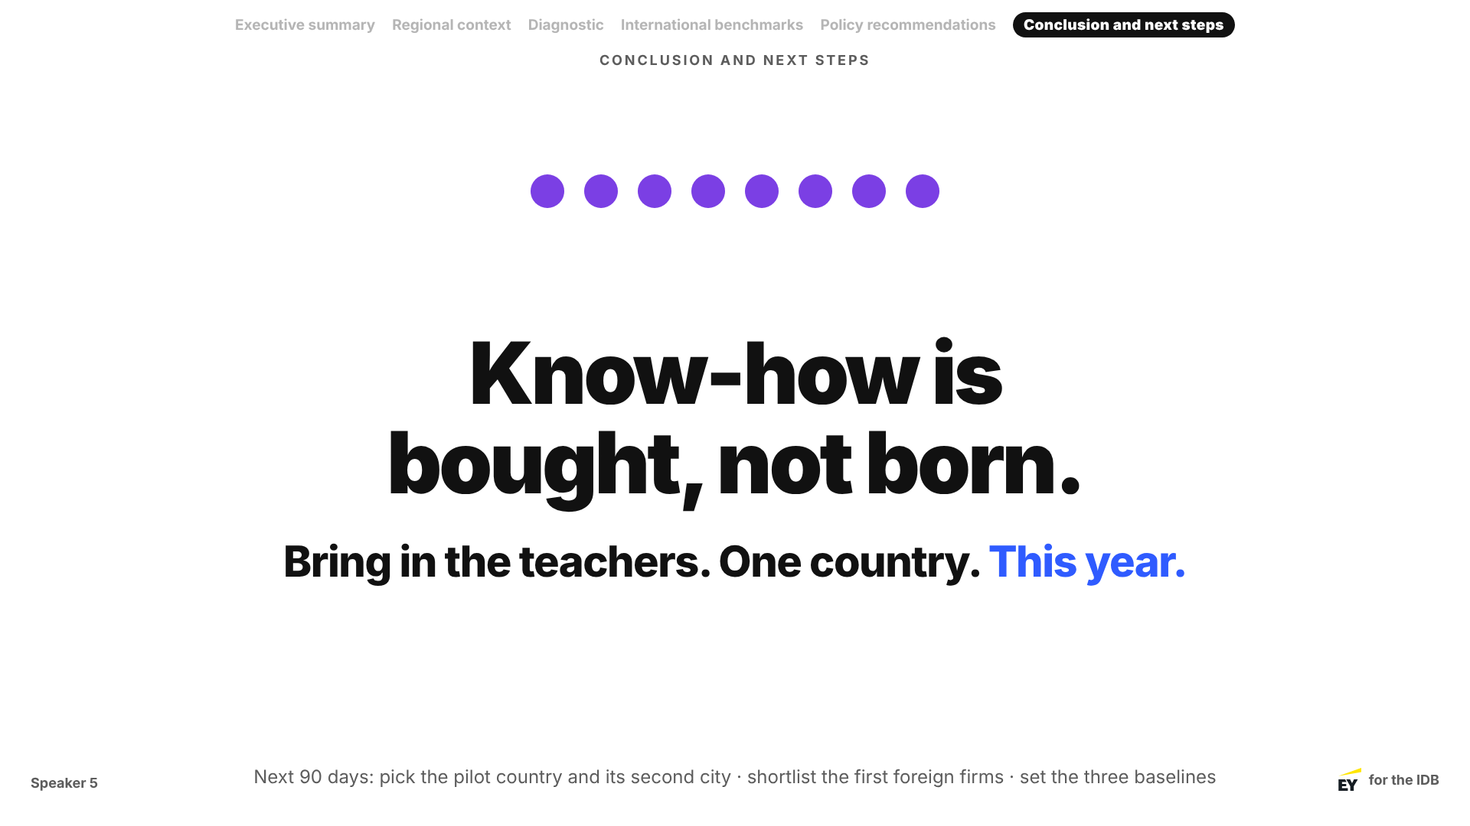
Notes:
Speaker 5
Speaker 5 · Conclusion and next steps · about 1 minute. The eight dots are back.
"Eight inventions. In 1980 Korea started where Mexico was. The difference was homework. Know-how is bought, not born. (Message #4) So bring in the teachers, in one country, this year. In the next 90 days: pick the pilot country and its second city, shortlist the first foreign firms, and set the baselines."
Pause. No "thank you". "We'd love your questions." Speaker 5 hosts Q&A.

Slide 20
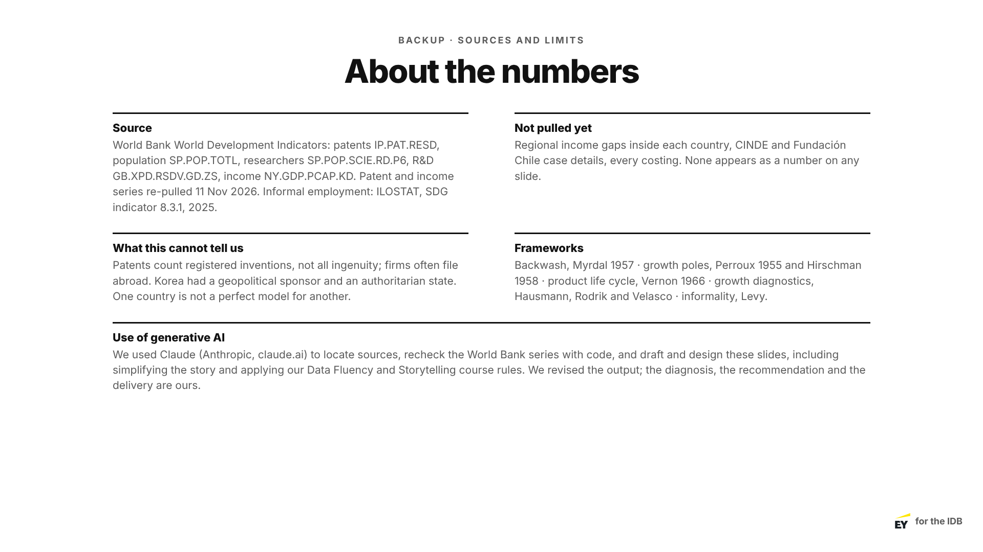
Notes:
Backup
Backup · Q&A only. See the Q&A plan in the script for who answers what.

