Slide 1
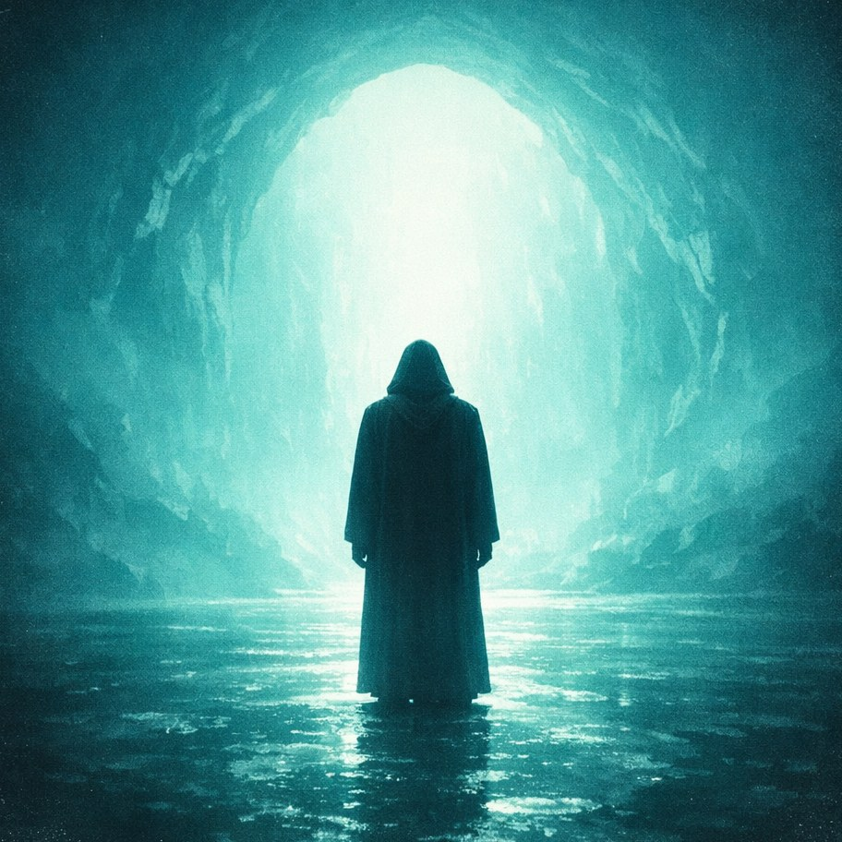
P H I L O S O P H I C A L K I N G
Design system
Philosophy, set to music. 250+ tracks, daily short-form video,
an audience that is ~90% Philippines.
Notes:
Brand guidelines for Philosophical King. Everything here is drawn from the shipping system, not invented.

Slide 2
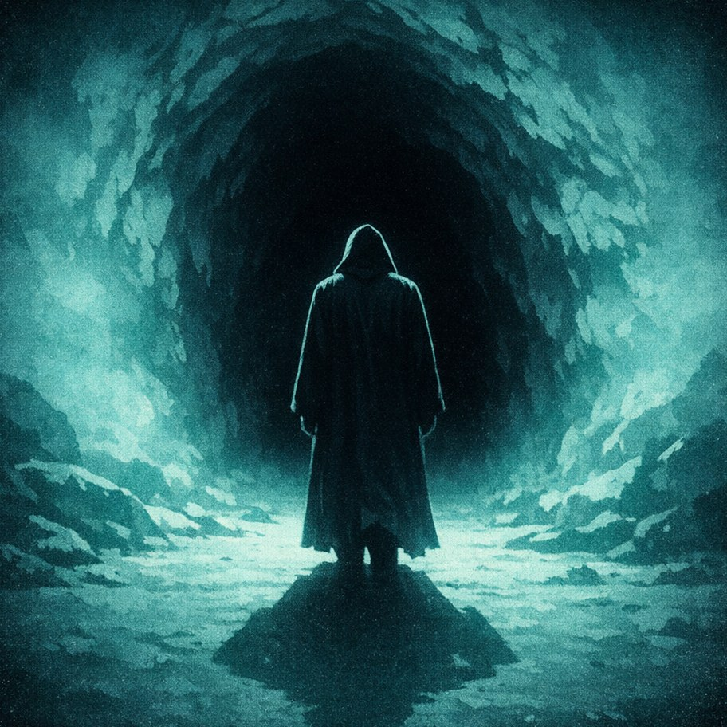
P H I L O S O P H I C A L K I N G
Voice
Calm, aphoristic, stoic-modern.
♛
Short declarative lines.
One idea carries a piece. Never two.
♛
Never salesy.
No exclamation marks, no hype punctuation, no urgency.
♛
Carved, not captioned.
The tone of a line cut into stone — not written for engagement.

Slide 3
P H I L O S O P H I C A L K I N G
Palette
Monochrome teal and cyan. Nothing else — this is the strongest identity signal.
#0E0F13
Near-black — ground for everything
#C8E0D8
Pale teal — text, wordmark, lyric lines
Emphasis comes from gold or from scale.
Never from a new colour.
#E9C46A
Gold — accent ONLY. Rules, one landing word.
#B09A4A
Dim gold — waveforms, secondary marks
#7A7E87
Grey — footers, URLs, metadata

Slide 4
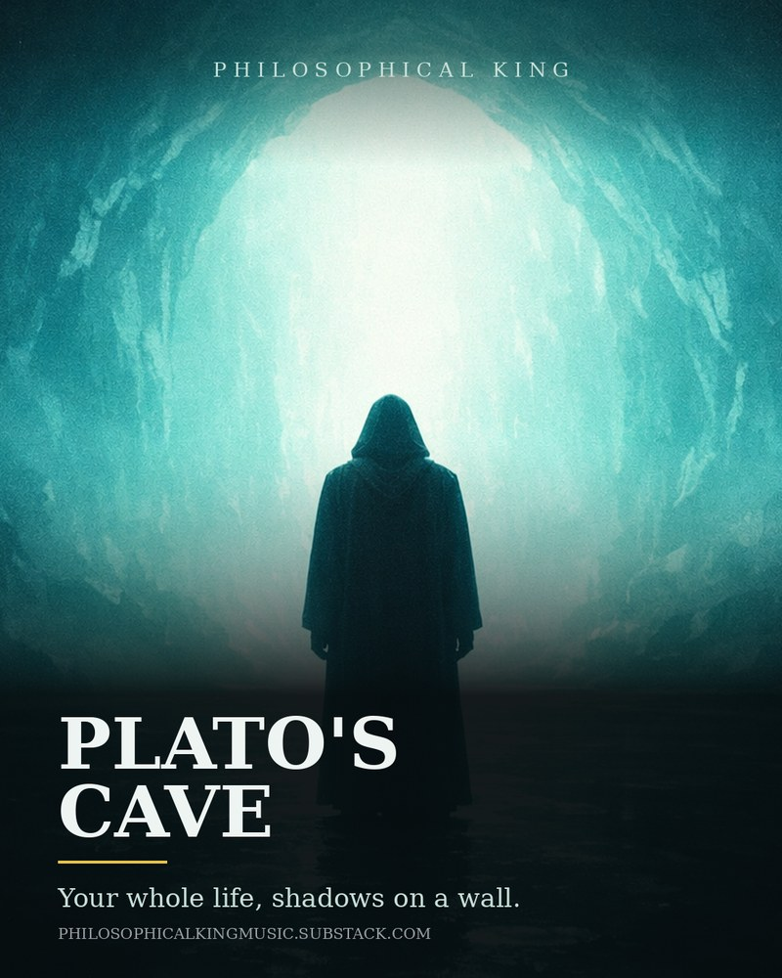
P H I L O S O P H I C A L K I N G
Typography
A serif throughout. It reads as inscription rather than interface — which is the point.
P H I L O S O P H I C A L K I N G
Wordmark — always spaced caps
Each step was a death,
Lyric line — 52px serif, pale teal, hard shadow
Hard drop shadows only — 0 3px 0 rgba(0,0,0,.9). No soft glows.
Zero border radius anywhere. Nothing rounds.
Mark: ♛

Slide 5
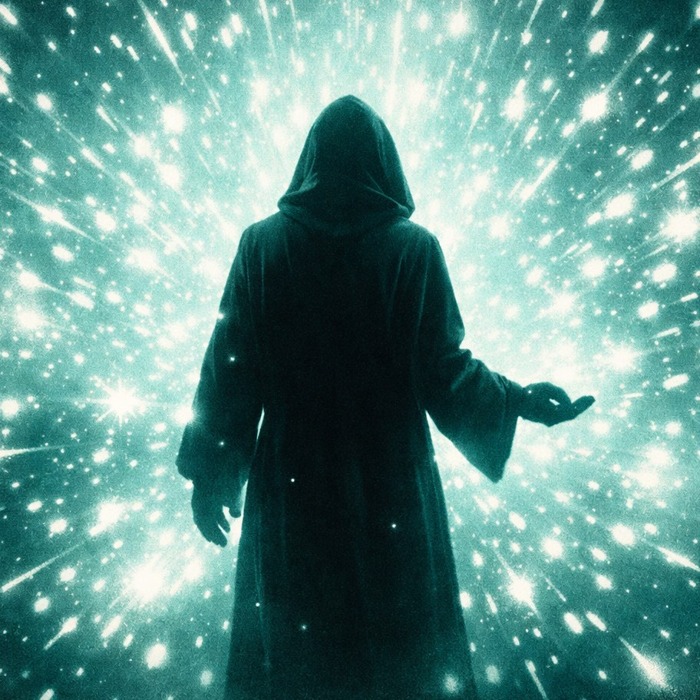
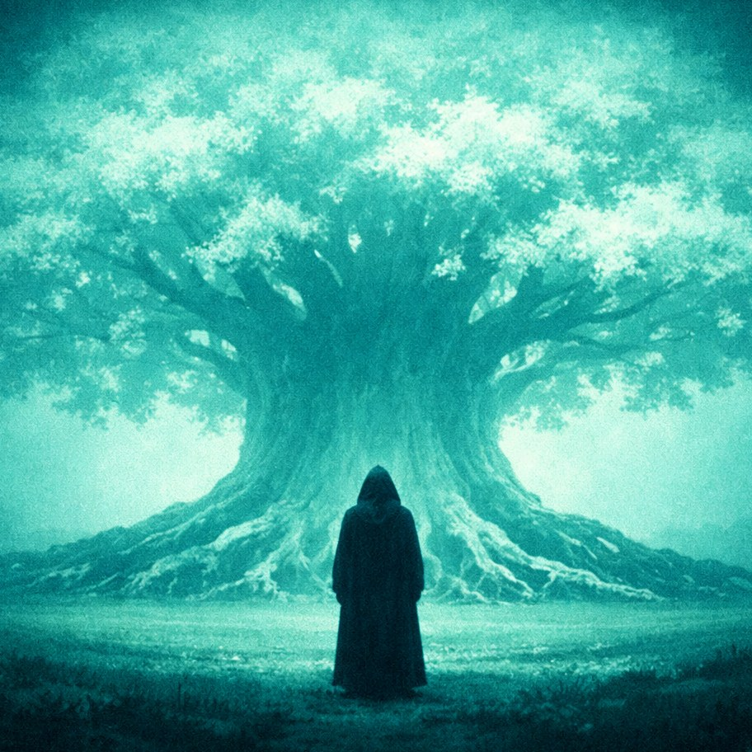
P H I L O S O P H I C A L K I N G
The Wanderer
One recurring character across the whole catalogue.
A solitary figure seen strictly from behind, face never visible, dead-centre, in a long dark ground-length hooded robe with the hood up, shoulders squared — a near-black silhouette with faint teal rim-light along the hood and shoulders.
He is never shown from the front. His identity lives in shape — hood, hem, squared shoulders — so it survives even as a cut-out against blown-out light.
Same man. Opposite lighting. Still unmistakable.

Slide 6
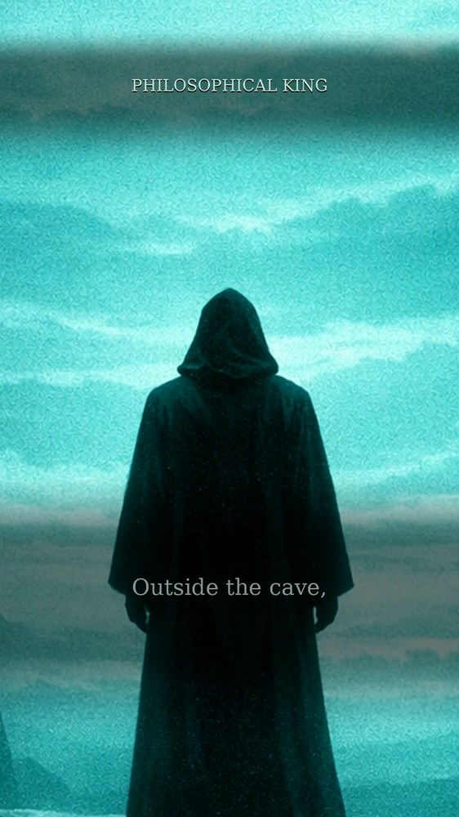
P H I L O S O P H I C A L K I N G
Layout
Vertical 1080×1920 is the native canvas. Everything is designed for a phone held upright.
y = 200
Watermark — below the platform's top UI band
y ≈ 1380
Lyric or quote line — above the bottom UI band
1100–1760
Needs a dark scrim behind it, or teal text disappears against teal imagery
edges
Platform UI eats the frame. The safe zone is real.

Slide 7
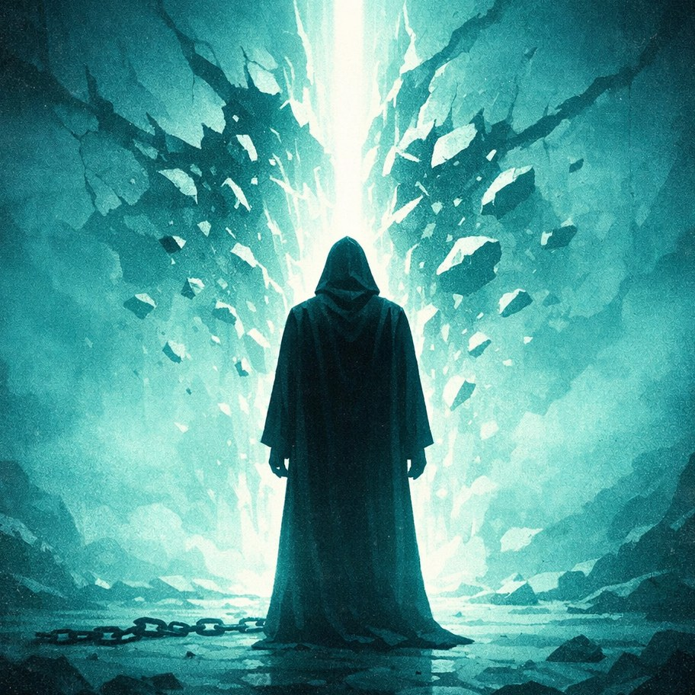
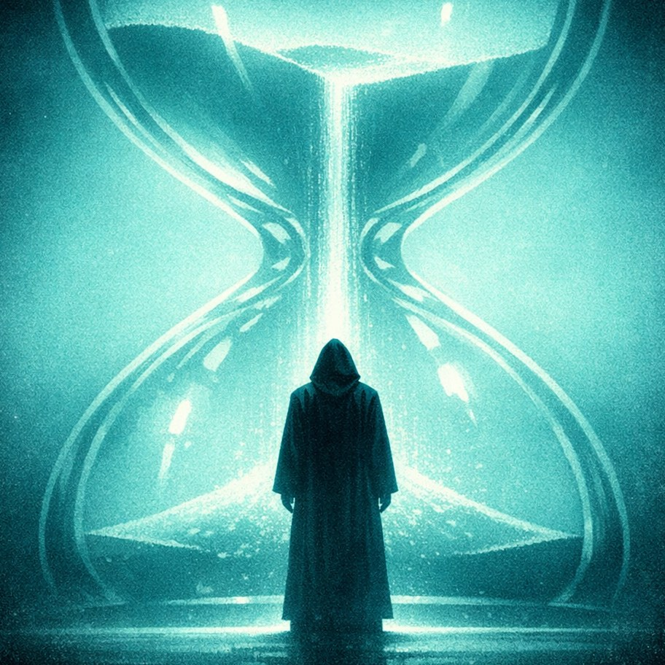
P H I L O S O P H I C A L K I N G
Imagery
Stylised cinematic illustration — the vintage 35mm film still.
Flat graphic shapes, minimal fine detail, heavy atmospheric haze and light bloom, soft vignette, subtle grain. Centred, symmetrical, still.
Never open on black.
Measured on real data: a video that faded in from black retained 48%, where the same-length alternatives retained 58–75%. On a short-form feed the first second is the entire retention decision.

Slide 8
P H I L O S O P H I C A L K I N G
What I need, what to avoid
Build
Avoid
Quote cards and lyric cards
Gradients as decoration
Substack headers
Rounded corners, blurred shadows
Instagram posts — 1080×1350
Stock-photo warmth
Reels covers and Shorts end cards
Emoji beyond ♛
A simple artist page
Any second accent colour
Every template carries the full URL as visible text — never “link in bio” alone.
https://hyperfollow.com/PhilosophicalKing
Anything resembling a SaaS landing page
The reference is a title card from a serious film.

