Slide 1
I/O
What goes in must come out

Slide 2
I/O Devices and Controllers
In general, the closer an I/O unit is to the CPU, the faster it can be accessed.
Three categories:
  Human Readable (display, keyboard) 80 b/s
  Machine Readable (disk) 6 Mb/s
  Communication (modem, network) 1 Gb/s
Other Differences:
  Data rate, latency, signal propagation, bus arbitration, buffering time
  Application - disk requires file system support
  Complexity of Control - keyboard driver simpler than disk driver
  Unit of Transfer (byte, block)
  Data Representation (character set, parity)
  Error Conditions

Slide 3
Memory Mapped I/O
Memory
One Address Space
Two Address Space
0xFF…
I/O Ports
0
Notes:
Control Registers mapped to PORT
Read and write to ports with special instructions
IN REG, PORT
OUT PORT, REG
Every instruction that goes to memory can go to the special registers

Slide 4
DMA
In general, polling is a waste of CPU time
Interrupt processing overhead is greater than polling but without “wasted” cycles
DMA reduces CPU involvement when transferring larger chunks of data
Cycle stealing causes the CPU to execute more slowly
  mitigated by cache
  smarter DMA controllers
Improved when path between DMA module and I/O module does not include the system bus

Slide 5
DMA (continued…)
Block structure
  Data count (# of bytes/words)
  Data register (data to/from device)
  Address register (memory location)
  Control logic
Structure of operations:
  CPU initializes DMA unit
    Inform unit if this is a read or write
    Set the address of I/O device
    Address of memory to read/write
    Amount of data to transfer
  DMA device performs transfer
    Steals memory cycles from CPU
    These may occur in the middle of an instruction
  DMA device interrupts CPU at end
Data Count
Data Lines
Data Register
Address Register
Address Lines
DMA request
DMA acknowledge
Interrupt
Read
Write
Control Logic

Slide 6
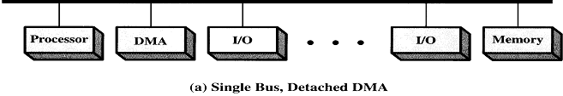
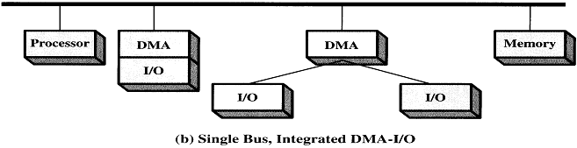
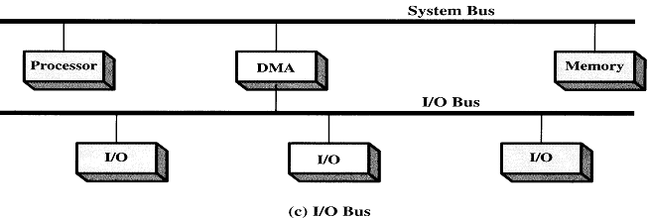
DMA Configuration

Slide 7
Interrupts
CPU
Interrupt
Controller
Disk
Keyboard
Clock
Printer
Notes:
Control arbitrates interrupts.
Once it chooses an interrupt, it writes a device number to the bus
Interrupts the CPU
CPU reads device and then goes to the interrupt vector to service.

Slide 8
Precise Interrupts
Leave machine in well-defined state
  PC saved
  All instructions before PC are complete
  No instructions beyond PC are executed
  The current state at PC is known
Hardware mixes precise and imprecise
Much easier to do imprecise!

Slide 9
Precise and Imprecise compared
not executed
not executed
not executed
10% executed
not executed
40% executed
PC
not executed
PC
35% executed
fully executed
20% executed
fully executed
60% executed
fully executed
80% executed
fully executed
fully executed

Slide 10
I/O Techniques
Programmed I/O
  Processor issues I/O command, waits for the operation to complete
  Often handles I/O transfer details
Interrupt-Driven I/O
  Processors issues I/O command, then proceeds to another process
  Device interrupts the CPU when the data is ready to be moved to memory
Direct Memory Access (DMA)
  Processor issues I/O command
  Device transfers data to/from memory (CPU will wait for memory)
  Device interrupts the CPU when the I/O transfer is completed

Slide 11
Programmed I/O
User space
String to print
ABCD
EFGH
Printed Page
Kernel Space
Notes:
The OS is going to copy down the data, and then wait for printer to be ready, once ready, it will send each character to the printer, making sure it gets the character and is ready for another. The OS is doing all of the work.

Slide 12
Programmed I/O
User space
Next
A
Printed Page
Kernel Space
ABCD
EFGH

Slide 13
Programmed I/O
User space
Next
AB
Printed Page
Kernel Space
ABCD
EFGH

Slide 14
Interrupt Driven I/O
Print System Call:
copy_from_buffer(buffer, p, count);
enable_interrupts();
while(*printer_status_reg != READY);
*printer_data_register = p[0];
scheduler();
Interrupt service routine:
if (count == 0) {
unblock_user();
} else {
*printer_data_register = p[i];
count = count – 1;
i = i + 1;
}
acknowledge_interrupt();
return_from_interrupt();
Notes:
Interrupt every character. Not cool!
Note the copy into kernel space for convenience.

Slide 15
DMA I/O
Print System Call:
copy_from_buffer(buffer, p, count);
set_up_DMA_controller();
scheduler();
Interrupt service routine:
acknowledge_interrupt();
unblock_user();
return_from_interrupt();
Notes:
Much Simpler!

Slide 16
Evolution of the I/O Function
CPU directly controls device
  Seen in simple microprocessor devices
I/O module (i.e., serial port chip)
  CPU uses programmed I/O
Add Interrupts
  More efficient – No polling needed
I/O module supports DMA
  Device can move a block of data without involving the CPU
I/O Processor
  I/O device enhanced with a set of I/O-specific instructions
  CPU creates I/O program
I/O Module with memory
  Module becomes a computer of its own
  Minimal CPU involvement

Slide 17
I/O Design Objectives
Efficiency
  I/O can be a bottleneck
  Swapping is used to increase number of ready processes
    Requires I/O activity to do this
  Major emphasis is on disk efficiency due to its importance
Generality
  Easier to handle devices uniformly
    How processes view I/O devices
    How O.S. manages I/O devices
  Because of differences in devices, it is hard to achieve true generality
  Can use a hierarchical, modular approach to hide I/O details
    Processes see open/read/write/close for all devices

Slide 18
I/O Organization
Logical I/O – Think of the device as a logical resource
  Directory Management
    Convert file names to identifiers that reference a file
  File System
    Deal with logical structure and open, read, write, also permissions
  Physical Organization
    Convert logical references to storage addresses
Device I/O – Convert operations and data into I/O instruction sequences
  May use buffering to improve speed
Scheduling and Control – Actual queuing and scheduling of operations
  This level handles interrupts, status

Slide 19
Logical Structure
User-level I/O Software
Device Independent OS Software
Device Drivers
Interrupt Handlers
Hardware
Notes:
Device independent: inteface, buffering, error reporting, allocating/deallocating devices, managing block sizes etc.

Slide 20
I/O Buffering
Operating System
User Process
No buffering
I/O Device
In
Operating System
User Process
Single buffering
I/O Device
In
Move
Operating System
User Process
Double buffering
I/O Device
In
Move
Operating System
User Process
Circular buffering
I/O Device
In
Move
Notes:
Single buffering is in either user or kernel space or both.

Slide 21
I/O Buffering
Block-oriented
  information is stored in fixed sized blocks
  transfers are made a block at a time
  used for disks and tapes
Stream-oriented
  transfer information as a stream of bytes
  used for terminals, printers, communication ports, mouse, and most other devices that are not secondary storage

Slide 22
Spooling
Addresses dedicated I/O devices
Special daemon process copies data
Spooling directory stages data to device
Daemon processes files in directory

Slide 23
Layers of I/O System
User Process
Make I/O call, format I/O, spooling
Device Independent Software
Naming, protection, blocking, buffering, alloc
Device Drivers
Setup device registers and check status
Interrupts
Wake up driver when I/O done
Hardware
Perform I/O operation

Slide 24
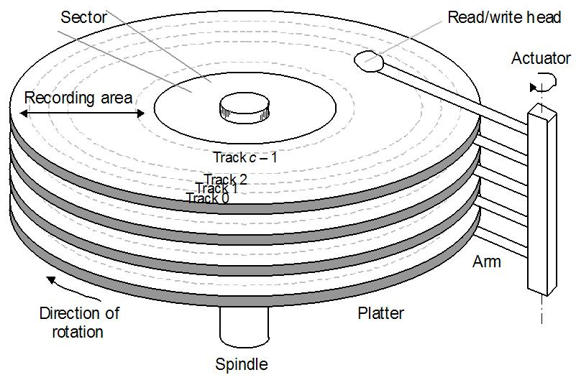
Disk Structure
Addressed as a one dimensional array of logical sectors
  Logical mapping to physical sectors on disk
  Sectors are smallest addressable blocks (usually 512 bytes)
  Clusters composed of one or more sectors
Simple, but……..
  Defective sectors
    Hidden by substituting sectors from elsewhere
  Number of sectors per track is not constant
    40% more sectors on outside track
0 | 512 bytes
1 | 512 bytes
2 | 512 bytes
3 | 512 bytes
4 | 512 bytes
5 | 512 bytes
6 | 512 bytes
7 | 512 bytes
8 | 512 bytes
9 | 512 bytes
10 | 512 bytes
11 | 512 bytes
12 | 512 bytes
13 | 512 bytes
14 | 512 bytes
… | …
Notes:
SATA and IDE have a microcontroller on the disk that does most of the heavy listing. The device driver has a higher level API to do block transfers.

Slide 25
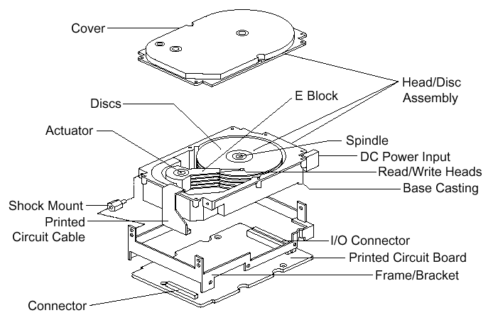
Disk Structure

Slide 26
Sectors
Actual Layout
Virtual (published) Layout
Notes:
A real disk has 16 or more zones. The number of sectors per zone increases by 4% as you move to the outer cylinder.
One the left is the actual layout of sectors. On the right is a virtual layout (though it does not match her in our diagram) of the published sector layout. The microcontroller handles the remapping from the virtual layout to the actual physical layout.

Slide 27
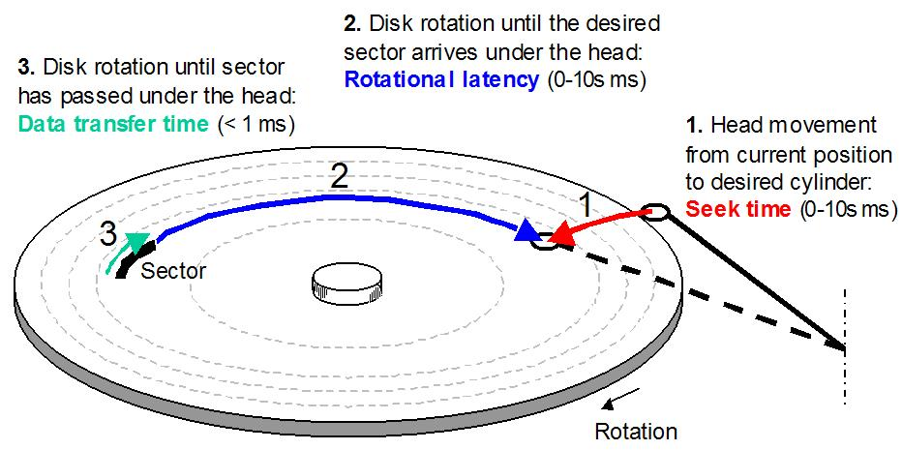
Disk speed

Slide 28
Disk Performance
Much slower than memory
  Typical disk speed: 4-10 ms (10⁻³ s)
  Typical memory speed: 1-10 ns (10⁻⁹ s)
I/O bus Protocols
  EIDE – Enhanced Integrated Drive Electronics
  ATA – Advanced Technology Attachment
  SATA – Serial ATA
  USB – Universal Serial Bus
  FC – Fiber Channel
  SCSI – Small Computer System Interface
  SAS – Serial SCSI
  IDE – Integrated Disk Electronics

Slide 29


Effective Transfer Rates
Performance measures
  Seek Time – Time to move the heads
    Approximation ≈ (# of tracks × c) + startup/settle time (12 ms)
  Rotational Delay – Waiting for the correct sector to move under the head
    Average 1/2 rotation
      HD: 5400rpm → 5.6ms, 10000rpm → 3ms
      Floppy: 300 rpm → 100ms
Effective Times
  Access Time – Sum of seek time and rotational delay
  Transfer Time – Actual time needed to perform the read or write
Time depends on locality

Slide 30
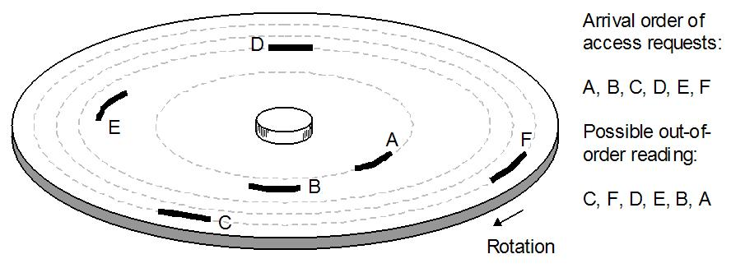
Disk scheduling
When a read/write job is requested, the disk may currently be busy
All pending jobs are placed in a disk queue
  could be scheduled to improve the utilization
Disk scheduling increases the disk’s bandwidth
  (the amount of information that can be transferred in a set amount of time)

Slide 31
Disk Scheduling
Random
  Select a random request to do next
  Worst possible performance, but useful for comparisons
FIFO
  Do in the order they arrive
  Simple and fair in that all requests are honored
  Poor performance if requests are not clustered
    Especially true in multiprogramming systems
Priority
  Do operations for high-priority processes first
  Not intended to optimize disk utilization, but to meet other objectives
  Users may try to exploit priorities

Slide 32
Disk Scheduling
LIFO (Last-In First-Out)
  Always take the most recent request
  Hope to catch a sequence of reads at one time (locality)
  Runs risk of starvation
SSTF (Shortest Service Time First)
  Select the read closest to the current track next
  Requires knowledge of arm position
  Also has risk of starvation
SCAN
  Arm moves in one direction, meeting all requests en route
  If no more requests, switch directions
  Bias against track just traversed
    Will miss locality in the wrong direction
    Favors innermost and outermost tracks; latest arriving jobs

Slide 33
Disk Scheduling
C-SCAN (circular SCAN)
  Always scan in one direction
  If no more requests, move to far end and start over
  Reduces time for requests on edges
N-step Scan
  Prevent one track from monopolizing disk (“arm stickiness”)
  Have sub-queues of size N
  Use SCAN for each sub-queue
FSCAN
  When one scan begins, only existing requests are handled
  New requests are put on a secondary queue
  When a scan ends, take the queue entries and start a new scan

Slide 34
FCFS (FIFO) Scheduling
Cylinder Requests: 53, 98, 183, 37, 122, 14, 124, 65, 67
0 14 37 53 65 67 98 122 124 183 199

Slide 35
SSTF Scheduling (Shortest service time first)
Cylinder Requests: 53, 98, 183, 37, 122, 14, 124, 65, 67
0 14 37 53 65 67 98 122 124 183 199
A form of Shortest Job First
Not optimal
May cause starvation

Slide 36
SCAN Scheduling (Scan one side to other)
Cylinder Requests: 53, 98, 183, 37, 122, 14, 124, 65, 67
0 14 37 53 65 67 98 122 124 183 199
Sometimes called the elevator algorithm
Think about requests when head reverses direction
- Just serviced those requests near disk head

Slide 37
C-SCAN Scheduling (Circular Scan)
Cylinder Requests: 53, 98, 183, 37, 122, 14, 124, 65, 67
0 14 37 53 65 67 98 122 124 183 199
Designed to provide more uniform wait time
Treat cylinders like a circular list

Slide 38
LOOK and C-LOOK
Cylinder Requests: 53, 98, 183, 37, 122, 14, 124, 65, 67
0 14 37 53 65 67 98 122 124 183 199
Don’t go all the way to the end cylinders
C-LOOK

Slide 39
Disk Scheduling Algorithms
Selection according to requestor
RSS | Random scheduling | For analysis & simulation
FIFO | First in first out | Fairest of them all
Priority | Priority by process | No disk optimization
LIFO | Last in first out | Max locality & resource
Selection according to requested item
SSTF | Shortest service time first | High utilization, small queues
SCAN | Back and forth over disk | Better service distribution
C-SCAN | One way with fast return | Lower service variability
N-step-SCAN | SCAN of N records at a time | Service guarantee
FSCAN | NsS w/N=queue at beginning of SCAN cycle | Load sensitive

Slide 40
Choosing an Algorithm
Seek time is the only thing that can be controlled
  SSTF is commonly used (appealing)
  SCAN & CSCAN perform better under heavy load
    Why? (Think about starvation issues)
  Can find optimal schedule but computation is expensive
  In low use systems, FCFS (FIFO) is fine

Slide 41
Choosing an Algorithm
Head movement is not the only consideration
  Rotational Latency
File system will play a part as well
  Typically file systems generate requests to read or write a larger unit of data (say 64K) and this request will be passed to the disk as a command to read or write 128 sectors.
Hardware can help too
  Caching a whole track at a time
  The disk device initially transfers data to a memory chip in the disk controller circuitry.
  The cheapest desktop computer disks have 2 megabytes of cache memory, while for a few dollars more you can get a disk with 8 megabytes.

Slide 42
Low-level Formatting
When made, a disk is just a magnetic plate
Low-level (or physical) formatting divides the disks into sectors
Header data – 512 bytes trailer
Sector number
Disk controller info
ECC

Slide 43
Interleaving
7
0
7
0
5
0
6
1
3
4
2
3
5
2
6
1
7
6
4
3
2
5
4
1
Notes:
Disk controller needs time to copy sector into memory. Interleave sectors so copy finishes when next sector is under read head.

Slide 44
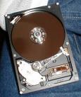
Disk formatting
Logical formatting
  file system structure is written onto the disk
Includes boot information (when requested) and FAT tables, inodes, NTFS database, etc.
Boot sector
  contains enough instructions to start loading the OS from somewhere else
  Called by bootstrap program in computer’s ROM

Slide 45
Bad blocks
In FAT, when a block gives an unrecoverable ECC error, the sector is marked bad (0xFF7) in the FAT
Bit mapped allocation just marks sector as used
Some systems keep a pool of spare blocks
  when a block goes bad, maps the logical sector to one of the spare blocks
    Same cylinder if possible
    Sector slipping (push down a group to free up a sector)
  Doesn’t recover the corrupted file, but does keep the same logical disk structure

Slide 46
Asynchronous I/O
Application makes request and proceeds
Ways to signal completion
  Signal a device kernel object
    Simple to handle
    Cannot distinguish multiple requests regarding the same file
  Signal a event kernel object
    Can create a separate object for each request
  Alertable I/O
    I/O manager places results in APC (asynchronous procedure call) queue
  I/O completion ports
    Use a pool of threads to handle requests
RAID
  Hardware – Done by disk controller
  Software – System combines space

Slide 47
Swap Space
Swap Space
This is the area of the disk where processes or memory pages are written if the system needs more physical memory
Can be either set aside area of disk or part of the regular file system
Set aside an area of the disk for swap space:
  Easier management and better performance
  Requires special code
Part of file system:
  Uses regular file functions
  Slower to access and change

Slide 48
Reliability
Although disks are fairly reliable - they still fail on a regular basis
Redundant arrays of independent disks (RAID) are more reliable
Simplest forms have duplicate copies of each disk
Twice the cost but twice as fast when reading
Another type uses 1 parity block per 8 disk blocks
The parity can be used to recalculate the information in a bad block

Slide 49

RAID
Database designers recognize that a H/W component can only be pushed so far…
If the data is on separate disks, we can issue parallel commands
  This can be individual requests or a single large request
  Provide physical redundancy
Industry has a standard for multiple-disk database design: RAID - Redundant Array of Independent Disks
Key advantage:
  Combines multiple low-cost devices using older technology into an array that offers greater capacity, reliability, speed, or a combination of these things, than is affordably available in a single device using the newest technology.

Slide 50
RAID
Common characteristics
  Views a set of physical disks as a single logical entity
  Data is distributed across the disks in the array
  Use redundant disk capacity to be able to respond to disk failure
Addresses the need for redundancy
  Caveat: More disks → more chance of failure

Slide 51
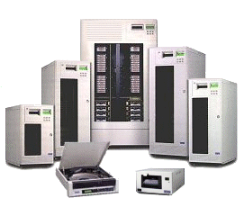
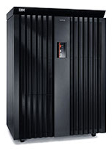
Raid Product Examples…
IBM ESS Model 750

Slide 52
Data Mapping for RAID 0 Array
Physical
Disk 0
Physical
Disk 1
Physical
Disk 2
Physical
Disk 3
strip 0
strip 1
strip 0
strip 1
strip 2
strip 3
strip 2
strip 4
strip 5
strip 6
strip 7
strip 3
strip 9
strip 10
strip 11
strip 4
strip 8
strip 12
strip 13
strip 14
strip 15
strip 5
strip 6
strip 7
strip 8
Array
Management
Software
strip 9
strip 10
strip11
strip 12
strip 13
strip 14
strip 15

Slide 53
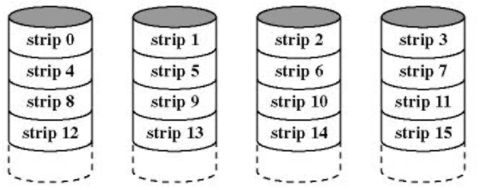
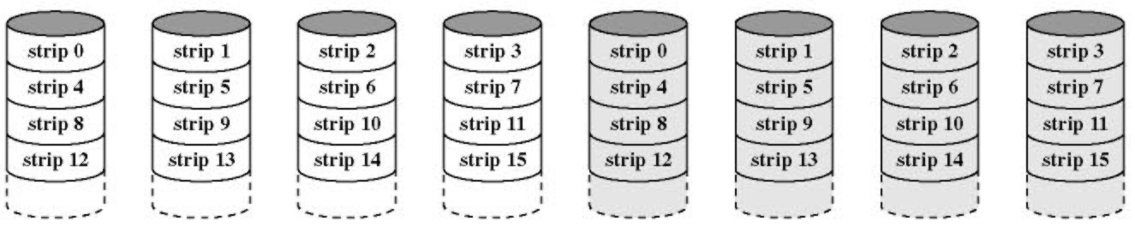
RAID
RAID 0
  Use of multiple disks means that a single request can be handled in parallel
  Greatly reduces I/O transfer time
  Also may balance load across disks
  Does not use redundancy
RAID 1
  Mirror data: read from either disk; writes update both disks in parallel
  Failure recovery easy
  Principle disadvantage is cost

Slide 54
Hamming Codes
Forward Error Correction (FEC) refers to the ability of receiving station to correct a transmission error.
The transmitting station must append information to the data in the form of error correction bits, but the increase in frame length may be modest relative to the cost of re-transmission.
Hamming codes provide for FEC using a "block parity" mechanism that can be inexpensively implemented (XOR).
Hamming codes are used as an error detection mechanism to catch both single and double bit errors or to correct single bit error. This is accomplished by using more than one parity bit, each computed on different combination of bits in the data.

Slide 55
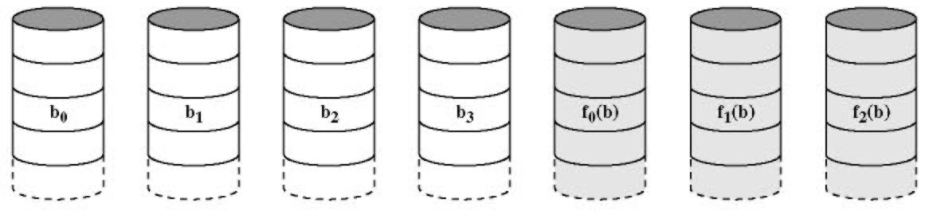
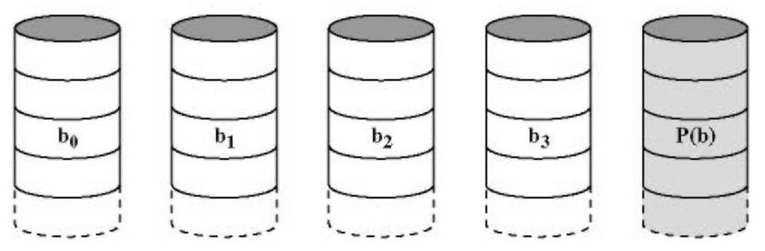
RAID (continued…)
RAID 2
  Parallel access – All disks participate in each I/O request
  Uses Hamming codes to correct single-bit errors, detect double-bit errors
  Spindles synchronized
  Strips small (byte or word)
  Overkill – not used
RAID 3
  Implements a single parity strip with a single redundant disk
  Parity = data1 ⊕ data2 ⊕ data3 ⊕ ...
  Missing data can be reconstructed from the parity strip and remaining data strips
  Capable of high data rates, but only
  one I/O request at a time
  Failure operates in reduced mode

Slide 56
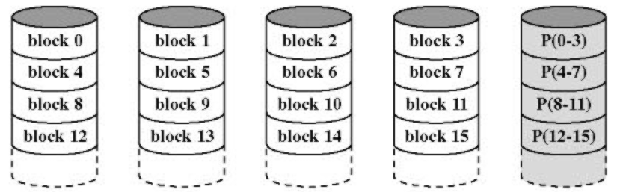
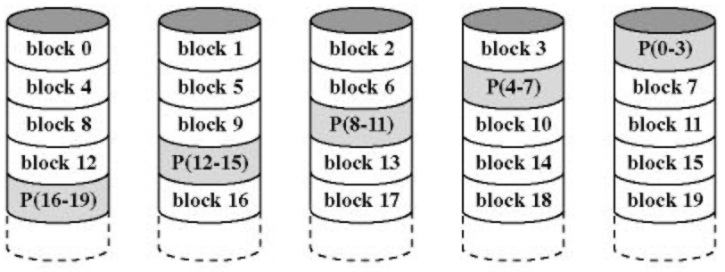
RAID (continued…)
RAID 4-6
  Independent access techniques
RAID 4
  Parity strip handled on a block basis
    Parity strip must be updated on each write
    Parity disk tends to be a bottleneck
RAID 5
  Like RAID 4, but distributes
  parity strips across all disks

Slide 57
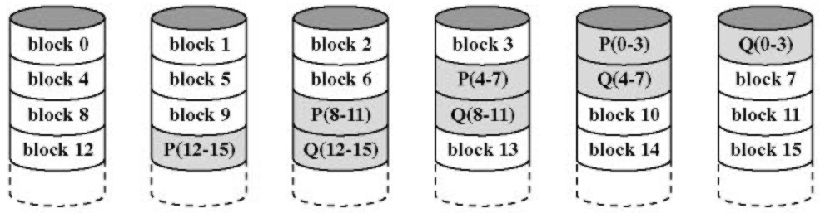
RAID (continued…)
RAID 6
  Use two different data check methods
  Can handle a double-disk failure
  Extremely high data availability w/substantial write penalty

Slide 58
RAID Level Summary
Category
Description
I/O Request Rate
(Read/Write)
Data Transfer Rate
(Read/Write)
Typical Application
Striping
0
Non-redundant
Large strings: Excellent
Small strips: Excellent
Applications requiring high performance for non-critical data
Mirroring
1
Mirrored
Good/fair
Fair/fair
System drives; critical files
Parallel access
2
Redundant via Hamming code
Poor
Excellent
3
Bit-interleaved parity
Poor
Excellent
Large I/O request size applications such as imaging, CAD
Independent access
4
Block-interleaved parity
Excellent/fair
Fair/poor
5
Block-interleaved distributed parity
Excellent/fair
Fair/poor
Applications requiring extremely high availability
6
Block-interleaved dual distributed parity
Excellent/poor
Fair/poor
Notes:
RAID 10 or 1+0 is mirrored set in a stripped set → handles multiple drive loses.

Slide 59
Disk Cache
Similar concept to memory cache
  Use main memory to hold frequently used disk blocks to exploit the principle of locality
  Can afford more complex algorithms due to the time factors involved
Handling a request
  If the data is in cache, pass it to the user (copy or use shared memory)
  If not in cache, read from the disk and add to the cache
Replacement algorithms
  LRU – Can keep a list and determine the one not used for most time
    Most commonly used algorithm
  LFU (least frequently used)
    Account for how often it is used
    Watch out for burst of uses, then idle
    Improved performance w/frequency-abased

Slide 60
Frequency-Based
First Version:
  Two sections: “new” and “old”
  Incoming blocks given count=1
Cache Hit:
  Move the block to the front of the new section
  It it was in the old section, increment count (else leave count unchanged)
Replace the block in the old section with the smallest count
Problem:
  A block referenced in a burst will stay in the new section with count = 1
  When moved to old section, will tend to be replaced fairly early
  This may be a poor choice to remove
Add middle section to allow counts to build up

Slide 61
Swap-Space Management
Swap Space
4.3 BSD
  Allocate process swap space when started
  Enough for text and data segments
  Page in when necessary
  Processes share identical text segments
Two per-process swap maps
  Text → 512K chunks (final is in 1K increments)
  Data → Map is fixed size but elements point to varying size blocks
    Entry i points to block of size 2^{i} x 16K

Slide 62
Swap-Space Management
Swap Space
Text Segment
…………
512K
512K
512K
71K
Data Segment
…………
16K
32K
64K
128K

Slide 63
Unix System V R4 (SVR4) I/O
Each I/O device associated with a special file (/dev/xxx)
  Use ordinary read/write calls to access the device
  Devices separated into character and block devices
Logical structure of the I/O facility:
File Subsystem
Character Queue
  Used for character-orientated devices
  Producer/Consumer model
    Data from the device is written to a queue
    Process reads data from the queue
    Data “destroyed” as it is read
Buffer Cache
Character Block
Device Drivers

Slide 64
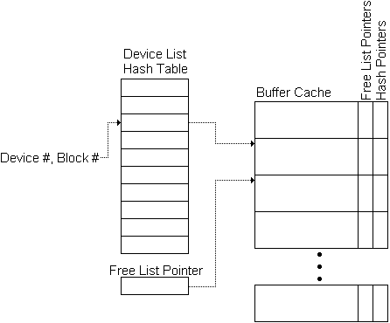
SVR4 Buffer Cache
Serves as a disk cache
Free List – Available slots/buffers
Device List – Associated with a device
Driver I/O Queue – Waiting or performing I/O
Use a hash table to quickly find the buffer corresponding to a particular device and block
Uses LRU for blocks in the queue
  Order kept by the free list order

Slide 65
UNIX Devices
Unbuffered I/O
  Send data directly to the process
  Faster, but process locked into memory
Devices suitable for unbuffered I/O or the buffer cache:
  Disk Drives
  Tape Drives
Devices suitable for Character Queue:
  Terminals
  Printers
Devices suitable for unbuffered I/O or the character queue
  Communication Lines

Slide 66
Windows 2000 I/O
The I/O Manager is responsible for all system I/O and providing a uniform interface
  Cache manager
  File system drivers
  Network drivers
  Hardware device drivers
I/O Manager
Cache manager
File System Drivers
Network Drivers
Hardware Device Drivers

Slide 67
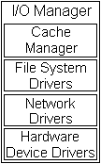
Windows 2000 I/O (continued…)
Cache Manager
  Handles caching for I/O subsystem
  Can dynamically vary the size of cache depending
  upon available memory
  Lazy write – Only cache updated on a write
  (not disk)
  Lazy commit – Similar, but for transactions
File System Drivers
  Treated as an ordinary device driver
  Routes messages for particular volumes to the proper driver

Slide 68
Windows 2000 I/O (continued…)
Network Drivers
  Integrated networking capabilities and support
  for distributed applications
Hardware Device Drivers
  Access hardware through NT DLLs
  Routine names are the same for all processors (better portability)

Slide 69
Windows 2000 I/O (continued…)
Synchronous vs. Asynchronous I/O
  Synchronous: Application blocks until I/O finishes
  Asynchronous: Application continues and is informed of completion later
    Signal a device kernel object
      Simple to handle
      Cannot distinguish multiple requests regarding the same file
    Signal a event kernel object
      Can create a separate object for each request
    Alertable I/O
      I/O manager places results in APC (asynchronous procedure call) queue
    I/O completion ports
      Use a pool of threads to handle requests

Slide 70
Windows 2000 I/O (continued…)
RAID configurations
  Hardware RAID
    Separate physical disks combined into one or more logical disks by the disk controller
  Software RAID
    Noncontiguous disk space combined into one or more logical partitions
    FTDISK – fault-tolerant software disk driver
    Available on W2K Server
    Implements RAID 1 and RAID 5

Slide 71
NT I/O
File System Drivers
  Treated as an ordinary device driver
  Routes messages for particular volumes to the proper driver
Network Drivers
  Integrated networking capabilities and support for distributed applications
Hardware Device Drivers
  Access hardware through NT DLLs
  Routine names are the same for all processors (better portability)
Synchronous vs. Asynchronous I/O
  Synchronous: Application blocks until I/O finishes
  Asynchronous: Application continues and is informed of completion later

