Slide 1

Computer System Overview
CS 345
Discussion #2 – Computer System Overview

Slide 2
Operating System Objectives
Operating systems are among the most complex pieces of software ever developed
  Convenience
    Makes the computer more convenient to use
  Efficiency
    Allows computer system resources to be used in an efficient manner
  Ability to evolve
    Permit effective development, testing, and introduction of new system functions without interfering with service
CS 345
Discussion #2 – Computer System Overview

Slide 3
Operating System Services
Program development
  Editors, debuggers, frameworks
Program execution
  Initialization, scheduling
Access to I/O devices
  Uniform interface, hides details
Controlled access to files
  Authorization, sharing, caching
CS 345
Discussion #2 – Computer System Overview

Slide 4
OS Services (continued…)
System access
  Protection, authorization, resolve conflicts
Error detection and response
  Hardware errors: memory error or device failure
  Software errors: arithmetic errors, access forbidden memory locations, allocation errors
Accounting
  collect statistics (billing)
  monitor performance
  used to anticipate future enhancements
CS 345
Discussion #2 – Computer System Overview

Slide 5
OS as a Resource Manager
OS executes same way as ordinary computer software - it is set of computer programs
The key difference is in the intent
  Directs use of resources
  Relinquishes control of the processor to execute other programs
Kernel or nucleus
  Portion of operating system that is in main memory
  Contains most-frequently used functions
CS 345
Discussion #2 – Computer System Overview

Slide 6
CS 345
Discussion #2 – Computer System Overview

Slide 7
Evolution of Operating Systems
Operating systems have evolved because
  New types of hardware and hardware upgrades
  Development of new services and needs
  Fixes to OS faults
Serial Processing
Simple Batch Processing
Multi-programmed Batch Systems
Time-Sharing Systems
Distributed/Shared Processing Systems
????
CS 345
Discussion #2 – Computer System Overview
Notes:
Serial: No OS. One program at a time. Must setup system, and must physically schedule time. Setup include loading compiler, source, compiling, and then running
Simple Batch: Program schedules and runs jobs sequentially. Program is a monitor. Branches to program, when it completes, takes control back.
Multi-programmed: more people get to play while waiting for I/O

Slide 8
Serial Processing
Evolution of Operating Systems
Serial Processing
  No operating system
  Machines run from a console with display lights and toggle switches, input device, and printer
  Schedule time
  Setup included loading the compiler, source program, saving compiled program, and loading and linking
CS 345
Discussion #2 – Computer System Overview

Slide 9
Simple Batch Systems
Evolution of Operating Systems
Simple Batch Systems
  Monitors
    Software that controls the running programs
    Batch jobs together
    Program branches back to monitor when finished
    Resident monitor is in main memory and available for execution
  Job Control Language (JCL)
    Special type of programming language
    Provides instructions to the monitor (what compiler/data to use)
CS 345
Discussion #2 – Computer System Overview

Slide 10
Hardware Features
Memory protection
  Do not allow the memory area containing the monitor to be altered
Timer
  Prevents a job from monopolizing the system
CS 345
Discussion #2 – Computer System Overview

Slide 11
Hardware Features
Privileged instructions
  Certain machine level instructions can only be executed by the monitor
Interrupts
  Early computer models did not have this capability
CS 345
Discussion #2 – Computer System Overview

Slide 12
Memory Protection
User program executes in user mode
  Certain instructions may not be executed
Monitor executes in system mode
  Kernel mode
  Privileged instructions are executed
  Protected areas of memory may be accessed
CS 345
Discussion #2 – Computer System Overview

Slide 13
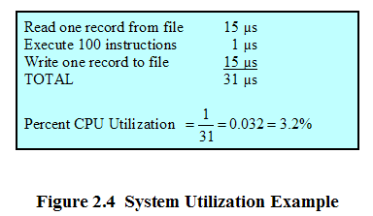
I/O Devices Slow
CS 345
Discussion #2 – Computer System Overview

Slide 14
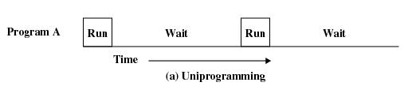
Uniprogramming
Processor must wait for I/O instruction to complete before preceding
CS 345
Discussion #2 – Computer System Overview

Slide 15
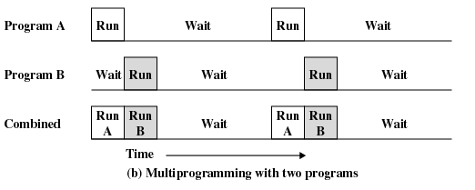
Multiprogramming
When one job needs to wait for I/O, the processor can switch to the other job
CS 345
Discussion #2 – Computer System Overview

Slide 16
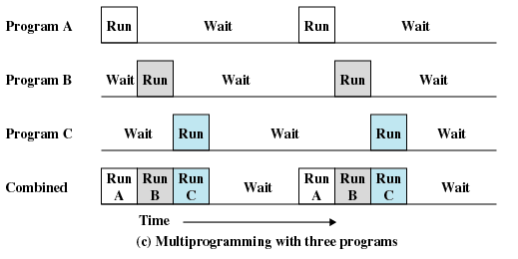
Multiprogramming
CS 345
Discussion #2 – Computer System Overview

Slide 17
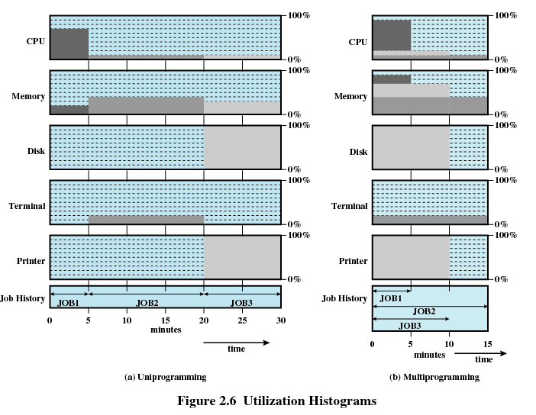
Utilization Histograms
CS 345
Discussion #2 – Computer System Overview

Slide 18
Effects of Multiprogramming
Evolution of Operating Systems
 | Uniprogramming | Multiprogramming
Processor use | 22% | 43%
Memory use | 30% | 67%
Disk use | 33% | 67%
Printer use | 33% | 67%
Elapsed time | 30 min. | 15 min.
Throughput rate | 6 jobs/hr | 12 jobs/hr
Mean response time | 18 min. | 10 min.
CS 345
Discussion #2 – Computer System Overview

Slide 19
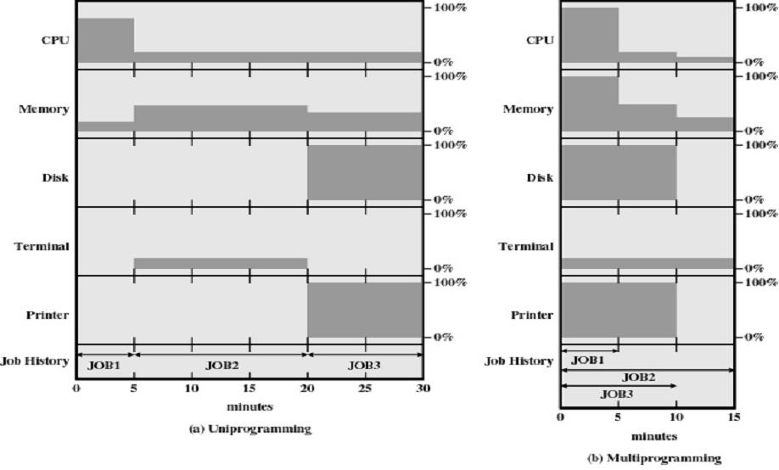
Multiprogramming
Evolution of Operating Systems
CS 345
Discussion #2 – Computer System Overview

Slide 20
Effects of Multiprogramming
Evolution of Operating Systems
 | Uniprogramming | Multiprogramming
Processor use | 22% | 43%
Memory use | 30% | 67%
Disk use | 33% | 67%
Printer use | 33% | 67%
Elapsed time | 30 min. | 15 min.
Throughput rate | 6 jobs/hr | 12 jobs/hr
Mean response time | 18 min. | 10 min.
CS 345
Discussion #2 – Computer System Overview

Slide 21
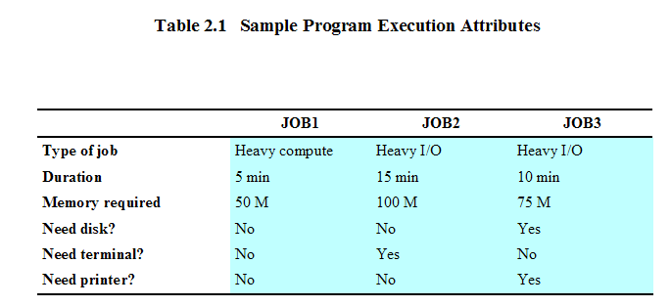
Example
CS 345
Discussion #2 – Computer System Overview

Slide 22
Time Sharing
Using multiprogramming to handle multiple interactive jobs
Processor’s time is shared among multiple users
Multiple users simultaneously access the system through terminals
CS 345
Discussion #2 – Computer System Overview

Slide 23
Time-Sharing Systems
Evolution of Operating Systems
Allow several users to interact at the same time
Emphasizes response time over processor use
Compatible time sharing system (CTSS) – 1962
  32K 36-bit words, switched users every 0.2 seconds
  Supported up to 32 users
MULTICS (1965) – Computer service for Boston
Systems grew as user requirements expanded
  MS-DOS 1.0 (8k, 1981)
  DOS 2.0 – Subdirectories (1983)
  DOS 3.1 – Networking (1984)
  Windows 3.1 – Graphical interface (1990)
  Windows 95 – 32-bit internals (1995)
  …
CS 345
Discussion #2 – Computer System Overview

Slide 24
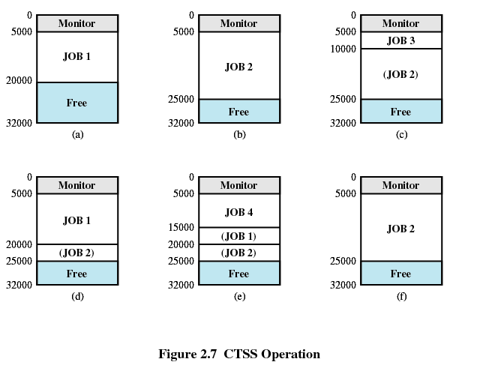
Compatible Time-Sharing System (CTSS)
First time-sharing system developed at MIT
CS 345
Discussion #2 – Computer System Overview

Slide 25
Distributed Processing Systems
Evolution of Operating Systems
Symmetric multiprocessing
  there are multiple processors
  these processors share same main memory and I/O facilities
  All processors can perform the same functions
Distributed operating systems
  provides the illusion of a single main memory and single secondary memory space
  used for distributed file system
CS 345
Discussion #2 – Computer System Overview

Slide 26
Major Achievements
Processes
Memory Management
Information protection and security
Scheduling and resource management
System structure
CS 345
Discussion #2 – Computer System Overview

Slide 27
Processes
Major Achievements
Processes are the fundamental structure of operating systems
  A unit of activity characterized by a sequential thread of execution, current state, and an associated set of system resources
Processes solved the problems introduced by
  Multiprogramming batch operations
  Time sharing
  Real-time transaction systems
Principle tool available to system programmers in developing multi-tasking systems was the interrupt!
CS 345
Discussion #2 – Computer System Overview

Slide 28
Processes (continued…)
Major Achievements
Coordination of processes turned out remarkably difficult
  Improper synchronization
  Failed mutual exclusion
  Non-determinate program operation
  Deadlocks
Processes consist of three components
  An executable program
  Associated data (variables, workspace, buffers, stacks, etc.)
  The execution context of the program
CS 345
Discussion #2 – Computer System Overview

Slide 29
Process
CS 345
Discussion #2 – Computer System Overview

Slide 30
Memory Management
Major Achievements
Principle storage management responsibilities
  Process isolation
  Automatic allocation and management
  Support of modular programming
  Protection and access control
  Long-term storage
These requirements typically met by
  Virtual memory
  File system facilities
CS 345
Discussion #2 – Computer System Overview

Slide 31
Virtual Memory and File System
Implements long-term store
Information stored in named objects called files
CS 345
Discussion #2 – Computer System Overview

Slide 32
Paging
Allows process to be comprised of a number of fixed-size blocks, called pages
Virtual address is a page number and an offset within the page
Each page may be located any where in main memory
Real address or physical address in main memory
CS 345
Discussion #2 – Computer System Overview

Slide 33
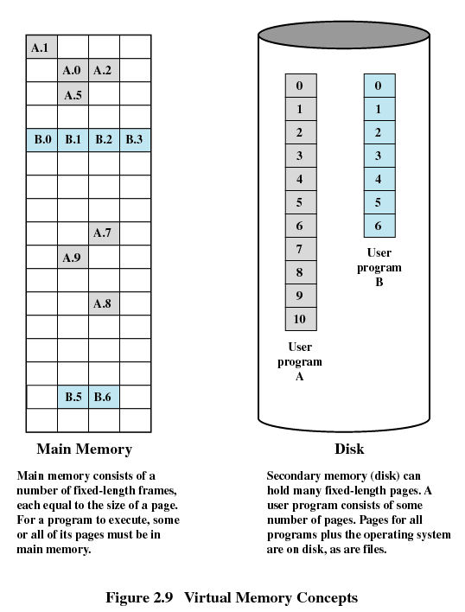
Virtual Memory
CS 345
Discussion #2 – Computer System Overview

Slide 34
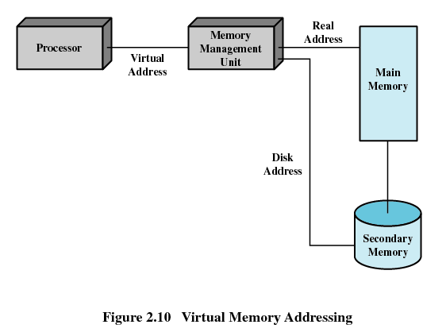
Virtual Memory Addressing
CS 345
Discussion #2 – Computer System Overview

Slide 35
Information Protection and Security
Major Achievements
Time-sharing and computer networks require
  Availability
  Confidentiality
  Data integrity
  Authenticity
CS 345
Discussion #2 – Computer System Overview

Slide 36
Scheduling and Resource Management
Major Achievements
Any resource allocation and scheduling policy must consider
  Fairness
  Differential responsiveness
  Efficiency
Processes/resources are dispatched using
  Round-robin
  Priority levels
  Long-term / short-term queues
CS 345
Discussion #2 – Computer System Overview

Slide 37
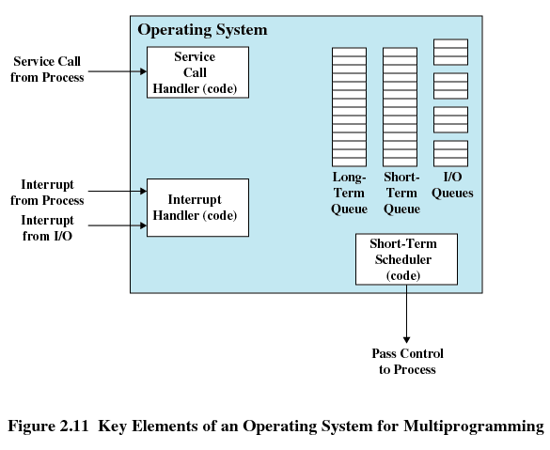
Operating System Elements
CS 345
Discussion #2 – Computer System Overview

Slide 38
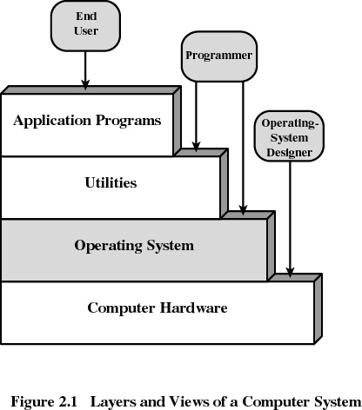
System Structure
Major Achievements
System structured as a series of levels - each level performs a related subset of functions
Each level relies on the next lower level for more primitive functions
Layers Concepts
  Hardware abstraction layer
  Microkernel
  Device drivers
CS 345
Discussion #2 – Computer System Overview

Slide 39
Modern Operating Systems
Microkernel architecture
  Assigns only a few essential functions to the kernel
    Address spaces
    Interprocess communication (IPC)
    Basic scheduling
CS 345
Discussion #2 – Computer System Overview

Slide 40
Modern Operating Systems
Multithreading
  Process is divided into threads that can run concurrently
    Thread
      Dispatchable unit of work
      executes sequentially and is interruptable
    Process is a collection of one or more threads
CS 345
Discussion #2 – Computer System Overview

Slide 41
Modern Operating Systems
Symmetric multiprocessing (SMP)
  There are multiple processors
  These processors share same main memory and I/O facilities
  All processors can perform the same functions
CS 345
Discussion #2 – Computer System Overview

Slide 42
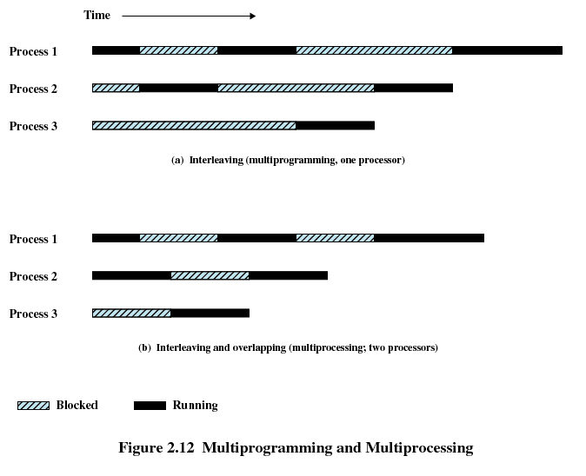
Multiprogramming and Multiprocessing
CS 345
Discussion #2 – Computer System Overview

Slide 43
Modern Operating Systems
Distributed operating systems
  Provides the illusion of a single main memory space and single secondary memory space
CS 345
Discussion #2 – Computer System Overview

Slide 44
Modern Operating Systems
Object-oriented design
  Used for adding modular extensions to a small kernel
  Enables programmers to customize an operating system without disrupting system integrity
CS 345
Discussion #2 – Computer System Overview

Slide 45
Windows Architecture
Modular structure for flexibility
Executes on a variety of hardware platforms
Supports application written for other operating system
CS 345
Discussion #2 – Computer System Overview

Slide 46
Windows
Modified microkernel architecture
  Not a pure microkernel
  Many system functions outside of the microkernel run in kernel mode
Any module can be removed, upgraded, or replaced without rewriting the entire system
CS 345
Discussion #2 – Computer System Overview

Slide 47
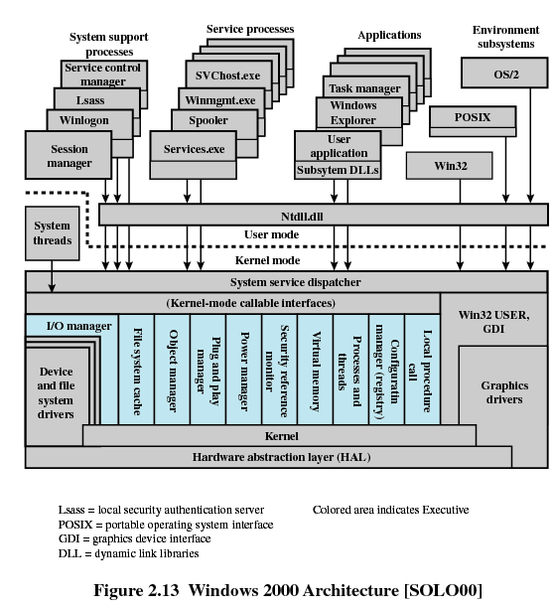
CS 345
Discussion #2 – Computer System Overview

Slide 48
Kernel-Mode Components
Executive
  Contains base operating system services
    Memory management
    Process and thread management
    Security
    I/O
    Interprocess communication
Kernel
  Consists of the most used components
CS 345
Discussion #2 – Computer System Overview

Slide 49
Kernel-Mode Components
Hardware abstraction layer (HAL)
  Isolates the operating system from platform-specific hardware differences
Device drivers
  Translate user I/O function calls into specific hardware device I/O requests
Windowing and graphics systems
  Implements the graphical user interface (GUI)
CS 345
Discussion #2 – Computer System Overview

Slide 50
Windows Executive
I/O manager
Cache manager
Object manager
Plug and play manager
Power manager
Security reference monitor
Virtual memory manager
Process/thread manager
Configuration manager
Local procedure call (LPC) facility
CS 345
Discussion #2 – Computer System Overview

Slide 51
User-Mode Processes
Special system support processes
  Ex: logon process and the session manager
Service processes
Environment subsystems
User applications
CS 345
Discussion #2 – Computer System Overview

Slide 52
Client/Server Model
Simplifies the Executive
  Possible to construct a variety of APIs
Improves reliability
  Each service runs on a separate process with its own partition of memory
  Clients cannot not directly access hardware
Provides a uniform means for applications to communicate via LPC
Provides base for distributed computing
CS 345
Discussion #2 – Computer System Overview

Slide 53
Threads and SMP
Operating system routines can run on any available processor
Different routines can execute simultaneously on different processors
Multiple threads of execution within a single process may execute on different processors simultaneously
Server processes may use multiple threads
Share data and resources between process
CS 345
Discussion #2 – Computer System Overview

Slide 54
Windows Objects
Encapsulation
  Object consists of one or more data items and one or more procedures
Object class or instance
  Create specified instances of an object
Inheritance
  Support to some extent in the Executive
Polymorphism
CS 345
Discussion #2 – Computer System Overview

Slide 55
UNIX
Hardware is surrounded by the operating system software
Operating system is called the system kernel
Comes with a number of user services and interfaces
  Shell
  Components of the C compiler
CS 345
Discussion #2 – Computer System Overview

Slide 56
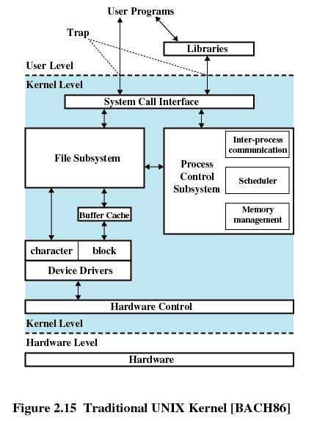
UNIX Kernel
CS 345
Discussion #2 – Computer System Overview

Slide 57
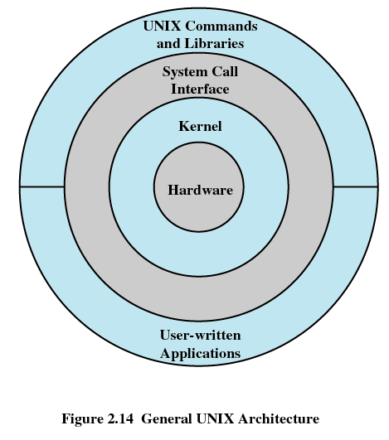
UNIX
CS 345
Discussion #2 – Computer System Overview

Slide 58
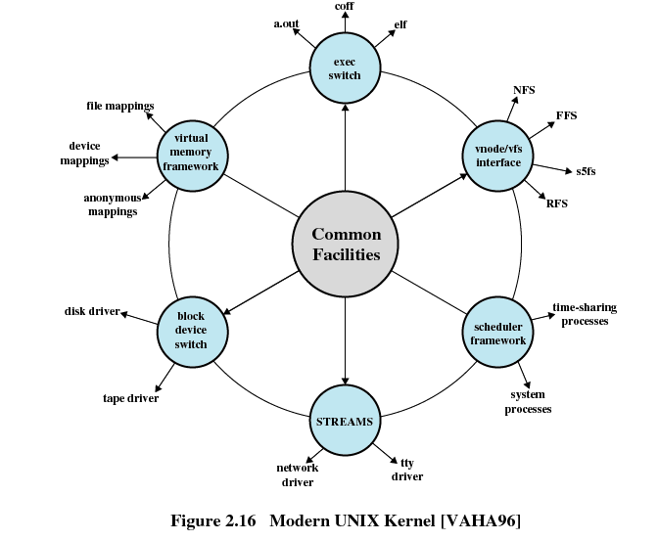
Modern UNIX Kernel
CS 345
Discussion #2 – Computer System Overview

Slide 59
Modern UNIX Systems
System V Release 4 (SVR4)
Solaris 9
4.4BSD
Linux
CS 345
Discussion #2 – Computer System Overview

Slide 60
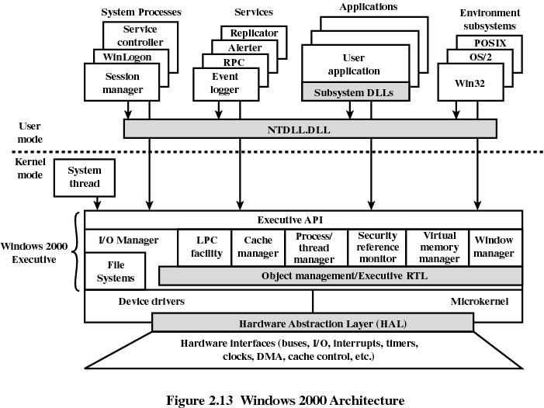
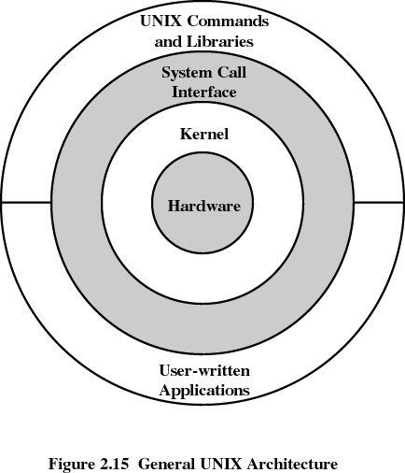
Modern OS Architecture
CS 345
Discussion #2 – Computer System Overview

Slide 61
Linux
Significant departure from UNIX
Key contribution is modules
Load modules dynamically in/out of kernel
Benefits of monolithic kernel (performance)
Benefits of micro-kernel (easily evolved)
Modules execute in kernel mode on behalf of user so user can access all system resources
CS 345
Discussion #2 – Computer System Overview

Slide 62
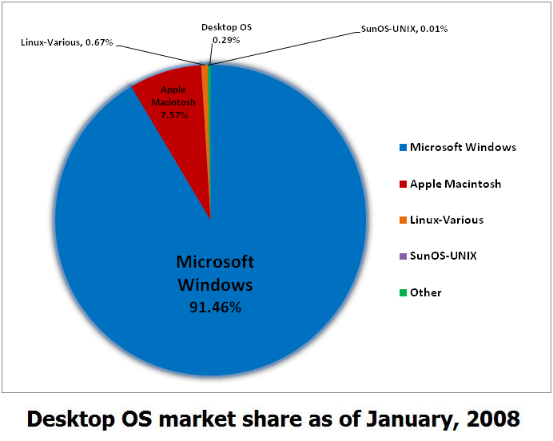
Some Disturbing (joyful) facts
CS 345
Discussion #2 – Computer System Overview

