Slide 1
Virtual Memory Madness
A simulator gone wrong

Slide 2
Your Goal
Implement virtual memory in the LC-3 simulator
Why on earth for?
  To learn virtual memory – thoroughly and completely
  Run multiple LC-3 programs on the simulator
All memory accesses through one function, getMemAdr().

Slide 3

Grease to make it turn
unsigned short int *getMemAdr(int va, int rwFlg)
{
unsigned short int pa;
// turn off virtual addressing for system RAM
if (va < 0x3000) return &memory[va];
// calculate physical from virtual address
pa = va;
// return physical memory address
return &memory[pa];
} // end getMemAdr

Slide 4
Virtual Memory
Virtual
Address
f (va)
Physical
Address
LC-3
MMU
LC-3
Memory
2¹⁶ Words
getMemAdr()
(Hardware)
→PC-Relative
→Indirect
→Base+Offset
IR, TRAP
LD, LDR, LDI
ST, STR, STI
OS Clock
Replacement Algorithm
Paged
Swap Space

Slide 5
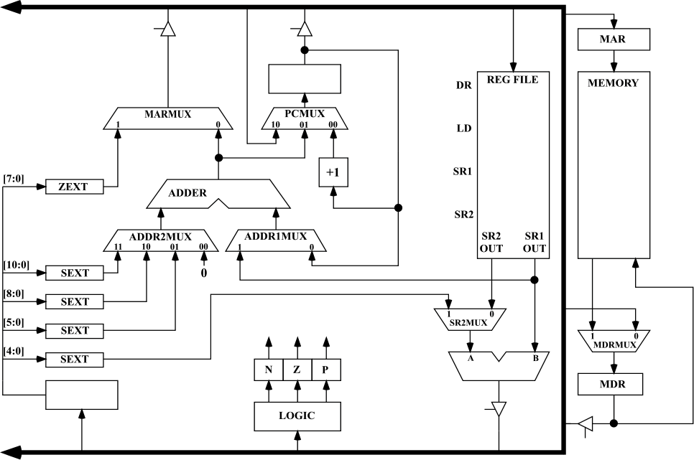
LC-3 Simulator
MAR access thru getMemAdr(va, rwflg)
MDR access thru getMemData(va)
setMemData(va)

Slide 6
Two-Level Paging System
Project 5
Virtual Address
15 … 11 10 … 6 5 … 0
RPTE #
UPTE #
Frame Offset
Root Page Table
User Page Table
LC-3 Main Memory
+
Flags / Frame #
Flags / UPT #
+
Frame<<6
Offset
15 … 6 5 … 0
RPT
One per process (tcb[i].RPT)
Physical Address

Slide 7
Virtual Memory
Project 5
x0000
Bit vector of available frames
System (unmapped)
Virtual Address
x2000
Frame Table
All tables in LC-3 memory
All memory accesses thru getMemAdr()
RPT’s pinned (never evicted)
Each process has an RPT pointer (swapped on context switch)
tcb[curTask].RPT
x2400
RPT’s (Pinned)
x3000
UPT’s
(Swappable Frames)
User Frames
Paged
Swap
Space
Memory Limit
(Variable)
xFFFF

Slide 8
Page Table Entry
4 bytes
 |  |  |  |  |  | Frame # (0 – 1023)
F | D | R | P | - | - | f | f | f | f | f | f | f | f | f | f
 |  |  |  | Page # (0 – 4095)
S | - | - | - | p | p | p | p | p | p | p | p | p | p | p | p
• Frame valid (1 bit): one if referenced frame is in main memory; zero otherwise.
• Dirty (1 bit): one if referenced frame has been altered; zero otherwise.
• Reference (1 bit): one if frame has been referenced; zero otherwise.
• Pinned (1 bit): one if frame is pinned in memory; zero otherwise.
• Frame number (10 bits): If referenced page is in memory, this value specifies which frame it occupies. (1024 frames × 64 words = 2¹⁰ × 2⁶ = 2¹⁶ words = 65536 words.)
• Swap valid (1 bit): one if referenced page has been allocated in swap space; zero otherwise.
• Swap page number (12 bits). This specifies where referenced page is stored in swap space. When you load a page into memory, you should include this value in your frame table summary. (4096 pages × 128 bytes = 2¹² × 2⁷ = 2¹⁹ bytes = 524,288 bytes.)

Slide 9
#defines…
2¹⁶ Words
#define LC3_MAX_MEMORY 65536
#define LC3_FRAME_SIZE 64
#define LC3_FRAMES 1024
#define LC3_FBT 0x2000
#define LC3_RPT 0x2400
#define LC3_RPT_END 0x2800
#define LC3_MEM 0x3000
#define LC3_MEM_END 0x10000
#define LC3_MAX_PAGE (LC3_FRAMES<<2)
#define LC3_MAX_SWAP_MEMORY (LC3_MAX_PAGE<<6)
#define LC3_FBT_FRAME (LC3_FBT>>6)
#define LC3_RPT_FRAME (LC3_RPT>>6)
#define LC3_RPT_END_FRAME (LC3_RPT_END>>6)
#define LC3_MEM_FRAME (LC3_MEM>>6)
#define LC3_MEM_END_FRAME (LC3_MEM_END>>6)
// parts of a virtual address
#define RPTI(va) (((va)&BITS_15_11_MASK)>>10)
#define UPTI(va) (((va)&BITS_10_6_MASK)>>5)
#define FRAMEOFFSET(va) ((va)&BITS_5_0_MASK)
2⁶ Words
2¹⁶ / 2⁶ = 2¹⁰ Frames
Frame Bit Table
Root Page Tables--32
Start User Memory
Root Page Table Index
User Page Table Index
Notes:
We only shift by 10 on RPTI because we have already zeroed out the low order bit with the mask. That means if we shift by 10, we have the scale by 2. It is equivalent to >> 11 followed by << 1.
The same is true for the UPTI. The two slides later makes it more clear.

Slide 10
Virtual to Physical Address
memory[taskRPT + ((((va)&0xf800)>>11)<<1)]
memory[(rpte1&0x03ff)<<6+((((va)&0x7c0)>>6)<<1)]
&memory[(upte1&0x03ff)<<6+((va)&0x003f)]
rpte1 = MEMWORD(taskRPT + RPTI(va));
upte1 = MEMWORD((FRAME(rpte1)<<6) + UPTI(va));
&memory[(FRAME(upte1)<<6) + FRAMEOFFSET(va)];
Notes:
The left shift by 1 is because each entry is 2 words (4-bytes). So we need to scale the number by 2 to get to the correct address!

Slide 11
Implementation
x3000
(192)
0____|0____
0____|0____
...
0____|0____
x3000–x303F
x3040–x307F
...
x3780–x37FF
Virtual
Address
Physical
Address
x2400
RPT0
1_193
0____|0____
0____|0____
0____|0____
0____|0____
0____|0____
0____|0____
0____|0____
0____|0____
...
0____|0____
0____|0____
0____|0____
0____|0____
0____|0____
x0000–x07FF
x0800–x0FFF
x1000–x17FF
x1800–x1FFF
x2000–x27FF
x2800–x2FFF
x3000–x37FF
x3800–x3FFF
...
xD800–xDFFF
xE000–xE7FF
xE800–xEFFF
xF000–xF7FF
xF800–xFFFF
1_194
x3000
⇒ x3040
x3040
(193)
x3001
⇒ x3041
x3000-x303F
Data Frame
x3040
⇒ x3080
x3041
⇒ x3081
x240C
1_192
x3080
(194)
xEF92
⇒ x3112
xD851
⇒ x3191
1_197
x3040-x307F
Data Frame
xD833
⇒ x31F3
x3833
1_195
x30C0
(195)
0____|0____
0____|0____
...
0____|0____
xE800–xE83F
xE840–xE87F
...
xEF80–xEFFF
x2440
RPT1
0____|0____
0____|0____
0____|0____
0____|0____
0____|0____
0____|0____
0____|0____
0____|0____
...
0____|0____
0____|0____
0____|0____
0____|0____
0____|0____
x0000–x07FF
x0800–x0FFF
x1000–x17FF
x1800–x1FFF
x2000–x27FF
x2800–x2FFF
x3000–x37FF
x3800–x3FFF
...
xD800–xDFFF
xE000–xE7FF
xE800–xEFFF
xF000–xF7FF
xF800–xFFFF
x3100
(196)
1_196
xEF80-xEFFF
Data Frame
x3140
(197)
0____|0____
0____|0____
...
0____|0____
xD800–xD83F
xD840–xD87F
...
xDF80–xDFFF
1_199
1_198
x3180
(198)
xD840-xD87F
Data Frame
x2480
RPT2
x0000–x07FF
x0800–x0FFF
x1000–x17FF
x1800–x1FFF
...
x31C0
(199)
0____|0____
0____|0____
0____|0____
0____|0____
...
xD800-xD83F
Data Frame
x3200

Slide 12
Clock Replacement Algorithm
Frame
7
0
1
2
3
4
5
6
7
8
3
4
5
0
1
2
7
8
5
6
0
7
7
7
7
7
7
5
5
5
5
5
5
5
5
5
2
2
2
2
2
1
0
0
0
0
0
0
6
6
6
6
6
6
6
6
6
6
6
5
5
2
1
1
1
1
1
1
7
7
7
7
7
7
7
7
7
7
7
6
3
2
2
2
2
2
2
8
8
8
8
8
8
8
8
8
8
8
4
3
3
3
3
3
3
3
3
3
0
0
0
0
0
0
0
5
4
4
4
4
4
4
4
4
4
1
1
1
1
1
1
4
1
4
4
2
1
7
4
5
2
7
5
5
0
4
1
6
6
3
0
3
0
3
0
0
5
3
5
3
2
2
2
1
8
1
8
8
7
8
7
6
7
7

Slide 13
Global Clock
Swap Space
RPTE’s
UPTE’s
Frame’s

Slide 14
Implementation
x3000
(192)
0____|0____
0____|0____
...
0____|0____
x3000–x303F
x3040–x307F
...
x3780–x37FF
1_193
Virtual
Address
Physical
Address
x2400
RPT0
0____|1___0
0____|1___1
0____|0____
0____|0____
0____|0____
0____|0____
0____|0____
0____|0____
0____|0____
0____|0____
...
0____|0____
0____|0____
0____|0____
0____|0____
0____|0____
x0000–x07FF
x0800–x0FFF
x1000–x17FF
x1800–x1FFF
x2000–x27FF
x2800–x2FFF
x3000–x37FF
x3800–x3FFF
...
xD800–xDFFF
xE000–xE7FF
xE800–xEFFF
xF000–xF7FF
xF800–xFFFF
1_194
x3000
⇒ x3040
x3040
(193)
0____|0____
0____|0____
...
0____|0____
x3800–x383F
x3840–x387F
...
x3F80–x3FFF
x3001
⇒ x3041
1_194
x3040
⇒ x3080
x3000-x303F
Data Frame
x3041
⇒ x3081
x240C
1_192
x3080
(194)
xEF92
⇒ x3112
1_193
xD851
⇒ x3191
x3800-x383F
Data Frame
xD833
⇒ x31F3
1_197
x3040-x307F
Data Frame
x3833
⇒ x30B3
1_195
x30C0
(195)
0____|0____
0____|0____
...
0____|0____
xE800–xE83F
xE840–xE87F
...
xEF80–xEFFF
#0 – x3000
x2440
RPT1
0____|0____
0____|0____
0____|0____
0____|0____
0____|0____
0____|0____
0____|0____
0____|0____
...
0____|0____
0____|0____
0____|0____
0____|0____
0____|0____
x0000–x07FF
x0800–x0FFF
x1000–x17FF
x1800–x1FFF
x2000–x27FF
x2800–x2FFF
x3000–x37FF
x3800–x3FFF
...
xD800–xDFFF
xE000–xE7FF
xE800–xEFFF
xF000–xF7FF
xF800–xFFFF
#1 – x3040
x3100
(196)
1_196
xEF80-xEFFF
Data Frame
x3140
(197)
0____|0____
0____|0____
...
0____|0____
xD800–xD83F
xD840–xD87F
...
xDF80–xDFFF
1_199
1_198
x3180
(198)
xD840-xD87F
Data Frame
x2480
RPT2
x0000–x07FF
x0800–x0FFF
x1000–x17FF
x1800–x1FFF
...
x31C0
(199)
0____|0____
0____|0____
0____|0____
0____|0____
...
xD800-xD83F
Data Frame

Slide 15
Implementation
x3000
(192)
0____|0____
0____|0____
...
0____|0____
x3000–x303F
x3040–x307F
...
x3780–x37FF
1_193
1_199|1___0
Virtual
Address
Physical
Address
x2400
RPT0
0____|1___0
0____|1___1
0____|0____
0____|0____
0____|0____
0____|0____
0____|0____
0____|0____
0____|0____
0____|0____
...
0____|0____
0____|0____
0____|0____
0____|0____
0____|0____
x0000–x07FF
x0800–x0FFF
x1000–x17FF
x1800–x1FFF
x2000–x27FF
x2800–x2FFF
x3000–x37FF
x3800–x3FFF
...
xD800–xDFFF
xE000–xE7FF
xE800–xEFFF
xF000–xF7FF
xF800–xFFFF
1_194
x3000
⇒ x3040
x3040
(193)
0____|0____
0____|0____
...
0____|0____
x3800–x383F
x3840–x387F
...
x3F80–x3FFF
x3001
⇒ x3041
1_194
x3040
⇒ x3080
x3041
⇒ x3081
x240C
1_192
x3080
(194)
xEF92
⇒ x3112
1_193
xD851
⇒ x3191
1_197
x3800-x383F
Data Frame
xD833
⇒ x31F3
x3833
⇒ x30B3
1_195
x30C0
(195)
0____|0____
0____|0____
...
0____|0____
xE800–xE83F
xE840–xE87F
...
xEF80–xEFFF
x3000
⇒ x31C0
#0 – x3000
x2440
RPT1
0____|0____
0____|0____
0____|0____
0____|0____
0____|0____
0____|0____
0____|0____
0____|0____
...
0____|0____
0____|0____
0____|0____
0____|0____
0____|0____
x0000–x07FF
x0800–x0FFF
x1000–x17FF
x1800–x1FFF
x2000–x27FF
x2800–x2FFF
x3000–x37FF
x3800–x3FFF
...
xD800–xDFFF
xE000–xE7FF
xE800–xEFFF
xF000–xF7FF
xF800–xFFFF
#1 – x3040
x3100
(196)
1_196
#2 – xD800
xEF80-xEFFF
Data Frame
x3140
(197)
0____|0____
0____|0____
...
0____|0____
xD800–xD83F
xD840–xD87F
...
xDF80–xDFFF
1_199
0____|1___2
1_198
x3180
(198)
xD840-xD87F
Data Frame
x2480
RPT2
x0000–x07FF
x0800–x0FFF
x1000–x17FF
x1800–x1FFF
...
x31C0
(199)
0____|0____
0____|0____
0____|0____
0____|0____
...
xD800-xD83F
Data Frame
x3000-x303F
Data Frame
x3200
Notes:
You are looking directly at memory in this slide. The root page table starts at 0x2400. Other root page tables are defined through 0x3000. At 0x3000 you have the beginning of free frames. Each row in the RPT (or UPT) shows some of the 4-byte page table entry. In this illustration we show the valid bit and page number for both frames and swap. An empty number indicates an unassigned entry (i.e., a fault because a frame has yet to be allocated for either the user page table or data).

Slide 16
How to proceed
Implement translation assuming you never run out of frames in memory
Implement the iteration over pages (i.e., the traversal of the circular list)
Implement page replacement assuming you never evict user page tables in memory
Implement page table eviction
Reclaim resource when a task exits (clear RPT, free all frames, free all pages on disk)

Slide 17
Thought…
Why not build an auxiliary structure to help with the page replacement algorithm?
Would be easier to traverse etc.?
What would such a structure look like?
How would you synchronize it with the page tables themselves?

Slide 18
Other Thoughts
Ask for two frames when an UPT is not in memory?
CS 345
Discussion #25 – Chapter 8e

Slide 19
unsigned short int *getMemAdr(int va, int rwFlg)
{ if (va < 0x3000) return &memory[va]; // turn off virtual addressing for system RAM rpta = p.rpt + RPTI(va); rpte1 = MEMWORD(rpta); rpte2 = MEMWORD(rpta+1); if (DEFINED(rpte1))
{ // rpte defined } else // rpte undefined 1. get a UPT frame from memory (may have to free up frame)
{ // 2. if paged out (DEFINED) load swapped page into UPT frame
// else initialize UPT frame = getFrame(LC3_MEM_FRAME, LC3_MEM_END_FRAME); rpte1 = SET_DEFINED(frame); if (PAGED(rpte2)) // UPT frame paged out - read from SWAPPAGE(rpte2) into frame
{ accessPage(SWAPPAGE(rpte2), frame, PAGE_READ);
} else // define new upt frame and reference from rpt
{ rpte1 = SET_DIRTY(rpte1); rpte2 = 0;
// undefine all upte's
}
}
MEMWORD(rpta) = rpte1 = SET_REF(SET_PINNED(rpte1)); // set rpt frame access bit
MEMWORD(rpta+1) = rpte2; upta = (FRAME(rpte1)<<6) + UPTI(va); upte1 = MEMWORD(upta); upte2 = MEMWORD(upta+1); if (DEFINED(upte1))
{ // upte defined } else // upte undefined 1. get a physical frame (may have to free up frame) (x3000 - limit) (192 - 1023)
{ // 2. if paged out (DEFINED) load swapped page into physical frame
// else new frame
} return &memory[(FRAME(upte1)<<6) + FRAMEOFFSET(va)]; // return physical address}
}
Starting point for getMemAdr…
MMU turned off for system access
Hit!
Page Fault
Go get a Frame
UPT Page in swap space
Frame referenced
New UPT Frame
Hit!
Page Fault

Slide 20
Other useful #defines…
// definitions within a root or user table page
#define DEFINED(e1) ((e1)&BIT_15_MASK)
#define DIRTY(e1) ((e1)&BIT_14_MASK)
#define REFERENCED(e1) ((e1)&BIT_13_MASK)
#define PINNED(e1) ((e1)&BIT_12_MASK)
#define FRAME(e1) ((e1)&BITS_9_0_MASK)
#define PAGED(e2) ((e2)&BIT_15_MASK)
#define SWAPPAGE(e2) ((e2)&BITS_11_0_MASK)
#define MEMWORD(a) (memory[a])
#define MEMLWORD(a) ((memory[a]<<16)+memory[(a)+1])
#define SET_DEFINED(e1) ((e1)|BIT_15_MASK)
#define SET_DIRTY(e1) ((e1)|BIT_14_MASK)
#define SET_REF(e1) ((e1)|BIT_13_MASK)
#define SET_PINNED(e1) ((e1)|BIT_12_MASK)
#define SET_PAGED(e2) ((e2)|BIT_15_MASK)
#define CLEAR_DEFINED(e1) ((e1)&~BIT_15_MASK)
#define CLEAR_DIRTY(e1) ((e1)&~BIT_14_MASK)
#define CLEAR_REF(e1) ((e1)&~BIT_13_MASK)
#define CLEAR_PINNED(e1) ((e1)&~BIT_12_MASK)

Slide 21
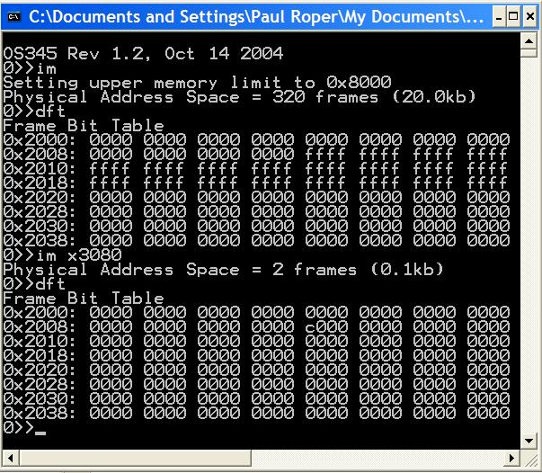
Frame Bit Table
0x3000
0x8000
2 Frames

Slide 22
setFrameTableBits
// ********************************************************************************************
// set frames available from sf to ef
// flg = 0 -> clear all others
// = 1 -> just add bits
void setFrameTableBits(int flg, int sf, int ef)
{ int i, data;
int adr = LC3_FBT-1; // index to frame bit table
int fmask = 0x0001; // bit mask
// 1024 frames in LC-3 memory
for (i = 0; i < 1024; i++)
{ if (fmask & 0x0001)
{ fmask = 0x8000;
adr++;
data = (flg) ? MEMWORD(adr) : 0;
}
else fmask = fmask >> 1;
// allocate frame if in range
if ( (i >= sf) && (i < ef)) data = data | fmask;
MEMWORD(adr) = data;
}
return;
}

Slide 23
getAvailableFrame
// ********************************************************************************************
// get frame number (must be on 16 bit boundary)
int getAvailableFrame(int sf, int ef)
{ int i, data;
int adr = LC3_FBT + (sf>>4) - 1; // index to frame bit table
int fmask = 0x0001; // bit mask
for (i = sf; i < ef; i++)
{ if (fmask & 0x0001)
{ fmask = 0x8000;
adr++;
data = MEMWORD(adr);
}
else fmask = fmask >> 1;
// deallocate frame and return frame #
if (data & fmask)
{ MEMWORD(adr) = data & ~fmask;
return i;
}
}
return -1;
}

Slide 24
accessPage
// ********************************************************************************************
// read/write to swap space
int accessPage(int pnum, int frame, int rwnFlg)
{ static unsigned short int swapMemory[LC3_MAX_SWAP_MEMORY];
switch(rwnFlg)
{ case PAGE_GET_ADR: // return page address
{ return (int)(&swapMemory[pnum<<6]);
}
case PAGE_NEW_WRITE: // new write
{ pnum = nextPage++;
}
case PAGE_OLD_WRITE: // write
{ memcpy(&swapMemory[pnum<<6], &memory[frame<<6], 1<<7);
return pnum;
}
case PAGE_READ: // read
{ memcpy(&memory[frame<<6], &swapMemory[pnum<<6], 1<<7);
return pnum;
}
}
return pnum;
}

Slide 25
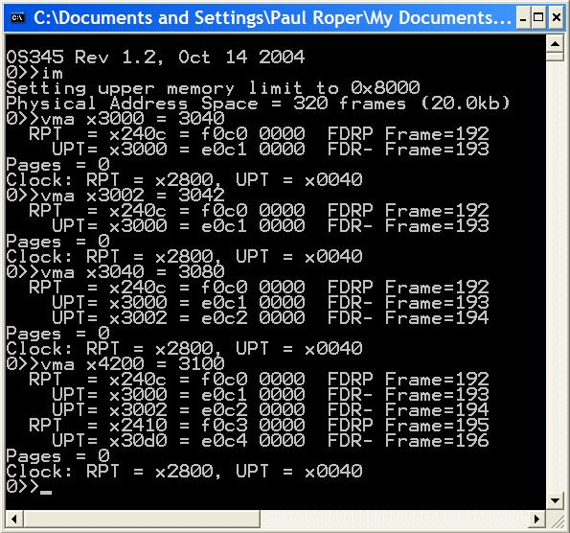
vma
2 frames – UPT, Frame
No new frames
Same UPT, new Frame
No swap pages
New UPT, new Frame
Clock did not advance

Slide 26
LC-3 Crawler, Memtest
Welcome to OS345 Rev 1.1
0>>crawler
178068>>
Crawler R1.1
Process 1: Move #1 to xE29E
Process 1: Move #2 to x6B3F
…
Process 1: Move #99 to x932E
Process 1: Move #100 to xDA8F
Process #1 Halted at 0x937e
1807827>>memtest
MemTest R1.0a
(1) Round 1, Writing to memory...
(1) Round 1, Verifying...
(1) Round 2, Writing to memory...lt
# TID name address line prior time semaphore status
0 0/0 shell 403b61 457 5 1 Running
1 1/0 LC3 MemTest 40190c 0 5 1 Waiting
1911162>>
(1) Round 2, Verifying...
(1) Round 3, Writing to memory...
(1) Round 3, Verifying...
…
(1) Round 10, Writing to memory...
(1) Round 10, Verifying...
Process #1 Halted at 0x305c

