Slide 1
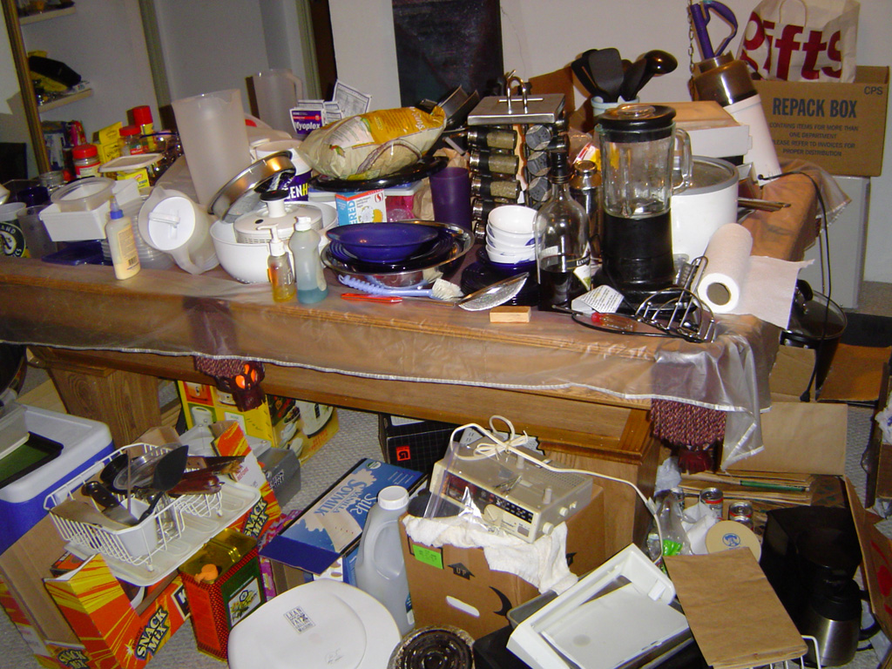
Hardware and C
Taming the chaos (mess)

Slide 2
What goes on…
_max:
pushl %ebp
movl %esp,%ebp
movl 8(%ebp),%edx
movl 12(%ebp),%eax
cmpl %eax,%edx
jle L9
movl %edx,%eax
L9:
movl %ebp,%esp
popl %ebp
ret
Set
Up
int max(int x, int y)
{
if (x > y)
return x;
else
return y;
}
Compiler
Body
Finish
Notes:
When we write C-code, the compiler turns it into assembly code, which is understood by the processor.

Slide 3
What goes on…
PC
newPC
valE
,
valM
Write back
valM
Data
Memory
Data
memory
memory
_max:
pushl %ebp
movl %esp,%ebp
movl 8(%ebp),%edx
movl 12(%ebp),%eax
cmpl %eax,%edx
jle L9
movl %edx,%eax
L9:
movl %ebp,%esp
popl %ebp
ret
Addr
, Data
valE
CC
CC
ALU
Execute
Bch
ALU
aluA
,
aluB
valA
,
valB
Decode
srcA
,
srcB
A
A
B
dstA
,
dstB
B
M
Register
M
Register
Register
Register
file
file
file
file
E
E
icode
,
ifun
valP
rA
,
rB
valC
Instruction
PC
Instruction
PC
Fetch
memory
increment
memory
increment
PC
Notes:
When we write C-code, the compiler turns it into assembly code, which is understood by the processor.

Slide 4
BASIC CPU
newPC
PC
valE
,
valM
Write back
valM
State
Program counter register (PC)
Condition code register (CC)
Register File
Memories
Access same memory space
Data: for reading/writing program data
Instruction: for reading instructions
Instruction Flow
Read instruction at address specified by PC
Process through stages
Update program counter
Data
Memory
Data
memory
memory
Addr
, Data
valE
CC
CC
ALU
Execute
Bch
ALU
aluA
,
aluB
valA
,
valB
Decode
srcA
,
srcB
A
A
B
dstA
,
dstB
B
M
Register
M
Register
Register
Register
file
file
file
file
E
E
icode
,
ifun
valP
rA
,
rB
valC
Instruction
PC
Instruction
PC
Fetch
memory
increment
memory
increment
PC
Notes:
Focus on different elements.
Follow the instruction flow
Be sure to discuss word size (width of the bus --- size of unit data passed around)

Slide 5
General Stages
newPC
PC
valE
,
valM
Write back
valM
Fetch
Read instruction from instruction memory
Decode
Read program registers
Execute
Compute value or address
Memory
Read or write data
Write Back
Write program registers
PC
Update program counter
Data
Memory
Data
memory
memory
Addr
, Data
valE
CC
CC
ALU
Execute
Bch
ALU
aluA
,
aluB
valA
,
valB
Decode
srcA
,
srcB
A
A
B
dstA
,
dstB
B
M
Register
M
Register
Register
Register
file
file
file
file
E
E
icode
rA
,
ifun
valP
,
rB
valC
Instruction
PC
Instruction
PC
Fetch
memory
increment
memory
increment
PC
Notes:
Classical architecture
5-stage pipeline
Almost universal in teaching

Slide 6
SEQ Stages
newPC
PC
valE
,
valM
Write back
valM
Fetch
Read instruction from instruction memory
Decode
Read program registers
Execute
Compute value or address
Memory
Read or write data
Write Back
Write program registers
PC
Update program counter
Data
Memory
Data
memory
memory
Addr
, Data
valE
CC
CC
ALU
Execute
Bch
ALU
aluA
,
aluB
valA
,
valB
Decode
srcA
,
srcB
A
A
B
dstA
,
dstB
B
M
Register
M
Register
Register
Register
file
file
file
file
E
E
icode
rA
,
ifun
valP
,
rB
valC
Instruction
PC
Instruction
PC
Fetch
memory
increment
memory
increment
rmmovl rA, D(rB)
4
0
rA
rB
D
PC
Notes:
‘rm’ is register to memory. So this instruction is a register to memory move using the base+offset addressing mode

Slide 7
Stage Computation: rmmovl
rmmovl rA, D(rB)
Fetch
icode:ifun ← M₁[PC]
Read instruction byte
rA:rB ← M₁[PC+1]
Read register byte
valC ← M₄[PC+2]
Read displacement D
valP ← PC+6
Compute next PC
Decode
valA ← R[rA]
Read operand A
valB ← R[rB]
Read operand B
Execute
valE ← valB + valC
Compute effective address
Memory
M₄[valE] ← valA
Write value to memory
Write
back
PC update
PC ← valP
Update PC
Use ALU for address computation
Notes:
Memory is treated as an array of _bytes_, so PC is the first byte, and PC+1 is the second byte. The subscript is the number of bytes to read, so M_4 reads 4 bytes.

Slide 8
SEQ Operation
State
PC register
Cond. Code register
Data memory
Register file
All updated as clock rises
Combinational Logic
ALU
Control logic
Memory reads
Instruction memory
Register file
Data memory

Slide 9
SEQ Operation #2
state set according to second irmovl instruction
combinational logic starting to react to state changes
Notes:
Shows how data flows through. Gray boxes are the state holding boxes.
White filled things are combnational logic. Currently, just finished cycle 2.
Boxes gray due to data created in cycle 2

Slide 10
SEQ Operation #3
state set according to second irmovl instruction
combinational logic generates results for addl instruction
Notes:
Just before clock edge.
Boxes gray (cycle 2 data)
Combinational logic green

Slide 11
SEQ Operation #4
state set according to addl instruction
combinational logic starting to react to state changes
Notes:
* Cycle 3 data is now latched

Slide 12
SEQ Operation #5
state set according to addl instruction
combinational logic generates results for je instruction
Notes:
* Cycle 5 data has propagated through the combinational logic

Slide 13
Typical Bus Structure Connecting CPU and Memory
A bus is a collection of parallel wires that carry address, data, and control signals.
Buses are typically shared by multiple devices.
CPU chip
register file
ALU
system bus
memory bus
main
memory
bus interface
I/O
bridge
memory
controller, etc.

Slide 14
Memory Read Transaction (1)
CPU places address A on the memory bus.
register file
Load operation: movl A, %eax
ALU
%eax
main memory
I/O bridge
A
0
bus interface
x
A

Slide 15
Memory Read Transaction (2)
Main memory reads A from the memory bus, retrieves word x, and places it on the bus.
register file
Load operation: movl A, %eax
ALU
%eax
main memory
I/O bridge
x
0
bus interface
x
A

Slide 16
Memory Read Transaction (3)
CPU reads word x from the bus and copies it into register %eax.
register file
Load operation: movl A, %eax
ALU
%eax
x
main memory
I/O bridge
0
bus interface
x
A

Slide 17
Memory Write Transaction (1)
CPU places address A on bus. Main memory reads it and waits for the corresponding data word to arrive.
register file
Store operation: movl %eax, A
ALU
%eax
y
main memory
I/O bridge
0
A
bus interface
A

Slide 18
Memory Write Transaction (2)
CPU places data word y on the bus.
register file
Store operation: movl %eax, A
ALU
%eax
y
main memory
I/O bridge
0
y
bus interface
A

Slide 19
Memory Write Transaction (3)
Main memory reads data word y from the bus and stores it at address A.
register file
Store operation: movl %eax, A
ALU
%eax
y
main memory
I/O bridge
0
bus interface
y
A

Slide 20
I/O Bus
CPU chip
register file
ALU
system bus
memory bus
main
memory
bus interface
I/O
bridge
I/O bus
Expansion slots for
other devices such
as network adapters.
USB
controller
graphics
adapter
disk
controller
mouse
keyboard
monitor
disk

Slide 21
Reading a Disk Sector (1)
CPU chip
CPU initiates a disk read by writing a command, logical block number, and destination memory address to a port (address) associated with disk controller.
register file
ALU
main
memory
bus interface
I/O bus
USB
controller
graphics
adapter
disk
controller
mouse
keyboard
monitor
disk

Slide 22
Reading a Disk Sector (2)
CPU chip
Disk controller reads the sector and performs a direct memory access (DMA) transfer into main memory.
register file
ALU
main
memory
bus interface
I/O bus
USB
controller
graphics
adapter
disk
controller
mouse
keyboard
monitor
disk

Slide 23
Reading a Disk Sector (3)
CPU chip
When the DMA transfer completes, the disk controller notifies the CPU with an interrupt (i.e., asserts a special “interrupt” pin on the CPU)
register file
ALU
main
memory
bus interface
I/O bus
USB
controller
graphics
adapter
disk
controller
mouse
keyboard
monitor
disk

Slide 24
The CPU-Memory Gap
The increasing gap between DRAM, disk, and CPU speeds.
Notes:
Key: this is a log plot! There are 5 orders of magnitude separating disk access time and DRAM access time. Not good!

Slide 25
An Example Memory Hierarchy
Smaller,
faster,
and
costlier
(per byte)
storage
devices
L0:
registers
CPU registers hold words retrieved from L1 cache.
L1:
on-chip L1
cache (SRAM)
L1 cache holds cache lines retrieved from the L2 cache memory.
L2:
on-chip L2
cache (SRAM)
L2 cache holds cache lines retrieved from main memory.
L3:
main memory
(DRAM)
Larger,
slower,
and
cheaper
(per byte)
storage
devices
Main memory holds disk
blocks retrieved from local
disks.
L4:
local secondary storage
(local disks)
Local disks hold files retrieved from disks on remote network servers.
L5:
remote secondary storage
(distributed file systems, Web servers)

Slide 26
OS Manages hardware and implements programmer model
CPU chip
register file
ALU
system bus
memory bus
main
memory
bus interface
I/O
bridge
I/O bus
Expansion slots for
other devices such
as network adapters.
USB
controller
graphics
adapter
disk
controller
mouse
keyboard
monitor
disk

Slide 27
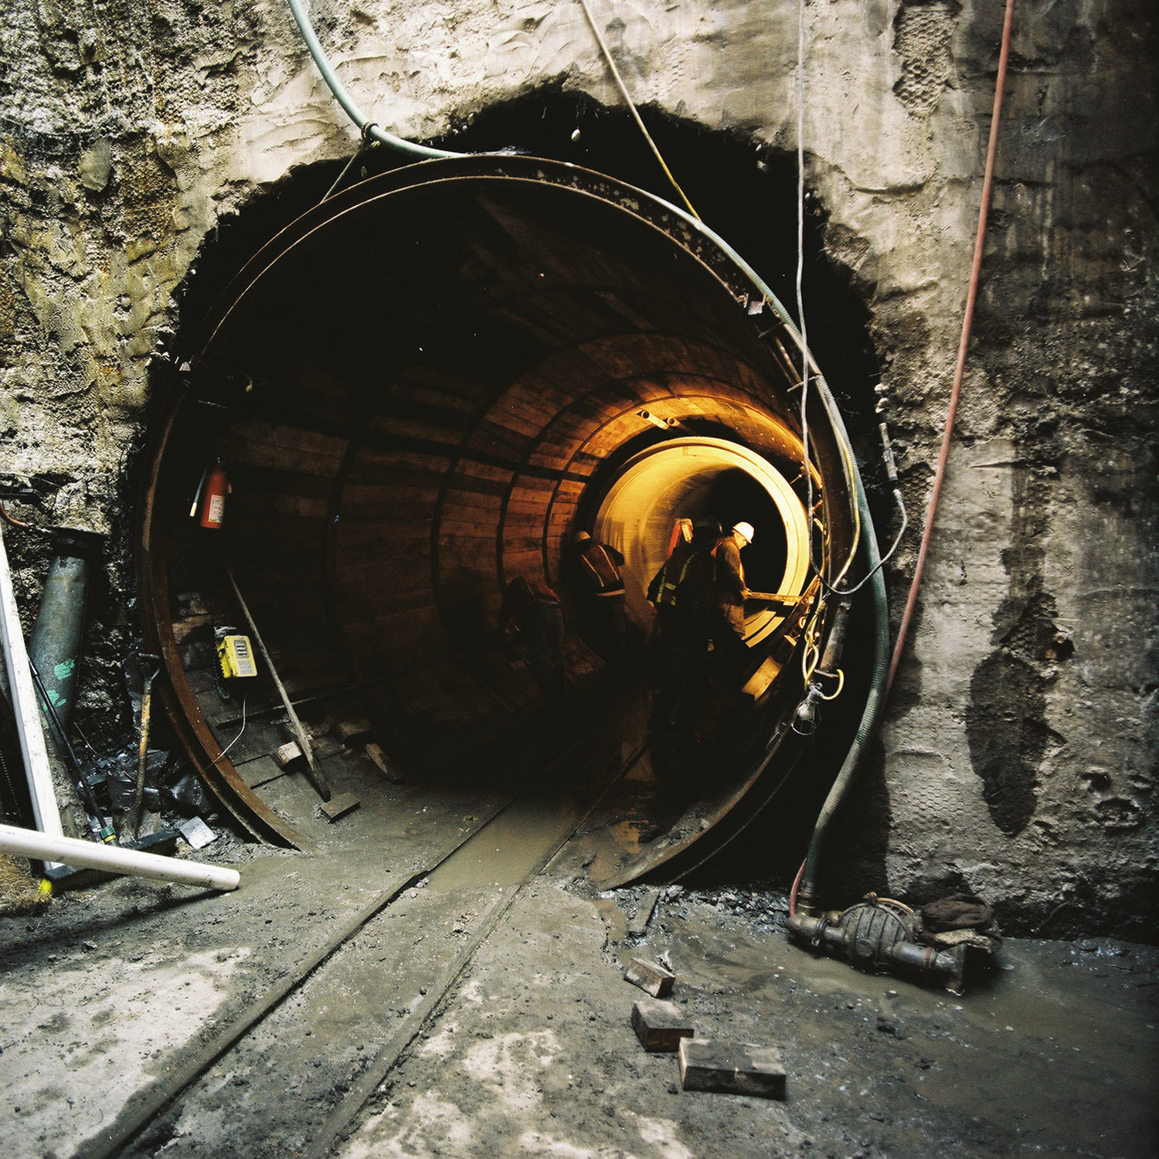
C or ASM
Notes:
The Gateway to hardware can be painful.
Our gateway is C and ASM (mostly C)
As C++ programmers, there are a few things to know about C
Also, a few things to know about the C in this course.

Slide 28

Objects
Templates
New
Delete
Incidentals
And a few other incidentials
Notes:
What do we loose in moving to C
printf versus cout
cannot declare variables anywhere you want

Slide 29
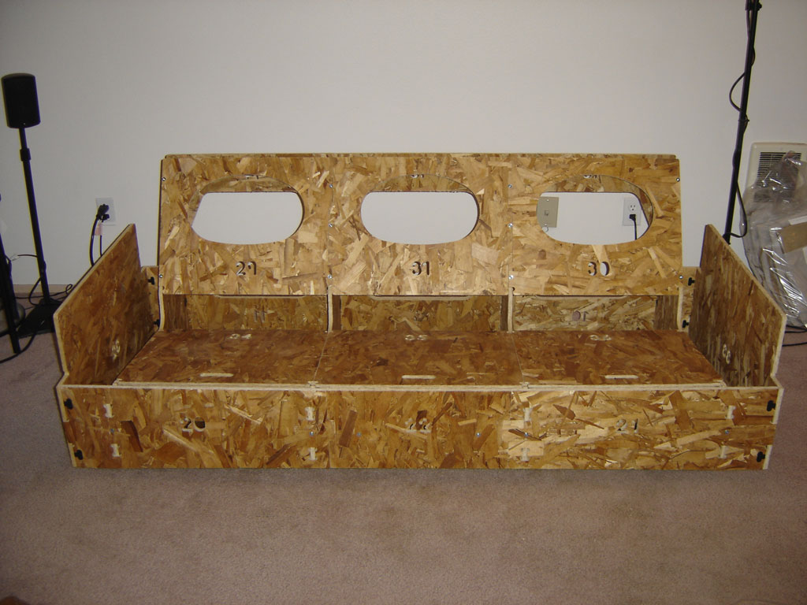
Arrays
Structs
Unions
If you need it, then you build it
Notes:
No help from templates here folks. Containers are all homegrown. Nothing comes from the factory. That also means everything takes more time to implement for some…

Slide 30
Array Allocation
Basic Principle
T A[L];
Array of data type T and length L
Contiguously allocated region of L * sizeof(T) bytes
char string[12];
x
x + 12
int val[5];
x
x + 4
x + 8
x + 12
x + 16
x + 20
double a[4];
x
x + 8
x + 16
x + 24
x + 32
char *p[3];
x
x + 4
x + 8
Notes:
Contiguous is true for arrays and structs; although, as we will see, it is possible to allocated Matrices in a variety of ways
Memorize the index formulas. Key to happy testing.
* I typically prefer arrays as they are simple and direct. Other structures become simple with practice (the linked list is invaluable)

Slide 31
Array Access
Basic Principle
T A[L];
Array of data type T and length L
Identifier A can be used as a pointer to array element 0
Reference Type Value
val[4] int 3
val int * x
val+1 int * x + 4
&val[2] int * x + 8
val[5] int ??
*(val+1) int 5
val + i int * x + 4 i
int val[5];
1
5
2
1
3
x
x + 4
x + 8
x + 12
x + 16
x + 20
WARNING
In C, val + i is equivalent to
val + i * sizeof(T)
Notes:
C adjusts for number of bytes in data type when doing pointer arithematic.
Incrementing a pointer in C is equivalent to val + 1 * sizeof(T)

Slide 32
Array Example
typedef int zip_dig[5];
zip_dig cmu = { 1, 5, 2, 1, 3 };
zip_dig mit = { 0, 2, 1, 3, 9 };
zip_dig ucb = { 9, 4, 7, 2, 0 };
zip_dig cmu;
1
5
2
1
3
16
20
24
28
32
36
zip_dig mit;
0
2
1
3
9
36
40
44
48
52
56
zip_dig ucb;
9
4
7
2
0
56
60
64
68
72
76
Notes
Declaration “zip_dig cmu” equivalent to “int cmu[5]”
Example arrays were allocated in successive 20 byte blocks
Not guaranteed to happen in general!
Notes:
The arrays follow one after another in memory
Not garaunteed but no uncommon either

Slide 33
Nested Array Example
#define PCOUNT 4
zip_dig pgh[PCOUNT] =
{{1, 5, 2, 0, 6},
{1, 5, 2, 1, 3 },
{1, 5, 2, 1, 7 },
{1, 5, 2, 2, 1 }};
zip_dig
pgh[4];
1
5
2
0
6
1
5
2
1
3
1
5
2
1
7
1
5
2
2
1
76
96
116
136
156
Declaration “zip_dig pgh[4]” equivalent to “int pgh[4][5]”
Variable pgh denotes array of 4 elements
Allocated contiguously
Each element is an array of 5 int’s
Allocated contiguously
“Row-Major” ordering of all elements guaranteed

Slide 34
Structures
Concept
Contiguously-allocated region of memory
Refer to members within structure by names
Members may be of different types
Accessing Structure Member
struct rec {
int i;
int a[3];
int *p;
};
Memory Layout
i
a
p
0
4
16
20
void
set_i(struct rec *r,
int val)
{
r->i = val;
}
Assembly
# %eax = val
# %edx = r
movl %eax,(%edx) # Mem[r] = val

Slide 35
Arrays of Structures
Principle
Allocated by repeating allocation for array type
In general, may nest arrays & structures to arbitrary depth
struct S6 {
short i;
float v;
short j;
} a[10];
a[1].i
a[1].v
a[1].j
a+12
a+16
a+20
a+24
a[0]
a[1]
a[2]
• • •
a+0
a+12
a+24
a+36
Notes:
Watch alignment again! Structures must fall on correct boundaries. May need to add padding to make it work.

Slide 36
Union Allocation
Principles
Overlay union elements
Allocate according to largest element
Can only use one field at a time
union U1 {
char c;
int i[2];
double v;
} *up;
c
i[0]
i[1]
v
struct S1 {
char c;
int i[2];
double v;
} *sp;
up+0
up+4
up+8
(Windows alignment)
c
i[0]
i[1]
v
sp+0
sp+4
sp+8
sp+16
sp+24

Slide 37
FF
C0
BF
Stack
To stack, to heap, or to global?
80
Heap
7F
40
DLLs
3F
Heap
Data
08
Text
00

Slide 38
IA32 Stack
Stack “Bottom”
Region of memory managed with stack discipline
Grows toward lower addresses
Register %esp indicates lowest stack address
address of top element
Increasing
Addresses
Stack Grows
Down
Stack
Pointer
%esp
Stack “Top”
Notes:
Stack convention for little-endian machine diagram
high addresses to low addresses.
Top of stack is at the bottomof the page.
Least address is at right, increase moving to left.
Consistent for big-endian machines as well

Slide 39
Call Chain Example
Code Structure
Call Chain
yoo(…)
{
•
•
who();
•
•
}
yoo
who(…)
{
• • •
amI();
• • •
amI();
• • •
}
who
amI
amI
amI(…)
{
•
•
amI();
•
•
}
amI
amI
Procedure amI recursive
Notes:
The goal is to see how each call is a separate instance.

Slide 40
Stack Frames
Contents
Local variables
Return information
Temporary space
Management
Space allocated upon entry to procedure
“Set-up” code
Deallocated just before return
“Finish” code
Pointers
Stack pointer %esp indicates stack top
Frame pointer %ebp indicates start of current frame
yoo
who
amI
Frame
Pointer
%ebp
proc
Stack
Pointer
%esp
Stack
“Top”
Notes:
The %ebp (frame pointer) makes this all work.

Slide 41
Stack Operation
•
•
•
Frame
Pointer
%ebp
Call Chain
yoo
yoo(…)
{
•
•
who();
•
•
}
Stack
Pointer
%esp
yoo

Slide 42
Stack Operation
•
•
•
Call Chain
yoo
who(…)
{
• • •
amI();
• • •
amI();
• • •
}
Frame
Pointer
%ebp
yoo
who
who
Stack
Pointer
%esp

Slide 43
Stack Operation
•
•
•
Call Chain
yoo
amI(…)
{
•
•
amI();
•
•
}
yoo
who
Frame
Pointer
%ebp
who
amI
amI
Stack
Pointer
%esp

Slide 44
Stack Operation
•
•
•
Call Chain
yoo
amI(…)
{
•
•
amI();
•
•
}
yoo
who
who
amI
amI
Frame
Pointer
%ebp
amI
amI
Stack
Pointer
%esp

Slide 45
Stack Operation
•
•
•
Call Chain
yoo
amI(…)
{
•
•
amI();
•
•
}
yoo
who
who
amI
amI
amI
amI
Frame
Pointer
%ebp
amI
amI
Stack
Pointer
%esp

Slide 46
Stack Operation
•
•
•
Call Chain
yoo
amI(…)
{
•
•
amI();
•
•
}
yoo
who
who
amI
amI
Frame
Pointer
%ebp
amI
amI
Stack
Pointer
%esp
amI

Slide 47
Stack Operation
•
•
•
Call Chain
yoo
amI(…)
{
•
•
amI();
•
•
}
yoo
who
Frame
Pointer
%ebp
who
amI
amI
Stack
Pointer
%esp
amI
amI

Slide 48
Stack Operation
•
•
•
Call Chain
yoo
who(…)
{
• • •
amI();
• • •
amI();
• • •
}
Frame
Pointer
%ebp
yoo
who
who
Stack
Pointer
%esp
amI
amI
amI
Notes:
This is a nice animation showing the creating and deleting of stack frames.

Slide 49
Stack Operation
•
•
•
Call Chain
yoo
amI(…)
{
•
•
•
•
}
yoo
who
Frame
Pointer
%ebp
who
amI
amI
amI
Stack
Pointer
%esp
amI
amI

Slide 50
Stack Operation
•
•
•
Call Chain
yoo
who(…)
{
• • •
amI();
• • •
amI();
• • •
}
Frame
Pointer
%ebp
yoo
who
who
Stack
Pointer
%esp
amI
amI
amI
amI

Slide 51
Stack Operation
•
•
•
Frame
Pointer
%ebp
Call Chain
yoo
yoo(…)
{
•
•
who();
•
•
}
Stack
Pointer
%esp
yoo
who
amI
amI
amI
amI

Slide 52
Creating on stack is easy…
int jurassicTask(int argc, char* argv[]) {
char buffer[32];
char* newArgv[2];
NewTask parkInterface;
tid_t parkInterfaceTid;
NewTask createDriverCarVisitor;
tid_t createDriverCarVisitorTid;
.
.
.
}
Use the ‘&’ (&parkInterface) operator to get addresses of stack variables.
Be careful to remember that when frame goes so does memory
Notes:
Please note that in general it is not a good idea to past around to other function addresses into stake frames. These are entry points for buffer overflow attacks!

Slide 53
malloc and free for HEAP
char* nameStr = (char*)malloc(sizeof(char)*NUMCHARS);
Requires a cast
Computes number bytes
needed for specified type
How many do you want
free(nameStr); // Memory returned to system
Warning: if you overwrite your memory allocation you will get strangeness.
> valgrind –tool=memcheck
Notes:
All the structures for free are included in the memory shipped with the pointer. Be careful to not write off the end or before the beginning. There is an actual header and footer you do not see.

Slide 54
Global is a no-brainer…
JPARK myPark;
int parkMutexSemId; // protect park access
int jurassicDisplaySemId;
int fillSeatSemId[NUM_CARS]; // (signal) seat ready to fill
int seatFilledSemId[NUM_CARS];// (wait) passenger seated
int rideOverSemId[NUM_CARS]; // (signal) ride over
int moveCarsSemId;
int visitors;
Declare outside of any scope and it is global: static restricts access to the file. Never declare globals in the header files, prefer the extern keyword to announce it exists but declared elsewhere in a c file.
extern JPARK myPark;
extern int parkMutexSemId;
extern int jurassicDisplaySemId;
extern int fillSeatSemId[NUM_CARS];
extern int seatFilledSemId[NUM_CARS];
extern int rideOverSemId[NUM_CARS];
extern int visitors;

Slide 55
Other incidentals
No strings: use char* and NULL terminate
No cout: use printf(format_string, var1, var2, …)
printf("%s\n", SHUTDOWN_MSG);
Variable should only be declared when the scope opens (right after ‘{‘) --- some compilers less picky than others
GCC very forgiving
CL (Windows) not so forgiving
Weirdness like: add this printf and it works; take it out and it core dumps --- no good! Always memory issue
Use a debugger!

Slide 56
GDB
quit: exit
run: starts your program
break: sets a break point
break sum → break at function sum
break foo.c:16 → break line 16 of foo.c
condition: set a condition on a break point
condition 1 (x < 10 && y != NULL)
step or next: step into or next line (step over)
print: show values
p x
where: show the current stack trace
frame: change to a different frame in the stack
frame 3
delete: delete a break point
info: command to learn more
Notes:
Do a live demonstration if time allows.

Slide 57
Nonlocal Jumps: setjmp/longjmp
Powerful (but dangerous) user-level mechanism for transferring control to an (almost) arbitrary location.
Controlled way to break the procedure call/return discipline
Useful for error recovery and signal handling
int setjmp(jmp_buf j)
Must be called before longjmp
Identifies a return site for a subsequent longjmp.
Called once, returns one or more times
Implementation:
Remember where you are by storing the current register context, stack pointer, and PC value in jmp_buf.
Return 0

Slide 58
setjmp/longjmp (cont)
void longjmp(jmp_buf j, int i)
Meaning:
return to the setjmp remembered by jump buffer j again...
…this time returning i instead of 0
Called after setjmp
Called once, but never returns
longjmp Implementation:
Restore register context from jump buffer j
Set %eax (the return value) to i
Jump to the location indicated by the PC stored in jump_buf j.

Slide 59
setjmp/longjmp Example
#include <setjmp.h>
jmp_buf buf;
main() {
if (setjmp(buf) != 0) {
printf("back in main due to an error\n");
else
printf("first time through\n");
p1(); /* p1 calls p2, which calls p3 */
}
...
p3() {
<error checking code>
if (error)
longjmp(buf, 1)
}

Slide 60
Putting It All Together: A Program That Restarts Itself When ctrl-c’d
#include <stdio.h>
#include <signal.h>
#include <setjmp.h>
sigjmp_buf buf;
void handler(int sig) {
siglongjmp(buf, 1);
}
main() {
signal(SIGINT, handler);
if (!sigsetjmp(buf, 1))
printf("starting\n");
else
printf("restarting\n");
while(1) {
sleep(1);
printf("processing...\n");
}
}
sugar> a.out
starting
processing...
processing...
restarting
processing...
processing...
processing...
restarting
processing...
restarting
processing...
processing...
Ctrl-c
Ctrl-c
Ctrl-c
Notes:
Take a moment to explain signals briefly. Details not needed. Just an understanding that a Ctrl-c calls the “handler” function. In this case, the handler returns control to main.

Slide 61
Limitations of Nonlocal Jumps
Works within stack discipline
Can only long jump to environment of function that has been called but not yet completed
env
P1
P1
jmp_buf env;
P1()
{
if (setjmp(env)) {
/* Long Jump to here */
} else {
P2();
}
}
P2()
{ . . . P2(); . . . P3(); }
P3()
{
longjmp(env, 1);
}
P2
After longjmp
P2
P2
P3
Before longjmp

Slide 62
Limitations of Long Jumps (cont.)
Works within stack discipline
Can only long jump to environment of function that has been called but not yet completed
P1
jmp_buf env;
P1()
{
P2(); P3();
}
P2()
{
if (setjmp(env)) {
/* Long Jump to here */
}
}
P3()
{
longjmp(env, 1);
}
P2
env
At setjmp
P1
env
P2
X
P1
P2 returns
env
P3
X
At longjmp
Notes:
Must be on the stack!

Slide 63
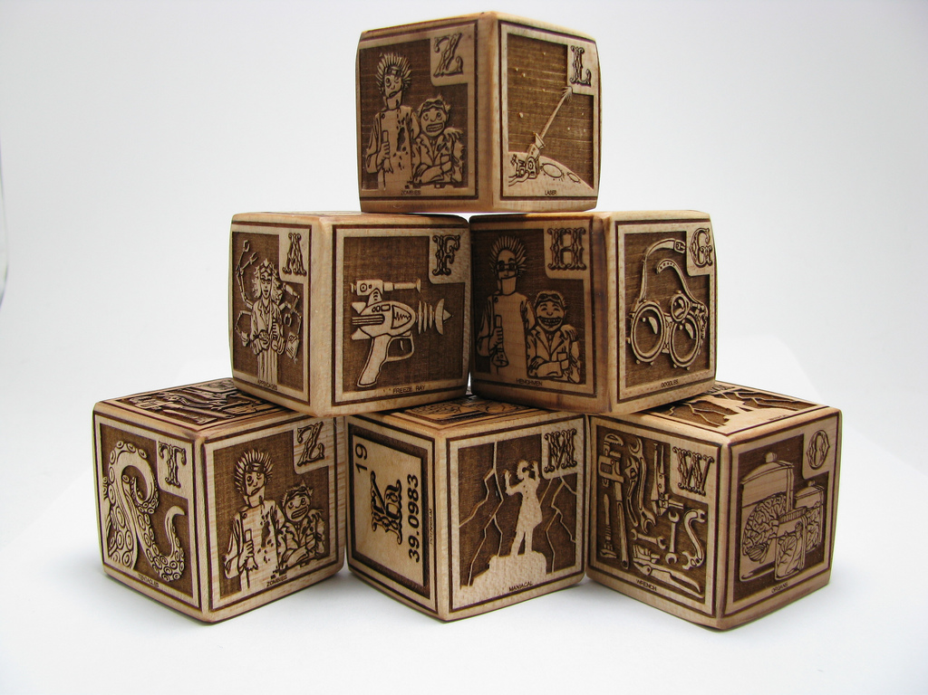
Conclusion
Lets Make an OS!
Notes:
You have the basic building blocks to create an operating system.
The key is to organize the mess so it makes sense.
That is what we are going to begin to look at.

