Slide 1
Writing Cache Friendly Code
Repeated references to variables are good
Stride-1 reference patterns are good
Examples:
  cold cache, 4-byte words, 4-word cache blocks
int sumarrayrows(int a[M][N])
{
int i, j, sum = 0;
for (i = 0; i < M; i++)
for (j = 0; j < N; j++)
sum += a[i][j];
return sum;
}
int sumarraycols(int a[M][N])
{
int i, j, sum = 0;
for (j = 0; j < N; j++)
for (i = 0; i < M; i++)
sum += a[i][j];
return sum;
}
Miss rate =
1/4 = 25%
Miss rate =
100%
Notes:
Animation:
Spend time needed to compute miss rates!

Slide 2
The Memory Mountain
Metric: read throughput (read bandwidth)
  Number of bytes read from memory per second (MB/s)
Memory system test
  Run program with many reads in tight loop
  Examine throughput as function of read sequence
Memory mountain
  A compact visualization of memory system performance.
  Surface represents read throughput as a function of spatial and temporal locality.

Slide 3
Memory Mountain Test Function
/* The test function generates the read sequence */
/* References the first elems elements of data[] with a stride offset */
void test(int elems, int stride)
{
int i, result = 0;
volatile int sink;
for (i = 0; i < elems; i += stride)
result += data[i];
sink = result; /* So compiler doesn't optimize away the loop */
}
/* A wrapper to call test() and return measured read throughput (MB/s) */
double run(int size, int stride, double Mhz)
{
double cycles;
int elems = size / sizeof(int);
test(elems, stride); /* warm up the cache */
cycles = fcyc2(test, elems, stride, 0); /* time test(elems,stride) */
return (size / stride) / (cycles / Mhz); /* convert cycles to MB/s */
}

Slide 4
Memory Mountain Main Routine
/* mountain.c - Generate the memory mountain. */
#define MINBYTES (1 << 10) /* Working set size ranges from 1 KB */
#define MAXBYTES (1 << 23) /* ... up to 8 MB */
#define MAXSTRIDE 16 /* Strides range from 1 to 16 */
#define MAXELEMS MAXBYTES/sizeof(int)
int data[MAXELEMS]; /* The array we'll be traversing */
int main()
{
int size; /* Working set size (in bytes) */
int stride; /* Stride (in array elements) */
double Mhz; /* Clock frequency */
init_data(data, MAXELEMS); /* Initialize each element in data to 1 */
Mhz = mhz(0); /* Estimate the clock frequency */
for (size = MAXBYTES; size >= MINBYTES; size >>= 1) {
for (stride = 1; stride <= MAXSTRIDE; stride++)
printf("%.1f\t", run(size, stride, Mhz));
printf("\n");
}
exit(0);
}

Slide 5
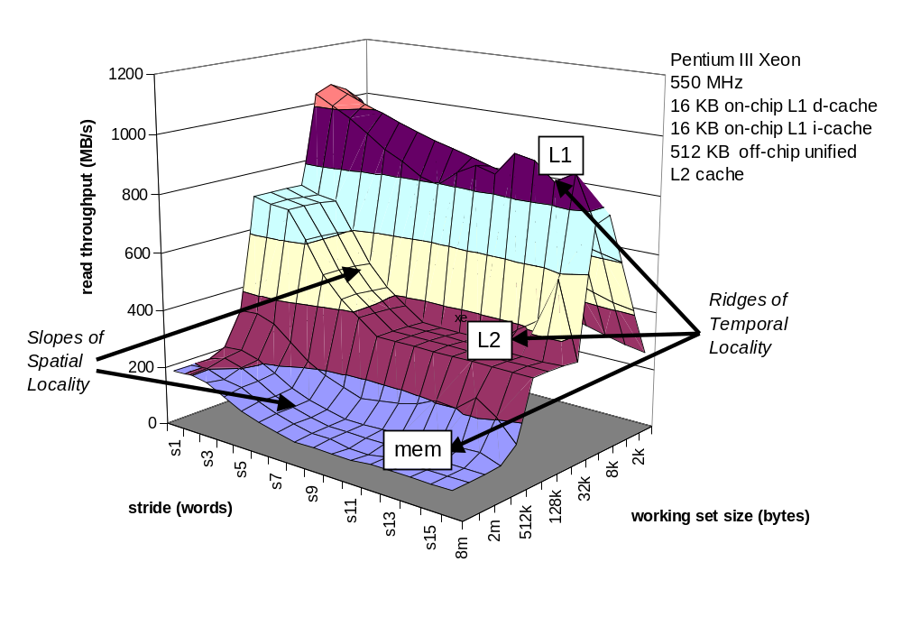
The Memory Mountain
Notes:
Note the affect of stride around the 256K working set size. Also note that at some point your working set is too small to really see the performance improvement. If you have to go to main memory, performance plumets. You see at least an order of magnitude difference.

Slide 6
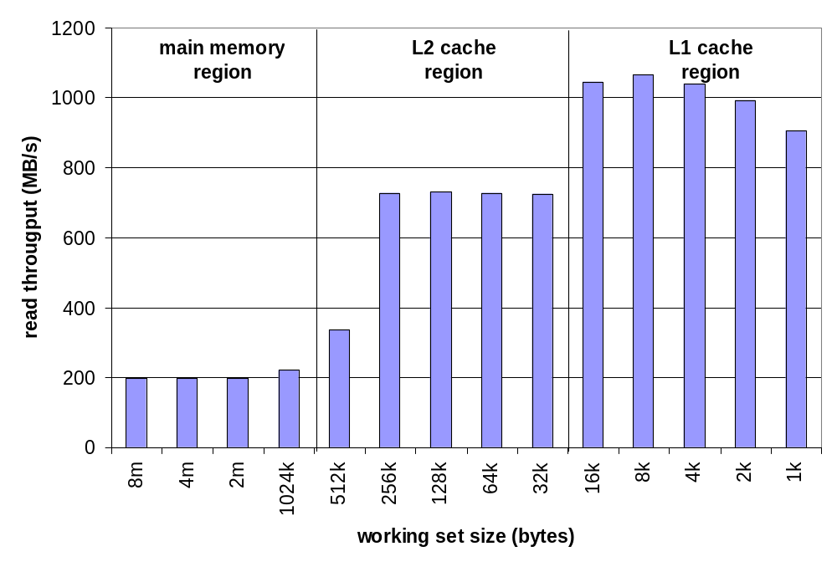
Ridges of Temporal Locality
Slice through the memory mountain with stride=1
  illuminates read throughputs of different caches and memory

Slide 7
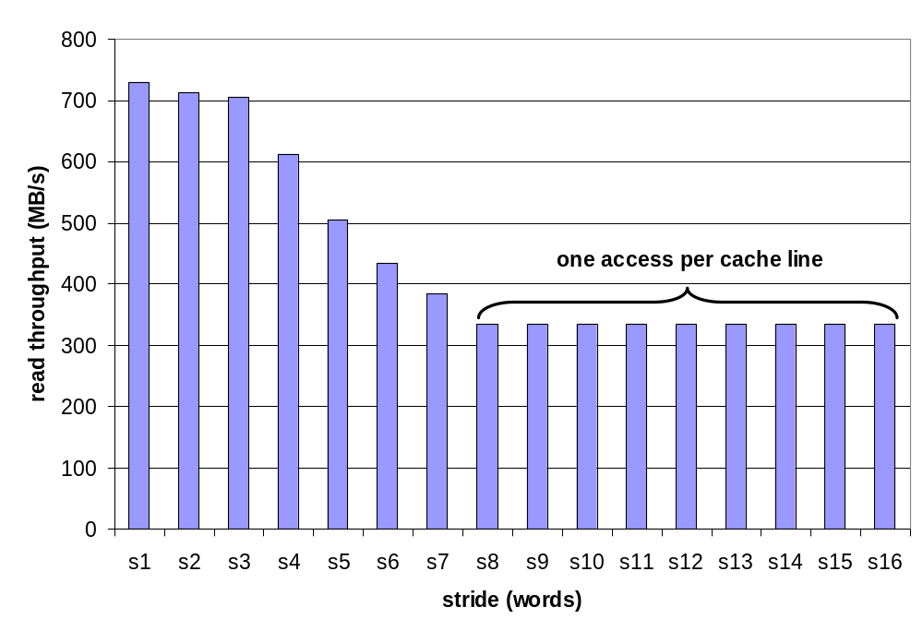
A Slope of Spatial Locality
Slice through memory mountain with size=256KB
  shows cache block size.

Slide 8
Matrix Multiplication Example
Major Cache Effects to Consider
  Total cache size
    Exploit temporal locality and keep the working set small
  Block size
    Exploit spatial locality
Description:
  Multiply N x N matrices
  O(N³) total operations
  Accesses
    N reads per source element
    N values summed per destination
      but may be able to hold in register
Variable sum
held in register
/* ijk */
for (i=0; i<n; i++) {
for (j=0; j<n; j++) {
sum = 0.0;
for (k=0; k<n; k++)
sum += a[i][k] * b[k][j];
c[i][j] = sum;
}
}

Slide 9
Miss Rate Analysis for Matrix Multiply
Assume:
  Line size = 32B (big enough for 4 64-bit doubles)
  Matrix dimension (N) is very large
    Approximate 1/N as 0.0
  Cache is not even big enough to hold multiple rows
Analysis Method:
  Look at access pattern of inner loop
k
j
j
i
k
i
A
B
C
Notes:
This is how we reference in the current code. k is the inner most loop.

Slide 10
Layout of C Arrays in Memory (review)
C arrays allocated in row-major order
  each row in contiguous memory locations
Stepping through columns in one row:
  for (i = 0; i < N; i++)
    sum += a[0][i];
  accesses successive elements
  if block size (B) > 4 bytes, exploit spatial locality
    compulsory miss rate = 4 bytes / B
Stepping through rows in one column:
  for (i = 0; i < n; i++)
    sum += a[i][0];
  accesses distant elements
  no spatial locality!
    compulsory miss rate = 1 (i.e. 100%)
Notes:
Bring this out in earlier slide on simple example.

Slide 11
Matrix Multiplication (ijk)
/* ijk */
for (i=0; i<n; i++) {
for (j=0; j<n; j++) {
sum = 0.0;
for (k=0; k<n; k++)
sum += a[i][k] * b[k][j];
c[i][j] = sum;
}
}
Inner loop:
(*,j)
(i,j)
(i,*)
A
B
C
Row-wise
Column-
wise
Fixed
Misses per Inner Loop Iteration:
  A B C
  0.25 1.0 0.0
Notes:
Remember: N is so big thath 1/N is almost 0. Cannot hold more than 1 row in cache at a time.

Slide 12
Matrix Multiplication (jik)
/* jik */
for (j=0; j<n; j++) {
for (i=0; i<n; i++) {
sum = 0.0;
for (k=0; k<n; k++)
sum += a[i][k] * b[k][j];
c[i][j] = sum
}
}
Inner loop:
(*,j)
(i,j)
(i,*)
A
B
C
Row-wise
Column-
wise
Fixed
Misses per Inner Loop Iteration:
  A B C
  0.25 1.0 0.0

Slide 13
Matrix Multiplication (kij)
/* kij */
for (k=0; k<n; k++) {
for (i=0; i<n; i++) {
r = a[i][k];
for (j=0; j<n; j++)
c[i][j] += r * b[k][j];
}
}
Inner loop:
(i,k)
(k,*)
(i,*)
A
B
C
Fixed
Row-wise
Row-wise
Misses per Inner Loop Iteration:
  A B C
  0.0 0.25 0.25

Slide 14
Matrix Multiplication (ikj)
/* ikj */
for (i=0; i<n; i++) {
for (k=0; k<n; k++) {
r = a[i][k];
for (j=0; j<n; j++)
c[i][j] += r * b[k][j];
}
}
Inner loop:
(i,k)
(k,*)
(i,*)
A
B
C
Fixed
Row-wise
Row-wise
Misses per Inner Loop Iteration:
  A B C
  0.0 0.25 0.25

Slide 15
Matrix Multiplication (jki)
/* jki */
for (j=0; j<n; j++) {
for (k=0; k<n; k++) {
r = b[k][j];
for (i=0; i<n; i++)
c[i][j] += a[i][k] * r;
}
}
Inner loop:
(*,k)
(*,j)
(k,j)
A
B
C
Column -
wise
Fixed
Column-
wise
Misses per Inner Loop Iteration:
  A B C
  1.0 0.0 1.0

Slide 16
Matrix Multiplication (kji)
/* kji */
for (k=0; k<n; k++) {
for (j=0; j<n; j++) {
r = b[k][j];
for (i=0; i<n; i++)
c[i][j] += a[i][k] * r;
}
}
Inner loop:
(*,k)
(*,j)
(k,j)
A
B
C
Column-
wise
Fixed
Column-
wise
Misses per Inner Loop Iteration:
  A B C
  1.0 0.0 1.0

Slide 17
Summary of Matrix Multiplication
ijk (& jik):
  2 loads, 0 stores
  misses/iter = 1.25
kij (& ikj):
  2 loads, 1 store
  misses/iter = 0.5
jki (& kji):
  2 loads, 1 store
  misses/iter = 2.0
for (i=0; i<n; i++) {
for (j=0; j<n; j++) {
sum = 0.0;
for (k=0; k<n; k++)
sum += a[i][k] * b[k][j];
c[i][j] = sum;
}
}
for (k=0; k<n; k++) {
for (i=0; i<n; i++) {
r = a[i][k];
for (j=0; j<n; j++)
c[i][j] += r * b[k][j];
}
}
for (j=0; j<n; j++) {
for (k=0; k<n; k++) {
r = b[k][j];
for (i=0; i<n; i++)
c[i][j] += a[i][k] * r;
}
}

Slide 18
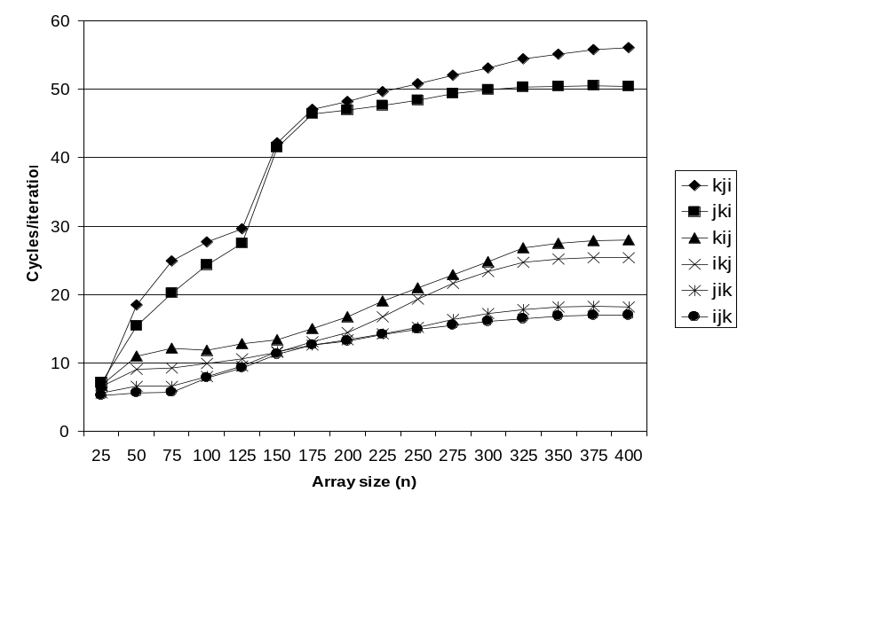
Pentium Matrix Multiply Performance
Miss rates are helpful but not perfect predictors.
    Code scheduling matters, too.
Notes:
Fastest version is 3 times the slowest
Same number of memory and locality references perform roughtly the same
2 versions cleary stand out as stinky
Cache miss rate is not the end of the story; the number of memory references matters too!

Slide 19
Improving Temporal Locality by Blocking
Example: Blocked matrix multiplication
  “block” (in this context) does not mean “cache block”.
  Instead, it means a sub-block within the matrix.
  Example: N = 8; sub-block size = 4
A₁₁ A₁₂
A₂₁ A₂₂
B₁₁ B₁₂
B₂₁ B₂₂
C₁₁ C₁₂
C₂₁ C₂₂
X
=
Key idea: Sub-blocks (i.e., A_{xy}) can be treated just like scalars.
C₁₁ = A₁₁B₁₁ + A₁₂B₂₁ C₁₂ = A₁₁B₁₂ + A₁₂B₂₂
C₂₁ = A₂₁B₁₁ + A₂₂B₂₁ C₂₂ = A₂₁B₁₂ + A₂₂B₂₂
Notes:
Method to deal with the size of the data; improves temporal locality!

Slide 20
Blocked Matrix Multiply (bijk)
for (jj=0; jj<n; jj+=bsize) {
for (i=0; i<n; i++)
for (j=jj; j < min(jj+bsize,n); j++)
c[i][j] = 0.0;
for (kk=0; kk<n; kk+=bsize) {
for (i=0; i<n; i++) {
for (j=jj; j < min(jj+bsize,n); j++) {
sum = c[i][j]
for (k=kk; k < min(kk+bsize,n); k++) {
sum += a[i][k] * b[k][j];
}
c[i][j] += sum;
}
}
}
}
Notes:
Breaking large matrix multiply into several smaller matrix multiplies.

Slide 21
Blocked Matrix Multiply Analysis
  Innermost loop pair multiplies a 1 X bsize sliver of A by a bsize X bsize block of B and accumulates into 1 X bsize sliver of C
  Loop over i steps through n row slivers of A & C, using same B
for (i=0; i<n; i++) {
for (j=jj; j < min(jj+bsize,n); j++) {
sum = c[i][j]
for (k=kk; k < min(kk+bsize,n); k++) {
sum += a[i][k] * b[k][j];
}
c[i][j] += sum;
}
Innermost
Loop Pair
kk
jj
jj
kk
i
i
A
B
C
row sliver accessed
bsize times
Update successive
elements of sliver
block reused n times in succession
Notes:
Compute values of all rows of C using only the bsize slivers of B.
Access each row bsize times
Access the bsizeXbsize block of B n times (n is size of matrix)
Draw 4x4 matrix on board. Show how algorithm works.

Slide 22
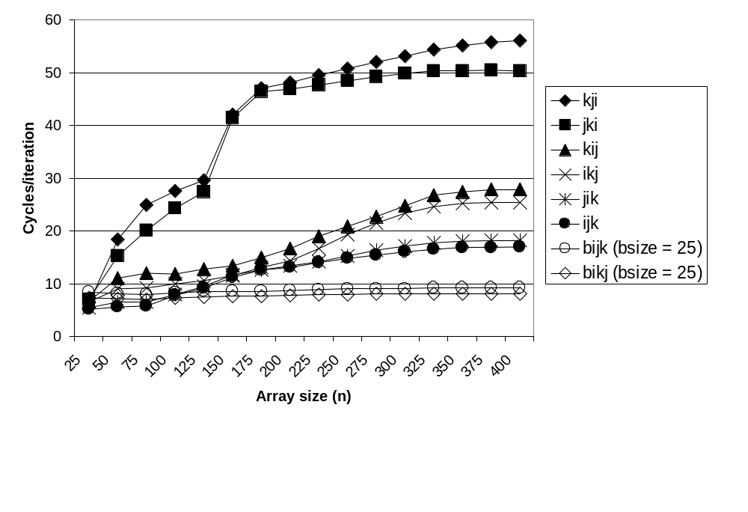
Pentium Blocked Matrix
Multiply Performance
Blocking (bijk and bikj) improves performance by a factor of two over unblocked versions (ijk and jik)
  relatively insensitive to array size.

Slide 23
Concluding Observations
Programmer can optimize for cache performance
  How data structures are organized
  How data are accessed
    Nested loop structure
    Blocking is a general technique
All systems favor “cache friendly code”
  Getting absolute optimum performance is very platform specific
    Cache sizes, line sizes, associativities, etc.
  Can get most of the advantage with generic code
    Keep working set reasonably small (temporal locality)
    Use small strides (spatial locality)

