Slide 1

Chapter 1 – Computer Systems
Let’s figure out
what’s inside
this thing...
CS 345
Chapter 1

Slide 2
CS 345 As Described by some…
An unpleasant place
fire, brimstone, eternal agony and suffering
BYU
blissful, love filled joy, and eternal happiness
CS 345
Just kidding, it is not quit that bad…
CS 345
Chapter 1
Notes:
The typo on “quit” instead of “quite” is a subliminal message…

Slide 3
Fundamental Course Premise
Details matter
  Ignoring the what is “under the hood” results in
    code that is occasionally incorrect
    code that isn’t portable
    code that runs slowly
What does this mean?
    “If you dedicate yourself to learning the concepts in this course,
    you’ll be on your way to becoming a rare “power programmer”…”
CS 345
Chapter 1

Slide 4
Course Theme
Abstraction is good, but do not forget reality!
  Many other computing courses emphasize abstraction
    Abstract data types
    Asymptotic analysis
  These abstractions have limits
  Someone has to implement these abstractions!!
Useful outcomes
  Get a solid understanding of fundamental OS issues
    Hardware, software, and their interrelationship
  Become more effective programmers
    Find and eliminate bugs; tune program performance
  Prepare for later “systems” classes in CS
    Internet programming, compilers, networking, etc.
CS 345
Chapter 1
Notes:
Systems work is fun and critical. There are a lot of jobs for systems programmers. A recent student is writing firmware for Applie iPods. How cool is that? I know another student who spent time on software transactional memory for the CLR at Microsoft. There is a lot of work for system programmers, and the work is very diverse and exciting.
Abstraction is good. Who implements those abstractions. For every cool managed language is an equally cool runtime environment to implement that language. For every proponent of greater abstraction there is an army of system programmers creating that abstraction. There is more to programming that using your favorite language. Someone has to create the environment that supports a new language. This course will help you prepare to be that somebody if you choose.

Slide 5
Why Don’t Computers Use Base 10?
Base 10 Number Representation
  That’s why fingers are known as “digits”
  Natural representation for financial transactions
    Floating point number cannot exactly represent $1.20
  The basis of scientific notation
    1.5213 X 10⁴
Implementing Electronically
  Hard to store
    ENIAC (First electronic computer) used 10 vacuum tubes / digit
  Hard to transmit
    Need high precision to encode 10 signal levels on single wire
  Messy to implement digital logic functions
    Addition, multiplication, etc.
CS 345
Chapter 1
Notes:
Let’s start with some basic hardware with its abstractions.

Slide 6
Binary Representations
Base 2 Number Representation
  Represent 15213₁₀ as 11101101101101₂
  Represent 1.20₁₀ as 1.0011001100110011[0011]…₂
  Represent 1.5213 X 10⁴ as 1.1101101101101₂ X 2¹³
Electronic Implementation
  Easy to store with bistable elements
  Reliably transmitted on noisy and inaccurate wires
  Straightforward implementation of arithmetic functions
0
1
0
3.3V
2.8V
0.5V
0.0V
CS 345
Discussion #3 – Chapter 1
Notes:
Base changes how you represent numbers
Encoding more than 0 and 1 in a voltage is hard
Binary makes it easier to detect actual state
Especially important as transistors get smaller and chips get more dense
More noise. More electrical issues
Bit-flips more common!

Slide 7
Byte-Oriented Memory
Programs use Virtual Addresses (usually)
  Conceptually very large array of bytes
    Implementation quite different, but transparent to your program
  In Unix and Windows NT forward (XP, Server, Vista, 7), address space is private to each “process”
    Typically each program running is a separate process
    Program can clobber its own data, but not that of others
Compiler + Run-Time System Control Allocation
  Where program objects are placed
  Multiple mechanisms: static, stack, and heap
  In any case, all allocation within single virtual address space
CS 345
Chapter 1
Notes:
Programmer perspective: virtual address space
Addresse start at 0 and go to size of memory
Think of it as a big array
Each program has its own virtual address space
Conceptually, there is no sharing of memory!
OS + hardware create this perspective for the programmer
Seg Fault does not mean you touched another processes memory
Seg Fault means you touched a part of your virtual memory space that is protected (i.e., most likely part of the OS)
Picture: program → OS/Hardware → memory
OS/Hardware remap every address from the program into memory
No memory is shared between processes (in its basic form)

Slide 8
Encoding Byte Values
Byte = 8 bits
  Binary 00000000₂ to 11111111₂
  Decimal: 0₁₀ to 255₁₀
  Hexadecimal 00₁₆ to FF₁₆
    Base 16 number representation
    Use characters ‘0’ to ‘9’ and ‘A’ to ‘F’
    Write FA1D37B₁₆ in C as 0xFA1D37B
      Or 0xfa1d37b
Decimal
Hex
Binary
0
0
0000
1
1
0001
2
2
0010
3
3
0011
4
4
0100
5
5
0101
6
6
0110
7
7
0111
8
8
1000
9
9
1001
A
10
1010
B
11
1011
C
12
1100
D
13
1101
E
14
1110
F
15
1111
CS 345
Chapter 1
Notes:
Review weights for bit positions
Review hex notation

Slide 9
Machine Words
Each Machine Has “Word Size”
  Nominal size of integer-valued data
    Including addresses
  Old machines have 32 bit (4 bytes) word sizes
    Limits addresses to 4GB
    Becoming too small for memory-intensive applications
  New machines are 64 bits (8 bytes)---although some OS’s are lagging…
    No longer reserved for “high end” systems
    Potentially address ≈ 1.8 X 10¹⁹ bytes
  Machines support multiple data formats
    Fractions or multiples of word size
    Always integral number of bytes
CS 345
Chapter 1
Notes:
The long int type is the full word size of the machine.
Not sure if this is ANSI standard

Slide 10
Word-Oriented Memory
32-bit
Words
64-bit
Words
Bytes
Addr.
0000
Addresses Specify Byte Locations
  Address of first byte in word
  Addresses of successive words differ by 4 (32-bit) or 8 (64-bit)
Addr
=
??
0001
0000
0002
Addr
=
??
0003
0000
0004
Addr
=
??
0005
0004
0006
0007
0008
Addr
=
??
0009
0008
0010
Addr
=
??
0011
0008
0012
Addr
=
??
0013
0012
0014
0015
CS 345
Chapter 1
Notes:
ANIMATION: fills in each word and double word address
Addressibility is the smallest unit a machine can address
Most machines are byte addressable
Address adjusted appropriatly for multi-byte datatypes

Slide 11
Data Representations
Sizes of C Objects (in Bytes)
  C Data Type Compaq Alpha Typical 32-bit IA32 IA64
    int 4 4 4 4
    long int 8 4 4 8
    char 1 1 1 1
    short 2 2 2 2
    float 4 4 4 4
    double 8 8 8 8
    long double 8 8 10/12 16
    char * 8 4 4 8
      Or any other pointer
What about a “long long int”?
CS 345
Chapter 1
Notes:
Show and run sizeof.c on this slide. Compare MAC with x86.
Long double is different on PowerPC than on x86
A long long in on 64-bit Mac Intel is 8 too (last column is Mac OSX on intel hardware)

Slide 12
Byte Ordering
How should bytes within a multi-byte object be ordered in memory?
Conventions
  Sun, IBM, PowerPC, HP are “Big Endian” machines
    Least significant byte has highest address
  Alpha, Intel, AMD, PC are “Little Endian” machines
    Least significant byte has lowest address
CS 345
Chapter 1

Slide 13
Byte Ordering Example
Big Endian: least significant highest address
Little Endian: least significant lowest address
An example:
  Variable x has 4-byte representation 0x01234567
  Address given by &x is 0x100
Big Endian
0x100
0x101
0x102
0x103
01
23
45
67
01
23
45
67
Little Endian
0x100
0x101
0x102
0x103
67
67
45
45
23
23
01
01
CS 345
Chapter 1
Notes:
ANIMATION: fills in memory contents for each byte ordering
A pointer (address) to a multi-byte data type is always the byte in the data type with the smallest address!
Drill this into class: pointers are always the least address in the multi-byte data type
Endianess affects the significance of the byte ordering: is the first byte at the least address (i.e., the pointer value) the least significant or the most significant byte!
Regardless of endianess, the pointer value is the same. The least address!

Slide 14
Representing Integers
Decimal: 15213
Binary: 0011 1011 0110 1101
Hex: 3 B 6 D
int A = 15213;
int B = -15213;
long int C = 15213;
Linux/Alpha A
Sun A
Linux C
Alpha C
Sun C
6D
00
6D
6D
00
3B
00
3B
3B
00
00
3B
00
00
3B
00
6D
00
00
6D
00
Linux/Alpha B
Sun B
00
00
93
FF
00
C4
FF
FF
C4
FF
93
Two’s complement representation
CS 345
Chapter 1
Notes:
ANIMATION: shows relation between big and little endian machines
Draw memory.
Show first address.
Draw big-endian right under little-endian using the same address for the data.
Be sure to talk about 64-bit machines

Slide 15
Representing Pointers
Alpha P
int B = -15213;
int *P = &B;
A0
FC
FF
Alpha Address
Hex: 1 F F F F F C A 0
Binary: 0001 1111 1111 1111 1111 1111 1100 1010 0000
FF
01
00
00
Sun P
00
EF
Sun Address
Hex: E F F F F B 2 C Binary: 1110 1111 1111 1111 1111 1011 0010 1100
FF
FB
2C
Linux P
Linux Address
Hex: B F F F F 8 D 4 Binary: 1011 1111 1111 1111 1111 1000 1101 0100
D4
F8
FF
BF
Different compilers & machines assign different locations to objects
CS 345
Chapter 1
Notes:
Compiler assigns address.
Changes from machine to machine.
Same concept: address is least value of multi-byte word; endianess only affects order

Slide 16
Representing Floats
float F = 15213.0;
Linux/Alpha F
Sun F
00
46
B4
6D
6D
B4
46
00
IEEE Single Precision Floating Point Representation
Hex: 4 6 6 D B 4 0 0 Binary: 0100 0110 0110 1101 1011 0100 0000 0000
15213: 1110 1101 1011 01
IEEE Single Precision Floating Point Representation
Hex: 4 6 6 D B 4 0 0 Binary: 0100 0110 0110 1101 1011 0100 0000 0000
15213: 1110 1101 1011 01
IEEE Single Precision Floating Point Representation
Hex: 4 6 6 D B 4 0 0 Binary: 0100 0110 0110 1101 1011 0100 0000 0000
15213: 1110 1101 1011 01
Not same as integer representation, but consistent across machines
Can see some relation to integer representation, but not obvious
CS 345
Chapter 1
Notes:
ANIMATION: shows endianess and where the number is embedded in the representation
The actual integer representation is embedded in the float format. The leading 1 is implied as part of the standard. More in section 2.4

Slide 17
Representing Strings
char S[6] = "15213";
Strings in C
  Represented by array of characters
  Each character encoded in ASCII format
    Standard 7-bit encoding of character set
    Other encodings exist, but less common
  String should be null-terminated
    Final character = 0
Compatibility
  Byte ordering not an issue
    Data are single byte quantities
  Text files generally platform independent
    Except for different conventions of line termination character(s)!
Linux/Alpha S
Sun S
31
31
35
35
32
32
31
31
33
33
00
00
CS 345
Chapter 1
Notes:
ANIMATION: shows byte ordering
Strings are an array of single byte data types
No endianess issues
Address is address of a single byte
Read byte and move to next address
Demo the ‘man ascii’ command. Note: digits start at 30 and go up.
Endianess only affect multi-byte data types like integers, floats, etc.
The character 1 is 0x31 from the asii table.

Slide 18
Machine-Level Code Representation
Encode Program as Sequence of Instructions
  Each simple operation
    Arithmetic operation
    Read or write memory
    Conditional branch
  Instructions encoded as bytes
    Alpha’s, Sun’s, Mac’s use 4 byte instructions
      Reduced Instruction Set Computer (RISC)
    PC’s use variable length instructions
      Complex Instruction Set Computer (CISC)
  Different instruction types and encodings for different machines
    Most code not binary compatible
Programs are Byte Sequences Too!
CS 345
Chapter 1
Notes:
Programs starts are least address and progress forward in memory
Instructions are multi-byte data types. What does that imply?
Endianess playes a role!
The least address of the instruction is the operational code
As seen before, if an integer constaint is used, then it is encoded according to endianess
For example, starts at least address, and bytes are correctly ordered

Slide 19
Representing Instructions
int sum(int x, int y){
return x+y;
}
Alpha sum
Sun sum
PC sum
00
81
55
00
C3
89
30
E0
E5
42
08
8B
  For this example, Alpha & Sun use two 4-byte instructions
  PC uses 7 instructions with lengths 1, 2, and 3 bytes
01
90
45
80
02
0C
FA
00
03
6B
09
45
08
89
EC
5D
C3
Different machines use totally different instructions and encodings
CS 345
Chapter 1

Slide 20
Computer Systems
Registers
Interrupts
Caching
Input/Output
Protection
Summary
CS 345
Chapter 1

Slide 21
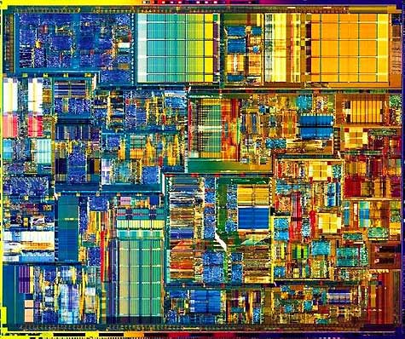
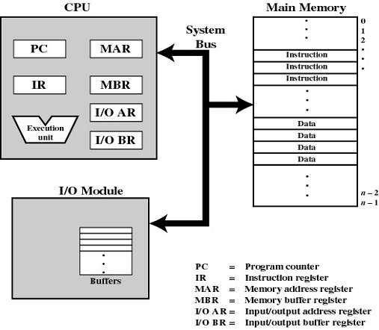
CPU
Registers
CS 345
Chapter 1

Slide 22
Processor Registers
Registers
User-visible registers
  May be referenced by machine language
  Available to all programs - application programs and system programs
    Data Registers – can be changed by user
    Address Registers – could be separate from data register
    Stack Registers – user / supervisor stacks
    Condition Codes – results of operations
Control and status registers
  May or may not be visible
    Program Counter (PC) – address of next instruction
    Instruction Register (IR) – most recently fetched instruction
    MAR/MBR – memory reference registers
    Program Status Word (PSW) – condition codes, interrupts, mode
CS 345
Chapter 1
Notes:
Refer to MSP430 registers

Slide 23
Instruction Execution
Registers
Processor executes instructions in a program
Instructions are fetched from memory on at a time
Fetch Cycle
Execute Cycle
Fetch Next
Instruction
Execute
Instruction
START
HALT
CS 345
Chapter 1

Slide 24
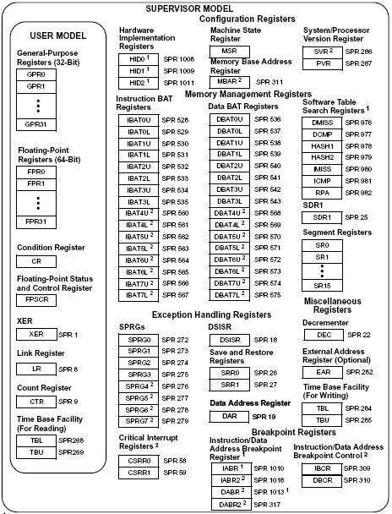
Lots of Registers…
CS 345
Chapter 1

Slide 25
Computer Systems
Registers
Interrupts
Caching
Input/Output
Protection
Summary
CS 345
Chapter 1

Slide 26
Interrupts
Interrupts
The interrupt was the principle tool available to system programmers in developing multi-tasking systems!
Improves processing efficiency by allowing the processor to execute other instructions while an I/O operation is in progress
A suspension of a process caused by an event external to that process and performed in such a way that the process can be resumed
CS 345
Chapter 1

Slide 27
Processing of Interrupts
Interrupts
Classes of Interrupts
  Program (exceptions)
    arithmetic overflow
    division by zero
    execute illegal instruction
    reference outside user’s memory space
  Timer
  I/O
  Hardware failure
An interrupt handler determines nature of the interrupt and performs whatever actions are needed
  Control is transferred to this program
  Generally part of the operating system (hardware helps)
CS 345
Chapter 1

Slide 28
Interrupt Cycle
Interrupts
Processor checks for interrupts
If no interrupts fetch the next instruction for the current program
If an interrupt is pending, suspend execution of the current program, and execute the interrupt handler
Fetch Cycle
Execute Cycle
Interrupt Cycle
Interrupts
Disabled
Fetch Next
Instruction
Execute
Instruction
Check for
Interrupt:
Process Interrupt
START
Interrupts
Enabled
HALT
CS 345
Chapter 1

Slide 29
Simple Interrupt Processing
Interrupts
Device controller or
other system hardware
issues an interrupt
Save remainder of
process state
information
Processor finishes
execution of current
instruction
Processor signals
acknowledgment
of interrupt
Process interrupt
Processor pushes PSW
and PC onto control
stack
Restore process state
information
Processor loads new
PC value based on
interrupt
Restore old PSW
and PC
CS 345
Chapter 1

Slide 30
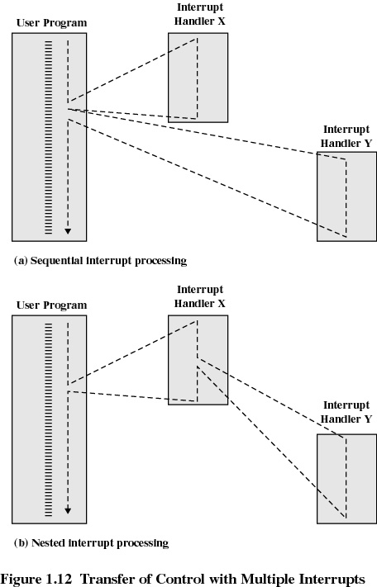
Multiple Interrupts
Interrupts
2 Choices
  Disable Interrupts
    Disable upon entering an interrupt handler
    Enable upon exiting
  Allow Interrupts
    Allow an interrupt handler to be interrupted
    Priorities?
CS 345
Chapter 1

Slide 31
Multiple Interrupts - Sequential Order
Interrupts
Disable interrupts so can complete task
Interrupts remain pending until the processor enables interrupts
After interrupt handler routine completes, the processor checks for additional interrupts
What happens to the interrupts that occur when disabled?
CS 345
Chapter 1

Slide 32
Multiple Interrupts - Priorities
Interrupts
Higher priority interrupts cause lower-priority interrupts to wait
Causes a lower-priority interrupt handler to be interrupted
Example when input arrives from communication line, it needs to be absorbed quickly to make room for more input
How does this change interrupt handlers?
CS 345
Chapter 1

Slide 33
Computer Systems
Registers
Interrupts
Caching
Input/Output
Protection
Summary
CS 345
Chapter 1

Slide 34
Memory Hierarchy
Caching
More Expensive
Faster & Smaller
Registers
Cache
Main Memory
Disk Cache
Bigger
Slower
Cloud Storage
Magnetic Tape
Optical Disk
CS 345
Chapter 1
Notes:
Performance is determined by how well your program interacts with the cache (make or break). Principle design challenge for modern processors because the memory hierarchy is getting very deep and complex when you consider multi-core chips.
Illustrate the typical multi-core architecture on the white board showing each processor with its own L1 cache. It complicates data sharing between threads in multi-threaded programs.

Slide 35
Memory Cache
Caching
Given:
  Processor speed is faster than memory speed
  Execution/data localizes
Cache:
  Contains a portion of main memory
  Invisible to operating system
  Used similar to virtual memory
  Increases the speed of memory
Processor first checks cache
If not found in cache, the block of memory containing the needed information is moved to the cache
CS 345
Discussion #3 – Chapter 1

Slide 36
Cache Design
Caching
Cache size
  small caches have a significant impact on performance
Block size
  the unit of data exchanged between cache and main memory
  hit means the information was found in the cache
  larger block size more hits until probability of using newly fetched data becomes less than the probability of reusing data that has been moved out of cache
CS 345
Discussion #3 – Chapter 1

Slide 37
Cache Design
Caching
Mapping function
  Determines which cache location the block will occupy
Replacement algorithm
  Determines which block to replace
  Least-Recently-Used (LRU) algorithm
Write policy
  write a block of cache back to main memory
  main memory must be current for direct memory access by I/O modules and multiple processors
CS 345
Discussion #3 – Chapter 1

Slide 38
Disk Cache
Caching
A portion of main memory used as a buffer to temporarily to hold data for the disk
Disk writes are clustered
Some data written out may be referenced again. The data are retrieved rapidly from the software cache instead of slowly from disk
CS 345
Discussion #3 – Chapter 1

Slide 39
Computer Systems
Registers
Interrupts
Caching
Input/Output
Protection
Summary
CS 345
Discussion #3 – Chapter 1

Slide 40
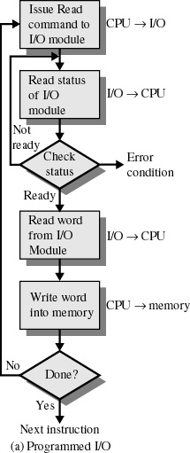
Programmed I/O
Input/Output
I/O module performs the action, not the processor
Sets appropriate bits in the I/O status register
No interrupts occur
Processor is kept busy checking status
CS 345
Chapter 1

Slide 41
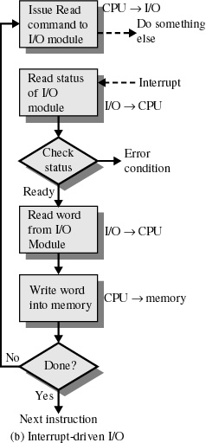
Interrupt-Driven I/O
Input/Output
Processor is interrupted when I/O module ready to exchange data
Processor is free to do other work
No needless waiting
Consumes a lot of processor time because every word read or written passes through the processor
CS 345
Chapter 1

Slide 42
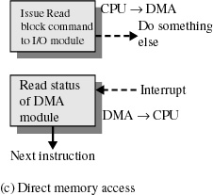
Direct Memory Access
Input/Output
Transfers a block of data directly to or from memory
An interrupt is sent when the task is complete
The processor is only involved at the beginning and end of the transfer
What does this mean with respect to a paged system?
CS 345
Chapter 1
Notes:
A paged system must allocate pages to the DMA, and the DMA writes to those pages.

Slide 43
Computer Systems
Registers
Interrupts
Caching
Input/Output
Protection
Summary
CS 345
Discussion #3 – Chapter 1

Slide 44
Hardware Protection
Protection
Why protect hardware?
From what?
  Shared hardware resources – memory, disk, …
  Errant programs
How?
  CPU provides 2 modes of operation
    User Mode (non-privileged)
    Supervisor mode (privileged)
  Privileged instructions can only be executed in monitor mode
    All I/O instructions are privileged (accesed by system calls)
CS 345
Chapter 1

Slide 45
Memory Protection
Protection
We must not allow a program access to memory outside of its space.
How? Add two registers
  Base and Limit
Use the registers to check every reference
Virtual memory
0
OS
256000
Job 1
300040
Job 2
420940
Job 3
880000
Base
300040
Job 4
Limit
120900
1024000
CS 345
Chapter 1

Slide 46
CPU Protection
Protection
What is there to protect?
  Configuration
  CPU as a resource
Timer
  Task Switching uses the timer
    When process is loaded timer is set
    Timer is decremented each cycle
    When time is zero, an interrupt is generated
    Process is switched
  Load-timer is a privileged instruction
Halt instruction? (IA32)
Reprogram micro-code?
CS 345
Chapter 1

Slide 47
Protect at all cost?
Protection
If all I/O instructions are protected, how do you perform input or output?
OS runs on behalf of a user!
System calls
  Often the call is a trap to a ISR (interrupt service routine)
  Control is passed to the ISR which sets the mode bit to monitor mode
  ISR verifies that parameters are correct
  ISR executes request, resets mode
  Control is returned to user program
CS 345
Chapter 1

Slide 48
Summary…
CS 345
Discussion #3 – Chapter 1

Slide 49
What is an O.S.?
Summary
Not always a clear definition as to what constitutes an O.S. and what is an application
  CD-Rom Driver
  Scandisk
  Internet Explorer
Intermediary between the hardware and the users
  Allocate resources (CPU, Memory, disk space, etc.) between programs and users efficiently
  Allow the user to conveniently access data and programs
  Protect the system from incorrect or malicious programs and users
CS 345
Chapter 1

Slide 50
Evolution of Operating Systems
Operating systems have evolved because
  New types of hardware and hardware upgrades
  Development of new services and needs
  Fixes to OS faults
Serial Processing
Simple Batch Processing
Multi-programmed Batch Systems
Time-Sharing Systems
Distributed/Shared Processing Systems
????
CS 345
Discussion #2 – Computer System Overview
Notes:
Serial: No OS. One program at a time. Must setup system, and must physically schedule time. Setup include loading compiler, source, compiling, and then running
Simple Batch: Program schedules and runs jobs sequentially. Program is a monitor. Branches to program, when it completes, takes control back.
Multi-programmed: more people get to play while waiting for I/O

Slide 51
Types of OSs
Server operating systems
Multiprocessor operating systems
Personal computer operating systems
Handheld computer operating systems
Embedded operating systems
Sensor node operating systems
Real-time operating systems
Smart card operating systems
CS 345
Chapter 1

Slide 52
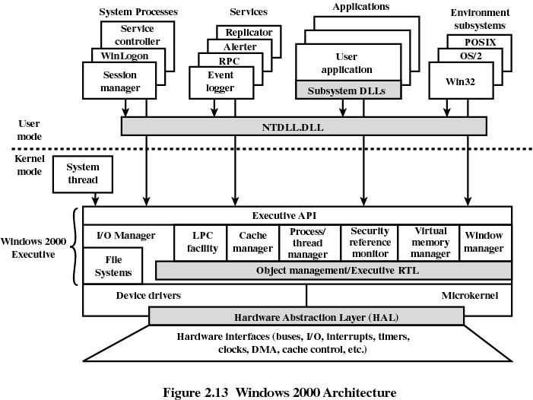
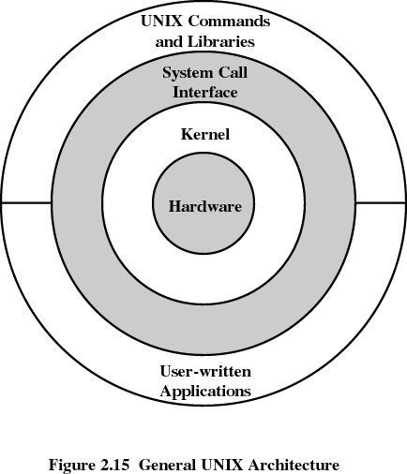
Modern OS Architecture
CS 345
Discussion #2 – Computer System Overview
Notes:
Microkernel versus a monolithic kernel

Slide 53
Linux
Significant departure from UNIX
Key contribution is modules
Load modules dynamically in/out of kernel
Benefits of monolithic kernel (performance)
Benefits of micro-kernel (easily evolved)
Modules execute in kernel mode on behalf of user so user can access all system resources
CS 345
Discussion #2 – Computer System Overview

Slide 54
Hardware Review
Summary
Elements of a system
  Processor
    Registers (address, data, control)
    Instruction cycle (fetch, decode, execute)
    Interrupts
    Usually includes hardware and special instructions to help the O.S. manage memory, devices, etc.
  Memory
    Different levels (cache, main memory, disk)
    Operating system will generally manage memory (both RAM and disk), and move data back and forth as required
  I/O
    Usually use Interrupts, DMA
    Operating system usually controls use of I/O devices
CS 345
Chapter 1

Slide 55
END
CS 345
Chapter 1

Slide 56
Registers
Summary
Used for frequently accessed items
User-Visible registers – Available to the programmer and compiler
  Data Registers
  Address Registers (Index, Segment, Stack Pointer)
  Condition code/flags
Control and Status registers – Used to control the processor
  Program Counter/Instruction Pointer
  Memory address/data
  Processor Status Word
  Debugging registers
  Temp registers
  Memory Management registers
CS 345
Chapter 1

Slide 57
Interrupts
Summary
Interrupts
  Allow I/O devices to get the CPUs attention at regular intervals (Program, Timer, I/O, Hardware failure)
  Helps the O.S. by reducing the time spent monitoring I/O devices
  CPU checks for interrupts after each instruction, starts the handler if needed
  May allow nested interrupts
I/O techniques
  Programmed I/O
  Interrupt-Driven I/O
  Direct Memory Access
CS 345
Chapter 1

Slide 58
Interrupts and I/O
Summary
Handling and Interrupts:
  Figure 1.10 (pg 23)
  Device sends interrupt request to CPU
  CPU finishes current instruction
  CPU acknowledges request
  CPU saves PC and PSW
  CPU loads PC with the address of the first instruction in the interrupt handler (may get help from interrupt request)
  Interrupt handler starts, often saves other CPU registers and key values
  Interrupt handler responds to the device
  Interrupt handler restores CPU registers and key values
  CPU restores PC and PSW and resumes previous program
CS 345
Chapter 1

Slide 59
Memory
Summary
Varying types of memory
  Registers, Cache, RAM, Disk, CD
  Vary in speed, size, cost
  CPU and O.S. try to keep frequently used data in faster memory
Cache – Use a small high-speed memory to improve the apparent speed of a larger low-speed memory
  Keep track of what is currently being used, load into high-speed memory
  Replacement Algorithm – What do we get rid of when we run out of memory?
  Write Policy – How do we respond to modifications?
CS 345
Chapter 1

