Slide 1
Concurrency
Mutual Exclusion and Synchronization
  Principles of Concurrency
  Mutual Exclusion
  Software Solutions
  Hardware Solutions
  Semaphores
  Producer/Consumer
  Message Passing
  Monitors
CS 345
Discussion #6 – Chapter 5a

Slide 2
Cooperating Processes
Concurrency
Operating systems allow for the creation and concurrent execution of multiple processes
  concurrency can ease program complexity
  concurrency can increase efficiency
How can the processes work together?
  Flags
  Files
  Messages
  Shared memory
x
P0
P1
1. Wait until x
has a value
1. Wait until x is able
to be set
2. Use the value
2. Produce a value
3. Change the value
to indicate used
3. Set x to the value
CS 345
Discussion #6 – Chapter 5a

Slide 3
How hard can this be?
Try preparing a seven-course banquet
  By yourself
  With one friend
  With twenty-seven friends …
Managed chaos…
Art of Multiprocessor Programming
Notes:
© 2003 Herlihy and Shavit

Slide 4
Cooperating Processes
Concurrency
Concurrent processes (or threads) often need to share data (maintained either in shared memory or files) and resources
If there is no controlled access to shared data, some processes will obtain an inconsistent view of this data
The actions performed by concurrent processes may depend on the order in which their execution is interleaved
With no synchronization, results are typically not deterministic nor reproducible.
CS 345
Discussion #6 – Chapter 5a

Slide 5
Examples
Concurrency
Coherence
void echo()
{
static char chin, chout;
chin = getchar();
chout = chin;
putchar(chout);
}
CS 345
Discussion #6 – Chapter 5a

Slide 6
A Simple Example
Process P1 Process P2
. .
chin = getchar(); .
. chin = getchar();
chout = chin; chout = chin;
putchar(chout); .
. putchar(chout);
. .
CS 345
Discussion #6 – Chapter 5a

Slide 7
Operating Systems must…
Concurrency
keep track of active processes.
allocate and deallocate resources.
  Processor time
  Memory
  Files
  I/O devices
protect the data and physical resources.
The results of a process must be independent of the speed of execution relative to the speed of other concurrent processes.
CS 345
Discussion #6 – Chapter 5a

Slide 8
Process Interaction
Concurrency
Degree of Awareness
Relationship
Process Interaction
Potential Control Problems
Processes unaware of each other
Competition
• Results of one process
independent of the
action of others
• Timing of process may
be affected
• Mutual exclusion
• Deadlock
• Starvation
Processes indirectly aware of each other (e.g., shared object)
Cooperation by sharing
• Results of one process
may depend on
information obtained
from others
• Timing of process may
be affected
• Mutual exclusion
• Deadlock
• Starvation
• Data coherence
Processes directly aware of each other (communication primitives available to them)
Cooperation by communication
• Results of one process
may depend on
information obtained
from others
• Timing of process may
be affected
• Deadlock
(consumable
resource)
• Starvation
CS 345
Discussion #6 – Chapter 5a

Slide 9
Concurrency Problems
Concurrency
Race Conditions
  Unregulated access to shared resources
  Observed behavior is not consistent or explained
Deadlock
  Process A holds resource x and is waiting for y and
  Process B holds resource y and is waiting for x
  Uh oh! We’re stuck!
  A very common and pernicious problem
Starvation
  A process never gets access to a resource
  Makes not progress (looks like deadlock in some ways)
CS 345
Discussion #6 – Chapter 5a

Slide 10
Critical Section to the Rescue?
Mutual Exclusion
Defines sections of the code as critical
Only one process may be in the critical code at a time
Properties of a good critical section (CS):
  Mutually Exclusive: only one process can be in the CS
  Deadlock free: some process gets access always
  Starvation free: every process that asks eventually gets access (the wait time is bounded and finite for a requesting process)
No assumptions about speed or number of processors
Some assumptions about scheduler and memory for correctness
Implemented using special entry and exit code around CS
Let’s talks turkey on how CSs are implemented
CS 345
Discussion #6 – Chapter 5a

Slide 11
Mutual Exclusion Key
Mutual Exclusion
Must be enforceable.
Not messed up by processes that die in non-CSs
Usually messed up when they die in CS
Advanced techniques can solve above issue (cs586)
Prefer free of deadlock at a minimum
Would be nice to be free of starvation too
If a resource is available, permit immediate access
No assumptions on processor speeds or number of processors (a few assumptions on scheduler)
Assume processes in CS a bounded amount of time
CS 345
Discussion #6 – Chapter 5a

Slide 12
Turns
Mutual Exclusion: Software
repeat
while (turn != me) do no-op
<critical section>
turn = you
other stuff
until false
CS 345
Discussion #6 – Chapter 5a

Slide 13
Warning
You will never use the next algorithm
  Get over it
You are advised to understand it
  The same issues show up everywhere
  Except hidden and more complex
Art of Multiprocessor Programming
Notes:
© 2003 Herlihy and Shavit

Slide 14
Bakery Algorithm
Mutually exclusive
Deadlock Free
Starvation free
  Provides First-Come-First-Served
  How?
    Take a “number”
    Wait until lower numbers have been served
    Lexicographic order
      (a,i) > (b,j)
      If a > b, or a = b and i > j
Art of Multiprocessor Programming
Notes:
© 2003 Herlihy and Shavit
Be sure students grasp “lexicographical order” because it is critical to correctness.

Slide 15
Bakery Algorithm
class Bakery implements Lock {
volatile boolean[] flag;
volatile Label[] label;
public Bakery (int n) {
flag = new boolean[n];
label = new Label[n];
for (int i = 0; i < n; i++) {
flag[i] = false; label[i] = 0;
}
}
…
Art of Multiprocessor Programming
Notes:
© 2003 Herlihy and Shavit
Two arrays, one of flags just as in all other algorithms, and one of labels.

Slide 16
Bakery Algorithm
class Bakery implements Lock {
volatile boolean[] flag;
volatile Label[] label;
public Bakery (int n) {
flag = new boolean[n];
label = new Label[n];
for (int i = 0; i < n; i++) {
flag[i] = false; label[i] = 0;
}
}
…
2
6
0
n-1
f
f
t
f
f
t
f
f
0
0
4
0
0
5
0
0
CS
Art of Multiprocessor Programming
Notes:
© 2003 Herlihy and Shavit
Two arrays, one of flags just as in all other algorithms, and one of labels.

Slide 17
Bakery Algorithm
class Bakery implements Lock {
…
public void lock() {
flag[i] = true;
label[i] = max(label[0], …,label[n-1])+1;
while (∃k flag[k]
&& (label[i],i) > (label[k],k));
}
Art of Multiprocessor Programming
Notes:
© 2003 Herlihy and Shavit
Relies of thread IDs to break ties on the counter. Meets FCFS property because the property only holds for D_A → D_B. When you get equal values of counters, it means the D_A → D_B does not hold and D_B → D_A does not hold either.

Slide 18
Bakery Algorithm
class Bakery implements Lock {
…
public void lock() {
flag[i] = true;
label[i] = max(label[0], …,label[n-1])+1;
while (∃k flag[k]
&& (label[i],i) > (label[k],k));
}
Doorway
Art of Multiprocessor Programming
Notes:
© 2003 Herlihy and Shavit

Slide 19
Bakery Algorithm
class Bakery implements Lock {
…
public void lock() {
flag[i] = true;
label[i] = max(label[0], …,label[n-1])+1;
while (∃k flag[k]
&& (label[i],i) > (label[k],k));
}
I’m interested
Art of Multiprocessor Programming
Notes:
© 2003 Herlihy and Shavit

Slide 20
Bakery Algorithm
Take increasing label (read labels in some arbitrary order)
class Bakery implements Lock {
…
public void lock() {
flag[i] = true;
label[i] = max(label[0], …,label[n-1])+1;
while (∃k flag[k]
&& (label[i],i) > (label[k],k));
}
Art of Multiprocessor Programming
Notes:
© 2003 Herlihy and Shavit

Slide 21
Bakery Algorithm
Someone is interested
class Bakery implements Lock {
…
public void lock() {
flag[i] = true;
label[i] = max(label[0], …,label[n-1])+1;
while (∃k flag[k]
&& (label[i],i) > (label[k],k));
}
Art of Multiprocessor Programming
Notes:
© 2003 Herlihy and Shavit

Slide 22
Bakery Algorithm
class Bakery implements Lock {
boolean flag[n];
int label[n];
public void lock() {
flag[i] = true;
label[i] = max(label[0], …,label[n-1])+1;
while (∃k flag[k]
&& (label[i],i) > (label[k],k));
}
Someone is interested
With lower (label,i) in lexicographic order
Art of Multiprocessor Programming
Notes:
© 2003 Herlihy and Shavit
Again, unique thread IDs are critical to making it all work.

Slide 23
Bakery Algorithm
class Bakery implements Lock {
…
public void unlock() {
flag[i] = false;
}
}
Art of Multiprocessor Programming
Notes:
© 2003 Herlihy and Shavit

Slide 24
Bakery Algorithm
class Bakery implements Lock {
…
public void unlock() {
flag[i] = false;
}
}
No longer interested
labels are always increasing
Art of Multiprocessor Programming
Notes:
© 2003 Herlihy and Shavit

Slide 25
Bakery Algorithm
Mutual Exclusion: Software
lock(i)
choosing[i] = true
n[i] = max(n[0], n[1], … n[n-1]) + 1)
choosing[i] = false
for j = 0 to n-1 do
while choosing[j] do no-op
while ((n[j], j) < (n[i], i) and
(n[j] != 0)) do no-op
endfor
unlock(i)
n[i] = 0
thread(i)
lock(i)
// critical section
unlock(i)
Wait until thread j receives its number
Wait for previous threads to complete
(a,b) < (c,d) equivalent to
(a < c) or ((a == c) and (b < d))
CS 345
Discussion #6 – Chapter 5a
Notes:
i is my id.
Shared variables: choosing[] flag, number[] turn
Do I have to write this code when I want synchronization? No! But possible to write own code (without H/W) to do exclusion.

Slide 26
Bakery Algorithm is Correct
Mutual Exclusion: Software
Mutually exclusive: never lots more than one through
Deadlock free: someone always gets access
Starvation free: FIFO order on servicing requests
Other software solutions
  Dekker’s algorithm: 2-process and not starvation free
  Peterson’s algorithm: 2-process and not starvation free
  Filter: generalization of Petersen’s to n-processes
All break on modern memory subsystems unless you use memory barriers
CS 345
Discussion #6 – Chapter 5a

Slide 27
Bakery Algorithm
class Bakery implements Lock {
volatile boolean[] flag;
volatile Label[] label;
public Bakery (int n) {
flag = new boolean[n];
label = new Label[n];
for (int i = 0; i < n; i++) {
flag[i] = false; label[i] = 0;
}
}
…
The volatile is a memory barrier and forces memory update
Art of Multiprocessor Programming
Notes:
© 2003 Herlihy and Shavit
Two arrays, one of flags just as in all other algorithms, and one of labels.

Slide 28
Software solutions icky
Mutual Exclusion: Software
Software solutions do not cut it
How hardware help?
We need to glue memory read and write together
Disable interrupts
  not all interrupts need to be disabled
  might (does) not work in multiprocessor environments
  Disable interrupts, critical section, enable interrupts
Atomic instructions…
CS 345
Discussion #6 – Chapter 5a

Slide 29
The fundamental issue
Task A (running)
1: void who() {
2: while(lock);
3: lock = 1;
4: // critical section
5: lock = 0;
6:}
Task B (ready)
10: void do() {
11: while(lock);
12: lock = 1;
13: // critical section
14: lock = 0;
15:}
CS 345
Discussion #6 – Chapter 5a

Slide 30
The fundamental issue
Task A (running)
1: void who() {
2: while(lock);
3: lock = 1;
4: // critical section
5: lock = 0;
6:}
Task B (ready)
10: void do() {
11: while(lock);
12: lock = 1;
13: // critical section
14: lock = 0;
15:}
CS 345
Discussion #6 – Chapter 5a

Slide 31
The fundamental issue
Task A (ready)
1: void who() {
2: while(lock);
3: lock = 1;
4: // critical section
5: lock = 0;
6:}
Task B (running)
10: void do() {
11: while(lock);
12: lock = 1;
13: // critical section
14: lock = 0;
15:}
CS 345
Discussion #6 – Chapter 5a

Slide 32
The fundamental issue
Task A (ready)
1: void who() {
2: while(lock);
3: lock = 1;
4: // critical section
5: lock = 0;
6:}
Task B (running)
10: void do() {
11: while(lock);
12: lock = 1;
13: // critical section
14: lock = 0;
15:}
CS 345
Discussion #6 – Chapter 5a

Slide 33
The fundamental issue
Task A (ready)
1: void who() {
2: while(lock);
3: lock = 1;
4: // critical section
5: lock = 0;
6:}
Task B (running)
10: void do() {
11: while(lock);
12: lock = 1;
13: // critical section
14: lock = 0;
15:}
CS 345
Discussion #6 – Chapter 5a

Slide 34
The fundamental issue
Task A (running)
1: void who() {
2: while(lock);
3: lock = 1;
4: // critical section
5: lock = 0;
6:}
Task B (ready)
10: void do() {
11: while(lock);
12: lock = 1;
13: // critical section
14: lock = 0;
15:}
CS 345
Discussion #6 – Chapter 5a

Slide 35
The fundamental issue
Task A (running)
1: void who() {
2: while(lock);
3: lock = 1;
4: // critical section
5: lock = 0;
6:}
Task B (ready)
10: void do() {
11: while(lock);
12: lock = 1;
13: // critical section
14: lock = 0;
15:}
CS 345
Discussion #6 – Chapter 5a

Slide 36
The fundamental issue
Task A (running)
1: void who() {
2: while(lock);
3: lock = 1;
4: // critical section
5: lock = 0;
6:}
Task B (ready)
10: void do() {
11: while(lock);
12: lock = 1;
13: // critical section
14: lock = 0;
15:}
Hmm…
CS 345
Discussion #6 – Chapter 5a

Slide 37
Hardware Solutions
Mutual Exclusion
Special machine instructions to glue memory read and write into a single atomic action (cannot be divided)
Some instructions better than others
Weak (do not support wait-free n-thread structures)
  test and set instruction (TSET)
  test and test and set instruction (TTSET)
  exchange instruction (XCHG)
Compare and swap (CAS) --- most common
Full support for n-thread wait-free constructs of any data structure (see CS 586 for more)
CS 345
Discussion #6 – Chapter 5a

Slide 38
Test-and-Set
Mutual Exclusion
bool testset(int &i)
{
if (i == 0)
{
i = 1;
return false;
}
else
{
return true;
}
}
Shared variable i (initialized to 0)
Only the first P_{i} who sets i enters CS
Requires special TSET machine instruction (atomic)
Process Pi:
repeat
repeat until !testset(b);
Critical section
b:=0;
Stuff
until false
CS 345
Discussion #6 – Chapter 5a

Slide 39
Mutual Exclusion w/Test-and-Set
Mutual Exclusion
while(true)
{ waiting[i] = true;
key = true;
while(waiting[i] && key)
{ if (key = TestAndSet(lock)) ...context switch...
}
waiting[i] = false;
// do critical section
// find the next waiting task (round robin)
j = (i + 1) % n;
while((j != i) && !waiting[j]) j = (j + 1) % n;
if (j == i) lock = false;
else waiting[j] = false;
// do remainder
}
CS 345
Discussion #6 – Chapter 5a

Slide 40
Mutual Exclusion w/XCHG
Mutual Exclusion
Shared variable b is initialized to 0
Each P_{i} has a local variable k
The only P_{i} that can enter CS is the one who finds b=0
This P_{i} excludes all the other P_{j} by setting b to 1
Process Pi:
repeat
k:=1
repeat xchg(k,b)
until k=0;
Critical section
b:=0;
RS
until false
CS 345
Discussion #6 – Chapter 5a
Notes:
Single operation to exchange 2 values
Complex structures and not fair

Slide 41
Mutual Exclusion: Exchange
Exchange Instruction
void exchange(int register, int memory) {
int temp;
temp = memory;
memory = register;
register = temp;
}
CS 345
Discussion #6 – Chapter 5a

Slide 42
Compare and swap: CAS
int CAS(int *word,
int testval,
int newval) {
int oldval = *word;
if (oldval == testval)
*word = newval
return oldval;
}
CS 345
Discussion #6 – Chapter 5a

Slide 43
Mutual Exclusion
int bolt = 0;
void P(int i) {
while(true) {
while (CAS(&bolt, 0, 1) == 1);
// critical section
bolt = 0;
// rest of code
}
}
void main() {
bolt = 0;
parbegin(P(1), P(2), P(3),…,P(n));
}
CS 345
Discussion #6 – Chapter 5a

Slide 44
Spin Locks
.
.
CS
.
spin
lock
critical
section
Resets lock
upon exit
Art of Multiprocessor Programming© Herlihy-Shavit 2007
Notes:
With spin locks, synchronization usually looks like this. Some set of threads contend for the lock. One of them acquires it, and the others spin. The winner enters the critical section, does its job, and releases the lock on exit.

Slide 45
Spin Locks
…lock introduces sequential bottleneck
.
.
CS
.
spin
lock
critical
section
Resets lock
upon exit
Art of Multiprocessor Programming© Herlihy-Shavit 2007
Notes:
Contention occurs when multiple threads try to acquire a lock at the same time. High contention means there are many such threads, and low contention means the opposite.

Slide 46
Spin Locks
…lock suffers from contention
.
.
CS
.
spin
lock
critical
section
Resets lock
upon exit
Art of Multiprocessor Programming© Herlihy-Shavit 2007
Notes:
Contention occurs when multiple threads try to acquire a lock at the same time. High contention means there are many such threads, and low contention means the opposite.

Slide 47
Spin locks
…lock suffers from contention
.
.
CS
.
spin
lock
critical
section
Resets lock
upon exit
Notice: these are distinct phenomena
Art of Multiprocessor Programming© Herlihy-Shavit 2007
Notes:
Our goal is to understand how contention works, and to develop a set of techniques that can avoid or alleviate it. These techniques provide a useful toolkit for all kinds of synchronization problems.

Slide 48
Spin locks
…lock suffers from contention
.
.
CS
.
spin
lock
critical
section
Resets lock
upon exit
Seq Bottleneck → no parallelism
Art of Multiprocessor Programming© Herlihy-Shavit 2007
Notes:
Our goal is to understand how contention works, and to develop a set of techniques that can avoid or alleviate it. These techniques provide a useful toolkit for all kinds of synchronization problems.

Slide 49
Spin Locks
…lock suffers from contention
.
.
CS
.
spin
lock
critical
section
Resets lock
upon exit
Contention → ???
Art of Multiprocessor Programming© Herlihy-Shavit 2007
Notes:
Our goal is to understand how contention happens, and to develop a set of techniques that can avoid or alleviate it. These techniques provide a useful toolkit for all kinds of synchronization problems.

Slide 50
Notable Notes
Spin locking good:
  For short waits
  On multiprocessor systems
  With low contention
Spin locking bad:
  For long waits
  Especially on Uniprocessor systems
  Or in High contention
Ways to fix… (see CS 586)
CS 345
Discussion #6 – Chapter 5a

Slide 51
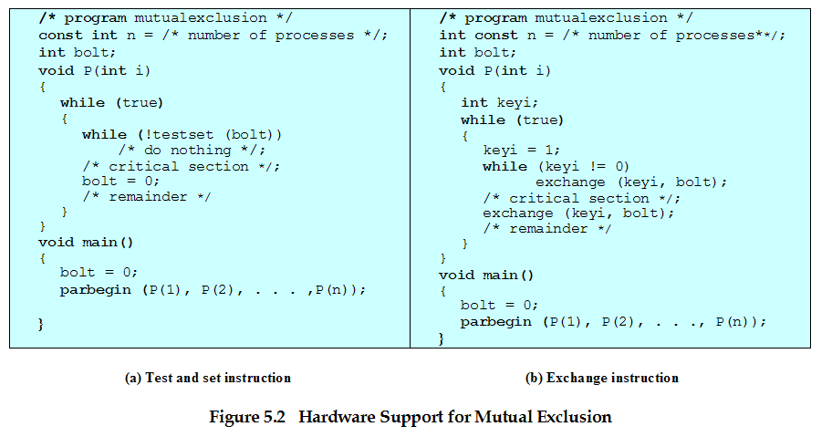
Mutual Exclusion
CS 345
Discussion #6 – Chapter 5a

Slide 52
Semaphores
Rather than spin…
Moved to a blocked queue and wait for an event indicating the resource is available
Special variable called a semaphore is used for just such an approach signaling
If a process is waiting for a signal, it is suspended until that signal is sent
Great for long waits, uniprocessor systems, or high contention resources
CS 345
Discussion #6 – Chapter 5a

Slide 53
Semaphores
Semaphore is a variable that has an integer value
  May be initialized to a nonnegative number
  Wait operation decrements the semaphore value
  Signal operation increments semaphore value
CS 345
Discussion #6 – Chapter 5a

Slide 54
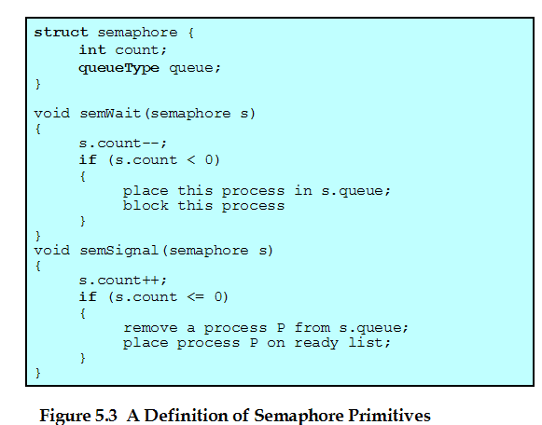
Semaphore Primitives
CS 345
Discussion #6 – Chapter 5a

Slide 55
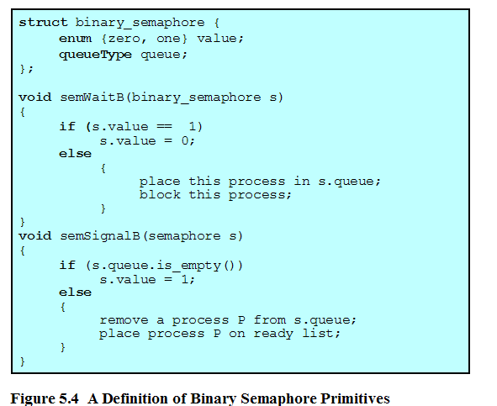
Binary Semaphore Primitives
CS 345
Discussion #6 – Chapter 5a

Slide 56
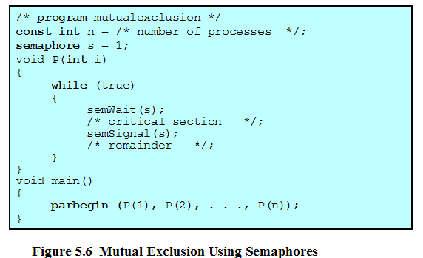
Mutual Exclusion Using Semaphores
CS 345
Discussion #6 – Chapter 5a

Slide 57
Strong and Weak
Strong semaphores: FIFO on waiting threads
Weak semaphores: arbitrary order on waiting threads
Semaphores good for:
  Long waits and high contention
  Always for uniprocessor systems
Semaphores bad for:
  Short waits on multiprocessor systems
  Low contention
CS 345
Discussion #6 – Chapter 5a

Slide 58
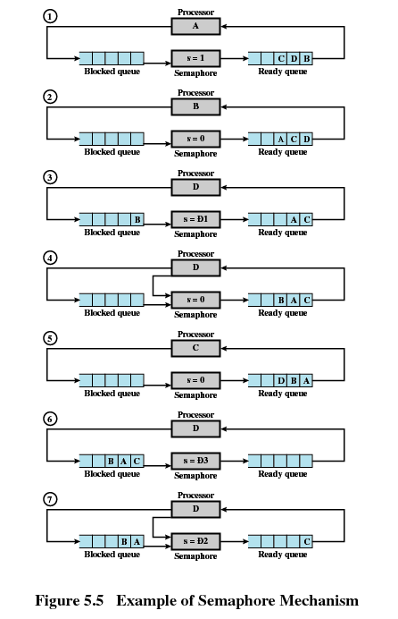
CS 345
Discussion #6 – Chapter 5a

Slide 59
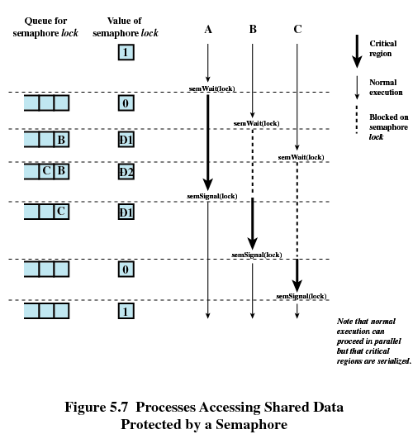
CS 345
Discussion #6 – Chapter 5a

Slide 60
Autonomy
Semaphores
Critical
  Semaphore operations must be atomic (still need locking)
Uniprocessor
  simply inhibit interrupts (normal user can’t)
  Use atomic instructions (spin lock)
Multiprocessor
  hardware must provide special support, or
  use software solutions – bad idea on shared system
  Prefer atomic instructions on shared memory
wait(Semaphore s)
{ while(TestAndSet(&lock));
s.value--;
if (s.value < 0)
{ add process to s.queue
*lock = FALSE;
block;
}
else *lock = FALSE;
}
CS 345
Discussion #6 – Chapter 5a

Slide 61
Consider…
Semaphores
P0:
wait(S);
wait(Q);
.
.
.
signal(S);
signal(Q);
P1:
wait(Q);
wait(S);
.
.
.
signal(Q);
signal(S);
Is there anything wrong with this?
CS 345
Discussion #6 – Chapter 5a
Notes:
How does deadlock occur?
P0 gets into S; interrupt; P1 gets into Q, waits on S; interrupt; P0 is waiting on Q

Slide 62
The Producer-Consumer Problem
Producer/Consumer
Producer
Consumer
repeat
…
produce an item in nextp
…
while counter == n do no-op
buffer[in] = nextp
in = (in + 1) mod n
counter = counter + 1
until false
repeat
…
while counter = 0 do no-op
nextc = buffer[out]
out = (out + 1) mod n
counter = counter -1
…
consume the item in nextc
…
until false
CS 345
Discussion #6 – Chapter 5a

Slide 63
Bounded Buffer Solution
Bounded Buffer
Shared semaphore: empty = n, full = 0, mutex = 1;
repeat
produce an item in nextp
wait(empty);
wait(mutex);
add nextp to the buffer
signal(mutex);
signal(full);
until false
repeat
wait(full);
wait(mutex);
remove an item from buffer
place it in nextc
signal(mutex);
signal(empty);
consume the item in nextc
until false
CS 345
Discussion #6 – Chapter 5a

Slide 64
Message Passing
Message Passing
A general method used for interprocess communication (IPC)
  for processes inside the same computer
  for processes in a distributed system
Another means to provide process synchronization and mutual exclusion
We have at least two primitives:
  send(destination, message) or post(destination, message)
  receive(source, message)
May or may not be blocking
CS 345
Discussion #6 – Chapter 5a

Slide 65
Synchronization
Message Passing
For the sender: it is more natural not to be blocked
  can send several messages to multiple destinations
  sender usually expects acknowledgment of message receipt (in case receiver fails)
  PostMessage() is asynchronous – returns immediately
  SendMessage() is synchronous –block until message delivered and processed
For the receiver: it is more natural to be blocked after issuing ReceiveMessage()
  the receiver usually needs the info before proceeding
  but could be blocked indefinitely if sender process fails before sending reply
CS 345
Discussion #6 – Chapter 5a

Slide 66
Addressing in message passing
Message Passing
Direct addressing:
  when a specific process identifier is used for source/destination
  but it might be impossible to specify the source ahead of time (ex: a print server)
Indirect addressing (more convenient):
  messages are sent to a shared mailbox which consists of a queue of messages
  senders place messages in the mailbox, receivers pick them up
CS 345
Discussion #6 – Chapter 5a

Slide 67
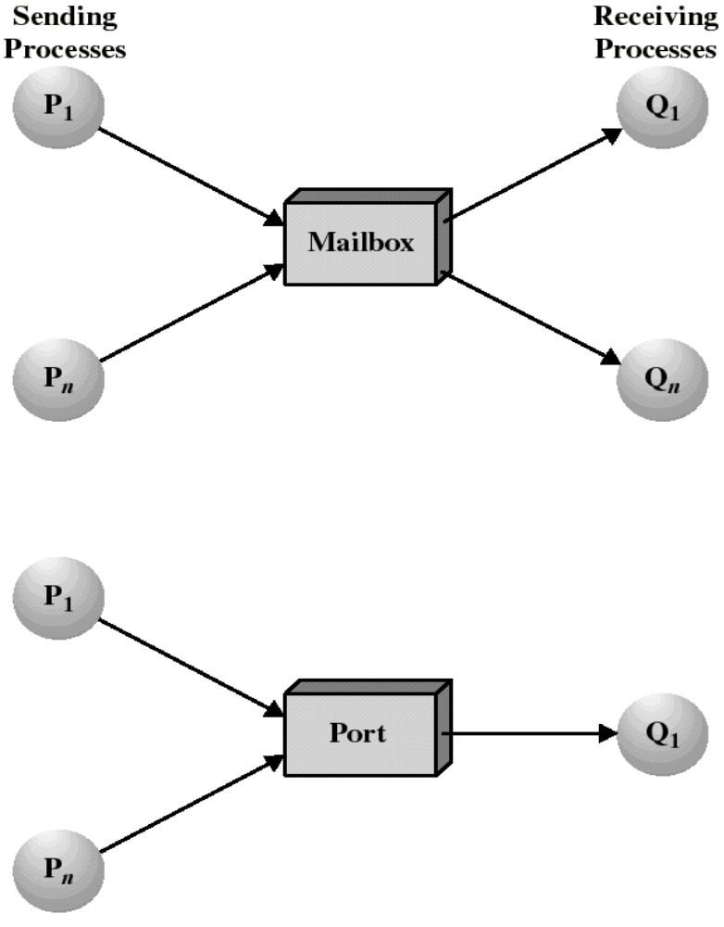
Mailboxes and Ports
Message Passing
A mailbox can be private
  one sender/receiver pair
A mailbox can be shared among several senders and receivers
  OS may then allow the use of message types (for selection)
Port: a mailbox associated with one receiver and multiple senders
  used for client/server application: the receiver is the server
CS 345
Discussion #6 – Chapter 5a

Slide 68
Ownership of ports and mailboxes
Message Passing
A port is usually owned and created by the receiving process
The port is destroyed when the receiver terminates
The OS creates a mailbox on behalf of a process (which becomes the owner)
The mailbox is destroyed at the owner’s request or when the owner terminates
CS 345
Discussion #6 – Chapter 5a

Slide 69
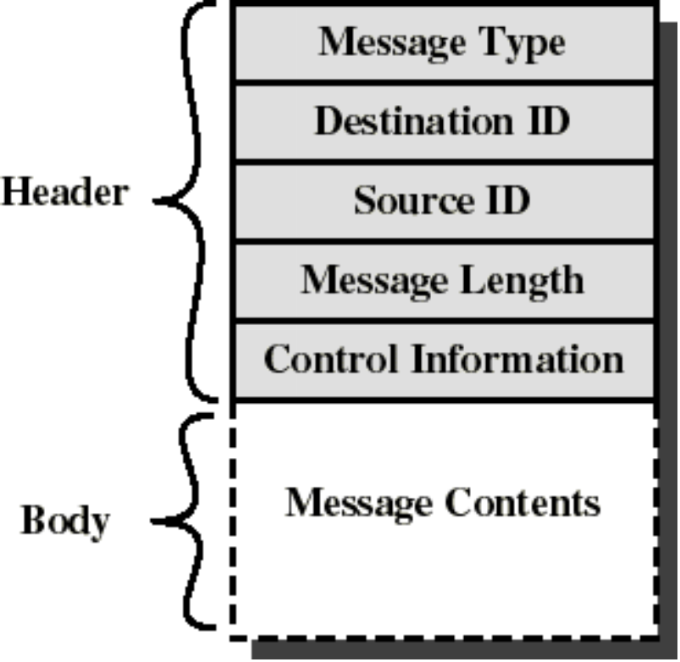
Message format
Message Passing
Consists of header and body of message
Control information:
  what to do if run out of buffer space
  sequence numbers
  priority...
Queuing discipline: usually FIFO but can also include priorities
CS 345
Discussion #6 – Chapter 5a

Slide 70
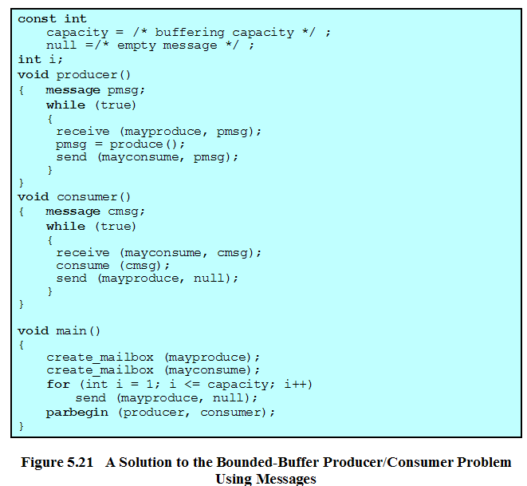
CS 345
Discussion #6 – Chapter 5a

Slide 71
Shared Memory
Message Passing
Single atomic variables (semaphores, modes)
Memory mapping (data structures, messages)
Test-and-set (atomic instructions)
Fast – do not require data movement (reference)
Ported memory
Multi-processor systems
CS 345
Discussion #6 – Chapter 5a

Slide 72
Monitor
Monitor
A software module containing:
  one or more procedures
  an initialization sequence
  local data variables
Characteristics:
  local variables accessible only by monitor’s procedures
  a process enters the monitor by invoking one of its procedures
  only one process can be in the monitor at any one time
Shared data
. . .
Entry Queue
operations
Initialization code
CS 345
Discussion #6 – Chapter 5a
Notes:
Was fairly restrictive, so other things were added.
What about in the middle of a procedure, we need something, but want control immediately back when condition is met.

Slide 73
Monitor Mutual Exclusion
Monitor
The monitor ensures mutual exclusion - no need to program this constraint explicitly.
The monitor locks (protects) shared data on process entry.
Process synchronization is done by the programmer by using condition variables.
  conditions needing to be satisfied before entering monitor
  local to the monitor - accessible only within the monitor
    cwait(a): blocks execution of the calling process on condition variable a. The process can resume execution only if another process executes csignal(a)
    csignal(a): resume execution of some process blocked on condition variable a.
      If several such processes exist: choose any one
      If no such process exists: do nothing
CS 345
Discussion #6 – Chapter 5a

Slide 74
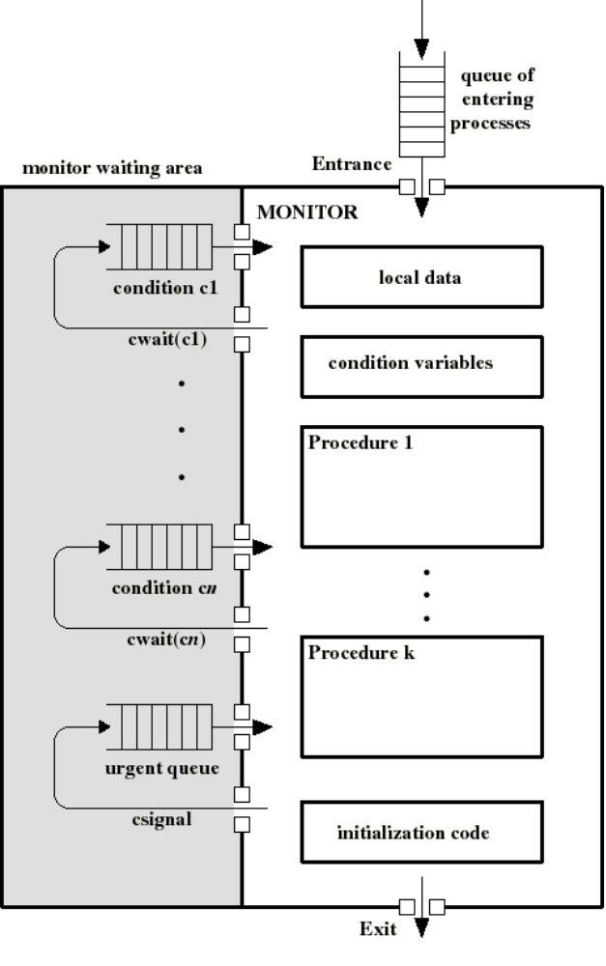
Monitor
Monitor
Waiting processes are
  in the entrance queue or
  in a condition queue
A process puts itself into condition queue cn by issuing cwait(cn)
csignal(cn) brings into the monitor 1 process in condition cn queue
csignal(cn) blocks the calling process and puts it in the urgent queue
  unless csignal is the last operation of the monitor procedure
CS 345
Discussion #6 – Chapter 5a
Notes:
Need to give someone in the monitor preference to someone waiting to get into the monitor.
Check urgent queue first.
How is it implemented? Semaphores
Wrap semaphore in procedure call (wait on entry)
Signal when leaving – BUT need to look in urgent queue first, if empty, signal entry queue.
Each conditional variable is a semaphore
cwait – needs to check the urgent queue first
csignal – may have to move condition variable semaphore to urgent queue.
Good or bad?? Could be more restrictive than just using semaphores.

Slide 75
Monitor implementation
Monitor
Semaphore to enter monitor
Semaphore for each condition variable
Must allow multiple processes in the monitor
  only one active
  others are in condition variable queues
How?
  Need to suspend ourselves after signaling
  Do we need another semaphore?
CS 345
Discussion #6 – Chapter 5a

Slide 76
Monitor for the P/C problem
Monitor
Monitor holds the buffer:
  buffer: array[0..k-1] of items;
Two condition variables:
  notfull: csignal(notfull) indicates that the buffer is not full
  notemty: csignal(notempty) indicates that the buffer is not empty
Buffer pointers and counts:
  nextin: points to next item to be appended
  nextout: points to next item to be taken
  count: holds the number of items in buffer
CS 345
Discussion #6 – Chapter 5a

Slide 77
Monitor for the P/C problem
Monitor
Monitor boundedbuffer:
buffer: array[0..k-1] of items;
nextin:=0, nextout:=0, count:=0: integer;
notfull, notempty: condition;
Append(v):
if (count=k) cwait(notfull);
buffer[nextin]:= v;
nextin:= nextin+1 mod k;
count++;
csignal(notempty);
Take(v):
if (count=0) cwait(notempty);
v:= buffer[nextout];
nextout:= nextout+1 mod k;
count--;
csignal(notfull);
CS 345
Discussion #6 – Chapter 5a

