Slide 1
Chapter 6
Concurrency: Deadlock and Starvation

Slide 2
Deadlock
System Model
  Process must request a resource before using
  Process must release the resource when done
Deadlock
  A set of processes is in a deadlock state when every process in the set is waiting for an event that can only be caused by another process in the set.

Slide 3
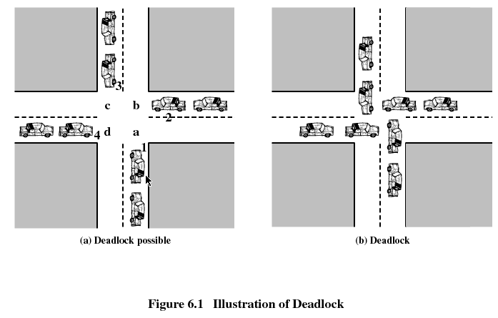

Slide 4
Joint Process Diagram
Progress
of Q
1
2
Release A
P and Q
want A
A
Required
Release B
Get A
B
Required
5
deadlock
inevitable
P and Q
want B
4
Get B
6
3
Fatal Region
Deadlock Possible!
Progress
of P
Get A
Get B
Release A
Release B
A Required
B Required

Slide 5
Example of No Deadlock
Progress
of Q
1
2
3
Release
A
P and Q
want A
4
A
Required
Release
B
Get A
P and Q
want B
B
Required
5
Get B
6
Progress
of P
Get A
Release A
Get B
Release B
A
Required
B Required

Slide 6
Reusable Resources
Used by one process at a time and not depleted by that use
Processes obtain resources that they later release for reuse by other processes
Processor time, I/O channels, main and secondary memory, files, databases, and semaphores
Deadlock occurs if each process holds one resource and requests the other

Slide 7
Consumable Resources
Created (produced) and destroyed (consumed) by a process
Interrupts, signals, messages, and information in I/O buffers
Deadlock may occur if a Receive message is blocking
May take a rare combination of events to cause deadlock

Slide 8
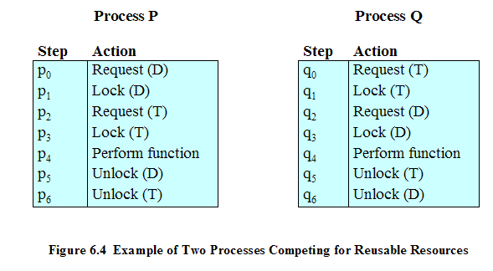
Example of Deadlock

Slide 9
Examples of Deadlock
200K bytes is available for allocation…
Process 1 |  | Process 2
Request 80K bytes |  | …
… |  | Request 70K bytes
Request 60K bytes |  | …
… |  | Request 80K bytes
Deadlock occurs if receive blocks…
Process 1 |  | Process 2
Receive(P2) |  | …
… |  | Receive(P1)
Send(P2) |  | …
… |  | Send(P1)

Slide 10
Necessary Conditions for Deadlock
Mutual exclusion
  only one process may use a resource at a time.
  no process may access resource allocated to another.
Hold-and-wait
  a process may hold allocated resources while awaiting assignment of other resources.
No preemption
  no resource can be forcibly removed from a process holding it.

Slide 11
Conditions for Deadlock
Circular wait
  a closed chain of processes exists, such that each process holds at least one resource needed by the next process in the chain
  consequence of the first three conditions
Other conditions are necessary but not sufficient for deadlock - all four conditions must hold for deadlock
Unresolvable circular wait is the definition of deadlock!

Slide 12

Circular Wait
Resource
A
Requests
Held by
Process
P1
Process
P2
Held By
Requests
Resource
B

Slide 13
Describing Deadlock
Deadlocks can be described using resource allocation graph
  Vertices
    Active processes {P1, P2, … }
    Resources {R1, R2, … }
  Edges
    A directed edge from Pi to Rj
      Process Pi requested an instance of resource Rj
    A directed edge from Rj to Pi
      Resource Rj has been allocated to process Pi
  Process are circles, Resources are rectangles

Slide 14
Resource Allocation Graph
R1
R2
P1
P2
P3
R3
R4

Slide 15
So?
If a graph contains no cycles, then no process in the system is deadlocked
If the graph contains a cycle, deadlock MAY exist
If each resource has only one instance, then a cycle implies deadlock

Slide 16
Deadlock?
R1
R2
Is there a cycle?
Is there deadlock?
P1
P2
P3
R3
R4

Slide 17
Deadlock?
P2
Is there a cycle?
Is there deadlock?
R1
P1
P3
R2
P4

Slide 18
Handling Deadlock
Ignore deadlock
Eliminate one of the four conditions
Deadlock avoidance
Deadlock Detection and Recovery

Slide 19

CS 345
Discussion #11 – Chapter 6a

Slide 20
Prevention by Elimination
Mutual Exclusion
  non-sharable resources (daemons to virtualize and spool everything)
  We can’t eliminate this condition
Hold and wait
  guarantee that when a process requests a resource, it does not hold any other resources
  two protocols
    system calls requesting resources precede all others
    a process can only request resources when it has none
  low resource utilization?
Notes:
Printer Daemon is only one that talks to printer. Must spool into directory, and then let the daemon talk to the printer.
Does not solve: what if you run out of file system space while 2 processes are spooling. Each holds what other needs to finish!

Slide 21
Eliminate No Preemption
If a process holds resources and requests more that cannot be allocated, all its other resources are preempted
  If you can’t hold all, you can’t hold any
  process is restarted only when it can have all
This works for resources whose state can be easily saved and restored later
  registers
  memory

Slide 22
Eliminate Circular Wait
Impose a total ordering of all resources
Require that all processes request resources in increasing order.
Whenever a process requests a resource, it must release all resources that are higher
These two protocols eliminate circular wait

Slide 23
Deadlock
System Model
  Process must request a resource before using
  Process must release the resource when done
Deadlock
  A set of processes is in a deadlock state when every process in the set is waiting for an event that can only be caused by another process in the set.

Slide 24
Deadlock Avoidance
Allow general requests, but make choices to avoid deadlock
Assume we know the maximum requests (claims) for each process
  Process must state it needs a max of 5 A objects, 3 B objects, 2 C objects.
  Do not need to use its max claims
    Ok to set max=5 and only use 3
  Can make requests at any time and in any order
Process Initiation Denial
  Track current allocations
  Assume all processes may make maximum requests at the same time
  Only start process if it can’t result in deadlock regardless of allocations

Slide 25
Resource Allocation Denial
Safe State – We can finish all processes by some scheduling sequence
  Example: Finish P1, P4, P2, P5, P3
Banker’s Algorithm (Dijkstra)
  Reject a request if it exceeds the processes’ declared maximum claims
  Grant a request if the new state would be safe
Determining if a state is safe
  Find any process P_{i} for which we can meet it’s maximum requests
    Don't forget already allocated resources
  Mark P_{i} as “done”, add its resources to available resource pool
  State is safe if we can mark all processes as “done”
Block a process if the resources are not currently available or the new state is not safe

Slide 26
Avoidance Example
Claim
Allocation
Allocation
C - A
 | A | B | C
P₁ | 3 | 2 | 2
P₂ | 6 | 1 | 3
P₃ | 3 | 1 | 4
P₄ | 4 | 2 | 2
A
A
B
C
A
B
B
C
C
P₁
2
1
2
2
2
P₁
1
P₁
1
1
2
0
0
0
0
0
1
P₂
1
1
0
0
2
P₂
2
P₂
5
5
5
1
1
1
1
1
1
P₃
1
1
0
0
3
P₃
3
P₃
2
2
2
1
1
1
1
1
1
P₄
4
4
2
2
0
P₄
0
P₄
0
0
0
0
0
0
2
2
2
Resource
A | B | C
9 | 3 | 6
Available
A | B | C
1 | 1 | 2
0
1
1
Are we in a safe state?
Yes!
P₁ wants 1 more A and 1 more C. Is it ok (safe state)?
No!
No! But, there is a potential for deadlock.
Are we deadlocked?

Slide 27
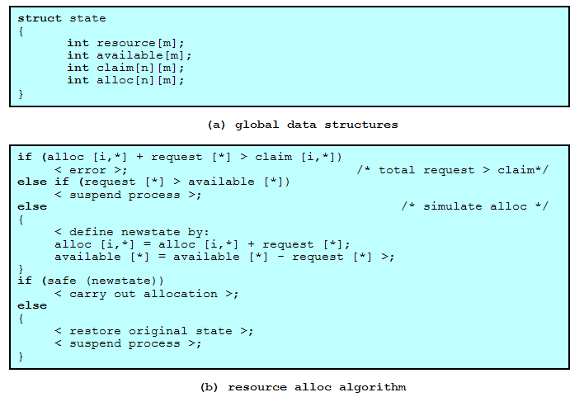
Deadlock Avoidance Logic

Slide 28
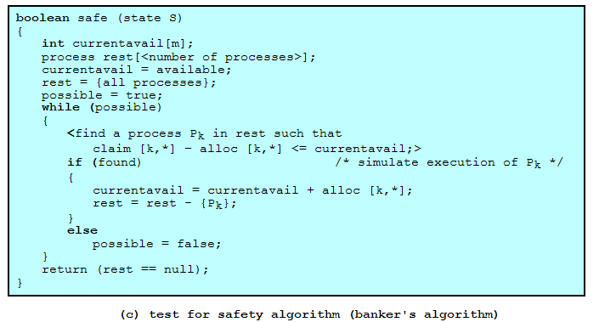
Deadlock Avoidance Logic

Slide 29
Deadlock Detection
Avoidance methods tend to limit access to resources
Instead, grant arbitrary requests and note when deadlock happens
Can vary how often we check
Early detection vs. overhead of checks
Algorithm
  Preparation:
    Create table of process requests, current allocations
    Note available resources
  Mark processes with no resources
  Mark any process whose requests can be met (requests ≤ available resources)
    Include resources from that process as ‘available’ (this process can finish)
    If multiple processes available, pick any
  If any processes cannot be marked, they are part of a deadlock

Slide 30
Detection Example 1
Request
Allocation
Resource
 | A | B | C | D | E
P₁ | 0 | 1 | 0 | 0 | 1
P₂ | 0 | 0 | 1 | 0 | 1
P₃ | 0 | 0 | 0 | 0 | 1
P₄ | 1 | 0 | 1 | 0 | 1
 | A | B | C | D | E
P₁ | 1 | 0 | 1 | 1 | 0
P₂ | 1 | 1 | 0 | 0 | 0
P₃ | 0 | 0 | 0 | 1 | 0
P₄ | 0 | 0 | 0 | 0 | 0
A | B | C | D | E
2 | 1 | 1 | 2 | 1
Available
A | B | C | D | E
0 | 0 | 0 | 0 | 1
A
B
C
D
E
Temporary Available
0
0
0
0
0
0
0
1
1
1
Mark P₄ (not holding anything someone else wants)
Mark P₃, new available: 0 0 0 1 1
Cannot mark P₁ or P₂, so we are deadlocked

Slide 31
Detection Example 2
Requests
Allocation
Resource
 | A | B | C
P₁ | 0 | 0 | 0
P₂ | 2 | 0 | 2
P₃ | 0 | 0 | 0
P₄ | 1 | 0 | 0
P₅ | 0 | 0 | 2
 | A | B | C
P₁ | 0 | 1 | 0
P₂ | 2 | 0 | 0
P₃ | 3 | 0 | 3
P₄ | 2 | 1 | 1
P₅ | 0 | 0 | 2
A | B | C
7 | 2 | 6
Available
A | B | C
0 | 0 | 0
A
B
C
Temporary Available
5
7
7
1
2
2
3
4
0
6
3
1
1
0
0
0
3
0
Are we deadlocked?
No!

Slide 32
Detection Example 3
Request
Allocation
Resource
 | A | B | C | D | E
P₁ | 0 | 1 | 0 | 0 | 0
P₂ | 0 | 0 | 1 | 0 | 0
P₃ | 0 | 0 | 0 | 1 | 0
P₄ | 0 | 0 | 0 | 0 | 1
P₅ | 1 | 0 | 0 | 0 | 0
 | A | B | C | D | E
P₁ | 1 | 0 | 0 | 0 | 0
P₂ | 0 | 1 | 0 | 0 | 0
P₃ | 0 | 0 | 1 | 0 | 0
P₄ | 0 | 0 | 0 | 1 | 0
P₅ | 0 | 0 | 0 | 0 | 1
A | B | C | D | E
1 | 1 | 1 | 1 | 1
Available
A | B | C | D | E
0 | 0 | 0 | 0 | 0
A
B
C
D
E
Temporary Available
0
0
0
0
0
Cannot mark P₁ thru P₅, so we are deadlocked

Slide 33
Detection Example 4
Request
Allocation
Resource
 | A | B | C | D | E
P₁ | 0 | 1 | 0 | 0 | 0
P₂ | 0 | 0 | 0 | 0 | 0
P₃ | 0 | 0 | 1 | 0 | 0
P₄ | 0 | 0 | 0 | 1 | 1
P₅ | 1 | 0 | 0 | 0 | 0
 | A | B | C | D | E
P₁ | 1 | 0 | 0 | 0 | 0
P₂ | 0 | 1 | 1 | 0 | 0
P₃ | 0 | 0 | 0 | 1 | 0
P₄ | 0 | 0 | 0 | 0 | 0
P₅ | 0 | 0 | 0 | 0 | 1
A | B | C | D | E
1 | 1 | 1 | 1 | 1
Available
A | B | C | D | E
0 | 0 | 0 | 0 | 0
A
B
C
D
E
Temporary Available
0
0
0
0
0
0
1
1
1
1
1
1
1
1
1
1
1
0
0
1
1
0
0
0
1
Mark P₄, (nothing allocated)
Mark P₂
, P₁
, P₃
, P₅

Slide 34
Deadlock Detection Questions?
Does it really work?
How often do you run it?
How often is deadlock likely to occur?
How expensive is it?

Slide 35
Deadlock Recovery
Several possible approaches
Abort all deadlocked processes
  Simple but common
Back up processes to a previously saved checkpoint, then restart
  Assumes we have checkpoints and a rollback mechanism
  Runs risk of repeating deadlock
    Assumes that the deadlock has enough timing dependencies it won’t happen
Selectively abort processes until deadlock broken
Preempt resources until deadlock broken
  Easy to do with some resources (i.e., memory → just swap to disk)
  Less easy with other resources

Slide 36
Mixed Strategy
May group resources into classes, have a different deadlock strategy for each class
  Swap Space
    Prevent Deadlocks by requiring all space to be allocated at once
    Avoidance also possible
  Tapes/Files
    Avoidance can be effective here
    Prevention by ordering resources also possible
  Main Memory
    Preemption a good approach
  Internal Resources (channels, etc.)
    Prevention by ordering resources
Can use linear ordering between classes

Slide 37
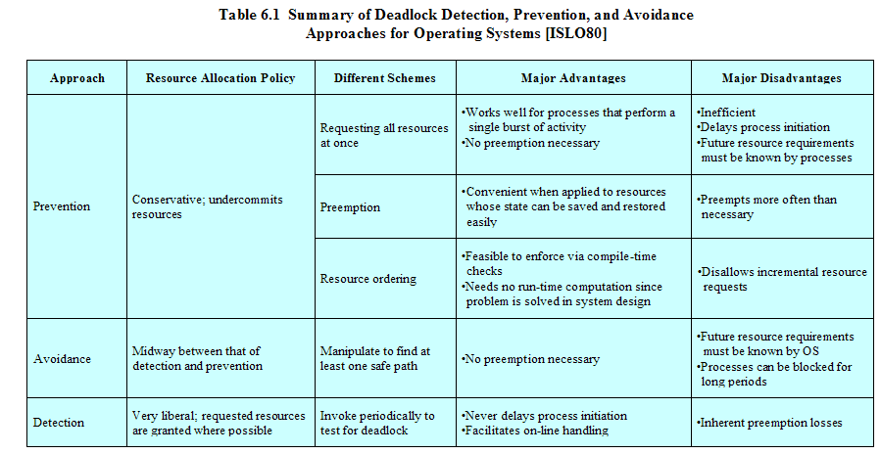
Strengths and Weaknesses

Slide 38
Livelock
process A() {
spin_lock(&r1);
spin_lock(&r2);
// use r1 and r2
unlock(&r2);
unlock(&r1);
}
process B() {
spin_lock(&r2);
spin_lock(&r1);
// use r1 and r2
unlock(&r1);
unlock(&r2);
}
Notes:
Processes just burning power and making no progress!
OS has not clue that they are “deadlocked”
Just ignore the problem → ostrich algorithm

Slide 39
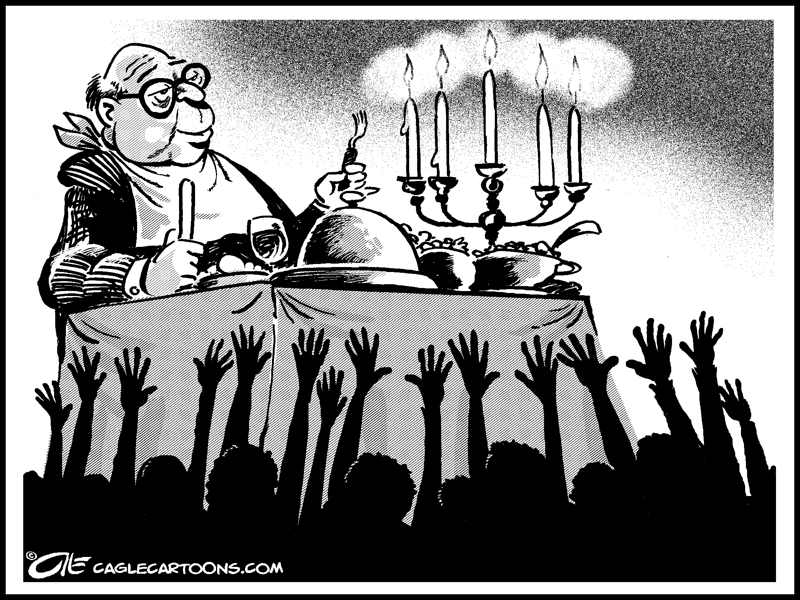

Slide 40
Conclusion
Deadlock is potential problem in any OS
Requires mutual exclusion, hold and wait, no preemption, and circular wait condition
Possible to ignore
Possible to prevent
Possible to avoid
Possible to detect and recovery

